Slide 1
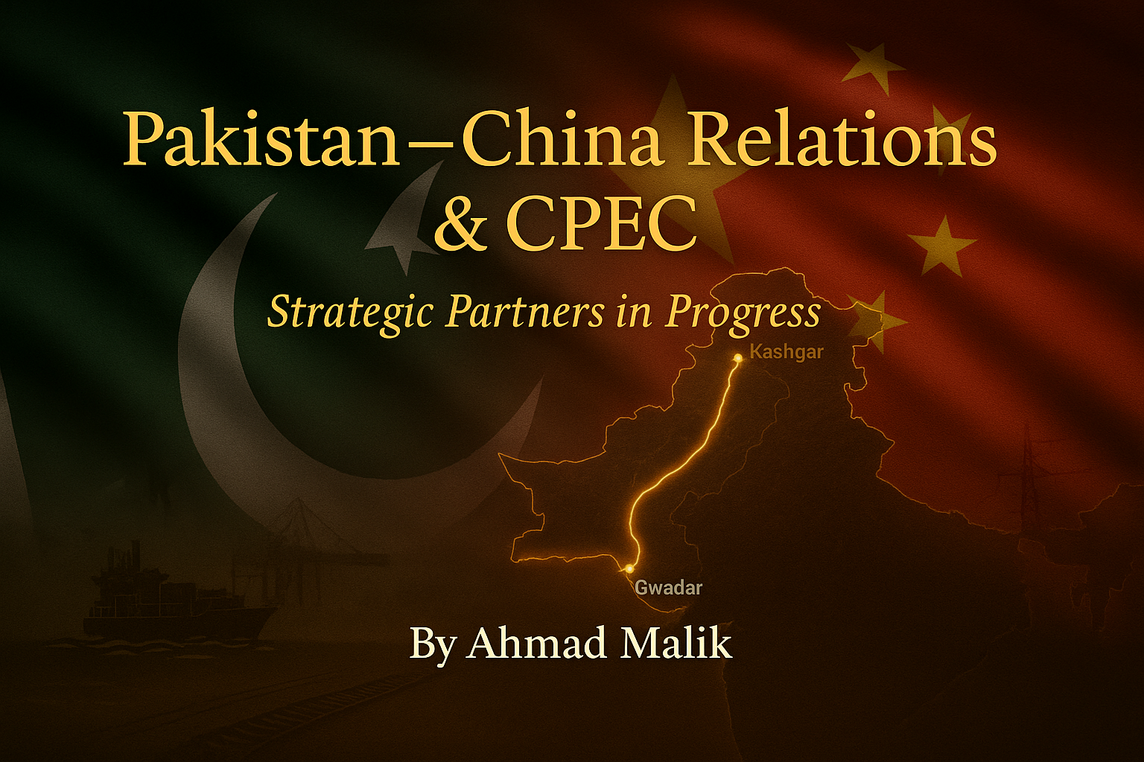

Slide 2
Fear by Khalil Gibran
It is said that before entering the sea a river trembles with fear
She looks back at the path she has traveled,
From the peaks of the mountains, the long winding road crossing forests and villages
And in front of her, she sees an ocean so vast,
that to enter there seems nothing more than to disappear forever.
But there is no other way.
The river can not go back.
Nobody can go back.
To go back is impossible in existence.
The river needs to take the risk of entering the ocean
because only then will fear disappear, because that's where the river will know
it's not about disappearing into the ocean,
but of becoming the ocean.

Slide 3
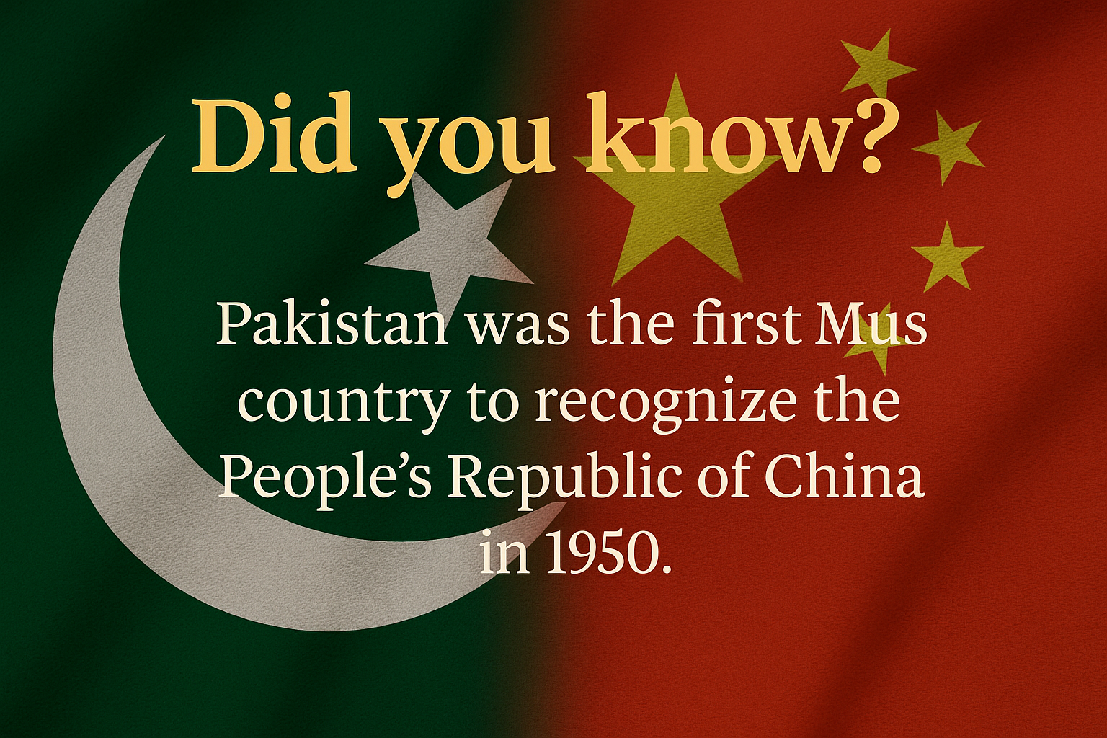

Slide 4
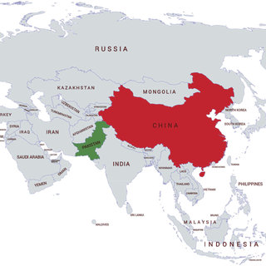

Slide 5
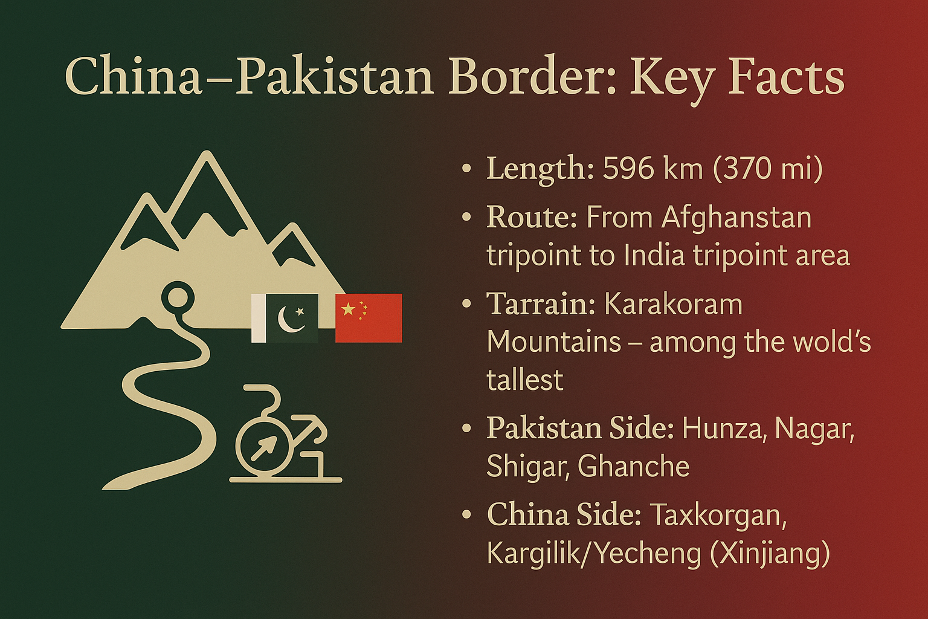

Slide 6
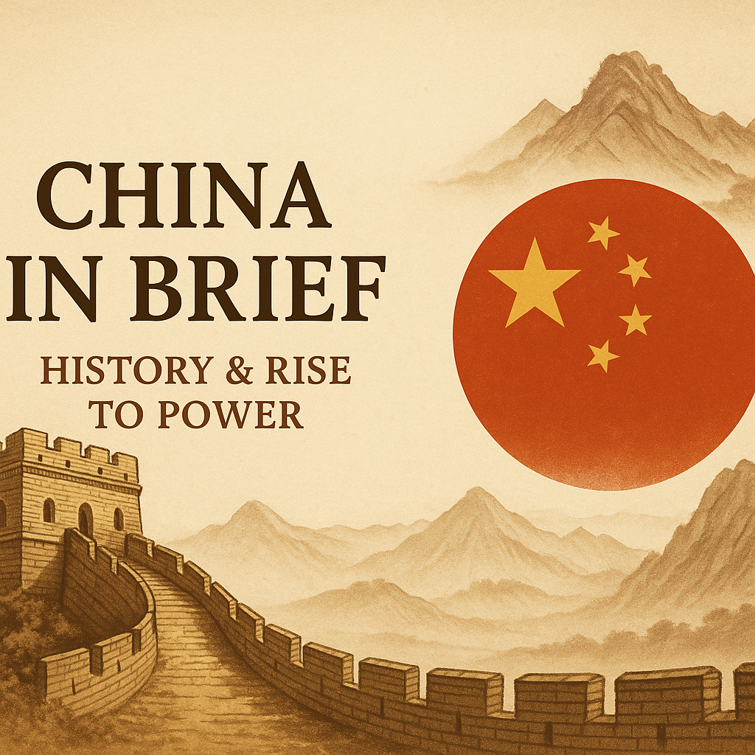

Slide 7


Slide 8
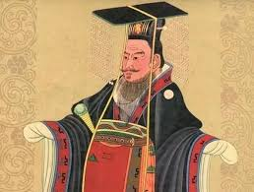
ZHANG QIAN

Slide 9
Ancient & Imperial China
Theme: Roots of a Civilization & Early Global Trade
  Over 4,000 years old civilization; earliest dynasties shaped Asia.
  Silk Road connected China to Rome, India, Middle East.
  Centralized governance under Confucian philosophy ensured stability.
  Innovations: Paper, compass, gunpowder, printing revolutionized world.
Critical Note: The combination of governance, trade, and innovation made China a pre-modern superpower, but also made it a target for outside powers.

Slide 10
“China is a sea that salts all rivers”
A Chinese Proverb

Slide 11
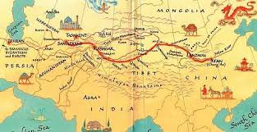

Slide 12
Century of Humiliation (1839–1949)
Theme: Decline, Foreign Domination, and Nationalist Struggle
  Opium Wars (1839–42, 1856–60) weakened Qing dynasty.
    Treaty of Nanking in 1842
  Treaty ports, loss of Hong Kong to Britain in 1842.
  1895 defeat by Japan; Taiwan ceded under Treaty of Shimonoseki.
  1931 Japanese invasion of Manchuria; Nanjing Massacre (1937).
  Nationalist–Communist civil war until Communist victory in 1949.
Critical Note: This period forged China’s obsession with sovereignty, shaping foreign policy till today. Mao often invoked “never again” as a rallying cry.

Slide 13
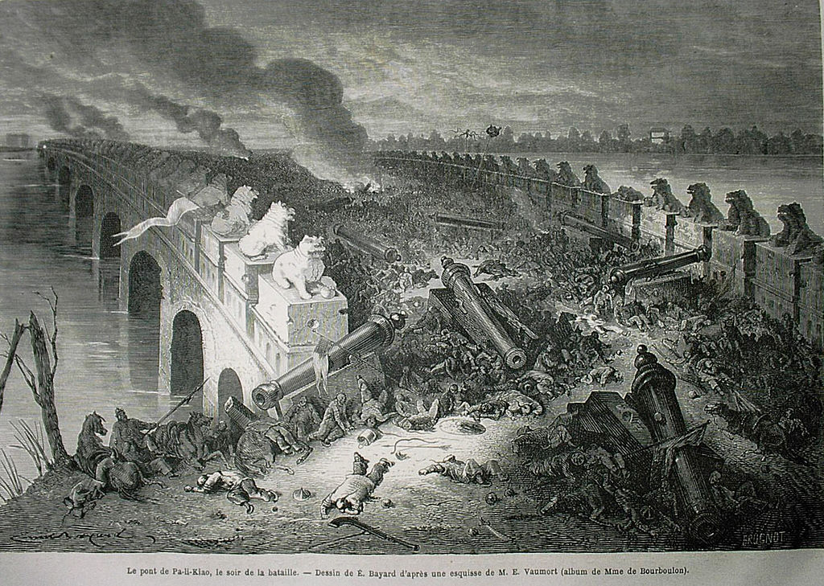


Slide 14
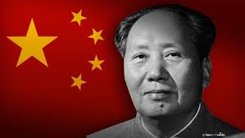

Slide 15
Mao Era (1949–1976)
Theme: Revolution, Centralization, and Isolation
  Mao Zedong declares People’s Republic of China on Oct 1, 1949.
  Land reforms and nationalization of industries.
  Break with USSR in 1960; Cold War isolation.
  The Great Leap Forward (1958–62) caused famine; 30M deaths.
  Cultural Revolution (1966–76) disrupted education, politics, culture.
Critical Note: Mao transformed China’s sovereignty and unity but at massive human cost. Isolation kept China militarily secure but economically stagnant.

Slide 16
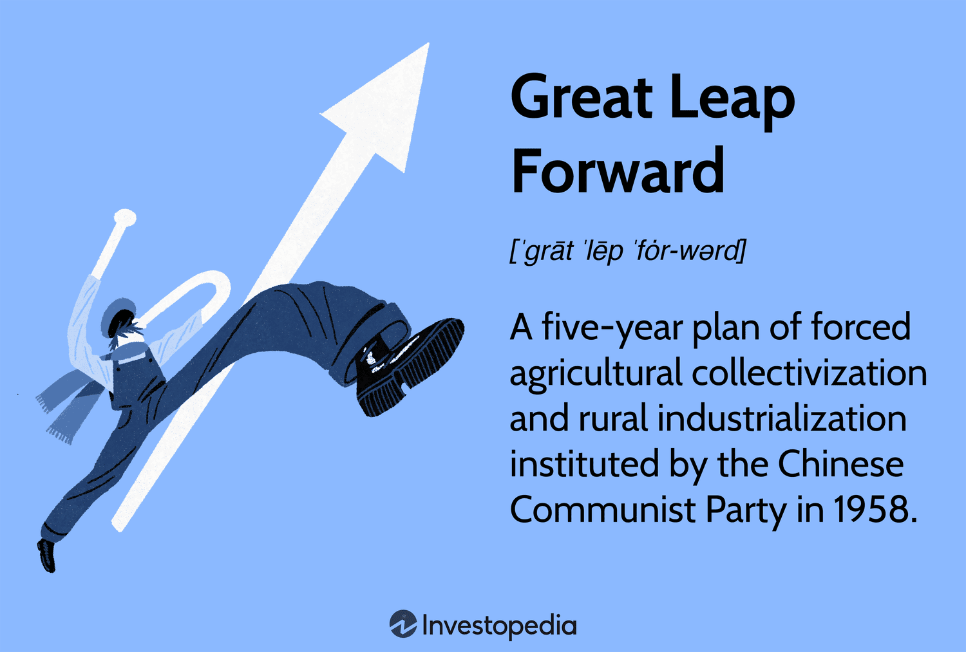
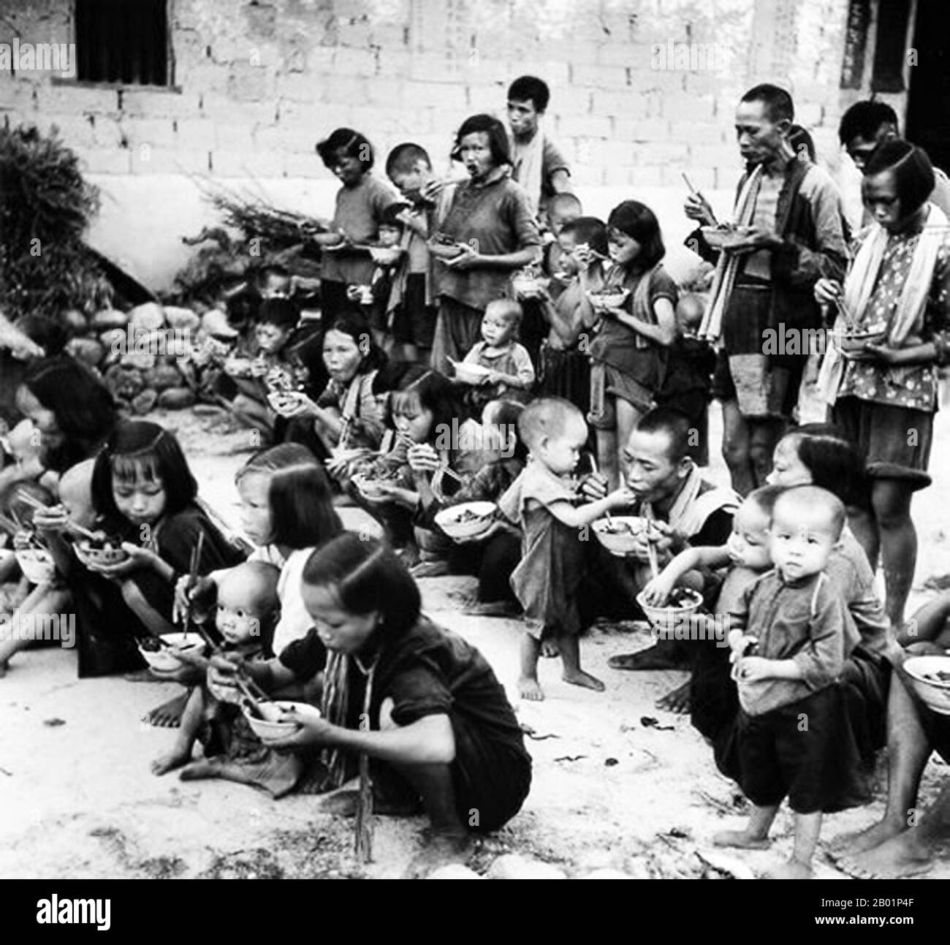

Slide 17
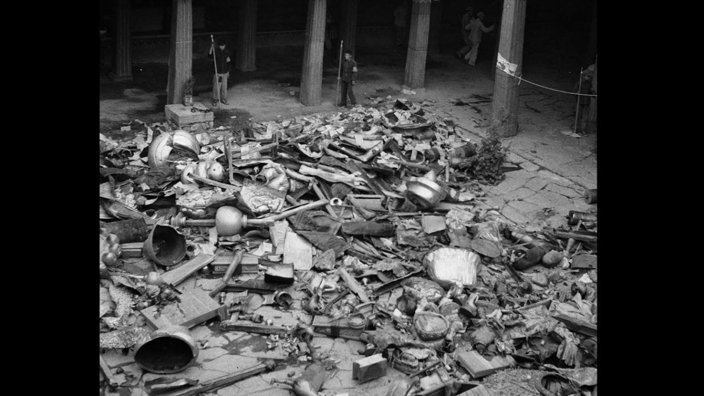

Slide 19
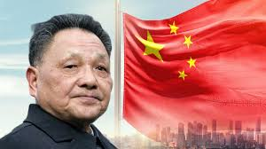

Slide 20
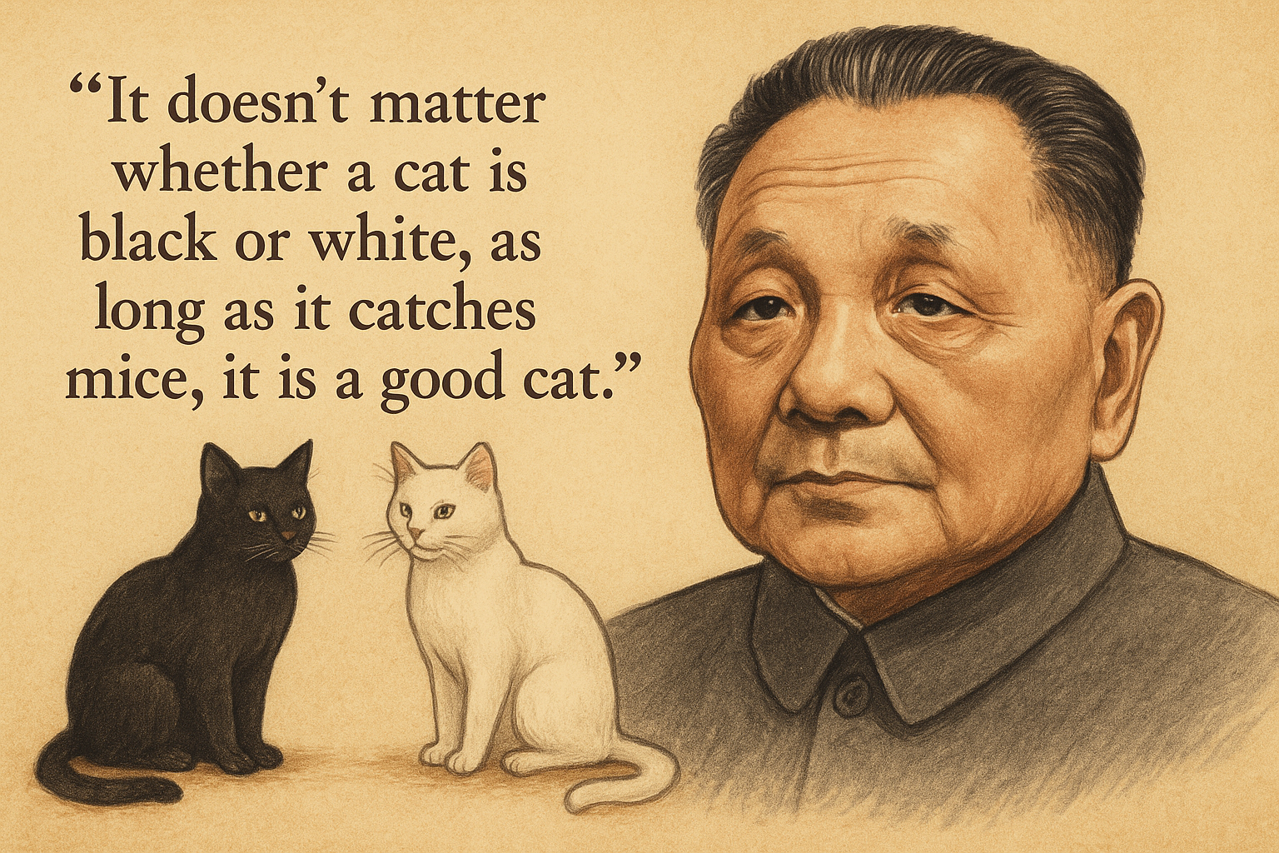

Slide 21
Deng Xiaoping Era (1978–1990s)
Theme: Reform, Opening Up, and Economic Takeoff
  Deng’s motto: “It doesn’t matter if the cat is black or white as long as it catches mouse, it is a good cat”.
  Special Economic Zones (SEZs) attracted foreign investment.
  Agricultural de-collectivization increased rural incomes.
  GDP grew 9–10% annually; export-led industrialization.
  China joins World Bank (1980), WTO (2001) foundations laid here.
Critical Note: Pragmatic economic reform turned China into the “world’s factory” but created inequality and environmental degradation.

Slide 22
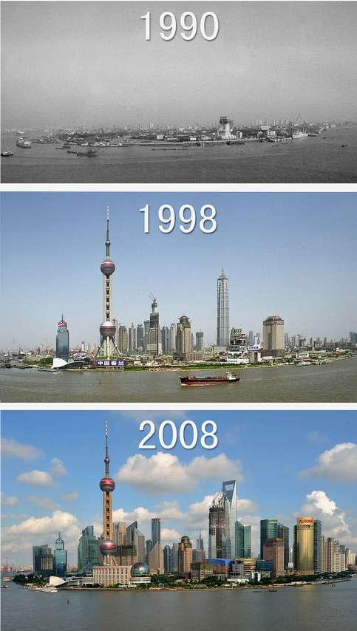
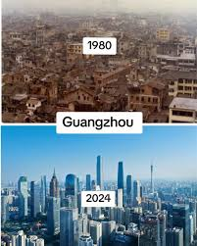
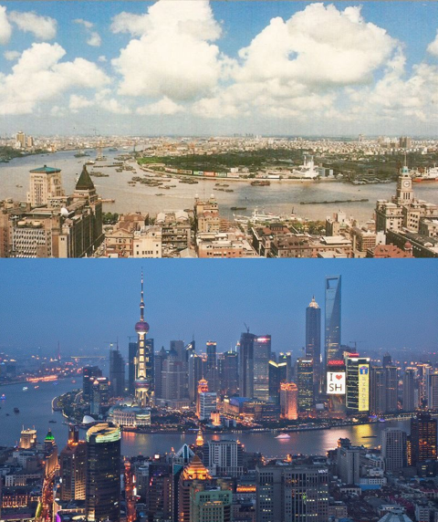

Slide 23
China Today (2000s–2025)
Theme: Global Power & Strategic Outreach
  Second-largest economy; GDP $18 trillion (2024).
  Leader in 5G, AI, high-speed rail, green energy.
  Belt & Road Initiative (BRI): 150+ countries partnered.
  Military modernization; largest navy by ship count (2023).
  Strategic competition with US in Indo-Pacific.
Critical Note: China’s rise inspires admiration and fear. Its authoritarian model challenges the Western-led order, making it central to 21st-century geopolitics.

Slide 25
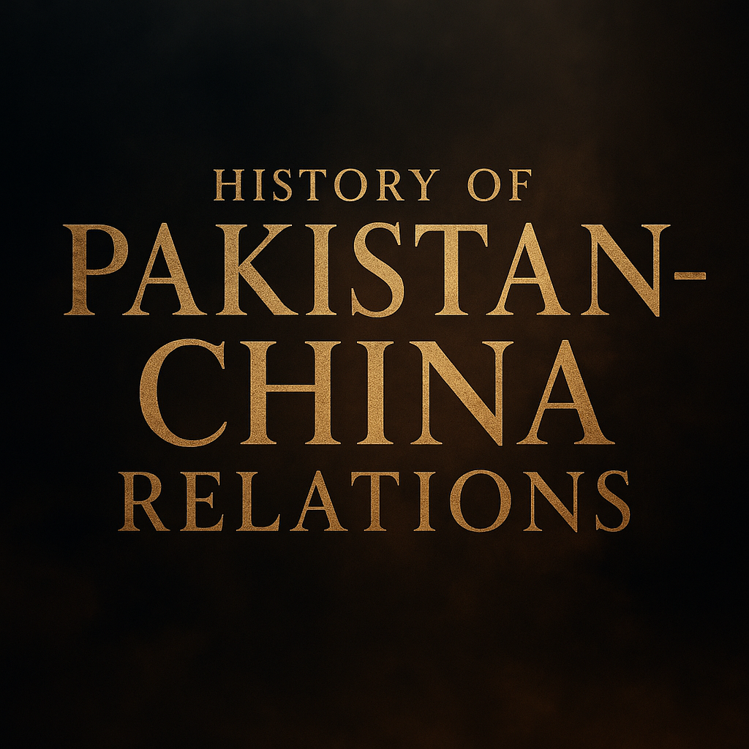

Slide 26
China–Muslim World Solidarity in WWII
Hui Imam Da Pusheng toured Middle East & South Asia to counter Japanese propaganda in Muslim nations.
At the World Islamic Congress (Hejaz), he exposed fake Japanese “Muslim” agents as non-Muslims.
Explained Japan’s imperialist record to Muslim leaders.
Muhammad Ali Jinnah pledged support for Chinese Muslims’ anti-Japanese effort.
Delegation led by Ma Fuliang met Tagore, Gandhi, Jinnah in Turkey & South Asia; also met Turkish President İsmet İnönü.
Strengthened China–Muslim solidarity before Pakistan’s creation.

Slide 27
1950: Pakistan Recognizes PRC
January 4, 1950: Pakistan becomes first Muslim country to recognize the PRC.
Diplomatic relations formally established May 21, 1951.
Early trade: 1952 trade agreement worth $1.8M in textiles & machinery.
Recognition defied Western bloc pressure during early Cold War.
Laid diplomatic foundation for a relationship based on mutual trust.

Slide 28
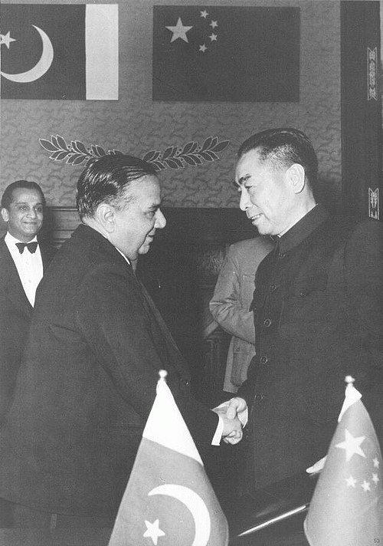
Pakistani Prime Minister Huseyn Shaheed Suhrawardy and Chinese Premier Zhou Enlai signing the Treaty of Friendship Between China and Pakistan in Beijing in 1956.

Slide 29
1963: Peaceful Border Agreement
March 2, 1963: China–Pakistan Boundary Agreement signed in Beijing.
Settled 596 km border in Karakoram Mountains without conflict.
Pakistan ceded 1,942 sq km in Shaksgam Valley to China.
Enabled future Karakoram Highway (completed 1978).Example cited in UN as a model peaceful settlement.

Slide 30
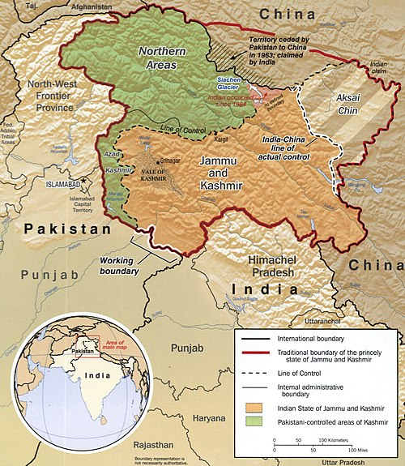

Slide 31
1965: War-time Support
Indo–Pak War (Sept 6–23, 1965): China aligned firmly with Pakistan.
Military Aid: Provided 200 artillery pieces, 200 tanks (Type 59), and spare parts for MiG-19 fighter jets.
Strategic Pressure: Issued ultimatum to India (Sept 16, 1965) over border disputes in Sikkim–Tibet area, forcing India to keep troops on the Chinese front.
Diplomatic Support: Chinese FM Chen Yi delivered strong UN speeches backing Pakistan’s stance on Kashmir, calling it a right to self-determination.
Symbolic Alliance: The popular phrase “Friendship higher than Himalayas, deeper than oceans” gained prominence during this period.

Slide 32
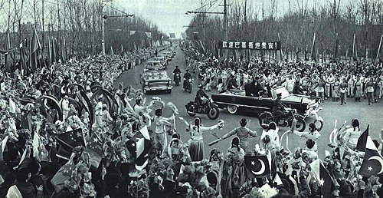
Ayub Khan’s 1965 visit of China.

Slide 33
1971: Secret US–China Diplomacy
July 1971: Pakistan secretly facilitated Henry Kissinger’s visit to Beijing.
Led to President Nixon’s historic 1972 China visit, normalizing US–China ties.
Pakistan Air Force flew Kissinger from Islamabad to Beijing.
Elevated Pakistan’s status as a strategic bridge between superpowers.
Won Beijing’s lasting goodwill for helping end China’s isolation.

Slide 34
1980s–1990s: Nuclear & Defense Cooperation
1986: China signs nuclear cooperation agreement with Pakistan.
Assisted in building Chashma Nuclear Power Plant.
1990s: Helped develop M-11 missiles and JF-17 Thunder fighter program groundwork.
Joint production agreements reduced reliance on Western arms.
Balanced India’s rising military capabilities post-1974 nuclear test.

Slide 35
2005–2013: Gwadar Port & Infrastructure
Gwadar Port construction funded by China ($248M Phase 1 cost).
Operational control given to China Overseas Port Holding Company (2013).
Linked to future CPEC maritime trade routes.
Projects included Coastal Highway, fiber optics, and energy plants.
Gwadar seen as China’s gateway to the Arabian Sea & Indian Ocean.

Slide 36
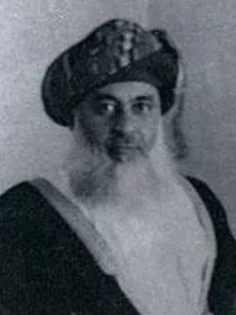

Slide 37
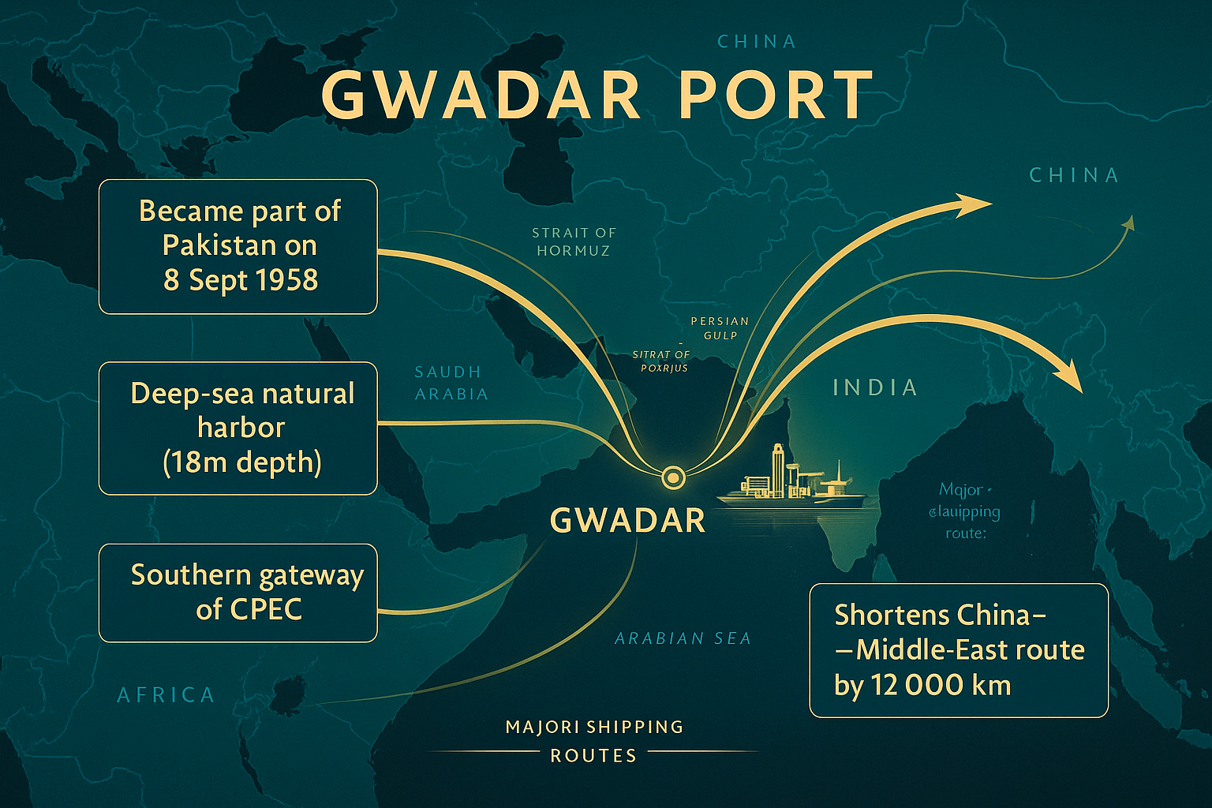

Slide 38
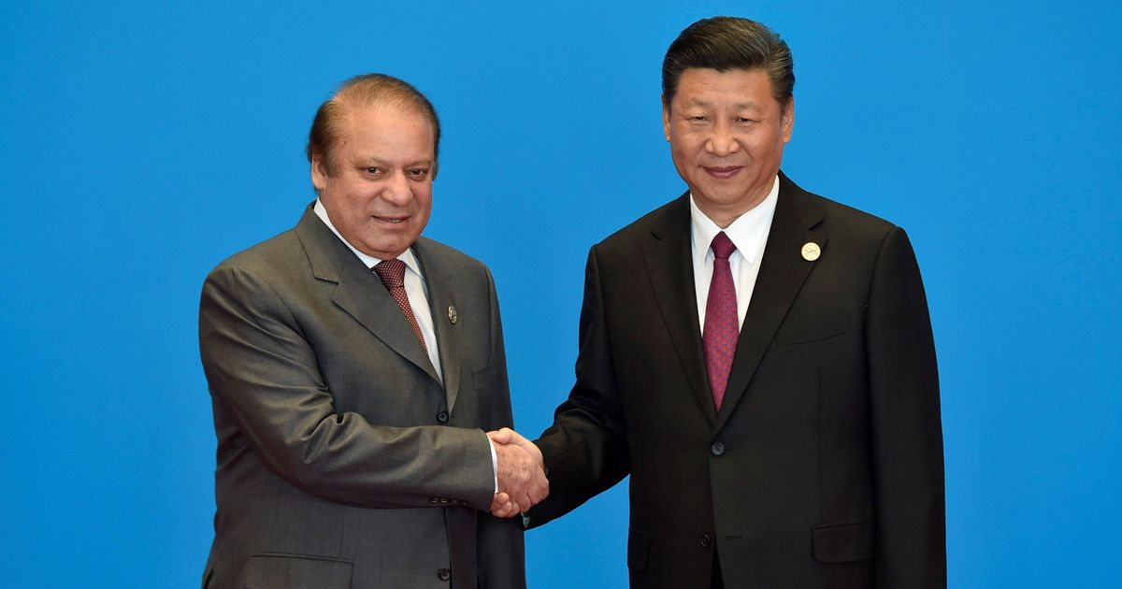

Slide 39
2015: CPEC Launch
April 2015: $46B pledged; later expanded to $62B.
Covers 3,000 km network of roads, railways, pipelines from Gwadar to Kashgar.
Early Harvest Projects (2015–2020) added 5,320 MW to Pakistan’s grid.
Flagship of Belt & Road Initiative with 150+ participating nations.
Seen by China as securing energy supply via shortest sea–land route.

Slide 41
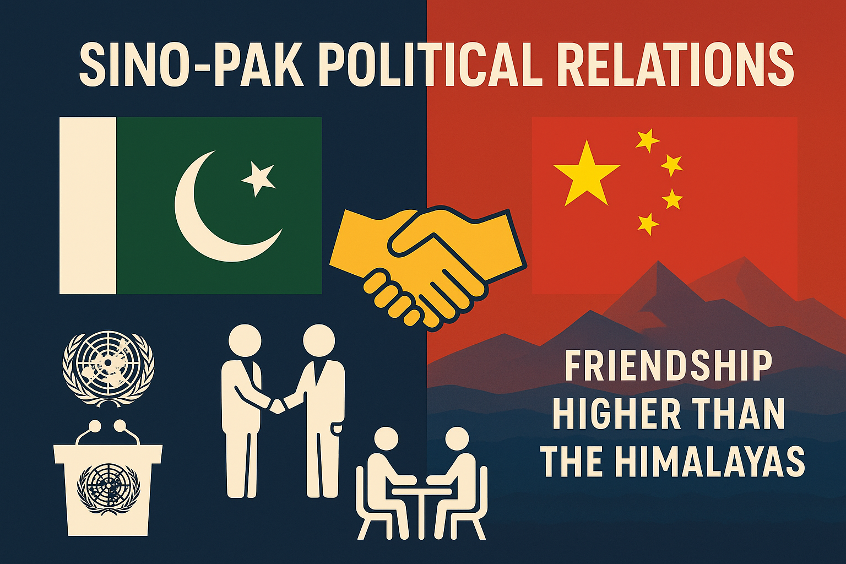

Slide 42
Consistent Mutual Support in International Forums
China has consistently backed Pakistan’s stance on Kashmir in the UN Security Council, opposing Indian unilateral actions.
  August 1999 and 2000 UN Security Council sessions where Beijing opposed attempts to dilute UNSC resolutions on the Kashmir dispute.
  China supported Pakistan’s request for UNSC discussion after the Kargil conflict and reaffirmed the need for a peaceful resolution “in accordance with the UN Charter and relevant resolutions,” implicitly countering India’s position that Kashmir was purely a bilateral matter under the Simla Agreement .
Pakistan reciprocates by supporting China’s positions on Taiwan, Xinjiang, Hong Kong, and Tibet, especially in UN Human Rights Council votes.
  In 2019, Pakistan was among 50 countries that signed a letter supporting China’s policies in Xinjiang when Western countries criticized them.

Slide 43
China’s Role in FATF Diplomacy
Evidence from Javid Husain’s Pakistan and a World in Disorder: China, as a permanent FATF member, repeatedly opposed moves to blacklist Pakistan despite pressure from the US and India.
Example: In February 2020, China used its position to delay or dilute resolutions aimed at pushing Pakistan into the FATF blacklist, giving Islamabad space to implement reforms.
This diplomatic shield prevented Pakistan from facing crippling international financial sanctions.

Slide 44
Non-Interference in Internal Politics
Evidence from Pakistan at Seventy: Unlike the US, which often comments on Pakistan’s governance, human rights, and democracy, China maintains a principle of non-interference.
This policy aligns with Beijing’s broader foreign relations approach under Xi Jinping, valuing stability and continuity over political change in partner states.
Impact: It allows Islamabad to deal with domestic political transitions (e.g., between civilian and military governments) without fearing a loss of Chinese support.

Slide 45
Pakistan’s “One China Policy” Commitment
Evidence from Abdul Sattar’s Pakistan’s Foreign Policy: Pakistan formally recognized PRC in 1950, long before the US did in 1979, and never had formal diplomatic relations with Taiwan.
Pakistan regularly reaffirms “One China” in joint statements, including during high-level visits (e.g., PM Imran Khan’s 2022 Beijing visit).
Example: Pakistan refused to send any representatives to events hosted by Taiwan despite trade incentives, maintaining strategic solidarity with Beijing.

Slide 46
Pakistan–Taiwan Relations: Trade over Politics
Primarily Economic Ties – Relations focus on commerce, limited political engagement due to Pakistan’s One-China policy.
Historical Shift (1947–1951) – Initially recognized Taiwan, switched to PRC after Chinese Civil War victory.
No Official Diplomatic Presence – No embassies or cultural centers; trade via private channels and third-party jurisdictions.
2019 Textile Relocation Interest – Taiwan considered moving textile industry from Vietnam to Pakistan for lower labor costs.
Trade Volume (2019) – Imports from Taiwan: US$626M; exports to Taiwan: US$100M (mainly textiles, leather, agricultural goods).
Key Imports from Taiwan – Petroleum, electrical machinery, plastics, iron, and steel dominate trade.
Strategic Context – Ties remain constrained by Pakistan’s strong political alliance with China.

Slide 47
Strategic Diplomatic Facilitation
Pakistan played a historic diplomatic role in 1971 when it facilitated Henry Kissinger’s secret trip to Beijing, paving the way for US–China rapprochement.
This act significantly elevated Pakistan’s importance in Chinese foreign policy and is still referenced by Chinese diplomats as an example of trust in the relationship.
Long-term Impact: Cemented Pakistan’s role as a bridge between China and the West, which Beijing values for backchannel diplomacy even today.

Slide 48
China’s Support for Pakistan in Multilateral Forums
1. Shanghai Cooperation Organization (SCO)
  Backed Pakistan’s full membership in 2017 alongside India, giving Islamabad a regional security & economic platform.
  Facilitated Pakistan’s integration into SCO’s counterterrorism and trade frameworks.
2. BRICS Engagement
  While Pakistan is not a BRICS member, China has advocated for greater outreach to include friendly developing countries like Pakistan in BRICS+ dialogues.
  This aligns with Beijing’s push for a multipolar world where Global South countries have a stronger voice.
3. Nuclear Suppliers Group (NSG)
  China blocked India’s entry into NSG multiple times (2016–2021) due to its non-signatory status to the NPT.
  Beijing insists on criteria-based membership, which would open the door for Pakistan’s entry as well.

Slide 50
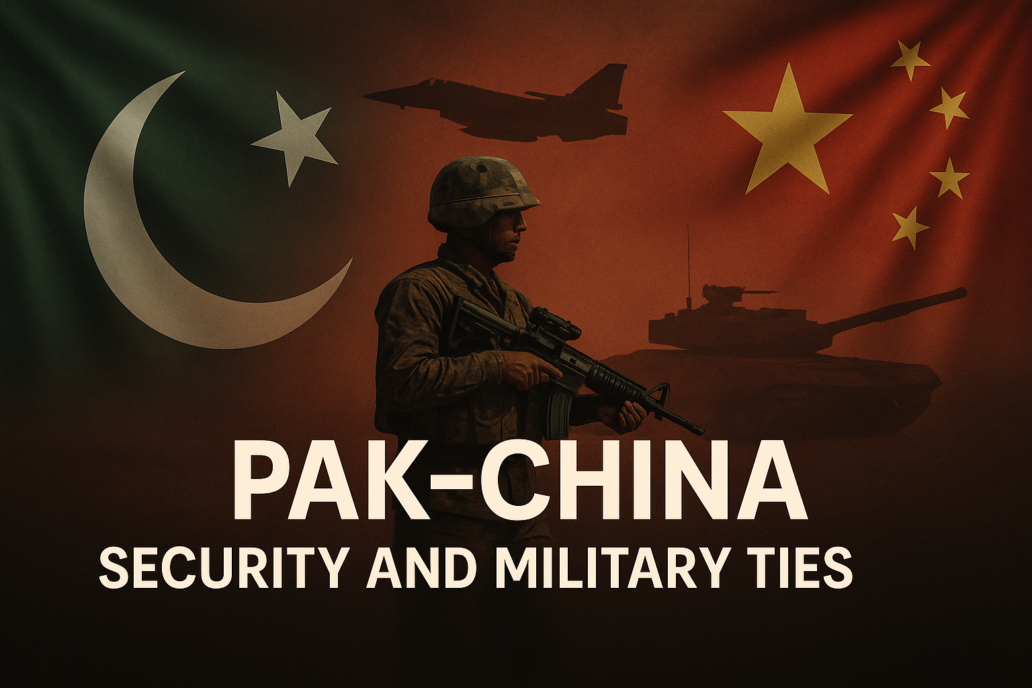

Slide 51
Strategic Depth of Pak–China Military Alliance
Nature of Ties: Long-standing, multi-dimensional military cooperation since 1962.
Purpose: Counter Indian & US influence, previously to repel Soviet presence.
Quote: Chinese Premier Li Keqiang – “If you love China, love Pakistan too.”
Geopolitical Significance: Strengthens regional deterrence architecture in South Asia.

Slide 52
Pakistan as China’s Top Arms Buyer
SIPRI Data:
  63% of Chinese arms exports go to Pakistan.
  81% of Pakistan’s arms imports (2019–2024) are from China.
Implication: Ensures strategic interoperability & dependence on Chinese tech.
Support Since 1962: Ammunition factories, tech transfer, facility upgrades.

Slide 53
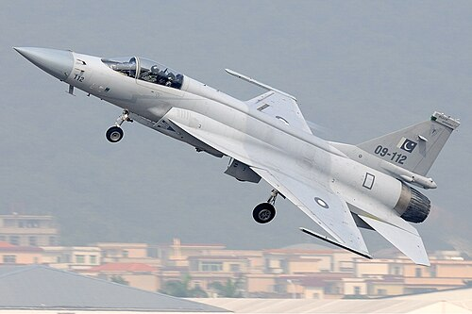
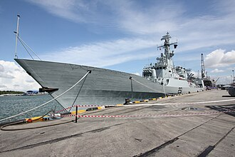
Joint Development & Major Platforms
Aircraft: JF-17 Thunder, K-8 Karakorum trainer, tailor-made training jets (Hongdu L-15 design).
Ground Systems: Al-Khalid tanks (Type 90/MBT-2000 base).
Air Systems: AWACS integration, LOMADS LY-80 air defense system.
Naval Assets: Zulfiquar-class frigates jointly built.

Slide 54
Joint Development of JF-17 Thunder
Origins: Co-developed by Pakistan Aeronautical Complex (PAC) Kamra & Chengdu Aircraft Corporation (CAC) of China.
Induction: First inducted into Pakistan Air Force (PAF) in 2007.
Features: Multirole fighter, cost-effective ($25–30 million/unit) compared to Western jets.
Impact: Reduced dependency on US aircraft (e.g., F-16s) and allowed Pakistan to export jets (e.g., Myanmar, Nigeria).
Analysis: Strengthens Pakistan’s air defense autonomy & China’s defense export market.

Slide 55
High-End Fighter & Submarine Deals
J-10C Acquisition: Chosen over US F-16C Block 52/60 due to advanced radar, OLS targeting, and stealth features (DSI intake).
Submarine Deal: 8 Yuan-class (Type 039B) AIP subs, $5B deal (largest arms sale in China’s history), low-interest financing.
Impact: Enhances deep-sea and aerial strike capabilities.

Slide 56
Chinese Drones for Pakistan
Models Supplied: CH-4 & Wing Loong UAVs for reconnaissance & precision strikes.
Purpose: Counterterrorism in tribal areas, border surveillance with India & Afghanistan.
Fact: CH-4 endurance 30 hours, payload 345 kg, range 5,000 km.
Example: Used in anti-TTP and anti-BLA operations.
Analysis: Enhances real-time intelligence and targeted strike capability without relying on US tech (post-2011 deterioration of ties).

Slide 57
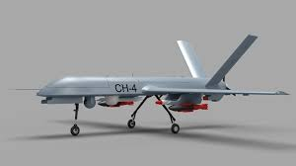

Slide 58
Submarine Cooperation
Project: Acquisition of 8 Type 039B Yuan-class submarines (AIP – Air Independent Propulsion).
Deal Value: $4–5 billion, delivery by 2028.
Impact: Strengthens Pakistan Navy’s deterrence in Indian Ocean.
Example: AIP tech allows 3 weeks submerged operation without surfacing.
Analysis: Balances India’s naval buildup, supports China’s strategic interests in Arabian Sea.

Slide 59
Maritime Strategy & Gwadar Port Security
Gwadar: Deep-sea port at Strait of Hormuz—possible future Chinese naval outpost.
Investment: China pledged $43B, making Gwadar central to CPEC logistics & security.
Perception: Watched closely by US & India for potential Chinese submarine/warship deployment.
Joint Exercises: “Sea Guardian 2” (July 2022) as part of naval security cooperation.

Slide 60
Intelligence, Satellites, and Real-Time Warfare Support
2025 India–Pakistan Conflict:
  China provided 44 satellites to aid Pakistan in tracking Indian troop/missile movements.
  Support Included:
    Signals intelligence.
    Adjusted satellite coverage for optimal monitoring.
    Assistance reorganizing radar & air defense systems.
Effect: Provided real-time operational advantage during hostilities.

Slide 61
Access to BeiDou Military Satellite Service
BeiDou: China’s global satellite navigation system, rival to GPS.
Access Granted: Pakistan is the only foreign country with full military-level access.
Benefits:
  Real-time precision targeting for missiles & drones.
  Secure, jam-resistant military communication.
Analysis: Enhances Pakistan’s C4ISR (Command, Control, Communications, Computers, Intelligence, Surveillance, Reconnaissance) capabilities, reducing reliance on US GPS which can be restricted in wartime.

Slide 62
Counterterrorism Cooperation & Security Challenges
Joint Efforts: Coordination with Afghanistan to stabilize region; Xinjiang as economic-security hub.
Chinese Recognition: Praised Pakistan’s elimination of al-Qaeda, TTP, and ETIM/Islamic Party of Turkistan.
Threats: Baloch separatist attacks (e.g., Majeed Brigade of BLA) targeting Chinese nationals & CPEC projects.
Response: Increased Chinese security presence & demand for tighter Pakistani protection.

Slide 63
Strategic Implications of Pak–China Defense Ties
Balance of Power: Counters India’s defense pacts with US, Israel, France, and Russia.
Technology Transfer: China provides ToT (Transfer of Technology), unlike most Western suppliers.
Regional Strategy: Secures Chinese interests in Arabian Sea & Persian Gulf energy routes (via Gwadar).
Evidence: CPEC-related security forces (Special Security Division) equipped with Chinese surveillance gear.
Analysis: Deep defense ties embed Pakistan in China’s regional security architecture under BRI.

Slide 64

Cultural
Confucius Institutes in Pakistan.
Scholarships (28,000 Pakistani students in China).
Growing Chinese language courses & cultural exchanges.

Slide 65
Ancient & Civilizational Roots
Silk Road Legacy: Over 2,000 years of trade and cultural exchange linking South Asia and China.
Buddhist Transmission: Gandhara (modern KP) served as a key source of Buddhist learning for China.
Chinese Pilgrims: Faxian (4th century) and Xuanzang (7th century) visited the Indus region, documenting its culture, education, and religious life.
Civilizational Link: Early people-to-people interaction predates modern diplomacy by centuries.

Slide 66
Early Diplomatic & Cultural Foundations (1950–1979)
Early Recognition: Pakistan recognized the PRC in 1950; diplomatic relations established May 21, 1951.
Cultural Cooperation Agreement (1965): Formalized exchanges in arts, media, and delegations.
Karakoram Highway (1978): Physical symbol of connectivity, facilitating cultural and social interaction.
Trust Building: Cultural ties reinforced political alignment during Cold War uncertainties.

Slide 67
Institutionalization & Strategic Culture (1980–2013)
Cultural Delegations: Regular exchanges in music, literature, sports, and broadcasting.
Media Collaboration: Joint productions like “Affection on the Highway” strengthened public goodwill.
Educational Exchange: Pakistani students increasingly enrolled in Chinese universities.
2005 Friendship Treaty: Explicitly emphasized cultural understanding and people-to-people bonds as pillars of the relationship.

Slide 68
CPEC Era & People-to-People Expansion (2013–Present)
Education Boom: Over 25,000 Pakistani students currently studying in China.
Language & Institutions: Five Confucius Institutes in Pakistan; Mandarin widely taught in universities.
Cultural Media: Film collaborations such as Batie Girl (2023) reflect modern cultural integration.
Heritage Cooperation (2025): Joint accord on archaeology, museums, and anti-smuggling efforts.
75th Anniversary (2026): “Platinum Jubilee” celebrations, logo launch, and Hero Mudan art exhibitions across Pakistan.

Slide 69
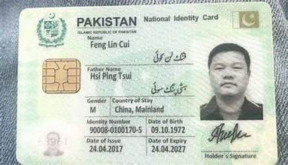

Slide 70
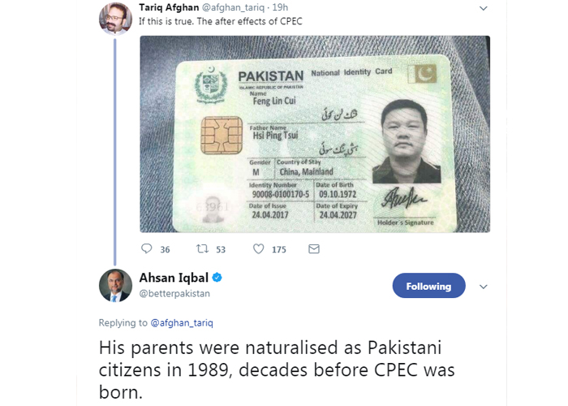

Slide 72
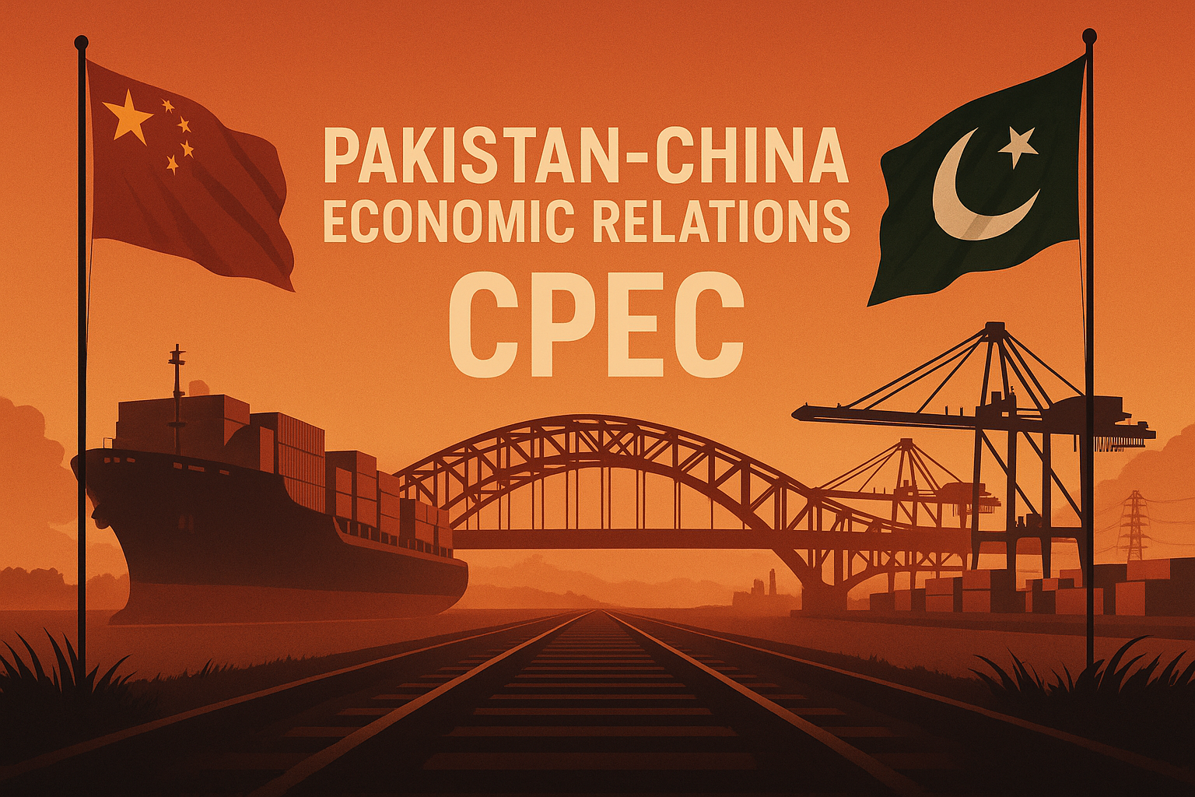

Slide 73
Economic
Bilateral trade: $18.69 billion (trade deficit in China’s favor).
  Pakistan's exports to China : $2.38 billion (FY2024-2025)
  Pakistan’s imports from China: $16.31 billion same period
  Trade Deficit (For Pakistan): $13.93 billion for FY2025
CPEC: $62 billion announced; $25 billion already invested (energy, transport).

Slide 74
China-Pakistan Free Trade Agreement (CPFTA)
Phase 1
Duration: July 2007 to December 2012
Primary Objective: reducing tariffs on appx 85% of product lines, with 36% becoming zero-rated within 3 years.
Trade Growth (Strong but Imbalanced)
  Bilateral trade grew 242% (2007–2018) → $3.5B to $13.8B.
  Pakistan’s exports: $0.5B (2006) → $1.6B (2016).
  China’s exports: $1.4B (2006) → $12.1B (2016).
  Pakistan’s trade deficit rose to $13B (35% of total trade)

Slide 75
Phase 1
Market Access Realities
  Pakistan benefited in: textiles, marble, sports goods, industrial alcohol, fruits.
  China gained in: machinery, electrical equipment, organic chemicals, raw materials.
Key Criticisms
  Pakistan’s concession utilization only 5% vs China’s 57%.
  Weak Pakistani competitiveness → surge of cheaper Chinese goods.
  Limited access for Pakistan’s major exports (textile value-added, leather, agriculture).
Overall Assessment
  Trade increased massively but asymmetrically.
  CPFTA-I exposed structural weaknesses of Pakistani industry and informed the need for Phase-II renegotiation on tariffs & safeguards.

Slide 76
CPFTA Phase II: Structure & Market Access (Effective Jan 2020)
Core Objective
  Correct Phase-I imbalance, expand access, add services & investment.
Tariff Liberalization
  313 Pakistani priority items granted immediate zero-duty access.
  Covers 75% of tariff lines over 10–15 years.
Key Pakistani Export Gains
  Zero-duty entry for: textiles, apparel, seafood, meat, leather, plastics, chemicals, auto parts.
Services Agreement Operational
  Access in 133 Chinese sub-sectors: IT, retail, wholesale, construction.
Safeguard Mechanism Introduced
  Countries may impose temporary tariffs on import surges threatening domestic industry.

Slide 77
Implementation, Impact & Future Outlook
Export Boost Potential
  Expected to raise Pakistan’s exports to China by $500M+ annually after full implementation.
Addressing Non-Tariff Barriers
  Emphasis on electronic data-sharing, customs transparency, and certification harmonization.
Status of Implementation
  Phased tariff reductions underway; full benefits expected over the next decade.
Challenges & Focus Areas
  Pakistan must diversify exports, improve standards, and enhance utilization rates (very low under Phase-I).
Strategic Importance
  Phase II positions Pakistan for deeper industrial integration, higher value-added exports, and more balanced bilateral trade with China.

Slide 78
CPFTA Phase II: Status, Structure & Opportunities (2020–2035)
Fully Operational Since Jan 2020
  Tariff reductions continuing in phases until 2035.
Tariff Relief on 313 Priority Items
  Immediate zero-duty access for textiles, seafood, meat, auto parts.
Stronger Safeguards & Protection Tools
  Balance-of-payments clause + anti-surge safeguards absent in Phase I.
Electronic Data Exchange Introduced
  Reduces misinvoicing, strengthens customs transparency and trade monitoring.
Opportunity Potential but Uncertain Outcomes
  Framework improved, but benefits contingent on Pakistan’s export readiness.

Slide 79
Is CPFTA Phase II Beneficial? Evidence & Constraints
Trade Deficit Still Worsening
  FY 2020–21: Imports $20.8B vs exports $3.1B.
Pakistan’s Low Concession Utilization
  Pakistan uses only 32.3% of concessions; China uses 79.8%.
Weak Export Diversification
  Pakistan concentrates on raw cotton, seafood, metals;
  China exports high-value machinery, chemicals, electronics.
External Shocks Distorted Early Outcomes
  COVID-19 and supply chain disruptions masked initial effects.
Internal Barriers Limit Real Gains
  Non-tariff barriers, weak standards, low capacity, and business awareness hinder full benefits.

Slide 80
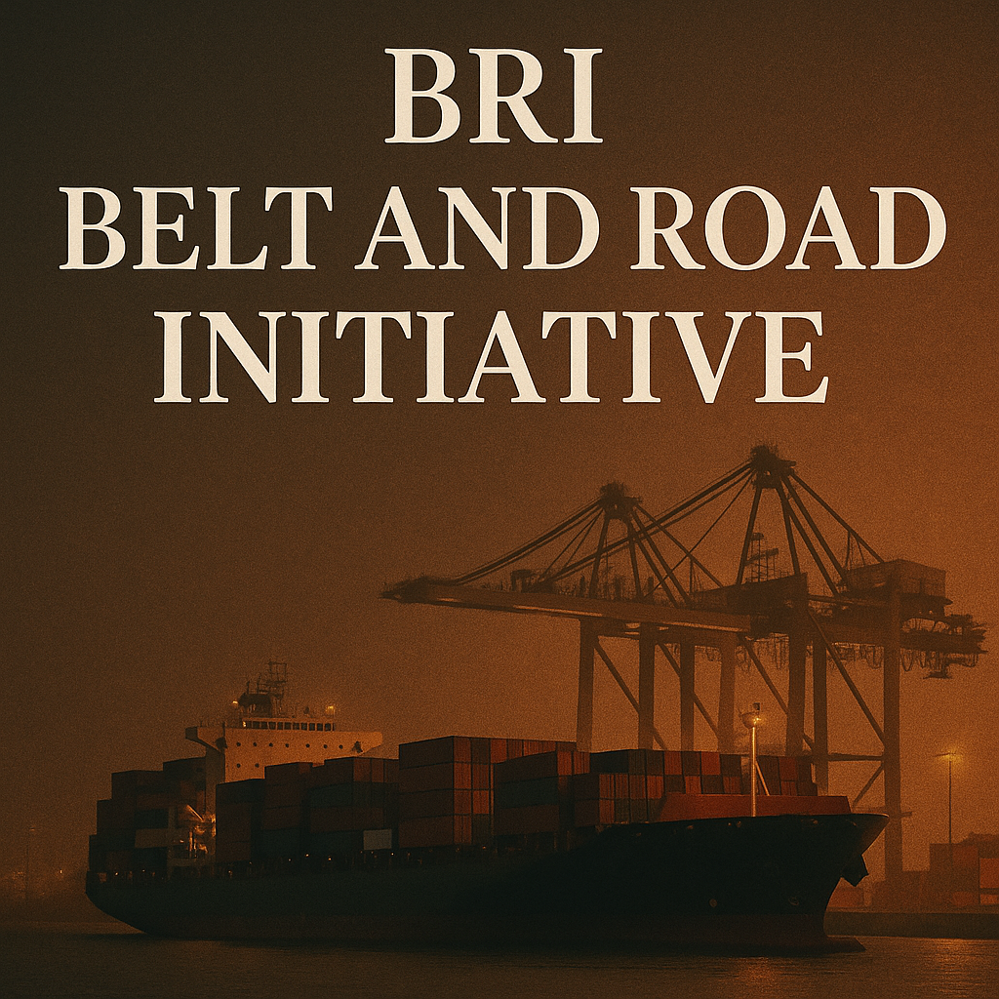

Slide 81
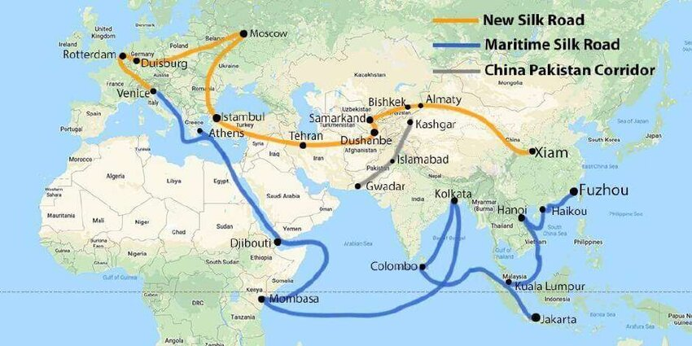

Slide 82
What is the Belt & Road Initiative?
Definition: China’s $1 trillion global infrastructure and connectivity project, launched by President Xi Jinping in 2013.
Scope: Connects Asia, Africa, Europe through overland & maritime networks.
Vision: Revival of the ancient Silk Road to enhance global trade and investment flows.
Global Reach: 140+ countries signed cooperation agreements (as of 2024).

Slide 83
Aims & Strategic Goals
Trade & Connectivity: Link China with Africa, Eurasia, Middle East, South & Southeast Asia.
Energy Security: Secure oil & gas supply lines bypassing chokepoints like the Malacca Strait.
Market Expansion: Open new markets for Chinese goods and technology.
Domestic Development: Boost China’s western provinces (esp. Xinjiang) through cross-border links.
Geopolitical Goal: Shape a China-centric global economic order.

Slide 84
Why BRI focuses on Major Energy Supply Choke Points
China imports over 70% of its oil through sea routes, much of it from the Middle East.
If the US Navy or regional instability blocks these choke points, China’s economy would be vulnerable.
CPEC & BRI goal:
  Reduce dependence on Malacca by building overland energy pipelines and rail from Gwadar to Xinjiang.
  Shortens oil shipping distance from 12,000 km (via Malacca) to 2,500 km.

Slide 85
Structure: Two Main Components
Silk Road Economic Belt (Overland)
  Connects Pacific Ocean to the Baltic Sea via Central Asia, Russia, and Europe.
  Focus on rail, road, and pipeline networks.
21st Century Maritime Silk Road
  Port and shipping routes linking China with Southeast Asia, Africa, and Europe.
  Includes strategic port investments (e.g., Gwadar in Pakistan, Hambantota in Sri Lanka).

Slide 86
Six Main Economic Corridors of BRI
China–Pakistan Economic Corridor (CPEC) – Xinjiang to Gwadar Port.
China–Mongolia–Russia Economic Corridor (CMREC) – Enhances Eurasian rail connectivity.
New Eurasian Land Bridge (NELB) – Direct rail links from China to Europe.
China–Central Asia–West Asia Economic Corridor (CCWAEC) – Links to Middle East & Mediterranean.
China–Indochina Peninsula Economic Corridor (CICPEC) – Connects China to mainland Southeast Asia.
Bangladesh–China–India–Myanmar Economic Corridor (BCIMEC) – South Asia & Bay of Bengal access.

Slide 87
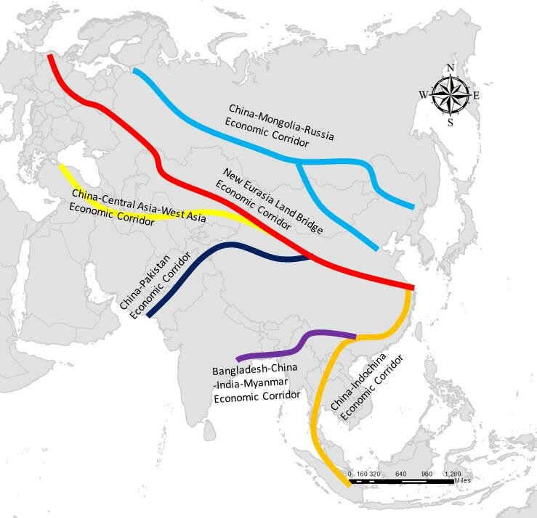

Slide 88
Strategic Purpose & Global Implications
Alternative to US-led Financial Models: Offers developing countries funding without Western conditionalities.
Political Stability via Development: Economic growth as a tool for regional stability.
Counter to US “Rebalancing” in Asia: Expands China’s influence across Indo-Pacific and Eurasia.
Potential Challenges: Debt sustainability debates, local resistance, security risks along routes.
Pakistan’s Role: CPEC as BRI’s “flagship” with strategic positioning between Middle East, Central Asia, and China.

Slide 90
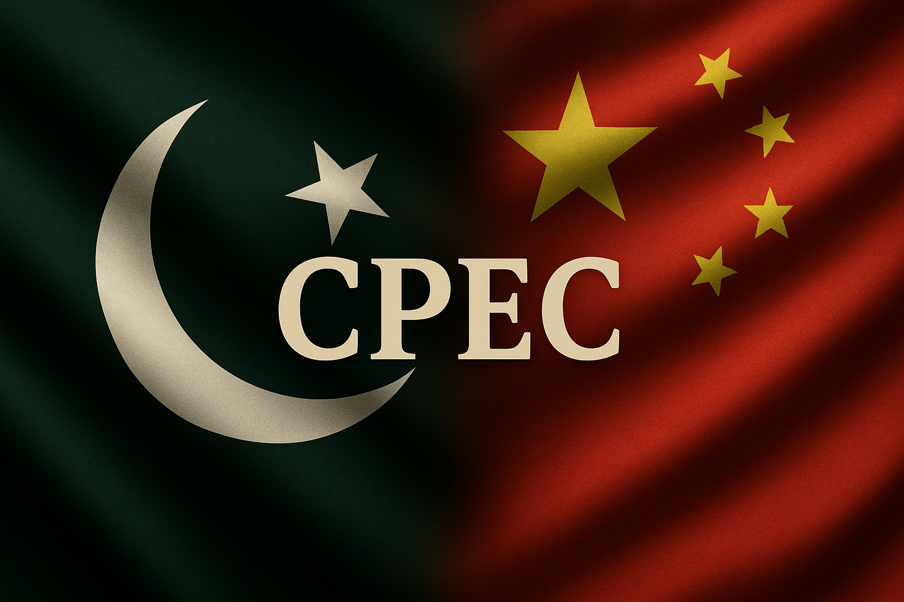

Slide 91
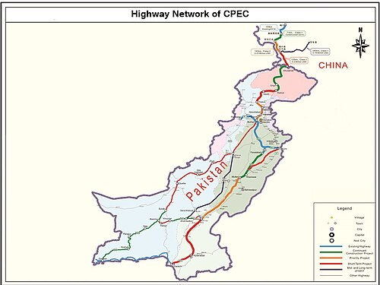

Slide 92
What is CPEC?
Definition:
  The China–Pakistan Economic Corridor (CPEC) is a network of roads, railways, pipelines, and ports connecting China’s Xinjiang region to Pakistan’s Gwadar Port on the Arabian Sea.
Key Facts:
  Part of: China’s Belt & Road Initiative (BRI).
  Launched: April 2015 during Xi Jinping’s visit to Pakistan.
  Initial Value: $46 billion (now $62 billion+).
  Purpose: Boost trade, energy supply, and connectivity for both countries.
  Importance: Gives China a shorter, safer route to Middle East & Africa; gives Pakistan major infrastructure and energy projects.

Slide 93
Why CPEC?
Shortest Route: Xinjiang → Arabian Sea via Gwadar (3,000 km shorter than current China–Middle East sea route).
Pakistan’s Needs:
  $10–12B annual infrastructure investment gap.
  Energy shortages (2013 deficit 4,500 MW).
China’s Needs:
  Secure trade bypass to avoid the Malacca Strait choke point (through which 80% of China’s oil imports pass).
Declared: “Flagship” of BRI by Xi Jinping.

Slide 94
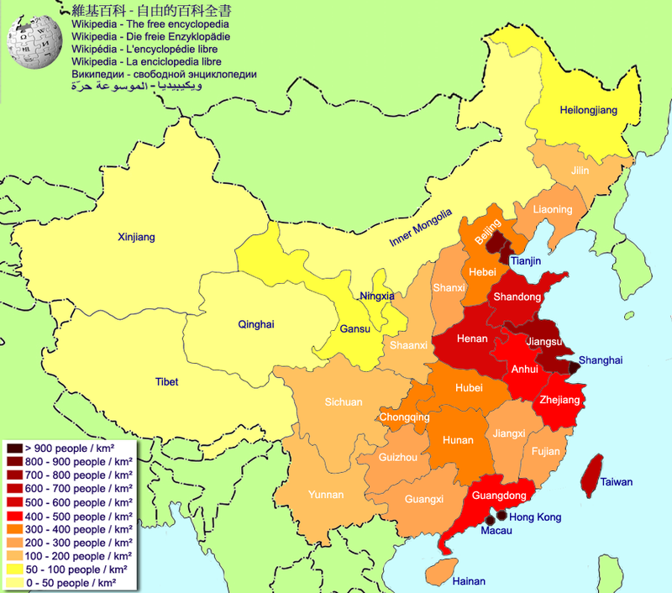

Slide 95
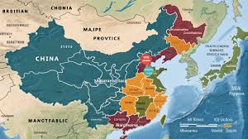

Slide 96
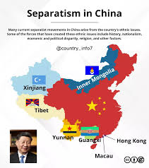

Slide 97
Historical Background
MoU Signed: 2013 (Nawaz Sharif’s visit to China).
Launch: April 20, 2015 (Xi Jinping’s state visit to Pakistan).
Scale: Initially $46B → now estimated at $62B+.
Nature: Mix of concessional loans, grants, and commercial investments.

Slide 98
CPEC Phases Overview
Early Harvest Projects (2015–2020) – Energy, transport, Gwadar upgrades.
Expansion (2020–2025) – SEZs, agriculture, IT.
Integration (2025–2030) – Regional connectivity & trade expansion.

Slide 99
Phase 1: Early Harvest Projects (2015–2020)
Energy Sector ($19B):
  Coal plants: Port Qasim (1,320 MW), Sahiwal (1,320 MW), Hub (1,320 MW).
  Hydropower: Karot (720 MW).
  Renewable: Quaid-e-Azam Solar Park Expansion.
Transport:
  Karakoram Highway (Havelian–Thakot).
  Motorways: Multan–Sukkur (M-5), Hakla–D.I. Khan.
Gwadar Development:
  Eastbay Expressway, Gwadar Free Zone Phase 1, Gwadar International Airport.

Slide 100
Phase 2: Expansion (2020–2025)
SEZs:
  Rashakai (KP) – Engineering goods, textile, IT.
  Dhabeji (Sindh) – Heavy industries, steel, petrochemicals.
  Allama Iqbal Industrial City (Punjab) – Value-added textiles, pharmaceuticals.
Agriculture: Modern irrigation, seed technology transfer.
IT: Fiber optic expansion (Khunjerab–Rawalpindi cable).

Slide 101
Phase 3: Integration (2025–2030)
Trade Network Expansion: Gwadar as transshipment hub for Middle East & Africa.
Regional Connectivity: Linkages with CARs, Iran, Turkey.
Energy Integration: Cross-border power trade with Central Asia (CASA-1000 synergy).
Industry: High-value manufacturing, tech parks.

Slide 102
Updated Information till SEP 2025
Updated Plan: Pakistan and China will release a revised CPEC Long-Term Plan within 90 days, aligning Pakistan’s 5Es framework with CPEC’s Five Corridors for Phase-II.
Phase-II Focus: The next phase will emphasize industrialization, technology, sustainability, and regional connectivity.
Key Projects: Major initiatives include the ML-1 Railway upgrade, Karakoram Highway realignment, and Gwadar port development.
Coordination: Minister Ahsan Iqbal proposed more frequent JCC and Working Group meetings to maintain progress and oversight.
Commitment: Pakistan reaffirmed safety of Chinese workers and called CPEC both an economic engine and a symbol of enduring Pak–China friendship.

Slide 103
“5Es” framework
Export Expansion: Diversify and boost Pakistan’s exports.
Energy: Ensure affordable, reliable, sustainable national power.
Environment: Promote green growth and climate resilience.
Equity & Empowerment: Reduce inequality, empower marginalized groups.
E-Governance: Digitize governance for transparency and efficiency

Slide 104
CPEC Phase-II: Progress, Promises, and Policy Gaps
14th JCC launched CPEC Phase-II roadmap – Focus on industrialization, tech, sustainability, connectivity.
Updated Plan in 90 days announced – Aligns Pakistan’s 5Es with Five Corridors of CPEC.
  Five Corridors of CPEC Phase-II: Growth, Innovation, Green Development, Livelihood, Regional Connectivity.
Unresolved issues: IPP dues, ML-1 financing – Rs 250 bn unpaid; China demands IMF clarity.
China’s caution shows trust-deficit emerging – Rollovers continue but new financing uncertain.
Institutional inertia stalls mega projects – SEZs like Rashakai, Dhabeji lag due to bureaucracy.

Slide 105
CPEC: Opportunities amid Fiscal & Strategic Risks
Economic relief but rising dependency visible – Debt rollovers $5–6 b annually since 2019.
Foreign investment remains below expectations – FDI < $1.5 b (2024)
Security concerns hinder Chinese participation – BLA attacks; 2024 Dasu incident rattled investors.
IMF, China dual pressure on sovereignty – Fiscal discipline vs. strategic loyalty dilemma grows.
Reform, transparency key to CPEC revival – Policy continuity + SEZ reform = sustainable dividends.

Slide 106
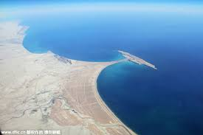

Slide 107
Gwadar Port: Strategic Importance
Location: At the mouth of the Strait of Hormuz (20% of world’s oil passes).
Advantages:
  Deep-sea port (18m depth, large vessel capacity).
  600 km from Oman, 380 km from Chahbahar.
Chinese Interest: Potential future naval logistics hub.
Trade Impact: Cuts shipping time from China to Europe/Middle East by 12–14 days.

Slide 108
Gwadar–Chabahar Dilemma
Chabahar (Iran): Developed by India as counter to CPEC.
Competition:
  Gwadar: Chinese-led, linked to Xinjiang.
  Chabahar: Indian-led, linked to Afghanistan & CARs via Iran.
Strategic Chessboard: US quietly supported Chabahar to counter Chinese influence in the Arabian Sea.

Slide 109
Global Reservations & Opposition
United States:
  Sees CPEC as strengthening China’s “String of Pearls” strategy.
  Concern over Chinese military foothold in Gwadar.
India:
  Objects as CPEC passes through Gilgit-Baltistan (claimed territory).
  Sees Gwadar as a threat to its western seaboard security.
Japan & Australia:
  Wary of BRI’s debt diplomacy; part of “Quad” response to China’s Indo-Pacific rise.
  Avoid direct support for CPEC-linked projects.
Some EU States:
  Raise concerns over transparency, environmental & debt risks.

Slide 110
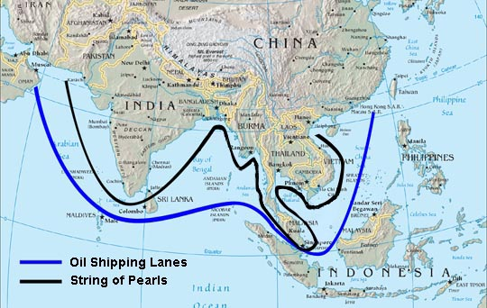

Slide 111
Significance for Pakistan: Energy Security & Economic Growth
Key Benefits:
  Mitigates chronic energy shortages. Pakistan’s energy shortfalls in 2013 reached 4,000–6,000 MW, peaking around 7,000 MW in 2017, stalling economic growth by 2% annually.
  CPEC energy projects helped reduce these deficits significantly.
  Massive energy additions. Approximately 11,110 MW of new generation capacity has been realized (though 17,000 MW was initially targeted) .
  Balanced energy mix. The corridor added over 5,000 MW to the national grid by 2021 via coal, hydro, wind, and solar projects.
  GDP uplift. Planning Commission projects CPEC will raise GDP growth by 2–2.5 percentage points by 2030

Slide 112
Infrastructure and Trade Connectivity
Key Benefits:
  Accelerated infrastructure growth. Over 1,500 km of new highways—including sections of the Karakoram and Multan–Sukkur motorways—have been constructed.
  Rail modernization. The ML-1 upgrade (Karachi–Peshawar line) is cutting transit times significantly, with rail's share of freight projected to rise from 4% to 20% by 2025.
  Gwadar strategic node. Development includes port expansion, East Bay Expressway, and a greenfield airport to handle wide-body aircraft & 400,000 passengers/year.
  Global trade gateway. Gwadar connects Pakistan to Middle East, Africa, and Central Asia, positioning it as a vital trade hub.

Slide 113
Industrialization & Employment
Key Benefits:
  SEZ-driven industrial growth. Zones like Rashakai SEZ (operational since July 2023) are forecasted to generate 70,000+ direct and 250,000 indirect jobs.
  Pakistani targets foresee 2.3 million new jobs by 2030, supported by infrastructure, energy, and SEZ expansion.
  FDI injection. CPEC is Pakistan’s largest FDI source: $27.3B in initial four years (2013‑2017), rising to $62B–65B by 2022.
  Industrial diversification. SEZs will boost manufacturing in sectors like textiles, auto-assembly, food processing, and minerals.

Slide 114
Hurdles & Controversies
Governance: Inconsistent policy enforcement, federal–provincial frictions.
Delays: Rashakai SEZ NOCs >1 year delay, Azad Pattan Hydro litigation, NEPRA compliance issues.
Debt Concerns: High-interest commercial loans for some energy projects.
Security Risks: Attacks in Balochistan (e.g., Majeed Brigade targeting Chinese workers).

Slide 115
Securing & Strengthening CPEC.
Address External Threats
  Strengthen naval & air surveillance around Gwadar to deter regional rivals (India/US concerns).
  Diplomatic engagement with neighbors (Iran, Afghanistan) to reduce regional hostility.
  Counter hostile narratives (“Debt Trap Diplomacy”) through transparency in agreements.
Counter Internal Security Risks
  Expand & professionalize the CPEC Special Security Division (SSD) to protect projects & Chinese personnel.
  Enhance intelligence coordination to counter BLA/TTP attacks in Balochistan & KP.
  Invest in local community development to reduce alienation in Gwadar & Balochistan.

Slide 116
Continued…
Overcome Governance & Delay Issues
  Federal–Provincial Coordination: Streamline approvals via a joint CPEC authority.
  Transparency: Publish project timelines, costs, and compliance status to boost confidence.
  Policy Continuity: Insulate CPEC from political instability (change of govt/military transitions).
  Reform NEPRA & SEZ Approvals: Fast-track energy tariffs, land allotments, and tax facilitation.
Strategic Vision
  Shift from just energy & roads to industrialization, IT, and export-led growth.
  Link CPEC with Central Asia, Turkey, Gulf states to maximize transit trade revenue.
👉 This way, Pakistan turns CPEC into a national project above politics, secures it against threats, and unlocks its full game-changer potential.

Slide 117
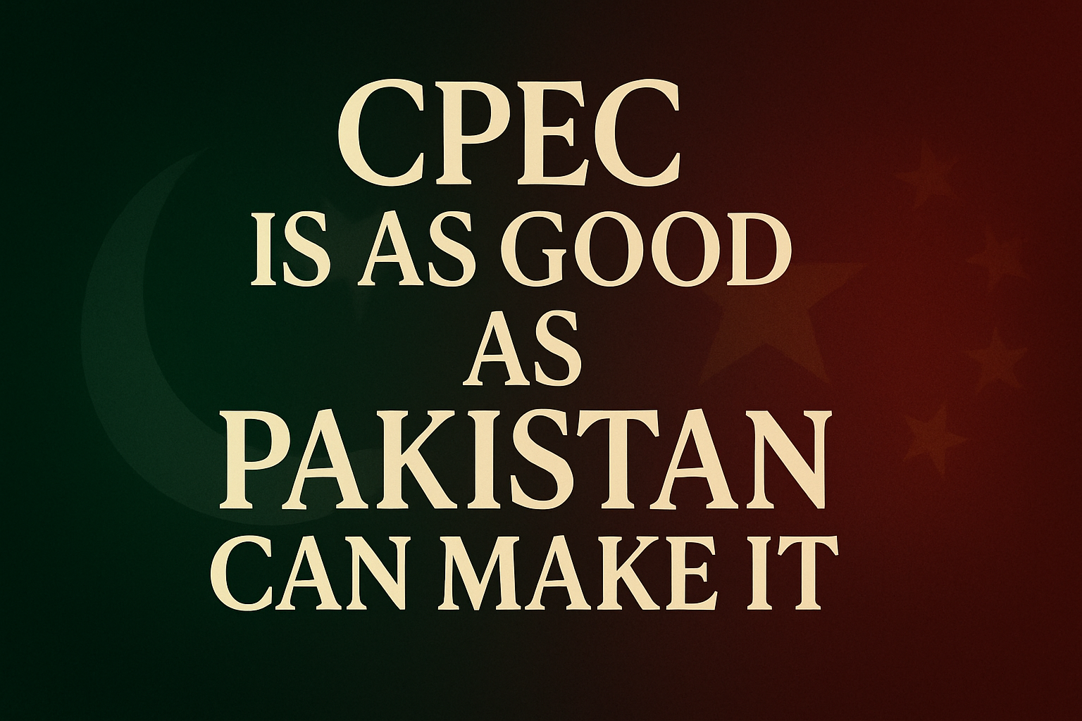

Slide 118
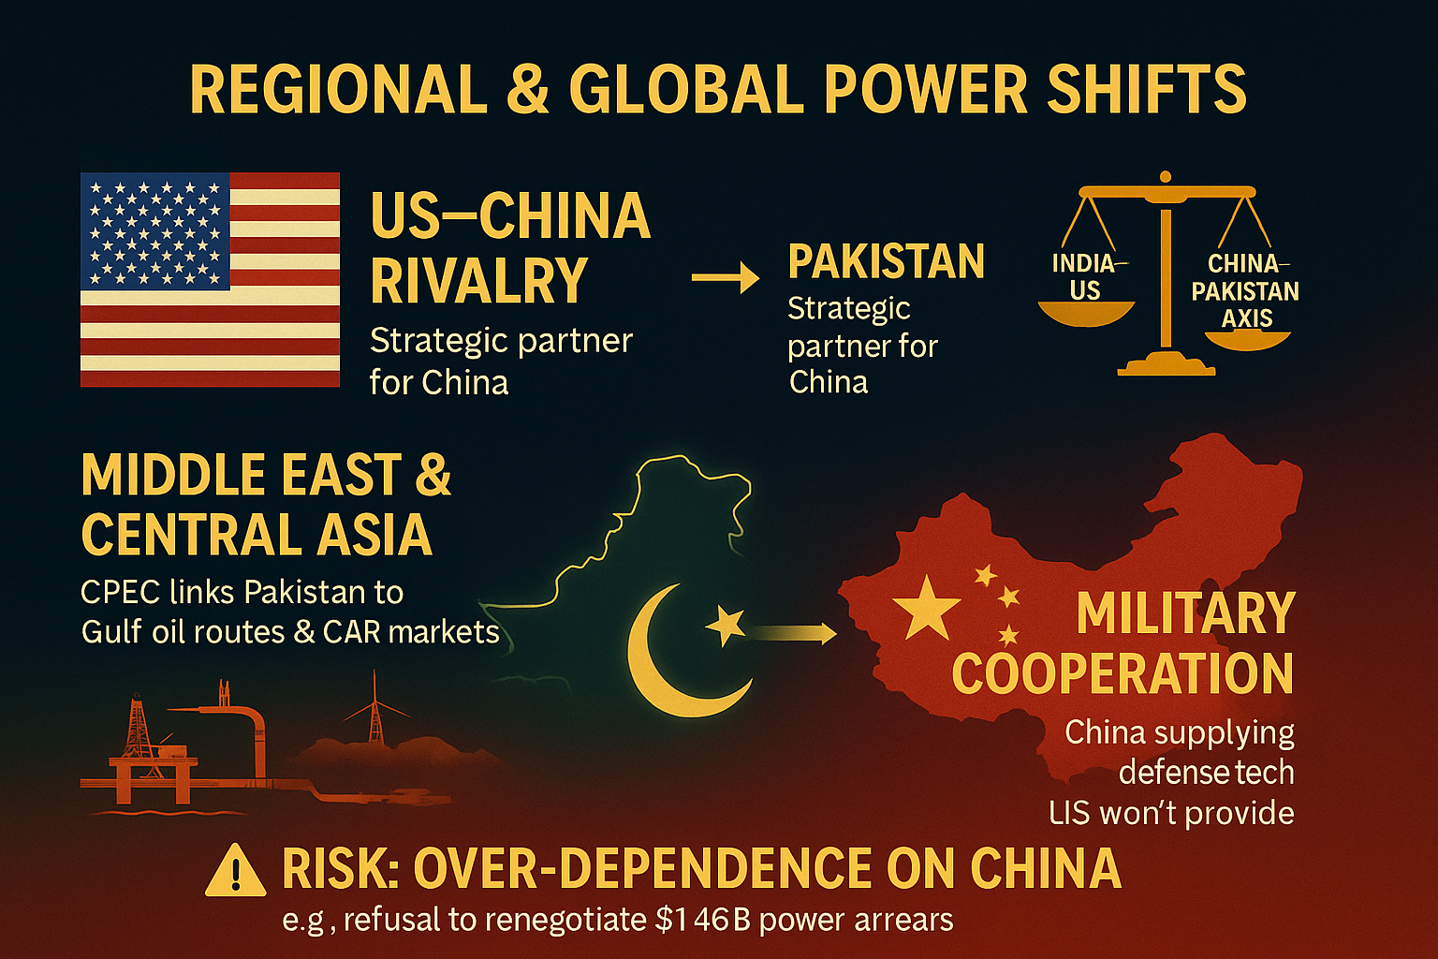

Slide 119
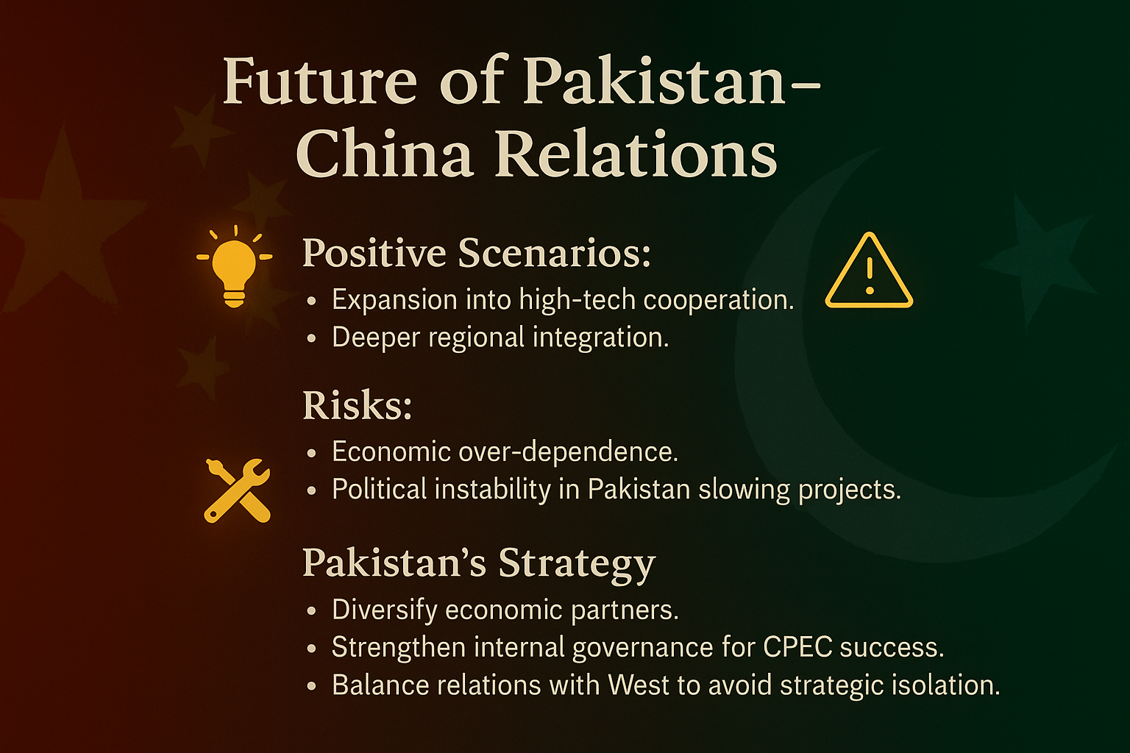

Slide 120
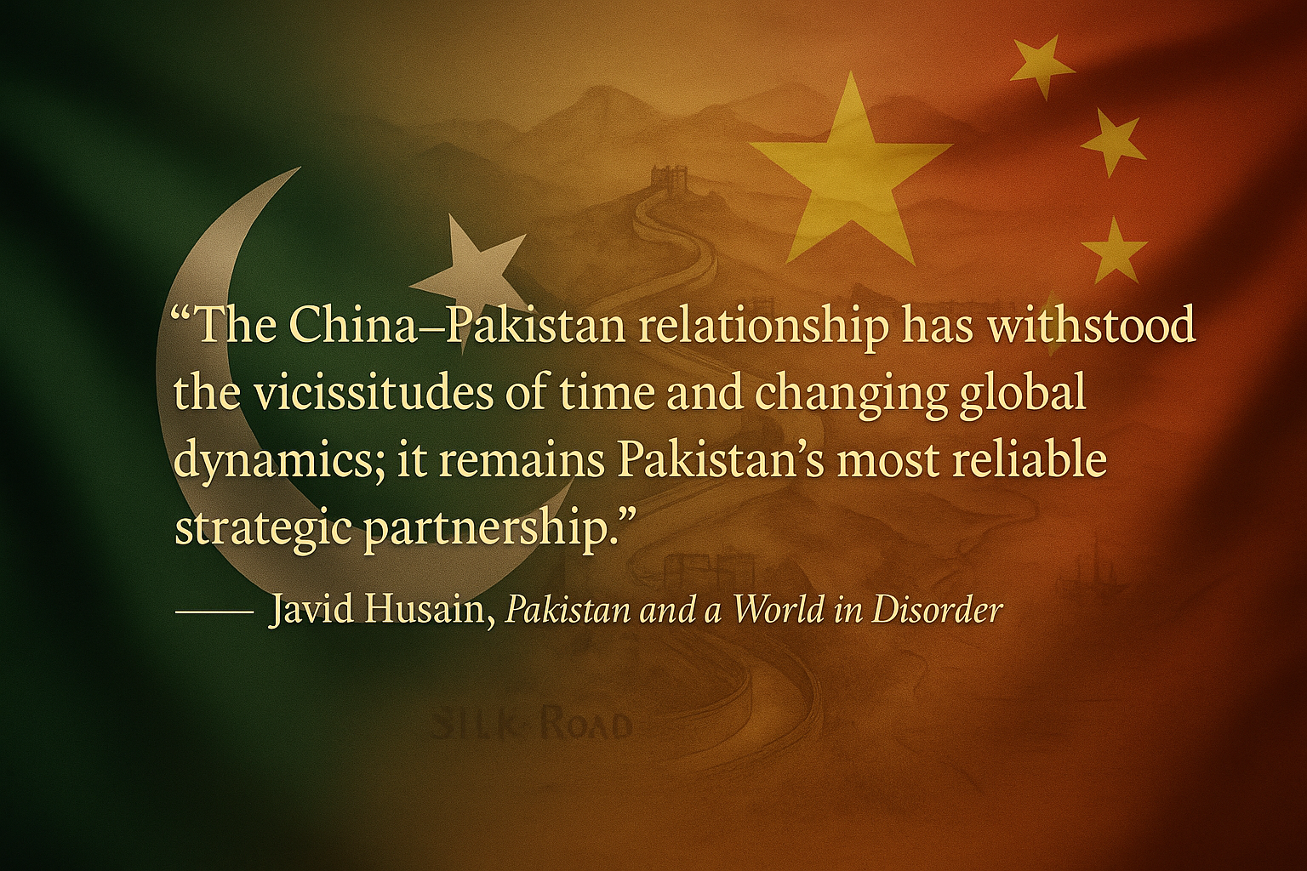

Slide 121
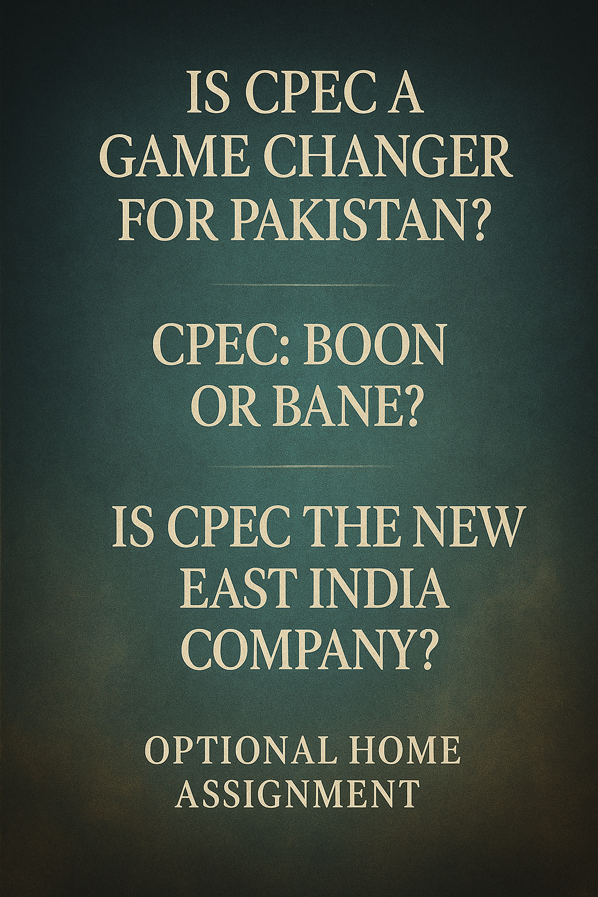

Slide 122


