Slide 1
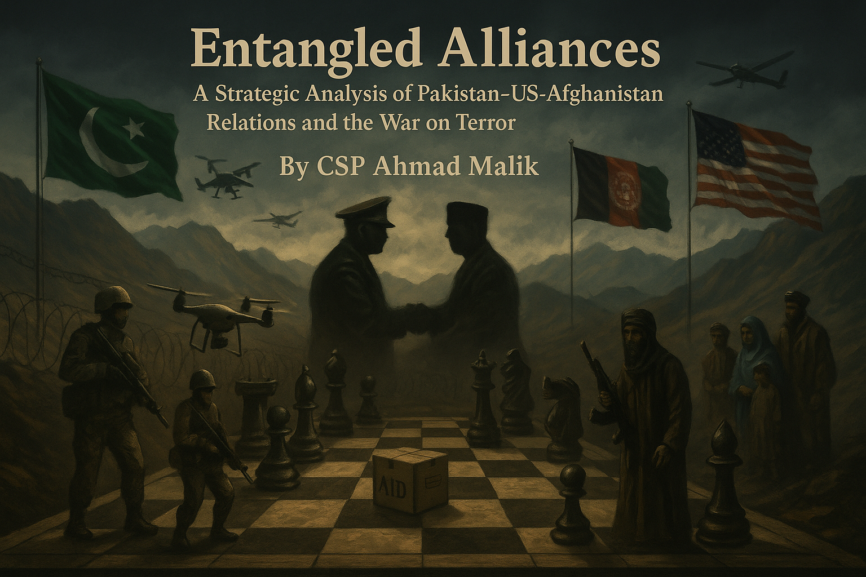

Slide 2
WHEN I RUN AFTER WHAT I THINK I WANT by RUMI
When I run after what I think I want,
My days are a furnace of distress and anxiety,
If I sit in my own place of patience,
What I need flows to me, and without any pain
From this, I understand that
what I want also wants me,
And is looking for me and attracting me,
There’s a great secret on this for all who can grasp it.

Slide 3
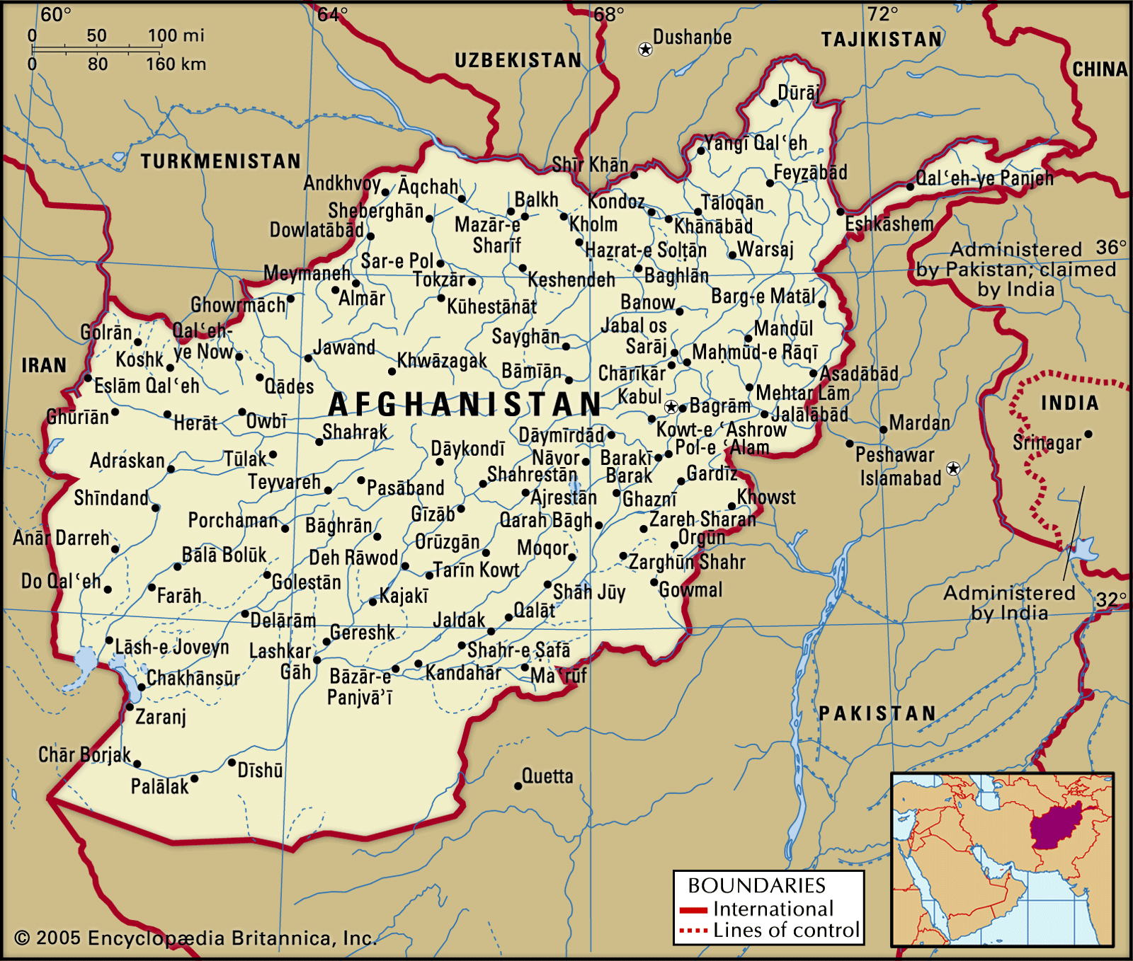

Slide 4
THE GREAT GAME

Slide 5
The Great Game, Rivalry between Britain and Russia in Central Asia in the late 19th century. The term was used by Rudyard Kipling in his novel Kim (1901). British attitudes were influenced by the reports of official, semiofficial, and private adventurers enjoying the thrill of clandestine operations beyond the frontiers of India, reports that frequently embellished (or even invented) accounts of Russian machinations and the vacillating loyalties of local chieftains.

Slide 7
Anglo-Russian Convention of 1907
Ended classic phase of Great Game.
Russia agreed: Afghanistan under British influence, no direct relations.
Persia divided:
South: British zone
North: Russian zone
Middle: Neutral buffer zone
In Tibet, both empires respected China’s suzerainty.

Slide 9
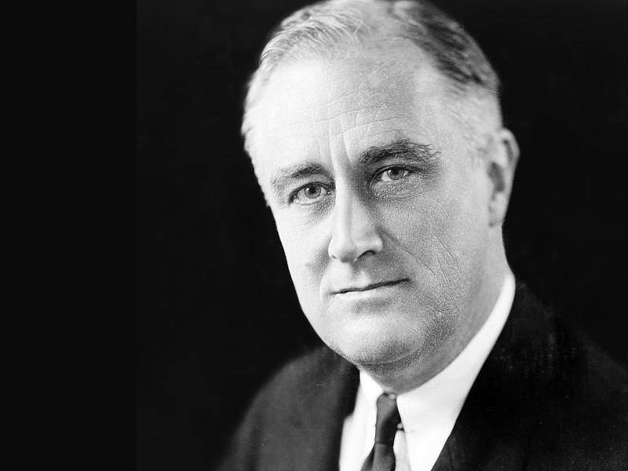

Slide 10


Slide 11
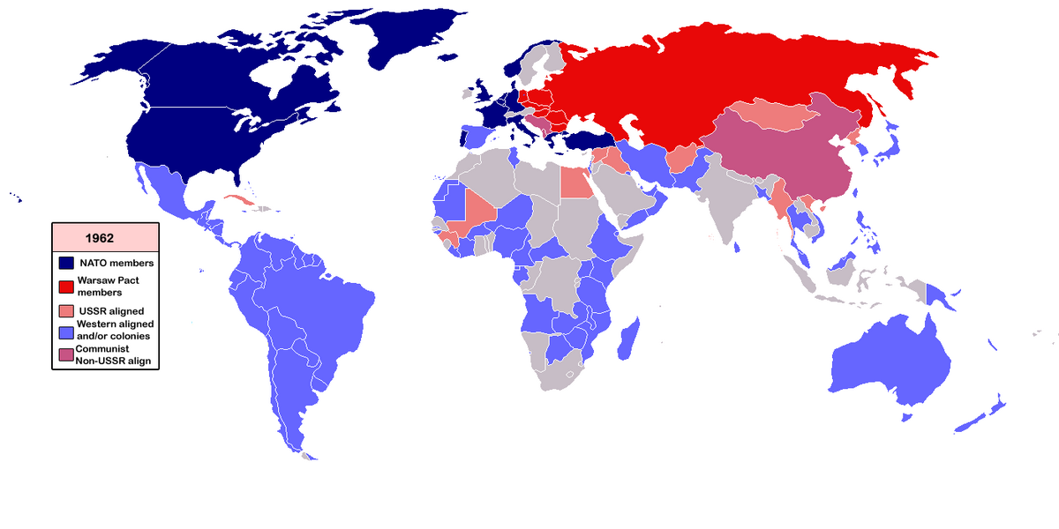

Slide 12
Cold War
Cold War, the open yet restricted rivalry that developed after World War II between the United States and the Soviet Union and their respective allies. The Cold War was waged on political, economic, and propaganda fronts and had only limited recourse to weapons. The term was first used by the English writer George Orwell in an article published in 1945 to refer to what he predicted would be a nuclear stalemate between “two or three monstrous super-states, each possessed of a weapon by which millions of people can be wiped out in a few seconds.” It was first used in the United States by the American financier and presidential adviser Bernard Baruch in a speech at the State House in Columbia, South Carolina, in 1947.

Slide 13
Soviet Invasion (1979–1989):
The USSR's invasion in 1979 to support the communist regime against the Mujahedeen.
U.S. and Pakistan's ISI, with Saudi funding, armed and trained Afghan rebels.
Tariq Ali, in his book, A forty-year War in Pakistan, emphasizes that the CIA's Operation Cyclone created a “Jihadist Frankenstein”.
‘’The seeds of al-Qaeda and Taliban were sown in the 1980s.’’
U.S. funded up to $630 million annually to Mujahideen in the 1980s.

Slide 14
The Mujahedeen
Jamiat e islami (Tajik)led by Burhanuddin Rabbani and Ahmad Shah Masoud
Hezb e Islami Gulbuddin led by Gulbuddin Hekmatyar (Pashtun group)
Hezb e Islami Khalis: Another Pashtun-dominted faction, led by Yunus Khan

Slide 15
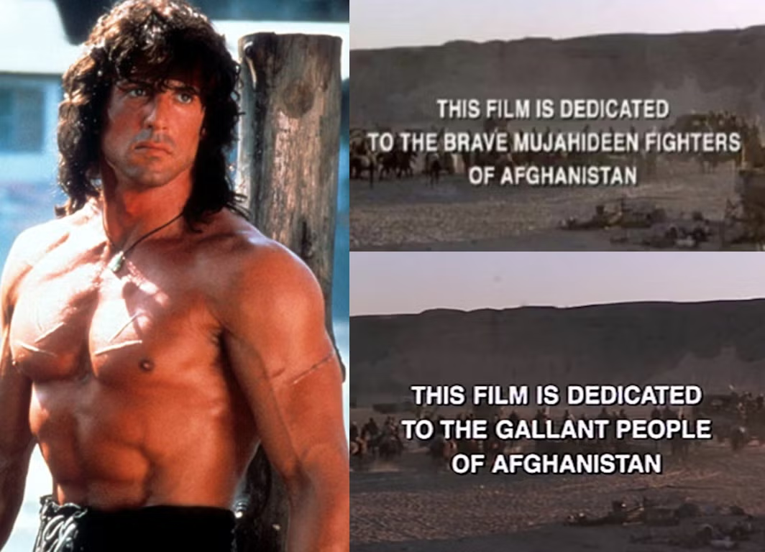

Slide 16
Civil War and Rise of the Taliban (1989–2001):
After Soviet withdrawal in 1989, Afghanistan plunged into civil war among warlords.
The Taliban, emerging in the early 1990s from madrassas in Pakistan, promised law and order and gained popular support.
1996: Taliban captured Kabul and imposed strict Islamic rule.
Tariq Ali critiques the West’s initial tolerance of the Taliban for regional stability and potential pipeline deals.

Slide 17
Civil War Groups:
Mujahedeen
The Northern Alliance:
United National Front for the Salvation of Afghanistan
Coalition of Mujahedeen groups, primarily from Tajik, Uzbek, and Hazara ethnic group led by Burhanuddin Rabbani
The Haqqani Network:
Found in 1970
Led by Jalaluddin Haqqani, a fundamentalist of th Zadran tribe, fought for Yunus Khan’s Khalis group.
The Taliban

Slide 18
The Unocal Pipeline Project (Trans-Afghanistan Pipeline – TAPI)
Who: Unocal Corporation (a U.S.-based oil and gas company) led a consortium with Delta Oil (Saudi Arabia) and other partners.
What: Proposed a pipeline from Turkmenistan to Pakistan and potentially India, passing through western Afghanistan (Herat–Kandahar).
Why: To transport Turkmen natural gas from the Daulatabad gas fields to warm-water ports on the Arabian Sea, bypassing Iran and Russia.
Taliban Role: U.S. and Saudi interlocutors engaged with Taliban leaders in 1997–1998, even hosting delegations in Texas to discuss security guarantees for the pipeline.
Diplomatic Implication: Tariq Ali argues that as long as the Taliban were seen as capable of providing "order," they were not heavily sanctioned or diplomatically isolated by the West.
Tariq Ali's View: This episode reveals the hypocrisy in Western foreign policy, where energy security and regional access were prioritized over human rights or democratic norms. The Taliban’s harsh rule was overlooked as long as commercial infrastructure and anti-Iranian containment could be achieved.

Slide 19
U.S. Invasion (2001–2021):
Post-9/11, U.S. invades Afghanistan under Operation Enduring Freedom.
The Taliban are removed, but warlords, corruption, and foreign dependency return.
The U.S. installed a “puppet government” and created a drug-based war economy.
Key Data:
2.3 trillion USD spent by the U.S.
Over 240,000 dead, including 47,000+ civilians (Brown University’s Costs of War Project)
85% of heroin worldwide originates from Afghanistan during this era.

Slide 20
Taliban’s Return (2021):
Tariq Ali was among the few who predicted Taliban resurgence, arguing that the U.S. mission had no legitimacy or public support.
Chaotic withdrawal and abandonment of Afghans.
The so-called liberal gains for women and civil society were fragile and dependent on foreign forces.

Slide 21
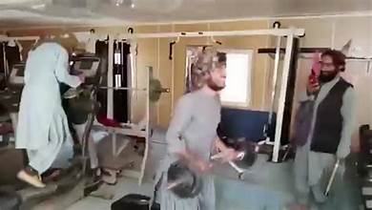

Slide 22
Important Examples & Quotes
On Warlords: "The men the U.S. trusted to fight the Taliban were often as brutal as the Taliban.”
On Afghan People: "No foreign invader in history has ever successfully subdued Afghanistan for long.”
On Empire: "Empires retreat in confusion. This one is no different."

Slide 23
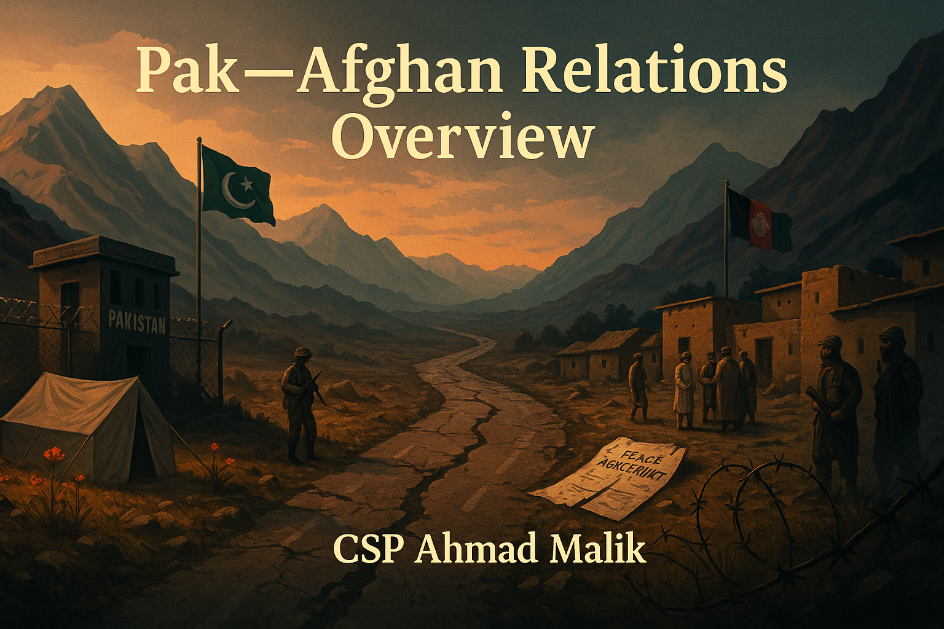

Slide 24
Birth of the Relationship: 1947 and the Durand Line Problem
Afghanistan was the ONLY country to oppose Pakistan's UN membership in 1947 — a fractious start to bilateral relations.
The Durand Line (2,611 km): Demarcated by British India's Mortimer Durand and Amir Abdur Rahman Khan in 1893. Afghanistan has never formally recognized it as an international border.
Pashtunistan Demand: Afghanistan historically championed a separate Pashtun homeland — directly challenging Pakistan's territorial integrity and sovereignty.
Pakistan's Strategic Dilemma: A hostile or unstable Afghanistan in the west compounds its security challenges from India in the east — the classic two-front problem.
Ethnic Fault Line: ~42 million Pashtuns span both sides — the world's largest tribal society without a state, a perennial source of cross-border identity politics.
Early Diplomatic Tensions: Pakistan's formation was seen as breaking Pashtun unity. This fueled early Afghan foreign policy aligned with India.

Slide 25
Key Historical Milestones: 1947–2001
1947
Pakistan gains independence. Afghanistan opposes UN membership over Durand Line & Pashtunistan. Cold War begins shaping regional alignments.
1955
Afghanistan's PM Daoud Khan pursues Pashtunistan actively. Pakistan closes the border for 5 months in retaliation — early use of economic coercion.
1965–73
Relations normalize under King Zahir Shah but Pashtunistan issue simmers. Pakistan backed by US/SEATO; Afghanistan non-aligned but Soviet-leaning.
1973
Daoud Khan topples Zahir Shah. Relations deteriorate. Afghan-Indian ties warm. Pakistan begins covert support to Afghan Islamists (Hekmatyar, Rabbani).
1978–79
Saur Revolution installs communist PDPA. Soviet invasion (Dec 1979). Pakistan becomes frontline state in Cold War — CIA/ISI partnership begins.
1980s
Pakistan hosts 3+ million Afghan refugees. ISI channels $3 billion in CIA aid to Mujahideen. Afghan jihad reshapes Pakistan's society, military, intelligence.
1989
Soviet withdrawal. Pakistan backs Hekmatyar's Hezb-e-Islami for Kabul control. Civil war erupts. Pakistan's 'strategic depth' doctrine takes shape.

Slide 26
1947-1950s: Early Tensions
Durand Line Dispute: Afghanistan was the only country to vote against Pakistan’s UN membership in 1947, citing the Durand Line issue and concerns over Pashtun areas.
Pashtunistan Issue: Kabul promoted the idea of a separate Pashtun state, undermining Pakistan’s territorial integrity.

Slide 27
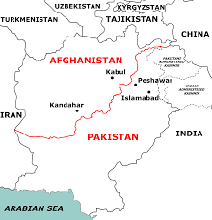
Durand Line

Slide 28
Legitimacy of the 1893 Agreement
The Durand Line was established through a formal agreement signed on November 12, 1893, between Sir Mortimer Durand of British India and Amir Abdur Rahman Khan of Afghanistan.
The agreement delineated the spheres of influence and was intended to serve as a permanent boundary.

Slide 29
Reaffirmation by Successive Afghan Rulers
Amir Habibullah Khan (1905) and Amir Amanullah Khan (1919, 1921) reaffirmed the Durand Line in subsequent treaties, including the Treaty of Rawalpindi (1919) and the Treaty of Kabul (1921).
These reaffirmations underscore the continuity and acceptance of the boundary by Afghan leadership over time.

Slide 30
Misconceptions and Myths
Shahid Raja, in his book, ‘Durand Line: Myths & Reality’, addresses common misconceptions, such as the belief that the agreement was coerced or that it had a 100-year expiration, clarifying that there is no clause indicating a temporal limitation.
He emphasizes that the agreement was made voluntarily and with the full authority of the Afghan Amir, who had the backing of tribal leaders.
State Succession is the replacement of one state by another in the responsibility for the international relations of a territory.

Slide 31
Treaty Basis: The Durand Agreement (1893)
Signed between two sovereign entities: British India and the Afghan Emirate.
Supplemented by 1905 and 1919 Anglo-Afghan agreements (notably Treaty of Rawalpindi 1919), where Afghanistan accepted British India's territorial claims, including the Durand Line.
Ref: Starke – treaties signed by colonial powers are binding on successors if not invalidated or renounced.

Slide 32
Pakistan’s Legal Position
Pakistan claims state succession from British India.
As the successor state, Pakistan maintains the validity of international borders inherited from British India under the principle of uti possidetis juris.
“International boundaries survive succession unless changed by mutual consent.”— Shaw, International Law
Pakistan references the 1905 reaffirmation and international recognition, including UN maps, as supporting legal proof.

Slide 33
Afghanistan’s Position
Afghanistan does not recognize the Durand Line as an international border.
Claims:
The 1893 treaty was imposed under duress.
It was not intended to be permanent.
Treaty expired with the fall of British colonial rule in 1947.
However:
Afghanistan reaffirmed the boundary in the 1919 Rawalpindi Treaty and 1930s correspondence.
No formal denunciation occurred at independence in 1919 or in 1947.
Starke: Under customary law, borders recognized in treaties and confirmed later cannot be unilaterally rejected.

Slide 34
Legal Arguments Supporting Validity
Treaty Continuity under State Succession
Pakistan inherits the border obligations of British India.
Reaffirmation by Successive Afghan Rulers
Multiple Afghan regimes post-1893 upheld the Durand Line.
Principle of Uti Possidetis Juris
Established borders remain post-decolonization.
International Recognition
UN, OIC, and most states treat it as Pakistan’s border.
Customary Law on Boundary Stability
Changing it requires mutual agreement, not unilateral rejection.

Slide 35
Counterarguments and Complexity
Afghanistan argues:
The treaty violated Pashtun self-determination.
Treaty was signed with a non-democratic ruler under pressure.
The agreement divides ethnic homelands.
Shaw: Ethnicity does not override legal boundaries unless backed by plebiscite or mutual treaty.

Slide 36
Pashtunistan Issue
Afghanistan argue that Pashtuns are separate, and consider themselves part of Afghanistan, therefore, the border is invalid.
BUT….
1947: NWFP referendum, approximately 289,244 Pashtun voters (99.02%) chose to join Pakistan
The referendum was rejected by the Khudai Khidmatgar movement, led by Bacha Khan, who advocated for an independent Pashtunistan.
The largest ethnic group in Afghanistan (65%) => 15 to 19 million
Pakistan: 15.4% Pashtun ethnicity , second largest ethnic group
More than 30 million

Slide 37
1979–1989: Soviet Invasion and Strategic Alignment
Pakistan became a frontline ally of the U.S..
Hosted over 3 million Afghan refugees.
Channeled $630+ million/year in U.S. and Saudi funding to Mujahedeen via the ISI.
Afghan warlord politics began spilling into Pakistan.

Slide 38
The Afghan Jihad Legacy (1979–1996): Gains & Blowback
Pakistan's Strategic Gains
Long-Term Blowback
Became a critical US ally — $3.2 billion in military aid (1980–88)
ISI emerged as regional power broker with pan-Islamist network
'Strategic depth' doctrine: using Afghanistan as defensive buffer vs. India
Acquired nuclear technology with reduced international scrutiny
Developed Mujahideen networks (Haqqani, Hekmatyar) as strategic assets
Pashtun belt leadership relationships strengthened
Kalashnikov culture: 3 million weapons flooded into Pakistan (1980s)
Heroin epidemic: Pakistan's addicts grew from 5,000 (1979) to 1.5 million (1990)
Sectarianism funded by Gulf money during jihad years
Madrassas proliferated — over 20,000 by 2001 vs. 900 in 1979
ISI-militant nexus became embedded — hard to dismantle
Afghan civil war (1992–96) created Taliban — Pakistan's Frankenstein moment

Slide 39
Taliban Rise & Pakistani Recognition (1994–2001)
Taliban Emergence (1994): Born in Kandahar's madrassas, largely from Pakistani Deobandi seminaries (especially Darul Uloom Haqqania, Akora Khattak — 'University of Jihad').
Pakistani Sponsorship: Pakistan, UAE, and Saudi Arabia were the only three countries to recognize the Taliban government (1996–2001). ISI provided critical logistical and financial support.
Strategic Calculation: Taliban offered 'strategic depth' against India, Pashtun-friendly governance, and access to Central Asian trade routes — the 'pipeline diplomacy' dream.
UNOCAL Pipeline: Pakistan mediated between Taliban and US oil company UNOCAL for a trans-Afghanistan gas pipeline from Turkmenistan — early geo-economics at play.
Al-Qaeda Complication: Bin Laden's presence in Afghanistan and the 1998 US Embassy bombings began straining Pakistan-US relations and the Taliban alliance.
Pre-9/11 Status: Afghanistan was effectively a Pakistani client state — Islamabad's ISI had enormous influence over Taliban leadership, policies, and foreign relations.

Slide 40
1990s: Rise of the Taliban
Pakistan recognized the Taliban regime (along with Saudi Arabia and UAE) in 1996.
Sought to install a “friendly” Afghan government to secure strategic depth.
Relations soured with anti-Taliban forces and Iran-backed Northern Alliance.

Slide 41
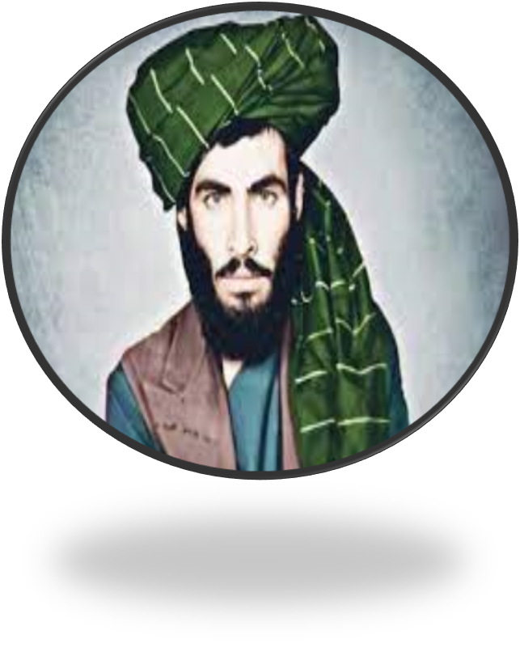

Slide 42
Who are Taliban?
Pashtun-educated religious students from Taliban movement
Mullah Muhammad Omer founded the group with 50 students
It was founded in Kandahar in 1994
Afghan Civil War (1992-1996) and the Taliban Rule
Islamic Emirate of Afghanistan (1996-2001)
The US Invasion in 2001 after the 9/11 Attacks
Fall of Kabul 2021 and Takeover of the Taliban

Slide 43
TTP: Tahreek e Taliban Pakistan
Formed in 2007 by Baitullah Mehsud
Also known as “Pakistani Taliban”
The Pakistani Taliban share a common ideology with the Afghan Taliban
Assisted them in the 2001–2021 war
It takes guidance from Al-Qaeda
Aims to overthrow the government in Pakistan
Terrorist Campaign against Pakistan Army

Slide 44
What Does TTP Want?
A substantial reduction of Pakistani military forces from the country’s former tribal areas
The Reversal of the 2018 merger of the tribal areas into mainland Pakistan through an amendment to Pakistan’s constitution — known as the FATA merger
Removal of border fences

Slide 45
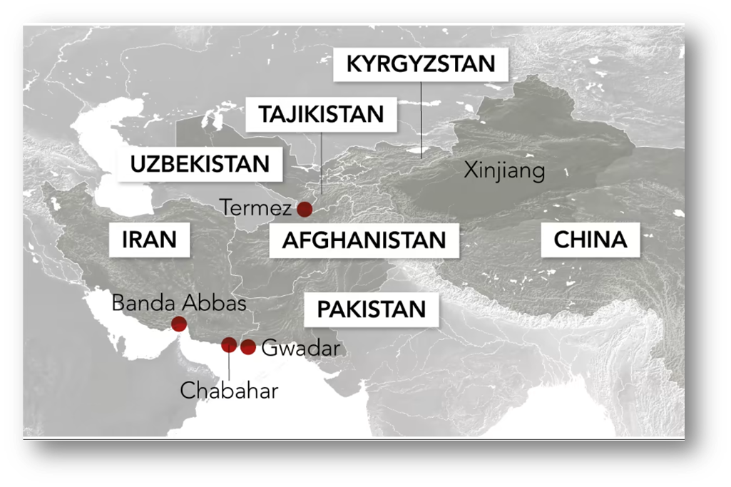
The Strategic Depth
In military literature, strategic depth encompasses the geographical distance between front lines and crucial areas such as industrial cores, capital cities, and military production centers.
Pakistan’s Context
Hostile Eastern Border
Favourable Government in Afghanistan
Good Relationships with CARs

Slide 46
Post-9/11 (2001–2021):
Complexity and Double Game
Pakistan officially joined the U.S.-led War on Terror.
Allegedly harbored elements of Afghan Taliban, while battling Tehrik-i-Taliban Pakistan (TTP) internally.
U.S. and Afghan governments accused Pakistan of duplicity.

Slide 47
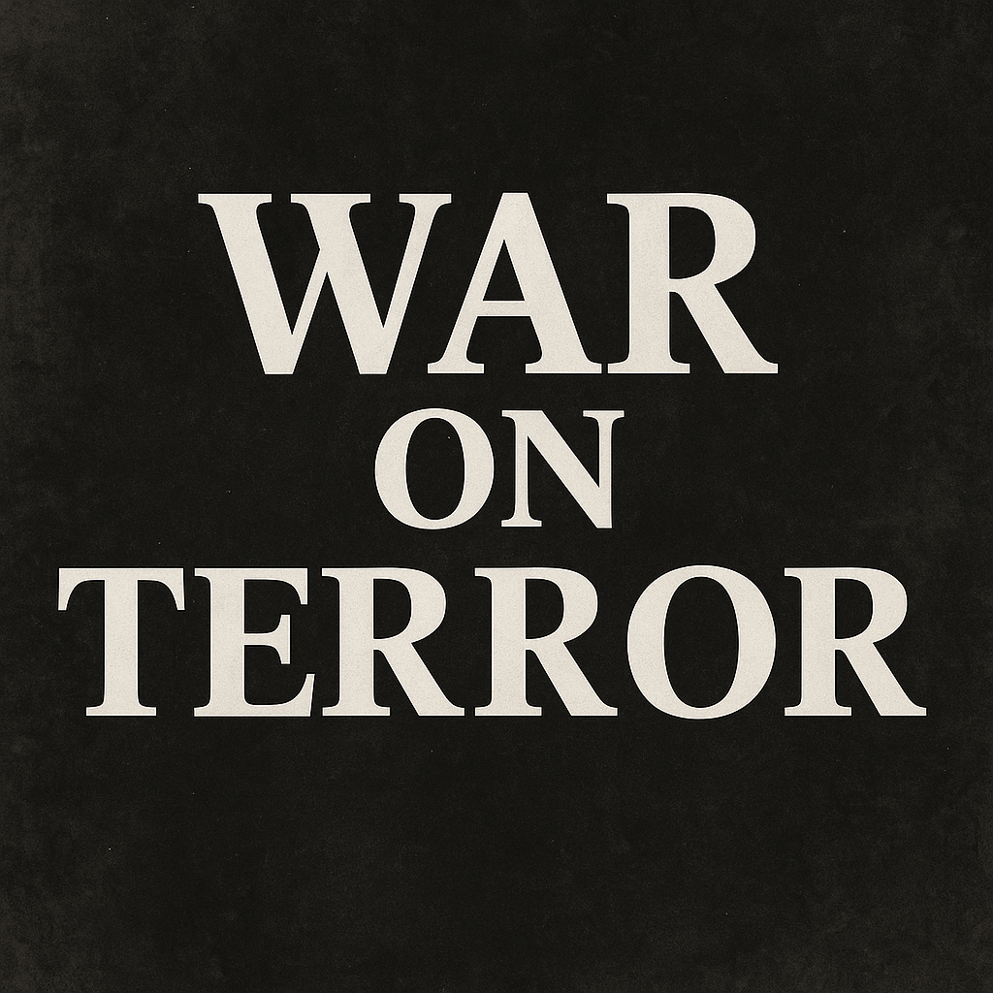

Slide 48
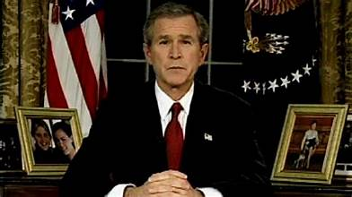

Slide 49
War on Terror
Pakistan as a frontline ally and a battlefield
9/11 and Global Response
NATO's invocation of Article 5
US invasion of Afghanistan
Article 5 of the North Atlantic Treaty is a cornerstone of NATO, establishing the principle of collective defense. It states that an attack against one member is considered an attack against all, obligating each member to assist the attacked nation. This assistance can include the use of armed force, but the specific actions taken are determined by each individual member

Slide 50
Pakistan's Post-9/11 Strategic Reversal: Musharraf's Fateful Choice
9/11 Ultimatum: US Deputy Secretary of State Richard Armitage reportedly told ISI Chief Mahmood Ahmed: 'Be prepared to be bombed back to the Stone Age' unless Pakistan cooperates.
Pakistan's Seven Commitments (Sept 2001): Granted US air corridors, logistical support, intelligence sharing, fuel depots — a 180° shift from Taliban patron to anti-Taliban partner.
The Double Game Allegation: Pakistan publicly fought Taliban while elements of ISI allegedly sheltered Afghan Taliban leadership (Quetta Shura) in Balochistan — a fundamental contradiction.
Quetta Shura: Afghan Taliban's senior leadership reportedly operated from Quetta, Pakistan — US intelligence confirmed Taliban commander networks in Peshawar and Quetta.
US Aid ($33 billion, 2001–2021): Pakistan received massive Coalition Support Funds — became heavily dependent on US financial flows even while maintaining Taliban contacts.
Haqqani Network: Jalaluddin and Sirajuddin Haqqani — ISI's prized assets — operated from North Waziristan, attacking NATO forces in Afghanistan with apparent impunity.

Slide 51
Key Events: Pakistan-Afghanistan Relations 2001–2021
2001
9/11 attack → US invades Afghanistan → Pakistan joins coalition. Operation Enduring Freedom begins. Taliban regime collapses in weeks. Bonn Agreement establishes Karzai government.
2004–07
Pakistan launches military operations in FATA (South Waziristan). TTP formed in 2007 as umbrella of anti-Pakistan militants. Red Mosque siege in Islamabad (2007).
2008–11
Haqqani Network attacks NATO supply lines. US-Pak tensions peak with Kerry-Lugar Act, Raymond Davis affair (2011), Abbottabad (OBL killed May 2011).
2011
NATO supply routes blocked after Salala attack (26 Pakistani soldiers killed). Relations hit historic low. US calls Pakistan 'veritable arm of Haqqani Network'.
2014–16
Operation Zarb-e-Azb: Pakistan's major offensive in North Waziristan — 3,500+ militants killed, 1 million displaced. Afghan Taliban peace talks (QCG process).
2018–20
Doha Process: Pakistan facilitates US-Taliban talks. Plays key role in bringing Taliban to negotiating table — major diplomatic victory for Islamabad.
2021
Doha Agreement (Feb 2020) leads to US withdrawal (Aug 2021). Taliban capture Kabul. Pakistan praises 'breaking chains of slavery' — immediately regrets.

Slide 52
The War on Terror: Human & Material Cost to Pakistan (2001–2021)
83,000+
$152B
3.5M
$33B
Pakistani lives lost — military, police & civilians combined
Total economic cost of the war to Pakistan (Govt estimates)
People internally displaced at the peak of military operations
US Coalition Support Funds received by Pakistan 2001–2021
70,000+
480+
Terrorist incidents recorded in Pakistan 2001–2020
US drone strikes inside Pakistani territory (FATA/KPK)

Slide 53
Pakistan's Reaction to Taliban Takeover (Aug 2021): Euphoria to Regret
Initial Pakistani Response
Harsh Realities That Followed
PM Imran Khan: Taliban 'broke chains of slavery' — celebrated withdrawal
Pakistan lobbied Western countries to engage with Taliban
Hoped for compliant, friendly government on western border
Expected Taliban to crack down on TTP in exchange for support
Envisioned trade routes to Central Asia via Afghanistan opening
Predicted Afghanistan as strategic depth finally achieved
TTP attacks in Pakistan SURGED by 50% within 6 months of Taliban takeover
Taliban refused to take action against TTP — called it Pakistan's 'internal matter'
Afghanistan-India ties improved — Taliban opened Indian trade routes
Durand Line tensions escalated — Taliban refused to accept it as border
Border incidents multiplied — Taliban forces clashed with Pakistani troops
Pakistan's strategic depth became a strategic nightmare

Slide 54
Why Taliban-Pakistan Relations Soured So Quickly (2021–2023)
TTP Sanctuary Issue: The Afghan Taliban refused to expel or act against TTP commanders sheltering in Afghanistan — a fundamental red line for Pakistan.
Ideological Brotherhood: Afghan Taliban and TTP share ideology, ethnicity (Pashtun), and social networks — Afghan Taliban cannot fully alienate TTP without internal fractures.
Durand Line Defiance: Taliban forces began demolishing Pakistani fences along the border — a direct challenge to Pakistan's territorial control. Hundreds of incidents recorded.
India Card: Taliban welcomed Indian consulates, trade, and investment — directly undermining Pakistan's goal of excluding India from Afghanistan.
ISKP Complication: Islamic State Khorasan Province (ISKP) — enemy of both Taliban and Pakistan — carried out attacks on both sides, complicating the security matrix.
No International Recognition: Taliban's global isolation increased its dependence on Pakistan, but paradoxically also reduced incentives to appease Islamabad.
Afghan Refugees: Pakistan began expelling Afghan refugees as leverage — a tactic that infuriated Kabul but yielded no concessions on TTP.

Slide 55
Escalation Timeline: 2024–February 2026
Mar 2024
Pakistan launches airstrikes in Paktika Province — 2nd round of strikes since Taliban takeover. Kills suspected TTP militants. Afghanistan condemns, recalls ambassador.
Dec 2024
Third round of Pakistani airstrikes inside Afghanistan (Paktika). Cross-border fire exchanges increase. Over 1,000 TTP incidents in Pakistan in 2024.
Jan 2025
Intense border skirmishes in Bajaur, Mohmand, Kunar regions. Pakistan rockets Afghan border posts. Afghan Taliban and TTP conduct joint cross-border raids.
Feb 2025
Torkham border closed due to Afghan border post construction dispute — 5,000+ trucks stranded. Jaffar Express hijacking in Balochistan — Pakistan blames Afghan handlers.
Oct 9, 2025
OPERATION KHYBER STORM: PAF strikes Kabul, Khost, Jalalabad, Paktika targeting TTP & leader Noor Wali Mehsud. Afghanistan retaliates — 23 Pakistani soldiers killed, 9 Afghan soldiers killed.
Oct 19, 2025
Qatar-mediated ceasefire brokered after deadliest clashes in years. Failed Turkey peace talks in November. Continued low-level skirmishes throughout.
Feb 21–28, 2026
Pakistan airstrikes hit 7 locations in Nangarhar, Paktika, Khost (80+ claimed militants killed; 18 confirmed civilian deaths). Taliban launches 'large-scale offensive.' Pakistan declares OPEN WAR.

Slide 56
The 2025–2026 Armed Conflict: Key Statistics
23
80+
18
70+
Pakistani soldiers killed in Oct 2025 border clashes
Claimed TTP/Taliban killed in Feb 2026 PAF airstrikes
Confirmed Afghan civilian deaths (Feb 22, 2026 — UNAMA)
UNAMA-confirmed Afghan civilian deaths (Oct–Dec 2025)
133
1,200+
Afghan Taliban claimed killed in Feb 26–27, 2026 exchanges
Pakistanis killed in militant attacks in 2025 alone (double 2021)

Slide 57
February 2026: 'Open War' — What Happened?
Trigger Chain: Series of attacks in Pakistan — BLA attacks in Balochistan (Jan 29–Feb 5, 2026); ISIS-P mosque bombing in Islamabad killing 36 (Feb 6); TTP attack in Bajaur killing 11 soldiers & a child (Feb 16).
Feb 21, 2026 Airstrikes: PAF struck 7 locations in Nangarhar, Paktika & Khost targeting TTP and ISKP camps. Pakistan reported 80 militant deaths. UNAMA confirmed civilian casualties.
Feb 26, 2026 — Afghan Retaliation: Taliban launched 'large-scale offensive operations' against Pakistani posts along the Durand Line. PAF struck Kabul, Kandahar, Paktia.
'Open War' Declaration: Defence Minister Khawaja Asif stated: 'Our cup of patience has overflowed. Now it is open war.' — First time Pakistan formally declared war on a neighbor since 1971.
Scale of Feb 26 Fighting: Pakistan claimed 133 Afghan Taliban killed, 200+ wounded, 27 posts destroyed, 9 captured. Afghanistan claimed 55 Pakistani soldiers killed, 19 posts destroyed.
International Response: Qatar mediating; UN appealing; China, Iran, Russia, Turkey urging restraint. Neither side independently verified by neutral parties.
Current Status (March 2026): Fragile de-escalation underway. Borders remain largely closed. Trade collapsed. Diplomatic missions reduced. Qatar and Saudi Arabia mediating.

Slide 58
Tehrik-e-Taliban Pakistan (TTP): Origins & Evolution
Formation (2007): TTP created as umbrella organization of 13 militant groups under Baitullah Mehsud in South Waziristan — directly responding to Pakistan Army's FATA operations.
Ideological Stance: TTP seeks to overthrow Pakistani state, impose Sharia, and avenge military operations in tribal areas — distinct from Afghan Taliban's focus on Afghanistan.
Afghan Taliban Relationship: Both share Deobandi ideology, Pashtun ethnicity, and social networks. Afghan Taliban served as ideological inspiration. Post-2021, TTP moved cadres into Afghanistan.
Leadership: Noor Wali Mehsud (current). Survived Oct 2025 Pakistani airstrike in Kabul. UNSC-designated terrorist. Leads from Afghan soil.
TTP Strength (2025): ACLED recorded 1,000+ violent TTP incidents in Pakistan in 2025 — most violent year in over a decade. Operating in KPK, Balochistan, Sindh.
Sanctuary in Afghanistan: Pakistan's core allegation — TTP command structures, training camps, and logistics based in Nangarhar, Kunar, Khost, Paktika provinces.
US Weapons Factor: Many attacks used weapons abandoned by US forces during 2021 withdrawal — Humvees, night vision gear, M16s, even helicopters.

Slide 59
Pakistan's Terrorism Crisis: By the Numbers (2024–2025)
1,000+
#2
2×
36
TTP violent incidents in Pakistan in 2025 (ACLED data)
Pakistan's rank in Global Terrorism Index 2024 — 2nd most affected country
Terrorist fatalities in 2025 vs. 2021 — doubled since Taliban takeover
Deaths in ISIS-P Islamabad mosque bombing, Feb 6, 2026
480+
60%
US drone strikes in FATA/KPK 2004–2018 — created anti-Pakistan radicalism
TTP attacks attributed to Afghan-based cells (Pakistani military estimates)

Slide 60
The TTP Impasse: Why Can't It Be Resolved?
Pakistan's Position
Taliban/Afghanistan's Position
Taliban must expel or neutralize TTP from Afghan soil
Written, verifiable guarantees required before border reopening
TTP is an internationally designated terrorist organization
Afghan soil cannot be used for cross-border terrorism
Will use military, economic, and diplomatic pressure
Cites right to self-defense under UN Charter Article 51
TTP is Pakistan's internal matter — not Afghanistan's problem
Cannot act against TTP without fracturing internal unity
Fear TTP fighters defecting to ISKP (Islamic State) if pressed
Denies operational links with TTP command structures
Pakistani airstrikes are violation of sovereignty/international law
Demands Pakistan stop fencing the Durand Line as precondition

Slide 61
Trade Structure, Transit & Key Challenges
Pakistan's Top Exports to Afghanistan: Cereals & wheat flour, cement ($10M/month), pharmaceuticals, edible vegetables, textiles, motorcycles, sugar, malt extracts.
Afghanistan's Top Exports to Pakistan: Fresh & dried fruits (grapes, pomegranates, apples), vegetables, minerals, marble, cotton.
Transit Trade (APTTA): Afghanistan-Pakistan Transit Trade Agreement — allows landlocked Afghanistan to import goods via Karachi/Gwadar. Critical for Afghan economy.
July 2025 PTA: Pakistan-Afghanistan Preferential Trade Agreement signed — limited to 8 agricultural products. Pakistan exports mangoes/oranges/bananas/potatoes; Afghanistan exports grapes/pomegranates/apples/tomatoes.
Structural Bottlenecks: No formal banking links (hawala-dependent), 2% IDC tax by KPK, cold chain infrastructure absent at Torkham, multi-agency customs delays.
Border Closures 2025: Pakistan closed 8 border crossings after Oct 2025 clashes — FY 2025–26 H1 trade fell 53% from $1.26B to $594M. Afghan traders lost $2.5M/day.
FTA Potential: Pakistan Business Council estimates FTA could boost bilateral trade from $1.7B to $5B+ annually — currently constrained by political tensions.

Slide 62
Afghan Refugees in Pakistan: The Staggering Numbers
4.4M
1.3M
800K
1.7M
Afghan nationals (documented + undocumented) in Pakistan as of 2023
Registered refugees with UNHCR Proof of Registration (PoR) cards
Afghan Citizen Card (ACC) holders — govt-issued temporary status
Estimated undocumented Afghans in Pakistan
2.9M
2.6M
Afghans returned to Afghanistan in 2025 (combined forced & voluntary)
Expelled from Pakistan AND Iran combined in 2025 (UN data)

Slide 63
Pakistan's Afghan Refugee Policy: From Hospitality to Expulsion
1979–89
Soviet invasion → 3.3 million Afghans flood Pakistan. World's largest refugee population. Pakistan accepted without formal agreements. Islamic solidarity narrative dominant.
1990–2001
Civil war & Taliban era — refugees remain. Pakistan hosts despite economic strain. UNHCR issues PoR cards from 2006. At peak, 5 million Afghans in Pakistan.
2001–2021
Post-9/11: Some repatriation. But steady inflow continues. Pakistan becomes permanent host. Refugees integrate into economy — KPK, Balochistan, Karachi.
2021
Taliban takeover: 200,000+ new arrivals. Pakistan initially closes border, then allows transit. Strategic decision not to absorb more refugees publicly announced.
Oct 2023
PHASE 1 Deportation: Pakistan announces Illegal Foreigners Repatriation Plan. 468,000 Afghans leave Oct–Dec 2023 amid widespread harassment and arrests.
Apr 2025
PHASE 2: 800,000 ACC holders ordered to leave. 60,000 cross border in first 2 weeks of April 2025 alone. UNHCR raises alarm.
Jul–Dec 2025
PHASE 3: 1.4 million PoR card holders ordered out. Cards expired Jun 30, 2025. Amnesty, UNHCR, UN experts condemn violations of non-refoulement principle.

Slide 64
Refugee Dimension: Humanitarian Crisis vs. Pakistan's Security Argument
Pakistan's Justification
International Community's Concerns
Rising terrorism linked to Afghan nationals (government claims)
Not signatory to 1951 Refugee Convention — no binding legal obligation
Hosted 5 million Afghans for 40+ years without adequate international support
UNHCR only received $116M of $478M requested in 2025
Economic strain on KPK and Balochistan border communities
Using refugee card as diplomatic leverage over Taliban on TTP
PM Shehbaz: 'Int'l community must share the burden'
Non-refoulement: Customary intl law — cannot return people to persecution
60% of deportees are women and children (UN data)
Taliban intensifying oppression — girls banned from education above Grade 6
Many deportees have never lived in Afghanistan — born in Pakistan
UNHCR documented 45x increase in Afghans arrested in Jan-Feb 2025 vs. 2024
Arbitrary arrest, night raids, detention without documentation
Funding gap: UN appeals for $2.42B for Afghanistan; only $663M received (2025)

Slide 65
China, USA & Iran: External Powers' Stakes in Pak-Afghan Relations
China's Position
USA & Iran
CPEC: Pakistan is China's most important BRI partner — Afghan stability vital for CPEC extension to Central Asia
China-Taliban relations: Engagement for mineral extraction ($1T+ estimated reserves) and counter-ISKP cooperation
Concerned about ISKP attacks on Chinese workers & projects in Afghanistan
Broker role: Hosted Pakistan-Afghan talks; wants both sides stable
Wakhan Corridor: Alternative route to Central Asia — ISI allegedly targeting Chinese projects there (Afghan analyst claim)
China formally recognizes Taliban ambassador in Beijing (2024)
USA: Trump 2.0 wants US weapons back from Taliban. Post India-Pak ceasefire (2025), emboldened Pakistan militarily
Bagram Airbase: Trump expressed interest — monitoring Chinese nuclear facilities
US designated TTP as Foreign Terrorist Organization — sanctions in place
Iran: Shares 936 km border with Afghanistan; deported 2M+ Afghans in 2025
Iran-Taliban: Complex — sectarian (Shia vs. Sunni) but shares anti-US interest
Russia: Only country to formally recognize Taliban govt — strategic counter to NATO

Slide 66
Water Dimension: The Kabul River & Helmand Basin
Kabul River: Originates in Afghanistan, flows into Indus via Khyber — critical for KPK's water supply. Kunar/Chitral tributaries shared. No formal water sharing treaty exists.
Afghan Dams on Kabul River: Afghanistan has built/planned dams on upper Kabul River — Pakistani farmers in Peshawar valley fear reduced flows. A future flashpoint.
Helmand Treaty (1973): Pakistan not a party, but Afghan water governance broadly affects Pakistan's Balochistan. Iran-Afghanistan Helmand dispute has Pakistani spillover effects.
Climate Change Multiplier: Glacial retreat in Hindu Kush-Himalayan range affects both countries. Unpredictable monsoon and snowmelt patterns will intensify water conflicts.
Shared Aquifers: Cross-border groundwater in FATA/KPK-Kunar-Nangarhar region — no agreed management framework. Over-extraction on both sides unsustainable.
Policy Gap: Despite decades of relations, no formal Pakistan-Afghanistan Water Treaty exists — a significant gap in bilateral institutional architecture requiring attention.

Slide 68
Pakistan’s Role
Military operations (Zarb-e-Azb, Rah-e-Nijat)
Civilian losses: over 80,000 lives
Economic cost: $150+ billion

Slide 69
Internal Impacts
Rise of TTP
Lal Masjid, APS attack
Security vs democracy dilemma

Slide 70
US Withdrawal
Doha Agreement (2020) & US Exit (2021)
Pakistan’s facilitation role
Taliban takeover & regional implications

Slide 71
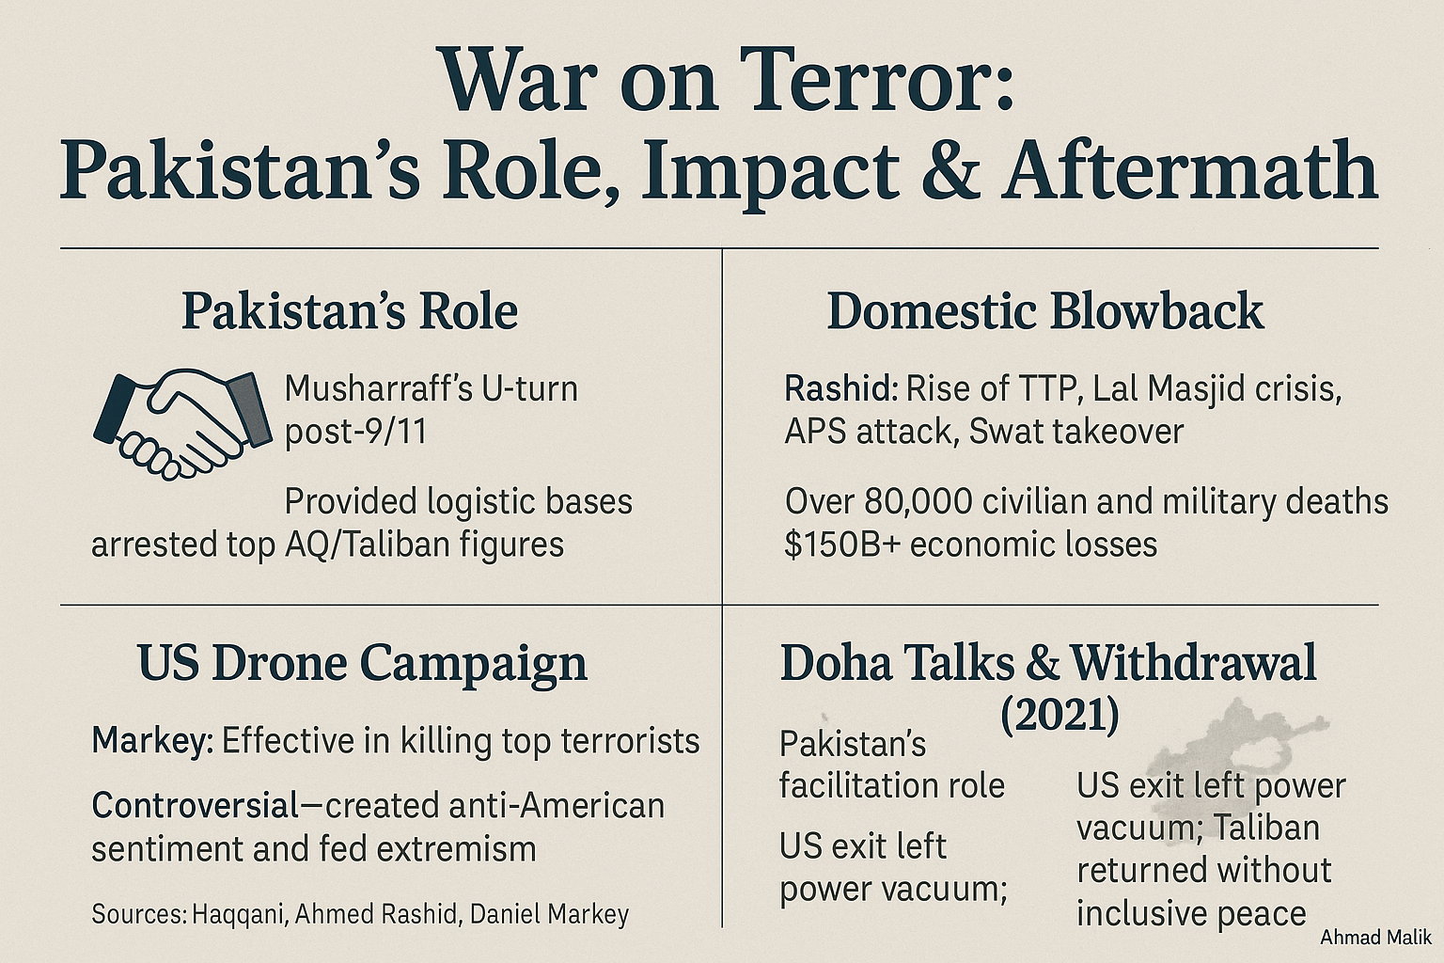

Slide 72
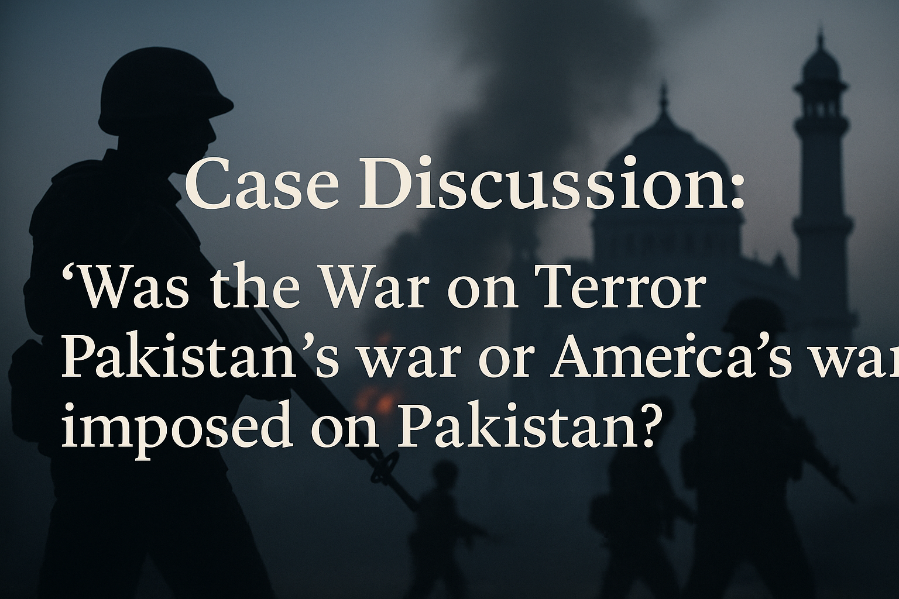

Slide 73
CSS CURRENT AFFAIRS
WAR
Pakistan–Afghanistan
Conflict & Its Consequences
An analytical overview of the ongoing cross-border tensions, TTP insurgency, border closures, and cascading impacts on Pakistan's economy, society, regional standing, and global image.
Security & TTP
Economy
Culture & Society
Region & World
Sources: ISPR, UNHCR, World Bank, FATF, IMF 2023–25

Slide 74
SLIDE 2 OF 4 | SECURITY CRISIS & ECONOMIC FALLOUT
🛡 Security Crisis
📉 Economic Toll — Key Indicators
TTP Attacks (2023–24):
~780+ terrorist incidents inside Pakistan
Casualties:
2,300+ security personnel & civilians killed
Border Closures:
Torkham & Chaman shut 40+ times since 2021
Afghan Refugees:
3.7 million registered; millions undocumented
Military Operations:
Op Azm-e-Istehkam launched 2024
TTP Sanctuaries:
$152B+
6.3%
FATF
Confirmed use of Afghan soil by TTP (ISPR)
Cumulative cost
since 2001 (Govt est.)
GDP contraction
link to border trade loss
Grey-listed 2018–22;
impact on FDI
*2024 projected | Sources: Pak Institute of Peace Studies, World Bank, IMF, Finance Ministry Report 2024

Slide 75
SLIDE 3 OF 4 | SOCIAL, CULTURAL & HUMANITARIAN CONSEQUENCES
The Human Cost of Conflict
👨‍👩‍👧 Refugee Crisis
🏫 Education & Society
🎭 Cultural Disruption
3.7M+ registered Afghan refugees in Pakistan (UNHCR 2024)
37% of KP schools damaged or closed due to militancy
Pashtun cultural ties disrupted by closed border (Durand Line)
KP & Balochistan host 80% of refugees
FATA/merged districts: literacy rate fell to 29% (2023)
Rise of extremist narratives in media & madrasas
Massive strain on health, schools & housing
Youth radicalization risk increases in conflict zones
Music, arts, civil society suppressed in FATA areas
2023 deportation drive — 1.7M Afghans deported
Women & girls: mobility restricted in border areas
Afghan drug trade fuels addiction crisis in Pakistan
Displacement creates identity & border tensions
PTSD rates high in conflict-affected communities
PTM movement emerges — Pashtun rights under spotlight
Sources: UNHCR 2024 | UNESCO | Human Rights Watch | Pak Social Policy Report | ISPR | PIPS Conflict Report 2024

Slide 76
SLIDE 4 OF 4 | REGIONAL & GLOBAL IMPACT
Pakistan in the World: Spillover Effects
🌏 Regional Consequences
📊 Global Standing — Key Metrics
Country/Actor | Consequence
China (CPEC) | Security threats to BRI projects; delay in CPEC Phase II
India | Exploits instability; proxy accusations; spy tensions
Iran | Drug & refugee spillover; cross-border militia risks
Central Asia | SCO credibility tested; TAPI pipeline stalled
Taliban (Afghanistan) | Safe haven for TTP; Pakistan-Taliban tensions rising
USA | Pakistan's role questioned; F-16 deal conditional
🌍 UN Credibility
⚠️ Nuclear Risk
🕊 Peace Talks
📰 Global Image
Pakistan repeatedly calls on UNSC to hold Taliban accountable; little action taken
Instability near nuclear state raises international alarm; strategic ambiguity grows
Multiple rounds of Pakistan-Afghanistan talks failed; SCO platform ineffective so far
Pakistan labeled 'most dangerous country'; impacts diaspora, tourism, soft power
Sources: World Bank FDI Data | UN General Assembly | FATF | Global Terrorism Index 2024 | Dawn / The News analysis

Slide 77
SECURITY ANALYSIS
Afghanistan Spillover:
Pakistan's Security Crisis
Post-2021 Taliban Takeover
+56%
+45%
1,203
60+
Increase in
Terrorist Attacks
Terror Deaths
in 2024
TTP Attacks
in 2023
Militant Factions
Absorbed by TTP

Slide 78
TTP ATTACK SURGE | 2021 – 2025
2× tripling
Attacks more than doubled between 2021 and 2023 alone
60 factions
TTP absorbed ~60 allied militant groups post-takeover
Safe havens
UN confirms 3 dedicated TTP guest houses in Afghan territory
Sources: AHSS, ISSRA, MEMRI, UN 2025

Slide 79
GEOGRAPHIC CONCENTRATION OF VIOLENCE | 2025
500 attacks in KP alone by Aug 2025 | Aug 2024 was deadliest month in 6 years | 2025 on track to be most violent year since Taliban's return

Slide 80
CASUALTIES & ESCALATION TRENDS | 2021–2025
+45%
Rise in terror deaths
in 2024 alone
1,081
Terror-related
deaths in 2024
73%
Overall attack increase
vs. pre-2021 baseline
34%
Violence surge
in 2025 vs. 2024

Slide 81
STRATEGIC OUTLOOK & CONCLUSIONS
KEY FAILURES
ACTIONS NEEDED
Afghan safe havens remain — Taliban actively supports TTP
Sustained diplomatic pressure on Kabul to deny TTP safe havens
2021–22 amnesty talks failed; TTP used ceasefire to rearm
Balance kinetic ops with civilian development in KP & Balochistan
Durand Line non-recognition creates diplomatic deadlock
Close remaining 2% of Durand Line fencing gaps urgently
Low conviction rates undermine the National Action Plan
Strengthen judiciary for higher terrorism conviction rates
Political divisions obstruct civilian CT leadership
Build regional intelligence-sharing frameworks
Verdict: Tactical CT wins are offset by structural failures — Afghan safe havens, diplomatic deadlock, and governance gaps continue to fuel the TTP resurgence.

Slide 83
US Weapons Now Fuel Regional Militancy
Taliban security strengthened by abandoned US equipment
$7.1bn worth left behind in 2021
Includes thousands of vehicles, 160+ aircraft
TTP gains superior American-origin weapons post-withdrawal
63 seized weapons match US-supplied serial numbers
Afghan Taliban providing consistent support to TTP fighters
UN notes logistical and operational assistance
Shared training creating stronger militant capabilities
TTP force estimated at 6,000 fighters
US monitoring loss enabled equipment diversion
SIGAR lost visibility after August 2021 takeover

Slide 84
Collapse of US Reconstruction Deepened Security Crisis
Two-decade US project failed to deliver stability
$144.7bn spent on reconstruction (2002–2021)
Enormous waste and corruption hollowed Afghan institutions
SIGAR estimates $26–29.2bn lost to fraud/waste
Afghan security sector collapse transferred assets to Taliban
ANDSF received 96,000 vehicles, 427,000 weapons
US-built infrastructure now under Taliban control
131 operational aircraft taken from Afghan Air Force
Failed governance choices fueled insurgent recruitment
Backing “corrupt, rights-abusing powerbrokers” worsened collapse

Slide 85
Pakistan Faces Direct Spillover and Intensifying Threats
TTP using Taliban-provided sanctuaries for attacks
Cross-border attack killed 16 personnel in Waziristan
Superior US weapons increasing lethality of TTP operations
Rifles “significantly superior” to pre-2021 arsenal
UN confirms Taliban-issued authorizations to TTP leadership
Guesthouses, weapons permits, movement immunity provided
Militants entrenched across key Afghan provinces
Presence in Ghazni, Helmand, Kandahar, Kunar, Zabul
Weapons diversion reshaping Pakistan’s security landscape
UN and SIGAR warn of regional destabilisation

Slide 86
UN Report (2025)
UNSC monitoring report rejects Taliban “no footprint”
Sixteenth report of Analytical Support Team
Taliban claim termed “not credible” by UN
Quote: “That claim is not credible”
Afghanistan viewed as growing regional insecurity source
Neighbors increasingly see spillover risks
Taliban pledged Doha commitment, performance questioned
2020 Doha Agreement
Taliban fights ISIL-K, differs on others
UN notes stance “markedly different”

Slide 87
Terrorist Organizations Present in Afghanistan
UN lists multiple groups operating in Afghanistan
ISIL-K, TTP, Al Qaeda, ETIM/TIP
Additional militant entities also reported present
Jamaat Ansarullah, Ittehadul Mujahideen Pakistan
Groups use Afghanistan for external attack planning
“Plan and prepare external attacks”
Al Qaeda maintains presence in several provinces
Benefits from “permissive environment”
ISIL-K degraded but remains resilient internationally
Attacks “inside Afghanistan and abroad”

Slide 88
Proof of Taliban Harbouring TTP
UN describes TTP enjoying Taliban elements’ support
“Strong support from elements within Taliban”
Taliban denies and deflects restraining responsibility
UN: denial and deflection continues
Taliban internally divided: liability versus loyalty
Some seniors view TTP “a liability”
Taliban unlikely to act against TTP
“Unlikely to confront or act”
Even willing Taliban may lack capability
“May lack the ability”

Slide 89
Economic Risks of an Open Durand Line
Open border increases large-scale smuggling opportunities
Illicit trade losses: PKR 3.4 trillion yearly
Government revenue declines from customs evasion
ATT misuse: PKR 1 trillion annual loss
Foreign currency outflows worsen fiscal instability
$5 million smuggled daily; $2B annually
Organized crime networks expand across borderlands
Narcotics trade: $102B Afghan opium economy
Security instability disrupts formal business activities
Seizures 2018–23: PKR 484M narcotics, 145M arms

Slide 90
Macroeconomic Impact of Unregulated Cross-Border Movement
Smuggled goods undermine domestic market competition
Tea smuggling: 30% market share, PKR 10B loss
Fuel smuggling damages petroleum revenue collection
Diesel smuggling: one-third national demand
Automotive smuggling hurts manufacturing and imports
Vehicles: 12% market share, parts 57% smuggled
Currency flight deepens foreign reserves crisis
Annual loss: $2 billion foreign currency
Illicit economy strengthens insurgent financing networks
Narcotics transit directly funds militant groups

Slide 91
Benefits of Formalized and Managed Border Controls
Regulated movement supports stable bilateral trade flows
Potential trade: over $5 billion annually
Formal systems reduce rampant smuggling activities
Customs revenue recovery: hundreds of billions possible
Improved border security attracts foreign investment
Stability reduces money-laundering risk rating
Formal transit increases government customs revenues
Transit fee potential: $150 million yearly
Structured border enhances infrastructure development planning
Example: pipelines, corridors, cross-border rail links

Slide 92
Strategic Necessity of a Secure Durand Line
Porous borders fuel terrorism and insurgency risks
War on Terror cost: $118 billion cumulative
Smuggling reduces Pakistan’s competitiveness regionally
Lost Afghan market share: 65% to Iran, India
Enhanced controls strengthen national economic governance
Reduced tax evasion and shadow economy size
Border fencing improves intelligence and surveillance capability
IBMS deployment enhances monitoring effectiveness
Stability encourages legal trade and investment confidence
Directly impacts exports and foreign currency inflows

Slide 93
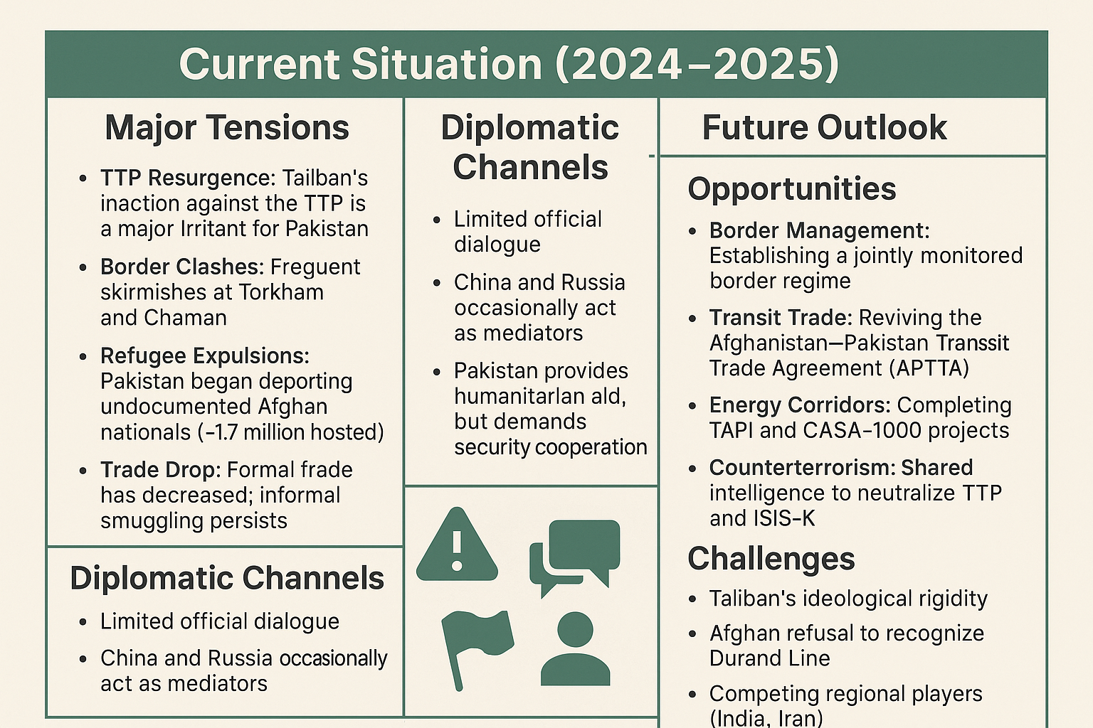

Slide 94
Recommendations
Hybrid Approach to deal with TTP
Temporary military operations to uproot terrorism from the country
Socio-economic uplifting of marginalized areas as long term policy
Diplomacy and talks with the Taliban Government to solve border Issues
Trade MOUs with Afghanistan
Optimization of CPEC: Engage Afghanistan
Pakistan needs to put its house in order: Political and Economic Stability
National Consensus on Zero Terrorism Policy
Capacity Building of CTD and Regular Audit and Performance Review

Slide 95
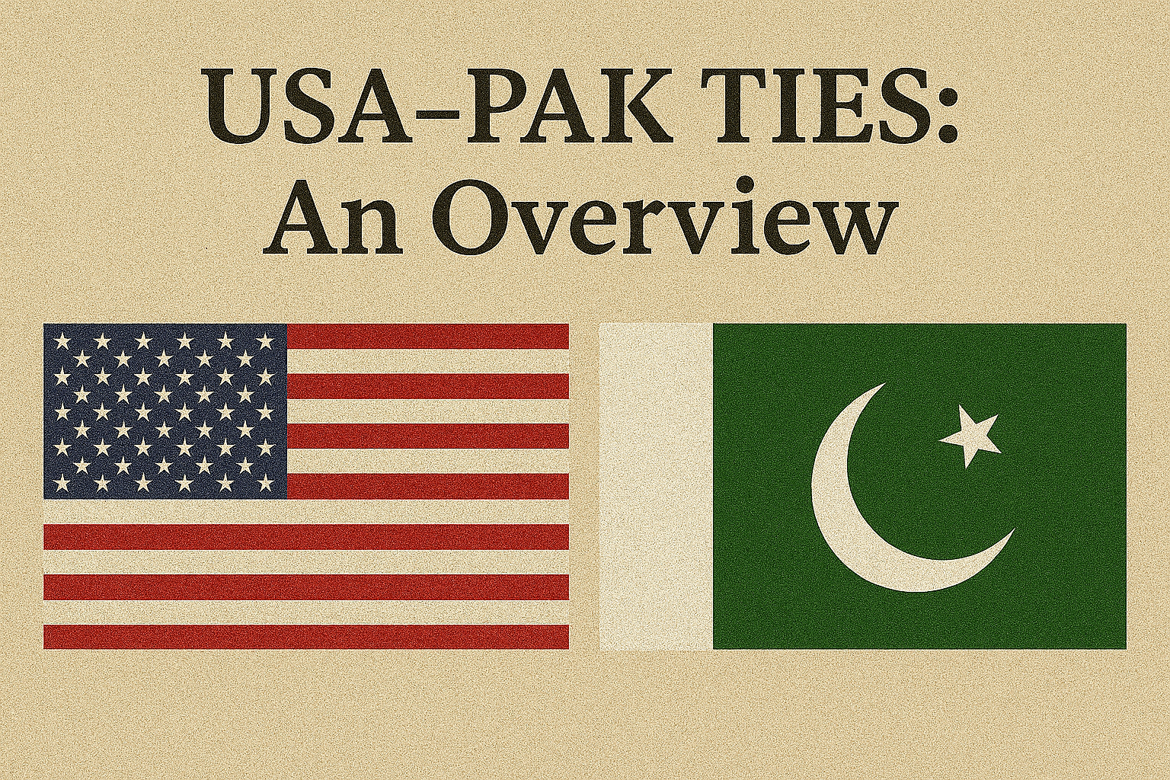

Slide 96
HISTORICAL BACKGROUND
1947–1953: The Foundational Years
Aug 1947
WHY USA MATTERED
TO PAKISTAN
Pakistan gains independence; US among first nations to recognize Pakistan (Oct 1947).
1948
Security umbrella against India post-partition wars
Pakistan requests US military & economic aid; Washington cautiously responsive amid South Asia policy formulation.
Economic reconstruction of a nascent state
1950
PM Liaquat Ali Khan visits Washington; chooses US over Soviet Union — a defining strategic tilt.
Access to military hardware & modernisation
1951
Pakistan receives first US economic aid package ($10 million). Foundation for future dependency laid.
Diplomatic backing in UN on Kashmir dispute
1953
Counter-balance to Afghan–Soviet threat from north
KEY INSIGHT
Eisenhower administration views Pakistan as key Cold War frontline state due to its geographic proximity to USSR.
Pakistan's early pro-US tilt was strategic, not ideological — driven by survival imperatives.
PAKISTAN–USA RELATIONS | CSS LEVEL 4 | 2026
3 / 14

Slide 97
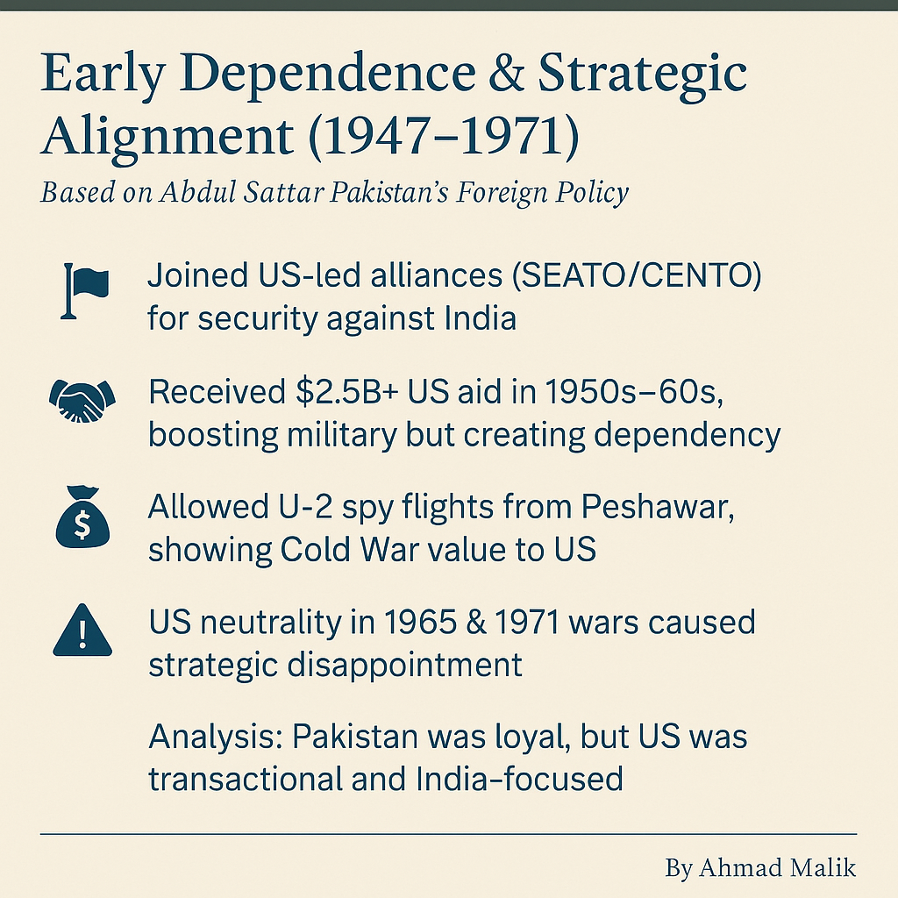

Slide 98
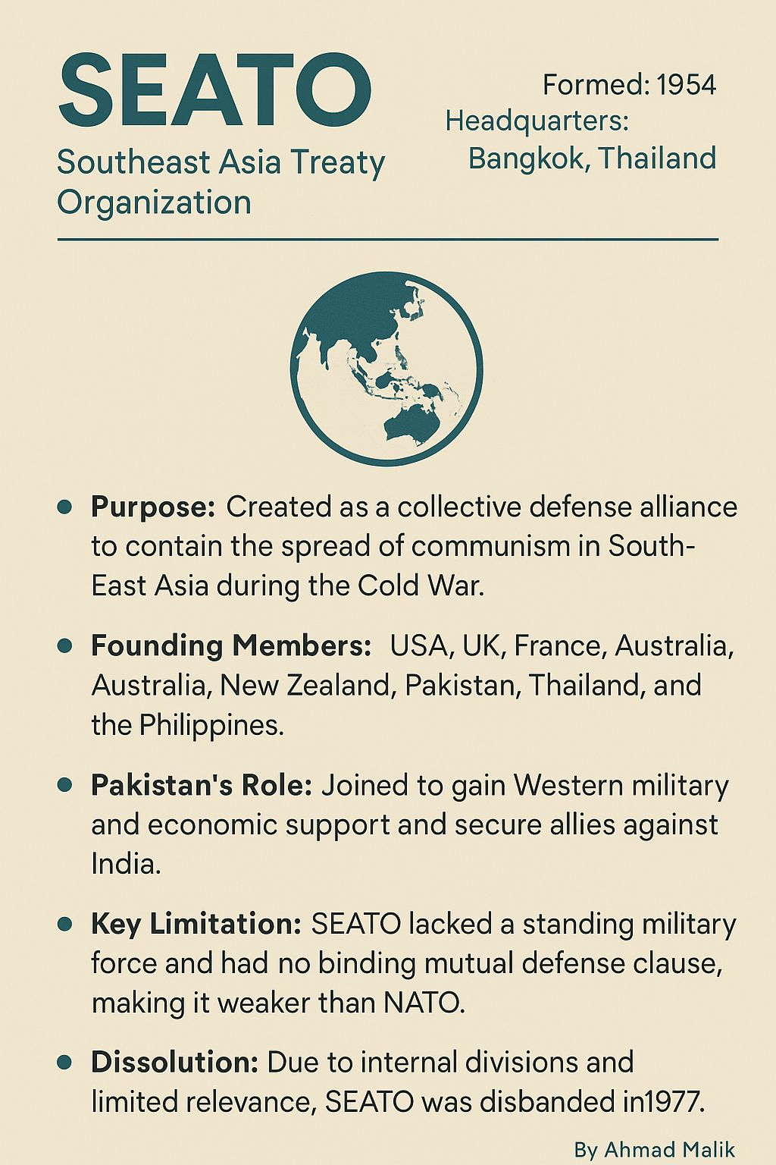

Slide 99
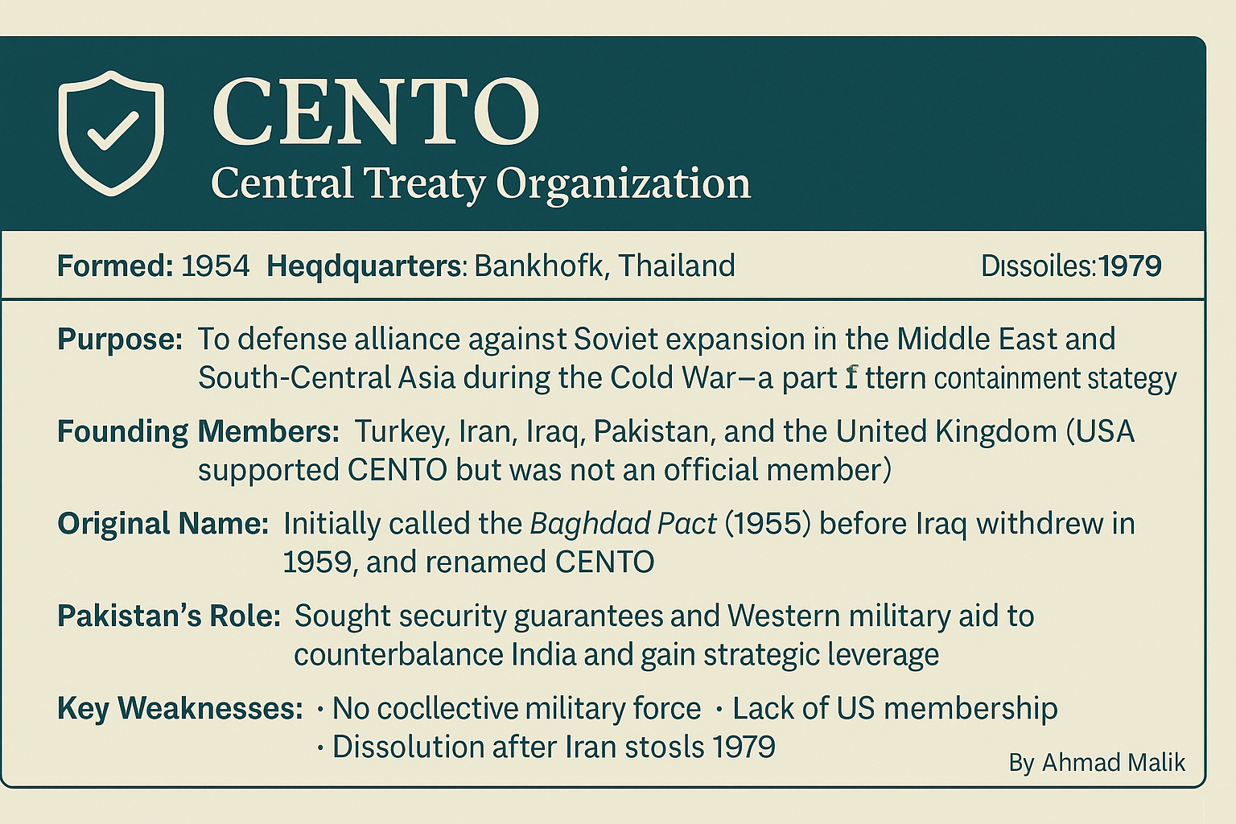

Slide 100
COLD WAR ALLIANCE ERA
1954–1989: Strategic Partnership
SEATO
1954
CENTO
1955
Bilateral
Pacts 1959
Southeast Asia Treaty Organization. Pakistan joined as a frontline non-SE Asian ally. Guaranteed US military support against communist aggression. Pakistan gained $500M+ in military aid.
Central Treaty Organization (Baghdad Pact). Pakistan, Iran, Turkey, UK. US backed but not formally a member. Key instrument of 'Northern Tier' containment against USSR.
US–Pakistan Bilateral Defence Agreement (5 March 1959). US committed to take 'appropriate action' against communist aggression on Pakistan — Islamabad's coveted security guarantee.
$500M+
Northern Tier
1959
Military Aid
Strategy
Defence Pact
1965 & 1971 WARS:
US imposed arms embargo on both India & Pakistan during 1965 war — deeply disappointing Islamabad. In 1971, Nixon's 'tilt toward Pakistan' was diplomatic but failed to prevent dismemberment. US sent USS Enterprise task force as show of support, but East Pakistan became Bangladesh. Massive trust erosion followed.
PAKISTAN–USA RELATIONS | CSS LEVEL 4 | 2026
4 / 14

Slide 101
COLD WAR ALLIANCE ERA
1954–1989: Strategic Partnership
SEATO
1954
CENTO
1955
Bilateral
Pacts 1959
Southeast Asia Treaty Organization. Pakistan joined as a frontline non-SE Asian ally. Guaranteed US military support against communist aggression. Pakistan gained $500M+ in military aid.
Central Treaty Organization (Baghdad Pact). Pakistan, Iran, Turkey, UK. US backed but not formally a member. Key instrument of 'Northern Tier' containment against USSR.
US–Pakistan Bilateral Defence Agreement (5 March 1959). US committed to take 'appropriate action' against communist aggression on Pakistan — Islamabad's coveted security guarantee.
$500M+
Northern Tier
1959
Military Aid
Strategy
Defence Pact
1965 & 1971 WARS:
US imposed arms embargo on both India & Pakistan during 1965 war — deeply disappointing Islamabad. In 1971, Nixon's 'tilt toward Pakistan' was diplomatic but failed to prevent dismemberment. US sent USS Enterprise task force as show of support, but East Pakistan became Bangladesh. Massive trust erosion followed.
PAKISTAN–USA RELATIONS | CSS LEVEL 4 | 2026
4 / 14

Slide 102
WAR ON TERROR PARTNERSHIP
2001–2011: Front-Line State Revival
$33B
~3,500
80,000
350+
Total US Aid
2001–2011
Pakistani
Soldiers Killed
Pakistani Civilian
Casualties (Indirect)
Drone Strikes
on Pakistani Soil
Sep 2001
2007
Colin Powell calls Gen. Musharraf. Pakistan granted 72 hrs to decide. Musharraf agrees to 7 US demands — airbases, intelligence sharing, cutting Taliban supplies.
Red Mosque (Lal Masjid) operation. Suicide attacks inside Pakistan spike dramatically. Pakistan paradox: fighting terrorism while hosting Afghan Taliban leadership in Quetta Shura.
2002
2010
Pakistan designated 'Major Non-NATO Ally' (MNNA). CSF (Coalition Support Fund) reimbursements begin — critical foreign exchange for Pakistan.
Floods: US provides $750M relief — largest ever humanitarian response. Goodwill brief. Raymond Davis affair in 2011 severely damages ties.
2004
May 2011
Waziristan Accord failure. US begins pressure for expanded military ops in FATA. Pakistani Army launches Operation Al-Mizan — thousands of troops deployed.
Operation Neptune Spear — OBL found in Abbottabad. US conducts raid without informing Pakistan. Seismic damage to bilateral trust. ISI credibility internationally devastated.
2009
2011
Kerry-Lugar-Berman Act: $7.5B over 5 years for civilian development. Conditions on bill spark civil-military crisis in Pakistan over 'sovereignty clauses'.
Salala Check-post attack: NATO kills 24 Pakistani soldiers. Pakistan shuts NATO supply lines for 7 months; demands drone halt. Relations in freefall.
PAKISTAN–USA RELATIONS | CSS LEVEL 4 | 2026
6 / 14

Slide 103
STRAINED RELATIONS ERA
2011–2022: Trust Deficit & Recalibration
2011 WATERSHED: THREE CRISES IN ONE YEAR — Raymond Davis affair | OBL Abbottabad raid | Salala check-post massacre
2012
Pakistan re-opens NATO supply routes after 7 months following US apology for Salala. Haqqani Network tensions escalate — US calls it 'veritable arm of ISI'.
2018
US suspends $1.3B in security assistance. Imran Khan elected; initially anti-US rhetoric. Pakistan placed on FATF Grey List (June 2018) — massive financial pressure.
2013
Nawaz Sharif elected; focuses on economy over geopolitics. US drone program continues despite parliamentary resolutions demanding cessation.
2021
US withdraws from Afghanistan (Aug). Pakistan accused of facilitating Taliban return. Strains over Kabul airport attack. Biden does not call PM Imran Khan for 7+ months.
2015
Obama visits India, not Pakistan. CPEC (China-Pakistan Economic Corridor) announced — $46B. US alarm grows over China's expanding footprint.
2022
Imran Khan alleges US-backed 'regime change' (cipher controversy). Pakistan exits FATF Grey List (Oct 2022). Shehbaz Sharif government adopts more cooperative stance.
2017
Trump tweets: 'Pakistan has given us nothing but lies and deceit.' Afghan policy review blames Pakistan for safe havens. CSF payments halted: $800M suspended.
PAKISTAN–USA RELATIONS | CSS LEVEL 4 | 2026
7 / 14

Slide 104
CRITICAL ANALYSIS
Structural Contradictions in Pakistan–USA Relations
⚖️ Transactional vs. Strategic
🔬 Nuclear Ambiguity
Relations have been consistently transactional — US values Pakistan as a tool, not a partner. Aid spikes during crises (Afghan jihad, WoT), then collapses. Pakistan's strategic depth narrative conflicts with US regional interests.
US turned a blind eye to Pakistan's nuclear programme during Afghan jihad (1980s). Post-Chagai tests, punitive sanctions applied. US now seeks non-proliferation commitments while Pakistan demands India's programme be addressed equally.
🕊️ The Afghan Paradox
💰 Aid Dependency & Leverage
Pakistan simultaneously presented as key counter-terrorism partner AND accused of harbouring Taliban/Haqqani Network. 'Strategic ambiguity' doctrine — Pakistan used Afghanistan as 'strategic depth' insurance, creating fundamental conflict with US goals.
Decades of US aid created dependency but also resentment. Pakistan's civilian governments often weakened by IMF/US conditions; military remains dominant partner for US. Democratic consolidation undermined by security-first engagement model.
🌏 China Factor
🎯 Trust Deficit
CPEC ($62B) has fundamentally altered the equation. US views growing China-Pakistan nexus as threatening. Pakistan argues it is exercising sovereign foreign policy. Strategic competition between US and China now plays out through Pakistan.
OBL raid (2011) epitomised mutual distrust. US never fully trusted ISI; Pakistan never trusted US commitment to stability. Each party hedged, creating self-fulfilling prophecy of unreliable alliance — the core structural failure.
PAKISTAN–USA RELATIONS | CSS LEVEL 4 | 2026
10 / 14

Slide 106
US–Pakistan Alignment Post-1979:
After Soviet invasion of Afghanistan, General Zia-ul-Haq emerged as a key US ally, facilitating the Afghan jihad through Pakistan’s territory.
Massive US & Saudi Funding:
Over $3.2 billion in US military and economic aid flowed to Pakistan (1981–1987).
CIA and ISI coordinated arms and funds for Afghan Mujahedeen.
Rise of Jihadist Infrastructure:
Thousands of madrassas, training camps, and religious networks emerged — laying the foundation for future militant groups like Taliban and Al-Qaeda.
Strategic Abandonment Post-1989:
After Soviet withdrawal, the US abruptly disengaged, cutting aid and leaving Pakistan with a militarized, radicalized region and millions of Afghan refugees.
Analysis: Zia maximized Pakistan’s strategic utility for short-term gains, but the unregulated jihadist ecosystem created during this era triggered long-term security blowback.

Slide 107
Sanctions & Mistrust (1990s)
Source: Husain Haqqani
Pressler Amendment halted US military aid completely
Nuclear program triggered global sanctions on Pakistan
No strategic engagement after Soviet withdrawal ended
Aid cuts deepened Pakistan’s sense of betrayal
Narrative of abandonment fueled long-term mistrust

Slide 108
Post-9/11 Partnership: Cooperation & Confusion
Sources: Daniel Markey, Ahmed Rashid
US–Pakistan alliance peaked after 9/11 attacks
Ties remained transactional, focused on counterterrorism
Pakistan pursued strategic depth in Afghanistan
Supported US operations but sheltered Taliban factions
Trust deficit worsened due to “double game” perception

Slide 109
Recent Trends (2014–2025)
Source: Javid Husain
US tilt toward India in Indo-Pacific strategy
China–Pakistan axis strengthened through CPEC cooperation
US exit from Afghanistan changed regional dynamics
Pakistan’s dependency on US influence declined gradually
Policy must shift from dependency to diversification
Policy under Trump 2.0.

Slide 110
Diplomatic Realignment and High-Level Engagement
Presidential Meeting:
Army Chief visits in 2025 for high-level meetings and CENTCOM change-of-command ceremony
U.S. Mediation Success
USAID resumption in July
Shifting Regional Favor
The U.S. imposition of new tariffs on India in 2025, linked to India’s continued Russian oil trade, has implicitly positioned Pakistan as a more favored regional partner.

Slide 111
Economic Cooperation and Trade Growth
Trade Deal reducing tariff on textiles
Record Trade volume
Total trade volume reached $7.6 b in FY 2024-25,
A 16% increase, with a 9% increase in Pakistan’s export to the U.S. in the first quarter of FY 2025-26
Major U.S. Investment:
U.S. Strategic Metals announced a $500 m investment in Pak’s critical mineral sector
U.S-Funded Port Exploration: Port Pasni

Slide 112
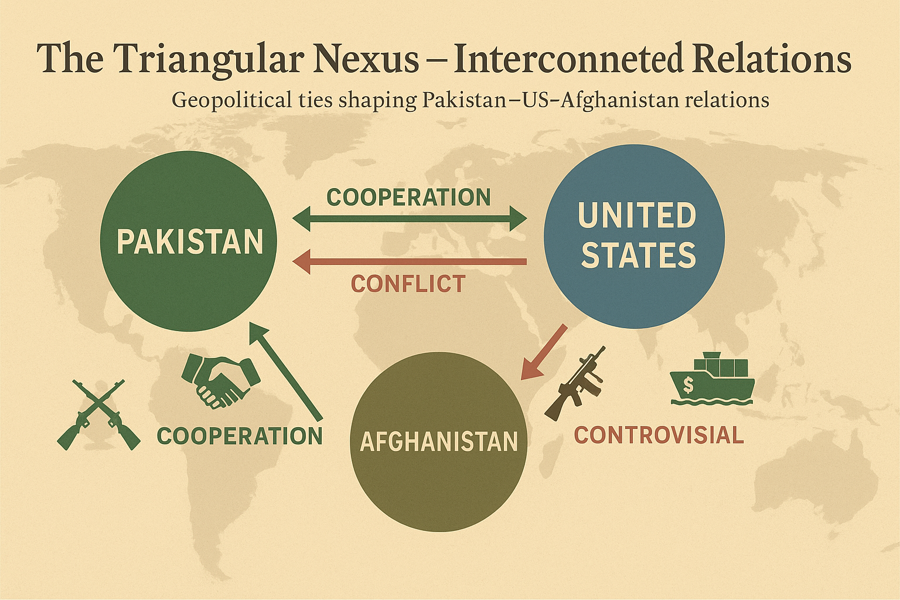

Slide 113
Pakistan–USA Trade Relations (FY 2024–25)
United States remains Pakistan’s largest export market ▫ Total trade volume: $7.6 billion
Pakistan enjoys strong trade surplus with USA ▫ Exports: $6.028 billion
Imports from USA remain comparatively moderate ▫ Imports: $2.588 billion
Bilateral trade showed strong year-on-year growth ▫ Trade volume growth: 16% increase
Economic ties remain resilient despite political shifts ▫ USA remains key destination for textiles, goods

Slide 114
Pakistan–Afghanistan Trade Trends (CY 2025)
Pakistan-Afghanistan trade shows post-instability recovery ▫ Total trade volume: $2.41 billion
Pakistan exports dominate bilateral trade structure ▫ Exports (CY 2025): $1.39 billion (annualized)
Afghan imports into Pakistan increased significantly ▫ Imports (CY 2025): $612.5 million
Earlier fiscal year showed limited Afghan imports ▫ Imports (FY 2024–25): $25.898 million
Trade growth despite political and border challenges ▫ Recovery from earlier security disruptions

Slide 115
India’s Trade Comparison with USA and Afghanistan
India–USA trade volume dwarfs Pakistan–USA trade ▫ Total trade: $132.2 billion
Indian exports to USA reached record levels ▫ Exports: $86.51 billion (FY 2024–25)
US tariff hikes disrupted Indian export momentum ▫ Tariffs raised from 10% to 50%
India expanded Afghanistan trade amid Pak-Afghan rift ▫ Total trade: $1.0087 billion
Alternative routes sustained India–Afghan trade flows ▫ Chabahar Port, Kabul–Delhi air corridor

Slide 116
People-to-People & Cultural Linkages (2025–26)
Pak–US cultural relations show pragmatic maturity
TechGirls, CEE, Global UGRAD active
Educational cooperation expanding beyond security domain
Focus on STEM, IT, tourism, hospitality
Pakistani-American diaspora acts as cultural bridge
Officials urge translating links into strategy
Pak–Afghan people-to-people ties severely disrupted
Torkham, Chaman closures separate families
Refugee repatriation reshaping border social fabric
99,000 Afghans returned in Oct 2025

Slide 117
Core Themes: Trust Deficit & Strategic Confusion
Source: Daniel Markey
Deep mistrust shaped US–Pakistan interactions
Both sides pursued conflicting strategic goals
“Double game” accusations damaged cooperation
US accused Pakistan of backing Taliban
Pakistan believed US abandoned it again

Slide 118
India Factor in Afghanistan–Pakistan Dynamics
Afghan–India strategic alliance raised Pakistan’s threat perception
India invested $3B+ in Afghan infrastructure & projects (roads, Parliament building, dams)
Shahtoot Dam in Kabul to store 146M m³ water – may reduce flow to Pakistan via Kabul River
India’s presence in Afghan security & development sectors boosts influence (training Afghan forces, soft power diplomacy)
Javid Husain: Advocates engagement-based diplomacy to offset Indian influence

Slide 119
Safe Havens & Cross-Border Attacks / Aid, Dependency & Narrative War
Sources: Ahmed Rashid & Husain Haqqani
TTP conducts attacks from Afghan territory (Rashid)
Taliban denial or silent complicity fuels tensions
US aid tied to counterterrorism & Afghan stability
Civil–military divide sends mixed signals to US (Haqqani)
Narrative war deepens mistrust between both sides

Slide 120
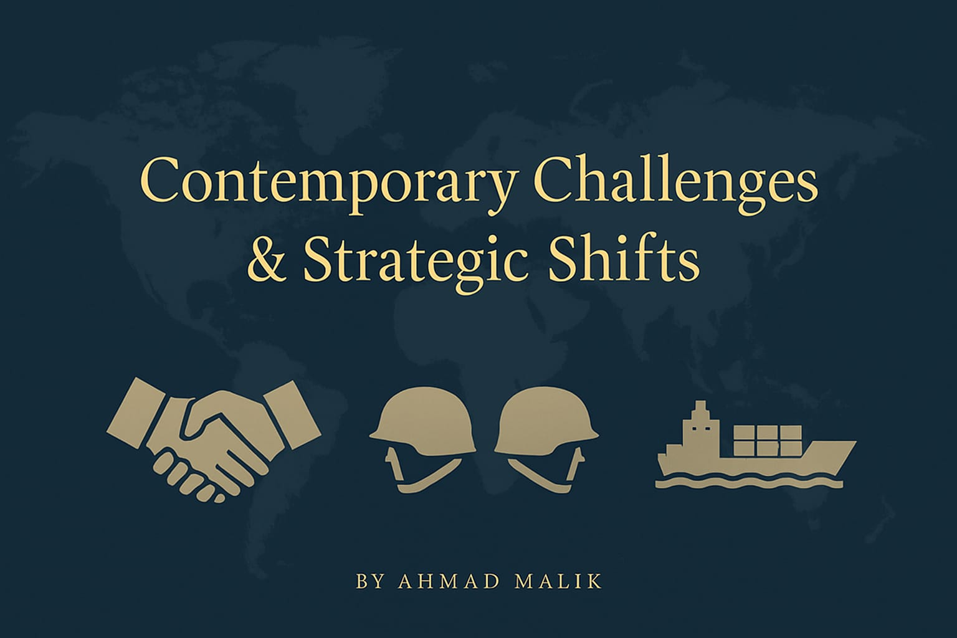

Slide 121
China–Pakistan–US Triangle
US sees CPEC as a strategic challenge, raising concerns over regional influence
Pakistan benefits from CPEC’s infrastructure investments, but faces rising scrutiny over dependency
China invested $540M (2023‑26) in Afghan oil extraction at Amu Darya, signaling growing economic ties with the Taliban regime
Tariff‑free trade incentives and mining contracts further embed China in Afghanistan’s post‑2021 economy
Javid Husain recommends balanced diplomacy, engaging both the US and China to safeguard Pakistan’s strategic autonomy

Slide 122
ACADEMIC & EXPERT PERSPECTIVES
Scholarly Views & CSS Relevant Analysis
"Pakistan-US relations have been characterised by a recurring cycle of engagement and estrangement, driven by America's short-term tactical needs rather than long-term strategic investment."
Realist School
— Bruce Riedel, Brookings Institution
"The fundamental problem is that the two countries have never shared the same threat perception — what Pakistan sees as an existential India threat, Washington sees as a manageable regional rivalry."
Structural View
— Hussain Haqqani, Former Pak Ambassador
"US-Pakistan relations are best understood through the lens of asymmetric dependence — Pakistan is far more dependent on US goodwill than vice versa, yet exercises outsized strategic leverage due to its geographic position."
Dependency Theory
— Stephen P. Cohen, Foreign Policy Analyst
PAKISTAN–USA RELATIONS | CSS LEVEL 4 | 2026
11 / 14

Slide 123
CURRENT SITUATION: 2025–2026
State of Pakistan–USA Relations Today
Diplomatic
Cautiously Stable
KEY DEVELOPMENTS 2024–2026
IMF bailout ($7B, Sept 2024) facilitated with tacit US support — signalling stabilisation interest
Military/Security
Limited Cooperation
Pakistan-US Defence Consultative Group meetings resumed after 2-year hiatus (2024)
Trump 2.0 administration (Jan 2025): transactional approach; focus on trade reciprocity
Economic/Trade
Positive
Pakistan imposes counter-tariffs in response to US tariff hike (April 2025 trade tensions)
Counter-Terrorism
Fragile
Visits by US Sec. of State to Islamabad (2025) — Afghanistan & regional security focus
FATF: Pakistan maintains 'White List' status; US acknowledges NACTA improvements
OVERALL ASSESSMENT
TTP cross-border operations remain key US concern; Pakistan demands Afghan soil clearance
Relations remain functional but sub-optimal. Neither estranged nor truly aligned. Pakistan navigates a multi-vector foreign policy — balancing US, China, Gulf and domestic pressures simultaneously.
PAKISTAN–USA RELATIONS | CSS LEVEL 4 | 2026
12 / 14

Slide 124
FUTURE OUTLOOK & POLICY RECOMMENDATIONS
Pathways Forward for Pakistan–USA Relations
Scenario A: Renewed Strategic Partnership
Scenario B: Managed Transactionalism
Scenario C: Continued Drift
Probability: Moderate
Probability: Most Likely
Probability: Possible
US re-engages Pakistan as counterweight to China's BRI expansion
Issue-specific cooperation without broad strategic partnership
Pakistan's internal instability reduces US appetite for engagement
Minerals diplomacy: Pakistan's lithium/copper reserves attract US investment
Trade relations expand but security cooperation stays limited
CPEC deepening widens strategic divergence
Afghan stability requires Pakistan — forcing re-engagement
China factor prevents deep realignment toward US orbit
Another security incident triggers sanctions or CSF suspension
IMF-backed economic stabilisation creates favourable climate
Pakistan maintains balancing act; US accepts limitations
Pakistan pivots more toward Gulf/China; US marginalised
POLICY RECOMMENDATIONS FOR PAKISTAN:
Diversify economic partnerships • Reduce aid dependency • People-to-people diplomacy • Civilian leadership in foreign policy • Consistent CT commitment
PAKISTAN–USA RELATIONS | CSS LEVEL 4 | 2026
13 / 14

Slide 126
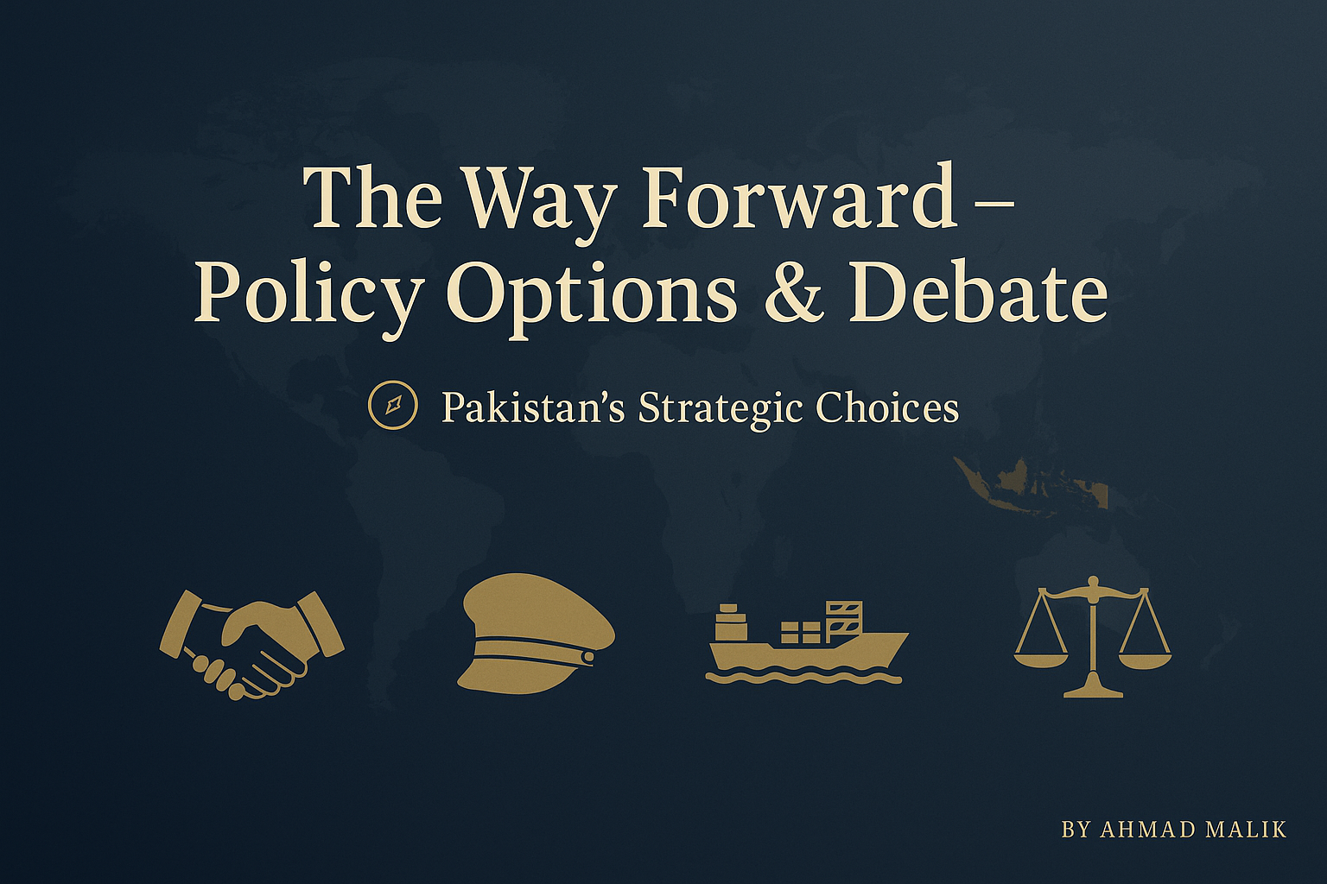

Slide 127
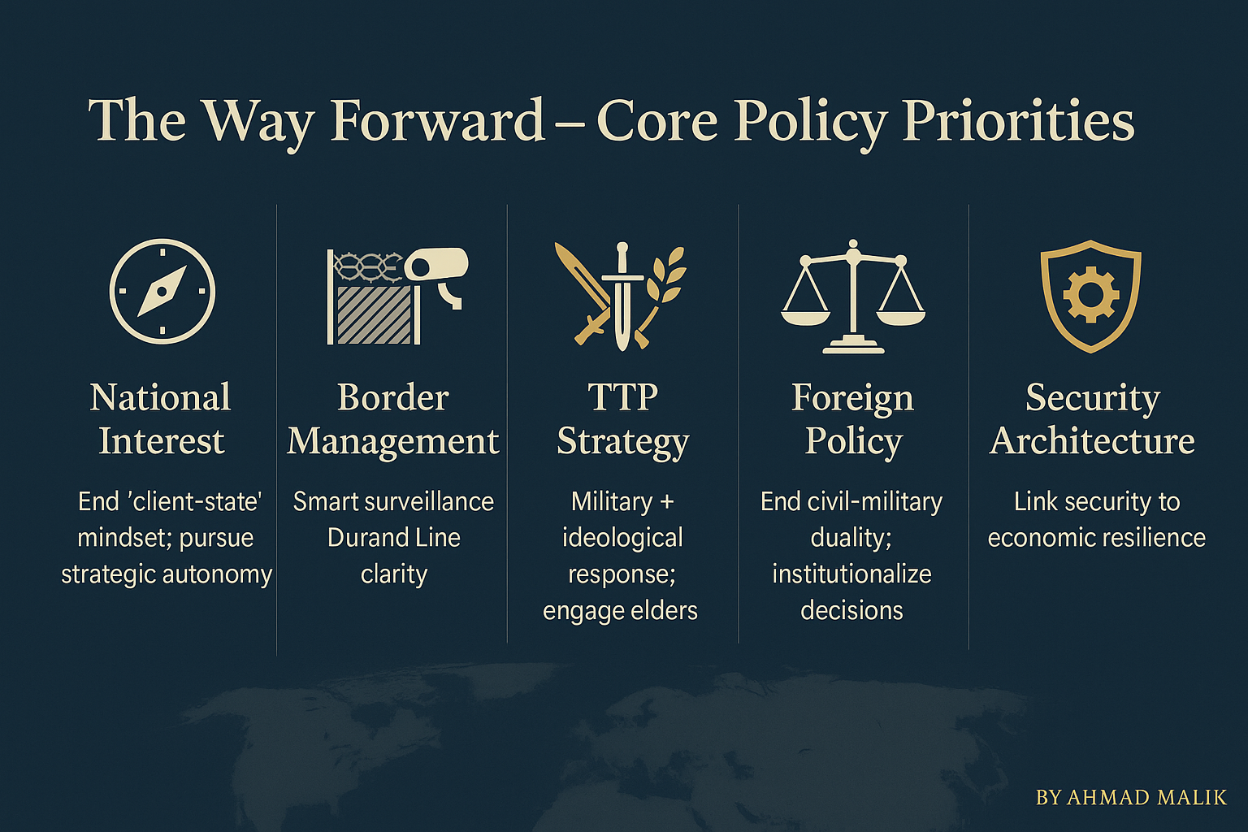

Slide 128
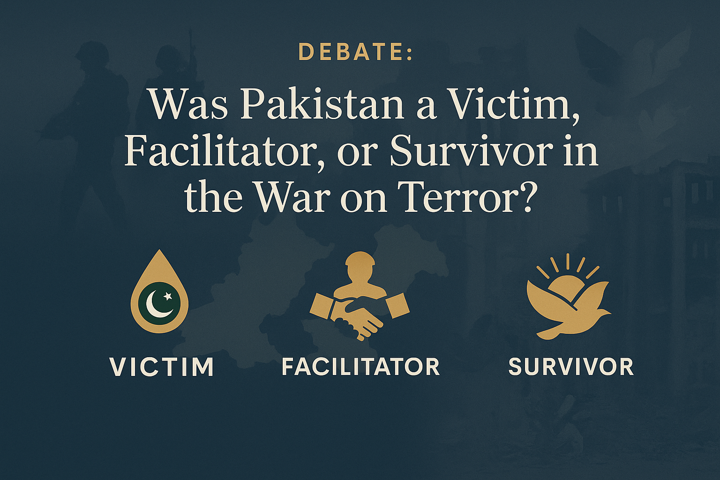

Slide 129
Thank You
Any Questions?

