Slide 1
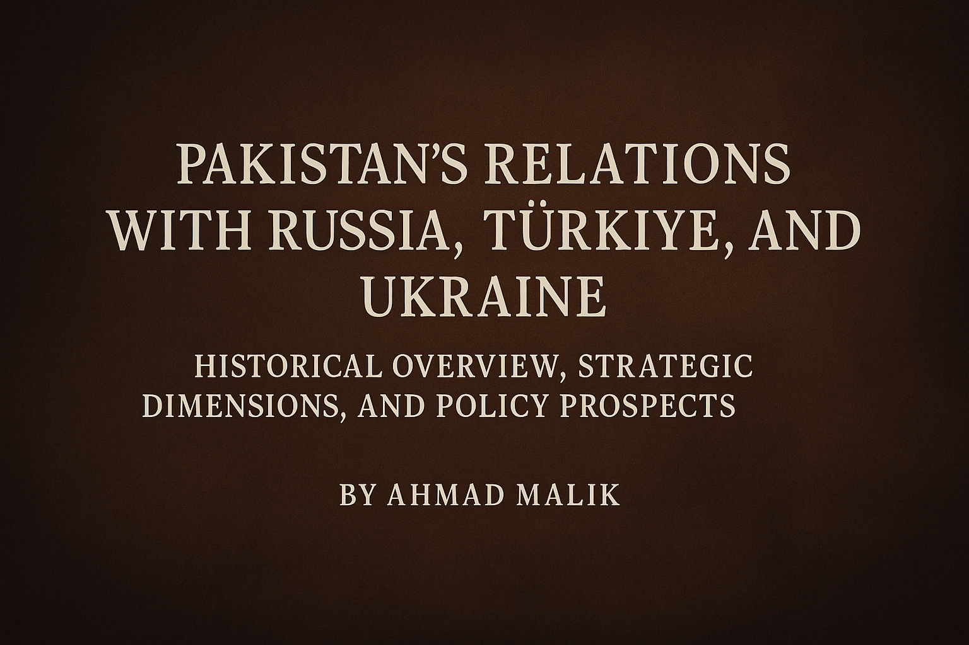

Slide 2
Invictus By William Ernest Henley (1849–1903)
Out of the night that covers me, Black as the pit from pole to pole,
I thank whatever gods may be, For my unconquerable soul.
In the fell clutch of circumstance, I have not winced nor cried aloud.
Under the bludgeonings of chance, My head is bloody, but unbowed.
Beyond this place of wrath and tears. Looms but the Horror of the shade,
And yet the menace of the years, Finds and shall find me unafraid.
It matters not how strait the gate, How charged with punishments the scroll,
I am the master of my fate,
I am the captain of my soul.

Slide 3
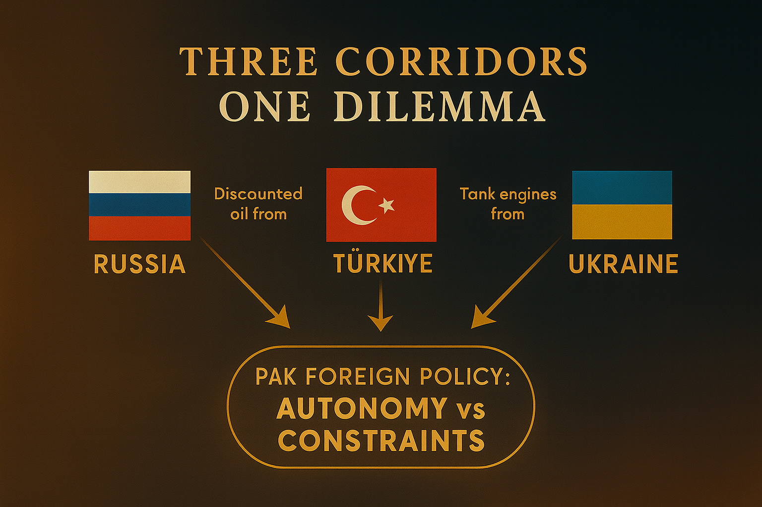

Slide 4
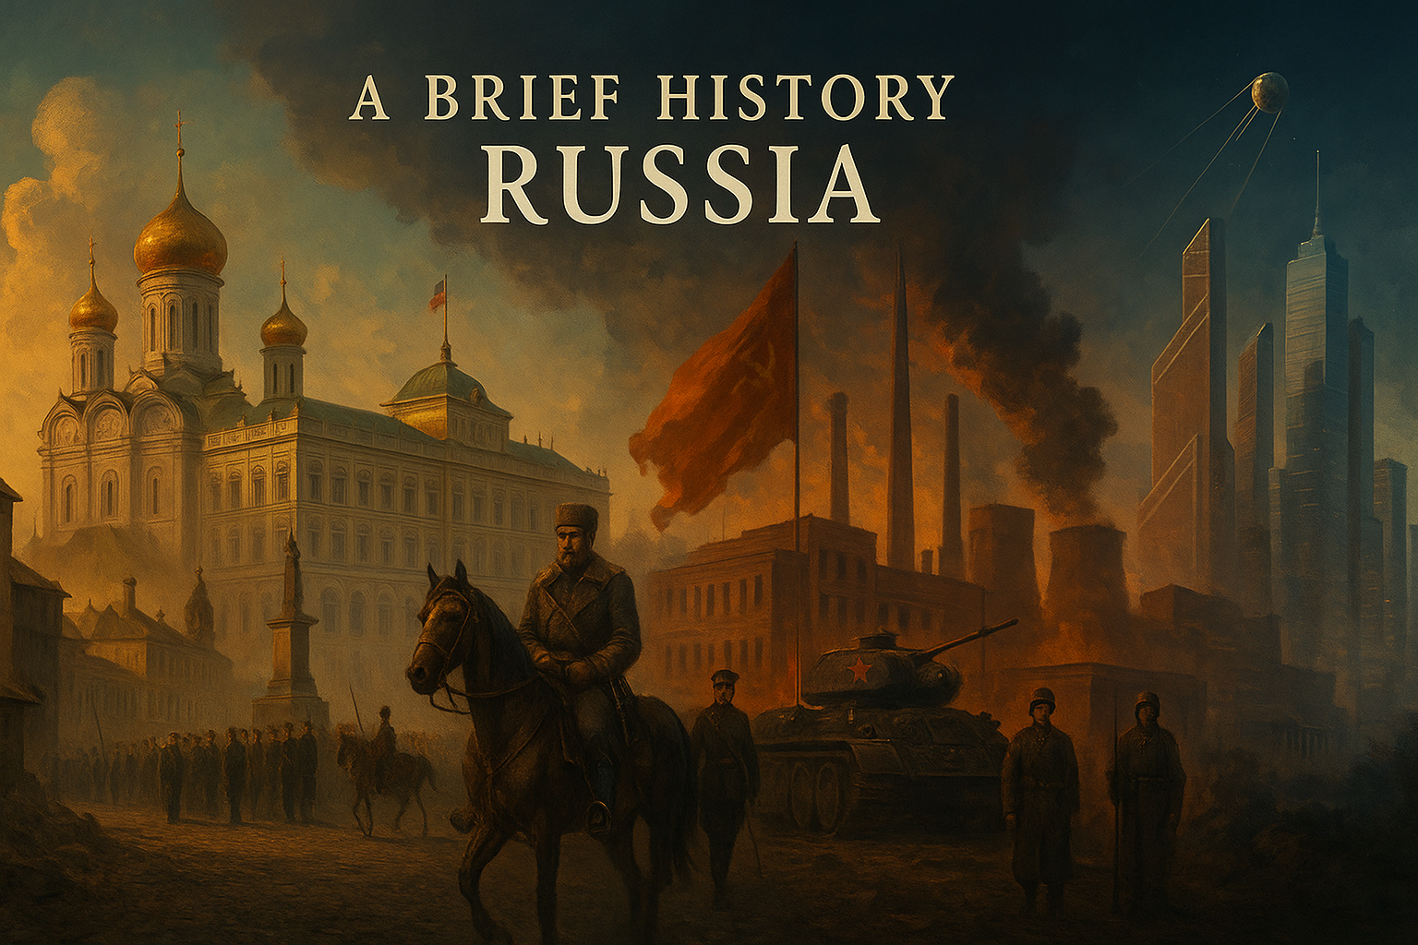

Slide 5


Slide 6
Early Foundations & Kievan Rus (9th–13th Century)
Origin: Russia’s roots trace back to Kievan Rus (founded 862 AD by Viking prince Rurik).
Religion: Conversion to Eastern Orthodox Christianity under Prince Vladimir in 988 AD shaped Russian identity.
Trade & Culture: Controlled trade routes between the Baltic and Black Sea; strong ties with Byzantium.
Decline: Mongol invasion (1240) destroyed Kiev → fragmentation.
Example: By the 11th century, Kiev was one of Europe’s largest cities with 50,000 people.

Slide 7
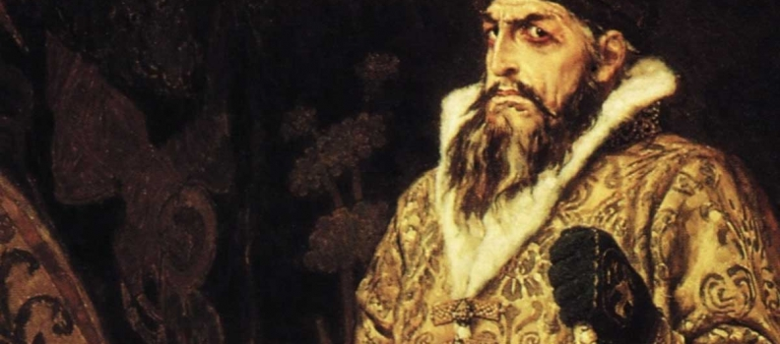

Slide 8
Rise of Moscow & Tsardom (14th–17th Century)
Mongol Yoke (1240–1480): Russia paid tribute to Mongols until Ivan III’s defiance in 1480.
Moscow’s Rise: Became the political & religious center. Ivan IV (“The Terrible,” 1547–1584) → first Tsar of Russia.
Expansion: Conquered Kazan & Astrakhan (1552–56), expanding into Central Asia.
Time of Troubles (1598–1613): Political chaos, famine (killed 1/3 population), and Polish invasion.
Analysis: This period forged the autocratic tradition—centralized power in Tsars to resist external/internal threats.

Slide 9
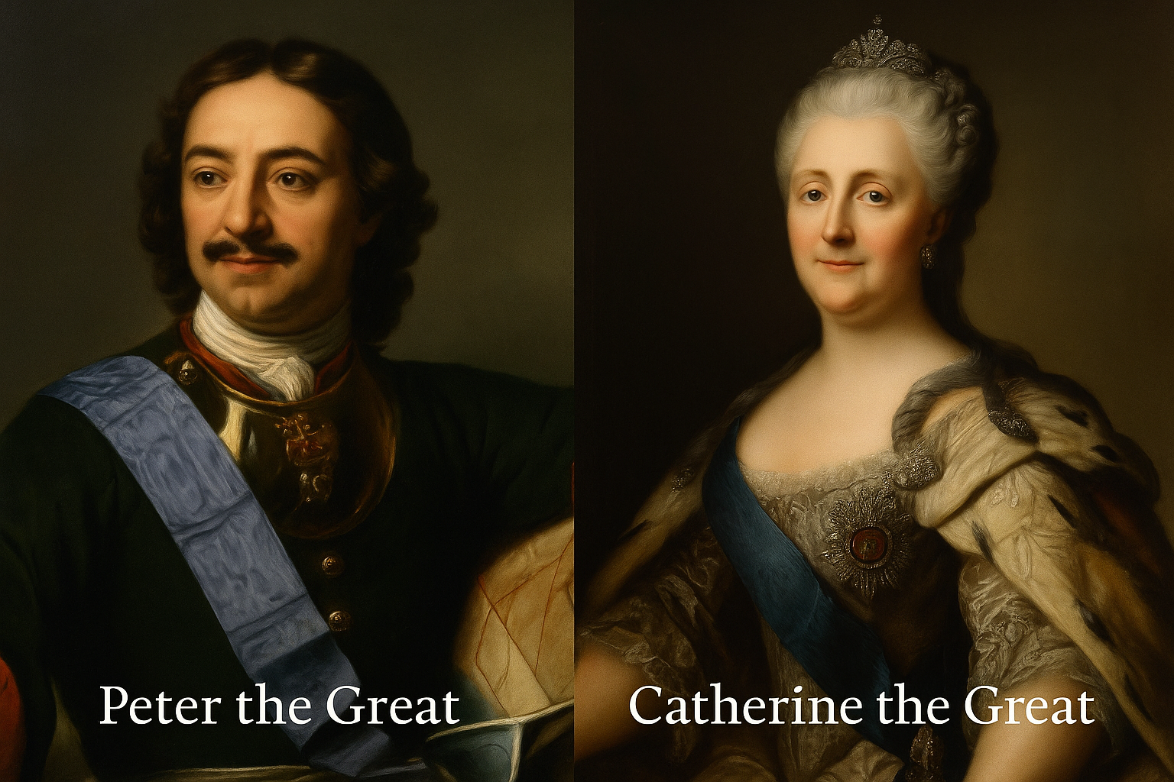

Slide 10
Imperial Russia & Westernization (18th–19th Century)
Peter the Great (1682–1725): Modernized army, navy, and state; founded St. Petersburg (1703) as “Window to Europe.”
Catherine the Great (1762–1796): Expanded into Crimea, Black Sea; promoted Enlightenment reforms (but reinforced serfdom).
19th Century: Industrialization began late (1850s–80s). Defeat in Crimean War (1853–56) exposed backwardness.
Reforms: Emancipation of Serfs in 1861 (40M freed).
Data: By 1900, Russia had the 4th largest railway network in the world (53,000 km).

Slide 11
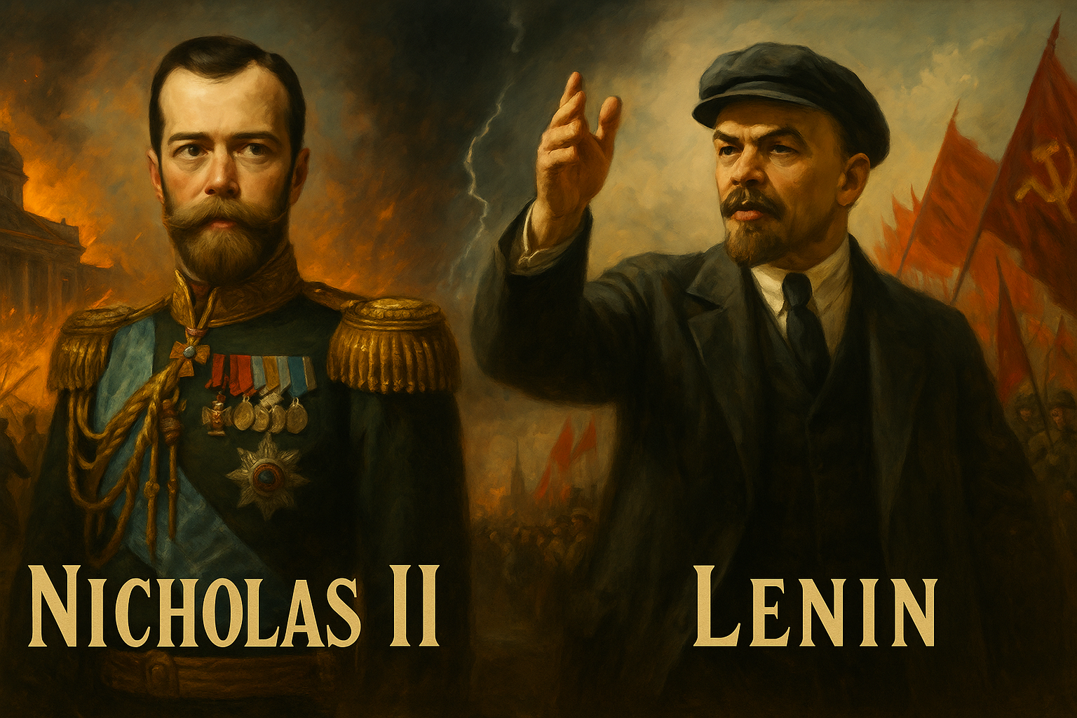

Slide 12
The Russian Revolution (Part I: Causes & February 1917)
Causes:
Autocratic Tsarist system resisted reforms.
Peasant poverty & land hunger (80% of population were peasants).
Industrial workers facing poor wages/conditions.
WWI devastation: 2M soldiers killed, economy collapsed.
February 1917 Revolution: Tsar Nicholas II abdicated → Provisional Government formed.
Example: By 1917, bread rations in Petrograd fell to 50g/day, fueling riots.

Slide 13
The Russian Revolution (Part II: October 1917 & Civil War)
October 1917 Revolution: Bolsheviks under Lenin seized power with slogan “Peace, Land, Bread.”
Civil War (1918–22): Red Army (Bolsheviks) vs. White Army (monarchists, liberals, foreign allies).
Victory secured through Trotsky’s leadership and control of industrial centers.
USSR officially established in 1922.
Data: Civil War caused 8–10M deaths, famine, and economic collapse.

Slide 14


Slide 15


Slide 16
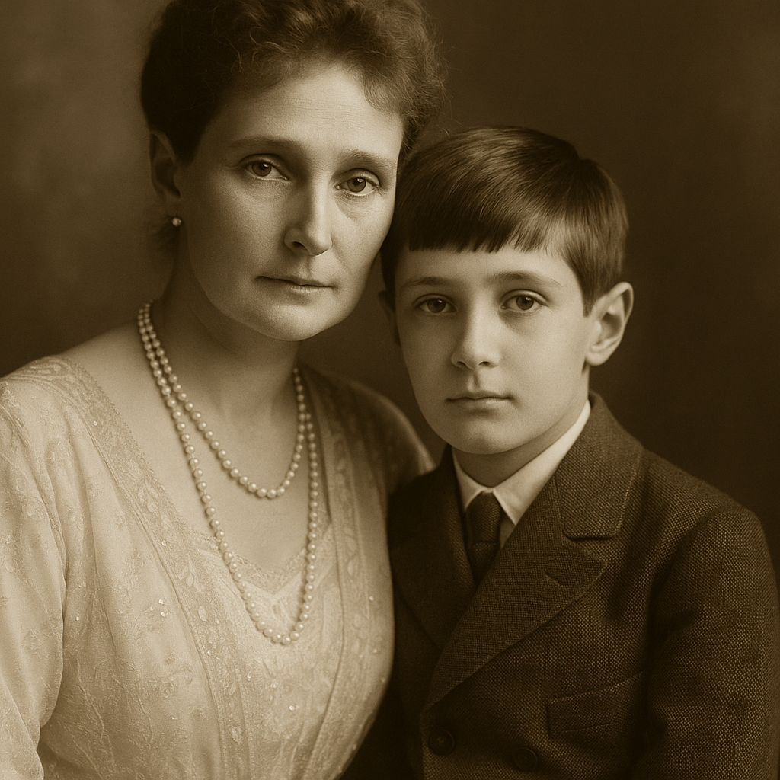

Slide 17
The Cold War (Part I: Origins & Global Role)
Origins (1945–47):
Ideological clash: Communism vs. Capitalism.
Nuclear monopoly ended with USSR’s first atomic bomb in 1949.
Global Expansion: USSR backed socialist regimes in Eastern Europe, Asia, Africa, Latin America.
Institutions: Formation of Warsaw Pact (1955) to counter NATO.
Example: By 1960, 1/3 of the world’s population lived under communist governments.

Slide 18
The Cold War (Part II: Peak & Decline)
Peak Tensions:
Cuban Missile Crisis (1962) brought world to brink of nuclear war.
Arms race: by 1980s, USSR had 40,000 nuclear warheads in 1986 while the US had 30000 warheads.
Space Race: USSR launched Sputnik (1957) and Yuri Gagarin (1961) – first human in space.
Decline: Stagnant economy, Afghan War (1979–89), technological lag vs. US.
Data: Afghan War cost 15,000 Soviet lives and $8 billion annually.

Slide 19
Downfall of the USSR (1991)
Three Main Reasons (Andrew Heywood – Global Politics):
Economic Stagnation:
Central planning inefficiencies, low productivity, consumer shortages.
Growth slowed to <1% annually by late 1980s.
Political Reform Backfiring:
Gorbachev’s glasnost (openness) unleashed public criticism.
Perestroika (restructuring) failed to revive economy.
Nationalism & External Pressures:
Baltic & Eastern European states demanded independence.
Arms race with US drained resources.
Example: In 1991, 15 Soviet republics declared independence → formal dissolution on Dec 25, 1991.

Slide 20
Post-Soviet Russia (1991–Present)
1990s: Boris Yeltsin → economic “shock therapy” reforms; GDP shrank 40% (1991–98).
2000s: Vladimir Putin restored stability, fueled by oil & gas boom. GDP grew 7% annually (2000–08).
Foreign Policy: Assertive stance (Georgia 2008, Crimea annexation 2014, Ukraine war 2022).
Current Era: Facing Western sanctions, pivoting to China, BRICS, and Global South.
Long-term Trend: Balancing great power ambitions with demographic & economic decline.
Analysis: Russia remains a military superpower but economically 11th largest economy (2024 IMF)—high reliance on energy exports.

Slide 21
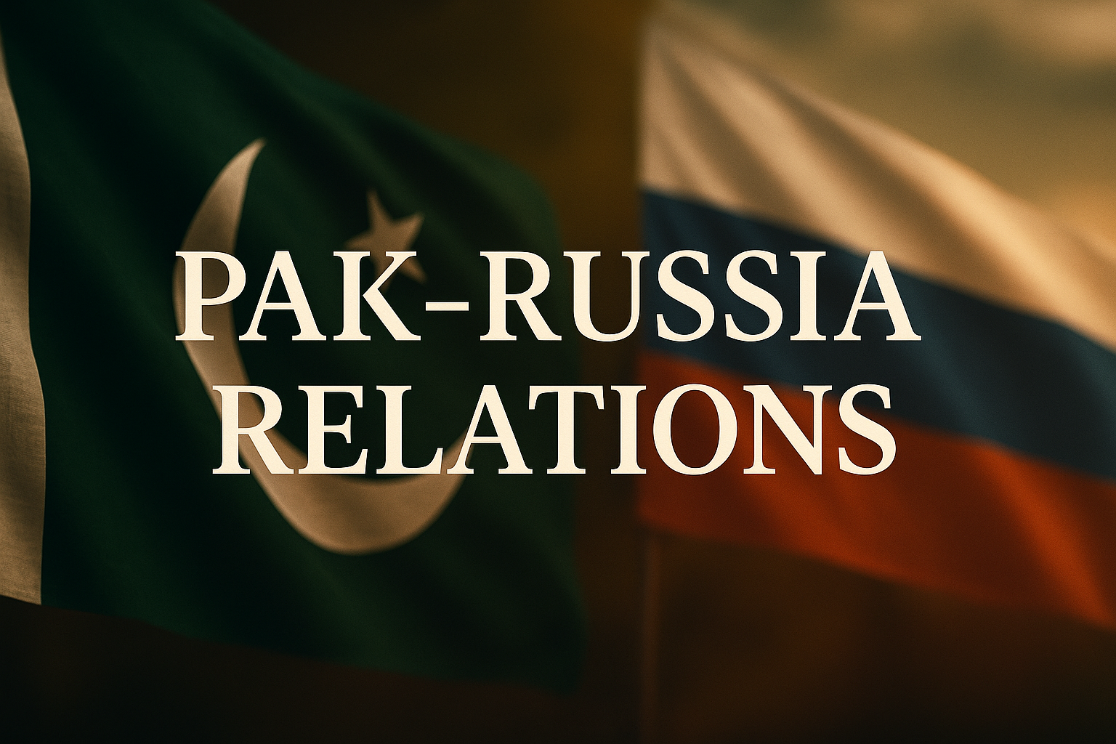

Slide 22
Introduction to Pakistan–Russia Ties
Relations formally began in 1948 when USSR recognized Pakistan, though initially marked by mistrust.
Cold War Legacy: Pakistan allied with the US via SEATO (1954) & CENTO (1955), alienating Moscow.
Soviet offer: Stalin invited Liaquat Ali Khan in 1949, but he chose Washington in 1950 → “the fateful missed opportunity” (Javid Husain).
Today, Pakistan and Russia call each other “strategic partners” (Putin, 2024) with cooperation spanning defense, energy, and diplomacy.
Heywood: “In international politics, alliances shift with the balance of power, not sentiment” — explaining the post-1991 reset.

Slide 23
The Evolution of the ties

Slide 24
Early Tensions & U-2 Incident (1950s–1960)
1957: PM Suhrawardy allowed CIA use of Peshawar Air Station → USSR alarmed.
1960 U-2 Incident: US spy plane shot down after takeoff from Pakistan.
Nikita Khrushchev thundered: “Do not play with fire! We have red-marked Peshawar.”
“Pakistan felt deceived because the U.S. had kept her in the dark about such clandestine spy operations launched from Pakistan’s territory" (Gen. Khalid Mahmud Arif).
Cold War alignment deepened: Pakistan in SEATO (1954) & CENTO (1955).
Abdul Sattar: “The U-2 affair froze any lingering Soviet goodwill and marked Pakistan in Moscow’s eyes as an American outpost”

Slide 25
Soviet Technical & Industrial Cooperation
1950: USSR–Pakistan founded Pakistan Oilfields → early industrial collaboration.
Late 1950s–60s: USSR engaged in technical projects; engineering aid in energy & minerals.
1969: Pakistan contracted V/o Tyaz Promexport (USSR consortium) for integrated steel mill in Karachi.
1972: Bhutto laid foundation of Pakistan Steel Mills with full Soviet financial & technical support.
Analysis: While political ties fluctuated, USSR invested in long-term industrial infrastructure unmatched by Western aid.

Slide 26
Military Balance & Asymmetry
After 1965 War, USSR emerged as India’s largest arms supplier, tilting South Asian balance.
Soviet diplomacy convinced US & Western powers to sustain arms embargo on Pakistan.
Result: Indo-Pak arms race turned asymmetric, with India outpacing Pakistan militarily.
1968: first USSR–Pakistan arms deal signed (minor but symbolic).
Critical point: USSR built Pakistan’s industry but simultaneously armed India heavily, reinforcing Pakistani mistrust.

Slide 27
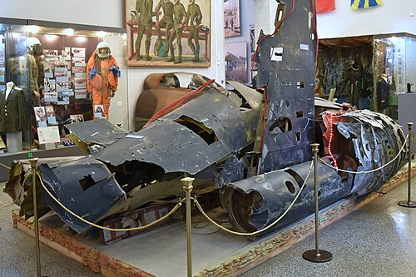
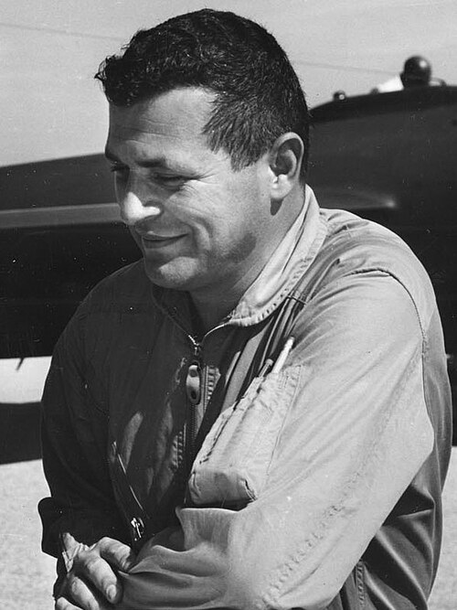
The wreckage of the American Lockheed U-2 Dragon Lady Shot down 65 years ago now on display at the Central Armed Forces Museum in Moscow
Francis Gary Powers, pilot of the plane

Slide 28
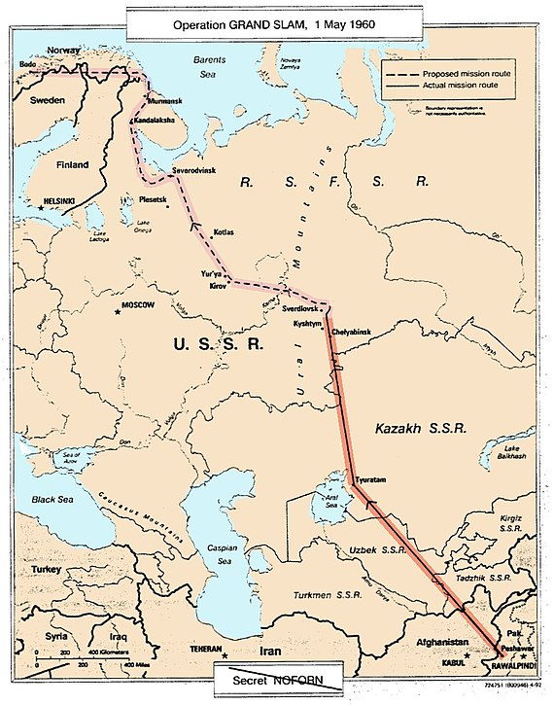

Slide 29
Ayub–Bhutto Diplomacy & 1965 Rapprochement
Ayub Khan tried balancing US tilt with Soviet outreach (via FM Z.A. Bhutto).
1965 Visits: Ayub Khan + Bhutto to Moscow → signed deals on trade, cultural exchange, cooperation.
Ayub: “Soviet Union is our next-door neighbor with which Pakistan had close friendly connections in the past.”
1965 Cultural Pact: exchanges of academics, artists, sportsmen, TV/radio programs.
Critical view: Bhutto’s Moscow diplomacy reduced hostility, but Pakistan remained structurally dependent on US aid.

Slide 30
Soviet Investment & Arms Cooperation (1968)
1968: Premier Kosygin visited Pakistan — first-ever Soviet leader to do so.
Kosygin pledged aid for steel mill, nuclear power plant, and broad economic projects.
USSR signed first arms deal with Pakistan (1968) → triggered protests from India.
Hafeez Jullundhri recited poem comparing Kosygin’s arrival to a “dawn for Kashmir.”
Kosygin smiled, but remained silent.
Kosygin: “Relations are very good indeed, and we should strengthen them.”

Slide 31
1971 War & Soviet Naval Presence
Indo-Soviet Treaty (Aug 1971): ensured USSR support to India against Pakistan.
USSR backed India + Mukti Bahini → vetoed Pakistan’s UN resolutions.
Dec 1971: Soviet Navy (subs & destroyers) deployed in Indian Ocean, shadowing US 7th Fleet’s Task Force 74.
Pakistan Navy detected Soviet subs K-320 & Charlie; refrained from escalation fearing nuclear retaliation.
Russian Ambassador (2012): “Our stance during 1971 somewhat embarrassed our relations with Pakistan.”

Slide 32
Soviet Tilt Toward East Pakistan / Bangladesh
USSR maintained closer ties with East Pakistan’s leftist & communist groups, especially during the Bengali Language Movement (1952–56).
Moscow sympathized with Bengali demands for recognition of Bangla as a state language, contrasting with its silence on Urdu–dominated West Pakistan.
East Pakistan’s anti-American sentiment aligned with Soviet interests; demonstrations erupted against Pakistan’s 1954 US defense pacts (SEATO, CENTO).
Communist Party influence in East Pakistan weakened the Pakistan Muslim League’s dominance, helping pave the way for Awami League’s rise.
In 1971, Indo–Soviet Treaty of Friendship reinforced Soviet support for Mukti Bahini and India’s intervention, culminating in Bangladesh’s independence.
Critical Point:
The USSR saw East Pakistan as a fertile ground for socialist influence, exploiting regional grievances and West Pakistan’s over-reliance on the US.

Slide 34
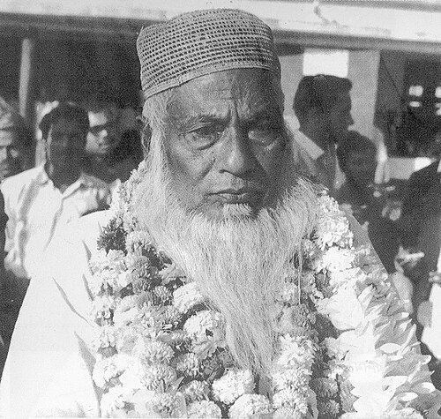

Slide 35
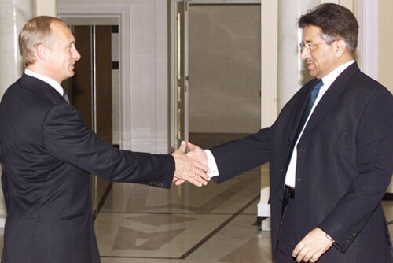

Slide 36
Normalization after Soviet Withdrawal (1989–1999)
1989: USSR offered Pakistan a commercial nuclear power plant (blocked by US pressure).
1994–95: Benazir Bhutto sought engagement, but setback when Pakistan recognized Taliban regime (opposed by Moscow).
1996: Russia launched Pakistan’s Badr-B satellite from Baikonur at minimal cost — first major tech cooperation.
1998: Russia congratulated India’s nuclear tests, but avoided harsh criticism of Pakistan’s Chagai-I & II tests.
1999: Nawaz Sharif’s visit to Moscow (first PM visit in 25 years); Moscow praised Lahore Declaration but condemned Pakistan’s role in Kargil War.
Critical Point: Early years were defined by tentative engagement, but Afghanistan & Indo-Russian closeness constrained ties.

Slide 37
Musharraf Era & Post-9/11 Shift (2000–2010)
1999 Coup: Russia condemned Musharraf’s takeover, calling it unconstitutional.
2001: Russian Deputy FM Losyukov visited Islamabad → pledged economic cooperation.
After 9/11, Pakistan’s role against Taliban/al-Qaeda aligned with Russia’s concerns in Chechnya & Central Asia.
Russia helped ease Indo-Pak nuclear tensions (2001–02) through diplomatic channels.
Abdul Sattar: “The war on terror opened limited but important space for Pakistan–Russia convergence.”
Critical Point: Security concerns (terrorism, Afghanistan) created shared strategic interests for the first time.

Slide 38
Strategic Warming & New Partnerships (2010s–Present)
2014 onwards: India–US closeness → Russia pivoted to Pakistan for balance in South Asia.
2016: First-ever joint Pak–Russia military exercise held → symbol of deepening defense ties.
2016: Pakistan granted Russia access to Gwadar Port, a warm-water outlet to Arabian Sea.
Energy Cooperation: Agreement on Pakistan Stream Gas Pipeline (Karachi–Kasur).
Javid Husain: “For the first time since 1947, Moscow saw Islamabad as a potential strategic partner, not merely an adversary’s proxy.”
Critical Point: Today, Pak–Russia relations rest on energy, military, and regional cooperation under SCO, though mistrust lingers.

Slide 39
Re-engagement & Diplomatic Reset (2007–2010)
2007: Russian PM Mikhail Fradkov’s 3-day visit to Islamabad — first Russian PM visit in 38 years.
Musharraf & Shaukat Aziz: discussed reviving economic cooperation & regional security.
Asif Zardari era: Russia identified as an “important neighbor & partner” (Cowasjee, Dawn).
Russia pledged support for Pakistan’s fight against Taliban militancy.
Analysis: Both states saw a chance to reset — Pakistan sought strategic diversification beyond US/China, while Russia balanced India’s tilt toward the West.

Slide 40
SCO, Energy & Political Convergence (2011–2012)
2011: Putin endorsed Pakistan’s Shanghai Cooperation Organization (SCO) membership, calling Pakistan “vital partner in South Asia & Muslim world.”
Russian offers: expansion of Pakistan Steel Mills, support for Guddu & Muzaffargarh plants, interest in Thar Coal Project.
Russia condemned NATO strike in Pakistan (2011) → stressed sovereignty & non-intervention.
2012: Putin postponed state visit, but FM Sergey Lavrov visited to offset damage.
Analysis (Javid Husain): Russia’s support for Pakistan’s sovereignty was a turning point, signaling Moscow’s independence from NATO’s Afghan strategy.

Slide 41
Military Cooperation & Defense Breakthroughs (2013–2015)
2013: First Pakistan–Russia Strategic Dialogue (Foreign Secretaries’ level, Moscow).
Gen. Kayani’s visit (2012), Gen. Chirkin’s visit to Pakistan (2013) — set ground for army-to-army dialogue.
Russia lifted arms embargo on Pakistan; negotiations on Mi-35 Hind attack helicopters.
2015: COAS Gen. Raheel Sharif visited Moscow — received at Kremlin with full Guard of Honour (first COAS visit).
Analysis (Abdul Sattar): Military ties marked a “historic shift” as Russia, long India’s arms supplier, began cautiously diversifying toward Pakistan.

Slide 42
Energy & Economic Partnership (2015 Landmark Deals)
2015 Defense Deal: Russia sold 4 Mi-35 Hind-E attack helicopters to Pakistan.
Energy Cooperation: Russia agreed to invest $2 billion in the North–South Gas Pipeline (Karachi–Lahore/Kasur), Phase I to conclude Dec 2017.
Russia expressed interest in joining CPEC → framing Pakistan as a connectivity hub for Eurasia.
Trade & investment dialogue institutionalized through strategic dialogues and SCO frameworks.
Critical Analysis (Heywood): For Russia, Pakistan offered a geostrategic corridor to Arabian Sea; for Pakistan, Russia became a third pillar in balancing US–India and China.

Slide 43
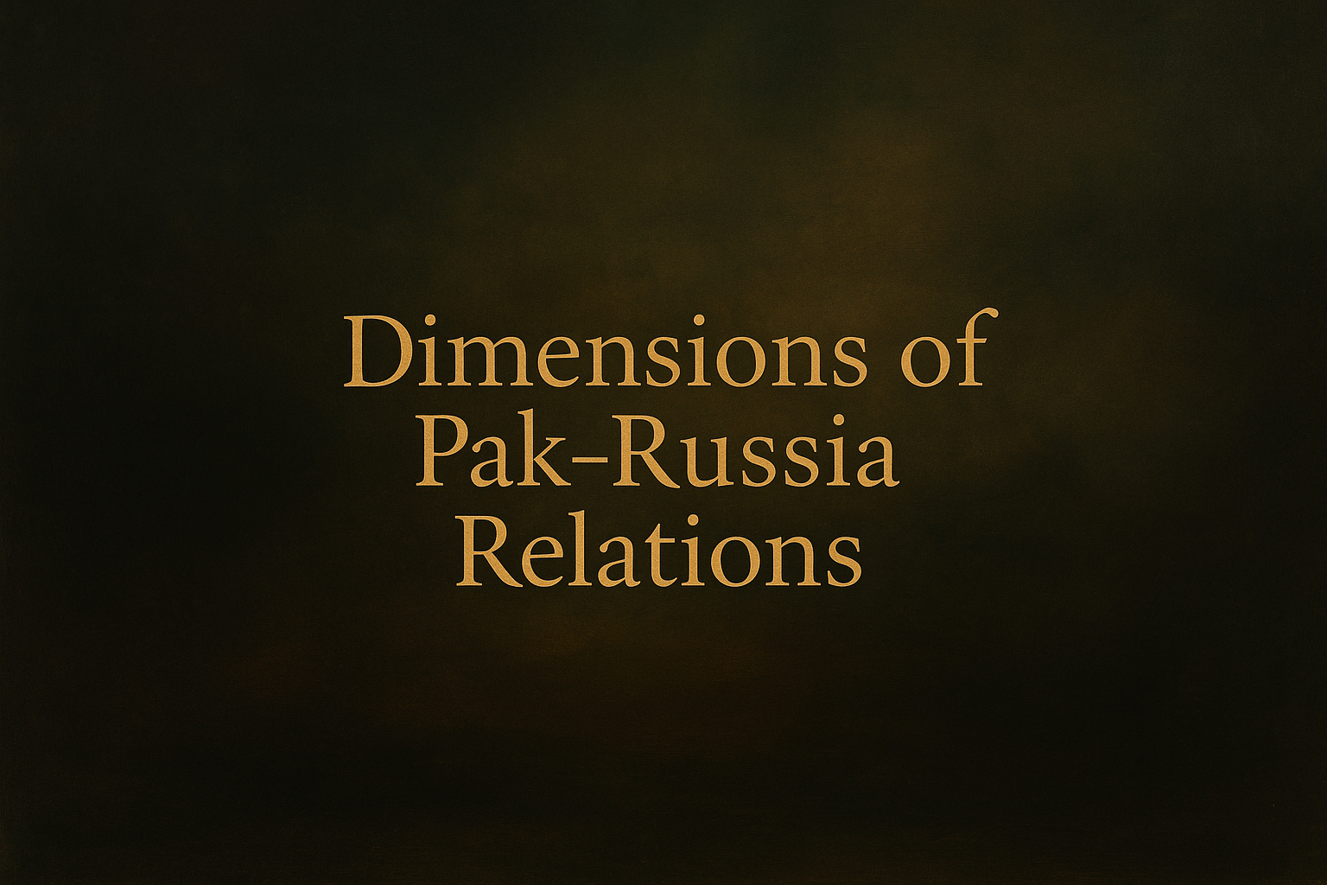

Slide 44
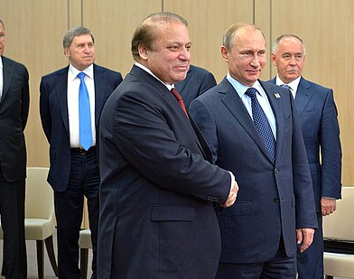
Pakistan–Russia: From Cautious Engagement to Strategic Convergence (1990–2014)
Economic Cooperation, Energy Partnerships, and Geopolitical Realignment in the Post-Soviet Era

Slide 45
Early Post-Soviet Outreach (1990–1999)
1990–91: Benazir Bhutto sent farewell messages to Moscow and led a high-level economic delegation to Russia & Central Asia after USSR collapse.
Pakistan sought access to Central Asian energy corridors; Russia sought regional partners post-USSR.
Limited progress — overshadowed by Pakistan’s recognition of Taliban govt in 1996, which Moscow opposed.
Trade remained negligible; political mistrust continued (Abdul Sattar, Pakistan’s Foreign Policy).
Analysis: Pakistan’s Afghanistan policy clashed with Russia’s Central Asian security concerns.

Slide 46
Trade & Institutional Mechanisms (2000–2009)
Trade rose from $92M (2003) → $411M (2006) → $630M (2008) before dipping to $400M (2009).
2009: Establishment of Russian–Pakistan Intergovernmental Commission on Trade, Economic, Scientific & Technical Cooperation.
Education & science exchanges initiated — signaling diversification beyond energy/security.
Javid Husain: called this a “slow but steady institutionalization” of economic ties.
Quote (Putin, 2007): “Pakistan can be an important partner for Russia in South Asia.”

Slide 47
Strategic & Energy Convergence (2010–2012)
2011 SCO Summit (Astana): PM Yousaf Raza Gillani & Putin held “frank, cordial” talks.
Russia financed CASA-1000 power project ($500M) to bring Central Asian energy to Pakistan.
Initiation of Free Trade Agreement and currency swap framework to de-dollarize bilateral trade.
Abdul Sattar: “Energy & trade became the foundation for redefining Pak–Russia convergence.”
Analysis: Energy interdependence was used to dilute Pakistan’s over-reliance on the West/China.

Slide 48
Geopolitical Reorientation (2012–2014)
2012: Russia & Pakistan quietly upgraded geopolitical dialogue “behind the scenes” (Stephen Blank, SSI).
Moscow viewed Pakistan as indispensable for post-2014 Afghanistan amid NATO withdrawal.
Javid Husain: termed this “geostrategic convergence born of mutual insecurity” — Russia wary of jihadist spillover, Pakistan wary of Western abandonment.
Heywood’s lens: example of “multipolar balancing” — Russia diversifying away from India-only policy, Pakistan diversifying away from US-dependence.
Analysis: Afghanistan became the driver of rapprochement, where interests of both states aligned for the first time since Cold War.

Slide 49
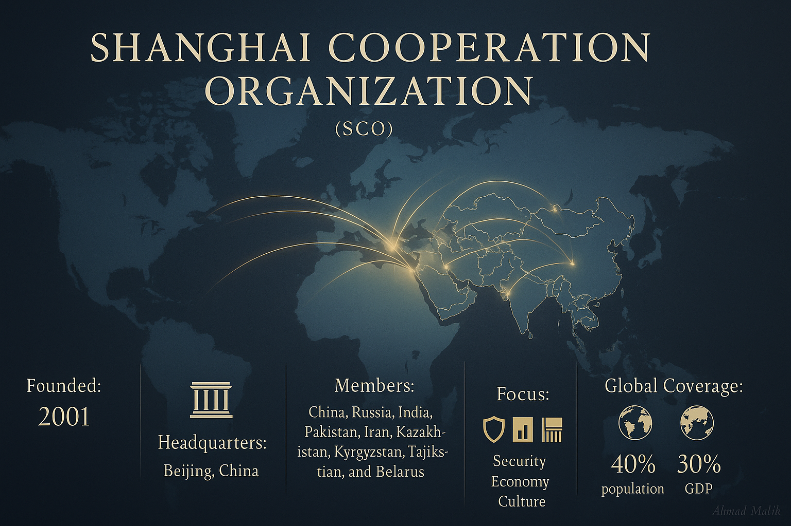

Slide 50
Economic & Trade Cooperation Post-SCO
2020: Pakistan settled a $93.5 million Soviet-era trade dispute, unlocking $8+ billion Russian investments (energy, steel, infrastructure).
3rd IGC in 2015 initiated; settled in Nov 2020
Russia offered gas and wheat supplies in response to Pakistan’s 2022 flood crisis and looming food insecurity.
SCO platform enabled direct Pakistan–Russia energy dialogue, including discussions on pipeline gas supply.
Expansion of economic ties reflects Moscow’s interest in South Asian markets amid Western sanctions.
Quote: Putin (2022, SCO Samarkand): “Part of the infrastructure for gas supply to Pakistan has already been created.”

Slide 51
Political & Security Convergence in SCO Framework
Shared views on Afghanistan stability — Moscow and Islamabad vowed continued consultations (Sept 2022).
Pakistan’s measured stance on Russia–Ukraine war at UN appreciated by Putin, seen as diplomatic neutrality.
Regular SCO summits enhanced strategic dialogue on counterterrorism, energy security, and regional integration.
Pakistan positioned as a bridge between Central Asia, Russia, and South Asia in SCO’s evolving security architecture.
Critical Analysis: Pakistan leverages SCO to diversify partnerships away from U.S. dependency, while Russia uses it to counterbalance India’s U.S. tilt.

Slide 52
Strategic Energy Cooperation
North–South Gas Pipeline (2015): $2 bn project, 1,100 km pipeline from Karachi to Lahore, later renamed Pakistan Stream.
LNG Agreement (2017): Formalized cooperation in Liquefied Natural Gas, aligning Russian supply potential with Pakistan’s rising import demand.
Offshore Pipeline (2018–19): MoU signed; Gazprom & ISGC agreed to feasibility for Middle East–South Asia supplies.
Quote (Javid Husain): “Energy partnership with Russia is both an economic necessity and a geopolitical statement of autonomy.”
Critical Analysis: Russia seeks access to South Asian markets; Pakistan diversifies energy sources away from Gulf + Western dependence

Slide 53
Oil & Gas Imports: New Phase (2022–23)
Imran Khan’s Push (Jan 2022): Supported discounted Russian oil, wheat & pipeline deals — challenging U.S. sanctions environment.
Musadik Malik Talks (Dec 2022): Claimed “fruitful negotiations” with Russia for cheap oil, diesel, and gas.
Test Cargo (Apr–Jun 2023): Russia demanded Pakistan prove seriousness → first discounted oil cargo arrived on 12 June 2023.
Economic Significance: First-ever Russian crude shipment diversified Pakistan’s oil basket; potential savings on import bill.
Argument (Heywood – Global Politics): Energy deals are not merely commercial — they symbolize strategic alignments in multipolar order

Slide 54
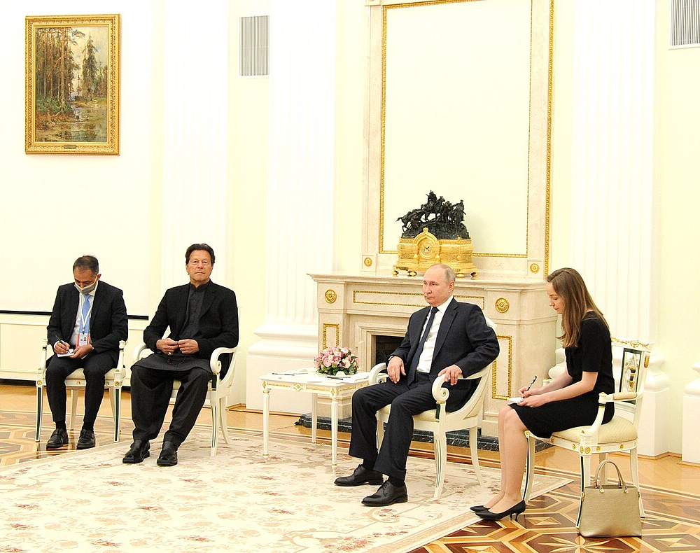
Pakistan–Russia military cooperation’s evolution
President Putin meets Pakistani Prime Minister Imran Khan in Moscow on the eve of the Russian invasion of Ukraine

Slide 55
Early Military Engagements (1990s–2000s)
1996: First defense deal → Russia supplied 70 Mi-17 multipurpose helicopters (1996–2004).
2000s: Arms sales slowly resumed despite India’s dominant share in Russian defense imports.
Strategic note (Abdul Sattar): Russia cautiously balanced Pakistan ties to avoid alienating India.
Critical analysis: These sales marked Russia’s pragmatic shift from Cold War hostility to cautious engagement with Islamabad.
Quote (Ryabkov, 2015): “Pakistan–Russia ties will not negatively impact Russia’s relations with India.”

Slide 56
Institutional & Training Cooperation
2014: Pakistan & Russia signed Defense Cooperation Agreement.
2018: Agreement allowed Pakistani officers to study in Russian Defense Universities (shift away from U.S.-centric training).
Joint Military Advisory Committee (JMCC): Institutionalized defense dialogue.
Military Diplomacy: Participation in Russian Army Games & “Master of Air Defense Battle” (2015).
Argument (Heywood – Global Politics): Education & training deepen “strategic socialization” between armed forces

Slide 57
Joint Exercises & Tactical Collaboration
Druzhba Exercises:
2016: First-ever Russia–Pakistan drills (130 Pak, 70 Russian troops).
2020: 5th edition in Krasnodar, >150 soldiers, focused on counter-terror ops.
2021: Emphasis on urban warfare & anti-terror “consolidated assault company.”
Aman Naval Exercise (2021): Russian Navy joined multinational drills in Karachi.
Analysis: Symbolic defiance of India’s pressure; reflects Moscow’s recognition of Pakistan as a counter-terrorism partner in South Asia.
Example: India asked Moscow to cancel Druzhba 2016, but Russia proceeded — highlighting its growing autonomy in South Asia.

Slide 58
Ukraine War Context & Geopolitical Balancing
Feb 2022: Imran Khan met Putin in Moscow — first Pakistani PM visit since 1999.
UN Vote (Mar 2022): Pakistan abstained, maintaining a neutral stance on Ukraine conflict.
Indian media claim: Pakistan supplied weapons to Ukraine → denied by Islamabad.
Critical analysis (Javid Husain – Pakistan & a World in Disorder): Pakistan seeks “multi-vector diplomacy” — balancing Russia, China, U.S., while avoiding entanglement in Ukraine war.
Quote (Imran Khan, 2022): “Our priority is Pakistan’s economic & energy security, not bloc politics.”

Slide 59
Emerging Trade Ties Amid Global Sanctions
Russia’s need to circumvent Western sanctions → Pakistan became a natural trade partner.
2023: Bilateral trade touched an unprecedented $1 billion (highest ever).
10th Pakistan-Russia Intergovernmental Commission (IGC):
Dec 2025, reaffirmed deeper trade and energy cooperation
Symbolizes Pakistan’s “multi-vector diplomacy” (Javid Husain – Pakistan & a World in Disorder).
2024: Pakistan’s export to Russia amounted to appx. $68.59 million, while imports from Russia were valued at around $631.66 million. Total: $1.3 billion
India-Russia ( $68.7 billion) ( 2024-2025)
Trade diversification: oil, wheat, energy tech, industrial goods.
Critical lens: Shows how Pakistan leveraged geopolitical shifts for economic gain.

Slide 60
Barter Trade Breakthrough (Oct 2024)
First Pakistan–Russia barter trade agreement signed.
60+ Pakistani companies participated in Pakistan–Russia Trade & Investment Forum (Moscow).
Forum inaugurated by Amb. Muhammad Khalid Jamali & Russian officials Alexey Gruzdev, Evgeny Fidchuk.
Reduces dollar dependency → alternative mechanism against sanctions pressure.
Analysis: A “post-dollar” experiment in Pakistan’s trade diplomacy, enhancing strategic autonomy.

Slide 61
Russian Deputy PM Overchuk’s Visit (Sept 2024)
High-profile meetings: President Asif Ali Zardari, PM Shehbaz Sharif, FM Ishaq Dar.
Agenda:
LNG deals (Russian terminals operational by 2026).
Proposal for state-of-the-art steel mill at Karachi (Pakistan Steel Mills site).
Quote – Overchuk: “Moscow supports Islamabad’s bid to join BRICS.”
Strategic significance: Russia elevating Pakistan as a pivot in Eurasian connectivity.

Slide 62
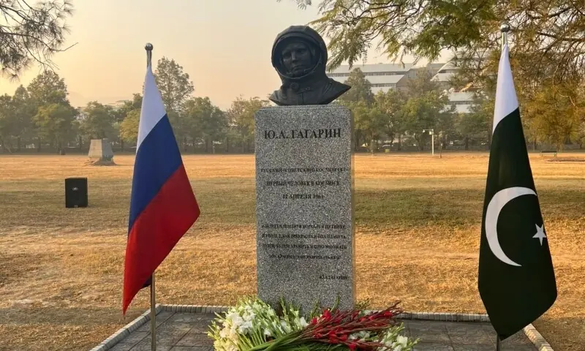

Slide 63
Historical Foundations of Pakistan–Russia Cultural Relations
Deep Roots (1948 onward):
Diplomatic ties led to major Soviet support in Pakistan’s early industrialization (Steel Mills, Guddu Power Plant).
Cultural Societies:
Soviet-Pakistan Friendship Society (Moscow, 1966)
Society for Pakistan–Soviet Cultural Ties (Pakistan)→ Hosted book exhibitions, academic talks, artistic exchanges.
Soviet Cultural Presence in Pakistan:
Magazines like Tulu published in Karachi.
Regular cultural troupes & scholarly delegations visited Pakistan before Cold War tensions.
Early Educational Linkages:
Student exchanges in engineering, literature, and sciences built a foundation of academic familiarity between the two societies.
Core Insight: Cultural ties historically acted as soft bridges, even when political relations were strained.

Slide 64
Modern Revitalization & Emerging Cultural Trends
SCO as Cultural Platform: Joint programs on youth exchanges, tourism, scholarships, and academic collaboration under the Shanghai Cooperation Organization.
Media & Digital Partnerships:
APP–Sputnik cooperation
Plans for content creator & influencer exchanges→ Enhancing people-to-people connection in the digital era.
Tourism Growth: Rising Russian interest in Pakistan’s northern regions, promoted through travel fairs & cultural showcases.
Academic Expansion: Pakistanis studying medicine/engineering in Russia
Revival of Urdu Studies faculty at Moscow State University
Cultural Festivals: Events like Kazan’s Oriental Bazaar strengthen artistic and social exchange.
Strategic Convergence: Cultural ties now complement broader cooperation in trade, connectivity, energy, and security, marking a shift from Cold War divides to mutual strategic alignment.

Slide 65
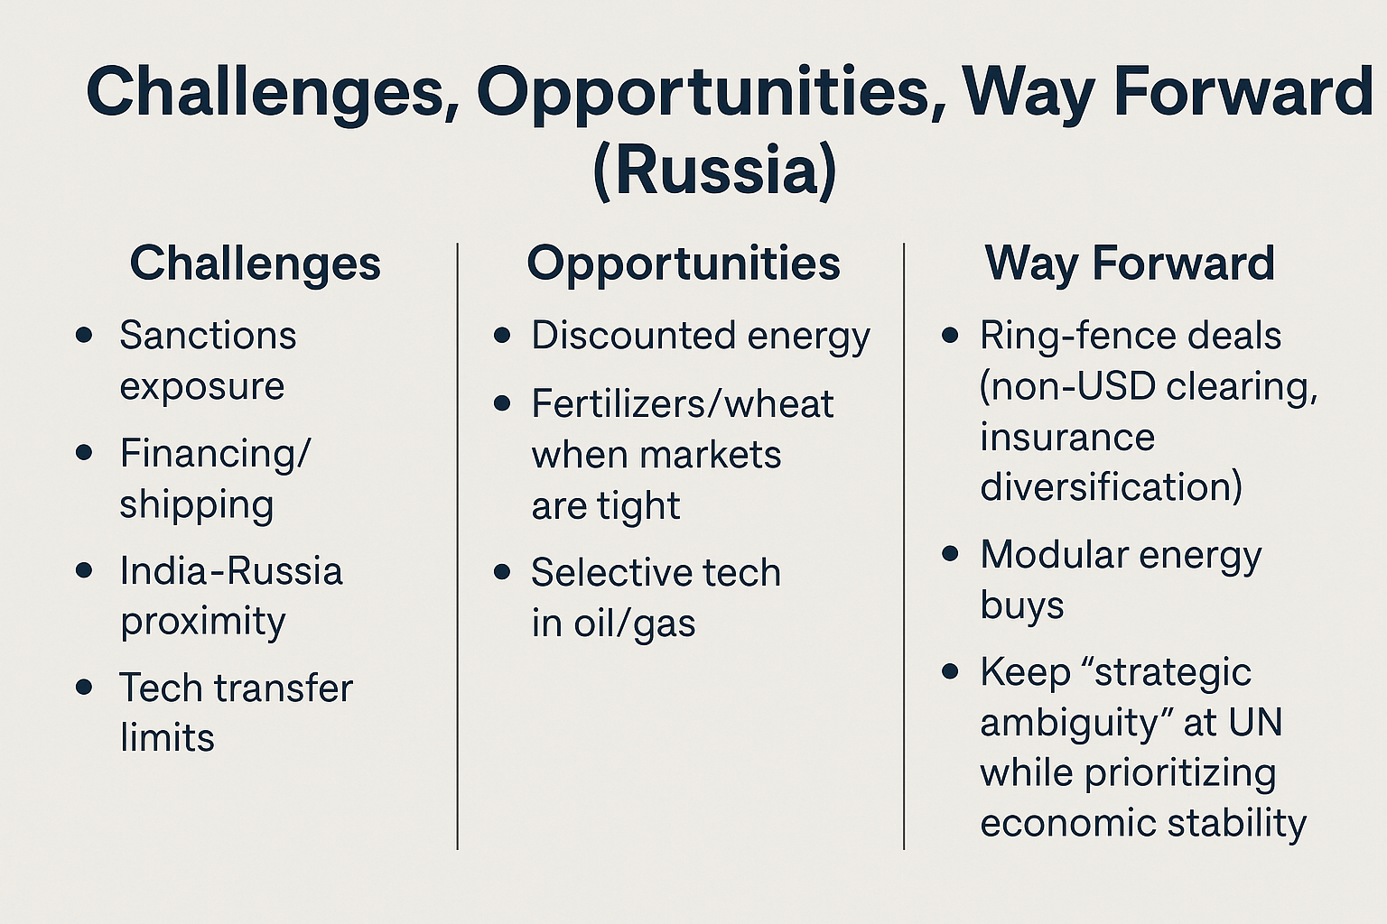

Slide 66
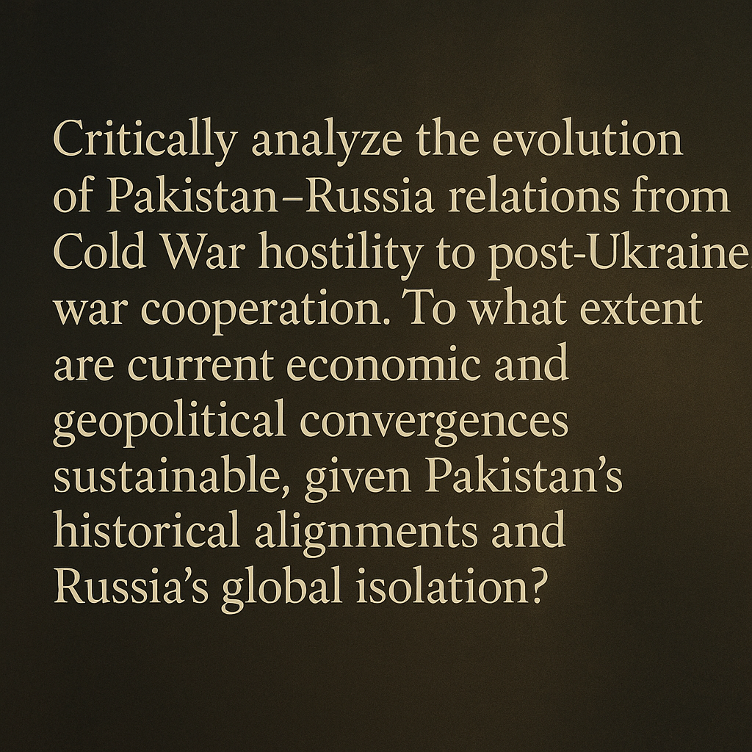

Slide 67
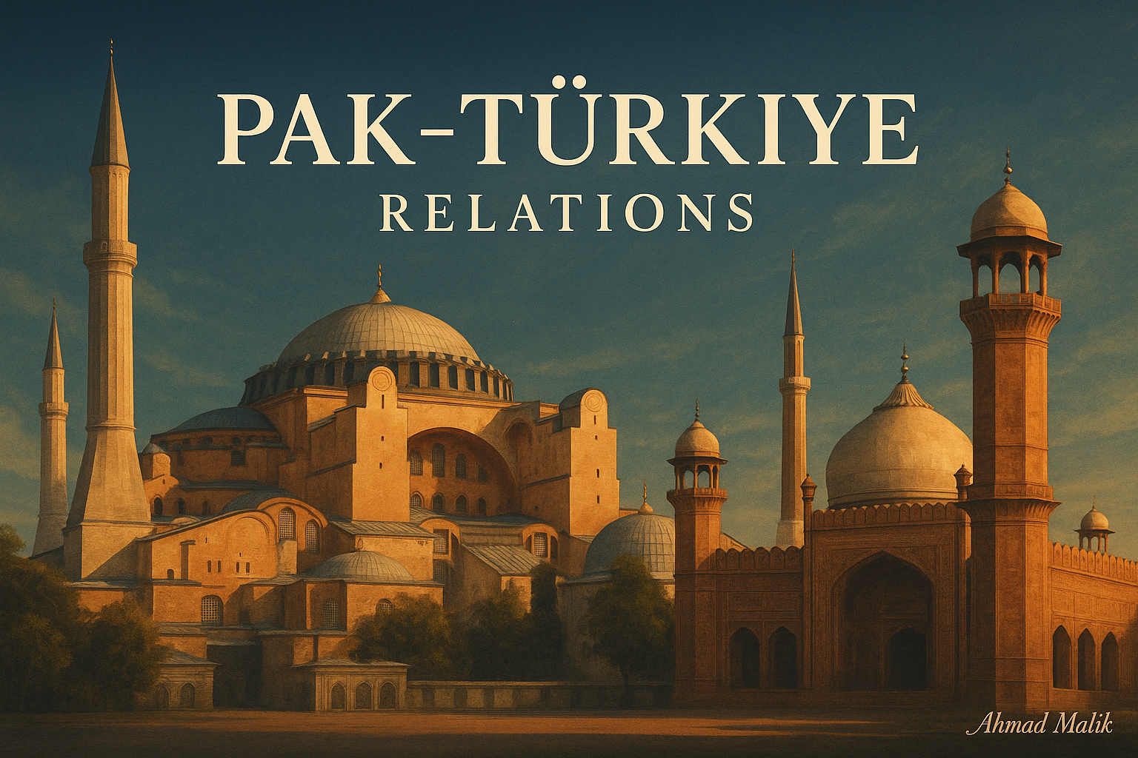

Slide 68
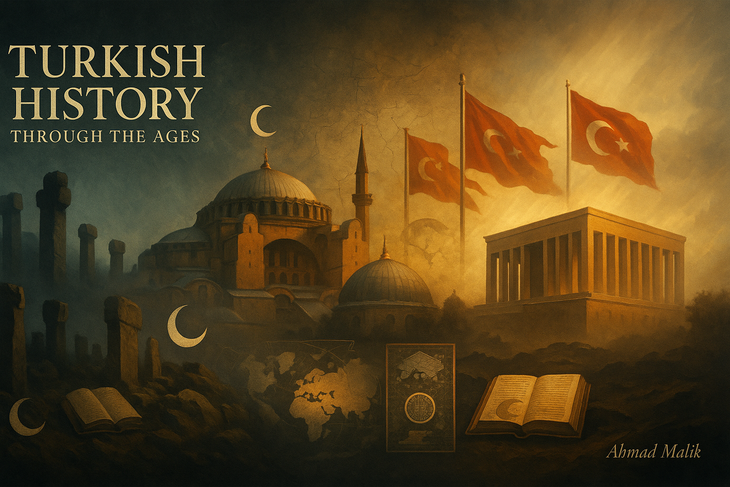

Slide 69
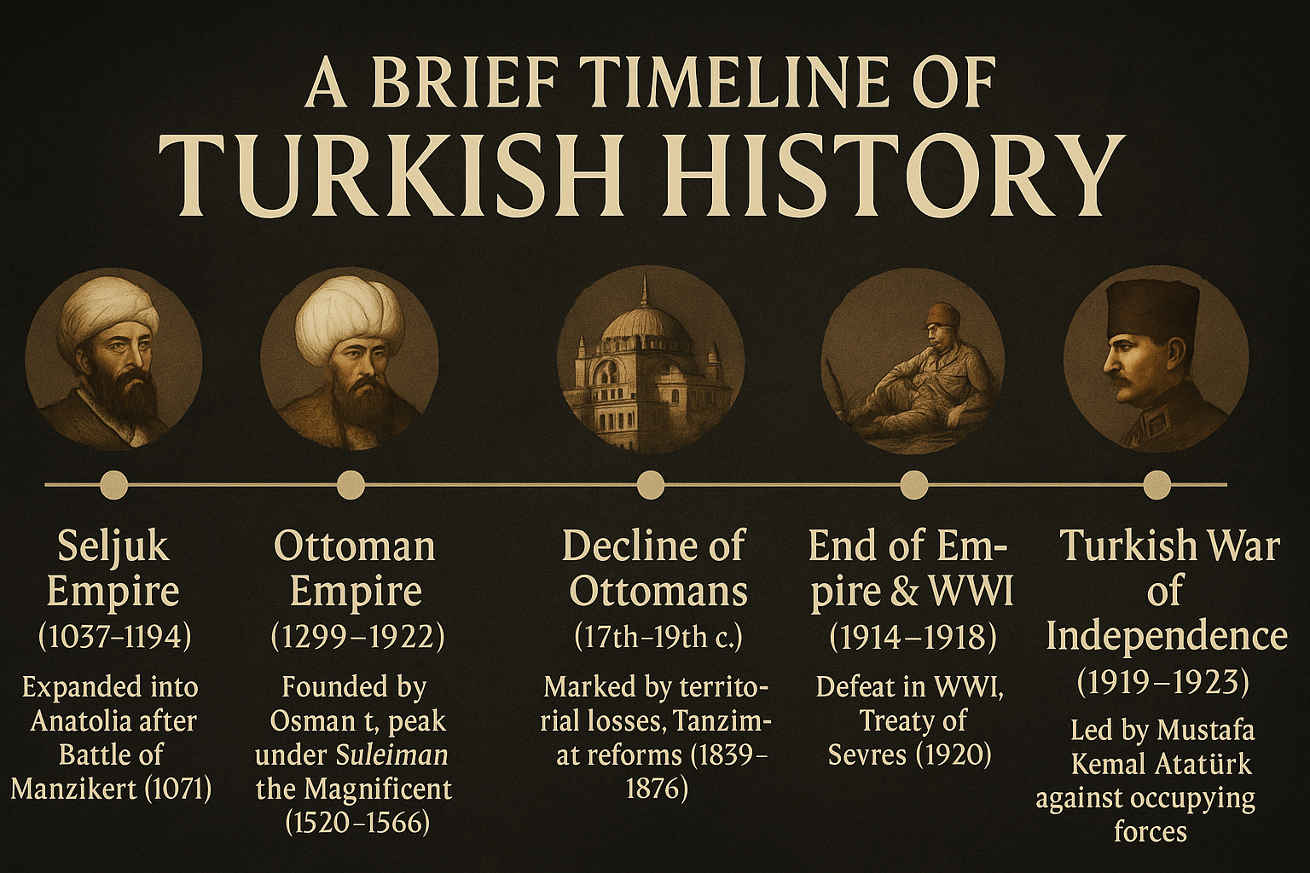

Slide 71
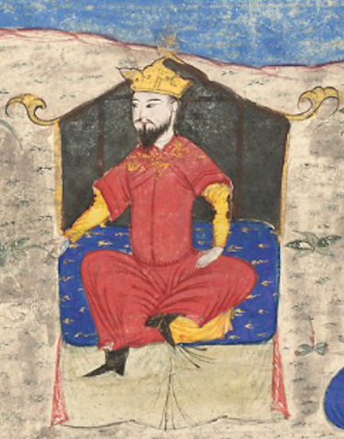

Slide 72
Omer Khayyam
Once in a while, a man arises boasting: ‘It is I!’
A day or two, his puny matters flourish;
Then Death appears
and cries out: ‘It is I!

Slide 73
Overview of Pakistan–Türkiye Relations
Historical Roots: Muslim support from British India (pre-Pakistan) to the Ottoman Caliphate during the Turkish War of Independence → foundation of enduring goodwill.
Diplomatic Ties: Embassies, consulates, and honorary missions across both countries → institutionalized presence.
Strategic Partnership (2016): Joint communique to elevate relations into a strategic partnership across political, military, and economic spheres.
Political Alignment: Türkiye supports Pakistan on Kashmir (UN plebiscite) & Nuclear Suppliers Group membership; Pakistan aligns with Türkiye on Armenian genocide issue (non-recognition).
Quote (Talat Masood): “Turkey and Pakistan enjoy close relations during both democratic and military regimes, reflecting the depth of the relationship.”

Slide 74
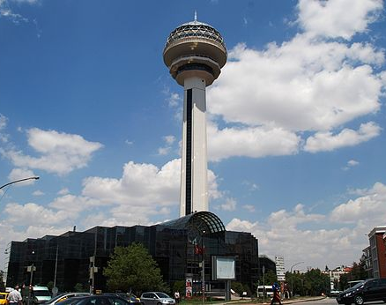
Diplomatic Relations
Cinnah Caddesi, the major road in the Turkish capital, Ankara, which is named after Muhammad Ali Jinnah, the founder of Pakistan.

Slide 75
Historical Foundations (1947–2000s)
1947: Türkiye one of the first countries to recognize Pakistan; supported its UN membership bid.
1954: Pact of Mutual Cooperation (precursor to Baghdad Pact) → reinforced cultural & geopolitical bonds.
Symbolic Respect: Jinnah admired Atatürk’s model; Cinnah Caddesi (Ankara) named after Jinnah, Atatürk Roads in Pakistan’s major cities.
Military Bond: Pervez Musharraf, trained in Turkey, strengthened personal and institutional defense ties.
Quote (Abdul Sattar): “Turkey was a natural partner for Pakistan, sharing Islamic identity and modernist aspirations.”

Slide 76
Strategic and Military Convergence (2000s–2024)
2009: Erdoğan awarded Nishan-e-Pakistan; addressed Pakistani Parliament.
Defense: Pakistan Air Force training Turkish pilots; emerging Pakistan–Turkey–Azerbaijan trilateral alliance.
Institutional Cooperation: High-Level Strategic Cooperation Council → 13 MoUs signed.
Target: Bilateral trade raised to $5 billion by 2023, covering energy, banking, finance, investment.
Analysis (Javid Husain): Deepening defense and economic convergence reflects a shift from symbolic friendship to institutionalized partnership.

Slide 77
Contemporary Diplomacy & Shared Global Vision
Dual Nationality Initiative: Plans for joint citizenship/dual passports to boost cultural & people-to-people links.
International Stance: Joint positions on Kashmir, Northern Cyprus, Afghanistan, and Islamophobia.
Türkiye supports Pakistan’s NSG membership; Pakistan backs Türkiye on historical and geopolitical issues.
Heywood’s lens (Global Politics): Example of “South–South cooperation” where identity, religion, and strategy converge in multipolar world.
Critical Point: Relations now go beyond rhetoric → strategic, economic, defense, and cultural interdependence.

Slide 79
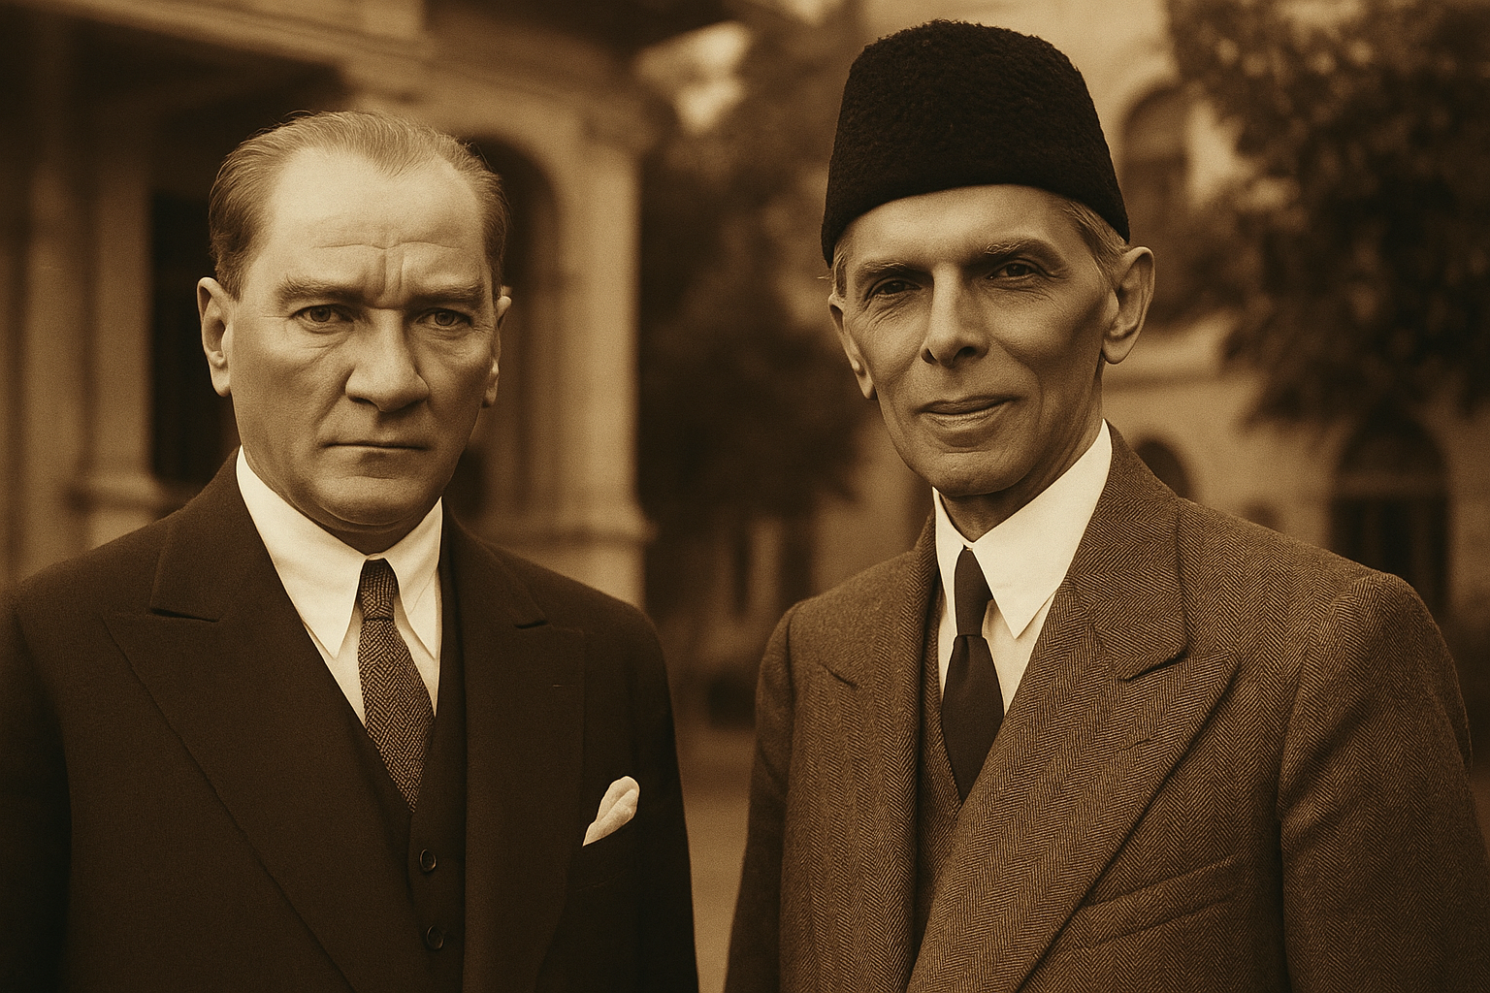

Slide 80
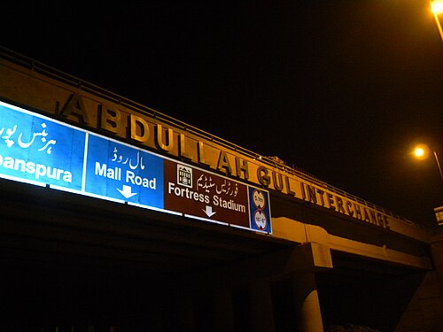
Economic Relations
The Abdullah Gul Interchange near Allama Iqbal International Airport in Lahore, this interchange was inaugurated by the Turkish President Abdullah Gul during his visit to Lahore in 2010.

Slide 81
Strategic Economic Framework & Action Plan
2019–2020: Pakistan & Türkiye launched Strategic Economic Framework (SEF) & Action Plan at high-level council meetings.
Goal: Boost bilateral trade above $1 billion (from $850M) in short-term (Pekcan, Turkish Trade Minister).
Turkish contractors encouraged to join Pakistani infrastructure & superstructure projects.
Financing tools: Turk Eximbank + Asian Infrastructure Investment Bank to fund projects.
Analysis (Javid Husain): SEF reflects a shift from symbolic brotherhood to structured economic institutionalism.

Slide 82
Trade, Investment & Preferential Agreements
Both nations: founding members of ECO & D-8 → forums for economic coordination.
Long-standing aim: raise bilateral trade from $690M (2005) to $1B+ by 2010; achieved later.
Aug 2022 PTA (Preferential Trade Agreement):
Türkiye gave Pakistan concessions on 261 tariff lines (agriculture + industry).
Pakistan gave concessions on 130 tariff lines.
2024: $ 1.4 billion (30% increase YoY)
Sep 2025: Pakistan’s X= $ 39.8 million; M= $33.2 million; BoT= $6.59 million
India –Turkey in 2024= $8.54 billion
Exports:
Pakistan → Türkiye: rice, sesame, textiles, sports goods, medical equipment.
Türkiye → Pakistan: wheat, machinery, diesel, chemicals, vehicles.
Analysis: Trade remains imbalanced, but PTA is step toward leveling ground.

Slide 83
Tourism, Property & Services Linkages
Tourism: In 2024, 135,000 Pakistani tourists visited Türkiye — rising yearly trend.
Property & business investments by Pakistanis form a small but growing fraction of Türkiye’s economy.
Air Transport: Heavy Pakistani reliance on Turkish Airlines for travel & transit routes.
Javid Husain: Tourism & services form a “soft power bridge” beyond political/military ties.
Heywood (Global Politics): Example of “interdependence theory” — people-to-people flows reinforcing economic diplomacy.

Slide 84
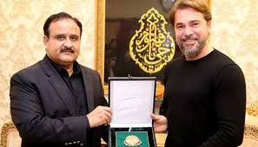
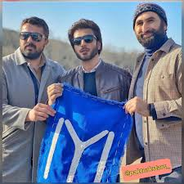


Slide 85
Ancient & Classical Influences
Persian Empires (5th c. BCE): Spread from Anatolia to Indus → Persianate political & cultural traditions across both regions.
Hellenistic Era (4th c. BCE): Alexander’s conquests linked Anatolia & Indus; both regions absorbed Greek culture.
Pakistan: Gandhara became hub of Greco-Buddhism & Indo-Greek kingdoms.
Türkiye: Retains Greek & Hellenistic sites (Ionia, Anatolia).Analysis: Shared Persian & Hellenistic layers built an early civilizational overlap.

Slide 86
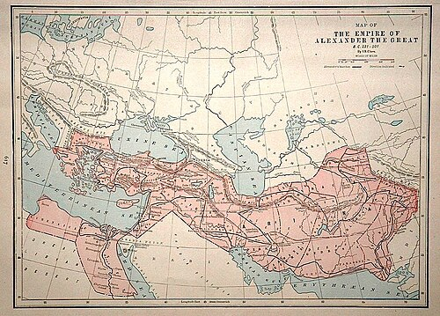

Slide 87
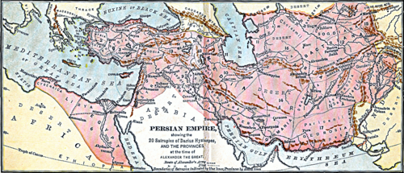

Slide 88
Turkic-Mongol Connections
Seljuqs & Turkification: Transformed Anatolia into a Turkic-speaking region.
Mughals in India: Turkic-Mongol dynasty → Chagatai influence on Urdu (loanwords, “Urdu” coined by poet Mashafi).
Both regions experienced Turco-Mongol cultural synthesis in governance, art, and military.
Quote (Abdul Sattar): “Pakistan’s Mughal past and Turkey’s Seljuq–Ottoman past provide a shared Turco-Islamic civilizational heritage.”
Critical lens: These influences still echo in language, administration & aesthetics.

Slide 89
Cultural Practices & Social Traditions
Food similarities: Kebab, Pilaf, Halva → Central Asian roots; difference: Pakistani spice content.
Clothing: Shared design origins from Central Asia → shalwar/kameez parallels with Turkish attire.
Architecture: Ottoman domes & Mughal domes share Persian–Turkic inspiration.
Music & poetry: Sufi traditions shaped Qawwali (Pakistan) & Mevlevi music (Turkey).
Analysis: Everyday cultural life reflects overlapping Central Asian roots.

Slide 90
Military Ties
Pakistan and Turkey

Slide 91
Air Force Cooperation
1954 Treaty of Friendship & CENTO membership: institutionalized early military partnership.
Türkiye trained PAF officers; helped upgrade Pakistan’s F-16 fleet.
1970s: Türkiye openly backed Pakistan’s Kashmir stance; Turkish envoy spent a week in Muzaffarabad as solidarity gesture.
Super Mushak deal (2016): Türkiye bought 52 Mushak trainer aircraft from Pakistan — biggest PAF–TuAF exchange.
Joint projects: Pakistani engineers involved in Türkiye’s TF-Kaan 5th-gen fighter jet program.

Slide 92
Naval & Defense Industry Cooperation
2018: Pakistan Navy signed $1.5 bn deal for 4 MILGEM-class corvettes (largest Turkish defense export at the time).
2019: Admiral Zafar Mahmood Abbasi & Erdoğan inaugurated first MILGEM plate-cutting ceremony.
Training: 1,500 Pakistani officers trained in Türkiye over the past decade.
Joint ventures: Drone production, co-development of future fighter jets and stealth tech.
Naval drills: Joint exercises in Mediterranean & Arabian Sea (2019).

Slide 93
Conflict & Security Dimensions
Both support each other on Kashmir (Türkiye) & Northern Cyprus (Pakistan); members of OIC.
Counter-terrorism cooperation: Joint drills with Uzbekistan (2019).
Allegations (2020 Syrian conflict): Both Türkiye & Iran reportedly recruited Pakistani fighters → rival groups faced each other.
A Turkish military source claimed 50+ Pakistani militants killed fighting for Iran-backed side.
Critical Analysis (Heywood – Global Politics): Military ties remain strong, but “mercenary flows” show how non-state dynamics complicate state-to-state cooperation.

Slide 94
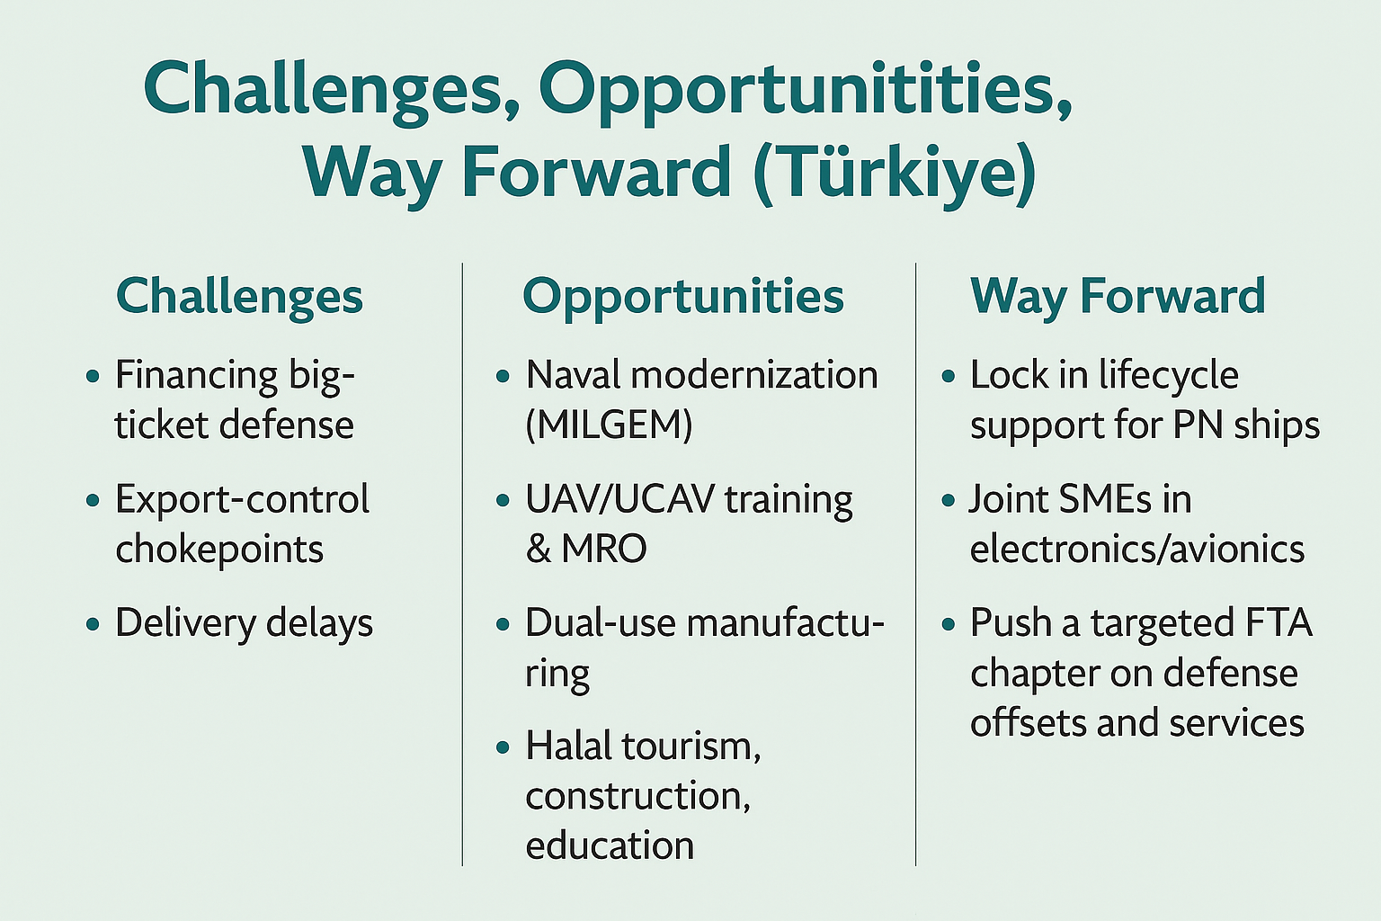

Slide 95
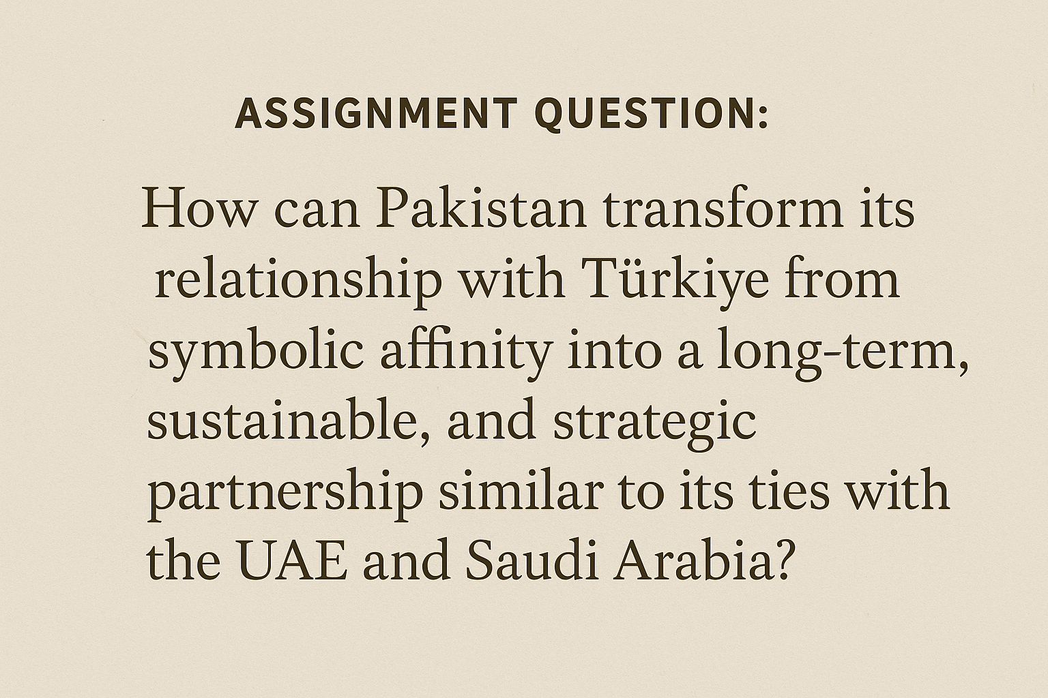

Slide 96
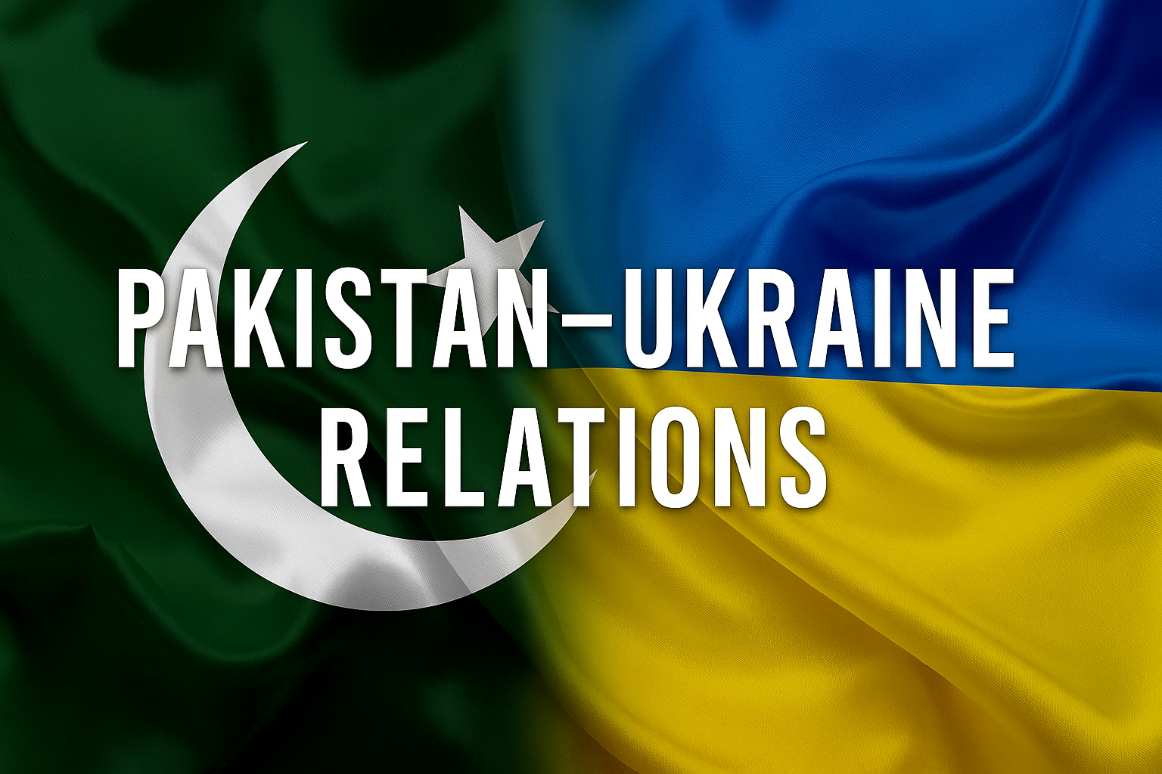

Slide 97
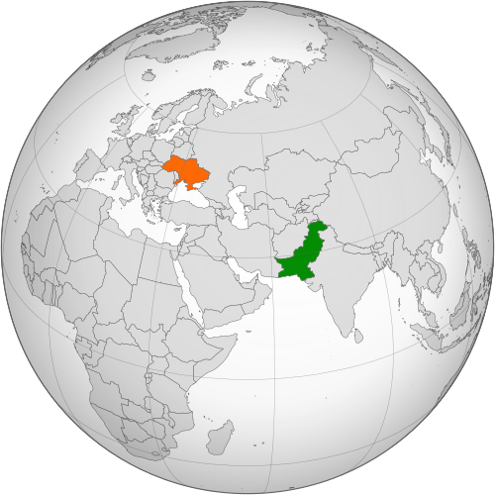

Slide 98
Establishment & Early Ties (1992–2021)
1992: Formal diplomatic relations established, soon after Ukraine’s independence (Pak embassy in Kyiv, Ukr embassy in Islamabad).
Military-Technical Cooperation: Ukraine supplied T-80UD tanks (1990s) and 6TD-2 engines for Pakistan’s Al-Khalid tanks → critical defense linkage.
Economic Relations: Bilateral trade reached US$411.8 million in 2021 (textiles, machinery, wheat).
Educational & Diplomatic: Ukraine maintains consulates in Karachi & Lahore; exchanges in engineering and defense training.
Analysis (Javid Husain): Pakistan–Ukraine ties remained transactional but vital, especially in defense, while political visibility stayed low.

Slide 99
Post-2022: War, Neutrality & Challenges
Russia’s Invasion (Feb 2022): Pakistan voiced support for Ukraine’s territorial integrity, but avoided direct criticism of Russia.
Humanitarian Aid: Limited assistance sent; no official arms supply acknowledged.
Allegations: Media reports claimed Pakistan supplied ammunition via UK/NATO routes → Pakistan consistently denied (Foreign Office statements).
Food Security Link: Pakistan affected by loss of Ukrainian wheat imports; partially alleviated by the Black Sea Grain Initiative (2022–23).
Critical Analysis: Pakistan’s neutrality reflects strategic balancing — safeguarding defense ties with Ukraine while avoiding rupture with Russia.

Slide 101
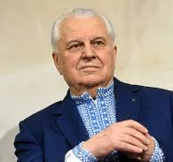
Leonid Kravchuk

Slide 102
Pakistan–Ukraine Economic Relations
1992: Bilateral trade formally began (March 16, 1992).2021: Trade turnover reached US$411.8 million (State data).
Key Imports: Pakistan imported 40% of its wheat from Ukraine in 2021 → vital for food security.
Exports: Pakistan exported textiles, surgical instruments, and sports goods; Ukraine exported wheat, machinery, and metals.
Critical Point: Trade is significant but fragile, highly dependent on agricultural flows and affected by the Ukraine war & Black Sea Grain Initiative.

Slide 103
Pakistan–Ukraine Defense Cooperation
1996–99: Ukraine sold 320 T-80UD tanks to Pakistan in a US$650M deal, saving Kharkiv Malyshev Tank Factory from collapse.
1991–2020: Ukraine signed arms contracts worth US$1.6B with Pakistan (SIPRI) → Pakistan ranked among Kyiv’s top defense clients.
2008–12: Pakistan purchased 4 Il-78 refueling aircraft, delivered by 2012.
2020–22: Upgraded Il-78 refueling tanker under Ukroboronprom contract → returned Feb 2022.
2021: Contract worth US$85.6M signed to overhaul T-80UD tanks, giving relief to Malyshev Factory.
Critical Point: Ukraine remains a vital defense supplier for Pakistan, especially for tank engines, refueling aircraft, and upgrades.

Slide 104
Pakistan and Russian Invasion of Ukraine
Pakistan dispatched PAF C-130 aircraft with aid to Poland (2022) for Ukrainian civilians.
FM Dmytro Kuleba (2023 visit) thanked Pakistan despite Islamabad’s own crises.
Gesture: Pakistan projected humanitarian neutrality rather than military alignment.
Critical View: Symbolic but limited → aid volume modest compared to Pakistan’s own economic needs.

Slide 105
Diplomatic Position on the War
Consistent support for Ukraine’s sovereignty & territorial integrity.
Abstained from UNGA votes condemning Russia → neutral stance.
FM Bilawal Bhutto: “Negotiations are the only resolution to the Ukraine-Russia conflict.”
Pakistan also lobbied Russia (Lavrov call, July 2023) to restore Black Sea Grain Initiative due to food security concerns.
Analysis (Heywood – Global Politics): Classic hedging behavior of middle powers caught in multipolarity.

Slide 106
Military Allegations & Arms Transfers
Reports: UK & NATO allies bought Pakistani-made 122mm, 155mm shells, M4A2 propellants, fuses → later used by Ukrainian army.
162 containers of ammunition (2023) allegedly shipped via Germany & Poland; >10,000 BM-21 Grad rockets reported by Indian press.
EU Ambassador Riina Kionka (Feb 2023): “Pakistan has been helping Ukraine with humanitarian and military aid.”
Ukraine FM Kuleba (2023 visit): “No arms deal with Pakistan.” (contradicts Western/Indian reports).
Critical View: Lack of transparency → plausible deniability strategy, keeping Moscow relations intact while aiding Western allies indirectly.

Slide 107
Geopolitical Balancing & Risks
Pakistan avoided direct condemnation of Russia to preserve energy & defense prospects.
Simultaneously, alleged indirect military support placated Western partners (UK, NATO).
Risk: Exposure via media leaks undermines Pakistan’s credibility of “neutrality.”
Critical Analysis: Pakistan risks alienating Russia while receiving little strategic reward from NATO.

Slide 108
Critical Evaluation & Future Outlook
Strengths: Maintained diplomatic neutrality, secured grain aid, upheld humanitarian diplomacy.
Weaknesses: Alleged covert arms transfers → perception of duplicity; could backfire with Moscow.
Opportunities: SCO platform with Russia, Ukraine defense-industrial ties (engines, tanks), energy imports.
Threats: Being caught in great-power rivalry; Russia’s potential retaliation if covert deals proven.
Conclusion: Pakistan’s stance is fragile pragmatism — balancing humanitarian optics, Western pressure, and Russian sensitivities, but risks credibility erosion if covert military role is exposed.

Slide 109
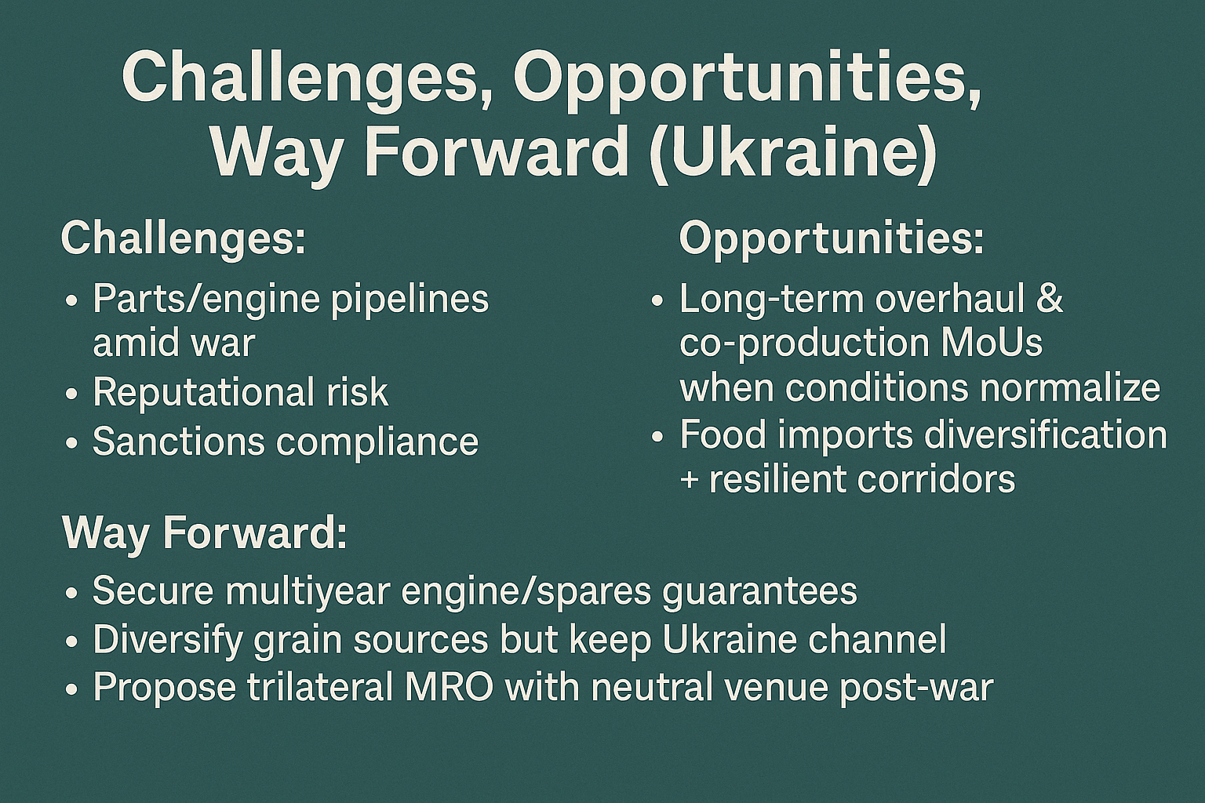

Slide 110
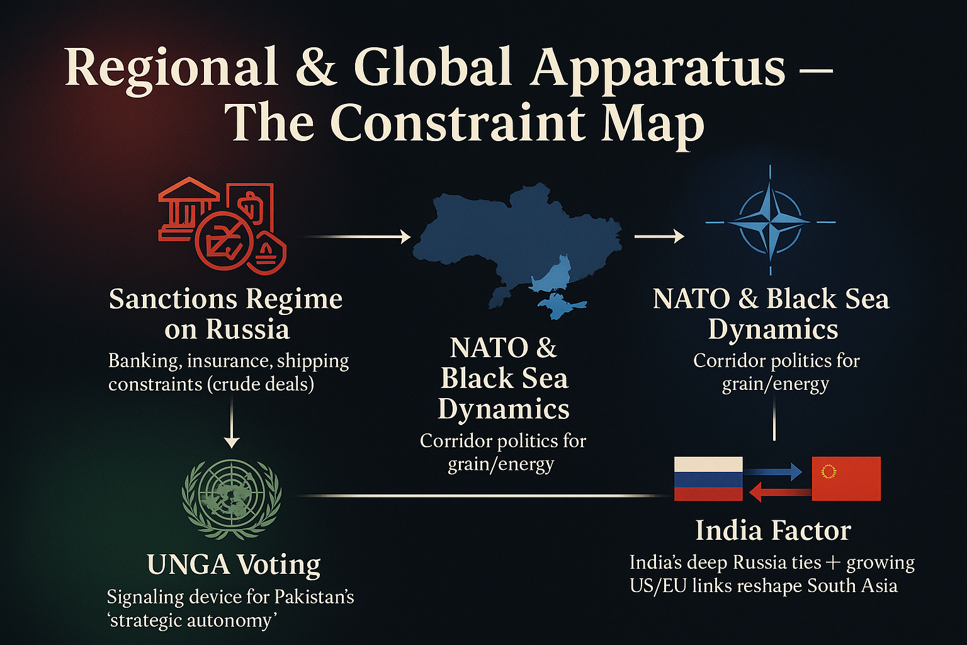

Slide 111
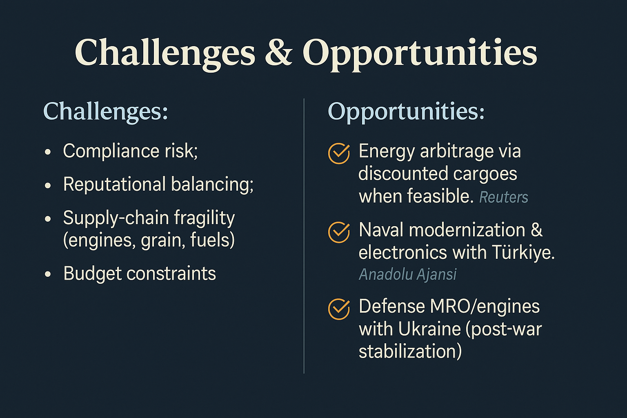

Slide 112
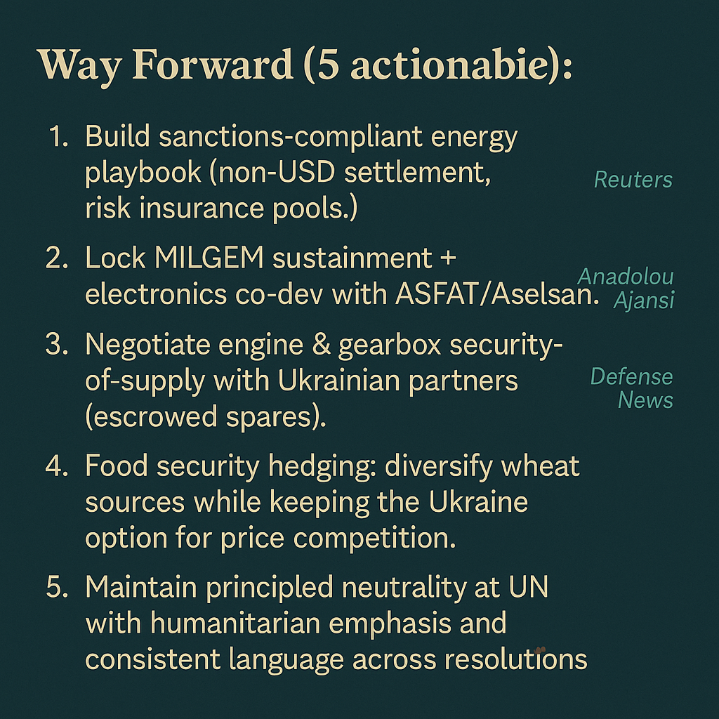

Slide 113
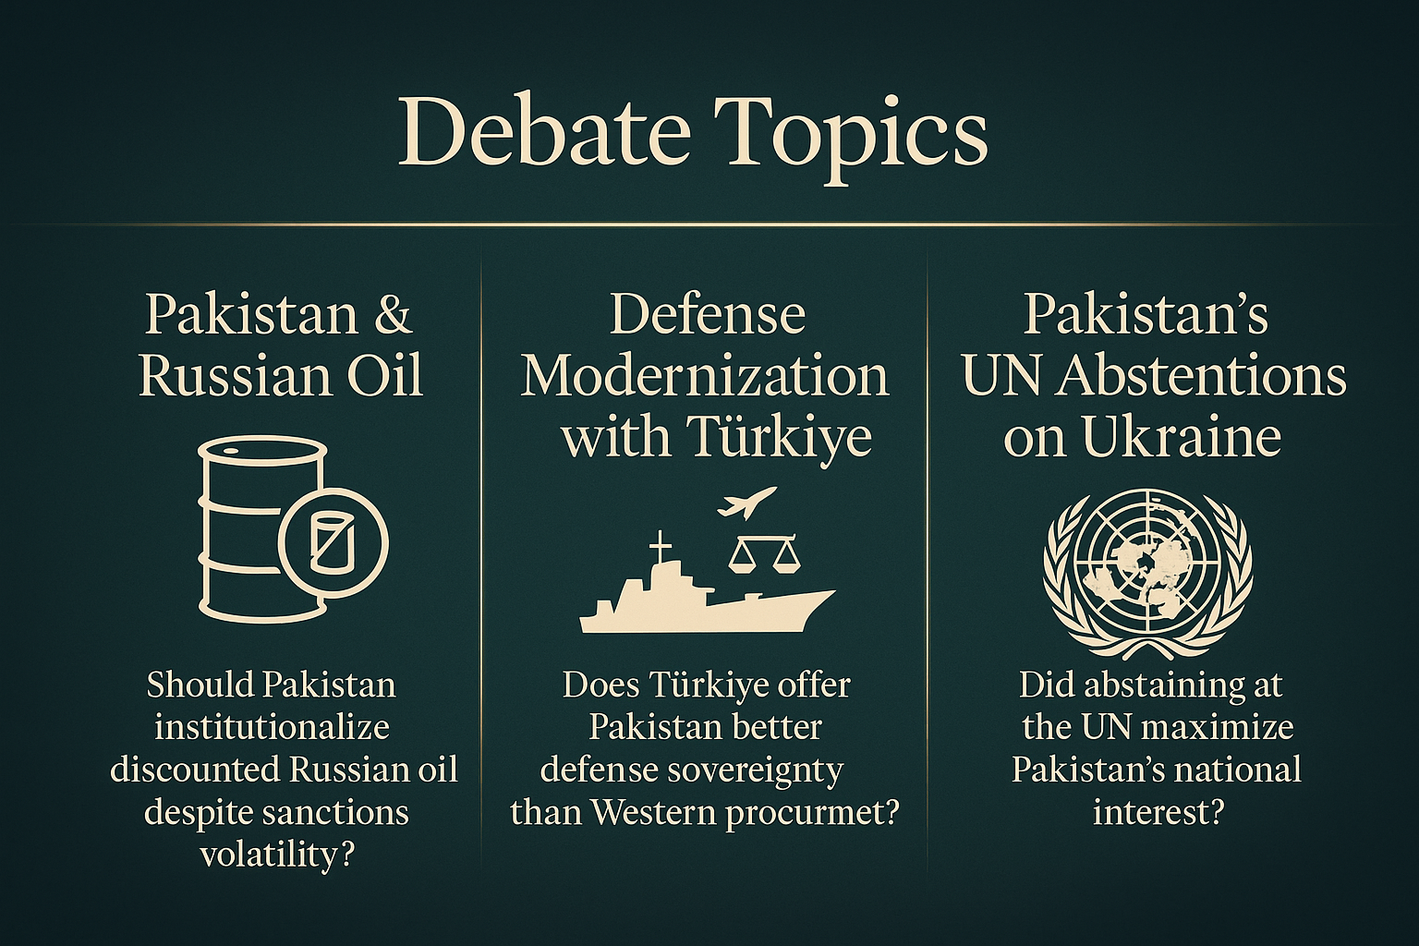

Slide 114
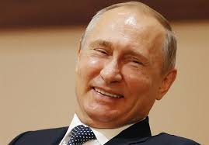
Hor Koi Saady laik

