Slide 1
Organizations
Lecture 01: League of Nations, UNO, Principal Organs of the UNO, Reforms in UNO
Lecture 02: SAARC, SCO, ASEAN
Lecture 03: EU, ECO, OIC
Lecture 04: IMF, WB, WTO
Note: current dynamics, articles and questions will be given after each lecture.

Slide 2
Lecture 01
Class Learning Outcomes
Formation of the League of Nations (LONs), Loopholes in the mechanism of the LONs, Failures of the LONs.
Conditions that led to the formation of the United Nations Organization (UNO), and steps of the formation
Objectives and Principles of the UNO
Principal organs of the UNO (UNGA, UNSC, and ICJ)
Reforms in the UNO (in line with the necessities of the 21st Century)
Past/expected questions in the exam

Slide 3
League of Nations
1. Formation of the League of Nations
Historical Context
Emerged from the devastation of World War I (1914–1918).
Objectives: Prevent future wars through collective security, diplomacy, and disarmament.
Key Figures
Woodrow Wilson (USA) was the intellectual architect (Fourteen Points).
Strong support from France & Britain, though with different priorities.
Legal Foundation
Established by the Covenant of the League of Nations, included in the Treaty of Versailles (1919).
Membership
Began with 42 member states; increased to 63 over time.
Major Absences:
United States never joined (Senate rejection).
USSR joined late (1934) and was expelled in 1939.
Germany joined in 1926 but withdrew in 1933.
Notes:
Homework: Documentaries about WW1 and Treaty of Versailles, Balfour Declaration

Slide 4
Failures of the LONs
1. Absence of major powers (USA, USSR, and Germany)
2. Weak and ineffective sanctions mechanism
3. Failure to prevent aggression:
a). 1931: Japan seized Manchuria.
b). 1935: Italy invaded Abyssinia.
c). 1936: Germany remilitarized the Rhineland
4. Easy withdrawal and loss of credibility:
a). USA never joined.
b). Germany withdrew in 1933.
c). Japan withdrew in 1933.
d). Italy withdrew in 1937
5. Rise of Dictatorships and Extremist Ideologies
a). Nazi Germany (Hitler) – pursued expansion (Rhineland 1936, Austria 1938).
b). Fascist Italy (Mussolini) – expansion in Ethiopia (1935)
c). Militarist Japan – expansion in Manchuria (1931).

Slide 5
United Nations Organization
Formation
The declaration of St. James’ Palace: (12th June, 1941): the representative of the 9 exile governments expressed their desire to establish peace.
The Atlantic Charter (14th Aug, 1941): Churchill and Roosevelt met in the Atlantic Ocean. Making joint effort to institutionalize the global security.
The United Nations Declaration (1st Jan, 1942): First time the world United Nations is used
Moscow Declaration (30th Oct, 1943): Representatives of Britain, USA, China, and Russia understood to take joint action against an aggressor
The Tehran Conference (1st Dec, 1943): USA represented the idea of four policemen to Stalin
Dumbarton Oaks Conference (1944): Organs of the Organization were discussed.
The Yalta Conference (11th Feb, 1945): Final shape to the proposed world organization
San Francisco Conference (25th June, 1945): The UN charter was voted unanimously. The charter came into force on 24th October, 1945, and 51 states were the original members of the UNO

Slide 6
Objectives of the UNO; Article 01 of the Charter
1. Maintenance of international peace and security
2. Development of friendly relations among nations
3. International cooperation in solving international problems
4. Making the UN a center for the attainment of the above common ends.

Slide 7
Principles of the UNO; Article 02 of the Charter
2(1). Sovereign equality (equal status of all states)
2(3). Peaceful settlement of disputes
2(4). Prohibition of use of force against territorial integrity and political autonomy
2(6). Universal application of the UN Charter
2(7). Non-intervention in the domestic affairs of states

Slide 8
6 Principal Organs of the UNO
1. The General Assembly Legislative Organ
2. The Security Council Executive Organ
3. The International Court of Justice Judicial Organ
4. The Trusteeship Council:Role ended in 1994(Palau last trust territory)
5. Socio-economic Council WHO, UNESCO, UNICEF
6. The Secretariat Administrative Organ

Slide 9
The General Assembly of the UN (UNGA)
FUNCTIONS AND POWERS OF THE GENERAL ASSEMBLY:
a). Deliberative functions: discussion, recommendations, and passing of resolutions (non-binding)
b). Supervisory functions: supervise the economic and social council and the trusteeship council
c). Financial functions: approve budget of the organization
d). Elective functions: induction, suspension, and expulsion of states
e). Constituent functions: amendments in the charter (with the consent of P5 members)
Annual Session: Beginning on the third Tuesday of September every year at the UN headquarters in New York.

Slide 10
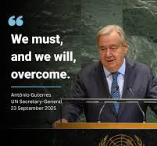
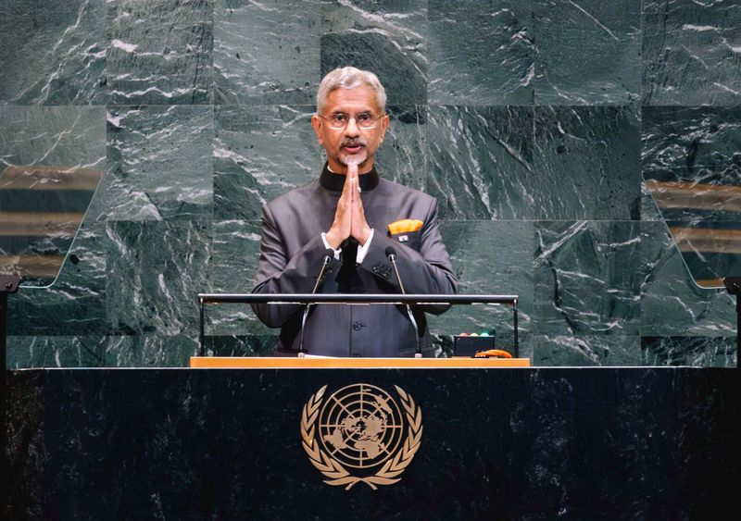
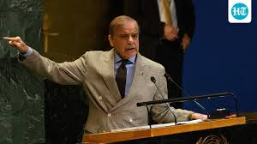
UNGA Important Speeches in 2025

Slide 11
Important Resolutions Passed by the UNGA
UNGA resolution 181—The Partition Plan for Palestine (1947)
Universal Declaration of Human Rights (UDHR), Resolution 217 (1948)
“Uniting for Peace” Resolution 377 (1950)—Allowed UNGA to act when UNSC is deadlocked
Note:
UNGA Resolutions are not legally binding
They carry strong, moral, political, and diplomatic weight

Slide 12
The United Nations Security Council (UNSC)
Composition: it is the principal organ of the UN. It consists of 15members 5P+10NP. 5NP members are elected every new year for a period of 2 years. President of security council is selected for 1month in alphabetical order.
The council has the prime responsibility of maintenance of international peace and security (article 24 of the UN charter)
P5 members (USA, UK, RUSSIA, CHINA, FRANCE) enjoy veto power in the council.
Decision of the security council on procedural matters requires affirmative votes of 9 members. But decision on substantial matters requires affirmative votes of 9 will must include P5.
The UNSC resolutions under chapter 07 of the UN charter is binding and resolutions of the UNSC under chapter 06 is non-binding

Slide 13
Important Resolutions passed by the UNSC
UNSC Resolution 47 (1948)—Kashmir dispute/Plebiscite Mandate
UNSC Resolution 465 (1980)—Israeli settlements declared illegal
UNSC Resolution 1373 (2001)—Counterterrorism obligations after 9/11
UNSC Resolution 2788 (2025)—Pakistan’s sponsored resolution on peaceful settlement of disputes
Note:
A Case Study of Kashmir

Slide 14
The International Court of Justice
It is the judicial organ of the UNO, and it states the existing laws
COMPOSITION: It consists of 15 judges which are elected by the security council and general assembly separately. Theses judges are elected for 9 year terms. It has become a custom that 5 judges are from the five permanent members of the security council.
Law applied by the ICJ: ICJ makes decision based on the four sources: a) International treaty, b) International Custom, c) General Principles, d). Judicial decisions
Jurisdiction of the ICJ:
a). Contentious Jurisdiction: the ICJ settles disputes between states that have accepted its authority.
b). Advisory jurisdiction: The ICJ gives legal opinions on questions referred to it.

Slide 15
Reforms in the UNO
Rationalization of the veto power (veto-restraint mechanism)
Peace reinforcing missions, not peace-keeping
Empowerment of the UNGA and UN Secretary General
Improvement in financial oversight and auditing transparency.
Binding mechanism on the Universal Declaration of Human Rights
Effective utilization of Chapter 06 of the charter
Re-examining the role of Trusteeship council
Enhancing conflict prevention capacity (positive peace)

Slide 16
Exam-centred Questions
Q: 01 Explain the primary objectives behind the formation of the League of Nations and critically analyze why it failed to prevent major conflicts in the 20th century.
Q: 02 Explain the main objectives of the United Nations Organization and assess their relevance in addressing 21st-century challenges.
Q: 03 Critically analyze the powers and limitations of the United Nations Security Council (UNSC) in maintaining international peace and security, with reference to recent conflicts.
Q: 04 Evaluate the key proposals for reforming the United Nations Security Council to make it more representative and effective in today’s multipolar world.

