Slide 1
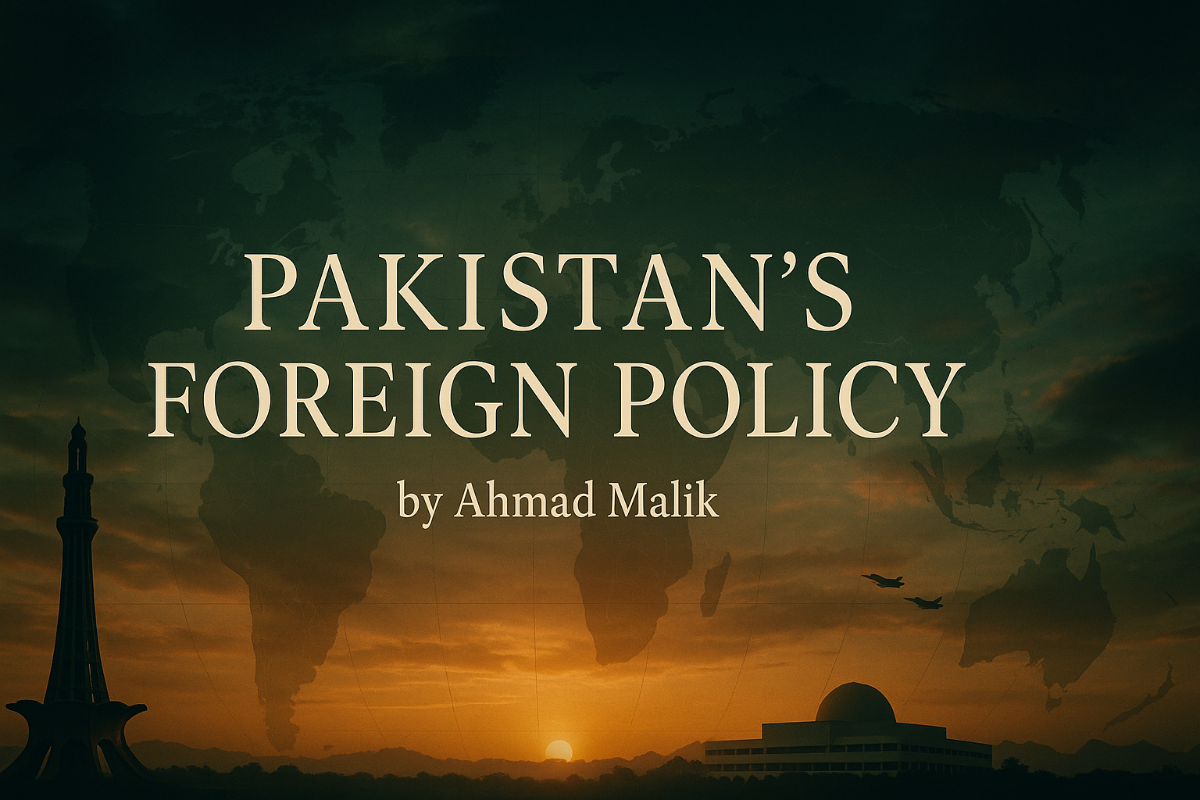

Slide 2
We Never Know How High We Are By Emily Dickinson
We never know how high we are
Till we are called to rise;
And then, if we are true to plan,
Our statures touch the skies.
The Heroism we recite
Would be a daily thing,
Did not ourselves the Cubits warp
For fear to be a King.

Slide 3
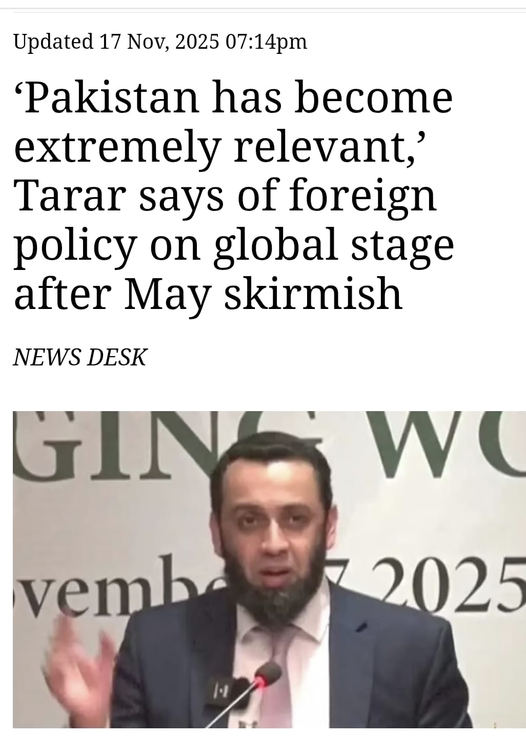
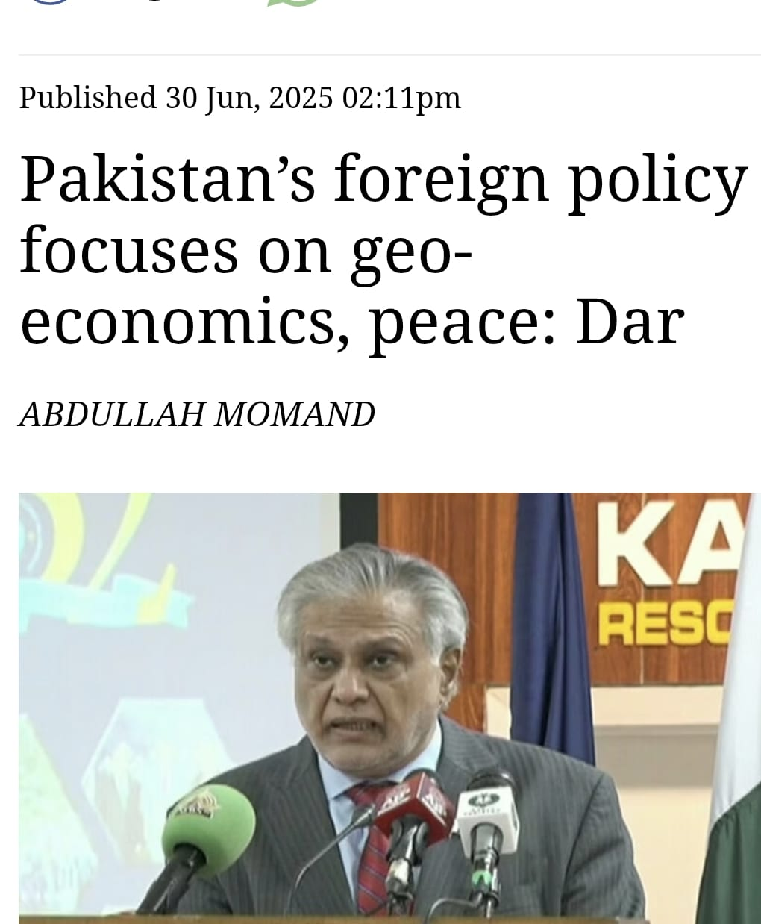
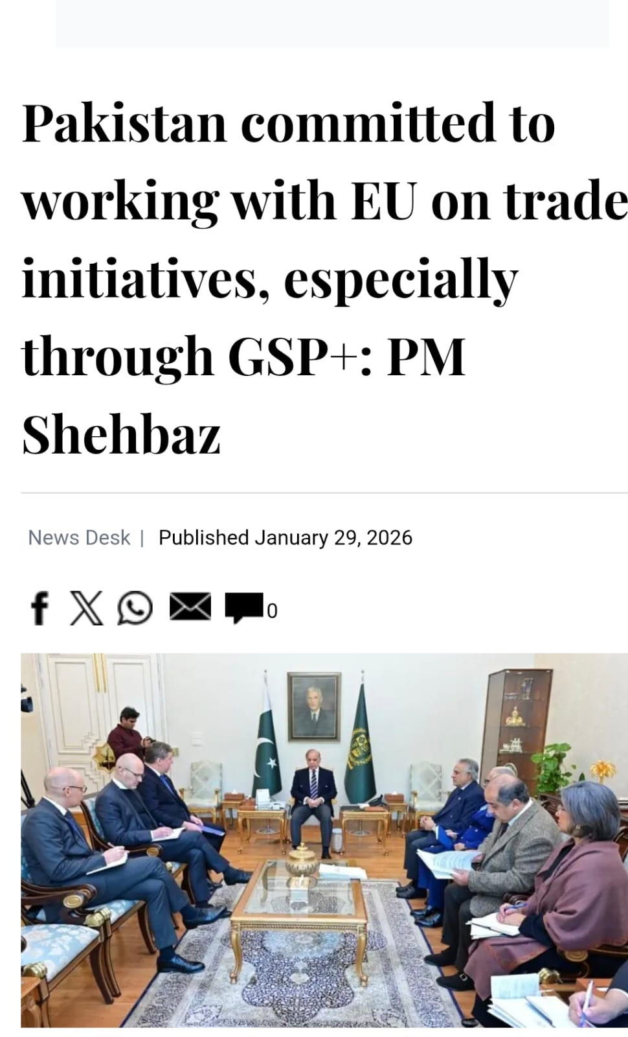
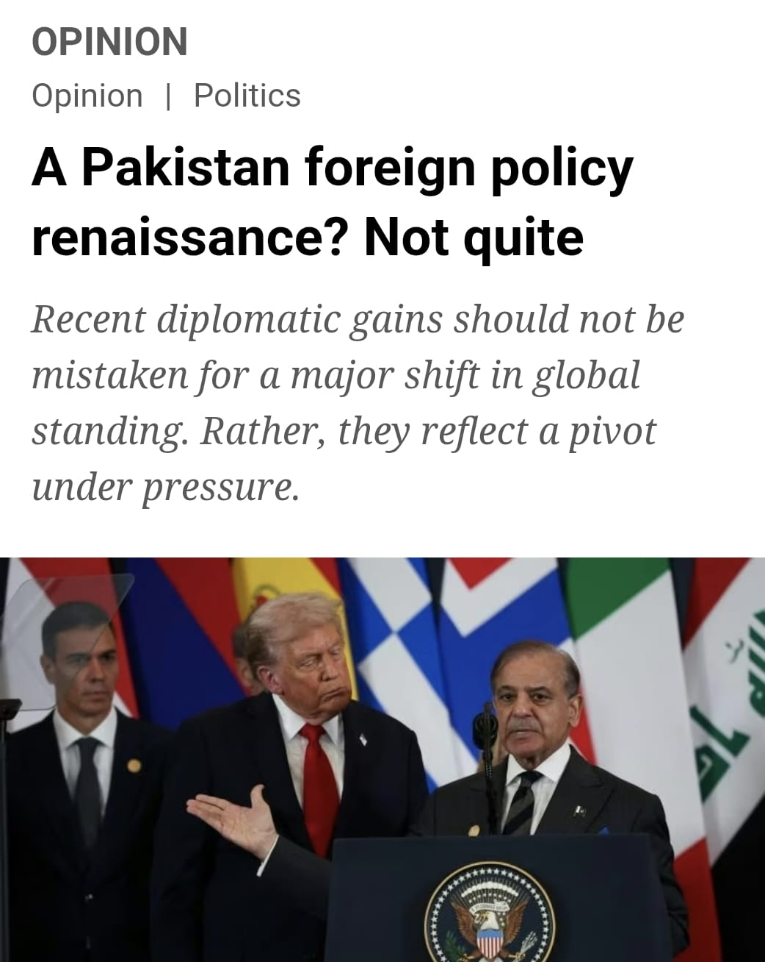

Slide 4
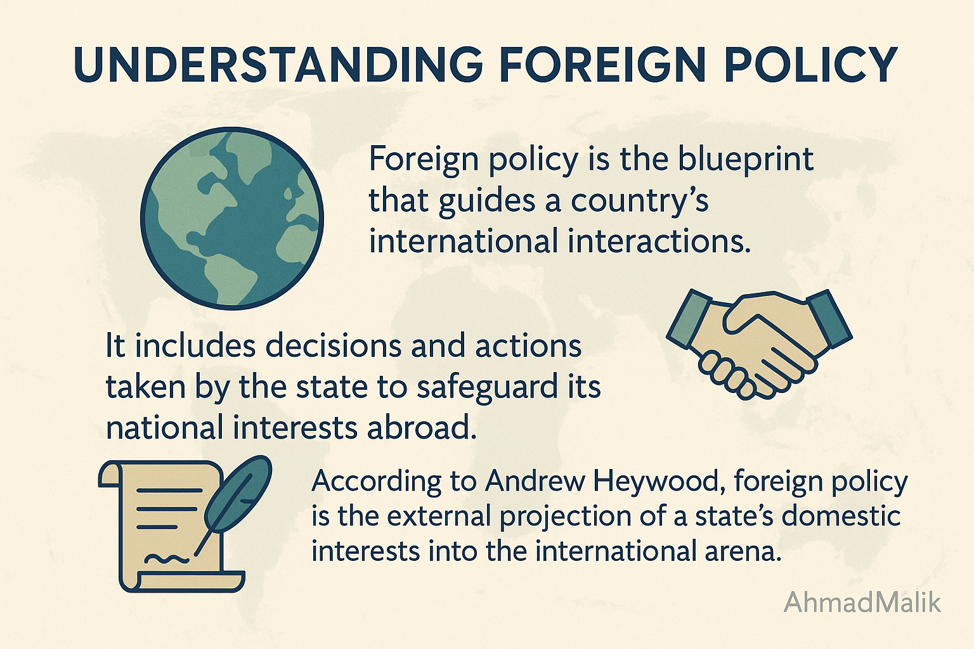

Slide 5
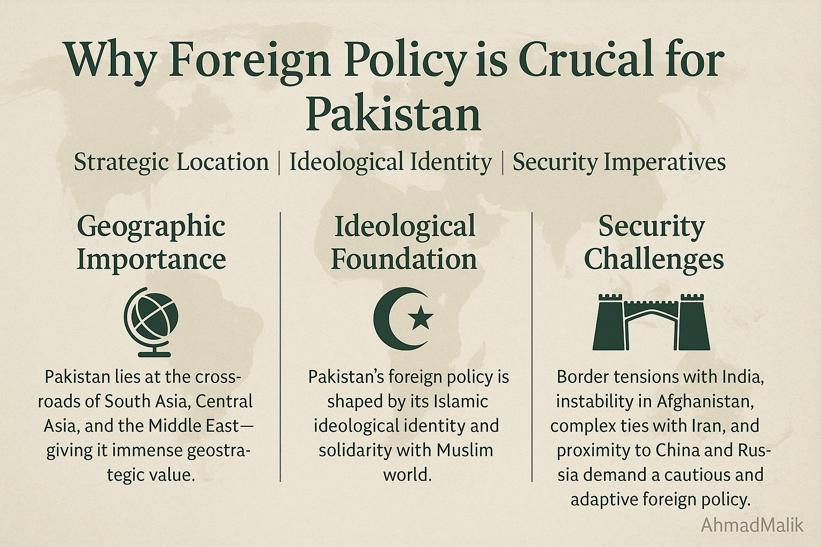

Slide 6
Main Goals of Foreign Policy:
Promotion of National Interests:
National Interests are the core objectives a country seeks to achieve and protect in the international system. These Includes:
Security: Protecting territorial integrity, sovereignty, and internal stability.
Economic Prosperity: Ensuring trade, energy security, investment, and economic growth.
Political Independence: Maintaining autonomy in decision-making, free from external coercion.
Ideological Identity: Preserving national values, culture, and in some cases, religious or political ideologies (e.g., Pakistan’s Islamic orientation).
Prestige and International Standing: Gaining respect, recognition, and influence in global affairs.
Welfare of Citizens Abroad: Protecting diaspora communities and ensuring their contribution to the home country (e.g., remittances, lobbying).

Slide 7
National Interests
Permanent
Variable

Slide 8
Objectives:
Maintaining Relations with other members of International community:
Promoting National Narrative and Counter Narratives in International Community to expand its international political clout.
Establishing Economic Links for Economic Clout.
Expanding International Influence and reducing foreign dependency
Protection of Nationals abroad
Social and Cultural Links.

Slide 9


Determinants of Foreign Policy:

Slide 10


Slide 11
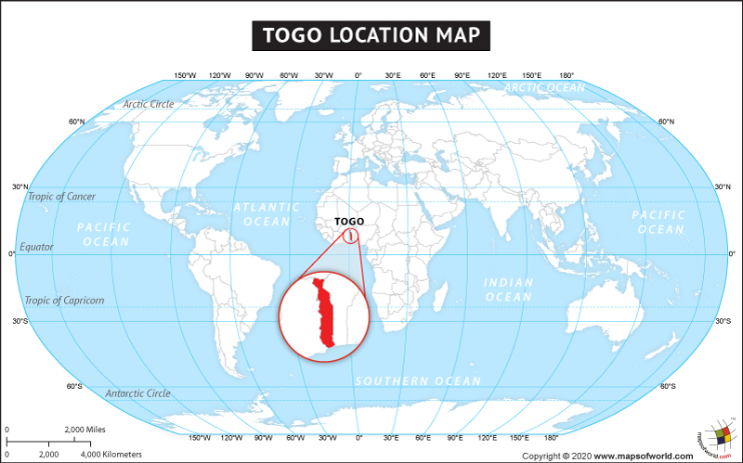


Slide 12
Internal Determinants:
SIZE and POPULATION:
Size of area and population matters a lot
Example of India: 1.451 billion people surpassing China (1.4 billion)
Global share of apple is around 2.4% and growing.
3.2 million smartphone shipped in India in 2023.
But…It is not a hard and fast rule
Middle East. Canada and Australia example.
Many other factors matter as well.

Slide 13
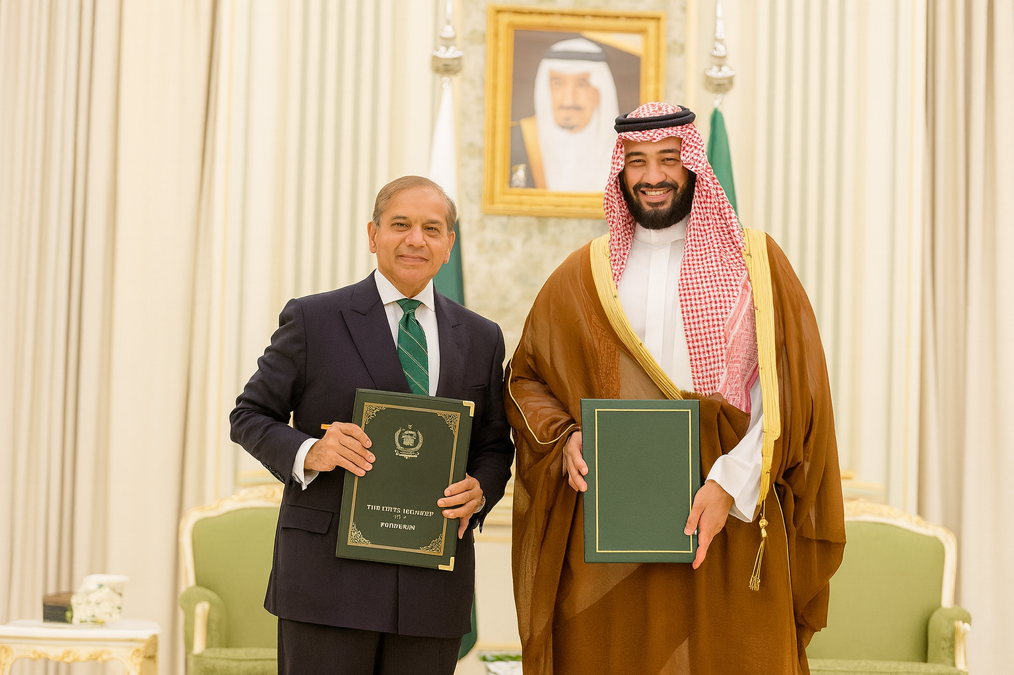

Slide 14
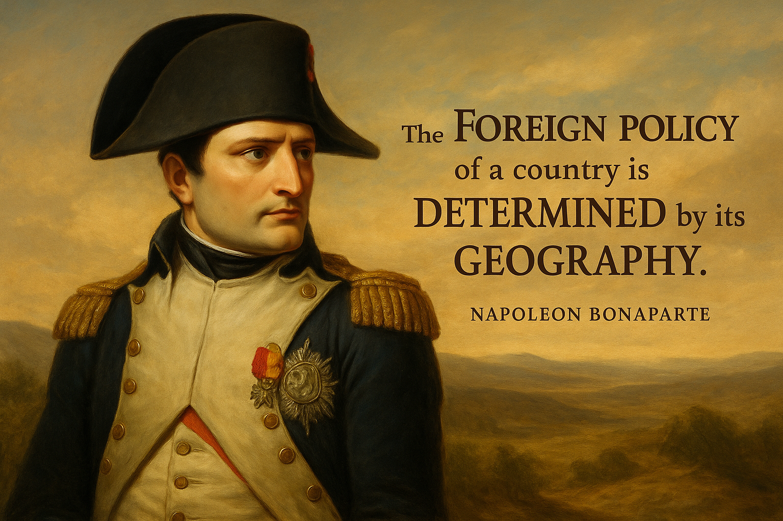

Slide 15
Geography
It includes:
Geo strategy:
Geo economics
Geo politics
Fertility
Climate
Physical features
Location in relation to their land masses and water ways
Significance:
Determining self sufficiency.
Generally and relatively, landlocked countries, nations in the tropics, and bordering a superpower are less-sufficient in comparison to the countries which have access to warm-water ports ,or which are located in the temperate zones and for removed from superpowers

Slide 16

Culture and History
Ideology
Pakistan
Israel

Slide 17
Economic Development and Technological Capacity
International Economic Clout.
Nokia
China
Japan
European countries
Taiwan (Chip war)

Slide 18
Japan: Economic Development as the Core Foreign Policy Determinant
Limited Natural Resources: Japan lacks major energy and raw material reserves.
Small Arable Land: Only about 12% of its land is suitable for agriculture.
Large Population and High-Tech Economy: Japan must import almost all of its energy, food, and industrial raw materials to sustain its population and industries.
Foreign Policy Shaped by Economic Needs:
Energy Diplomacy: Japan maintains close ties with Gulf countries and invests in renewable energy projects globally to ensure long-term energy security.
Maritime Strategy: Protecting sea lanes in the South China Sea and Indian Ocean is vital for uninterrupted trade and oil flow.
Bilateral and Multilateral Trade Deals: Japan is part of CPTPP, RCEP, and maintains strong economic ties with the US, EU, and ASEAN.
ODA and Economic Soft Power: Japan provides large-scale Official Development Assistance (ODA) to secure diplomatic goodwill and access to markets/resources.
Japan’s foreign policy is driven less by military ambitions and more by economic survival, trade security, and access to global resources—a direct reflection of its geographic and demographic constraints.

Slide 19
National Capacity
Depends on:
Military preparedness
Technological advancement
Economic development
USA: from policy of isolation to superpower.

Slide 20

Public Mood and Opinion
Pressure group
Nationalists sentiments
Pakistan-Israel

Slide 21
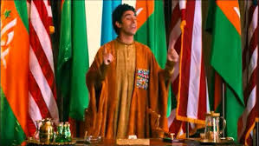
Political Organization
Authoritarianism leads to quick decisions
Democracy: Takes time but highly scrutinized.
DEMOCRACY…I LOVE YOU…

Slide 22

Role of Media and Press
Literature (Rachel Carson)
media
Plays
Arts
Activists (Greta Thunberg)
The significance depends on the political system and culture of the country

Slide 23
External Determinants

Slide 24
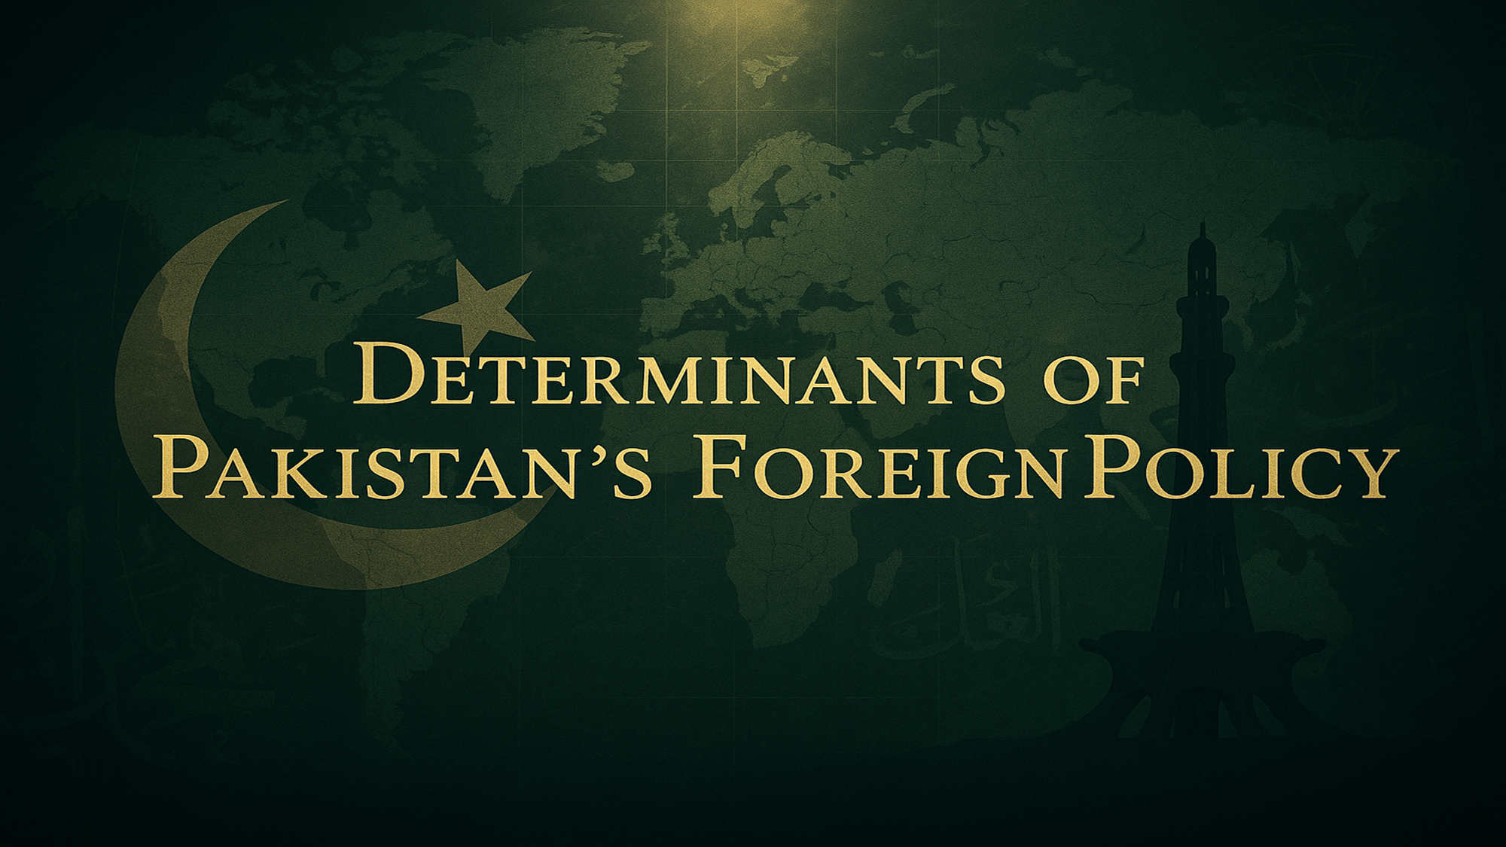

Slide 25
Geography and Strategic Value
Pakistan lies at the crossroads of South Asia, Central Asia, and the Middle East.
This location provides immense geostrategic value, especially for trade and connectivity.
Example: CPEC (China-Pakistan Economic Corridor) positions Pakistan as a gateway to global trade.
However, this position also exposes Pakistan to regional instability, such as the Afghan war spillover and cross-border tensions with India and Iran.
Pakistan shares borders with India, Afghanistan, Iran, and China — each with its own complex dynamics.
Source: South Asia Center, Atlantic Council (2023)

Slide 26
Islamic Identity and the Two-Nation Theory
Pakistan was founded on the Two-Nation Theory, defining its identity as a homeland for Muslims of South Asia.
This ideological foundation shapes its foreign policy alignments, especially with Muslim-majority countries.
Pakistan supports Muslim causes globally — such as Palestine and Kashmir.
It plays an active role in the Organization of Islamic Cooperation (OIC).
Example: Pakistan led the UN resolution on Islamophobia in 2022.
Source: Ministry of Foreign Affairs Pakistan

Slide 27
Security-Centric Foreign Policy
Pakistan has fought four wars with India (1948, 1965, 1971, Kargil 1999), deeply embedding security concerns.
Internal threats like TTP militancy, Baloch insurgency, and sectarian violence drive a militarized foreign outlook.
Proximity to Afghanistan's instability has shaped refugee, border, and Taliban policy.
Example: Alliances like SEATO (1954) and CENTO (1955) reflect past security alignments.
Ongoing defense cooperation with China, especially in CPEC and Gwadar, remains crucial.
Source: Pakistan Institute for Peace Studies (PIPS)

Slide 28
Economy as a Limiting Factor
Pakistan faces chronic economic instability, with recurring current account deficits and high debt servicing.
Foreign policy flexibility is restricted due to reliance on IMF bailouts and foreign aid.
Remittances are a key economic pillar, especially from the Gulf region.
Example: The 2023 IMF bailout of $3 billion came with tough policy conditions.
Export base remains limited to low value-added textiles, reducing strategic leverage.
Source: State Bank of Pakistan, IMF Reports (2023)

Slide 29
Global Shifts and Realignment
During the Cold War, Pakistan was a key US ally (e.g., in the Afghan Jihad).
Post-2000s, Pakistan began tilting towards China (especially after US trust deficit post-2011 Osama bin Laden raid).
Now balancing ties with China (CPEC), the US (security aid), Russia (energy cooperation), and OIC (identity politics).
Example: Since 2015, CPEC has redefined Pakistan's strategic posture toward the East.
Pakistan maintains a non-aligned but pragmatic stance in shifting global dynamics.
Source: Foreign Policy Journal, SIPRI Database

Slide 30
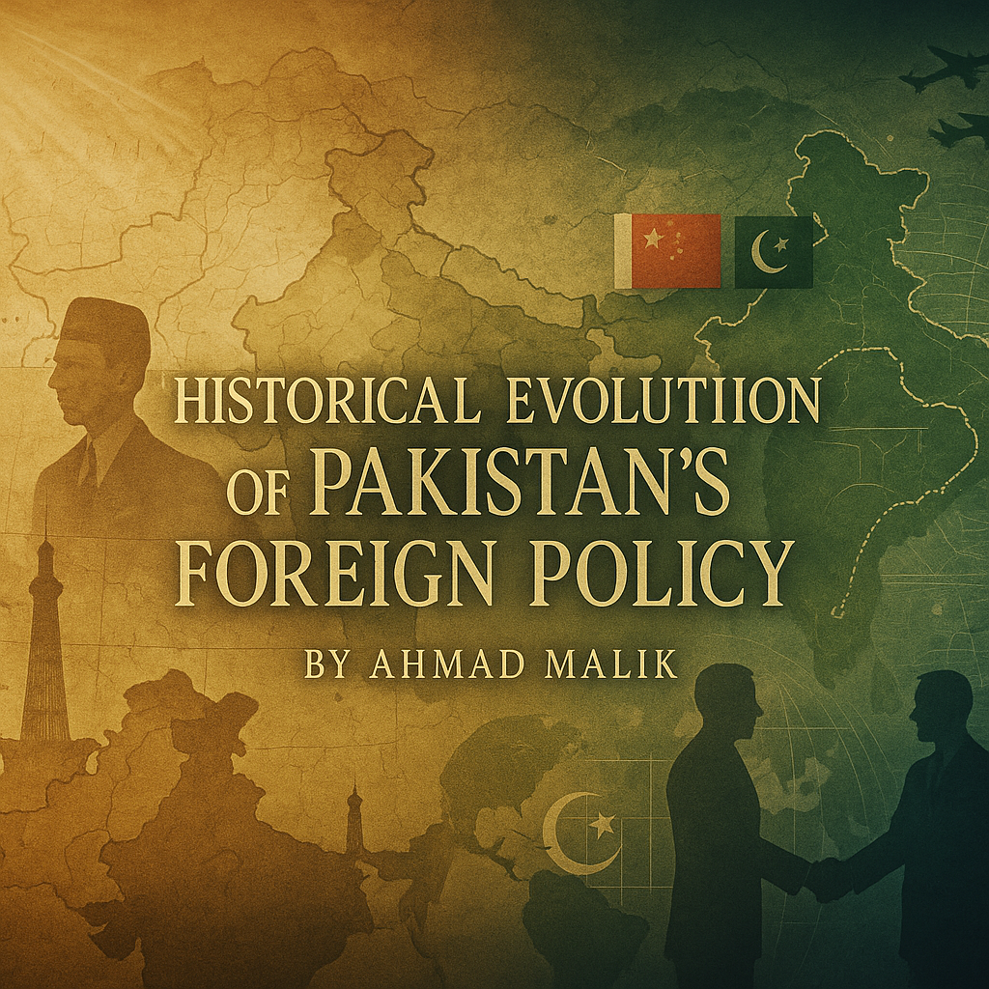

Slide 31
1947–1958 — Alignment with the West
Pakistan pursued Western alliances to counterbalance India and secure external support.
Joined SEATO (1954) and CENTO (1955) as part of the US-led anti-communist bloc.
Focus was on military and economic aid, not regional integration.
Foreign policy largely India-centric and influenced by Cold War polarity.
Example: US-Pakistan Military Assistance Agreement (1954)
Source: South Asia Center – Atlantic Council

Slide 32
1958–1971 — Controlled Diplomacy & China Ties
Ayub Khan's military regime maintained strong ties with the West.
But also initiated Pakistan's historic outreach to China (Sino-Pak relations started mid-60s).
1965 Indo-Pak war caused a cooling of relations with the US.
Pakistan played mediator between China and the US (Nixon-Kissinger visit groundwork).
Source: Foreign Policy Archives, Pakistan Studies Centre

Slide 33
1971–1988 — Islamic Bloc & Afghan Jihad
Post-1971, under Zulfiqar Ali Bhutto, Pakistan shifted toward the Islamic world.
Hosted OIC Summit in Lahore (1974) to strengthen Muslim solidarity.
Under Zia-ul-Haq, Pakistan became frontline state in the US-Soviet Afghan war.
Massive influx of US aid, weapons, and Afghan refugees.
Source: Institute of Strategic Studies Islamabad (ISSI)

Slide 34
1989–2001 — Strategic Drift & Nuclear Posture
Post-Cold War, Pakistan’s relevance declined globally.
1998 nuclear tests led to global sanctions.
Kargil conflict (1999) further tarnished Pakistan's global image.
Pakistan became increasingly isolated diplomatically.
Source: SIPRI, Brookings Institution

Slide 35
2001–2018 — War on Terror & Duality
After 9/11, Pakistan became a major non-NATO ally of the US.
Received billions in aid, but trust deficit grew.
Accusations of double game: helping US while tolerating Taliban sanctuaries.
2011 OBL raid in Abbottabad deeply damaged Pakistan-US relations.
Source: US Congressional Research Service, BBC Timeline

Slide 36
2018–Present — Pivot to Geo-economics
Under Imran Khan’s government, focus shifted to economic diplomacy.
Emphasis on CPEC, regional trade, and connectivity with Central Asia.
Ties with the US cooled, while ties with China and Gulf countries deepened.
Promotion of geo-economics over geostrategic in official doctrine.
Source: Pakistan Foreign Office Policy Brief (2021), Dawn News

Slide 37

2025 UPDATE
Yahan bhi ho ga….wahan bhi ho ga….
Ab to saray jahan mein ho ga
Kya???

Slide 38
Post India Conflict 2025
Close ties with China
Close ties with Türkiye and Azerbaijan
USA growing warmth towards Pakistan
Inclusion in the ranks of Muslim Leadership
Gaza Plan Formulation
Pak-KSA Defence Pact

Slide 39
How Can Pakistan Benefit from them?
Focus on:
IMF Bailout Free Economy
No dependence on rollover from KSA, CHINA, and UAE

Slide 40
Achieving Sustainable External Position
Competitive Export Sector
Attracting FDI from Countries with ABUNDANT CAPITAL and STRATEGIC INTERST in PAKISTAN
China, UAE, Qatar,KSA, and etc.
FDI MUST BE :
Export oriented
Medium-technology intensive
Employmet generating

Slide 41
Continued…
3. Demographic Shift in Advanced Economies
Germany, South Korea, Japan, Europe, and etc.
Country Specific Manpower export agreements aligned with each country’s demographic and skill need.
Language and training
4. Actively seek scholarships from the U.S., U.K., Canada, Australia, Germany, China, and Japan in STEM Discipline
5. Partnership with China, Türkiye, and Azerbaijan: From Defence to Civilian industry regarding technology

Slide 42
Continued…
6. Pakistan’s links with Multinational Institutions Evolved from BoP Stabilization to development oriented (WB , ADP, IMF,& etc.)

Slide 43
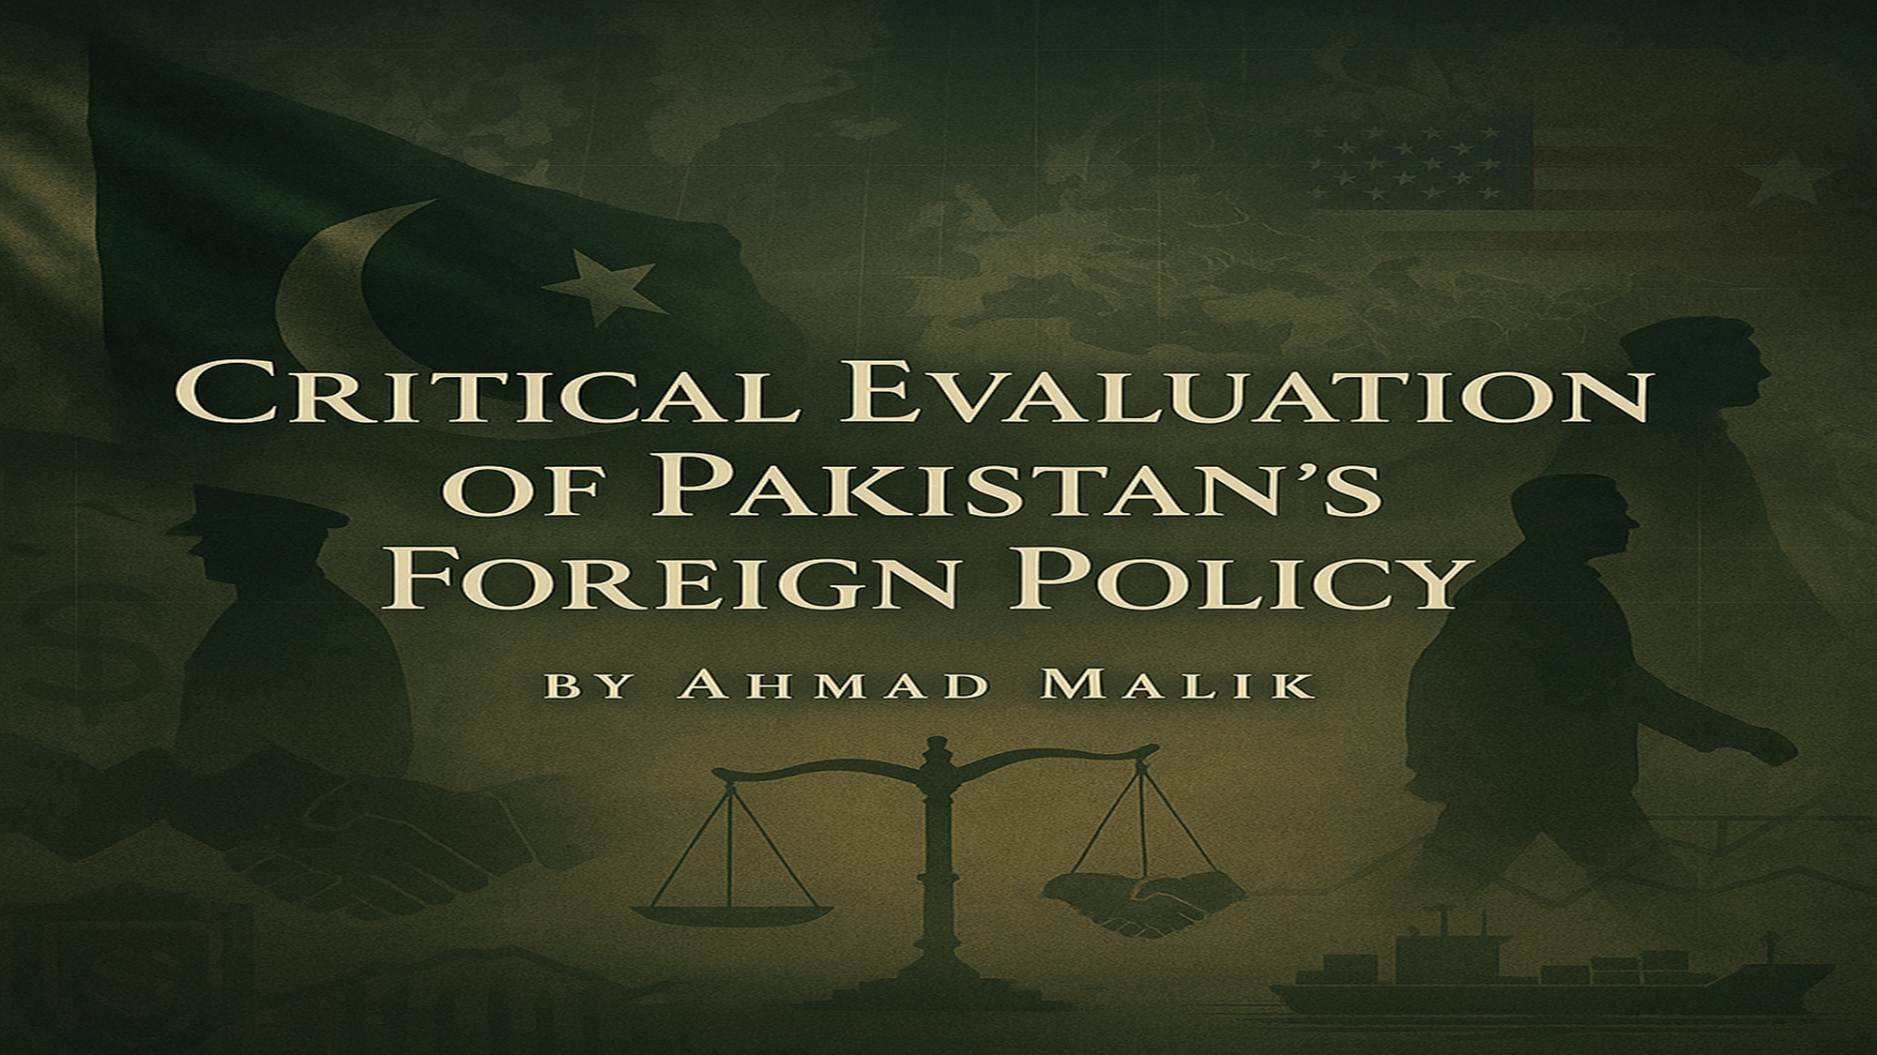

Slide 44
Reactive Posture – No Long-Term Vision
Pakistan’s foreign policy has historically been reactive, not proactive.
Major shifts have occurred in response to crises (e.g., wars with India, US invasion of Afghanistan, FATF grey-listing).
There is no consistent long-term foreign policy doctrine—every government pivots abruptly.
Result: Missed opportunities for strategic leadership in South Asia and the Muslim world.
Example: Sudden shifts after OBL raid, Taliban return, or Kashmir revocation (Article 370).
Verdict: Lack of foresight weakens credibility and consistency.

Slide 45
Overdependence on Alliances
Pakistan has repeatedly relied on external alliances for economic, military, and political survival.
From the US (Cold War, War on Terror) to China (CPEC) and Gulf states (remittances, bailouts).
This overreliance leads to external influence over internal decision-making.
Pakistan is often treated as a client state rather than an equal partner.
Example: Aid-for-support in Afghan war → blowback and strategic instability.
Verdict: Strategic autonomy remains compromised.

Slide 46
Security Centric Approach
Foreign policy, especially on India, Afghanistan, and the US, is largely driven by the security concern
This causes inconsistency, especially during regime changes.
Example: trade with India;prioritize security concerns.
Verdict: Democratic institutions lack authority over core foreign policy direction.

Slide 47
Neglect of Economic Diplomacy
Trade, investment, and connectivity are crucial in modern foreign relations — but remain underutilized by Pakistan.
Pakistan has failed to diversify export markets, attract FDI, or lead in regional trade integration.
Too much focus on security alliances and too little on economic leverage.
Example: Pakistan not part of major Asian trade blocs like RCEP or ASEAN frameworks.
Verdict: Economic diplomacy must become the new cornerstone of foreign policy.

Slide 48
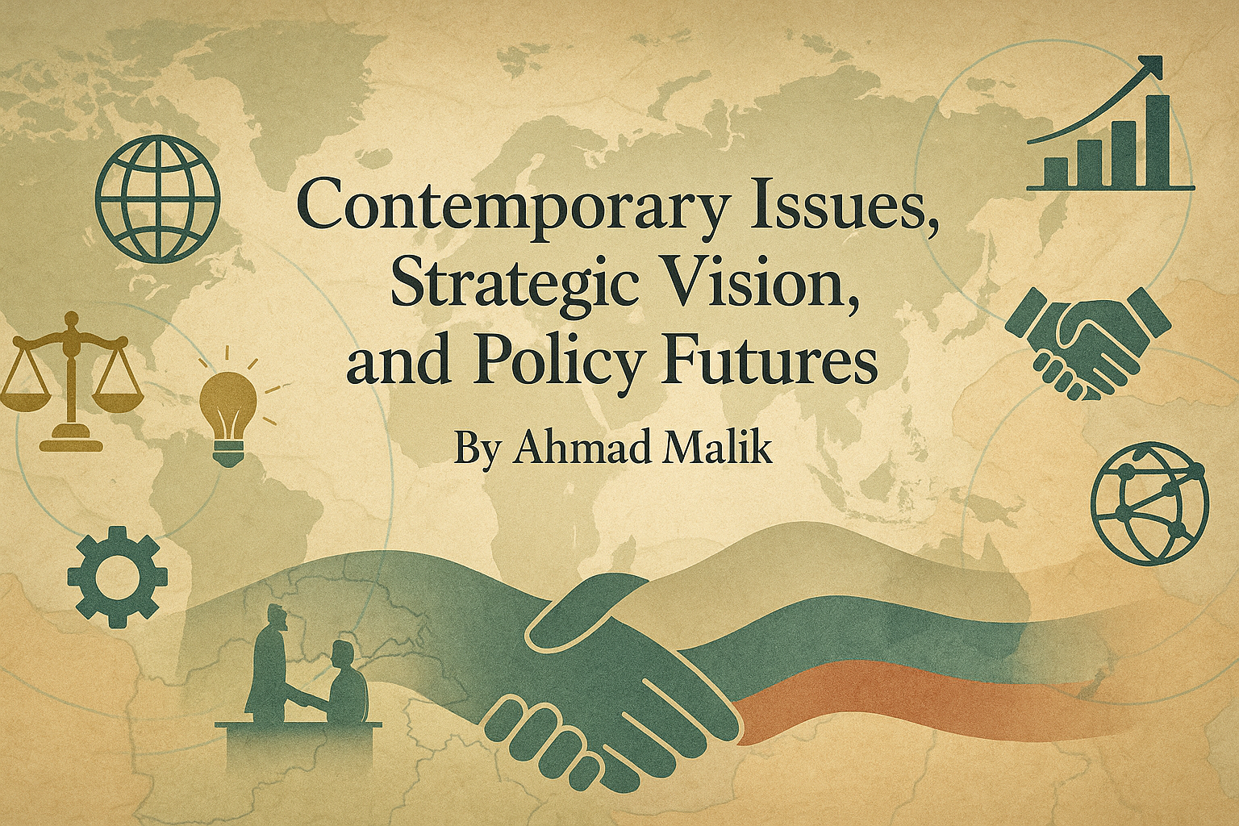

Slide 49
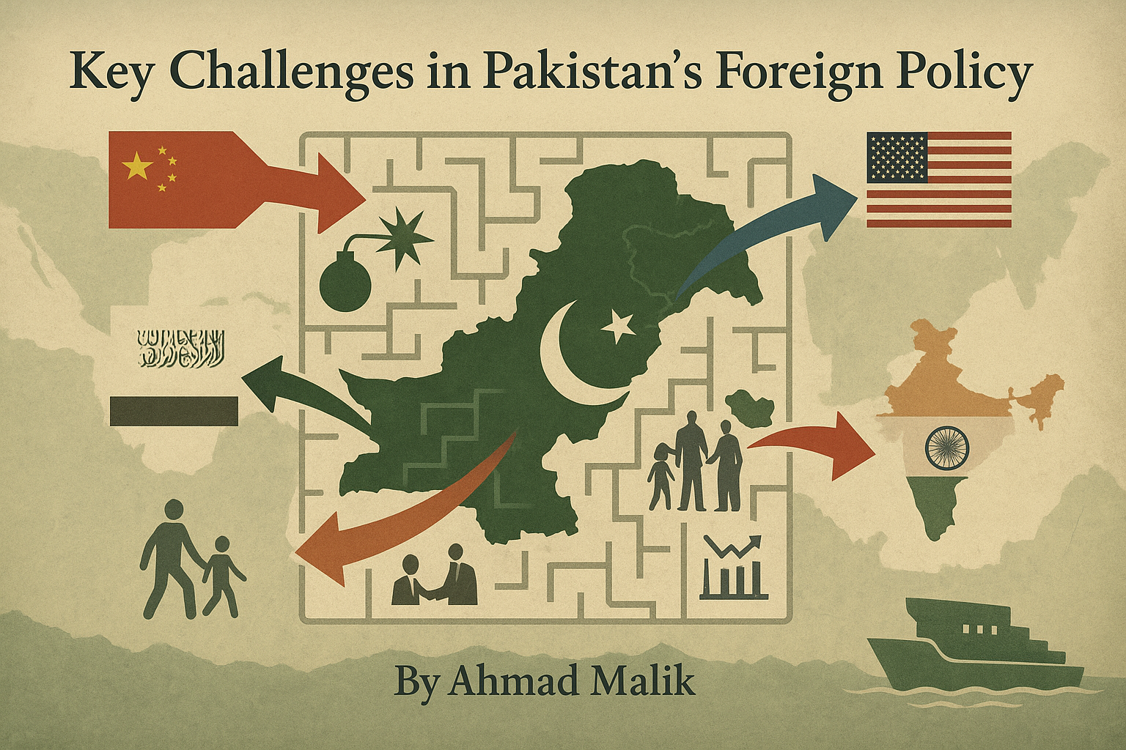

Slide 50
Civil–Military Tug-of-War / Over dominance of Security Factor:
One of the most persistent structural challenges is the imbalance of power between elected governments and the military.
The military dominates foreign policy on India, Afghanistan, US relations, and nuclear doctrine.
Civilian governments often find themselves sidelined, undermining democratic accountability.
Result: Policy inconsistency, especially with leadership transitions.
Source: International Crisis Group, 2023

Slide 51
Image Crisis & Global Perceptions
Pakistan faces a trust deficit globally due to:
• Accusations of supporting militancy
• Human rights concerns
• Political instability
Consequences include:
• Visa restrictions
• Suspended trade talks
• Reluctance in foreign investment
Pakistan’s soft power is severely limited.
Source: Pew Global Attitudes Survey, 2022

Slide 52
Suspended Trade Talks:
The European Union’s Generalized Scheme of Preferences Plus (GSP+), which gives Pakistan duty-free access to EU markets, was reviewed in 2022–2023 due to concerns over human rights violations, press freedom, and minority protections.
EU Parliament passed a resolution (April 2021) expressing deep concern about blasphemy laws and rising religious intolerance in Pakistan, which threatened the renewal of GSP+ privileges.
Although not officially suspended, renewal of trade privileges was delayed, and several rounds of negotiations were stalled pending Pakistan’s compliance with EU human rights conventions.
Source: European Parliament Resolution 2021/2647(RSP); EU Trade Reports 2023

Slide 53
Overdependence on External Assistance
Frequent IMF bailouts, emergency aid from China, Saudi Arabia, and UAE.
This creates a “client-state” image, undermining strategic leverage.
Dependence impacts policy freedom on key issues (e.g., Iran pipeline, FATF compliance).
Urgent need for economic sovereignty to ensure independent diplomacy.
Source: IMF Pakistan Review Report, 2023

Slide 54
Institutional Weaknesses
Pakistan’s Ministry of Foreign Affairs lacks sufficient budget, autonomy, and expertise.
Absence of:
• Dedicated strategic think tanks
• Long-term policy units
• Research-backed policy formation
Diplomats often lack specialized training in emerging global challenges (e.g., cyber diplomacy, climate diplomacy).
Source: Pakistan Foreign Service Reform Committee Brief, 2021

Slide 55
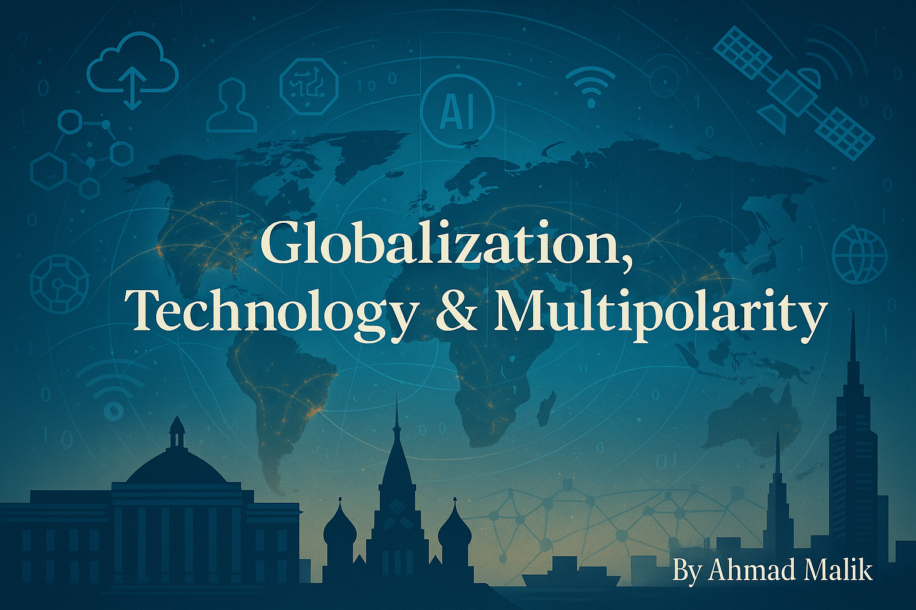

Slide 56
Globalization: Opportunity Missed?
The global order is increasingly interconnected through trade, finance, labor, and technology.
Geographic borders are less relevant in shaping influence and power.
Pakistan, however, has been a passive participant — limited export base, low digital infrastructure, and weak global brand.
Missed opportunities: GVCs (Global Value Chains), e-commerce, and skilled labor export.
Source: WTO Global Trade Report 2023; World Bank

Slide 57
Tech is the New Battlefield
Digital diplomacy now shapes narratives and public opinion in real time.
Cybersecurity, data leaks, and information warfare are core concerns.
Pakistan lags behind in institutionalizing cyber diplomacy.
Weak counter-narratives to anti-Pakistan propaganda on platforms like X, YouTube, international think tanks.
Urgent need: Digital Ministry–MOFA synergy
Fact: Pakistan ranked 79/193 in ITU’s Global Cybersecurity Index (2023)

Slide 58
Rise of Multipolarity
Unipolarity is fading: China rises, Russia resurges, India gains ground, and regional blocs (SCO, BRICS, ASEAN) matter more.
Pakistan must adopt strategic balancing — avoid excessive dependency on any one power.
Engagement in SCO, trilateral forums (China-Russia-Pak), and cautious relations with the West are essential.
Must move beyond reactive postures to proactive diversification.
Policy Insight: Adopt a “multi-vector diplomacy” strategy like Turkey, Vietnam, and UAE.

Slide 59
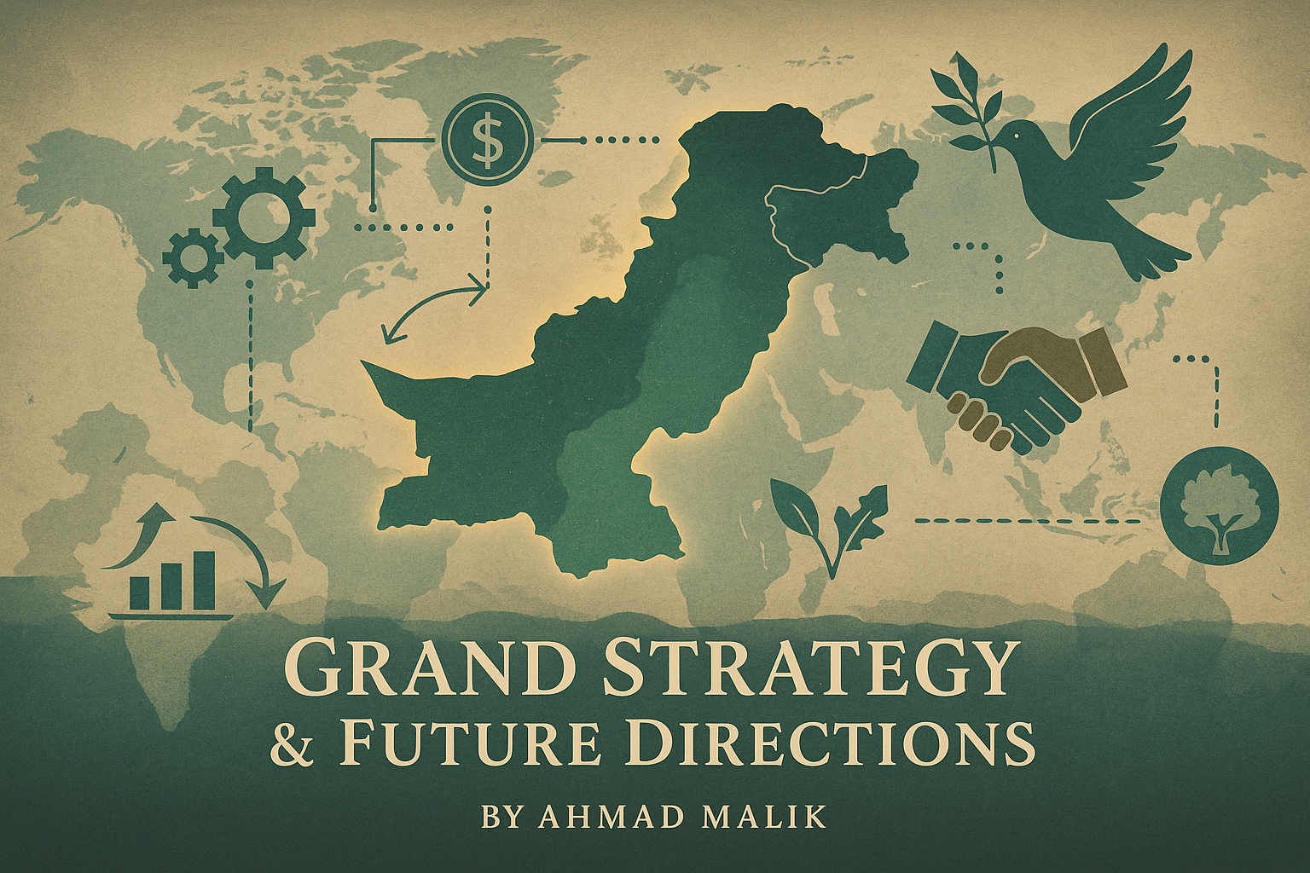

Slide 60
Introduction to Grand Strategy
Javed Husain, in Pakistan and a World in Disorder, calls for a coherent Grand Strategy.
Foreign policy must integrate military, economic, diplomatic, and cultural power.
Strategy should ensure continuity beyond personalities and crises.

Slide 61
Shift from Geopolitics to Geo-economics
Emulate China’s peaceful rise — development before defense.
Prioritize CPEC, trade, and regional connectivity.
Link foreign aid to economic reform, not military leverage.
Use economic incentives to build diplomatic ties

Slide 62
Shift Security Approach in Foreign Policy
Reduce security-dominated foreign policy.
Empower Ministry of Foreign Affairs and Parliament.
Build diplomatic institutions, not just strategic doctrines.
Civilian input ensures continuity and democratic legitimacy.

Slide 63
Reform Internal Governance
Political instability damages external credibility.
Strengthen institutions to align foreign and domestic goals.
Economic discipline enhances bargaining power globally.
Rule of law and transparency attract investors and partners.

Slide 64
Build Regional Cooperation
Normalize ties with neighbors (India, Afghanistan, Iran).
Revive SAARC, engage with ECO, SCO, and ASEAN.
Prioritize energy and water diplomacy.
Regional peace ensures Pakistan’s long-term growth.

Slide 65
Tools to Operationalize Pakistan’s Grand Strategy
Core Idea: Implementing a future-ready foreign policy requires robust instruments.
Key Tools:
Multilateral diplomacy
Trade diversification
Strategic communication
Diaspora engagement

Slide 66
Multilateral Engagement
Why It Matters:
Expands diplomatic space
Balances great power politics
Action Points:
Deepen participation in SCO, ECO, revive SAARC
Leverage UN platforms for Kashmir, climate, and peacekeeping
Example: Pakistan’s active role in COP28 climate diplomacy

Slide 67
Trade Diplomacy
Why It Matters:
Reduces aid dependency
Boosts global relevance
Action Points:
Join regional value chains
Expand SEZs under CPEC to attract FDI
Data: Pakistan’s exports rely 60% on only 5 countries — diversification is critical (SBP 2024)

Slide 68
Digital and Media Diplomacy
Why It Matters:
Shapes international image
Counters hostile propaganda
Action Points:
Create cyber diplomacy units in embassies
Invest in public storytelling, influencers, documentaries
Reference: Estonia and Israel are world leaders in digital diplomacy

Slide 69
Public and Diaspora Engagement
Why It Matters:
Soft power asset
Political and economic lobbying
Action Points:
Mobilize Pakistani diaspora for investment & advocacy
Establish Pak Diaspora Councils in US, UK, Gulf
Data: Remittances = $38.3B (FY2025) — critical economic support (SBP)

Slide 70
Conclusion – A Vision for the Future
From Crisis to Strategy: The Path Ahead
“In an age of fluid geopolitics, Pakistan’s survival and growth lie not in outdated alliances but in a grand strategy that fuses internal strength with diplomatic maturity.” — Javid Husain
Key Takeaway:
Shift from reaction to vision, security to economy, and alliances to autonomy.

Slide 71


Slide 72
Is Pakistan’s Foreign Policy Based on Emotions or Rationality?

Slide 73
Yes, Pakistan can maintain its Islamic identity while pursuing rational foreign policy decisions. Three core drivers illustrate this balance: economic interests, strategic neutrality, and realpolitik diplomacy. Ties with Gulf states like Saudi Arabia are based on remittances, aid, and energy—not just religious brotherhood. Pakistan’s neutrality in the 2015 Yemen war showed a pragmatic move to avoid sectarian fallout and maintain regional balance. Similarly, its hedged diplomacy with Iran and Qatar, and its refusal to be locked into Islamic blocs, reflects calculated realism. While Islamic rhetoric may serve public sentiment, Pakistan’s foreign policy actions are consistently shaped by national interest, not emotion.

Slide 74
Some questions to practice:
Is Afghanistan a bigger threat to Pakistan or is India?
Should Pakistan resume trade with India?
Should Pakistan recognize Israel?
Should have Pakistan helped Iran against Israel?
Is Pakistan’s nuclear weapon for the Muslim Ummah as well?
How should Pakistan maintain balance between Us-China , Russia-the West, and Saudi-Iran rivalries?

Slide 75


