Slide 1
Current Affairs
Pakistan’s External Relations
By
Assistant Professor
Dr. Zahid Mehmood Zahid (PhD – IR)
https://chat.whatsapp.com/K6dh8E7KFJ5KrlLCQIpWue
https://www.facebook.com/groups/144123599347978

Slide 2
Syllabus of CA
Foreign Policy
Determinants, Decision Making Models and Analysis, Pakistan’s National Interests, Challenges to the sovereignty, Cold War geopolitics.
  Pak-Afghan Relations
  Pak-India relations,
  Pak-US Relations
  Pak-Russia Relations,
  Pak-China Relations
  Pak-Turkiye Relations

Slide 3
Is Pakistan’s foreign policy driven more by ideology, geography, or security?

Slide 4
Foreign Policy
What do states want?
How do they make decisions (choose one option among many) to get what they want?
After independence in 1947, Pakistan had to make choice – USA, USSR, Non-alignment!

Slide 5
FP defined by the scholars
FP is "the art of establishing priorities among objectives and finding the means to achieve them." Kissinger
“The totality of interactions by which a state pursues its objectives with actors in other states." James Rosenau
Foreign policy is the deliberate set of strategies and actions adopted by a state to pursue its national interests in the international system, influenced by both internal determinants (political, economic, ideological) and external dynamics (threats, alliances, opportunities).

Slide 6
Stages in FP DM (Initiation, Formulation, implementation)
Problem recognition and need for a FP response: the Int. & domestic political environment.
Setting priorities.
Determination of FP Options.
Decision-making process/calculation.
Implementation of a selected option – resource allocation.
Evaluation of outcomes – for possible reversal or reinforcement.

Slide 7
Permanent and Variables in Pakistan’s FP DM
Permanent Factors:
Geographical location (India, Afghanistan, China, Iran)
Relations with the Superpowers (US and China)
Relations with the Muslim world (ideology)
India & Afghan Factor (security-centric)
Variable Factors:
Domestic Factors (Economy, Technology, leadership’s cognitive biases, public opinion, etc.)
International Factors (Great powers politics, threat perception, international structure, alliances, etc.)

Slide 8
FP Decision Making structure
Prime Minister
Cabinet
National Security Committee & NSD
Parliament
Foreign Ministry
Defence & Intelligence Community
Interest Groups & Think Tanks
Public opinion

Slide 9
Foreign Policy Decision-Making Models
Rational Actor Model (RAM)
States are unitary actors to make utility-maximizing decisions.
Cost-benefit analysis with goal-oriented choices to achieve objectives.
Given the available information, the model predicts logical responses to events.
Steps in Decision Making: Pakistan’s Joining of CPEC
Problem Identifying: energy, infrastructure, FDI, strategic ties.
Objectives: energy, infra, counter, investment, etc.
Options: ME, IMF, China, USA, etc.
Calculations: 62 US$ B, Debt burden, etc.

Slide 10
Organizational Process Model (OPM)
Govt. as a mix of powerful organizations working in concert.
Pre-decided SOPs are followed.
Decentralization of responsibilities.
Decision are made step-by-step (incrementalism).
Organizational priorities, goals, and policies matter.
Pakistan’s Response to Pulwama:
PM Office – Expressing Resolve and Political Commitment
Military and ISPR – deterrence and signaling,
FO – China, USA, KSA, IMF talks- economic constraints,
SPD – Risk assessments to keep nuclear off the table.

Slide 11
Bureaucratic Politics Model/Govt Bargain Model
Decision-making is done by a number of competing entities.
Each brings input to the DM process, with its own view of personal, organizational, and national interests.
Collective decision is contingent upon successful negotiation, bargaining, and compromises among entities.
Players’ positions and priorities matter.
Examples: War on Terror Military Interests, ISI, FO, religious and political parties, cooperation with US, managing protests by parties.

Slide 12
Explanation of Pakistan’s joining of CPEC
RAM: Pakistan joined to boost its economy and regional connectivity through a rational cost-benefit analysis.
OPM: Decision followed SOPs of economic and planning institutions operating within their established mandates.
BPM: CPEC joining was the result of negotiations & compromises among powerful stakeholders – military, civilian leadership, and planning ministries.

Slide 13
Implementation
Instruments of Pakistan’s Foreign Policy:
Diplomacy (Bilateral or multilateral negotiations – OIC, UN, SAARC, SCO) Track I & II: FP is the content & diplomacy is the process through which it is carried out.
Economy (CPEC, IMF, trade agreements, etc.)
Strategic Partnerships (China, US, Turkey, etc.)
Soft power (Media, Religion, Sports, Education, Scholarships, culture, etc.)
Public Diplomacy (Kashmir literacy, Islamophobia, Image)
Covert activities (secret operations and intelligence cooperation)

Slide 14
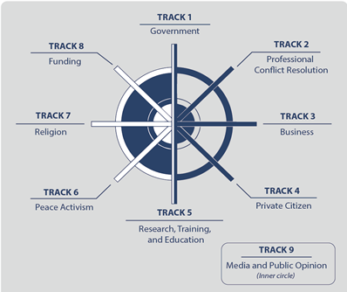
Tracks of Diplomacy: Bringing NSAs into statecraft – Conflict Resolution and international cooperation through negotiations

Slide 15
Pakistan’s FP Objectives
Promotion of Pakistan as a dynamic, progressive, moderate, and democratic Islamic country.
Friendly relations with all/especially major powers, & immediate neighbors.
Safeguarding national security & geostrategic interests, including Kashmir. (2022 NSP – traditional defense, Geo-economics, human security)
Note: 2010s, Pak-US , geoeconomics – China, Russia, Iran, Turkiye, image repair, etc.

Slide 16
4. Consolidating commercial & economic cooperation with the international community.
5. Safeguarding the interests of Pakistanis abroad.
6. Ensuring optimal utilization of national resources for regional & int. cooperation.

Slide 17
Pak’s National Interests
Territorial integrity and security
Counter terrorism and Internal stability
Development and Prosperity (poverty, healthcare, education, employment)
Political stability & good governance
National cohesion
Access to resources (energy and food security)
Tech advancement

Slide 18
Challenges to the Sovereignty
India (risk of conv, nuclear, hybrid war)
Cross-border Terrorism (Afghanistan)
Non-Traditional Security
  (Climate, Cyber, Disinformation, Identity)
Terrorism & Extremism (militancy, sectarian)
Insurgency & Separatism (Balochistan)
Economic Dependence (IMF & foreign Loans)
Political Instability (Weak Gov, Corruption)
Geopolitical Pressures (US, China, Russia)
External (State) Threats
Internal (Non-State) threats

Slide 19
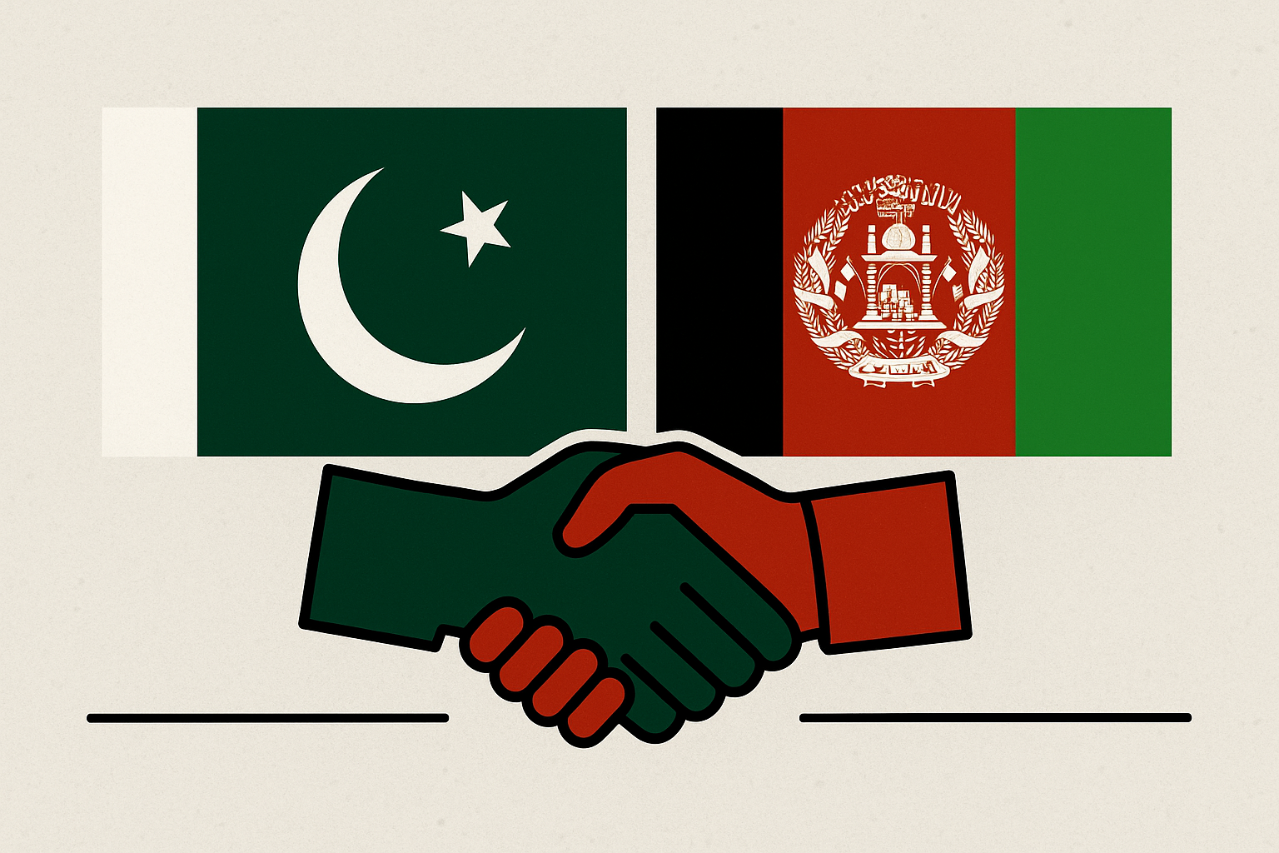
Pak-Afghan Relations

Slide 20
Afghanistan in the Cold War Theater and beyond
Cold War geopolitics, Soviets into Afghanistan1979,
‘Jihad against godless’ – fusion of religion and geopolitics.
Pakistan, US, ME monarchies (even China joined) – an axis of believers.
Geneva Accord 1988,
Rise of Taliban 1994,
Al-Qaeda Enters Afghan Theater
9/11, OEF, and toppling of the Taliban govt.,
Bonn Conference 2001, Karzai and Ashraf Ghani govts.
Doha Process 2018 – 2021, US withdrawal,
Return of Taliban - Aug 2021.

Slide 21
Pak-Afghan Relations

Slide 22
Pak-Afghan Relations
Both share more than 2600 KMs border.
Despite common culture, ethnicity, faith, history & geopolitical dilemmas, relations have been troublesome.
Afghanistan always maintained a hostile attitude towards Pakistan. WHY?
Primarily because of ‘Durand Line’ issue.
July 26, 1949 – terminated all agreements with British, including the ‘Durand Agreement’
Loya Jirga declared August 31, Pakhtunistan Day.

Slide 23
Pak-Afghan Relations:
Initial Phase: 1947 to 1979 (Durand, Pakhtunistan, Afghan opposition of Pakistan’s entry to UN, Afghan support to Pashtoon, 1950 Chaman, Dir 1960-61, Khyber 1961, Bajour 1960-61, Baloch, mob attacked embassy and consulates in 1955 , Pak closed, 1961-1963 Pakhtunistan diplomatic severance Daud resigned, ATTA 1965, Pakistan trade route as leverage).
  Border and ethnic issues – polarization at home.
2nd Phase: 1979 to 1989 (Soviets in Afghanistan, Pak viewed national security threat, - Indo-USSR-Afghan nexus, Pak-US-KSA, Pak facilitated logistics and training, 4 million refugees – drugs and weaponization, diplomatic breakdown, Afghan saw Pakistan as terror sponsor; health education, housing breakdown
  Cost: Militarization extremism, refugees.
3rd Phase: 1989 to 1994 (Cold war proxy conflict to regional competition, Peshawar Accords 1992, Islamabad Accords 1993, Pakistan’s diplomatic efforts for peace & stability in Afghanistan – under a power sharing mechanism, Civil War)

Slide 24
Pak-Afghan Relations:
4th Phase: 1996 to 2001 (strategic alignment, diplomatic recognition, stable Afghanistan – Western border, access to CARs for trade, eliminate Indian influence, Pak/Taliban Vs. NA/India, Russia, Iran. Afghanistan relied on trade and transit with Pak.
  Pakistan isolated, extremism & militancy, long term security challenge
5th Phase: 2001 to 2021 (OEF, Pak joins WoT withdrew support for Taliban, recognizes Karzai govt., transit for NATO/US supplies, trade starts, Military operations – Security, TTP emerges, border clashes, informal trade, Pak-Afghan diplomatic relations remains low – OBL, Haqqanis, Pakistan Vs. NDS/RAW, TTP, TTA 2010, 2-2.5 US$ B trade, Developmental assistance 1.5 US$ B, Murree process, declined, Afghan-Iran-India in Chabahar, 2018 peace process.
  Terrorism in Pakistan, TTP, US goes away China enters

Slide 25
Latest Phase: Afghanistan under Taliban 2.O
Optimism (Indian sponsored Terrorism + Recognition)
Desperation (Refugee’s Expulsion, Aerial raids, border closure)
Commonalities: Security & Economic development (1 US$ B. 1st half of 2025)
Differences: Terrorism (rose to 28% in 2022, 79% in 2023, & 70% in 2024)
Recent Developments – Since April 2025
Pak-Afghan-China tri-lateralism, Afghanistan in CPEC,
Trans-Afghan railway, 10 % Duty waiver to 860 items – Why?,
Pak-Afghan Joint Coordination Committee agreed to discuss issues of security/TTP, trade, and border crossing.

Slide 26
Escalation and Border Clashes Oct-Nov 2025:
Terrorism, cross-border raids, Qatar-Turkiye mediated ceasefire 18th Oct, 2025
The third round of talks in Türkiye failed, Taliban govt refused to commit to act against terrorism.
Taliban’s inclination towards India:
  Weaponization of water, Indo-Afghan intelligence cooperation in promoting violence in Pakistan, even against the Chinese.
Need of the Hour: Engagement is the only way forward, as coercion will not work alone, persuasion should also be part of the recipe.
  Tribal Jirgas, Religious Diplomacy, and mediation by the friends.

Slide 27
Ask yourself, challenge your conventional wisdom!
Can a middle power like Pakistan ever have an independent foreign policy in a world of great powers?
Can Pakistan use foreign policy as a tool of economic transformation — or is it trapped in geopolitics?
Has Pakistan made its foreign policy — or has its geography and great powers made it for Pakistan?
If Pakistan’s foreign policy since 1947 were a movie, would you call it ‘The Pursuit of Security’ or ‘The Search for Identity’?
Is Pakistan’s foreign policy guided more by Islamic ideology, security imperatives, or economic necessity?
From SEATO to CPEC, from CENTO to the China–Pakistan Economic Corridor — has Pakistan really changed partners, or just strategies?
Can a state obsessed with survival ever pursue an independent foreign policy?
Is Pakistan’s foreign policy shaped more by geography or ideology?

Slide 28
Questions to Attempt
Given Pakistan's growing concerns over TTP-led terrorism originating from Afghanistan, what diplomatic and strategic steps can be taken to prevent Afghanistan from serving as a sanctuary for anti-Pakistan elements?
How have shifting U.S. priorities in the region, particularly after its withdrawal from Afghanistan, influenced Pakistan’s approach towards the Afghan Taliban and regional stability?
Given Pakistan’s recent policies on Afghan refugees, including deportations, what are the humanitarian, security, and diplomatic implications for bilateral relations between the two countries?
With Pakistan increasingly concerned about cross-border militant activities, what diplomatic or strategic measures could be taken to ensure Afghanistan does not become a safe haven for anti-Pakistan elements?

