Slide 1
Reform Movements
Deoband

Slide 2
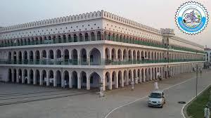

Slide 3
Deoband – A brief History
Legacy of Hazrat Shah Waili Ullah (Allah's mercy be on him)
Established – 30th May, 1866- Muhammad Qasim Nanautavi & Rashid Ahmad Gangohi- Principal founders
1857 – Ulema participated & even led the struggle
Downfall of education – Madaris
The British rule as a threat – Various strategies to stem the tide of decline – Renaissance
Renaissance ---- Political (education) and Religious (education)
Political path led in the creation of Pakistan
Religious path led to the revivalist movements to purify Islam– Bralvi, Ahle Hadith, Nadwa , Tablighi Jamaat, Jamat -i- Islami etc.

Slide 4
The system of Education – Deoband
Syllabus – influenced by Dars-i-Nizami---developed in 18th century
Emphasis on manqualt (revealed sciences) instead of maqulat ( rational sciences)
Create & train a community of believers to serve the spiritual needs of Muslims and defend Islam
Writers- preachers – teachers & prayer leaders (Imam) to disseminate knowledge
Academic excellence & moral character
Religious orientation --- Ahl al-Sunnah wal-jamaat (people of the Sunna and jamaat) ---Life based on the teachings and practices of Hazrat Muhammad (PBUH)
Guidance from the Quran and sunnah
Belief in theological puritanism
Oppose Western Ideas & values
Oppose shrine-based sufi Islam
Service to religion, support to Islam, renaissance of Islamic arts and sciences and their dissemination, and help to the students craving religious knowledge

Slide 5
Services – Contribution – Achievements
Religious service
Free religious education to Muslims
Incomparable teaching institution for the religious education of the Muslims not only in the sub-continent but also throughout the Islamic world
The most popular educational institution of the Islamic world, students from the Islamic countries flocking to it for the study and research of different arts and sciences
Religion, education, missionary-work and knowledge creation by writing books
A clarion call to the Muslims in the Subcontinent to come to the fold of Islam
A center of both the Shariah and the Tariqa
Revival of the spirit of Jihad
Bulwark of Islam in India
Connected to Pakistan Movement

Slide 6
Services – Contribution – Achievements
Educational Services
Free education to Muslims
Spread of religious teaching
knowledge creation by teaching & writing books etc.
Training of Ulema
Character building
Guidance & leadership
Connected to Pakistan Movement

Slide 7
Services – Contribution – Achievements
Political Services
Raising consciousness of Muslim identity in India
Muslim Nationalism
Separate political identity of Muslims in India based on Islam & Muslim Rule
Resistance to the British Rule
Teaching Muslims the art of resisting foreign rule
Jamiat Ulema-i- Hind ----- Struggle against the British Rule
Connected to Pakistan Movement

Slide 8
Changing Character of Deoband
Deobandi Leadership under the banner of Jamiat Ulema-i-Hind opposd the Two Nation Theory of Muslim League
Aligned with the INC to fight the British
After 1947, Deoband played a moderate role by participating in political regimes
Confined to religious education & spiritual guidance
Fatwa against Terrorism -2008

Slide 9
Modern Challenges and Deoband
Conservative Approach
Fatwa against Muslim women to observe veil
Opposed by various groups as fatwa can only be issued on religious maters
Fatwa against Muslim women working in government and private institutions – severely criticized
Opposition of modernizing madaris – undue interference by the govt.

Slide 10
Impact of Deoband
Pakistan--- denunciation of terrorism by Muhammad Tahi ul- Qadri, 2010
Qadri’s fatwa was endorsed by the British govt.
Welcomed by the State Department of the USA
Indonesian religious organization like Nahdatul – Ulema and Muhammadiya also denounced terrorism following Deoaband
Who are you ? Food for thought

Slide 11
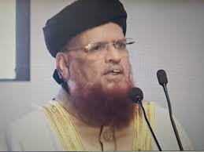
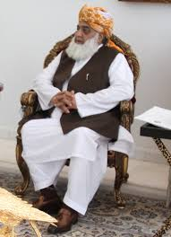
Deoband – legacy in Pakistan
Two strands in Pakistan since 1947
Scholarship vs. Politics
Jihad and Terrorism
Mujahid vs. karkun

Slide 12
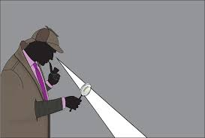
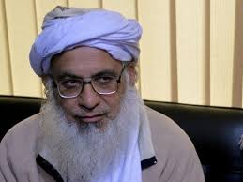
Aligarh Vs. Deoband
A debate between Mr. & Mullah
Unity of Purpose – Revival of Muslim Power in India & protection of Muslims
Difference – Modus operandi
Religious Education VS. Modern Education
Different Political paths – INC Vs. AIML
Connected to Pakistan Movement

Slide 13
Further Readings
https://www.files.ethz.ch/isn/125623/WP219.pdf
http://www.darululoom-deoband.com/english/
https://www.britannica.com/topic/Deoband-school
http://www.islam.ru/en/content/story/what-tariqa-and-shariah-what-difference-between-them

Slide 14


