Slide 1


Slide 2
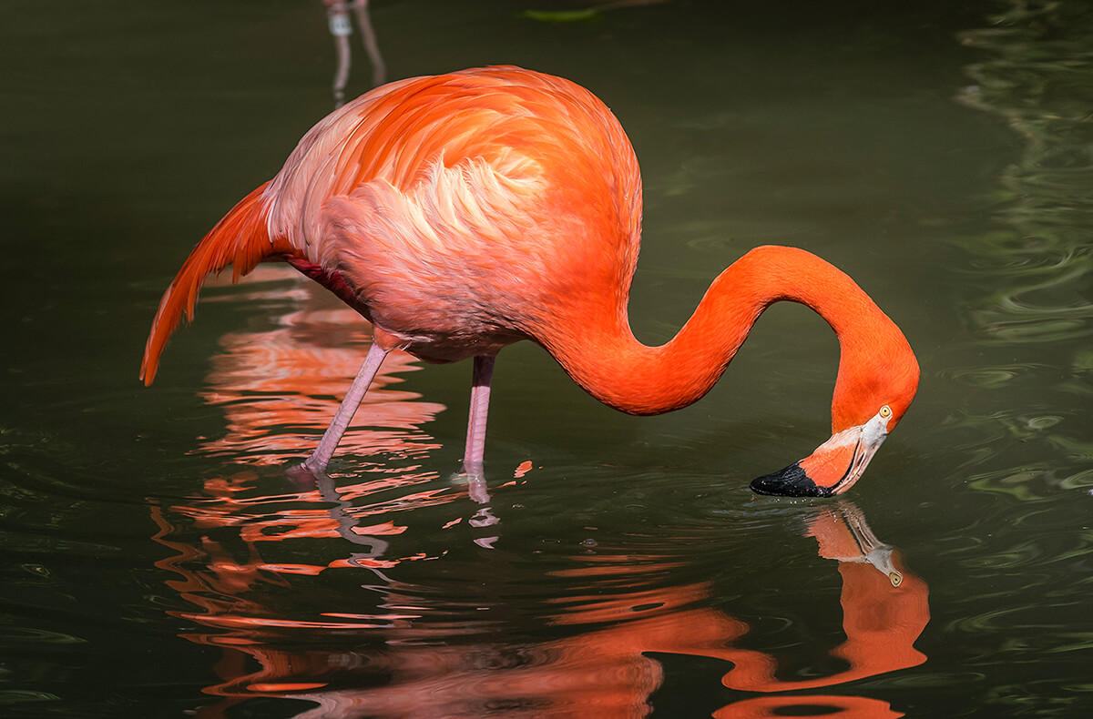

Slide 3
Part-II (General Ability) 40 Marks VI. Quantitative Ability/Reasoning · Basic Mathematical Skills. · Concepts and ability to reasons quantitatively and solve problems in a quantitative setting. · Basic Arithmetic, Algebra and Geometry (Average, Ratios, Rates, Percentage, Angles, Triangles, Sets, Remainders, Equations, Symbols, Rounding of Numbers · Random Sampling

Slide 4
VII. Logical Reasoning and Analytical Reasoning/Ability · Logical Reasoning includes the process of using a rational, systematic series of steps based on sound mathematical procedures and given statements to arrive at a conclusion · Analytical Reasoning/Ability includes visualizing, articulating and solving both complex and uncomplicated problems and concepts and making decisions that are sensible based on available information, including demonstration of the ability to apply logical thinking to gathering and analyzing information. VIII. Mental Abilities · Mental Abilities Scales that measures specific constructs such as verbal, mechanical, numerical and social ability.

Slide 5
Missing Terms/Number Series

Slide 6
Find the missing number to complete each sum a. 9+8-5=2x(__) b. 3x9-14=24-(__) c. 15÷3x12=41+(__) d. 24÷4+5=66÷(__) e. 8x6-13+3=7x6-(__)

Slide 7
Find the missing terms in given series 4, 12, 20, ____ 4, 9, 16, 25, 36, ____ 4, 8, 16, 32, ____ 2, 5, 11, 23, 44, _____

Slide 8
1, 8, 4, 27, 9, ___, ___ 3, 6, 8, 16, 18, ____ 2, 8, 512___ 4, 16, 36, 64, ____

Slide 9
3,5,10,20,37_____ 1, 1/4, 1/13, 1/40, _____ 8,5,13,11,18,17,23,23,28____ 14, 27, 52, 101, 198, _____

Slide 10
CSS-2024 Find the missing terms a. 121, 11, 81, 9, ___, 7 b. 100, 50, 25, ___, 6.25 c. 4, 9, 64, 125, 1296, ___ d. 2, 5, 12, 24, 48, ___ e. 44, 22, 66, 33, 132, ___

Slide 11
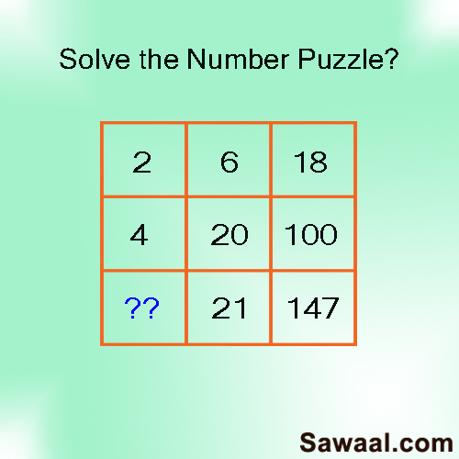

Slide 12
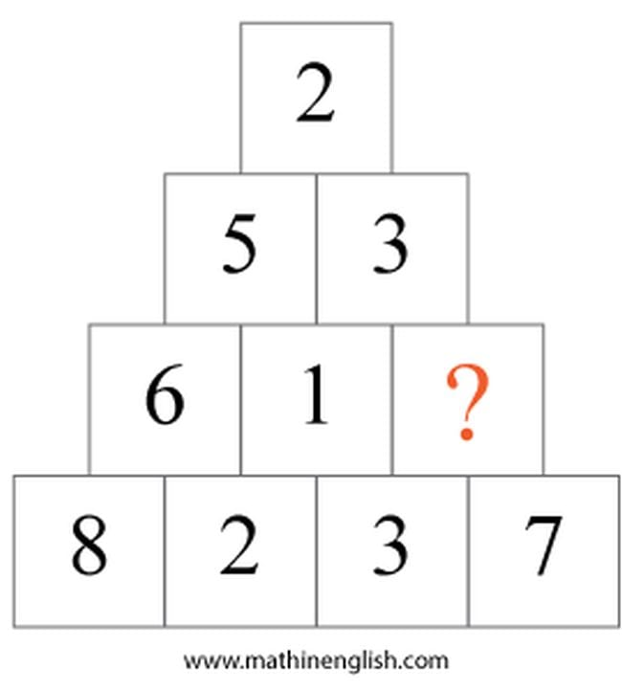

Slide 13
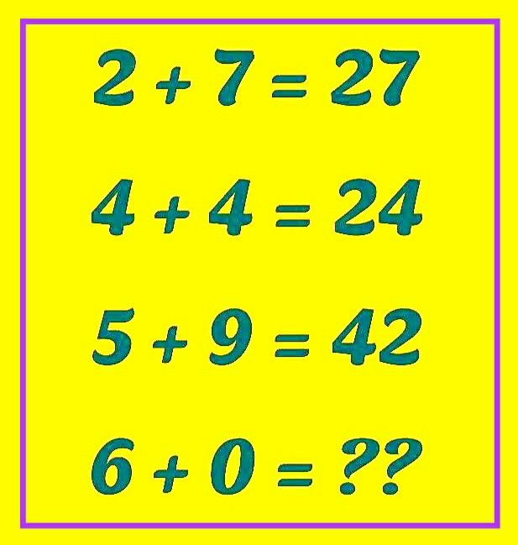

Slide 14
Alphabetical Series & Coding/Decoding

Slide 15
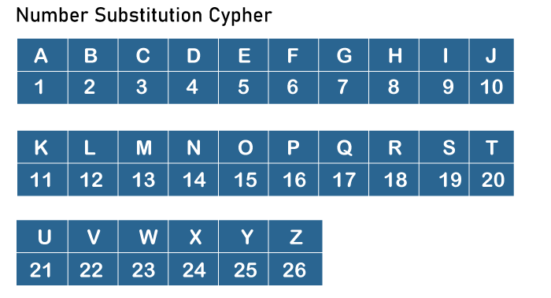

Slide 16
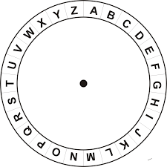

Slide 17
Questions:
Find the missing term in given 1. E, H, L, O, S, ____
2. A, A, B, F, ____ 3. AB,DE,GH,JK, ____ 4. PDZ, ____, RBX, SAW

Slide 18
3. A,D,I,P,Y,J___ 4. AZ, GT, MN, ___, YB 5. PMT, OOS, NQR, MSQ, ___ 6. O,T,T,F,F,S,S,E,N____

Slide 19
The word SUPERMAN is written as a code TTQDSLBM then the code of SPIDERMAN is?
In a certain language ENGINEERING is written as IPKTGELGELC. How will PROGRAMMING be written in that code language?

Slide 20
If in a certain language, BROTHER is written as QDGSNQA, then in the same language SISTER would be written as…? (CSS-2022)
COMPUTER: RFUVQNPC MEDICINE: ??? (CSS-2017/19)

Slide 21
Look at this series: F2,___, D8, C16, B32. What number should fill the blank? (CSS-2018) In a certain language LANDMINE is written as PYRBQGRC. How will HOMEMADE be written in that code language? (CSS-2018)

Slide 22
PAKISTAN: SCLIRRXJ PESHAWAR: ?
CERTAIN: BFQUZJM MUNDANE: ?

