Slide 1
PHYSICAL SCINCES

Slide 2
CONTENTS
CONSTITUENTS AND STRUCTURE
1. UNIVERSE
2. LIGHT YEAR
3. GALAXIES
4. SOLAR SYSTEM
5. SUN
6. ECLIPSES
7. EARTH

Slide 3
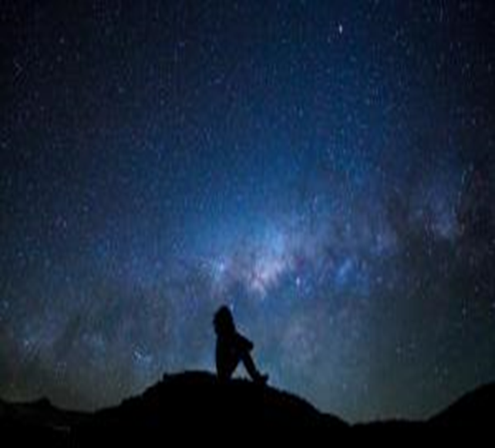

Slide 4
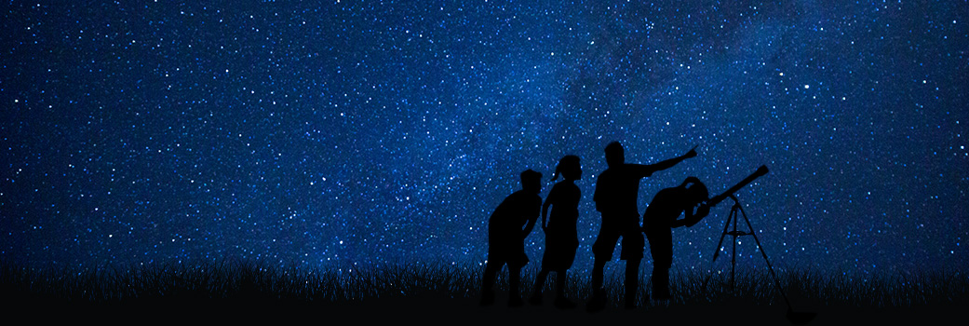

Slide 5
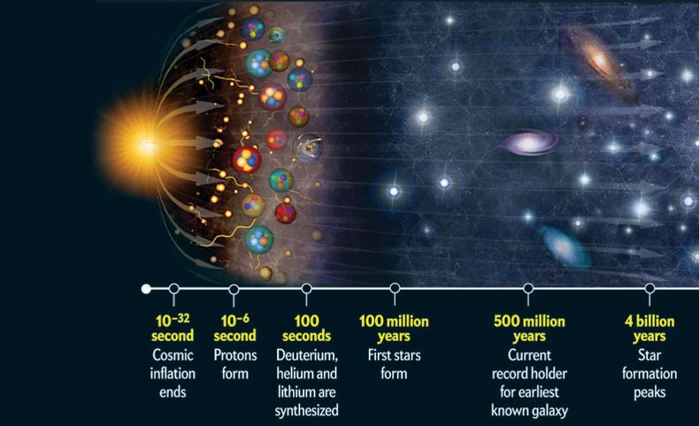
From Singularity to the Existed Universe

Slide 6
UNIVERSE: The total of all that exists or has existed, both in space and time. Matter and energy, stars, planets, galaxies and contents of intergalactic space(Plasma). Universe = All Matters + Energy
ORIGIN OF UNIVERSE
THE BIG BANG THEORY
Big bang, a term coined by Sir Fred Hoyle in 1950.
13.8 billion years ago
Singularity
Released a large amount of energy
Electrons and Protons came into existence
Gravity came into existence
E + P = Hydrogen atoms
Atoms formed nebulas, a group of molecules, which then developed into stars
Temp Drop = 1 bn degree C

Slide 7
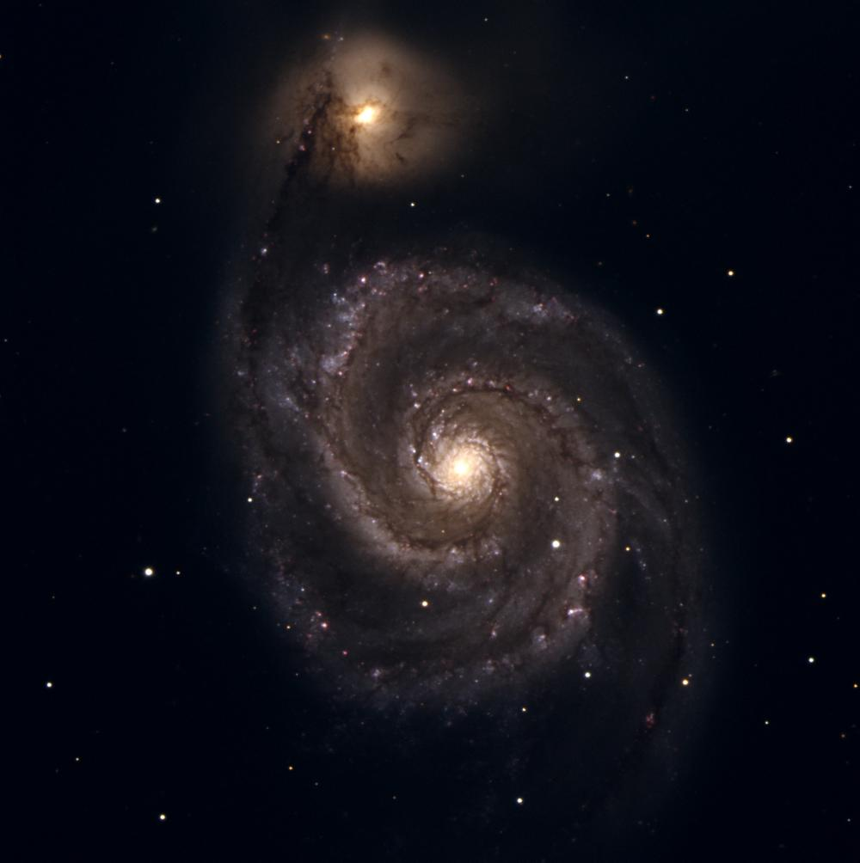
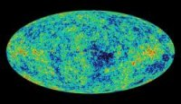
Evidences for the Big Bang
2. Microwave Background
After Big Bang => Universe was very hot
As it grew in the size, the heat left a "glow" which fills the entire Universe.
Detected this glow as microwave light.
Redshift of Galaxies
The redshift of distant galaxies tells us the Universe is expanding.
A. RedShift = Light shifts => longer and redder wave length (Moving away)
B. Blueshift = Shorter and Blue wave length (Moving towards Earth)

Slide 8
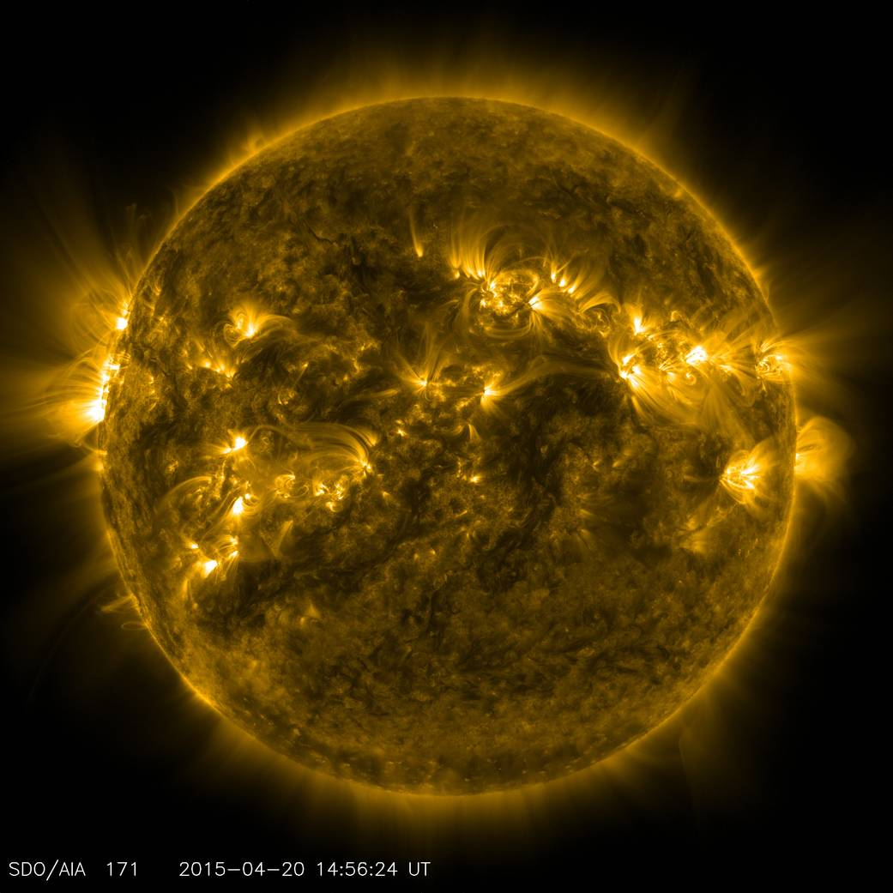
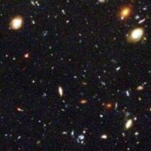
4. Looking back in time
Steady State theory
The Universe does not change much over time.
3. Mixture of Elements
Some chemical elements were created soon after the Big Bang.
Elements like hydrogen and helium.

Slide 9
Future of the Universe (Models) 1. Closed Model Contracting Universe Theory: Many billion years from now, expansion will stop and universe will contract back upon itself. 2. Flat Model Steady State Theory: Expansion will slow down but will not collapse upon itself. And it will approach a stable size. 3. Open Model Expanding Universe Theory: The universe will continue to expand forever. 4. Cyclic Model Cyclic Universe Theory: Universe will collapse upon itself, then there will be a big bang again, it will expand and will collapse again. This cycle will go on.

Slide 10
THE WHOLE UNIVERSE
Known Universe (5%)
Composed of normal matter and normal energy.
2. Unknown Universe (95%)
Composed of unknown (dark) matter and unknown (dark) energy.
DARK MATTER
Non-Luminous matter
Invisible in nature
Present within galaxies
Cosmic glue ( produces an attractive force-gravity)
Can not be utilized
DARK ENERGY
Energy responsible for expansion/big bang
Present in between galaxies
Properties Unknown
Can not be controlled or utilized
Visible and Invisible (infrared)
Luminous matter
Known Properties (Chemical composition)
The energy can be controlled and utilized
Particles (e, p, n)
Physical laws
JADES-GS-z14-0 is the farthest galaxy (1600 light years wide and very luminous)

Slide 11
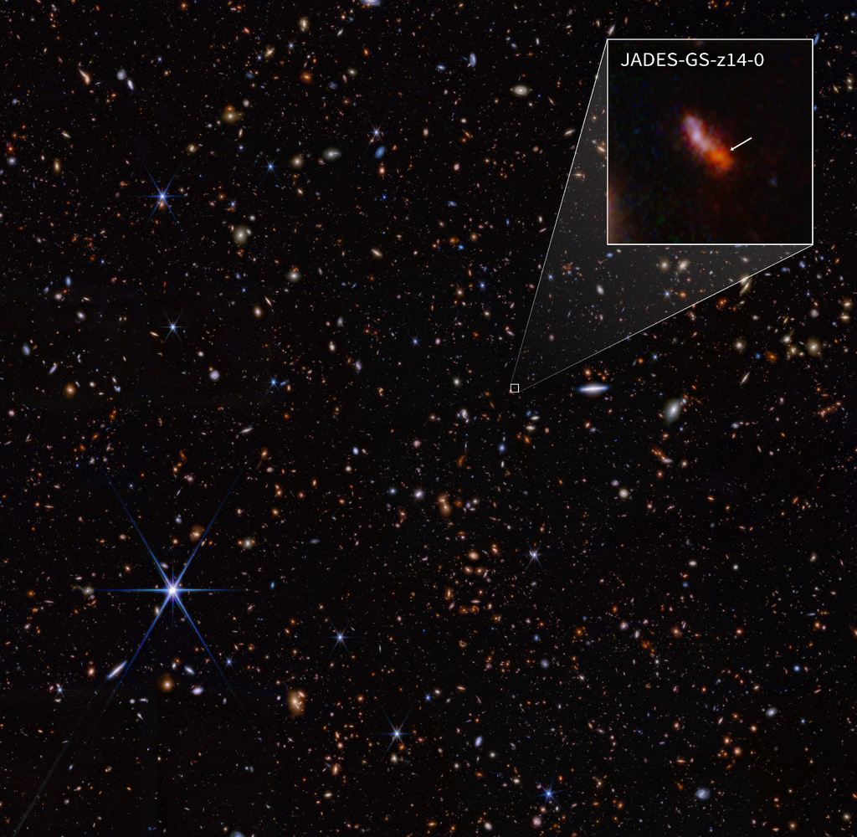

Slide 12
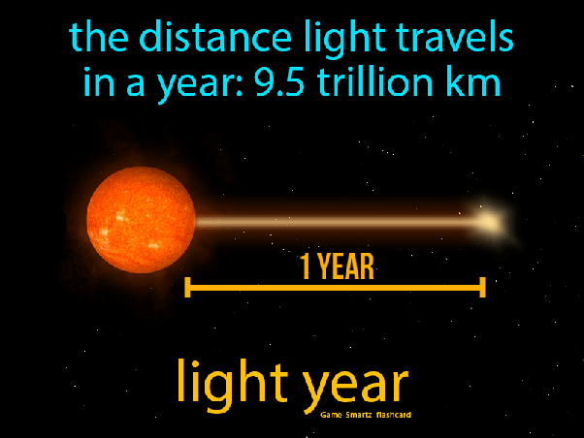
LIGHT YEAR A light year is an astronomical unit of length informally used to express astronomical distances. As defined by the International Astronomical Union (IAU), a light-year is the distance that light travels in vacuum in one Julian year (365.25 days) 1 lightyear = 6 trillion miles One light second is 186,000 miles

Slide 13
GALAXY
Massive aggregate of hundreds of billions of stars, all gravitationally interacting and orbiting about a common Centre.
Astronomers estimate that there are 125 billion galaxies in the universe.
Milky way and Andromeda are examples of galaxy
Size
Dwarfs: with a few thousands stars
Giants: with 100 trillion stars
Shapes
Spiral
Elliptical
Irregular

Slide 14
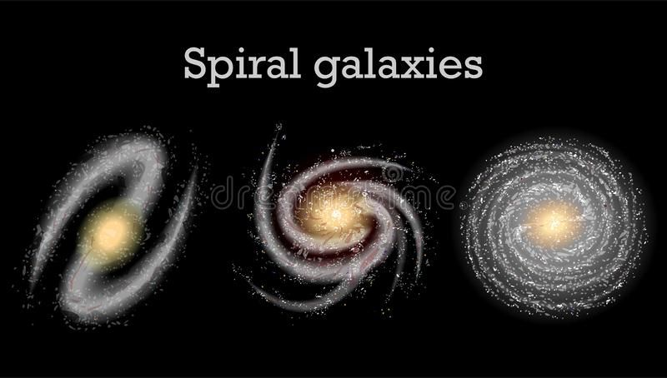
1. Spiral galaxies
A spiral galaxy is a disc shaped galaxy, with a bulge at the center and with arms that spiral outwards as the galaxy rotates.
It contains more middle-aged stars along with clouds of gas and dust.
Spiral galaxies are further divided into a, b and c depending on the extent of the unwinding of arms and on relative clarity of the arms & the nucleus.
Milky way is a spiral galaxy.

Slide 15
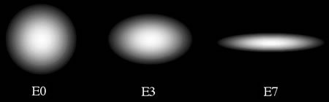
2. Elliptical galaxies
Elliptical galaxies appear as luminous elliptical discs with a smooth distribution of light.
Brightness decreases from the center.
Contains older stars with very little dust & gas.
Elliptical galaxies are further divided into
E-O (face on as circular discs)
E-3 ( oval shaped)
E-7 (edge on galaxy)

Slide 16
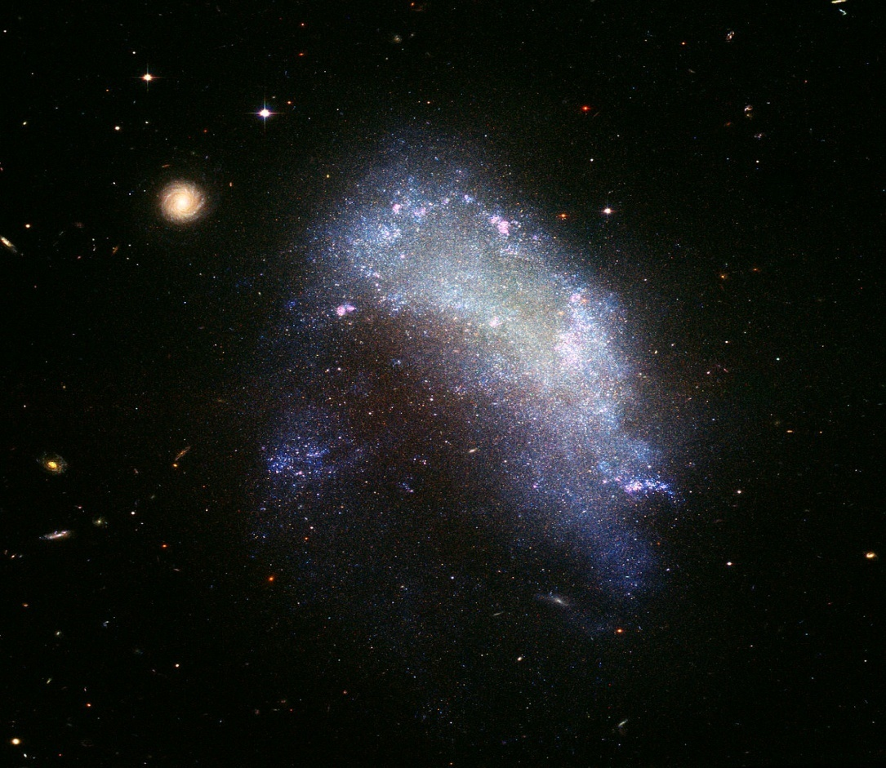
3. Irregular galaxies
Irregular galaxies have undefined and indefinite structure.
Irregular galaxies have lots of young stars with dust and light.
Irregular galaxies do not have distinct shape because they are in the gravitational influence of other galaxies.
Irregular galaxies are divided into
Irr- I
Irr-II

Slide 17
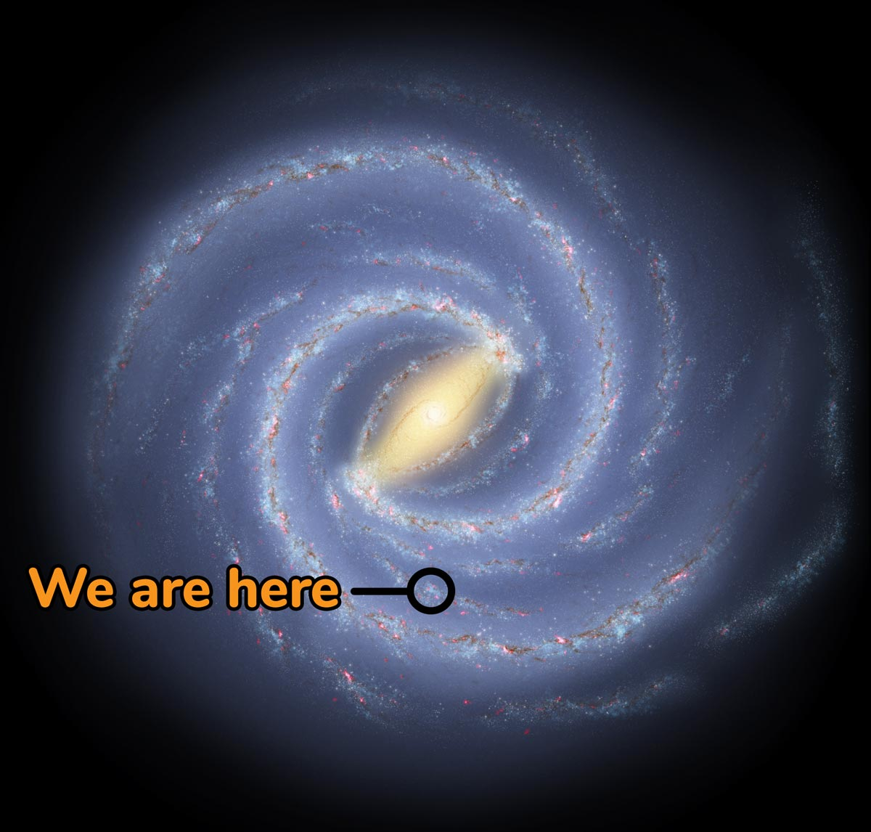
Milky Way
Large, disc-shaped
Includes Earth’s Solar System and about 200-400 bn other stars, in which most of them are visible
Diameter = 100,000 light years (Light-year is the distance light travels in one year)
Earth’s Solar System distance from center = 30,000 light years
Sun rotation = 225 to 240 million years to complete one orbit
Spiral – Bugle in the center and with arms
Nearest galaxy = Andromeda
The Region occupied called Galactic Plane
Major Arms: 1. Pursues 2. Sagittarius 3. Centaurs 4. Cygnus Arm
Minor Arms: 1. Orion Spur/arm

Slide 18
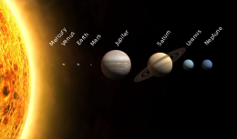
Solar System
Made of Planets, Dwarfs, satellites, Asteroids, meteoroids, Comets
Elliptical/Egg Shaped
Sun contains more than 99% of the solar system mass
4.5 bn years old
Formed out of solar nebula (a huge cloud of gas)

Slide 19
SUN
Closest star, lies in milky way galaxy, yellow dwarf star and of medium size.
4.5 billion years old
Scientists predict it will die after 4.5 billion years.
Diameter is 870,000 miles, 1.4 million kms
Mass of sun is 1.989 × 10^30 kg and 330,000 times of earth.
Composed of 90% H2, 8% He, 2% heavy metals
Density 1.41 g/cm3
Temperature is 5778 K (9932 F)
Temperature at core is 15 million degree Celsius
Mean distance from the earth 149-150 million km or 93 million miles.
Sun has very active and large magnetic field

Slide 20
SUN
Sun rotates around its axis in 25-35 days (25 at the equator and 35 at the poles)
Sun rays reach the earth in 8 minutes and 20 seconds.
The minimum distance between the sun and the earth is known as perihelion and maximum distance is called aphelion.
Sun is moving around the center of the galaxy at a velocity of 220 km/s. It completes its one revolution in 250 million years and this time taken is known as cosmic year .

Slide 21
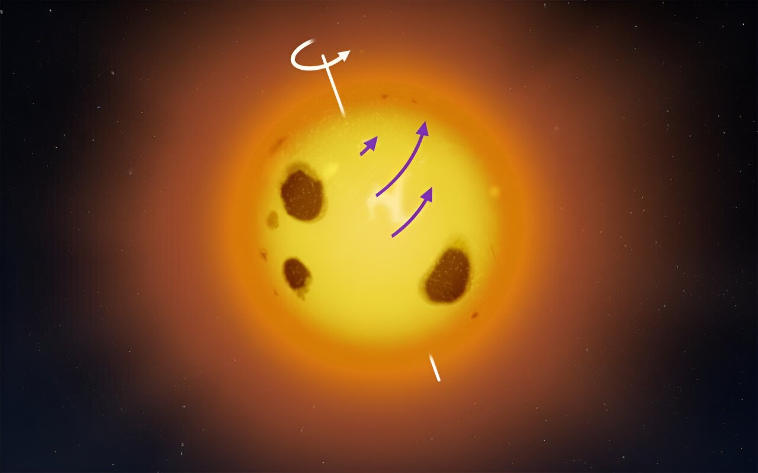

Slide 22
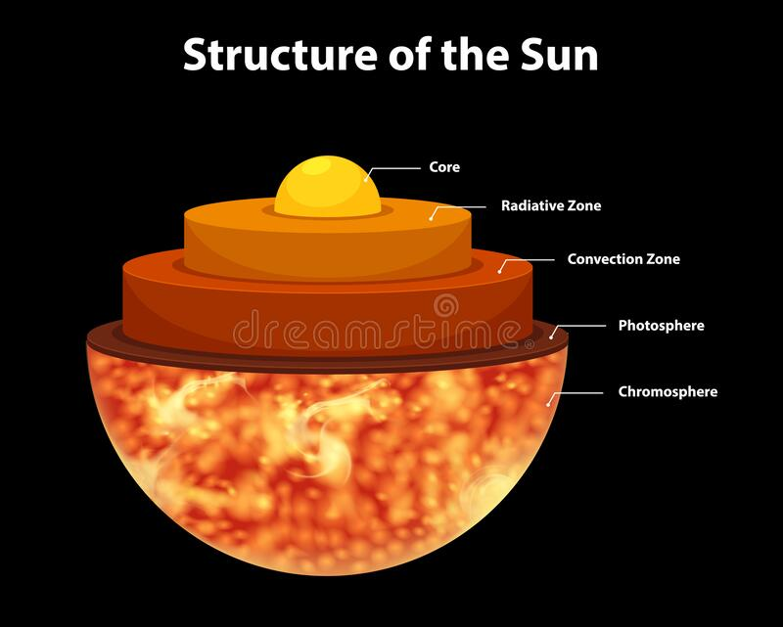
SUN
Star: Composed of Hydrogen and Helium
Reaction: Nuclear Fusion
Regions of Sun: 1. Interior 2. Solar Atmosphere 3. Visible Surface
INTERIOR: 1. Core 2. The radiative zone 3. The convective zone
VISIBLE SURFACE: Photosphere
SOLAR ATMOSPHERE: 1. Chromosphere 2. Corona

Slide 23
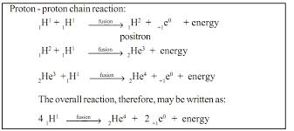
The Core
Central part; Hottest
Reactor (Fusion Reaction in four stages)
1. Two Hydrogen nuclei or Protons collide to produce deuterium --- produce a positron
2. Positron collides with an electron to produce two photons
3. The deuterium nucleus collides with another proton to form helium-3
4. Two helium-3 nuclei collide to produce helium-4
10% of the Sun’s Mass
Density: 150 times of water’s density
Temperature: 15 million degree Celsius, which is almost 3000 time higher than at the surface.
Pressure: 340 billion times the atmospheric pressure on Earth’s surface

Slide 24
The Interior Part of Sun
The Radiative Zone
The Convective Zone
Dominant mode of energy flow by thermal convection (Heat Transfer)
Not dense or hot enough
Once the material cools off at the surface, it plunges downward to the base of the convective zone to absorb more heat from the top of the radiative zone and repeat the cycle.
Energy from core carried out through this layer by photons as thermal radiation.
Hot, dense and highly ionized
Temperature: 2 to 7 million degree Celsius
It is about 75% hydrogen and 24% helium.
Occupies roughly 45% of the Sun's radius

Slide 25
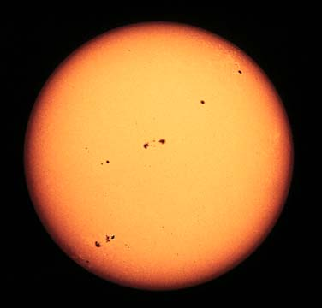
The Photosphere
Visible surface of the Sun
Lies between Sun’s interior and the solar atmosphere
Average temperature: 5800 - 6000K
400km thick
Dense enough to emit plenty of light but not so dense that the light can not escape.
Sunspots: 1. Typical size of spots is similar to the size of the Earth. 2. These regions are cooler than average, so they look darker than the surrounding hotter region.
3. With higher Magnetic Field

Slide 26
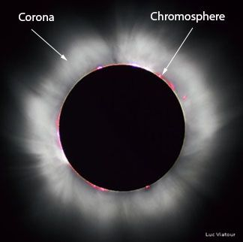
The Solar Atmosphere
Chromosphere
Lower Region
Bright Red (viewed during solar eclipse): Appears red because hydrogen atoms are in excited state and emit radiations in visible spectrum near red part.
Thin transition region where temperature rises sharply between chromos
Temperature from 6000 to 50,000 centigrade.
Corona
Outer most region
Hotter than photosphere (a million degrees Celsius or higher)
Magnetized waves of plasma could carry huge amounts of energy

Slide 27
PLANETS: (Wanderers) Mercury, Venus, Earth, Mars, Jupiter, Saturn, Uranus and Neptune
1. Terrestrial/Inner/Inferior
2. Jovian/Gaseous Planets
Mercury, Venus, Earth and Mars
Close to Sun
Small masses and radii
Rocky-Solid surface (Metallic core)
High Densities
Slow Rotation (Speed)
Weak magnetic field
No Rings
Few moons
Carbon dioxide and nitrogen
Jupiter, Saturn, Uranus and Neptune
Far from Sun
Large masses and radii
Gaseous surface (Molten rock core)
Low densities
Fast Rotation (Speed)
Strong magnetic field
Many rings
Many moons
Hydrogen, helium and ammonia

Slide 28
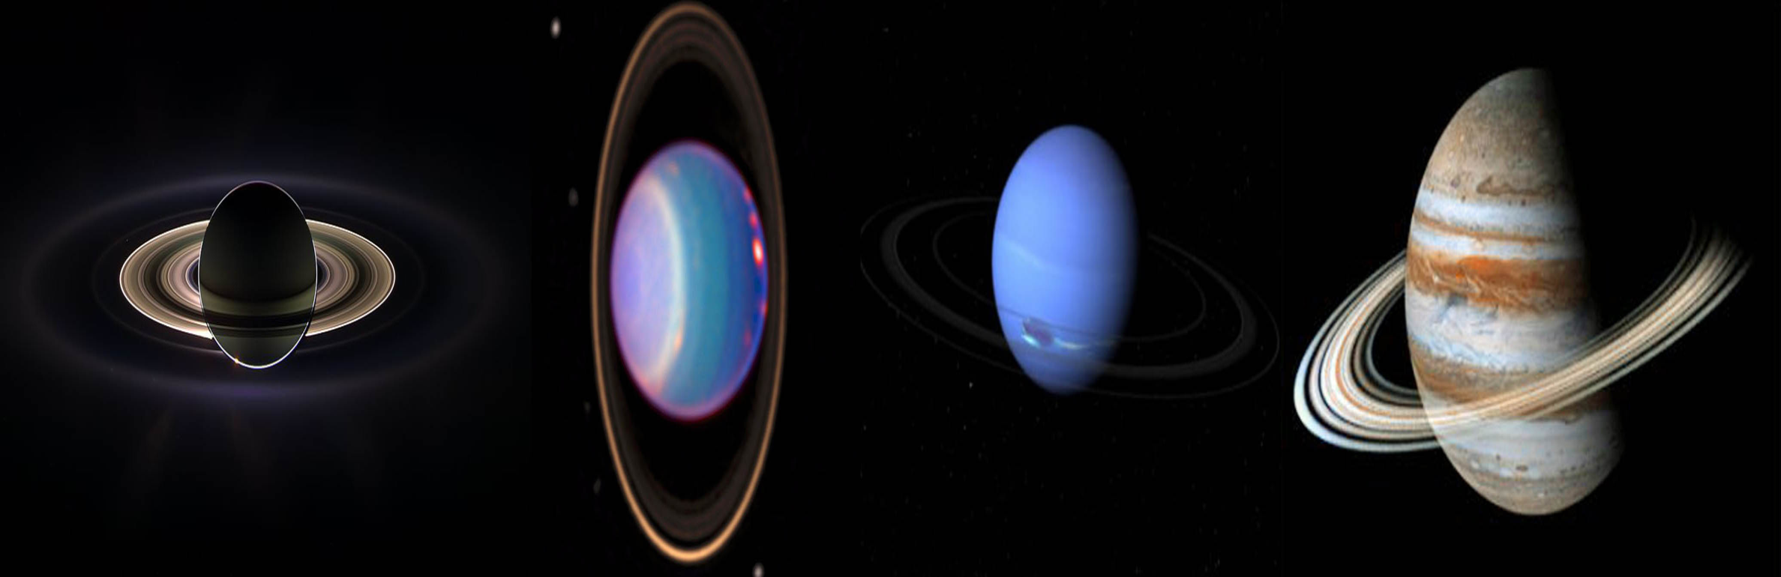

Slide 29
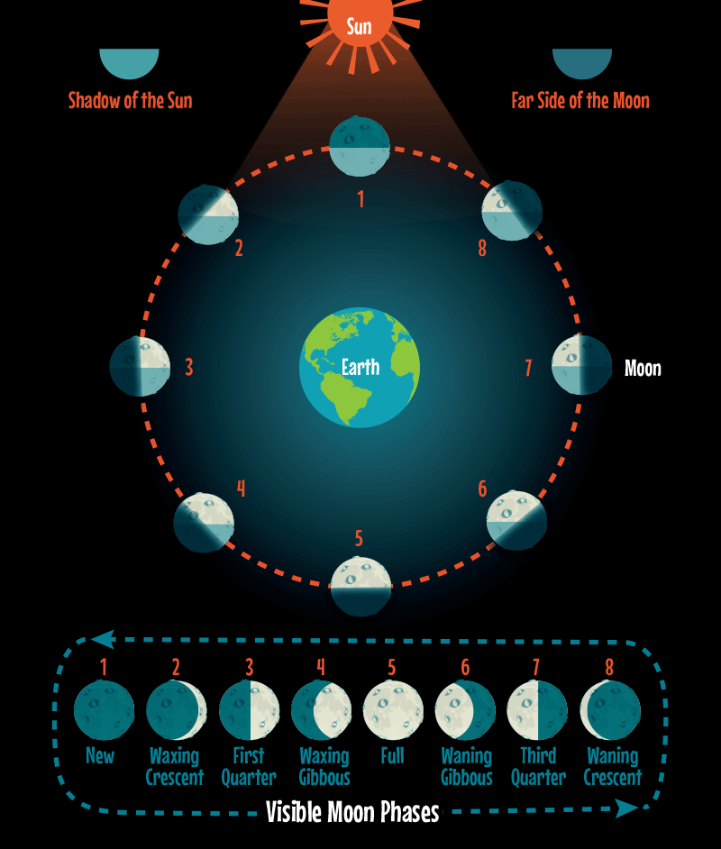
MOON ( EARTH’S ONLY NATURAL SATELLITE)
All natural satellites that orbit planets are called moon
Our moon named Luna is fifth largest moon in the solar system
Diameter 3474 km
Mass 7.34767309 × 1022 kilograms
Density 3.34 g/cm³
Average distance b/w moon & earth 384,400km
Orbital period of moon around earth 27 days and 7 hours (actual).
Same time is taken by the moon to rotate around its axis.
Gravity is 1/6th of earth’s gravity.
Average surface temperature during the day is 107 degree Celsius and at night -153 degree Celsius.
No atmosphere but negligible amount of inert gases.

Slide 30
Planet | Distance from the Sun (million km) | Period of Revolution Round the Sun | Period of Rotation on own Axis | No. of Satellites | Mass Time of Earth | Other Details
Mercury | 57.9 | 88 days | 58 days 15h and 30 min | 0 | 0.055 | Nearest to the Sun, Smallest and fastest planet
Venus | 108.2 | 224.7 days | 243 days and 14 hours | 0 | 0.815 | Brightest, Hottest, Closest to Earth and earth twin planet
Earth | 149.6 | 365.25 days | 23 h, 56 min and 40 sec | 1 | ----- | Most dense planet, watery planet
Mars | 227.9 | 687 days | 24 h, 37 min and 22 sec | 2 | 0.108 | --------
Jupiter | 778.3 | 12 years | 9 h, 50 min and 30 sec | 95 | 317.9 | Largest Planet, Largest no. of satellites and smallest day
Saturn | 1427 | 30 years | 10 h & 14 min | 145 | 95.2 | Least Dense
Uranus | 2869.6 | 84 years | 16 h & 10 min | 28 | 14.6 | -------
Neptune | 4496.6 | 165 years | 18 h | 16 | 17.2 | Coldest, slowest to move around the sun and largest year

Slide 31
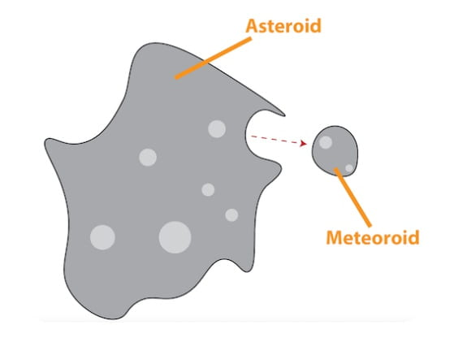
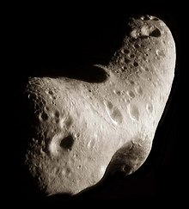
Some Important Definitions
Asteroid
A small rocky object that orbits the Sun
Diameter: From 100m to 1000km
Largest asteroid is Ceres (D=950km)
Irregular in shape and surface cover with Craters (a bowl-shaped depression
Found in the main asteroid-belt (btw Mars and Jupiter)
2. Meteoroid
Segment of rock or iron that orbit the Sun
Originate from comets and asteroids
Meteor: If a meteoroid enters to earth’s surface (Shooting stars)
Meteorite: A fragment that survives to hit the ground

Slide 32
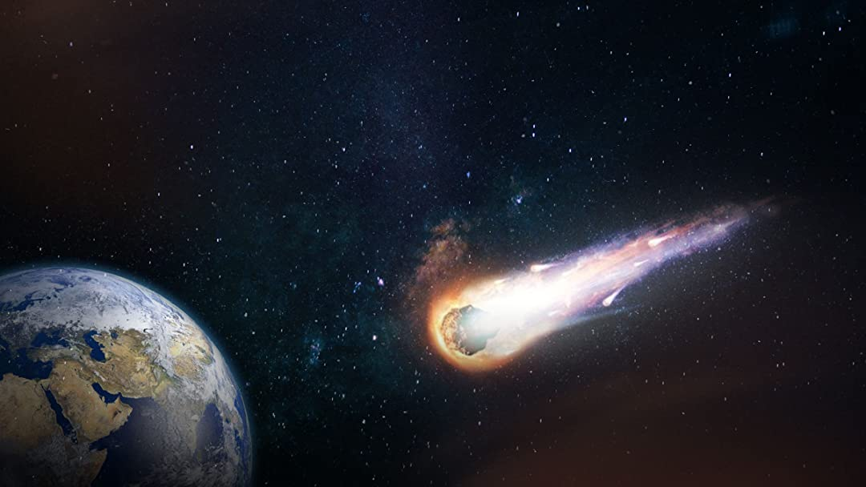
3. Comet
Cosmic snowballs of frozen gases, rock, and dust that orbit the Sun
Long Tail (made of dust and ionized gas) always point away from the Sun
Tail length: 250 million km
Visible when near the Sun
The current number of known comets is: 3,743
Halley’s Comet: Periodic comet orbits around the Sun
4. Constellation:
Group of visible stars within a particular region of the night sky forming various shapes and pattern.

Slide 33
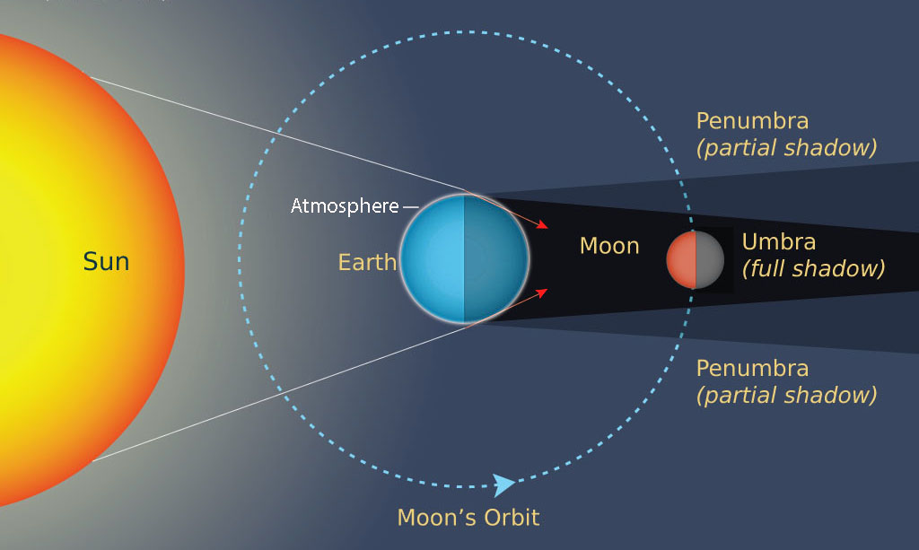
LUNAR ECLIPSE
Penumbral Eclipse:
Moon in penumbra
Rarely visible from earth as there is slightly change of color of the moon.
2. Partial Eclipse:
Moon in between penumbra and umbra
Moon slightly obscured (conceal)
3. Total Eclipse:
Entire moon passes through the umbral region
Moon is totally obscured
Note: Occur only on full moon
* Moon light to reach earth takes 1.3sec

Slide 34
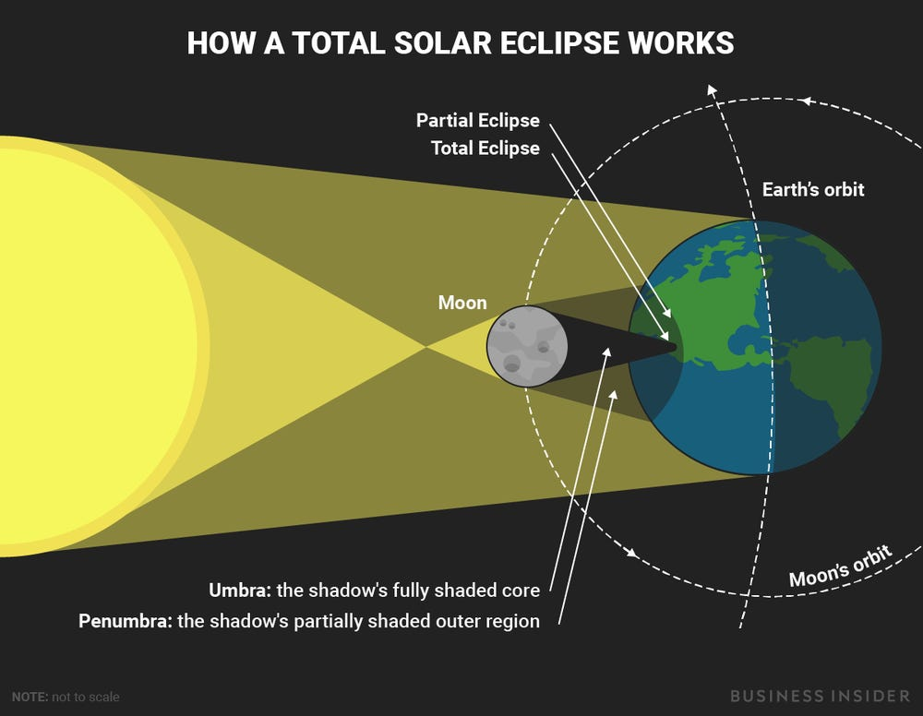
SOLAR ECLIPSE
Always occurs at new moon
Total Eclipse
Moon completely covers the sun light
2. Partial Eclipse
Earth, moon and sun do not align in a perfectly straight line. The moon only partially covers the disc of the sun.
3. Annular Eclipse
The moon appears smaller than the sun
The Sun remains visible

Slide 35
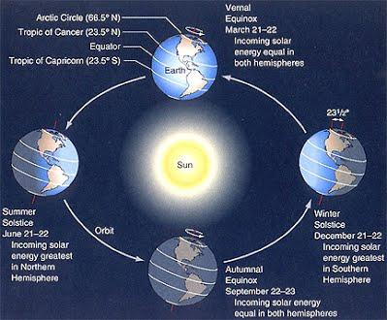
DAY/NIGHT and Their Variation

Slide 36
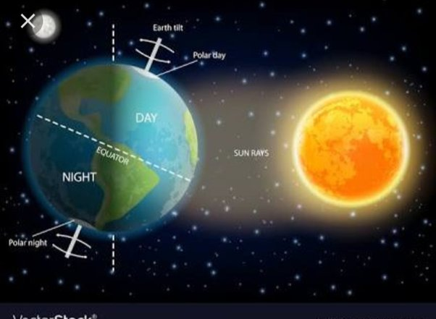
Day/Night Variations

Slide 37
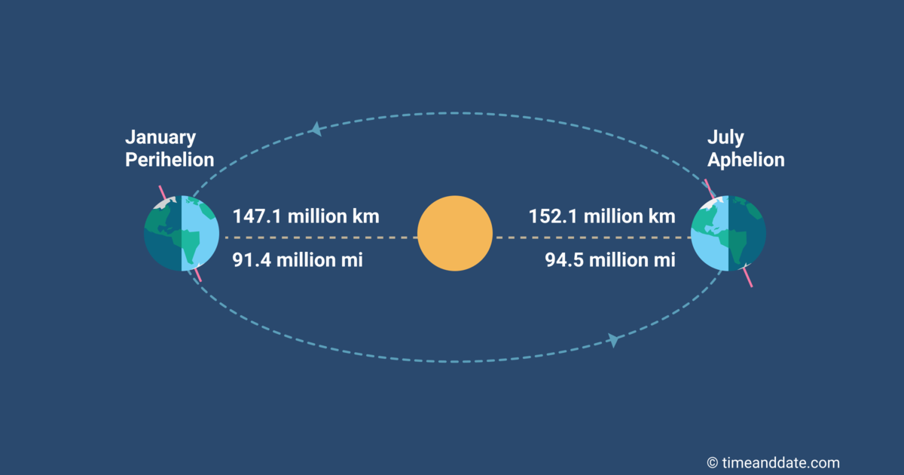
Aphelion and Perihelion
Perihelion | Aphelion
Perihelion is where the Earth is closest to the Sun (91.4 million miles, or 147 million kilometers) | Aphelion is when our planet reaches its farthest point from the Sun (94.5 million miles, or 152 million kilometers)
This occurs around January 3 every year | This occurs around July 4
The closest point to the Sun in a planet’s orbit is called perihelion | The furthest point is called aphelion

Slide 38
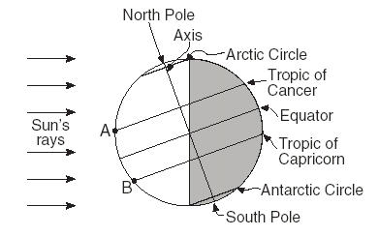

Slide 39
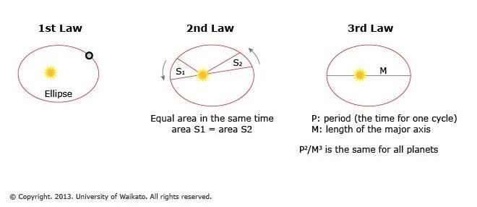
Kepler’s laws of Planetary Motion

