Slide 1
Probability

Slide 2
A bag contains 4 red balls, 3 greens and 5 black ball. A ball is drawn at random from the bag. Find the probability that the ball is drawn is
1. black ball, 2. Not black

Slide 3
Classification of blood groups is based on the presence or absence of inherited antigenic substances on the surface of red blood cells. In a survey of British population the blood group distribution among 1000 people was as follows: 300 had blood group A, 325 had blood group B, 250 had O and 125 AB. Out of this group a person was selected at random, calculate his probability of having blood group AB. (CSS)

Slide 4
Coin/Dice/Cards

Slide 5
What is the probability if a coin is thrown.
On tossing a coin twice, what is the probability of getting only one tail?
Three coins tossed once, the probability of at least two heads.

Slide 6
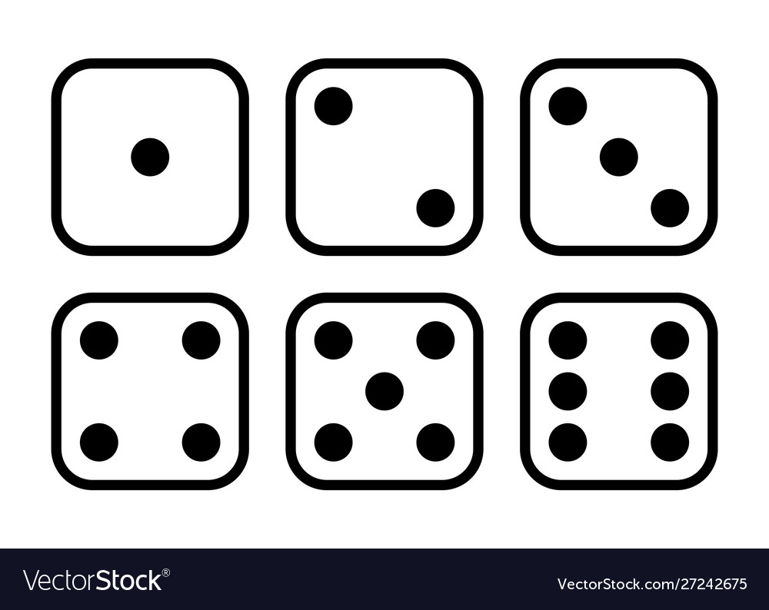

Slide 7
What is the possibility of even numbers when a die is rolled.
When two dice are rolled simultaneously. What is probability that the sum of outcome will be 7.
3. When two dice are rolled what is the possibility to a get a sum of an even?

Slide 8
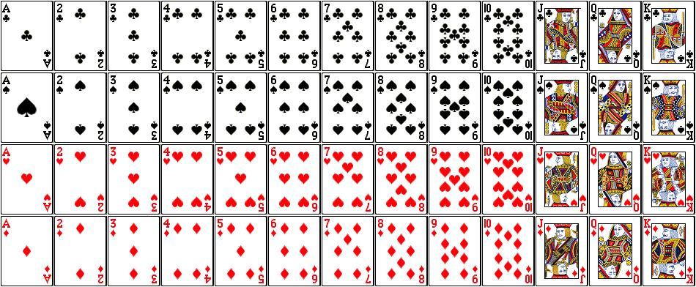

Slide 9
A card is drawn from a well shuffled pack of cards. Find the probability of a. A jack b. A king of red color c. A king or queen d. A non-faced card e. Neither a spade nor a jack

Slide 10
Combination
A collection of things in which order does not matter ncr= n!/r!(n-r)!
Permutation
A Collection of things in which order matters. npr= n!/(n-r)!

Slide 11
How many different combination do you get if you have 4 items and choose 2.
Father asks his son to choose 4 items from the table. If the table has 18items to choose, how many different answers could the son give?
How many words can be formed from the letters of the word ‘PLANE’ using all letters when no letter is to be repeated?

Slide 12
Five people are being selected for president, vice president, CEO, and Secretary. The president will be chosen first, followed by other three positions. By how many different ways the positions be filled?
How many signals can be given by 5 flags of different colors, using 3 flags at a time?

Slide 13
Geometry

Slide 14
Ali is standing 10meters away from a tree. The distance of his eyes from his feet is 1.5m. Given that the distance from his eyes to the top of the tree is 15m, find the height of the tree. (CSS)
Calculate the total area and perimeter of the given shape (CSS)

Slide 15
The perimeter of the rectangle given below is 114cm. Find the area of the rectangle. (CSS)

Slide 17
Aslam is willing to use the stylish ceramics tiles in the lounge of his under-construction house. The shape of the tile is a right triangle, having the lengths of two legs of 12cm and 4cm. Each tile costs Rs. 15. How much will it cost to fill the lounge of 8 meters length and 6 meters width with these tiles? (CSS)

Slide 18
A farmer needs to build a boundary wall around his farm. If the area of the farm is 484m2, what will be the total area of the wall if it is two meters high on three sides ad three meters high on one side? (CSS)

Slide 19
There are three cars and start moving in such a way that car A and B are moving opposite with speed 60 and 100 km/h. Car C is moving perpendicularly to both with speed 80 km/h. What is distance after 15 minutes between (i) A and B (ii ) A and C (iii) B and C?
(CSS)

Slide 20
Direction Sensing

Slide 21
If Rahim moves 20meters in East direction and then turn to his left and then moves 15m and then he turns to his right and moves 25m. After this he turns to his right and moves 15m.
1. In which direction he is moving?
2. Total travelling path covered?
3. How far is he from his initial position?

Slide 22
A man starting from his home walks 5km towards East, and then he turn left and goes 4km. At last he turn to his left and walks 5km. Now find the distance between man and his home and also find in which direction.

Slide 23
1. A man travels over the path of a right-angle triangle having base and hypotenuse 4 and 5 kilometers, respectively. After a complete round he continues in the same direction for 6km and then turns 90degree and continues for another 8km. How long he has travelled and how far he is from his starting point? (CSS-2024)
For his morning walk Aslam went 110m towards east from his house and then turned right to keep walking for 40m before turning right again. After continuing to walk for 50meters, he turned right again and kept walking for another 120m, before he sat down on a bench at the park. How far was the bench located from his house? (CSS-2022)

Slide 24
Seating arrangement

Slide 25
There are five boys sitting in a row in the college party. ‘P’ is sitting to the left of ‘M’ and to the right of ‘O’. ‘R’ is sitting to the right of ‘N’ but left to the ‘O’. Who is sitting in the middle?

Slide 26
Eleven students A,B,C,D,E,F,G,H,I,J & K are sitting in a row facing towards a teacher. D, who is immediate left to F, is second right to the C. A, is second right to E, who is at the one end. J is the neighbor of A and B third to the left of G. H is on the left of D and third to the right of I. Who is in the middle, also draw the table.

Slide 27
Eight friends P,Q,R,S,T,U,V & W are sitting on a circular table facing towards centre. Q is between V and S. W is sitting third left to the Q and second right to the P. R is sitting between P and V. Q and T are not sitting in front of each other. Who is at the third left of S?

Slide 28
Fiver girls A,B,C,D,E and four boys W,X,Y,Z have to go on a trip in three cars. The following restrictions for seating in the car to be observed. 1. Only three persons can sit in one car 2. At least one boy and one girl must be in each car 3. A and D should remain together 4. Z cannot sit with B or C in the same car Distribute boys and girls in three cars (CSS)

Slide 29
If Asif standing in a queue in such a way that He is 6th in the queue from either side, then how many people are standing in the queue?
If five cars are parked bumper to bumper, how many bumper are touching each other?

Slide 30
Comparison Questions

Slide 31
A,B,C,D,E,F,G and H are eight friends, three of them play cricket and table tennis each and two of them play football. Each one of them has a different height
1. The tallest does not play football and the shortest does not play cricket.
2. F is taller than A and D but shorter than H and B.
3. E who does not play cricket, is taller than B and is 2nd to the tallest.
4. G is shorter than D but taller than A.
5. H, who is 4thfrom the top, play table tennis with D.
6. G doe not play either cricket or football, B does not play football.
Draw the table in descending order

Slide 32
Mushtaq, Pervaiz, Ehsan, Umair and Saleem are friends having different heights and weights. Mushtaq weights four times as much as Pervaiz and Pervaiz weight double than Ehsan. Ehsan weights half as much as Umair and Umair weight half as much as Saleem.
1. Who is the heaviest among them
2. Who is the 2nd heaviest?
3. Who has the lowest weight?
4. who are equal in weights?
5. Mention the descending order (CSS)

