Slide 1
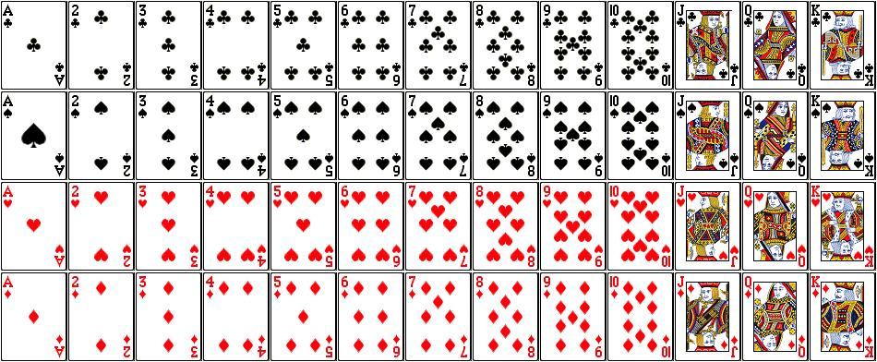

Slide 2
Direction Sensing

Slide 3
Comparison Questions

Slide 4
A,B,C,D,E,F,G and H are eight friends, three of them play cricket and table tennis each and two of them play football. Each one of them has a different height
1. The tallest does not play football and the shortest does not play cricket.
2. F is taller than A and D but shorter than H and B.
3. E who does not play cricket, is taller than B and is 2nd to the tallest.
4. G is shorter than D but taller than A.
5. H, who is 4thfrom the top, play table tennis with D.
6. G doe not play either cricket or football, B does not play football.
Draw the table in descending order

Slide 5
Mushtaq, Pervaiz, Ehsan, Umair and Saleem are friends having different heights and weights. Mushtaq weights four times as much as Pervaiz and Pervaiz weight double than Ehsan. Ehsan weights half as much as Umair and Umair weight half as much as Saleem.
1. Who is the heaviest among them
2. Who is the 2nd heaviest?
3. Who has the lowest weight?
4. who are equal in weights?
5. Mention the descending order (CSS)

