Slide 1
Civil-Military Relations in Pakistan

Slide 2
Civil-Military relations
Civil-Military relations ,an ideal barometer of the quality of democracy & institutional harmony.
Anarchies are democracies in transition where the democratic institutions have not developed strong roots
Anarchies prone to the interventions of the bureaucracy, violent non-state actors, & the military.

Slide 3
Civil –military interventions
Civil- military fault line shapes Pakistani politics
Strain between two contributes to instability
Chile,Brazil,Egypt,Ghana,Nigeria,Turkey,Syria, Thailand, Indonesia, North Korea and Pakistan repeatedly experienced disruption of civilian rule
Notes:
Bangladesh : 1975 - Sheikh Mujibur Rahman is assassinated in a military coup in August. Martial law is imposed.
1982 - General Hussain Muhammad Ershad seizes power.
Turkish model Military interventions 1960, `1971, 1980 & 1997
Sudan's military leaders responsible for the October 25, 2021- Abdel Fattah al-Burhan, who led the military coup
Presently military governments in Burkina Faso, Guinea, Chad, Myanmar, Mali and Sudan.

Slide 4
Chronology
Ayub Khan’s rule 1958-69
Yahiya's rule 1969-71
Zia’s rule 1977-88
Mushraf’s rule 1999-08
Wars
Ousted Junejo,ZAB,NS,BB
Political movements MRD,ARD
Devolution 2001-02
Police Order (2002)
Akbar Bugti’s death
Lal Masjid Operation
Judicial activism
Chapter II of the constitution : Articles 243- 245
8th &17th amendment
Referendums

Slide 5
Civil-military relations
In democracies civilian supremacy
In newly established states institutional encroachment , an historical fact
Parliamentary Standing Committee on Defence
Defence Cabinet Committee ( In Pak)
In Bangladesh National Security Council (NSC) proposed by Gen Ershad in 1982
In Pak NSC established -2004
In India Mishra Committee report expressed that ‘The Principle of CIVILIAN CONTROL over DEFENCE MACHINARY should be interpreted to mean not BUREAUCRATIC but essentially Political control by the Parliament & Cabinet ‘

Slide 6
Colonial overhang & powerful CinC
The pre-eminence enjoyed by the Commander in Chief (CinC) in the British colonial era was unparalleled, compared to democratic countries.
The CinC enjoyed the title of His Excellency and ranked second only to Viceroy.
The CinC also a member of the Viceroy’s Executive Committee and upper legislature as per the Government of India Act 1919.
Most of the powers enjoyed by CinC were retained in the Government of India Act 1935.
Notes:
The CinC enjoyed the title of His Excellency and ranked second only to Viceroy.
The Indian government changed the colonial warrant of precedence to place its CinC at 25th position, but the same practice could not be followed in Pakistan

Slide 7
Civilian leadership reliance on military leadership
Since inception Pakistan confronted external aggression, political leadership had to rely on military leadership for important national security decisions.
Demise of the Jinnah & Liaquat, Ghulam Muhammad & Iskander Mirza edged out politicians & looked towards military.
In 1954, Ayub accepted the offer of GG GM to become Minister of Defence in the cabinet of PM Chaudhry Muhammad Ali as a serving general.
Pakistan had 7 prime ministers & 8 cabinets between 1947 -58 & only 1 CinC.
Notes:
There are structural issues of civil-military imbalance, like weak political oversight over defence affairs.

Slide 8
Vacuum of democratic leadership
Demise of Jinnah 11th September 1948
Demise of Liaqat 16th October 1951
With the demise of Liaqat the facade of Parliamentary democracy started eroded
After demise of Jinnah+ Liaqat office of GG became instrumental for creating hurdles for democratic process
Governor rule in provinces, despite majority in house CMs were dismissed
During 1951-58 two Governor Generals (Ghulam Mohd & Iskander Mirza) but 7 Premieres were replaced
2nd line leadership could not translate the political vision into democratic reality
Bureaucratic intervention

Slide 9
Provincialism
Geographic separation
East & West wings
Economic disparity
Instead of political solutions non-political solutions explored
Deprivation, alienation converted into separatist movement
Constitution making delayed for 9 years
East Pak demanded maximum provincial autonomy
West Pak advocated strong center
Failure to convene session of Parliament, failure of negotiations & Ops Search Light
Provincialism
Tug of war between East & West Pakistan

Slide 10
Civil-military divide
Policies were primarily west –Pakistan centric
Increased frustration & deprivation in East-Pak
Delayed constitution making
Increased gulf between Punjabi elite & Bengali egalitarian leadership
Quantum of representation: East Pak had 54 pc population hence demanded universal adult franchise but leadership of west Pak was reluctant

Slide 11
Long absence of civilian democratic rule
Strong centralized internal command & control
Highly organized military
Cold War, Afghan Jihad & WoT provided opportunities , recognition of Pakistan’s military
33 years long rule
Absence of constitution
Alternate constitutional recipes
3 military coups(1958,1977,1999)
Superior impression of military

Slide 12
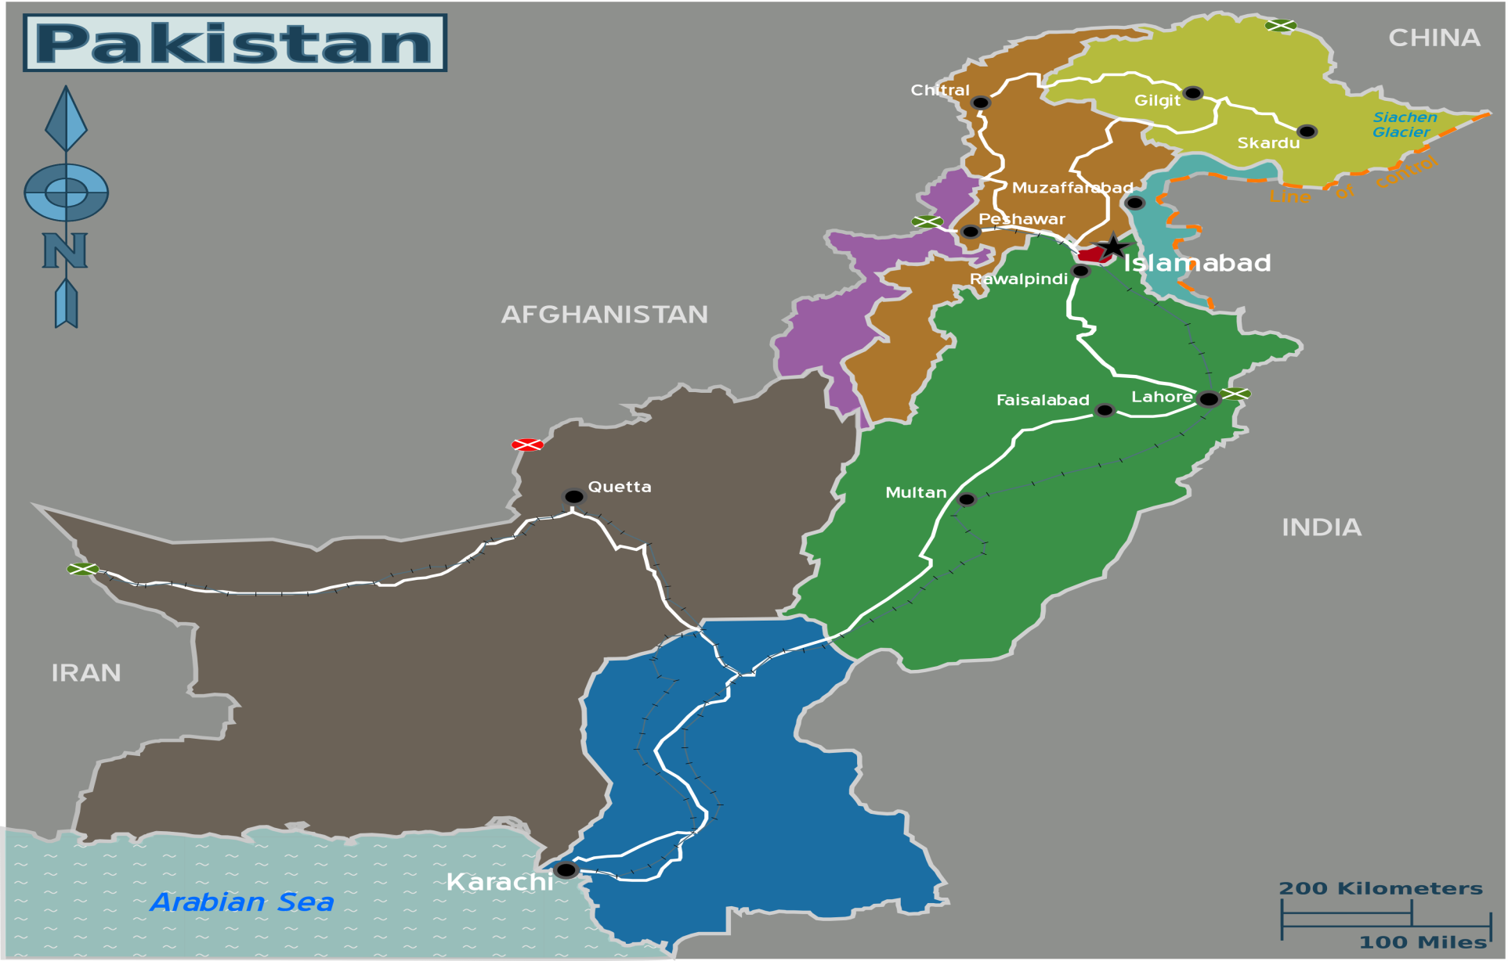
External & internal threats: Military emerged as a strong institution

Slide 13
Indian Factor & need for a strong military
India an existential threat to Pakistan
Hindu-Muslim antagonism
Kashmir dispute
Wars 1947-65-71-99
Cross border terrorism

Slide 14
Challenges
East Pakistan 1971
Turbulent tribal belt (NMDs)
Insurgency & terrorism in Baluchistan
Ethnic & Political strife in Karachi
Increased influence of VNSAs
Sectarian extremism
Internal security duties

Slide 15
Bad era for Parliamentary democracy
1951-58 , two Governor Generals , 1 Army chief & 7 Premiers changed
Emergence of Ghulam Mohammad followed by Iskandar Mirza paved the path for military interventions
Political instability at its peak & stage was set for military to assume power
Initially Ayub Khan was reluctant to come into limelight

Slide 16
Political vacuum
In 1954 political forces wanted to reduce the powers of Governor General but GG dissolved the constituent assembly
PML lost its public standing – a political party vacuum
PML who provided a platform for the masses to attain a separate homeland failed to transform itself from a movement to a party

Slide 17
Failure of politicians
PML failed to lead the nation for constitutionalism & economic development
PML lost its democratic ideals ,had annual conventions but after independence in 9 years no convention
Factional politics- inner infighting within PML
Widespread impression regarding corruption & inefficiency of politicians

Slide 18
Role of Judiciary
1955 Maulvi Tamiz uddin case Justice Munir upheld the arbitrary decision of GG GM of the dissolution of first constituent assembly
Judiciary employed “Doctrine of necessity”
Opened doors for interventions
Role of judiciary from 1950’s to 2007 (except ouster of Ch. Iftikhar Judiciary remained under critical review

Slide 19
Civil & military intervention
In the wake of weakening political culture country rapidly became dependent upon the civil & military bureaucratic support
Such need created space for interventions
Political parties failed to flourish as democratic entities
Successors of Jinnah failed to translate the ideals of Jinnah

Slide 20
Need for autonomous Election Commission
Autonomous Election Commission ensures smooth democratic transitions
One part of COD – had focus on electoral reforms
Without an autonomous EC, electoral credibility will always be questioned

Slide 21
Low conviction rate: Need for Military courts
21 & 23 Constitutional amendments
Establishment of military courts
Challenged in Apex Court
Court validated military courts
Need to reform Anti-terrorism Courts(ATCs) & revamp the Criminal Justice system (Point 20 of NAP I)

Slide 22
Sindh: weak law & order
Military/Rangers led operations
Improved peace & law & order situation in Karachi
What about hopes after 18th amendment ?
Reforming Sindh Police is needed

Slide 23
Weak disaster management capacity of civilian institutions
Army employed for relief & recovery operation during 1948, 1950, 1955, 1956, 1973, 1975, 1976, 1978, 1998, 1992, 1995, 1998, 2001, 2003, 2010 and 2011 2014 & 2022 floods
Anti-terrorism operations
Internal security duties including assistance to Police & civil admin
Establishment of Special Security Division
Special Security Units
Disaster management
Other areas

Slide 24
Democratic control of Armed Forces (DCAF)
DCAF control over military’s “mission, composition, budget and procurement policies.”
Oversight of military performance by democratic parliamentary and judicial institutions, a strong civil society & an independent media.
Civilian expertise in the defence affairs.
Minimal role of the military in the national economy.

Slide 25
Separation model
Developed by Huntington
Book ‘ The Soldier & the state ‘ explains
‘Objective civilian control
Best model for preventing occurrences of military .
To turn the military into a tool of the state by grating certain amount of autonomy in exchange for non-intervention in political arena
High level of unity between the military & other parts of society
Politicians should avoid addressing issues that require military expertise.
Objective control includes
High level of military professionalism
Effective subordination of military to political leaders
Minimization of military interventions
Notes:
Samuel P. Huntington

Slide 26
Recommendations
The ideal model for Pakistan would be Huntington’s model of civil-military relations with low military political power and high professionalism.
Increased spending on human security development
Political parties should improve their human capital & democracy within the parties
The Ministry of Defence (MoD) should be properly resourced to provide meaningful policy guidance and administrative oversight over the armed forces.
A permanent cadre of defence bureaucracy needs to be created from amongst the civilian bureaucracy.

Slide 27
Thank you!

