Slide 1
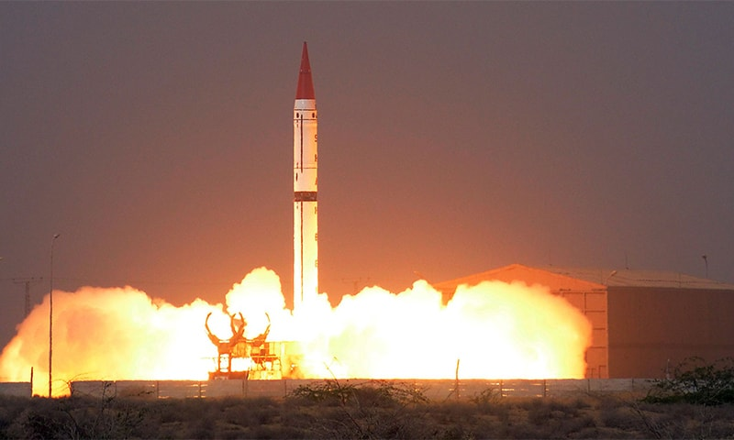
Nuclear issues
By Musab Umair
Notes:
NOTE:
To change the image on this slide, select the picture and delete it. Then click the Pictures icon in the placeholder to insert your own image.

Slide 2
Content
Lecture 3:
Nuclear South Asia
Nuclear Free Zone in South Asia
Confidence Building Measures
Pakistan’s Efforts

Slide 3
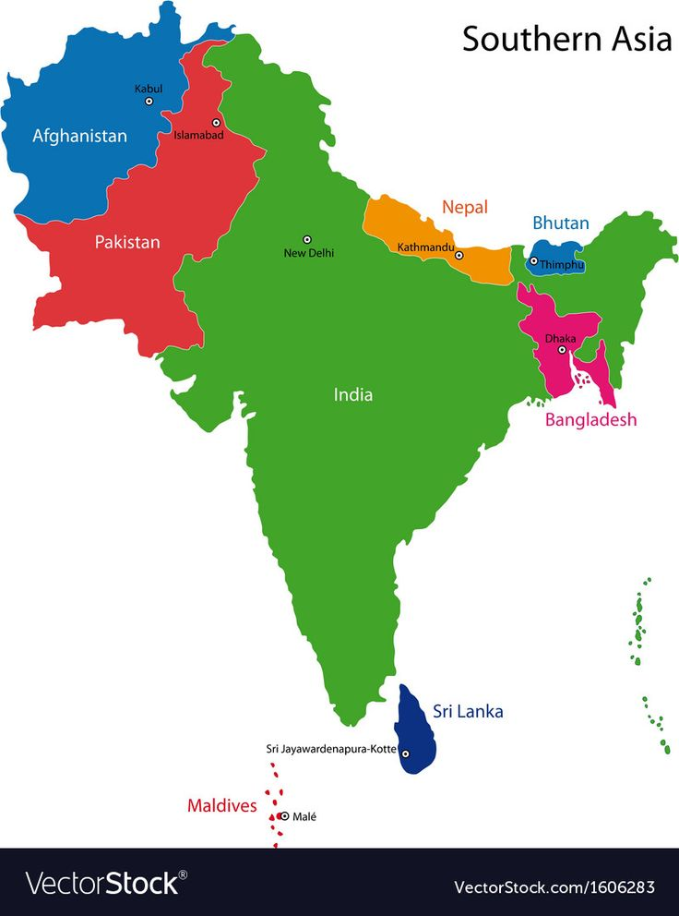
South Asian Countries

Slide 4
Nuclear South Asia
It was India and not Pakistan that introduced nuclear weapons in our region
India started its nuclear programme in 1964 right after Chinese nuclear tests
India’s nuclear doctrine is status led, it strives for regional superpower status
India disguised its nuclear programme as peaceful, they tried to manipulate the west with attempts such as calling it “Smiling Buddha”
The west and major power have been discriminatory in their non-proliferation strategies between Pakistan and India
After India’s nuclear test, Pakistan had no option but to develop its own nuclear bomb to ensure our security

Slide 5
Pakistan’s Efforts for Nuclear-free Zone in South Asia
Pakistan has, over the years, proposed several bilateral or regional non-proliferation steps and confidence-building measures to India, including:
A joint Indo-Pakistan declaration renouncing the acquisition or manufacture of nuclear weapons, in 1978.
South Asian Nuclear Weapons Free Zone, in 1978.
Mutual inspections by India and Pakistan of each other's nuclear facilities in 1979.
Simultaneous adherence to the NPT by India and Pakistan in 1979.
A bilateral or regional nuclear test-ban treaty, in 1987.
A South Asia Zero-Missile Zone, in 1994.
India rejected all six proposals.

Slide 6
Treaty on the Prohibition of Nuclear Weapons (TPNW)
Adopted by UN: July 7, 2017, | In force since: Jan 22, 2021
First international treaty to completely ban nuclear weapons
Prohibits: development, testing, possession, use, and threat of use
Promotes: victim assistance & environmental clean-up
Over 90 signatories, 70+ ratifications (as of 2025)
Not signed by any nuclear-armed state (e.g., India, Pakistan, US)
Pakistan’s stance: Supports universal disarmament, not a party to TPNW
Seen as a symbolic step toward a nuclear-free world

Slide 7
Confidence Building Measures in South Asia
In 1989, they agreed not to attack each other's nuclear facilities. Since then they have been regularly exchanging lists of nuclear facilities on 1 January of each year.
Another bilateral agreement was signed in March 2005 where both nations would alert the other on ballistic missile tests called “Agreement on Pre-Notification of Flight Testing of Ballistic Missiles”
In June 2004, the two countries signed an agreement to set up and maintain a hotline to warn each other of any accident that could be mistaken for a nuclear attack.
Notes:
CBM: Actions or agreements between countries aimed at reducing mistrust, misunderstandings, and the risk of conflict—especially in sensitive areas like defense or nuclear policy.

Slide 8
CBMs – Lahore Declaration 1999
Both countries agreed to establish confidence building measures to avoid nuclear war and inter alia stated:
Recognizes that the nuclear dimension of the security environment of the two countries adds to their responsibility for avoidance of conflict between them.
Commits both to the principles and purposes of the Charter of the United Nations, and the universally accepted principles of peaceful co-existence.
Commits both countries to the objectives of universal nuclear disarmament and nonproliferation.
It also realized the resolution of mutual disputes to ensure avoidance of nuclear conflict

Slide 9
Pakistan’s Position on CBM
Pakistan has maintained that strategic stability in South Asia is inseparably linked to the conventional balance between the two countries.
Imbalance in the conventional field is a destabilizing factor that impacts strategic stability by lowering the nuclear threshold.
The central objective of our proposals has been:
Reduce the risk of conflict
Prevention of an arms race
Promote measures for strategic restraint and strategic stability in South Asia

Slide 10
India’s Position on CBM
India’s approach is restrictive
India does not recognize the linkage between conventional and strategic stability
While showing keenness on nuclear-related CBMs, in part to play to the international audience, India has not been forthcoming on conventional CBMs with Pakistan
India is opposed to any bilateral restraint measures, saying its security concerns transcend South Asia

Slide 11
Pakistan’s Position on Treaties on Weapons of Mass Destruction
Pakistan is a signatory to the following treaties:
Geneva Protocol 1925
Partial Test Ban Treaty
Biological Weapons Convention 1972
Chemical Weapons Convention 1993
Notes:
Geneva - Asphyxiating, Poisonous or Other Gases, and of Bacteriological Methods of Warfare

Slide 12
Pakistan’s Position on Treaties on Weapons of Mass Destruction
Pakistan is NOT a signatory of the following treaties:
Nuclear Non-Proliferation Treaty
Comprehensive Test Ban Treaty
Fissile Material Cut-Off Treaty
Treaty on the Prohibition of Nuclear Weapons
Notes:
Geneva - Asphyxiating, Poisonous or Other Gases, and of Bacteriological Methods of Warfare

Slide 13
Pakistan’s Position on NPT
Pakistan has always favored “general and complete disarmament”
Pakistan had been a vocal participant of NPT negotiations in favour of NPT
However, due to India’s reluctance to sign NPT shifting the strategic balance in South Asia dangerously, Pakistan couldn’t sign NPT
Currently, Pakistan’s stance is against signature of NPT as a NNWS
Foreign Secretary Aizaz Ahmad Chaudhry clarified Pakistan’s stance in 2015:
“It is a discriminatory treaty. Pakistan has the right to defend itself, so Pakistan will not sign the NPT. Why should we?”

Slide 14
Pakistan’s Position on CTBT
Pakistan voted in favour of the resolution of UNGA in 1996 that called for the adoption of CTBT
Therefore, Pakistan was not opposed to the objectives and purposes of the treaty
Pakistan has not signed the treaty yet because of a loophole
The CTBT would not be a complete disarmament measure because some more technologically advanced states would continue to develop and improve weapons designs through sub-critical or non-detectable tests

Slide 15
Pakistan’s Position on FMCT
Pakistan has opposed consensus in the Conference on Disarmament (CD) on the treaty; all 65 members should accept the treaty for it to pass to the UNGA
Pakistan’s reason is the existing disparity in the fissile stockpile between India and Pakistan
India agrees to dismantle future stockpile while Pakistan wants the existing dismantle of stockpile
Later, countries including Egypt, Indonesia, Iran, North Korea, Sri Lanka, and Syria have joined the Pakistani position, while others, like Israel, are remaining silent about their opposition to the treaty and taking advantage of the Pakistani position
Pakistan’s stance is that strategic stability can only happen when there is strategic parity of fissile material
Therefore, the cut-off must be accompanied by a program for the elimination of asymmetries in existing stockpiles
Notes:
The CD is the world’s sole multilateral disarmament negotiating forum, based in Geneva.
Fissile Material Cut-off Treaty (FMCT), Discussed Since 1990’s

Slide 16
Anti Ballistic Missile Systems
Anti-Ballistic Missile Systems are used to intercept Ballistic Missiles mid-flight and neutralize them
8 countries in the world have missile defense systems
India, with its Prithvi Air Defence system, gained the technology in 2006
Anti-Ballistic Missiles counter the nuclear deterrence capabilities in turn causing a strategic imbalance
The strategic imbalance leads to nuclear buildup in an attempt to counter the defense
ABM in South Asia by India would force Pakistan to develop an ABM system of its own or build nuclear warheads to counter the Indian ABM with quantity.

Slide 17
Second Strike Capability
The second-strike capability is the ability of a nation to counter a first nuclear attack on its territory
Conventionally in South Asia, a second-strike capability was attempted by having multiple nuclear warheads distributed widely as to avoid an attack
In 2017, India inaugurated INS Arihant, its nuclear-capable submarine which gave it submarine-launched second-strike capability, disturbing the strategic balance in South Asia
As a result, Pakistan is forced to counter this deficiency by quantity of warheads, mobile missiles, and by working on its nuclear-capable submarine

Slide 18
Sample Questions – Lecture 1
What obligations does the Nuclear Nonproliferation Treaty (NPT) impose on different categories of countries? Why have these obligations been the subject of disagreement in the decades since the treaty was negotiated?
How have the threats posed by nuclear weapons evolved over time? Are these threats greater today than in past decades, and if so, how?
What is a Nuclear Umbrella? Has this policy measure successfully served its purpose?
In what ways are the peaceful use of nuclear energy and the production of nuclear weapons related? What challenges does this relationship pose to nonproliferation efforts?
Why have some countries chosen to pursue nuclear weapons while others have not? How have the general international context, and specific historical events, affected certain countries’ decisions?
To what extent is the NPT an effective tool for limiting the spread of nuclear weapons? In what ways has it succeeded and in what ways has it fallen short?

Slide 19
Sample Questions – Lecture 1
The U.S. withdrawal from the JCPOA (Iran Nuclear Deal) and its support for Israel have reshaped Middle East power dynamics. Discuss the geopolitical consequences.
In light of the Iran-Israel tensions, analyze how nuclear proliferation in the Middle East threatens the global non-proliferation regime. Suggest measures to prevent escalation.
Can the Iran-Israel rivalry be contained under existing international diplomatic frameworks? Evaluate the effectiveness of the UN and IAEA in addressing nuclear disputes.“

Slide 20
Sample Questions – Lecture 2
What are the international concerns about Pakistan’s nuclear programme? What has Pakistan done to address them?
Since the 2003 episode, what measures has Pakistan taken to ensure the safety and security of its nuclear programme.?
What are the pillars of Pakistan’s nuclear safety regime and how do they work?
What is Pakistan’s current nuclear doctrine? How has it changed in the past couple of decades?
What were the reasons behind Pakistan’s development of nuclear weapons? Did the development of nuclear weapons help Pakistan address those reasons?
“Pakistan’s nuclear weapons have shifted from being a liability to an asset.” Discuss.
In the wake of renewed hostilities between Pakistan and India in 2025, assess the risk of nuclear escalation in South Asia. How effective are existing confidence-building measures (CBMs) in preventing a nuclear exchange?

Slide 21
Sample Questions – Lecture 3
What role has nuclear deterrence played in establishing strategic stability in South Asia? Would South Asia be more stable with or without nuclear weapons?
“Pakistan is an aggressive nuclear state.” Do you agree with this statement? What measures has Pakistan taken that may refute or support this statement?
What has Pakistan’s position been on major non-proliferation treaties?
India has been developing and improving its Missile Defence System. How would this system affect the strategic balance in South Asia? What measures can Pakistan take in this regard?
What confidence-building measures do have Pakistan and India have in place to reduce the risk of a nuclear conflict? Are they enough to avoid Mutually Assured Destruction?
Pakistan has made numerous efforts to avoid a nuclear arms race in South Asia. What are they? Have they been successful?
How has nuclear deterrence influenced conventional warfare dynamics in South Asia? Discuss in light of the implications of a limited war between Pakistan and India in 2025.

