Slide 1
EMR/Optical Fiber
Mobile Communication Satellite (GPS, NAVSTAR: The Navigation Satellite Timing and Ranging GPS) Basics of Computer Semiconductors, Ceramics

Slide 2
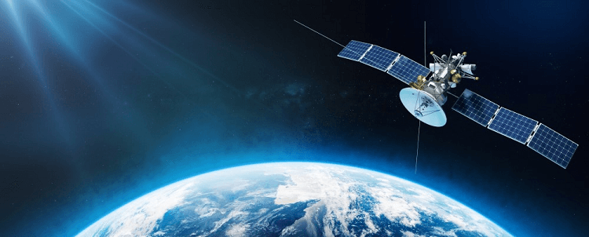
Satellite
A satellite is an object that orbits a larger object in space:
Natural satellites: Celestial bodies that orbit a larger body, such as the Earth and Moon
Man-made satellites: Machines launched into space to orbit a body, such as the Hubble Space Telescope and the International Space Station

Slide 3
GPS
A satellite based navigation system that allows users to determine their precise location, speed and time anywhere on Earth
Uses radio waves to navigate or share information
Segments: 1. Space Segment 2. GPS Control Segment a. Master Control Stations (Ground Segment, send data to satellite) b. Grand Antennas and Monitoring Stations (Receiver, data from satellite) 3. User Segment

Slide 4
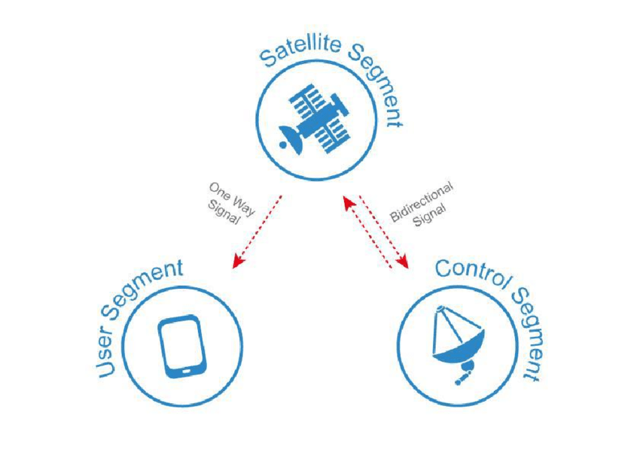

Slide 5
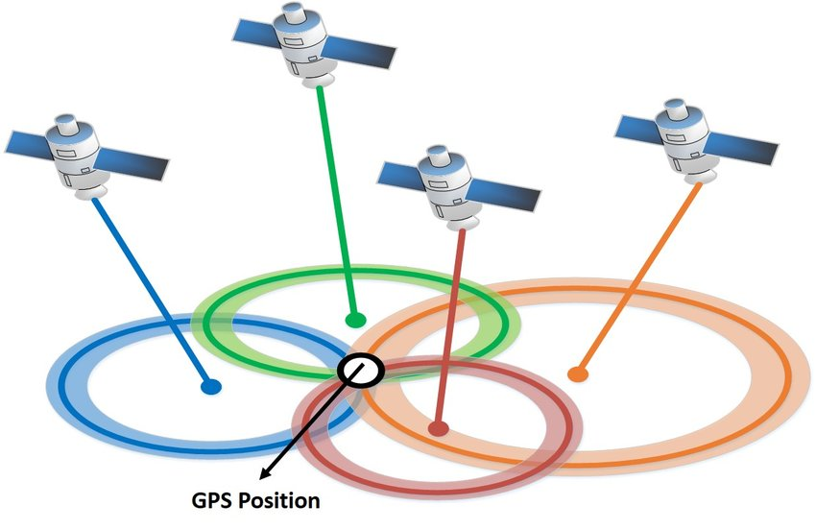
Working (Trilateration)

Slide 6
USES
Navigation for Transportation
Aviation navigation
Military and defense
Weather prediction
Wildlife conservation
Agriculture
Mining and geology
Maritime Application
Space exploration and satellite tracking
Emergency services
Surveying and Mapping
Telecommunication and Network synchronization
Disaster Response and Management

Slide 7
Types
GEO
Polar
Above equator
Communication (TV)
Weather forecasting
Take one day to complete the orbit
36000km from surface
42200km from center
Synchronized with Earth’s rotation
Above earth
Circular Orbit
Above north and south pole
Earth observation
Two orbit in one day
Detailed information of whole earth
200km to 1000km
High resolution
Sun-synchronization
Spy, Scientific research
Above pole
Elliptical Orbit

Slide 8
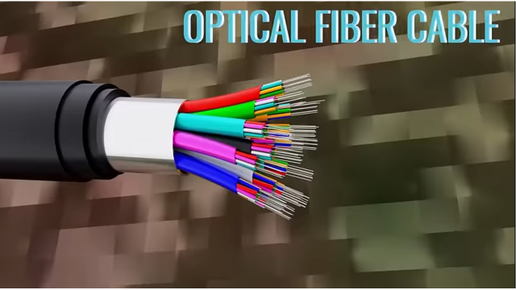

Slide 9
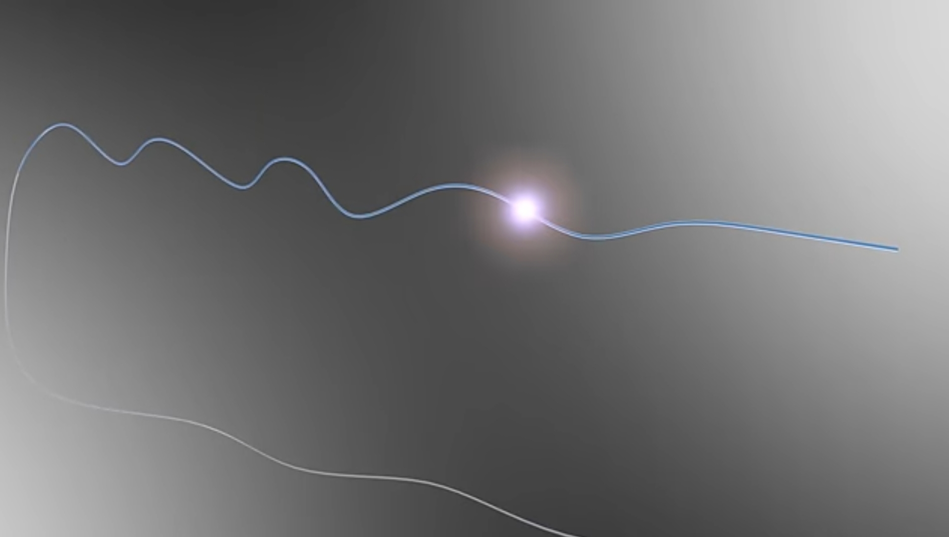

Slide 10
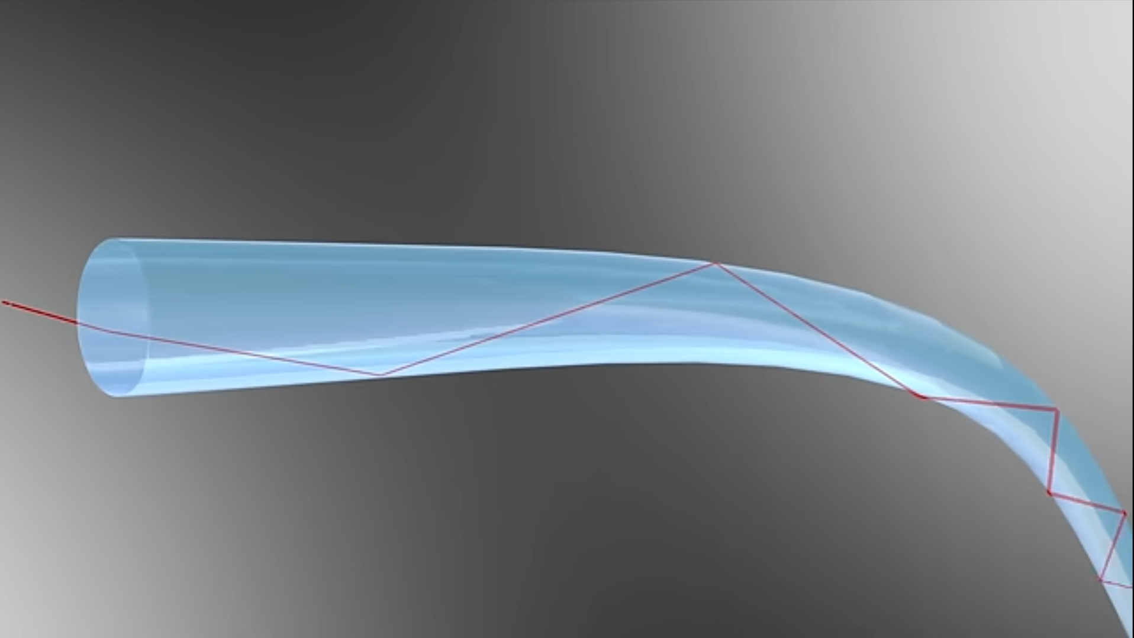

Slide 11
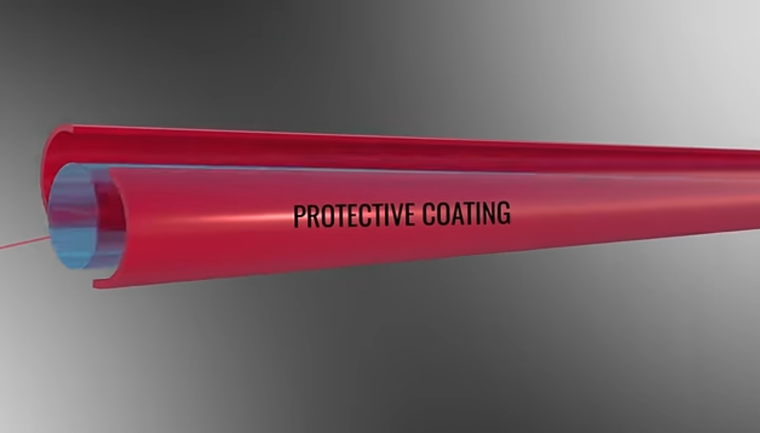

Slide 12
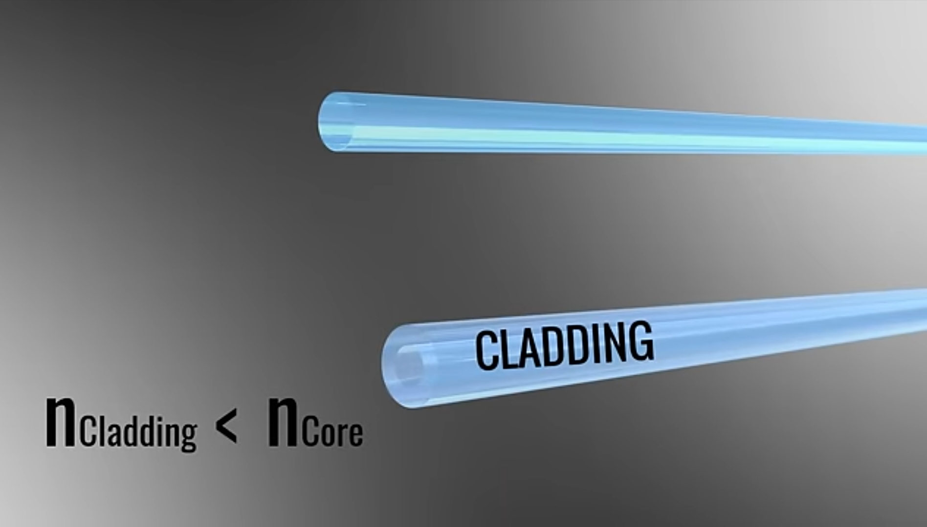

Slide 13
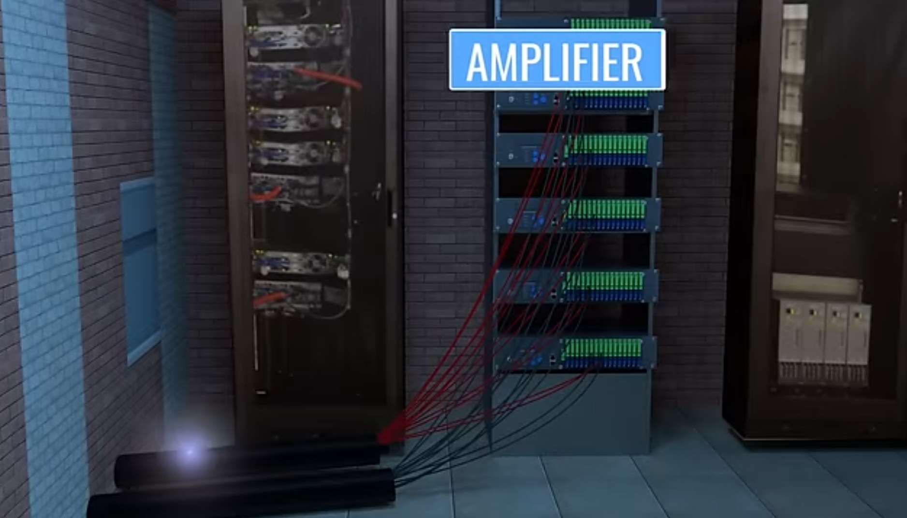

Slide 14
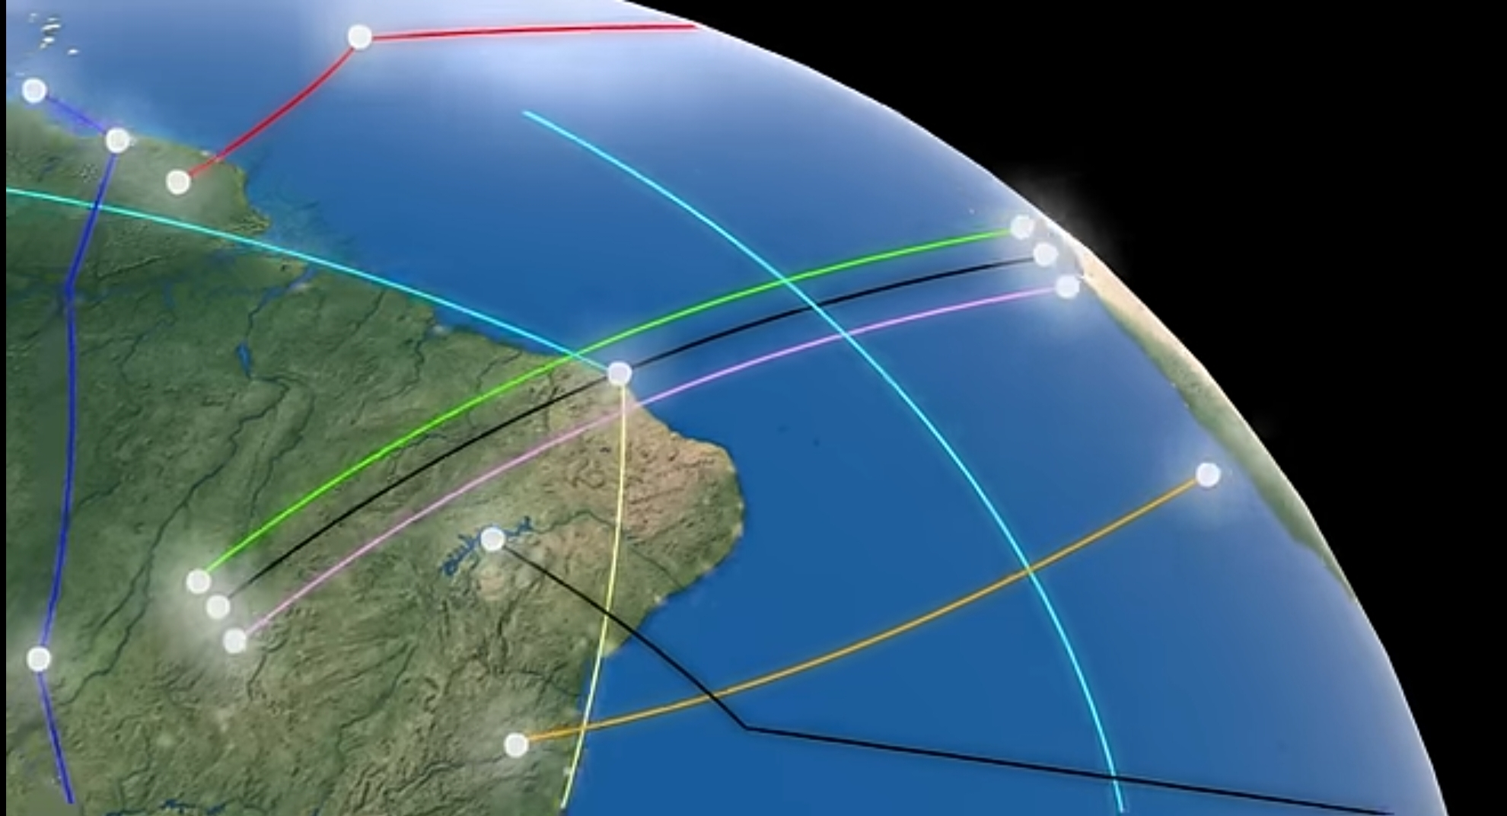

Slide 15
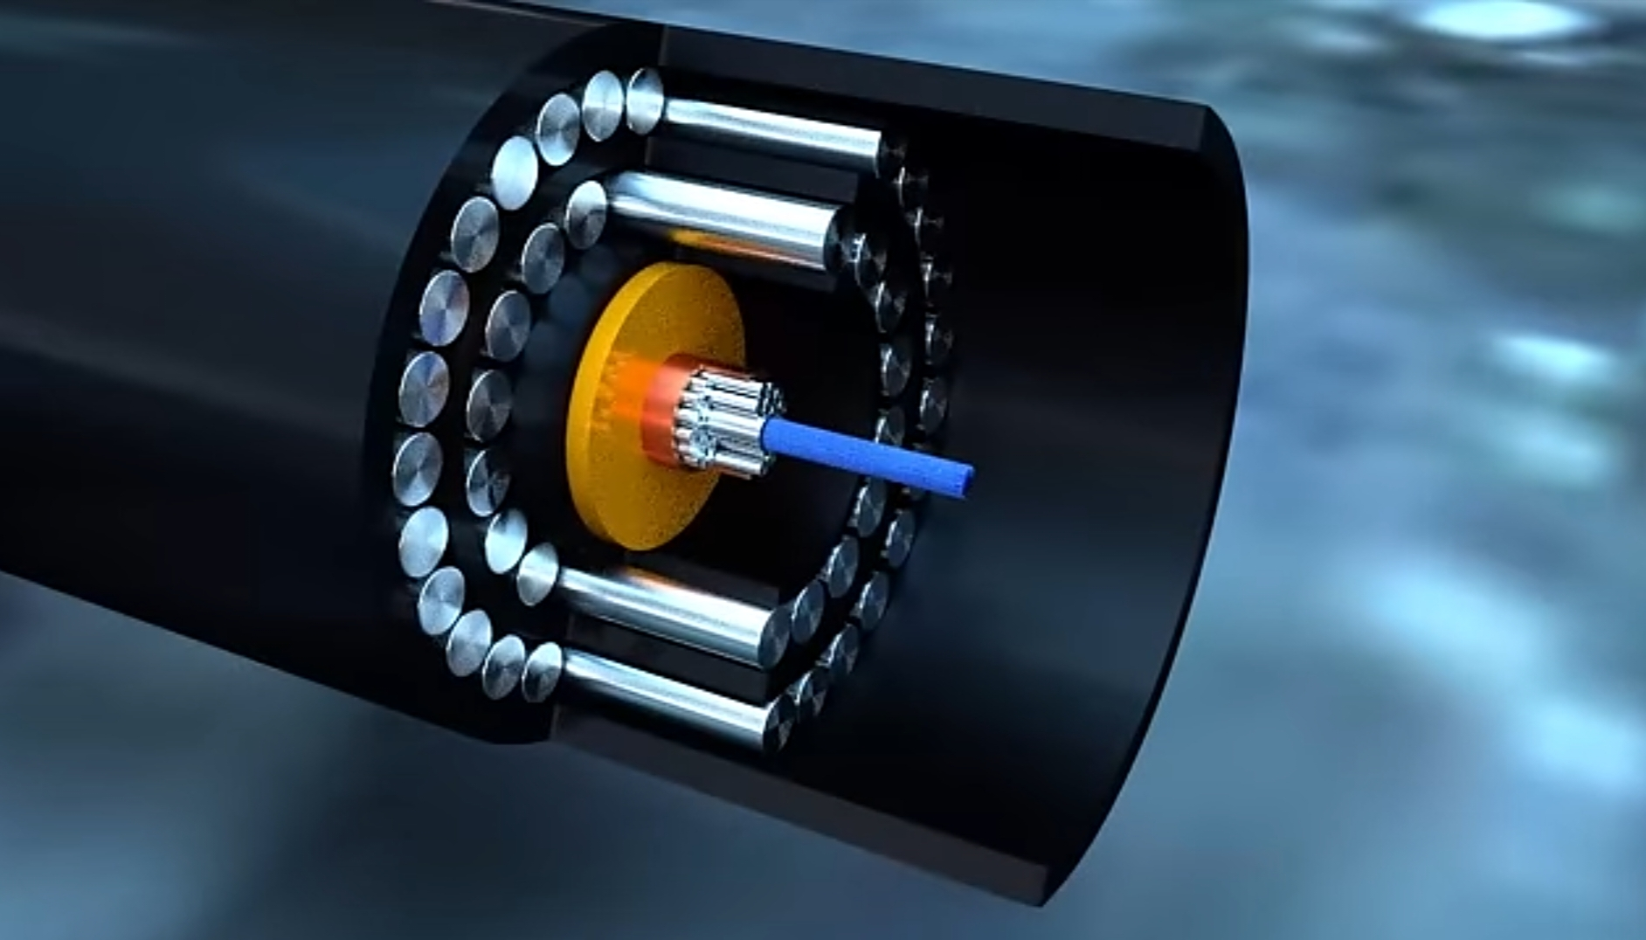

Slide 16
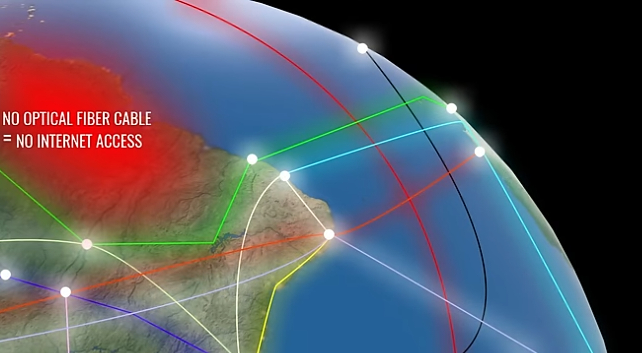

Slide 17
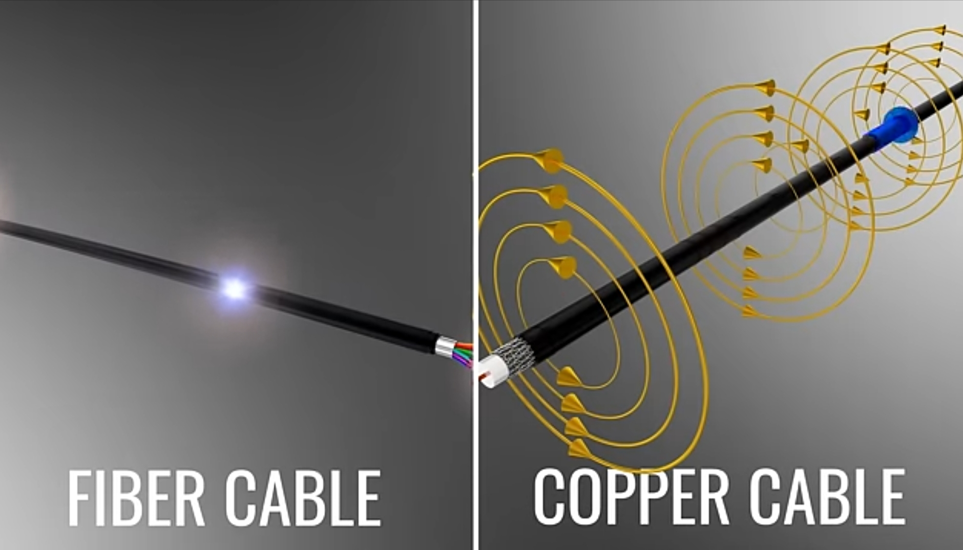

Slide 18
Basic of Fiber
Core: Light mainly propagates along the core, glass/plastic
Cladding: Glass/Plastic Reduces loss of light from the core into the surrounding Reduces scattering loss at the surface of the core Protects the fiber from absorbing surface containments Add mechanical strength
Coating: Used to protect the fiber from physical damage Elastic in nature
Jackets: Used to bundle all fiber in one cable

Slide 19
Types of Fiber
Multimode: (Orange) Designed to carry more than one signal at a time Each with a slightly different reflection angle Used for short distance (less than 500m)
Single-mode: (Yellow) One signal at a time Narrow core For long distances (more than 500m)

Slide 20
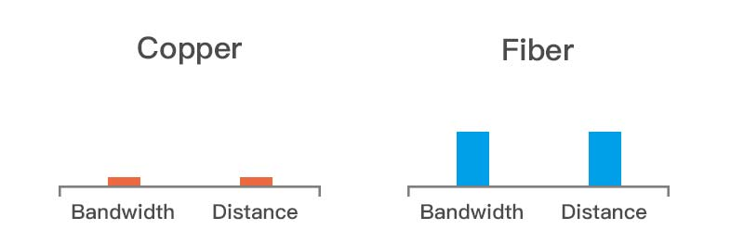
Advantages and Disadvantages
Bandwidth, greater than metal cables
Low power loss
Interference free
Size (cross sectional area less than copper)
Weight
Safe (dielectric, doesn't present a spark hazard)
Secure (difficult to tap)
Flexible
Cost efficient
Cost: Expensive to install
Transmission: require repeating at distance
Fragile
Protection: Require more protection

Slide 21
USES
Telecommunication
Broadcasting and Streaming
Automotive and aerospace
Banking and Financial transaction
Underwater and submarine communication
Retail and E-commerce
Medical Imaging and surgery
Defense and Military Communication
Industrial automation
Power and Energy sector
Security system
Remote sensing and environmental monitoring
Robotic Industry

Slide 22
Mobile Communication

Slide 23
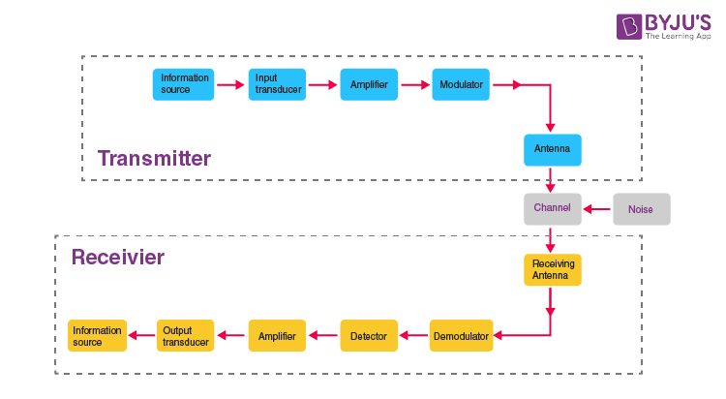
Cell Phone Block Diagram

Slide 24
Signal: The signal-valued function of time carries the information. Converted into electrical form.
Transducer: Converts one form of energy to another. The Photo detector: Light signal into electrical signal
Amplifier: Increases the amplitude or strength of transmitted signals. B/w transmitter and receiver. DC power source will be provided.
Modulator: An original message (Signal) cannot be transmitted over a large distance because of their low frequency and amplitude, they are superimposed with high frequency and amplitude waves called carrier waves. Amplitude Modulation Frequency Modulation Phase Modulation
Transmitter: It is the arrangement that process the message signal into a suitable form for transmission
Receiver: An arrangement that extracts the message or information from the transmitted signal at the output end
Antenna: A structure or devices tat will radiate and receive electromagnetic waves. Basically a metallic object, often a collection of wires
Demodulator: Opposite of modulation, separation of message signal from carrier waves
Repeater (Tower): Repeaters are placed at different locations b/w the transmitter and receivers. A repeater receives the transmitted signals, amplifies it and sends it to the next repeater without distorting the original signal

Slide 25
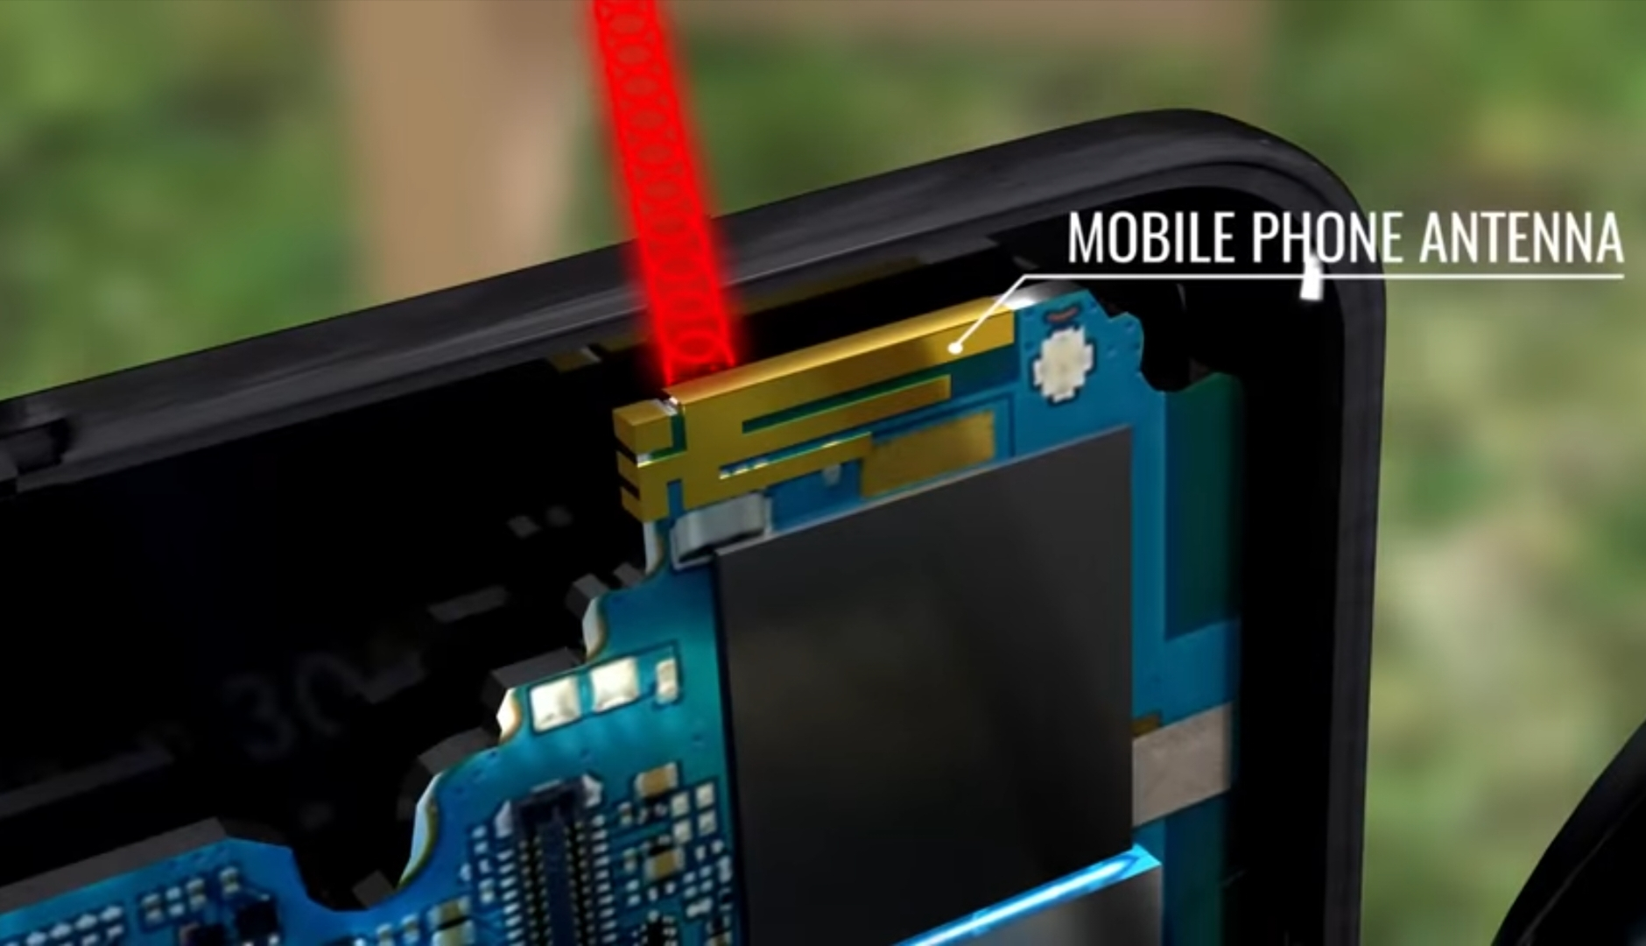

Slide 26
Artificial Intelligence (AI)
With circuits and codes, it learns to think, mimicking minds in each data link, a future forged in algorithmic ink
The science and engineering of making intelligent machines
AI as systems capable of exhibiting behavior that would be considered intelligent if performed by humans

Slide 27
Importance
Health care diagnostic
Enhanced security
Agriculture innovation
Improved transportation
Efficient data management
Personalized education
Predictive maintenance
Financial forecasting
Nature disaster prediction
Environmental monitoring
Supply chain optimization

Slide 28
Impacts
Job displacement
Death of creativity
Cyber security threats
Labor market transformation
Health care disparities
Ethical dilemma
Economic inequality
Social manipulation
Dependence of technology
Mental health issues
Enhanced surveillance states
Cultural homogenization
Erosion of traditional jobs
Impact on International Relations

Slide 29
Hardware
The physical part of a computer that can be touched and manipulated
An umbrella term of physical components
Required to function a component in sequential order
E.g. Input devices, output devices, motherboard, CPU, heat sink, VR, transistors, dielectric etc

Slide 30
Basic Of Computer
Input Devices: Mouse, Keyboard, Camera, microphone, joystick, scanner, light pen, etc.
Output Devices: Monitor, Printer, Projector, speaker, headphones, etc.

Slide 31
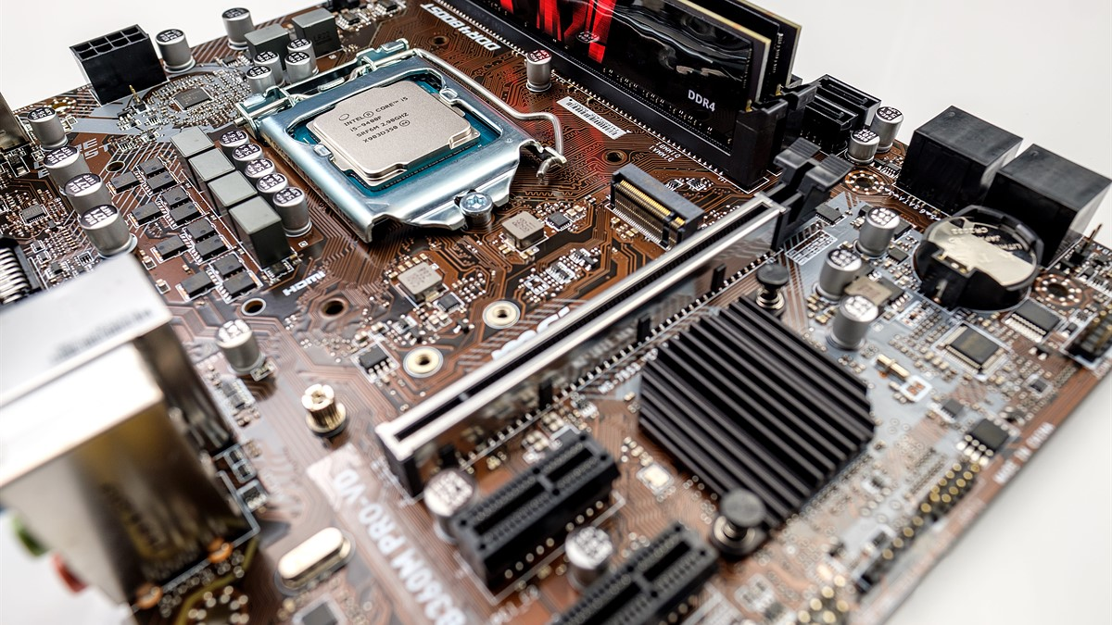
Motherboard

Slide 32
Motherboard
Main circuit
Connects all the internal components (Memory, graphics cards, processor and other hardware)
Provides power to each component and allows them to communicate (through slots and ports) with each others

Slide 33
CPU
Block Diagram
Electric Circuitry (Transistors)
Carries out the instruction of a computer
Connects with DRAM
Performs the basic arithmetic logics and control the input operation
Processors: Multi, dual and Quad-Core processors
ALU: Perform basic arithmetic and comparison using binary number (0,1).
CU: Manager of all operations, handles all processor control signals, direct all the input and output flow, it issues order and ensure execution correctly. Brain of Processor.

Slide 34
GPU
Graphic processing unit
Chip based devices used for graphical quality

Slide 35
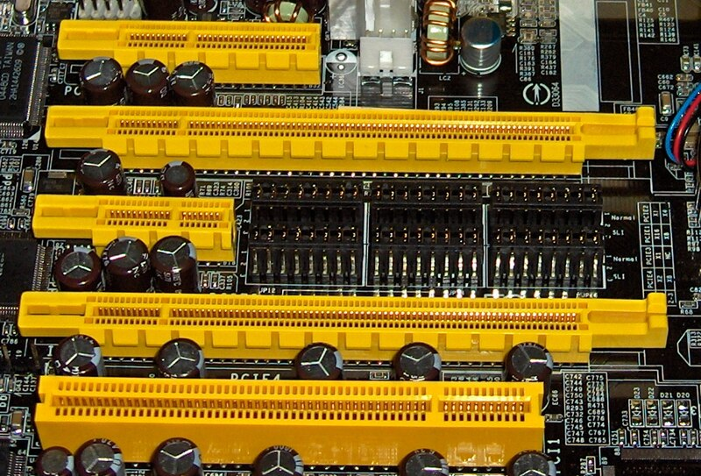
Computer Buses

Slide 36
Computer Buses
Consists of a parallel lines
Used to transfer data between different component of the computer
One-line buses can transfer one bit at a time
The capacity of a computer bus depends on the number of lines on it
A bus is a communication system that transfer data b/w component inside a computer
System Buses: (part of motherboard)
Internal Buses: (connect internal components of a computer)
External Buses: (connect the different external devices, such as printer etc.)

Slide 37
Types of Buses
Data Buses: Transfer data to and from the memory of a computer It acts like an engine
Address Buses: Provide address to data access The address is stored in the form of a binary numbers to enable the data bus the access memory storage
Control Buses: Manage communication b/w CPU and Other components Coordinate and regulate the hardware actions Ensuring that operations are carried out in correct sequence

Slide 38
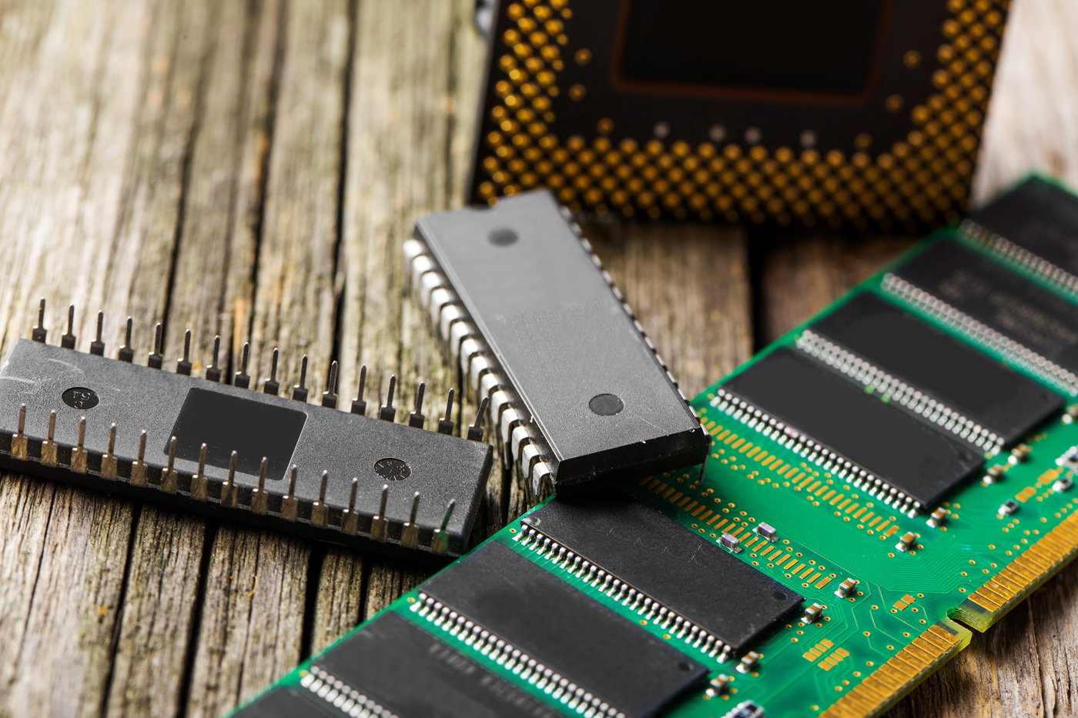
Memory (RAM&ROM)

Slide 39
RAM (Random Access Memory)
Volatile memory: Temporary storage on motherboard in modules called DIMMS (dual line memory modules), 168, 184, 240, 288 pins
Installed in the memory slots
Stores data and machine code currently being used
Allows to read or write in the same amount of time irrespective of their physical location
Increasing the numbers of RAMs will make computer faster
Requires constant electric supply to store data
RAM contains multiplexer and demultiplexer
Non-Volatile RAMs have developed (e.g. NOR-Flash)

Slide 40
Types
DRAM: Dynamic RAM (contains capacitors)
SDRAM: Synchronous-DRAM
RIMM: Rambus inline memory modules (184pins)
DDR: Double data rate
DDR2&DDR3 (240pins)
DDR4: (288pins)
ECC: Error correction code

Slide 41
ROM (Read Only Memory)
ROM is a memory containing hard-wired instructions that the computer uses when it boots up
Non-Volatile: Permanent Memory
Memory is maintained even after the power is shut off.
The data stored cannot be changed
Data stored from the factory
Can be overwrite through a special process
When the power is supplied to the system, by turning on, it knows what to do
BIOS: Instructor (Memory that is hard-wired, such as diode)

Slide 42
Types
MROM: Masked Read Only Memory
PROM: Programmable read only memory
EPROM: Erasable-PROM
EEPROM: Electrically-EPROM

Slide 43
Software
A set of instructions that tell a computer, what to do, how to do and when to do
A collection of programs, procedures and routines that run a computer system

Slide 44
Types
System Software: Controls the computer internal functions, including the operating system, monitor, printer and storage devices a. System management program Operating System Device Drivers System Utilities b. Developing Software Language and Translator
Application Software: Directs the computer to perform tasks based on user commands a. For General Purpose (Word processor, image editor, paint etc) b. Specific Purpose (Reservation system, NOA LMS, Attendance system, Billing System, Report card etc)

Slide 45
Importance of software
Accessibility. This is the degree to which a diverse group of people, including individuals who require adaptive technologies such as voice recognition and screen magnifiers, can comfortably use the software.
Compatibility. This is the suitability of the software for use in a variety of environments. Software compatibility is important for different devices and browsers.
Efficiency. This is the ability of the software to perform well without wasting energy, resources, effort, time or money.
Functionality. This is software's ability to carry out its specified functions.
Installation. This is the ability of the software to be installed in a specified environment.
Localization. For software to function correctly, it needs localization, which entails the various languages, time zones and other features a software program can works in.

Slide 46
Maintainability. This is how easily the software can be modified to add and improve features and fix bugs.
Performance. This is how fast the software performs under a specific load.
Portability. This is the ease with which the software can be transferred from one location to another.
Reliability. This is the software's ability to perform a required function under specific conditions and for a defined period without any errors.
Scalability. A software's ability to increase or decrease performance in response to changes in its processing demands is its scalability.
Security. This is the software's ability to protect against unauthorized access, invasion of privacy, theft, data loss and malicious software.
Testability. This is how easy it is to test the software.
Usability. This is how easy it is to use the software.

Slide 47
Networking and Internet
Networking: The process of building relationships and making connections
The internet is defined as a global network of linked computers, servers, phones, and smart appliances that communicate with each other using the transmission control protocol (TCP) standard to enable the fast exchange of information and files, along with other types of services.

Slide 48
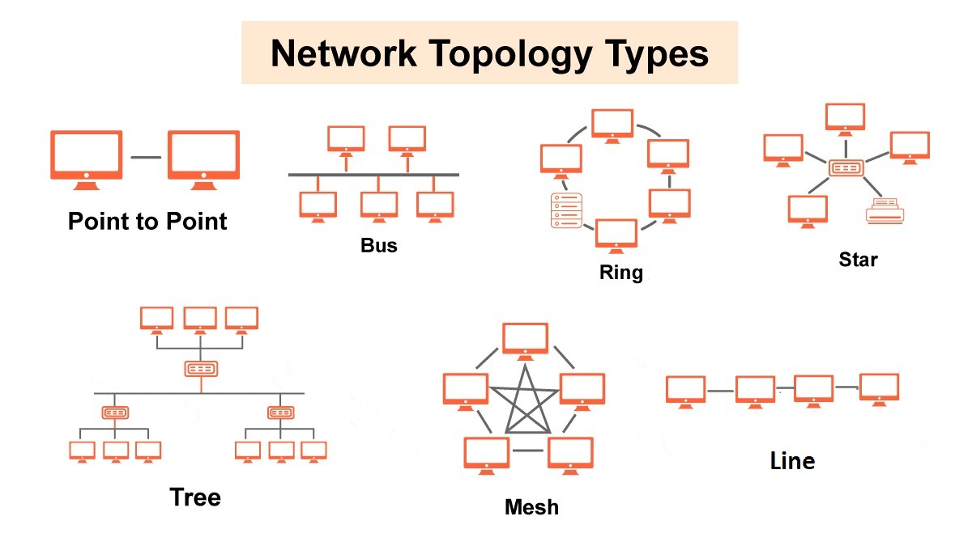

Slide 49
Semiconductors
A solid material that can conduct electricity under certain conditions
P-type Semiconductors
N-type Semiconductors

Slide 50
Ceramics
An organic non-metallic solid made up of clay that have been shaped and then hardened by heating to high temperature, like tiles, bricks, plates, glass and toilets
Ceramic can be found in: Watches, Automobiles

Slide 51
General Properties
Hard, extremely strong, showing considerable stiffness under compression and bending
Corrosion resistant and durable
High melting point
Do not react with most liquids, gases, alkalis and acids
Thermal and electrical insulators but some conduct electricity (Chromium dioxide)
Non-magnetic but some containing Iron oxide
Oxidation resistant
Brittle, having little elasticity

