Slide 1
enzymes

Slide 2
What are enzymes ?
Enzymes are proteins that act as biological catalysts by accelerating chemical reactions by lowering its activation energy
The molecules upon which enzymes may act are called substrates
The substrate is converted into different molecules known as products

Slide 3
Enzymes are also produced commercially!
Enzymes are used commercially, for example:
In the synthesis of antibiotics
In biological washing powders break down protein, starch or fat stains on clothes
In meat tenderizer break down proteins into smaller molecules, making the meat easier to chew
Dairy industry – Renin is used in the manufacturing of cheese
Environmental use – Degradation of residual waste and detoxification of toxic substances
Also used in tanning industry, textile industry and biofuel production

Slide 4
Characteristics of enzymes
Increases the rate of a reaction
Cellular reactions occur a million times faster in the presence of enzymes
Enzymes are proteins in nature
Sensitive to PH
Sensitive to Temp. Higher temperatures can denature enzymes.
Enzymes are mostly substrate specific

Slide 5
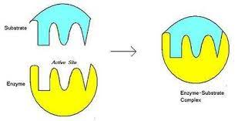
Lock & key model
To explain the observed specificity of enzymes, in 1894 Emil Fischer proposed that both the enzyme and the substrate possess specific complementary geometric shapes that fit exactly into one another. This is often referred to as "the lock and key" model

Slide 6
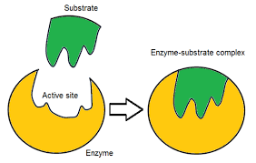
Induced fit model
In 1958, Daniel Koshland suggested a modification to the lock and key model: since enzymes are rather flexible structures, the active site is continuously reshaped by interactions with the substrate as the substrate interacts with the enzyme

Slide 7
Co-factors
Most enzymes are proteins. However, some enzymes also have a non-protein molecules called “cofactors” required for full activity
Cofactors can be either inorganic e.g (metal ions and iron–sulfur clusters) or organic compounds e.g (flavin and heme)
The protein part of the enzyme is called “apoenzyme”
The cofactor and apoenzyme together are called “holoenzyme”

Slide 8
THANK YOU!

