Slide 1
diseases

Slide 2
malaria
Malaria is caused by single-celled microorganisms of the Plasmodium group
The plasmodium has five types namely P. falciparum, P. vivax, P. ovale, and P. malariae and P. knowlesi
Malaria is a mosquito-borne infectious disease that affects humans and other animals
So the vector in case of malaria is the anopheles mosquito

Slide 3
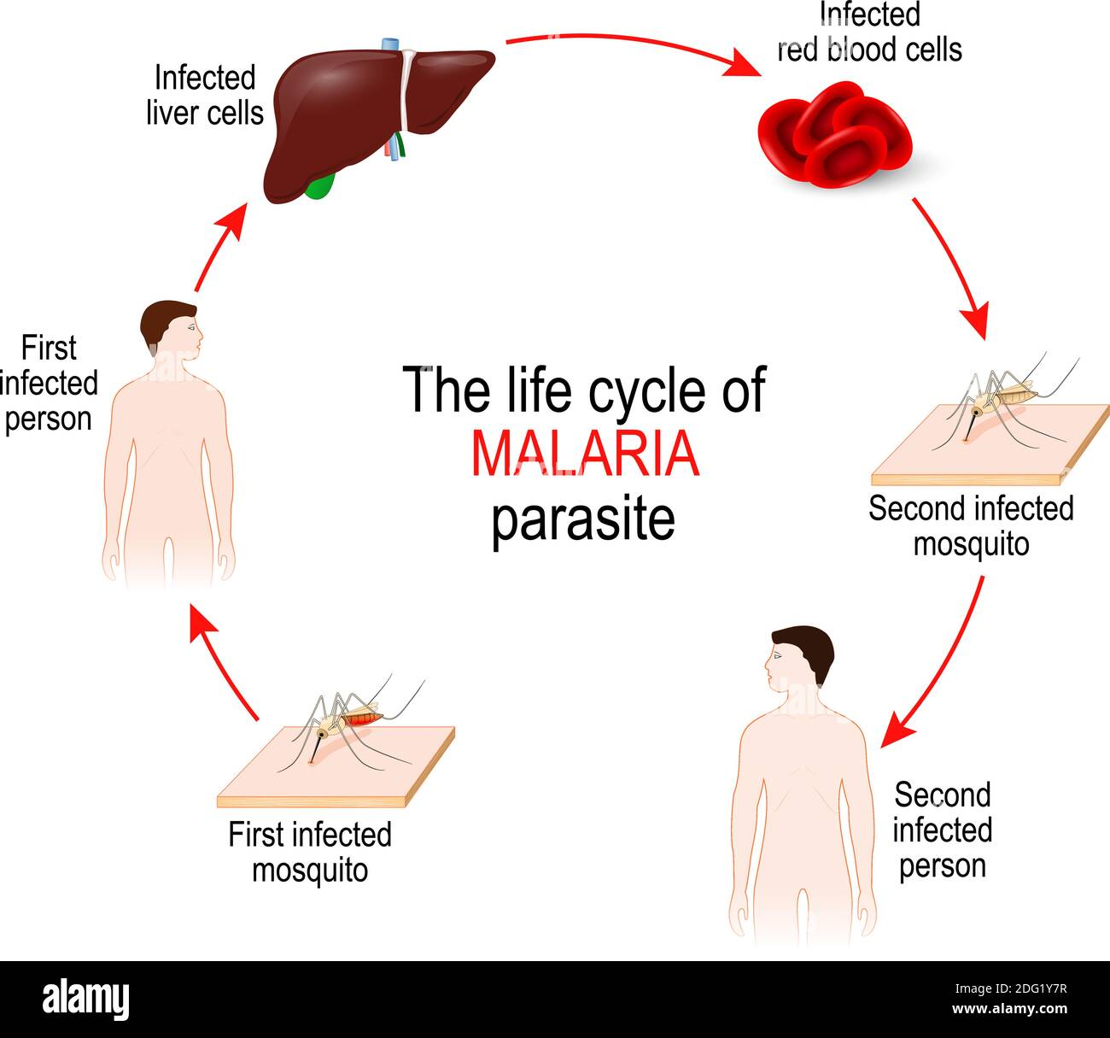
Transmission & The cycle of malaria

Slide 4
Symptoms of malaria
Malaria causes symptoms that typically include fever, fatigue, vomiting, and headaches
In severe cases, it can cause jaundice, seizures, coma, or death
Symptoms usually begin 10 to 15 days after being bitten by an infected mosquito

Slide 5
Treatment of malaria
  Quinine
  Chloroquine
  Hydroxychloroquine
  Pyrimethamine
  Halofantrine
  Lumifantrine etc.

Slide 6
polio
Poliomyelitis, commonly shortened to polio
It is an infectious disease caused by the poliovirus
Polio occurs naturally only in humans

Slide 7
Transmission of polio
It is highly infectious and is spread from:
  Person to person either through fecal-oral transmission(e.g. poor hygiene, or by ingestion of food or water contaminated by human feces)
  Via the oral-oral route

Slide 8
Signs and symptoms
Common symptoms include sore throat and fever, headache and neck stiffness
In paralytic polio poliovirus spreads along certain nerve fiber pathways, preferentially replicating in and destroying motor neurons within the spinal cord, brain stem, or motor cortex leading to paralysis of one leg most commonly in children under 5 while extensive paralysis of the chest and abdomen also affecting all four limbs – quadriplegia most commonly in adults
Spinal polio invades the spinal column affect muscles on both sides of the body, but more often the paralysis is asymmetrical
Bulbar polio invades the brain stem causing double vision, difficulty in chewing,, abnormal respiratory rate, depth, and rhythm (which may lead to respiratory arrest), pulmonary edema and shock are also possible and may be fatal
Bulbospinal polio have both bulbar and spinal symptoms

Slide 9
Treatment and prevention of polio
There is no cure for polio
Prevention is possible through immunization
Salk vaccine – injected (contains killed vaccine)
Sabin vaccine – given orally (contains live attenuated vaccine)

Slide 10
dengue
Dengue fever is caused by dengue virus spread by a mosquito
The mosquitoes which act as a vector happen to be female mosquitoes mainly of the specie Aedes Aegypti
Symptoms: These may include a high fever, headache, vomiting, muscle and joint pains, and a characteristic skin itching and skin rash. Sometimes it may develops into a more severe dengue hemorrhagic fever, resulting in bleeding, low levels of blood platelets and blood plasma leakage, or into dengue shock syndrome, where dangerously low blood pressure occurs
Two types of dengue vaccine have been approved and are commercially available - Qdenga (live tetravalent attenuated vaccine) and Dengvaxia
Treatment includes giving fluid either by mouth or intravenously for mild or moderate disease. For more severe cases blood transfusion may be required. Paracetamol (acetaminophen) is recommended instead of nonsteroidal anti-inflammatory drugs (NSAIDs) for fever reduction and pain relief

Slide 11
THANK YOU!

