Slide 1
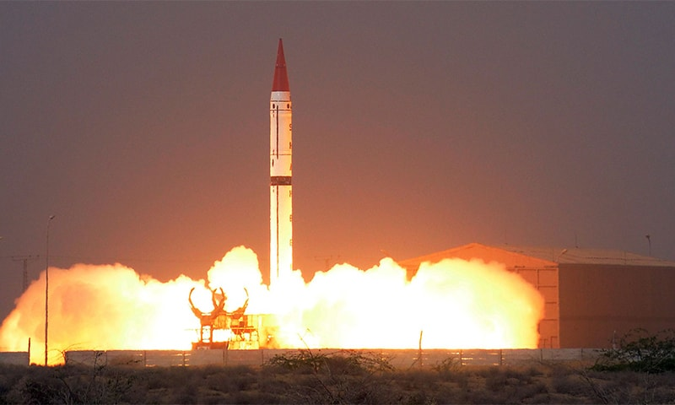
Nuclear issues
By Musab Umair
Notes:
NOTE:
To change the image on this slide, select the picture and delete it. Then click the Pictures icon in the placeholder to insert your own image.

Slide 2
Content
Lecture 2:
A Brief History of Pakistan’s Nuclear Programme pre-1998
Dr. Abdul Qadeer Khan Episode
Current Nuclear Regime of Pakistan
Pakistan’s Nuclear Doctrine
International Concerns on Pakistan’s Nuclear Prog
Comparison of Nuclear Policies of India and Pakistan
Suggestions for Pakistan to enhance deterrence
Suggestions for both to maintain peace

Slide 3
Pakistan’s nuclear programme
A brief history

Slide 4
Brief History of Pakistan’s Nuclear Programme
PAEC
PARR - I
Multan Meeting
MA Khan – A Khan Meeting
KANUPP
1965
1956
1965
1972
1972
TPG
A Q Khan
First Cold Test
Youm-e-Takbeer
1974
1972
1983
28th May 1998
1974
India’s Nuclear Test
Notes:
TPG :Technical Planning Group

Slide 5
Pakistan’s Nuclear Programme – Pre-1971
Pakistan initially wanted to have a peaceful nuclear programme:
In 1953, Foreign Minister Muhammad Zafarullah Khan publicly stated that "Pakistan does not have a policy towards the atom bombs".
Pakistan became an active part of the Atoms for Peace Program and received PARR-I in 1955
The Pakistan Atomic Energy Commission was formed to oversee peaceful nuclear technology in 1956
Pakistan Institute of Nuclear Science and Technology (PINSTECH) was also formed under Dr. Abdus Salam in 1965
Uranium deposits were discovered near Dera Ghazi Khan in 1970
The first civil-purpose nuclear power plant, built by Canada, based on the CANDU reactor technology, was constructed near Karachi
Called KANUPP-I, this plant was completed in 1972
Notes:
PARR1 :( Pakistan Atomic Research Reactor)]
CANDU : Canada Deuterium Uranium
KANUPP-I :Karachi Nuclear Power Plant Unit 1
Acc to International Campaign to Abolish Nuclear Weapons: In 2022, Pakistan spent an estimated US$1 billion to build and maintain its nuclear weapons.

Slide 6
The Need for Nuclear Weapons
A lesson from the fall of Dhaka 1971 was that Pakistan could not rely on allies such as the United States or China to protect it against the much bigger and aggressive India
India was economically, militarily, geographically and demographically bigger than Pakistan and growing; Pakistan would not be able to deter it conventionally
India was already in the process of developing nuclear weapons, as Munir Ahmed Khan had already notified; a nuclear India against a non-nuclear Pakistan, would have tilted the strategic balance in South Asia dangerously against Pakistan
Pakistan had great scientists and engineers, such as A.Q Khan, Abdus Salam, Munir Ahmed Khan, Raziuddin Siddiqui, Tufail Naseem, etc., who could help her develop nuclear weapons
Notes:
Munir khan was a Pakistani nuclear engineer who is credited, among others, with being the "father of the atomic bomb program" of PakistanFrom 1972 to 1991, Khan served as the chairman of the Pakistan Atomic Energy Commission (PAEC)

Slide 7
The Need for Nuclear Weapons
"If India builds the (atom) bomb, Pakistan will eat grass or leaves, even go hungry, but we (Pakistan) will get one of our own (atom bomb)." (Z.A. Bhutto)
India conducted its first nuclear test, codenamed "Smiling Buddha", on May 18, 1974. Pokhran-II (Operation Shakti) was a series of five nuclear weapon tests conducted by India in May 1998

Slide 8
Developing Nuclear Weapons
Pakistan started its development of nuclear weapons in 1972
Zulfiqar Ali Bhutto, Munir Ahmed Khan, and Abdus Salam gathered premier Pakistani scientists and engineers working around the world for the program
Initially, the less technologically advanced plutonium-based gun-type fission weapon was planned, but later on, the uranium-based implosion-type weapon was worked upon
AQ Khan, having worked at Urenco Group in the Netherlands, had technical expertise in gaseous centrifuges, which were then developed and used by PAEC for uranium enrichment
The first cold test was successfully carried out in 1983
Pressler Amendment 1985
Finally, nuclear tests were on 28th May 1998 and 30th May 1998
On the first day, series of tests named Chagai-1 in which 5 uranium-based devices were successfully tested, while on the second day, test named Chagai-II a plutonium-based device was tested successfully
Notes:
Pakistan Atomic Energy Commission (PAEC)

Slide 9
Nuclear Proliferation Episode/2003 Episode/ Dr.A.Q.khan Episode
In 2003, Bush administration shared intelligence with Musharraf administration that P-1 type, centrifuges similar to ones designed by Pakistan were found in Iran by IAEA
It was alleged that a network in Pakistan had sold nuclear technology to Iran, Libya and North Korea with AQ Khan as its head
AQ Khan was serving as Advisor on Science and Technology to President Musharraf
He was fired from his post and on 4 February 2004 publicly apologized on National TV, saying that he had sold the secrets out of greed without government authorization
The reaction by US was subdued due to popularity of AQ Khan in Pakistan and the need of US for Musharraf and Pakistan as an ally in Afghanistan War
Later allegations were levelled by US, AQ Khan and some countries in Europe that past top army generals were a part of the proliferation, but never proven
Notes:
IAEA: International Atomic Energy Agency

Slide 10
Nuclear Security
“Nuclear security is the prevention of, detection of, and response to, criminal or intentional unauthorized acts involving or directed at nuclear material, other radioactive material, associated facilities, or associated activities.”
The responsibility for nuclear security within a State rests entirely with the State, which has to ensure the security of nuclear material, other radioactive material, associated facilities, and activities under its jurisdiction.
The three pillars of Pakistan’s nuclear security are:
Legislative and Regulatory
Institutions and Organizations
Systems and Measures

Slide 11
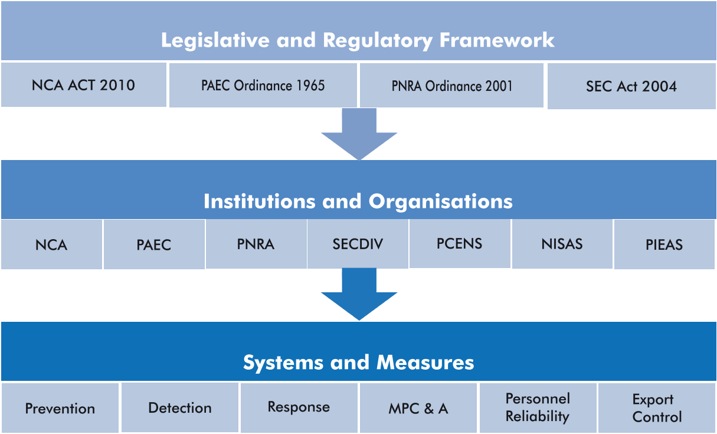
Pakistan’s Nuclear Regime
Notes:
Legislative: independent bodies with enough power
NCA: Nuclear Command Authority (NCA) Act 2010, act has a wide range of activities
PAEC: ordinance made PAEC a statutory body with requisite powers
PNRA: Pakistan Nuclear Regulatory Authority Ordinance 2001 was enacted to establish an independent regulatory body responsible for ensuring the safe use of nuclear energy and radiation in Pakistan.
Strategic Export Control (SEC) Act 2004
PCENS: Pakistan Centre of Excellence for Nuclear Security
NISAS: National Institute of Safety and Security is a specialized training and capacity-building institute under the PNRA.
PIEAS: Pakistan Institute of Engineering and Applied Sciences
MPC&A: Material Protection, Control, and Accounting

Slide 12
Salient Features - Strategic Export Control Act
Controls over export, re-export, trans-shipment and transit of goods, technologies, material, and equipment covered under the National Control List.
Wide jurisdiction (also includes Pakistanis visiting or working abroad).
Provide for an authority to administer rules and regulations framed under this legislation. Also provides for the establishment of an Oversight Board to monitor the implementation of this legislation (SECDIV).
Prohibition on diversion of controlled goods and technologies to unauthorized use.
Control over transfer of technology by any means.
Control lists and catch-all provisions.
Licensing and record keeping provisions.
Penal provisions: Up to 14 years imprisonment and Rupees 5 million fine or both, and on conviction, confiscation of the offender’s property and assets.

Slide 13
Pakistan’s Nuclear Regime - Institutions and Organizations
NCA
Apex committee with PM as chairman, oversees the whole regime
PAEC
Operator of Nuclear facilities and research and development of nuclear weapons
PNRA
Regulation of
nuclear safety, physical protection, radiation protection, transport
and waste safety in Pakistan
SECDIV
A part of MoFA to administer export controls in accordance with NSG, Australia Group, Missile Control Regime
Notes:
NCA PRP
Nuclear Suppliers Group (NSG): For nuclear materials, Nuclear exports & technology
Australia Group: Voluntary, consensus-based group. Controls the export of dual-use chemicals, biological agents, and related equipment.
Missile Control Regime: Controlling the transfer of missile technology and related components.

Slide 14
IAEA Global Concerns
Theft of nuclear weapons
Theft of material to make an improvised nuclear explosive
Theft of other radioactive material for an RDD
Sabotage of a facility or transport
Notes:
Radiological Dispersal Device (RDD) is commonly known as a “dirty bomb”—is a weapon that uses conventional explosives to spread radioactive material, not to cause a nuclear explosion but to contaminate an area, cause panic, and disrupt life.

Slide 15
Pakistan specific concerns
Extremist government in power
Radical’s take over
Terrorist attack on nuclear installations
The insider dimensions

Slide 16
Propaganda against the Pakistan Nuclear Program
Institute for Science and International Security (ISIS) assumption about enrichment of Uranium, construction of heavy water nuclear reactors, and plutonium reactor by Pak ( 1998, 2000, 2002,2006, 2007)
ISIS published 26 reports between 2009-2016 about Pak’s nuclear technology
The 9/11 episode and the Assassination of Benazir Bhutto further hit Pakistan’s image
Indian and Israeli allegations against Pakistan
ICAN 2022 report on Pak’s nuclear spending, i.e. US $1 billion and non-ratification of TPNW
Notes:
Treaty on the Prohibition of Nuclear Weapons.
https://www.icanw.org/Pakistan
ICAN : International Campaign to Abolish Nuclear Weapons

Slide 17
Key Terminologies and explanation
False Flag Operations
Cold Start doctrine
Nuclear Umbrella
Minimum-credible deterrence
Full-spectrum deterrence
Notes:
False Flag Operations
A covert operation where one country, group, or actor carries out an attack or action but makes it appear as if another party is responsible.

Slide 18
Pakistan’s Nuclear Doctrine
A doctrine is meant to explain how material capabilities can be used to achieve policy goals.
The key policy goal of Pakistan’s nuclear weapons capability is to deter Indian conventional as well as nuclear aggression. Its secondary policy goal, if deterrence fails, is to deny India victory in the event of a war.
Initially, our doctrine was minimum-credible deterrence, but now covers full-spectrum deterrence in 2013
Pakistan refuses to declare a no-first-use
4 thresholds: 1) Spatial, 2) Military, 3) Economics 4) Political
Notes:
small but credible nuclear arsenal
full-spectrum deterrence: Includes a range of nuclear capabilities, including: Tactical nuclear weapons (e.g., Nasr missile), Strategic and sub-strategic delivery systems
Sea-based deterrence (second-strike capability)

Slide 19
Comparison of Nuclear Policies of India and Pakistan
Aspect | India | Pakistan
Nature | Hegemonic | National security
Nuclear Doctrine | No First Use (NFU); Retaliatory strike only | First Use; May strike preemptively if threatened
Strategic Aim | Deterrence against China and Pakistan | Deterrence against India's conventional military superiority
Warhead Use | Strategic (not for battlefield use) | Strategic and tactical (battlefield nukes like Nasr)
Delivery Systems | Triad: Land (Agni), Air, Sea (Arihant SSBNs) | Land (Shaheen, Babur), Air, Tactical Missiles (Nasr), Ocean (Babur-III SLCM)
International Commitments | Not part of NPT; Civil nuclear deals with US & others | Not part of NPT; No major civil nuclear agreements except China
Deterrence Approach | Credible Minimum Deterrence; restrained and stable | Full Spectrum Deterrence; flexible and risk-ready posture
Notes:
Tactical : short range
Pak and China Nuclear agreement: Agreement for Cooperation in Peaceful Uses of Nuclear Energy 2009, CHASNUPP-1 and 2 (Chashma Nuclear Power Plants) – earlier projects.
CHASNUPP-3 and 4 – developed under the 2009 agreement.
Later expanded to include Karachi Nuclear Power Plants (K-2 and K-3)
Babur III Submarine Launched Cruise Missile

Slide 20
Pak-India War 2025
False Flag operations by India:
2000 36 Sikhs killing – Bill Clinton visit
2001 Parliament Attack
2007 Samghota Express attack- 68 casualties
2008 Mumbai attack
2015 Pathankot Airbase attack
Pulwama Attack – Shah Suleiman’s visit to Pak
Pahalgam Attack- 25 casualties of tourists

Slide 21
Pak-India War 2025
India was suspended from the Indus Water treaty
Launched Operation Sundoor on 7 May 2025
Missiles -31 killed
Drones Attack
Attack on 3 Air bases
Pak’s Response
Unofficially Suspended the Shimla Agreement
Halt Trade with India
Closing Land and Air routes
Launched Operation Bunyan Marsoos
Attack 7 Indian Airbases on 10 May 2025
If water blockage, then strict action will be taken

Slide 22
Suggestions for Pakistan to enhance deterrence
Improve leadership and economic strength
Develop a strong Anti-Ballistic missile system
Increase production of cruise missiles like Raad.
Increase production of MIRV (Multiple Independently Targetable Reentry Vehicles), like Ababeel
Decoy built-up
Notes:
MIRV – Multiple Independently targetable Reentry Vehicles: MIRV is a type of ballistic missile payload that carries multiple nuclear warheads, each capable of being directed to a different target independently during reentry.
A cruise missile is a guided missile that flies low and fast to hit a specific target accurately.

Slide 23
Suggestions for both to maintain peace
Resume strategic dialogue
Strengthen hotline communication
Enhance confidence-building measures (CBMs)
Avoid an arms race
Clarify nuclear doctrines
Promote Track-II diplomacy
Avoid deployment of tactical nuclear weapons
Collaborate in peaceful nuclear uses
Stop proxy support and cross-border terrorism
Notes:
Hotline communication: A hotline is a direct, secure, and real-time communication channel between the top military or political leaderships of two countries.
CBMs: Prior notification of missile tests, Annual exchange of nuclear facility lists, Border troop transparency
Promote Track-II diplomacy :Track-II diplomacy refers to informal, non-governmental dialogue between influential individuals (e.g., retired officials, academics, think tank experts, journalists, and civil society members) from two countries to address sensitive issues that formal diplomacy (Track-I) struggles to resolve.

