Slide 1
Current Affairs
Pakistan’s External Relations
By
Assistant Professor
Dr. Zahid Mehmood Zahid (PhD – IR)
https://chat.whatsapp.com/FBRsuzoIbNoBGsHnKUmCih
https://www.facebook.com/groups/144123599347978

Slide 2
Syllabus of CA
Foreign Policy
Determinants, Decision Making and Analysis, Pakistan’s National Interests, Challenges to the sovereignty.
  Pak-Afghan Relations
  Pak-India relations,
  Pak-China Relations
  Pak-US Relations
  Pak-Russia Relations,
  Pak-Turkiye Relations

Slide 3
Foreign Policy
Determinants, Decision Making, and Analysis

Slide 4
Question to Ponder!
As a citizen, what is the purpose of the state, and why do states need a foreign policy?

Slide 5
FP defined by the scholars
FP is "the art of establishing priorities among objectives and finding the means to achieve them." Kissinger
“The totality of interactions by which a state pursues its objectives with actors in other states." James Rosenau
“An element of the process by which a state translates its broadly conceived goals and interests into concrete courses of action.” Padelford & Lincoln

Slide 6
Stages in FP DM (Initiation, Formulation, implementation)
Problem/Need for a decision/Assessment of the Int. & domestic political environment.
Setting priorities.
Determination of FP Options.
Decision-making process/calculation.
Implementation of a selected option – resource allocation.
NOTE: Evaluation and Effectiveness are measured afterwards.

Slide 7
Permanent and Variables in Pakistan’s FP DM
Permanent Factors:
Geographical location
Relations with the US and China
Relations with the Muslim world (ideology)
India & Afghan Factor (security-centric)
Variable Factors:
Domestic Factors (economy, leadership, civil-military relations, public opinion, etc.)
International Factors (Great powers politics, polarity in the international system, alliances, etc).

Slide 8
FP Decision Making structure
Prime Minister
Cabinet
National Security Committee
Parliament
Foreign Ministry
Defence & Intelligence Community
Interest Groups
Public opinion

Slide 9
Foreign Policy Decision-Making Models
Rational Actor Model (RAM)
Assumes the decision-making actor is rational and can be relied on to make informed and calculated decisions.
Assumes – he has complete information for optimized decision-making.
Steps in Decision Making:
Goals: Preventing Iran from becoming nuclear-capable
Options: Sanctions, Negotiations, Military attack
Rational Decision: diplomacy and negotiations
Examples: WoT and Pakistan’s cooperation with US

Slide 10
Organizational Process Model (OPM)
Govt. as a mix of powerful organizations working in concert.
SOPs – are followed.
Decentralization of responsibilities.
Decision are made step-by-step (incrementalism).
Organizational priorities, goals, and policies matter.
May 28, 1998:
PM, PAEC, KRL, GHQ, PIA, PAF, NLC.
Response to Pulwama:
Military and ISPR – deterrence and signaling,
FO – China, USA, KSA, IMF talks- economic constraints,
SPD – Risk assessments to keep nuclear off the table.

Slide 11
Bureaucratic Politics Model/Govt Bargain Model
Decision-making is done by a number of competing entities (organizations).
Each brings input to the DM process, with its own view of personal, organizational, and national interests.
Collective decision is contingent upon successful negotiation, bargaining, and compromises among entities.
Players’ positions and priorities matter.
Examples: WoT: Military Interests, ISI, FO, religious and political parties – cooperation US, Taliban, managing protests by reli groups and protests by parties.

Slide 12
Implementation
Instruments of Pakistan’s Foreign Policy:
Diplomacy (Bilateral or multilateral negotiations – OIC, UN, SAARC, SCO)
Economy (CPEC, IMF, trade agreements etc.)
Strategic Partnerships (China, US, Turkey, etc.)
Media and Culture/ideology (media, education, sports, religion, diaspora)
Covert activities (secret operations, and intelligence cooperation)

Slide 13
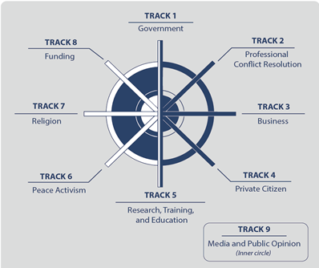
Tracks of Diplomacy: Bringing NSAs into state craft – Con Resolution and international cooperation through negotiations

Slide 14
Pakistan’s FP Objectives
Promotion of Pakistan as a dynamic, progressive, moderate, and democratic Islamic country.
Friendly relations with all/especially major powers, & immediate neighbors.
Safeguarding national security & geostrategic interests, including Kashmir. (FP starts at home)

Slide 15
4. Consolidating commercial & economic cooperation with int. community.
5. Safeguarding the interests of Pakistanis abroad.
6. Ensuring optimal utilization of national resources for regional & int. cooperation.

Slide 16
Pak’s National Interests
Territorial integrity and security (India, Afghanistan)
Counter terrorism and Internal stability
Development and Prosperity (Human, Eco, infra, energy security)
Political stability (demo and good gov)
Identity and cultural values (cultu and relig harmony)
Access to resources (water, energy, climate security)
Tech advancement (cyber and innovation)

Slide 17
Challenges to the Sovereignty
India
Cross Border terrorism (Afghan)
Terrorism and Extremism
Insurgency and Separatism
Economic Dependence
Political instability
Climate vulnerability
State (Hard)
Non-State (Soft)

Slide 18
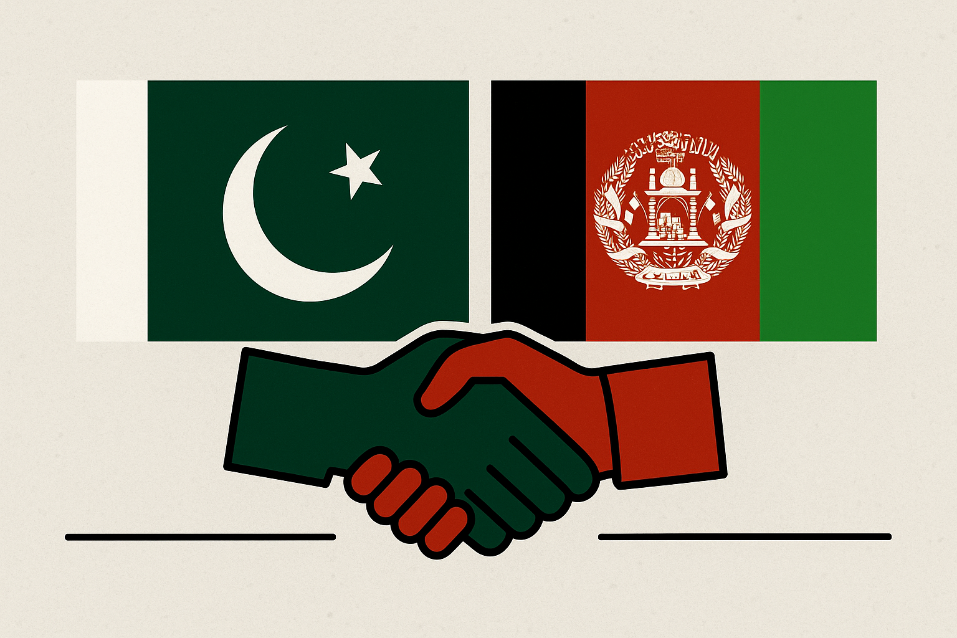
Pak-Afghan Relations

Slide 19
Afghanistan in the Cold War Theater
Cold War geopolitics, Soviets into Afghanistan1979,
‘Jihad against godless’ – fusion of religion and geopolitics.
Pakistan, US, and ME monarchies – an axis of believers.
Geneva Accord 1988,
Rise of Taliban (Appeal? .. Promise?),
Al-Qaeda Enters Afghan Theater
9/11, OEF, and toppling of Taliban govt,
Bonn Conference 2001, Karzai govt, US/NATO in Afghanistan till 2021.
Doha Process 2018 - 2021
Return of Taliban - Aug 2021.

Slide 20
Pak-Afghan Relations

Slide 21
Pak-Afghan relations
Both share more than 2600 KMs border.
Afghanistan always maintained a hostile attitude towards Pakistan.
Despite common culture, ethnicity, faith, history & geo-political dilemmas, relations have been troublesome. WHY?
Primarily because of ‘Durand Line’ issue.
Afghanistan opposed Pakistan’s entry into UNO.
July 26, 1949 – terminated all agreements with British including ‘Durand Agreement’

Slide 22
Pak-Afghan Relations:
Initial Phase: 1947 to 1979 (Afghan assertion and Pakistan’s Defensive behavior)
2nd Phase: 1979 to 1989 (Soviets in Afghanistan, Pakistan diplomatic, Economic, and Security support to liberate Afghanistan)
3rd Phase: 1989 to 1994 (Civil War, Pakistan’s diplomatic efforts for peace & stability in Afghanistan)
4th Phase: 1996 to 2001 (Pak accords diplomatic recognition, economic and military support – religion for national security & strategic interests)
5th Phase: 2001 to 2021 (WoT, Strategic Shift, multilateral relations between Pak-Afghanistan)

Slide 23
Latest Phase: Afghanistan under Taliban 2.O
Optimism – India factor,
Desperation – betrayal and broken promises.
Commonalities: Stability and economy
Differences: Terrorism (TTP and BLA attacks rose to 28% in 2022, 79% in 2023, & 70% in 2024 – PIPS report), Border management, Refugees.
Mr. Dar visited Afghanistan
Pak-Afghan-China revived,
Trans-Afghan railway project,
Afghan transit trade agreement will be revived in 2025,
Duty waiver to 860 items (10% duty),
Helpline for outgoing refugees’ property settlements.
PAK-Afghan Joint Coordination Committee agreed to talk about issues of security/TTP, trade, and border crossing.

Slide 24
Solution!
Forget, learn, and move into the future.
Engagement – Track I & II dialogue (economic and religious diplomacy).
Political Recognition (conditional)
Pakistan should engage Afghanistan multilaterally, based on ground realities.
Engaging friends (guarantors) – China, KSA, Turkey, etc.
Refugee and border management.
Intelligence sharing for counter-terrorism.
Trade and Transit

Slide 25
Questions to Attempt
Given Pakistan's growing concerns over TTP-led terrorism originating from Afghanistan, what diplomatic and strategic steps can be taken to prevent Afghanistan from serving as a sanctuary for anti-Pakistan elements?
How have shifting U.S. priorities in the region, particularly after its withdrawal from Afghanistan, influenced Pakistan’s approach towards the Afghan Taliban and regional stability?
Given Pakistan’s recent policies on Afghan refugees, including deportations, what are the humanitarian, security, and diplomatic implications for bilateral relations between the two countries?
With Pakistan increasingly concerned about cross-border militant activities, what diplomatic or strategic measures could be taken to ensure Afghanistan does not become a safe haven for anti-Pakistan elements?

