Slide 1
ASTEROIDs

Slide 2
introduction
Mostly rocky and metallic in nature
Metals may include Iron, Nickle, Gold, Platinum, Clay, Silicate etc.
In size they can range from the size of a pebble to bodies as large as dwarf planets

Slide 3
How they were formed?
Theory No:1
In the early chaotic solar system, large planetismals collided with one another and rocky chunks broke off, forming asteroids
  Theory No: 2
In the early solar system, some debris never came together to form planets and dwarf planets. They remained out of the reach of gravity and are free floating since in the form rocky asteroids

Slide 4
Examples
Asteroids belt
Trojans
Near earth objects

Slide 5
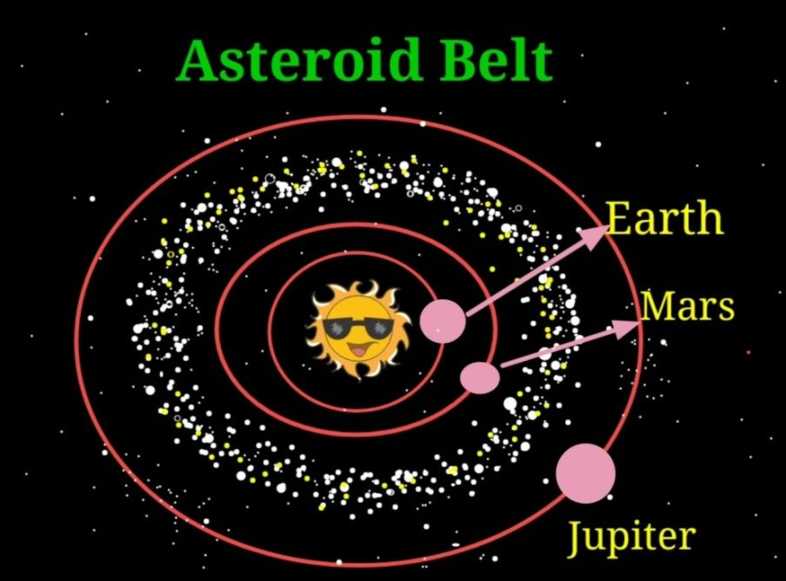
Asteroid belt
This belt is between Mars and Jupiter
It carries an estimated 1.9 million asteroids

Slide 6
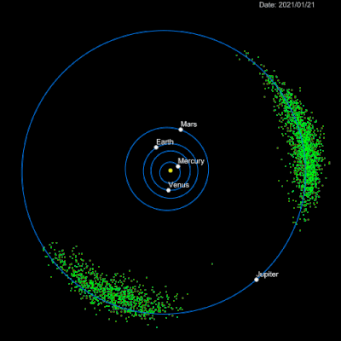
trojans
Any asteroid sharing its orbit with a larger planet is called a Trojan.

Slide 7
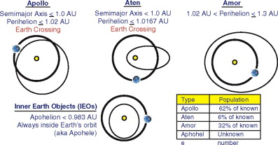
Near Earth objects!
Any celestial body whose closet approach to sun (perihelion) is less than 1.3 AU (Amore, Appollos, Florence etc.)
When these near Earth object cross Earth’s orbit during their revolutionary course, they are called Earth Crossers
It is called a Potentially Hazardous Object (PHO), when its size is bigger than 140 meters and is at a distance of less than 0.05 AU

Slide 8
Importance of asteroids!
Pieces of asteroids breakdown and can be seen as a meteor shower (phenomenon called shooting star)
Sometimes, they collide with Earth wrecking a havoc
Examples:
Arizona USA Meteor Crater
South Africa’s Vredefort Crater
Tunguska Incidence - The most scariest asteroid crash ever witnessed in Siberia 1908
Chelyabinsk incidence in Ukraine 2013

Slide 9
THANK YOU!

