Slide 1
Title

Slide 2
planets
Any celestial body which fulfills the criteria set up by International Astronomical Union (IAU) for planets can be treated as a planet:
It revolves in an orbit around the Sun
Has a sufficient mass so it is nearly spherical in shape
Has cleared it neighbourhood around its orbit
Is not itself a satellite

Slide 3
DWARF PLANETS
Any celestial body which fulfills the criteria set up by International Astronomical Union (IAU) for dwarf planets can be treated as a dwarf planet:
It revolves in an orbit around a star
Has a sufficient mass so it is nearly spherical in shape
Has not cleared it neighbourhood around its orbit
Is not itself a satellite

Slide 4
Was pluto rightly demoted?
Pluto is stationed in the Kuiper belt
Pluto was discovered in 1930 and readily declared the ninth planet.
However, in the 1990s, its status as a planet was questioned following the discovery of several objects of similar size in the Kuiper belt
Either Pluto had to be demoted or all the newly discovered bodies had to be declared as planets
The International Astronomical Union (IAU) in 2006 to define the term planet formally—excluding Pluto and reclassifying it as a dwarf planet
So yes, Pluto was rightly demoted!

Slide 5
Other notable dwarf planets
Ceres
Eris
Haumea
makemake

Slide 6
Star vs. planet
  Star:
Star is a massive shinning sphere of hot gas
Stars shine
Objects which revolve around a star are called planets, dwarf planets and solar system bodies
Stars revolve around a galactic center
Stars are very hot
Examples: Sun, Alpha centuri, Betelgeuse
Planet:
Planet is a round body in space which orbits a star
A planet does not shine
Objects which revolve around a planet are called satellites
Planets revolve around stars
Planets are not as hot
Examples : Venus, Mercury, Earth, Mars etc

Slide 7
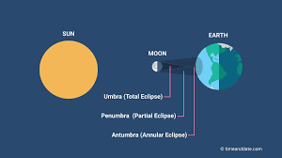
eclipse
An eclipse is an astronomical event in which one astronomical object is temporarily obscured either by passing into the shadow of another body or having another body pass between it and the viewer
An eclipse occurs during a “syzygy”
In astronomy, a syzygy is a straight line configuration of three celestial bodies

Slide 8
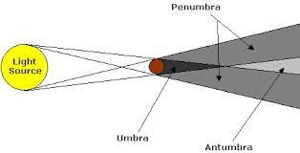
TOTAL, PARTIAL & ANNULAR ECLIPSE
UMBRA
PENUMBRA
ANTUMBRA

Slide 9
Why a LUNAR ECLIPSE DOESN’T OCCUR EVERY MONTH WITH FULL MOON ?
Lunar eclipses can happen only when the Moon is opposite the Sun in the sky, a monthly occurrence we know as a full Moon. But lunar eclipses do not occur every month with full Moon because the Moon's orbit is tilted five degrees from Earth's orbit around the Sun, so most of the time the Moon passes above or below the shadow!

Slide 10
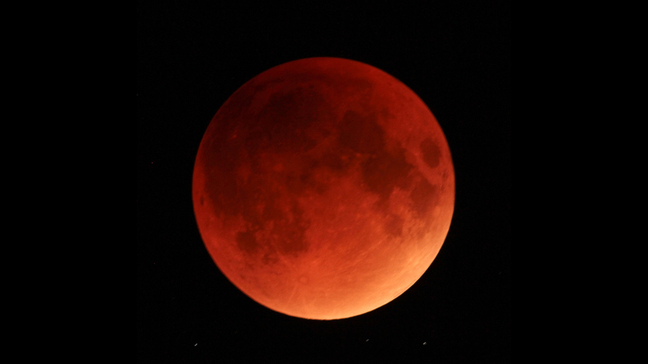
Blood moon
A total lunar eclipse is sometimes called a Blood Moon, because of the reddish tinge the Full Moon takes on when fully eclipsed
This happens when the Sun's rays pass through the atmosphere, most colors in the light spectrum are filtered out. However, red wavelengths are least affected by this effect, so the light refracted from Earth’s atmosphere and reaching the Moon's surface has a reddish hue, causing the fully eclipsed Moon to take on a red color and hence, a blood moon

Slide 11
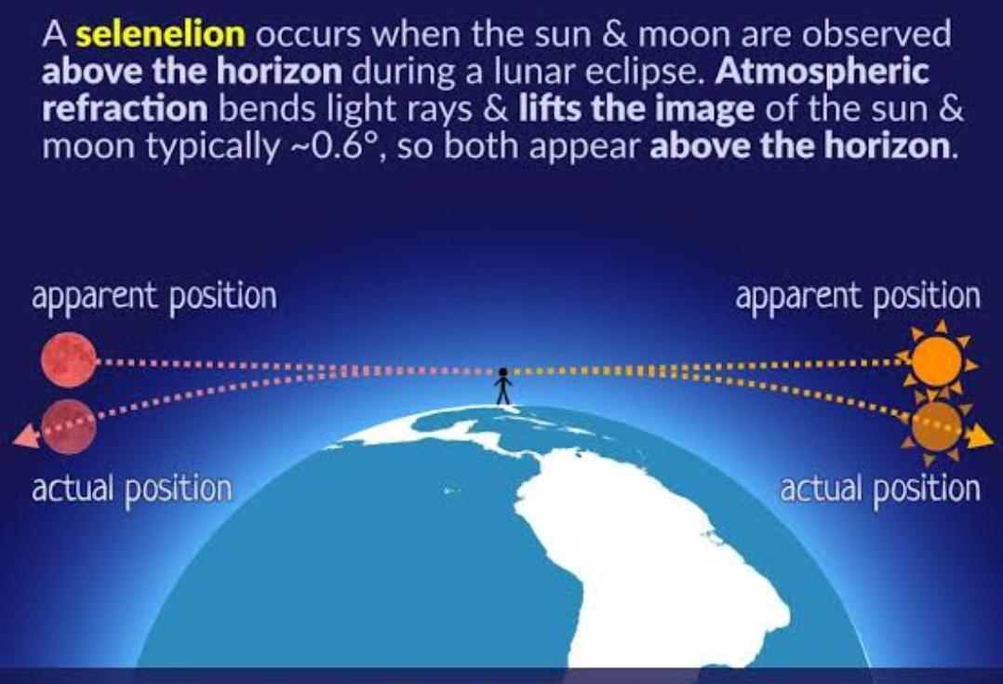
What is a horizontal eclipse?
A selenelion or selenehelion, also called a horizontal eclipse, occurs where and when both the Sun and an eclipsed Moon can be observed at the same time

Slide 12
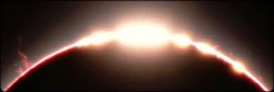
Bailey’s beads
As the Moon covers the Sun during a solar eclipse, the rugged topography of the lunar limb allows beads of sunlight to shine through in some places while not in others. The effect is named after Francis Baily, who explained the phenomenon in 1836
Lunar topography is not smooth has considerable irregularity and it has highs and lows because of the presence of mountains, craters, valleys, and other topographical features
The sunlight from behind shines through craters and valleys on moon’s surface and they appear like bright beads

Slide 13
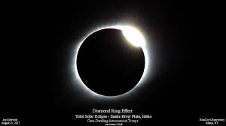
Diamond ring effect
The diamond-ring effect occurs at the beginning and end of totality during a total solar eclipse. As the last bits of sunlight pass through the valleys on the moon's surface. It looks like a glittering diamond is set on a ring

Slide 14
THANK YOU!

