Slide 1
United Nations

Slide 2
Introduction (Pre-Basics)
General mandate of UN.
League of Nations 1920-1946 ( Historic Development)

Slide 3
Organizational Structure
Charter of UN
6 Main Organs
Economic and Social Council
Trusteeship Council
International Court of Justice
Secretariat

Slide 4
Organizational Structure
General Assembly
General Composition and Committees
Forms of Voting in UNGA

Slide 5
Organizational Structure
Security Council
Mandate
Composition
Voting

Slide 6
Organizational Structure
Shortcomings/ Issues of UN
General Assembly Decision Making Power
Security Council and VETO

Slide 7
Organizational Structure
Security Council
Proposed Reforms
Structural Reforms
VETO Reforms

Slide 8
UN (Failed or Successful)
Unresolved Conflicts
Failed Peace-Keeping Mission
Stagnant structural Reforms
Recent Failures?

Slide 9
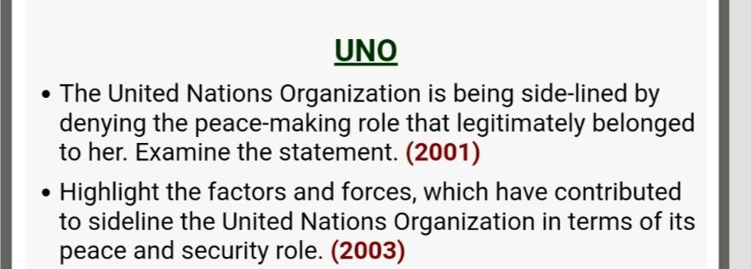
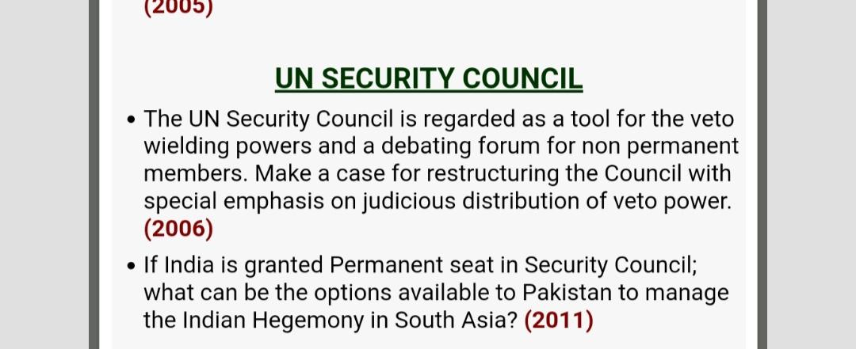
Questions

