Slide 1
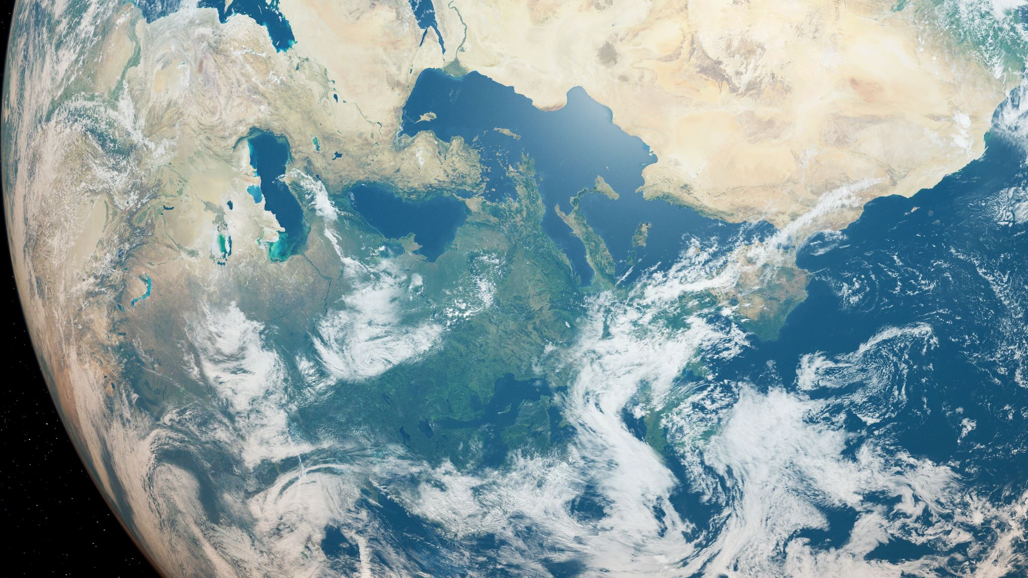
SECTION 5
ISLAM & THE WORLD

Slide 2
Past Paper Questions
What are the contemporary challenges of Muslim world? Suggest its solutions in the light of Quran and Sunnah. (2016)
Enumerate the reasons of extremism in Pakistan and suggest solutions to eradicate it in the light of Islamic teachings. (2017)
Point out the motives of terrorism in Pakistan. How can the society get rid of terrorism. (2018)
Is extremism a challenge to Islam? Discuss in the context of contemporary challenges faced by Muslim Ummah. (2019)
Islamophobia is a sign of extremism. Give suggestions for its remedy. (2021)
What are the motives of Extremism in Pakistan? How can the society get rid of extremism by following the teachings of Islam? (2023)
How is it possible to eliminate the religious and political extremism in Pakistan in the light of the teachings of the Holy Prophet? Explain. (2024)

Slide 3
Common Topics
Extremism
Terrorism
Islamophobia

Slide 4
Contemporary Challenges Faced by the Muslim Ummah
The Ummah in Tatters; Severely dis-unified
Religious Extremism
Terrorism in the name of religion. Rise of outfits such as ISIS, TTP etc.
The rise of Islamophobia
Far behind in Providing Quality Education, Religious as well as Contemporary
Lagging in the Fields of Science & Technology
Nowhere Near in Competing with the Global Economic Powers

Slide 5
Some Common Remedies
Reforming Religious Education
At Schools & Colleges
Seerah of the Prophet SAW to be taught at different levels
Practical lessons from Seerah to be highlighted
Emphasis on the kindness & tolerance of Prophet SAW
How Islam promotes moderation in everything and discourages extremism
How Islam encourages to strive and earn a respectable living
Islamic Studies to be taught by subject specialists. Especially at initial levels
Women rights must be highlighted at initial levels
Islam to be presented beyond beliefs and rituals. Must be presented as an ideal way of life
How Islam is a flag bearer of human rights, regardless of religion, cast and creed

Slide 6
At Seminaries (Madrassah Reforms)
Seerah to be incorporated as a compulsory course
Students to be provided with contemporary education
Seminary graduates to be included in different segments of the society
Formulating a strict criteria for setting up a new seminary
A suitable criteria for admitting students
Teachers to undergo various workshops
A complete ban on inciting sectarian violence or divide
Students to be taught to co-exist peacefully

Slide 7
2. Government to take Religion Seriously
Curbing the sectarian divide
Looking after mosques & seminaries
Imam to be appointed after undergoing proper scrutiny
Malaysia a brilliant example where state takes religion extremely seriously. This seriousness has helped them curb all kinds of sectarian divides and allowed them to inculcate the Islamic ideologies in an effective manner
Putting an end to the use of religion for personal and political gains
3. A Dire Need for the Positive Role of Media
2 aspects
Educational & positive Islamic content
Strict ban on inciting religious ideas through negative content

Slide 8
4. The International Muslim Community to Play its Part
OIC needs to play a proactive and effective role
Muslim scholars to discuss the matter of unification of the Ummah
Islam to be portrayed in its true essence through media and other modern platforms
Muslim scholars and jurists to openly condemn any act of extremism/terrorism performed in the name of religion
5. Amr bil Ma’roof wa Nahi ‘Anil Munkar
The Muslim Ummah must revive this great responsibility bestowed by the Almighty
Every Muslim must realize that it is his responsibility as well to contribute to the positive image of Islam
Every Muslim is responsible and not just the governments or the clergy

Slide 9
Solutions to Unite the Muslim Ummah
Political & Diplomatic Efforts
Promoting Dialogue & Discussions Between Muslim Countries
Making Positive Use of the OIC
Strengthening Diplomatic Ties between All Muslim Countries
Socio-Economic Initiatives
Trade Partnerships
Humanitarian Assistance in Times of Need
Financial Assistance for the Economic Development of Developing Muslim Countries

Slide 10
Solutions to Unite the Muslim Ummah
Educational & Cultural Exchange
Educational Exchange Programs
Promoting Easy Tourism Between Muslim Countries
Positive Role of Media
Responsible Reporting
Promoting Harmony Between Various Islamic Sects
Providing Digital Platforms for Muslim Unification
Effective Conflict Resolution
Resolving disputes and conflicts through dialogue and mediation rather than confrontation
Clergy to play its role in educating people to co-exist peacefully

