Slide 1
IMF & WTO (WB)

Slide 2
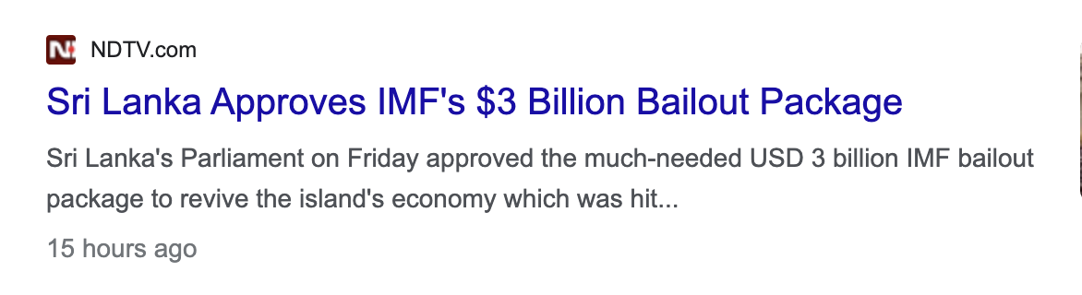


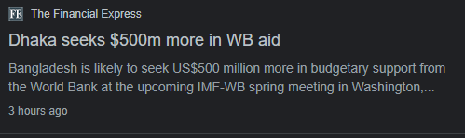

Slide 3
International Monetary Fund (IMF)
Introduction
Bretton Wood Conference (1944-1971)
Mandate

Slide 4
International Monetary Fund (IMF)
Functions of IMF
Technical Assistance and Training
Surveillance of Member Economic Policies

Slide 5
International Monetary Fund (IMF)
Functions of IMF
Financing Balance of Payment Deficits
What is BOP Deficit?
IMF Lending
IMF Letter of Intent
Pakistan and IMF

Slide 6
International Monetary Fund (IMF)
Criticism on IMF
Favoring the Capitalistic Segments of the World
Structural Adjustment Program
Unbalanced Voting Power

Slide 7
International Monetary Fund (IMF)
Recommended reads:
https://www.imf.org/external/pubs/ft/pam/pam45/pdf/chap1.pdf
https://www.everycrsreport.com/files/20040422_RL32364_f41976f70a807d54eea351d4f07e04c03c8a720d.pdf
https://niu.edu.in/sla/online-classes/PSM-204-Role-and-Functions-of-IMF.pdf

Slide 8
World Trade Organization (WTO)
Introduction
Background/GATT
Functions
Essence of Multilateral Trading System
Notes:
WTO is all about Agreements, negotiated and signed by a large majority of the world’s trading economies, and ratified in their parliaments (30 Agreements)
Ensuring the smooth, free, and fair movement of the following:
Goods(dealing with specific sectors such as agriculture and textiles + specific issues such as state trading, product standards, subsidies, anit-dumping(Dumping enables consumers in the importing country to obtain access to goods at an affordable price. However, it can also destroy the local market of the importing country, which can result in layoffs and the closure of businesses))
Services (Banks, insurance firms, telecommunications companies, tour operators, hotel chains and transport companies)
IPR ( copyrights, patents, trademarks, geographical names used to identify products, industrial designs, integrated circuit layout-designs)
Administering trade agreements
Acting as a forum for trade negotiations
Settling trade disputes (Dispute Settlement Understanding)
Reviewing national trade policies (All WTO members must undergo periodic scrutiny, each review containing reports by the country concerned and the WTO Secretariat.):
improve transparency.
create a greater understanding of the policies that countries are adopting.
assess their impact.

Slide 9
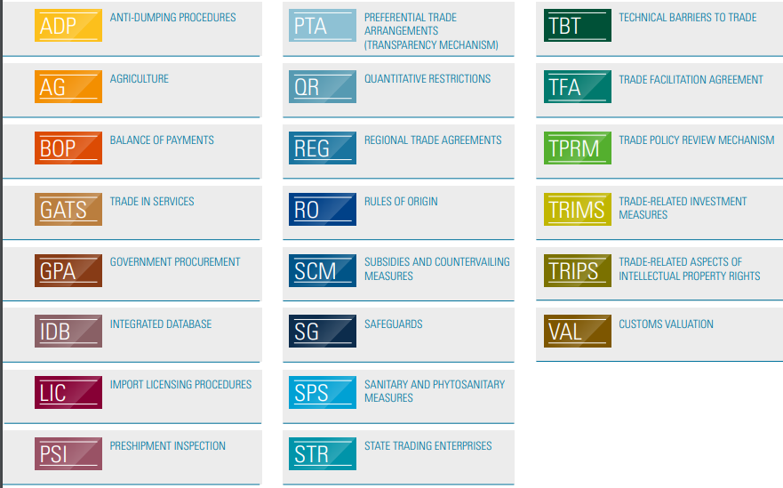

Slide 10
World Trade Organization (WTO)
WTO and Pakistan
Agreement on Agriculture (AOA)
Trade Facilitation Agreement (TFA)
Technical Barriers to Trade (TBT)
Trade Related Aspects of Intellectual Property Rights (TRIPS)
Trade Related Investment Measures (TRIMS)
Notes:
National Treatment: The TRIMs agreement requires that WTO members treat foreign investors and their investments no less favorably than domestic investors and their investments. This principle of national treatment ensures that foreign investors are not subjected to unfair or discriminatory treatment.

Slide 11
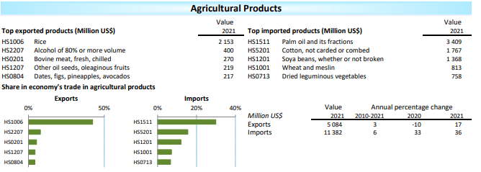
World Trade Organization (WTO)

Slide 12
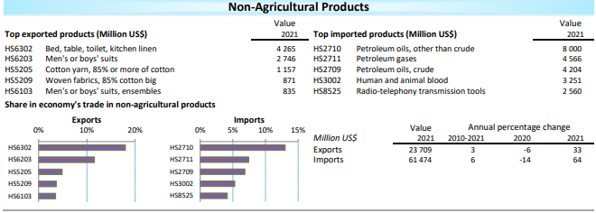
World Trade Organization (WTO)

Slide 13
World Trade Organization (WTO)
WTO Challenges
China Factor
Digitization of Economy
Development Divide
Notes:
Disparities in Capacity
Market Access Barriers
TRIPS can pose challenges for developing countries in accessing affordable medicines, technology transfer, and promoting innovation

Slide 14
World Trade Organization (WTO)
Recommended reads:
https://www.wto.org/english/thewto_e/whatis_e/inbrief_e/inbr_e.pdf
https://sgp.fas.org/crs/row/R45417.pdf
https://depts.washington.edu/wtohist/Research/documents/WTOinbrief.pdf
Notes:
Disparities in Capacity
Market Access Barriers
TRIPS can pose challenges for developing countries in accessing affordable medicines, technology transfer, and promoting innovation

Slide 15
World Bank
Introduction

Slide 16
World Bank
Organization
Bretton Woods Conference
Aims/Objectives

Slide 17
World Bank
Institutions of WB
International Bank for Reconstruction and Development (IBRD)
International Development Association
(IDA)
International Finance Corporation (IFC)
Multilateral Investment Guarantee Agency (MIGA)
International Centre for Settlement of Investment Disputes
(ICSID)

Slide 18
World Bank and Pakistan
World Bank Projects in Pakistan
Constructions
Financing
Capacity Building
Education
Health
Social Safety Net
Agriculture
Trade and Transport
Notes:
Education
Project Name
Aims
Total Cost
Approval Date
Closing Date
Actions to Strengthen Performance for Inclusive and Responsive Education Program
respond to school disruptions caused by the COVID-19 pandemic
Recover access and improve education quality
US$ 671.25 million
July 31, 2020
June 30, 2025
Sindh Early Learning Enhancement through Classroom Transformation
To improve reading skills of early grade primary students and increase student retention in primary schools in selected districts.
US$ 154.76 million
(as of board presentation)
July 29, 2021
April 30, 2026
Higher Education Development Project
To support research excellence in strategic sectors of the economy, improve teaching and learning and strengthen governance, in the higher education sector.
Estimated $400 million
(as of board presentation)
May 31, 2019
June 30, 2024
Health
Project Name
Aims
Total Cost
Approval Date
Closing Date
National Health Support Program
To strengthen equitable delivery and quality of essential health services at the primary health care level
US$ 300.00 million
(as of board presentation)
June 7, 2022
December 31, 2026
KP- Spending Effectively for Enhanced Development
To improve the availability and management of public resources for delivery of primary, middle and high school education and primary health care services.
US$ 400.00 million
(as of board presentation)
April 22, 2021
June 30, 2026
Balochistan Human Capital Investment Project
To improve utilization of quality health and education services in selected refugee hosting districts of Balochistan.
US$ 36.00 million
(as of board presentation)
June 23, 2020
June 30, 2025
Social Protection Drives
Project Name
Aims
Total Cost
Approval Date
Closing Date
Crisis-Resilient Social Protection (CRISP) Program
To support the development of a more adaptive social protection system that will contribute to any future crisis-resilience among po or and vulnerable households
US$ 600.00 million
(as of board presentation)
March 25, 2021
June 30, 2025
Punjab Human Capital Investment Project
The Project Development Objective is to increase the utilization of quality health services, and economic and social inclusion progr ams, among poor and vulnerable households in select districts in Punjab.
US$ 200.00 million
(as of board presentation)
March 3, 2020
June 30, 2025
Agriculture
Project Name
Aims
Total Cost
Approval Date
Closing Date
Sindh Barrages Improvement Project AF
The PDO is to strengthen the Sindh Irrigation Department’s capacity to operate and manage barrages and improve the reliability and s afety of Guddu and Sukkur Barrages in the Province of Sindh.
US$ 140.00 million
(as of board presentation)
May 25, 2018
N/A
Daso Hydro Power Project
The overall project development objective is to facilitate the expansion of electricity supply of hydro-power in Pakistan
US$ 700.00 million
(as of board presentation)
March 31, 2020
Tarbela 4th Extension Hydropower Project
the Objective of the Project is to facilitate a sustainable expansion of the Borrower 's electricity generation capacity.
US$ 390.00 million
(as of board presentation)
September 20, 2016
Transport
Project Name
Aims
Total Cost
Approval Date
Closing Date
Khyber Pass Economic Corridor Project
to expand economic activity between Pakistan and Afghanistan by improving regional connectivity and promoting private sec tor development along the Khyber Pass corridor.
US$ 460.60 million
(as of board presentation)
June 14, 2018
May 28, 2026

