Slide 1
Aristotle

Slide 2
Father of Political Science
The first man to distinguish between various branches of knowledge had been Aristotle.
According to Aristotle, political science is a master science.
Political science pertains to the ends of human existence in itself.
"Hierarchy of Ends", implying that each branch of knowledge is merely a means and would ultimately serve the end of leading a good life.

Slide 3
Aristotle and his View on Man
Aristotle believes that Man is a political animal
This analogy is intriguing because it does not only consider man to be a social animal but also interprets him as a political being.
He asserts that all kinds of living beings happen to exist in groups, and thus, they can be understood as social animals. However, it is solely the quality of human beings to aspire for a good and qualitative life.
For human beings, satisfaction doesn't cease at survival; the constant aspiration to lead a good life makes them political beings by default. He says, "he who does not live in a state or who does not need a state is either a beast or a god".

Slide 4
Aristotle and his View on State
Aristotle views the state as natural
State is a necessary condition of a good life.
Any human being cannot survive in isolation, and thus, a man and a woman establish a household. A village is formed when a family expands itself, and when many such villages are formed, a state comes into existence. As and when a state is formed and society is organised, human beings can meet their need

Slide 5
However, most human associations are flawed and help to fulfil one or a few facets of the good life, but that's untrue for a state.
He viewed the state as being able to meet the whole or all facets of a good life.
According to him, there is no difference between an animal or a human being, other than the fact that a human being has the desire and a sense of living a good life.

Slide 6
What it means is that human beings become different from animals only if they exist in a state. It is the same desire to lead a good life that makes the formation of a state a natural thing to occur.

Slide 7
State and Its Relation with Man
Aristotle is known for his dictum that State is prior to man
Chronologically, it is a man who appears before the state. Still, since it is the state that makes human beings capable of completing their needs and fulfilling the objective of a good life, the state is given priority over the man.
Aristotle draws a relation between organ and organism.
A leg or a hand is a part of the body, but a leg or a hand without a body is useless; an individual without a state is incomplete, and it is the state that makes him whole.

Slide 8
Aristotle and His Classification of Governments/Constitutions
Aristotle was troubled by the instability that existed in Greek city-states' governments.
He studied over 158 case histories of various city-states by sending his students to prepare case studies of various constitutions.
The case history of Athens is an important source to understand his classification of the constitutions. One can understand this fact based on two factors:

Slide 9
The number of individuals ruling the state: whether it is one person ruling the state, a few individuals or if it is a rule of many.
The intent of the ruler or rulers: whether the ruler is ruling for his state's interest (known as a normal form of government), or whether the ruler is looking after his self-interest (known as a perverted form of government)

Slide 10
Aristotle’s Classification of Government
 | Public Interest | Selfish Interest
The One | Monarchy | Tyranny
The Few | Aristocracy | Oligarchy
The Many | Constitutional Democracy | Democracy

Slide 11
Cycle of Change of Government
According to Aristotle, without any adequate checks on a ruler's power, no form of government would be stable. He believes that power and virtue cannot coexist.

Slide 12
He has provided the cycle of change of governments over time. Kingship, a normal form of government, turns to tyranny when there is an absence of control over the monarch's power. Tyranny leads to a rebellion or a revolution by a few individuals who establish an aristocracy. Aristocracy can deteriorate and turn into an oligarchy, the perverted form. With time, a greater many rebels against oligarchy and supersede it with polity. Polity further decays in democracy when the many rulers begin to seek their self-interest. In the end, a single individual who seems virtuous establishes a monarchy, and the progression of ideal form and perverted form continues in a circular motion.

Slide 13
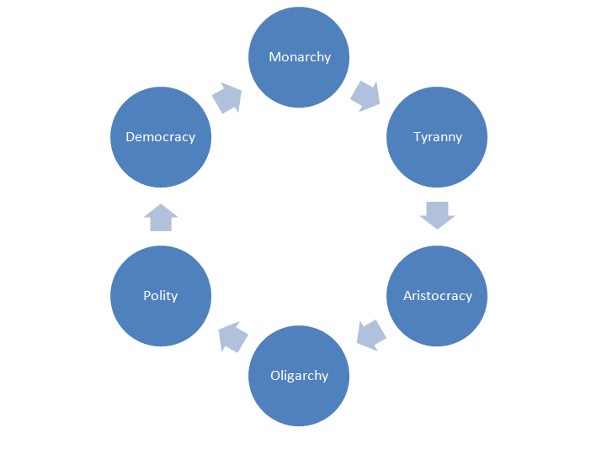

Slide 14
Aristotle gave the concept of a mixed constitution as a solution to prevent instability and establish a lasting form of government in the Greek city-state.
He employed his idea of the "Golden Mean" to create stability
Virtue lies between two extremes
His solution to bring a stable form of government is the combination of rule by few and rule by many.
He discarded Monarchy because it would be corrupt from absolute power

Slide 15
Aristocracy would suit because few would make the rules.
This would comprise the chosen minority who are educated and rich. However, in case of no checks on aristocracy, it would deteriorate.
To prevent that, Aristotle suggests that the decisions made by the aristocracy should be ratified by the ordinary many.
Aristotle's suggestion of a judicious mixture between aristocracy and what is sometimes referred to as Polity or, at other times Democracy, embodies his belief in the Golden Mean formula
In modern times, Aristotle's formula is arguably referred to as Constitutional Democracy.

