Slide 1
Sociological Theorists

Slide 2
Auguste Comte
Born in 1798 in southern France
First thinker who realized the need for a distinct signs of human society: called father of psychology
First, he gave name ”social physics” and later coined word sociology
Important books: A program of scientific work required for the re-organization of society, positive philosophy

Slide 3
The law of three stages
He not only created specific methodology of studying knowledge but also analyzed the evolution of human thinking and its various stages: successive stages of historical evolution leading to some final stage of perfection
He called it universal law of intellectual development
He opined: Evolution of the human mind is parallel to evolution of individual mind

Slide 4
First stage: theological or fictitious stage
World prior to 1300 A.D.
All theoretical conceptions bear a supernatural impress
Social and physical world was produced by God
Man’s thinking is regulated by theological dogmas

Slide 5
Further sub-stages in theological stage
Fetishism: same living spirit in every object
Anthropomorphism: gradual development and improvement in human thinking, man also exist: dualism
Polytheism: evolved form of anthropomorphism and fetishism- Man thinks on God and classifies him according to functions
Monotheism: This stage marks victory of human intellect.

Slide 6
Second stage: metaphysical or abstract stage
Improve form of theological stage
Believe that an abstract power or force guided and determined all events of the world
Against belief in concrete God

Slide 7
Third stage: positive stage
Scientific stage: entered in 1800
Believe in science
People gave up search for absolute cause
Concentrated on finding definite principles and laws
Observations and classifications are beginning of scientific knowledge
Observation predominates imagination

Slide 8
Ibn e khaldun
14th century economist, historian, sociologist, jurist
Analyzed economic, political and social development of organized societies systematically
Kitab al-abar: World history
Introduction of Kitab al-abar: known as Muqqadimah: Prolegomena: established a sophisticated theory to explain the rise and fall of dynastie

Slide 9
What is Asabiya?
Rosenthal defines it as group feeling
Desire for cooperation to exist on a larger scale
Not just a matter of tribal cohesion
The goal of facia is royal power
All references to asbiya our strictly sub ordinate it to the analysis of state
It deals with collective will formation and commitment to sustained action, rather than simply a high degree of social cohesion

Slide 10
Umran: civilization
As soon as some kind of social organization is formed Umran results
Social organizations grow more populous
Larger and better civilization results
Culminates in the highest form of sedentary culture man is able to achieve

Slide 11
Three civilizational patterns
Badawa: agricultural: hire form of Asabiya
Bediun: semi nomadic: relatively lower form of Asabiya
Hadara: urban and sedentary: lowest asabiya

Slide 12
Changes due to historical determinism of mode of production and changing spiritual realm

Slide 13
Khaldun as father of sociology
Five centuries before Darwin, he wrote species become more numerous. Millennium before Marx, he wrote labor is the real basis of profit. 400 years before Comte he unveiled his science of culture

Slide 14
Science of culture
400 years before Comte he emphasized for the science of culture
Need of logical obstruction of universal’s: laws of society
Scientific methodology: use of priory assumption, using logical hypothesis, use of empirical data
Dialectical relationship between past and present
Analyze the human nature Colin man is domineering, Savage, ignorant: Asabiya is required to hold them together

Slide 15
Herbert Spencer
Born in Derby, England 1820
One of the important philosophers of the 19th century
Continuer of Comte’s evolutionary approach

Slide 16
Organismic analogy
Tendency to see society as an organism
Borrowed his concept from biology

Slide 17
Four assumptions
Growth and development of both society and living organism, from simple to complex
Close relationship between parts and organs: importance of parts only due to hole
One center of control: brain and government
Similar methods of efficient functioning: digestion, circulation, respiration etc.

Slide 18
Criticism
Living organism is a concrete and integrated hole, society is composed of discrete and dispersed elements
There is no centralization of consciousness in society
In society parts are not always necessarily meant for the welfare of hole
Parts of society are capable of independent existence

Slide 19
Social Darwinism
Spencer lived in a time when Darwin’s book origin of species introduce evolutionary theory of plants and animals
Organismic analogy is concerned with the maintenance of society
But social advancement is caused by competition
Spencers application of Darwinism to his own ethical and social thought came to be known as social Darwinism: survival of the fittest
Natural selection, when applied to societies and government, meant that there was a natural dominance in the world that allowed certain races to dominate because they were superior in natural order

Slide 20
Criticism
Growth of capitalism
White man’s burden
Colonialism and imperialism

Slide 21
Emile Durkheim
French sociologist
Considered one of the founding fathers of sociology
Society is most important
Society is the super most thing possible
Society is God

Slide 22
Social facts
Social facts are observed indirectly to make generalized laws using scientific methods
Subject matter of sociology
For example, family, religion, marriage

Slide 23
Characteristics of social facts
Externality
Constraint
Generality
Independence

Slide 24
Types of social facts
Institutional; excepted social facts like morality and religion, contrary can be non-institutional
Structural morphological: housing pattern, clothing
Non-institutional: rise spontaneously
Pathological: suicide

Slide 25
Study of social facts
Rules of observation
Rules of classification
Rules of distinction
Rules of explanation

Slide 26
Division of labor
Durkheim sees it is a social concept rather than economic concept: social fact
Mechanical solidarity: primitive society; likeness of norms, values
Modern society: organic solidarity based on differences and interdependence, skill create independence
Low collective consciousness in modern society
Increased individuality in modern society
Organic division of labor maintains ‘functional independence’
Individual while becoming autonomous comes to depend more than sociey

Slide 27
Abnormal forms of division of labor
Anomic: when people don’t follow norms for example corruption
In adequate organization: overburdening someone
Forced division of labor: caste system

Slide 28
Suicide
Social fact
Definition: any death caused directly or indirectly by a positive or negative action of the victim himself which he knows will produce the result
Based on spatial and temporal data: gathered from different countries end of different times
Not psychological

Slide 29
Suicidogenic forces
Forces of integration
High: Altruistic
Low: egoistic
Forces of regulation
High: Fatalistic
Low: Anomic

Slide 30
Suicide as a social fact
Rate of suicide in various societies is fairly constant
Not psychological because normal people committed it and certain ill people did not
Suicidogeic forces originate from society
Certain rate of suicide as normal

Slide 31
Religion
Social fact, not intellectual phenomena
Roots of religion cannot be found in complex society, only simple society
Origin of society and religion went hand-in-hand
Definition: Religion is a unified system of believes and practices relative to sacred things which unite into a single moral community

Slide 32
Cause of religion
Primitive men were wanderers, occasionally meeting-Ecstasy; State of exaltation
When they went away such feelings disappeared
Wanted to re-experience
They found and made totems to re-experience such feelings
Totem is the material representation of nonmaterial force and that force is society
Totem is nothing but symbol of society

Slide 33
As society becomes complex religion also becomes complex
We were ship collectivity not Totem
In modern society size is a new religion
Society always reinforce itself
Facebook is the revenge of Society

Slide 34
Max Weber
One of the founding fathers of sociology
He emphasized the role of individual
He was interpretivist in contrary to Durkheim who was positivist
He bridges the gap between positivism and anti-positivism
Sociology is a science which attempts at interpretive understanding of social action
Subject matter drawn from idealists: ideas shape the world
Scientific methodology drawn from positivists to understand social action

Slide 35
Social action
Sociology is a science which attempts at interpretive understanding of social action: explanation of cause and effect

Slide 36
Why it is a social action?
Meaning attached
Orientation towards others

Slide 37
Why study social action
To establish cause-and-effect

Slide 38
How to study social action?
Vesrtehn: means comprehending or understanding

Slide 39
Verstehn
Reconstruct choices and constraints of actors
Come at same wavelength with actors: communication, appearance, behavior
Detachment: objectivity

Slide 40
Types of social action
Traditional action: meanings drawn from traditions
Effective action: emotions are the source of meaning
Wert Rational (value Rational)- End: value, Mean: Rational
Zweck rational (End Rational)- Mean and end both rational
Actual action: mix of all

Slide 41
Ideal types
Method to comprehend reality
Abstractions employed to understand complexity of social world
Yardsticks

Slide 42
Characteristics of ideal types
Measuring Rod
Device, not reality
Reflect partialreality

Slide 43
Ideal type of authority
Power cloaked in legitimacy is authority
In contrast to brute, naked power

Slide 44
Three sources of Authority
Traditional authority
Charismatic authority
Rational-legal authority: experienced in modern life, most important of all
Actually is mix of all

Slide 45
Protestant ethics and spirit of capitalism
Protestant ethics
Own glory: God created the world for Own glory not for priest
Doctrine of predestination
Asceticism: self-discipline to receive glory of God
Notion of calling

Slide 46
Ideal type of capitalism
Wealth: not for enjoyment but for creating more wealt
Individualism: leads to Hardwork and innovation
Profit
Ethics: time is money, work is worship

Slide 47
Comparison of both ideal types
Predestination Colin tension for more wealth and wealth as sign of blessing by God
Asceticism Colin reinvestment and individualism
Notion of calling Colin work is worship
Greater profit means you are chosen

Slide 48
Bureaucracy
Refers to rule by appointed officials

Slide 49
Characteristics of bureaucracy
Division of labor
Hierarchy
Public private differentiation: Impersonal order
Written documents And rules
Meritocracy
Monocratic type

Slide 50
Karl Marx
Discontented with social climate of his time
Envisioned a revolutionary society
Romantic and utopian viewpoint
Classless society

Slide 51
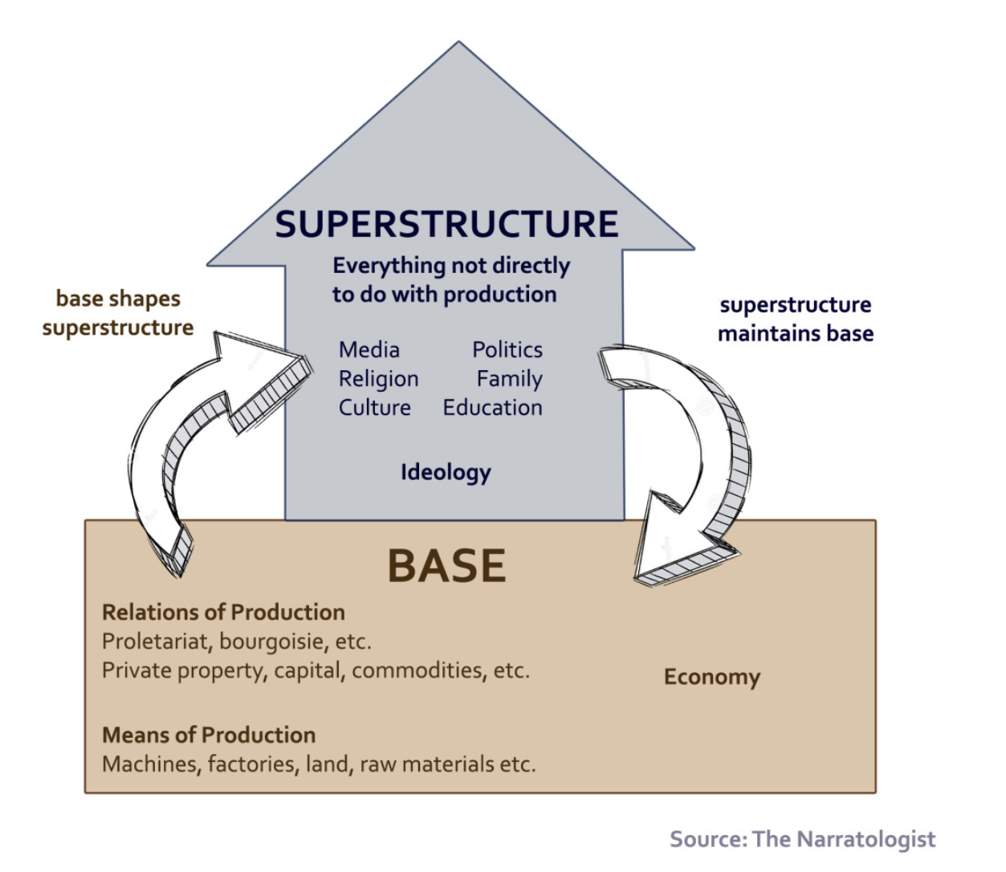
Marx’s materialism

Slide 52
Historical materialism
Materialistic conception of society
Evolution of society
Production represents the material factors and society changes with changing material factors through various stages

Slide 53
First stage: primitive communism
No inequality
No class
No ruler
No governed

Slide 54
Second stage: ancient mode of production
Master slave relationship
Master calling mystery of tools
Slaves: without tools
Revolution of slaves

Slide 55
Third stage: feudalism
Feudal serf relation
Feudal: on large tracts of lan
Serfs: work on the land of feudals
Serfs are slaves of previous stage
Fuedals are masters of previous stage
Revolution of serfs

Slide 56
Fourth stage: capitalism
Capitalists workers relationship
Capitalists own capital like land factories etc.
Workers work on the capital
Capitalists earn profits
Workers earn Wages
Capitalists are feudal of previous stage now they are bourgeoisie
Workers are serfs of previous stage
Revolution of workers: proletariat revolution

Slide 57
Fifth stage: socialism/dictatorship of proletariat
Dictatorship to check counterrevolution
No injustice
Dictatorship of proletariat is a temporary state
State will wither away

Slide 58
Final stage: communism
No need for state
Classless society
All are enlightened and free
End of history

Slide 59
Theory of alienation
Literally means ‘separation from’
Feeling of estrangement and disenchantment
Also refers to a situation of powerlessness, isolation, meaninglessness
Alienation of workplace is most important

Slide 60
Causes of alienation
Maddening work
No expression of creativity

Slide 61
Alienation and human nature
Being: Creative and constant aspect
Social being: you are as defined by society
Alienation comes when there is a gap between being and social being

Slide 62
Types of alienation
Increasing alienation between different stages of historical materialism like alienation in capitalism is more than that in feudalism
Increasing alienation Increasing alienation within specific mode of production/stage of historical materialism

Slide 63
Increasing alienation within stage
Alienation from process of production
Alienation from product
Alienation from fellow workers
Alienation from self

Slide 64
De- alienation
Reintegration of one’s self with oneself
It can only come in communism
The arrival of Total man

