Slide 1
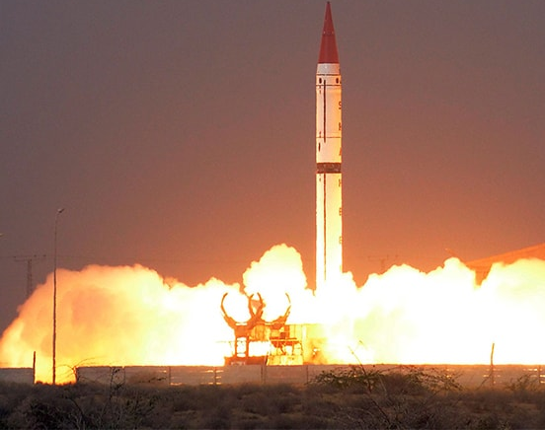
Nuclear issues
By Musab Umair
Notes:
NOTE:
To change the image on this slide, select the picture and delete it. Then click the Pictures icon in the placeholder to insert your own image.

Slide 2
Introduction of the course
Syllabus and Content

Slide 3
Syllabus
Current Affairs
Nuclear Proliferation and Nuclear Security
Pakistan Affairs
Nuclear Program of Pakistan, its Safety and Security; International Concerns
Nuclear Politics in South Asia

Slide 4
Syllabus
International Relations
Proliferation of Nuclear Weapons
Nuclear Weapon States- Programs and Postures: Indian-Pakistan Nuclear Doctrines
Nuclear Non –Proliferation Regime: International Atomic Energy Agency, Nuclear Non- Proliferation Treaty; Nuclear Supplier Group; Partial Test Ban Treaty; Comprehensive Test Ban Treaty; Fissile Material Cut-off Treaty
Challenges of Non-Proliferation, Cooperation for Nuclear Energy
Arms Control /Disarmament and Nuclear Non proliferation Regime

Slide 5
Content
Lecture 1:
Brief Nuclear History, 1945 – Present
Baruch Plan
Atoms for Peace
International Atomic Energy Agency
Cuban Missile Crisis
Limited Test Ban Treaty
Nuclear Non-Proliferation Treaty
Nuclear Suppliers Group
Strategic Arms Reduction Treaty
Comprehensive Test Ban Treaty

Slide 6
History of nuclear proliferation
1945 - present

Slide 7
Brief History of Nuclear Proliferation
Manhattan Project
Hiroshima and Nagasaki
UK
Baruch Plan
USSR
6th and 9th August 1945
1942 to 1946
1946
1949
1952
Limited Test Ban Treaty
Cuban Missile Crises
France
IAEA
Atoms for Peace
  1963
  1962
  1960
  1957
  1953

Slide 8
Brief History of Nuclear Proliferation
China
NPT
Israel
India
NSG
1970
1964
1974
1974
1979
START
CTBT
North Korea
Pakistan
Indo-US
Open on 1996
1994
28th May 1998
2005
2006

Slide 9
Two blocs in World War II
Bloc | Main Member Countries | Leaders | Goals
Axis Powers | -Germany - Italy (until 1943) - Japan | -Adolf Hitler (Germany) - Benito Mussolini (Italy) - Emperor Hirohito / ------Hideki Tojo (Japan) | -Expand territory - Establish empires - Assert military dominance
Allied Powers | - United States - Soviet Union - United Kingdom - China - France | Franklin D. Roosevelt (USA) - Joseph Stalin (USSR) - Winston Churchill (UK) | - Defeat Axis powers - Restore peace - Liberate occupied nations

Slide 10

Manhattan Project
1942-1946
Secret nuclear weapons project of USA

Slide 11
Baruch Plan 1946
UNAEC was formed by UNGA’s very first resolution
A proposal by the US government proposed to the United Nations Atomic Energy Commission during its first meeting in June 1946.
US agreed to decommission
Condition that all other countries pledged
International Atomic Development Authority monopoly over Nuclear Energy
Soviets rejected, UN dominated by US and allies, submitted counter proposal

Slide 12
Atoms for Peace Program
Speech by D. Eisenhower in 1953
United States then launched an "Atoms for Peace" program that supplied equipment and information to schools, hospitals, and research institutions within the U.S. and throughout the world.
US provided 5MW Swimming pool type nuclear reactor to Pakistan- upgraded 10MW.
Pakistan’s first nuclear reactor Pakistan Atomic Research Reactor (PARR-1)—in 1962.
Created the ideological background for the creation of the International Atomic Energy Agency and the Treaty on the Non-Proliferation of Nuclear Weapons, but also gave political cover for the U.S. nuclear weapons build-up
Under Atoms for Peace related programmes the U.S. exported over 25 tons of highly enriched uranium (HEU) to 30 countries, mostly to fuel research reactors, which is now regarded as a proliferation and terrorism risk

Slide 13
International Atomic Energy Agency (IAEA)
An autonomous organization formed in 1957
Established independently of the UN, through its own international treaty but reports to both the UNGA and the UNSC
Headquarter in Vienna, Austria
Missions
Peaceful use
Safeguards
Nuclear Safety

Slide 14
Key Terminologies and explanation
Deterrence
Theory of Anarchy & Balance of Power Theory
Security Dilemma
Nuclear politics
Nuclear Strategy
False Flag Operations
Cold War doctrine

Slide 15
Cuban Missile Crisis
1 month, 4-day (16 October – 20 November 1962) confrontation between the United States and the Soviet Union
In response to US missiles in Italy and Turkey and failed invasion of Bay of Pigs, to overthrow Fidel Castro's communist government in Cuba, Soviet N. Khrushchev accepted to Cuban secret request of installing nukes in Cuba
Rejecting other options, J. F. Kennedy decided to impose naval “quarantine” in Cuba
Several days of negotiations lead to agreement:
Publicly, Soviet would dismantle and return their nukes to Soviet Union in return for US public declaration and agreement to not invade Cuba again
Secretly, US would dismantle and remove their nukes from Turkey
Aftermath: temporary easing of nuclear arms race, Washington-Moscow hotline, realization of the nuclear threat

Slide 16
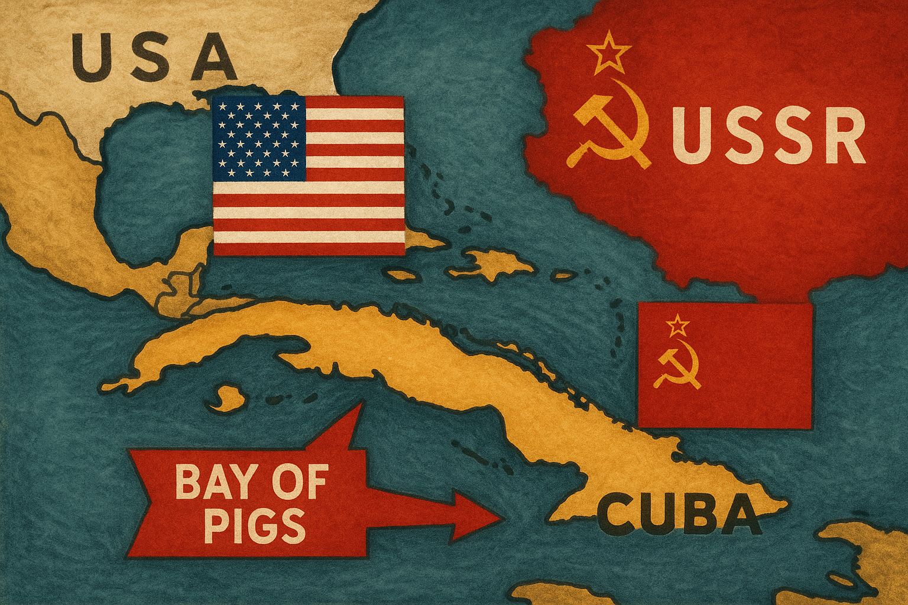

Slide 17
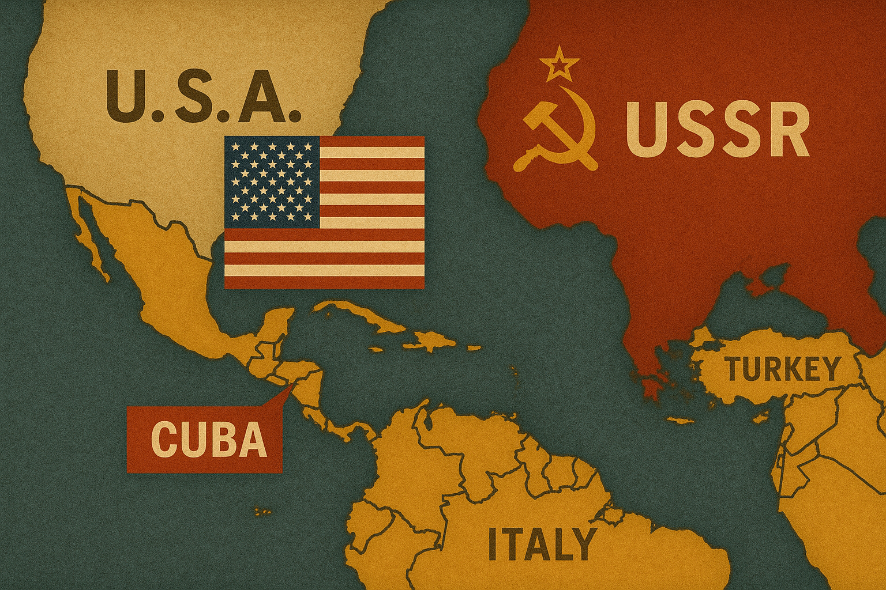

Slide 18
Limited Test Ban Treaty (LTBT)
Also called Partial Test Ban Treaty or Nuclear Test Ban Treaty
Was signed in 1963
Due to public unease about radioactive fallout
Bans parties from conducting a nuclear test in the atmosphere, outer space, or underwater
China, France and North Korea have not signed
Reduced radioactive debris in atmosphere and slowed proliferation

Slide 19
Nuclear Non-Proliferation Treaty (NPT)
Came into force in 1970
India, Israel and Pakistan rejected on discriminatory grounds
Nuclear Weapon States (NWS), (USA, Russia, UK, France, China), those who have made and
openly tested nuclear weapons before
1 January 1967
Pillars
Non-Proliferation
Peaceful Use
Disarmament

Slide 20
Nuclear Non-Proliferation Treaty - Pillars
Non-Proliferation
Art I - NWS cannot in any way “assist, encourage or induce” NNWS to nukes
Art II – NNWS vice versa and not manufacture nukes
Art III – NNWS accept safeguards and IAEA’s role as a regulator
Peaceful Use
Art IV – Right of every member to nuclear tech for peace and promote international cooperation in this regard
Art V – Non-discriminatory assistance to NNWS for peaceful tech
Disarmament
Art VI – “pursue negotiations in good faith” to disarm nuclear weapons “at an early date”

Slide 21
Nuclear Non-Proliferation Treaty – Strengths and Weaknesses
Strengths
Weaknesses
First treaty of its kind
191 (now 190 after North Korea withdrew) states are signatories
Provides a legal framework
Discriminatory
No work on Article VI
Non-signatories
North Korea
Intergovernmental pressure is more effective than the treaty

Slide 22
Nuclear Suppliers Group (NSG)
Founded in response to the Indian nuclear tests in 1974
48 Members
Also called London Club, London Group or London Suppliers Group
Control of exports nuclear technology that can readily be used for weapons development to non-nuclear weapons states
Zangger’s “Trigger List”
Listed items can only be supplied to non-nuclear weapon states if they have certain safeguards in place
India and Pakistan are not members, though India is backed by all except China, New Zealand, Ireland, and Austria. India received a special NSG waiver in 2008

Slide 23
Chernobyl Nuclear Disaster – 1986 (Largest nuclear disaster in history)
Chernobyl Nuclear Power Plant, USSR
Cause: Reactor No. 4 exploded during a late-night safety test due to design flaws and operator errors
Impacts: Immediate deaths: ~30 workers and firefighters, Radiation-related cancers and illnesses, Over 100,000 people evacuated

Slide 24
WANO – World Association of Nuclear Operators
Established: May 1989, after the Chernobyl disaster (1986)
Headquarters: London, United Kingdom
Purpose: To promote nuclear safety and reliability worldwide by connecting all nuclear operators

Slide 25
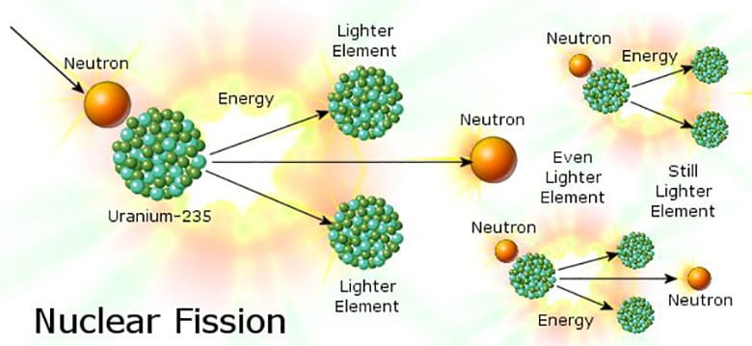
235U + 1n -> 141Ba + 92Kr + 3n + Q
Notes:
235U: represents a Uranium-235 nucleus.
1n: represents a neutron.
141Ba: represents a Barium-141 nucleus.
92Kr: represents a Krypton-92 nucleus.
3n: represents three neutrons released.
Q: represents the energy released during the reaction.

Slide 26
Strategic Arms Reduction Treaty (START)
Bilateral treaty between the United States and the Soviet Union on the reduction and limitation of strategic offensive arms
Signed on 31 July 1991 and entered into force on 5 December 1994
Barred its signatories from deploying more than 6,000 nuclear warheads and a total of 1,600 intercontinental ballistic missiles (ICBMs)
Implemented in 2001, removed 80% of all strategic nuclear weapons in existence
Treaty expired in 2009 and was replaced by New START or START II, which will expire in 2026, having been extended in 2021

Slide 27
Comprehensive Test Ban Treaty (CTBT) 1996
A multilateral treaty that bans all nuclear tests, for both civilian and military purposes, in all environments
Signed by 185, ratified by 170
Not in force as 8 of the 44 Annex 2 states, including Pakistan, India, the US, and China, have not ratified it
Annex 2 states are states that participated in the CTBT's negotiations between 1994 and 1996 and possessed nuclear power reactors or research reactors at that time

Slide 28
Fukushima Nuclear Disaster – 2011
Fukushima Daiichi Nuclear Power Plant, Japan
Cause: 9.0 magnitude earthquake followed by a 14-meter tsunami -Tsunami disabled power and cooling systems, leading to meltdowns in 3 nuclear reactors-
2200 people lost their lives
Germany closed all its nuclear power plants

Slide 29
Joint Comprehensive Plan of Action (JCPOA)
The JCPOA, commonly known as the Iran Nuclear Deal, is an international agreement reached in 2015 between Iran and a group called the P5+1 (the U.S., U.K., France, Russia, China + Germany) along with the European Union
For 13 years, Iran agreed to eliminate its stockpile of medium-enriched uranium, cut its stockpile of low-enriched uranium by 98%, and reduce by about two-thirds the number of its gas centrifuges.
For 15 years, Iran agreed to enrich uranium only up to 3.67% and not to build heavy-water facilities.
For 10 years, uranium enrichment would be limited to a single facility using first-generation centrifuges. Other facilities would be converted to avoid proliferation risks.
IAEA would have regular access to all Iranian nuclear facilities to monitor compliance.

Slide 30
Joint Comprehensive Plan of Action (JCPOA)
Trump withdrew it in 2018
Israel’s Attack on Iran
US attack on Nuclear facilities
Failure of Israel and the USA
Way forward

Slide 31
Assignment
Read a book review on the Age of Deception by ElBaradei, you can find one in the Los Angeles Times
Pakistan and World Affairs by Shamshad Ahmad

