Slide 1
Lecture 2
Pak-India Relations
Peace-making and Peace-Building in South Asia

Slide 2
How do you see the creation of India and Pakistan?

Slide 3
Peace or War?
Co-existence or Co-destruction
Peace is not the absence of conflict, it is the ability to handle conflict by peaceful means.
Peace cannot be kept by force; it can only be achieved by understanding.
If states are free to fight, they also are free to refrain from fighting. War is costly and rarely profitable; therefore, strong incentives exist to refrain from it

Slide 4
Why Pak-India rivalry has endured?
Realism:
Enduring Security Dilemma.
Both prioritize national security (arms race - nuclear weapons).
Liberalism:
No economic interdependence, No institutional cooperation, democratic deficit.
Constructivism:
Identity, historical narratives, and socially constructed norms.
The elite on both sides socialize the enemy image & perpetuate it through wars.

Slide 5
Pak-India Relations
The Context: A Troubling Legacy
Phenomenon that can be approached from different perspectives (political, historical, and religious).
Relationship have been characterized by conflict & lack of trust.
Both place NATIONALISM above everything – nonstarter, making the relationship a ‘ZERO-SUM.’
Despite strategic asymmetry, Pakistan looms large on the Indian horizon.

Slide 6
History of occasional optimism & often gloom
Pre-Partition (Opposing Ideologies)
Partition and Aftermath (identity)
  Communalism 1.2 Million killings, Disputes over territories and assets.
Cold War Geopolitics further deteriorated Indo-Pak Relations
Wars 1948, 1965, 1971, Indian nuclearization 1974, Siachen 1984, Kashmir Intifada 1989 – kept rivalry alive.

Slide 7
Rare opportunities for peace – Crisis stability
Nuclearization, Balance of Threat, & Regional instability
  1998 Tests, Lahore Process (Bus Yatra), Kargil 1999 (Koh Paima), MAD, and Balance of Threat.
21st Century and Renewed Rivalry
  Agra Summit 2001 (Musharraf 4 Point Formula), Indian Parliament Attack, Military Standoff 2001-2002, 11th SAARC summit Katmandu & Golden Handshake Jan 05, 2002, SAARC 12th Summit Islamabad 2004.
Composite Dialogue Process 2004
  Samjhouta Express Blast 2007
  Mumbai Attacks 2008

Slide 8
Eight Agenda Items of CDP
Peace and Security including confidence-building measures (CBMs)
Jammu and Kashmir (J&K)
Siachen
Wullar Barrage (Jehlum river)
Sir Creek (96 KM – Gujrat and Sindh, Thalweg principle)
Economic and commercial cooperation
Terrorism and drug trafficking
Promotion of friendly exchanges in various fields

Slide 9
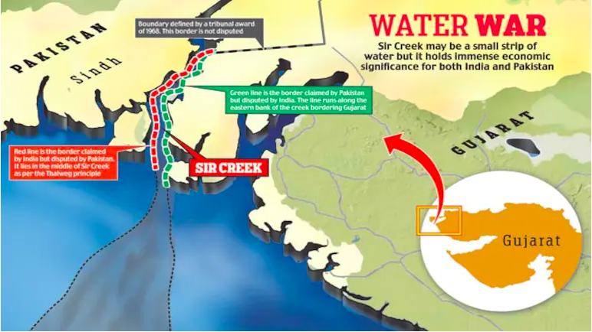

Slide 10
Musharraf’s Four Point Kashmir Formula (2001)
Demilitarization (Kashmir)
Self-governance (autonomy and self-rule)
Joint Mechanisms (bilateral institutions)
Soft Borders (free movement, people to people) .

Slide 11
Indo-Pak relations under Modi in India
Act East
Pro-active FP based on strong leadership
Soft power-based assertiveness Int. power transition
Strategic Autonomy (S. Ganguli, 2017)
Hindu nationalism Wishwa Guru
Neighborhood first

Slide 12
Relations have touched the lowest possible point.
Acts according to realist dictates – great power ambitions with assertive FP.
Indian regional and global profile is rising.
    Internally: Hindufication of India.
    Externally: Hegemonic aspirations with assertive FP
Calculated risk-taking (Doklam, Urri, Balakot, Russia oil & S400, and Energy from Iran, Article 370 & 35 A, Modi in Moscow on NATO’s 75 Years).

Slide 13
Genesis of the Relationship
Historically: Muslim nationalism & identity – a majority/minority issue (after 1947 - big India and Small Pakistan).
Zero-Sum Nature of Relationship: powerful India and weaker Pakistan – hence zero-sum relationship & continuation of rivalry.
Structures of Political, Security, and Administrative Institutions: designed & institutionalized on suspicions on both sides.
Solution: Strong leadership can defy and generate popular consensus and momentum within institutions politically and in security terms.

Slide 14
Way out/Suggestion
Forget, learn, and move
Political will & intent is the pre-requisite.
Track I and II, what is doable and what is desirable
Demilitarization of certain zones - Siachen
People-to-people contacts
Relaxing visa regime, Medical visas,
Integration and connectivity Bilateral trade, SAARC
International and regional friends to be brought in.
India’s non-contact warfare failed has failed.
Religious tourism (Kartarpura, Hassan Abdal, Nankana),
Military CBMs (DG MOs flag meetings, frequent use of hotline),
Role of Media, Dialogue on Kashmir (taking Kashmiris as well)
Resumption of composite dialogue…. Will India?

Slide 15
Peacemaking
Agreeing to end active conflict/war through negotiations.
It is short-term process.
It Involves:
Immediate focus (ceasefire through peace agreement)
Negotiation & Mediation:
  It involves direct negotiation between conflicting parties, often facilitated by third-party mediators.
Solution through addressing the ‘immediate’ cause.
Diplomacy (all the stakeholders and guarantors)

Slide 16
Peacebuilding
Creating the conditions for sustainable peace by addressing the root causes of conflict.
It is long-term process.
It Involves:
Reconciliation
Social Cohesion
Economic Development
Through – Community Engagement and sustainable institutions (prevention)

Slide 17
Q/A
Discussion

