Slide 1
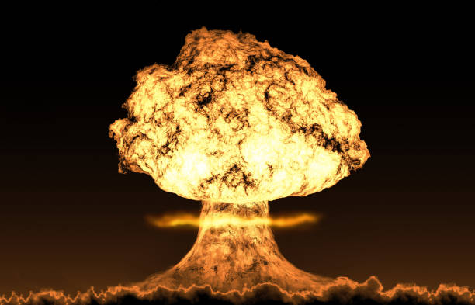
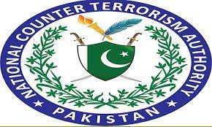
CURRENT AFFAIRS
Ammar Javaid Siddiqui
DD( Counter FINANCE TERRORISM ) NATIONAL COUNTER TERRORISM AUTHORUTY

Slide 2
NUCLEAR ISSUES
Ammar Javaid Siddiqui
DD( Counter FINANCE TERRORISM ) NATIONAL COUNTER TERRORISM AUTHORUTY

Slide 3
Agenda
Concepts
History of Nuclearisation
How Pakistan came to acquire its nukes
Pakistan –India Nuclear Stand off
Non Proliferation and Disarmament Regime
Nuclear Proliferation and TF
Militarisation and Weaponisation of outer space

Slide 4

Food for thought

Slide 5
The presence of 14900 nuclear weapons poses an existential threat to global peace and security
1. 14900 and still counting
a) Nuclear Aspirant states(Iran , KSA , Israel etc)
b) Non-signatory NWS continued to proliferate
2. Ongoing Rivalry among Nuclear Weapon States
3. The failure of WOT and its aftermath
Terrorist Organisations have become far more methodical and sophisticated
4. Proliferation Financing and Terrorism

Slide 6
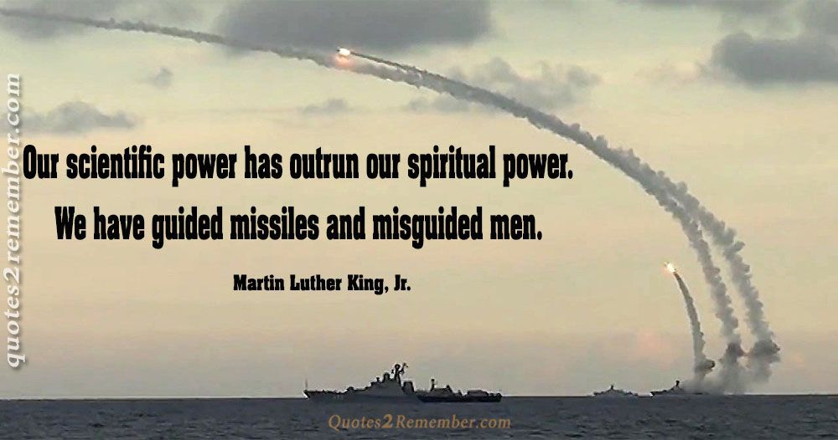

Slide 7
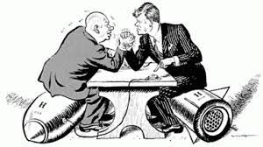
CONCEPTS
DETERRENCE : the ability to stop
NUCLEAR DETERRENCE : deterrence acquired through nuclear weapons

Slide 8
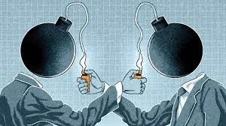
Why Nuc. Deterrence is considered an ultimate form of deterrence?
MAD (Mutually Assured Destruction) the two military forces are capable of causing complete annihilation to each other

Slide 9
Theoretical Perspectives of Nuclearisation (State Behavior Theories )
Theory of Anarchy assumes :
1. Absence of Central Authority
2. Self-Help System
3. Trust Deficit
Security Dilemma
Arms Race
Weaponisation

Slide 10

Theoretical Perspectives of Nuclearisation (State Behavior Theories )
Balance of Power Theory
When in an international system a state tends to acquire overwhelming power through which it can dominate other states or the system , the remaining states react to restore the balance of power

Slide 11
History of Nuclearisation
MANHATTAN PROJECT
The End of WWII marked the beginning of :
The Nuclear Age
The Bi-polar World Order
The Cold War

Slide 12
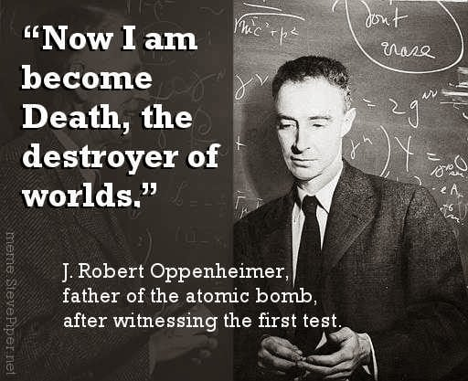

Slide 13
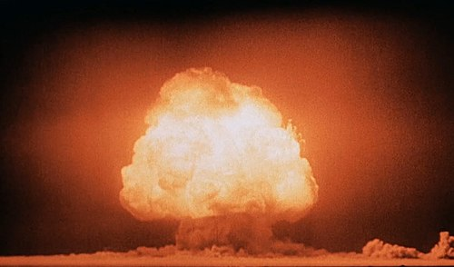
How Pakistan Came to acquire its Nukes?
Criticism: Pakistan is a 3rd World Country and it could have been economically better off had it invested its recourses on its socio-economic uplift
Critical Analysis of Pakistan’s quest for Nuclear Waepons
Atoms for Peace Programe December 8th 1953(Dwight D. Eisenhower)
1974 Smiling Budha

Slide 14
Pakistan’s apprehensions
India is developing nuclear weapons to undermine Pakistan’s National Security
India is on the path of becoming a regional hegemon

Slide 15
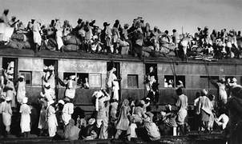
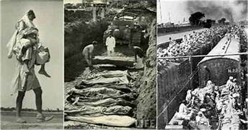
Factors Contributing to Pakistan’s Decision
1 1947: The shadow of Partition
Mass Exodus accompanied by Communal violence

Slide 16
2. Indian Hegemony
“India must perish or dominate; perish it won’t so dominate it must “
Nehru
3. History of Conflicts
4. Lessons from the fall of Dhaka
India wont stop undermining Pak’s National Security
Self-help
Non-conventional Weapons

Slide 17
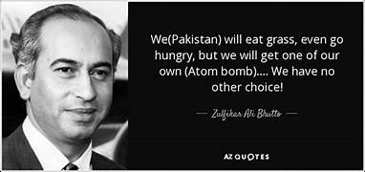

Slide 18
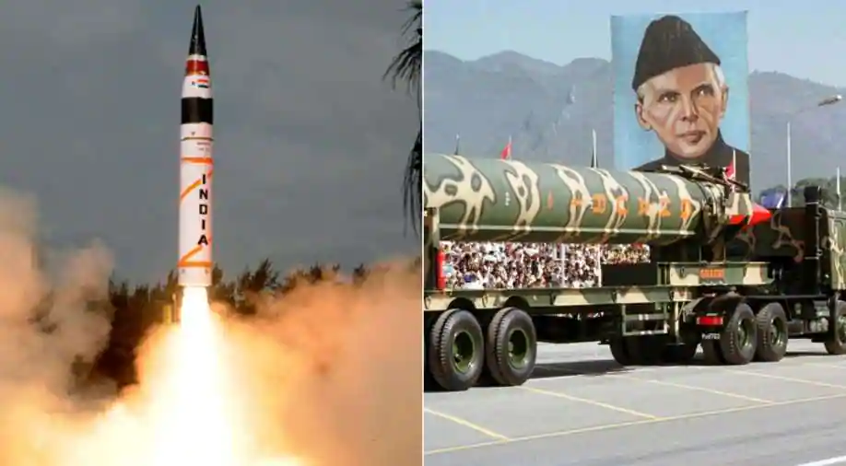
Pakistan-India Nuclear Stand Off

Slide 19
Doom’s DAY
Researchers warn India-Pakistan nuclear war could kill 100 million
The year is 2025 and militants have attacked India's parliament, killing most of its leaders. New Delhi retaliates by sending tanks into Azad Jammu and Kashmir (AJK).
Fearing it will be overrun, Islamabad hits the invading forces with its battlefield nuclear weapons, triggering the deadliest conflict in history — and catastrophic global cooling, with temperatures not seen since the last Ice Age.

Slide 20
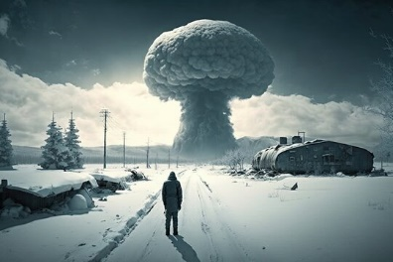
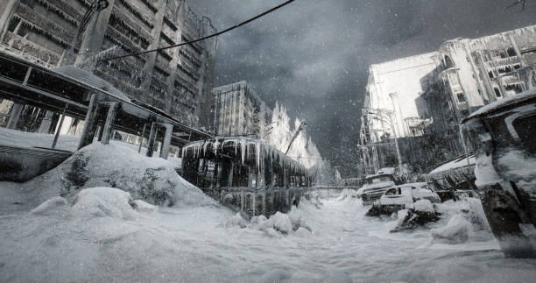
NUCLEAR WINTERS

Slide 21
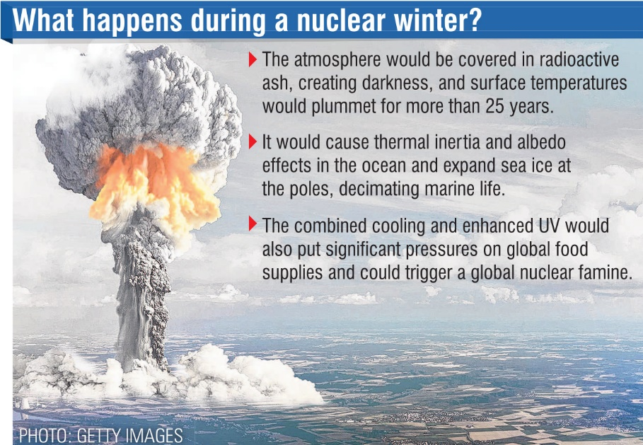
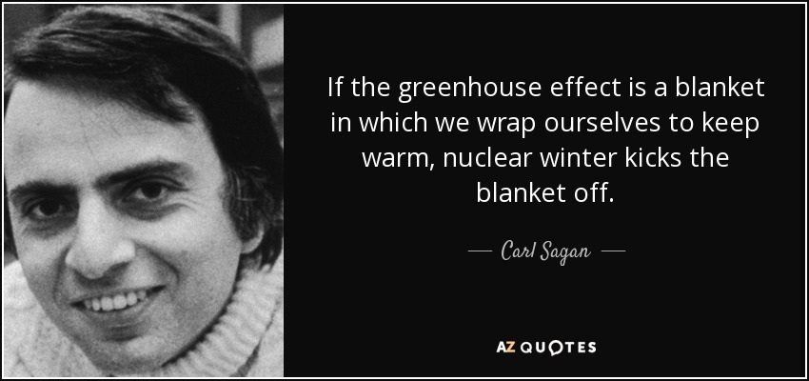
End of Times?

Slide 22
Factors contributing to the stand off
The History of Bilateral relations
The history of the two countries is as such that it makes the two prone to entering into another conflict
Indian Policies of Provocation
False Flag Operations
When a country orchestrates an attack on its own soil to make it the basis of carrying out an attack on another country
The Cold Start Doctrine
3. The Dynamics of War
4. The Changing Nuclear Posturing of India

Slide 23
Factors contributing to the stand off
5. The rise of Hyper/muscular nationalism in India
An extreme form of nationalism where the glorification of a nation is sought through the supremacy of one group at the cost of other groups
Akhand Baharat : A grand unified Indian state under a Hindu rule
6. Kashmir a flashpoint
On August 5th 2019 , India revoked its two articles namely Article 370 and 35-A which granted Kashmir a special status in India . The Articles were revoked to alter the demographic equation of Kashmir

Slide 24
Kashmir holds a key to the national security of Pakistan
The factors which make a nation state secure form internal and external threats
Water Security
Food security
Energy Security
Economic Security
Environmental Security

Slide 25
How to avert the stand-off
Role of Global Community:
Pressurizing India to stop its policies of Provocation
Resolution of Kashmir Issue
Introspection
Leadership Crisis
Governance
Economic Dependance

Slide 26
Non-Proliferation & Disarmament Regime
“Collective initiatives taken by International community towards containing the spread of nuclear weapons leading to its total elimination”
State Volunteerism
Nuclear Politics
Absence of Road Map on Disarmament
Discrimination

Slide 27
Militarisation & Weaponisation of Outer Space

Slide 28

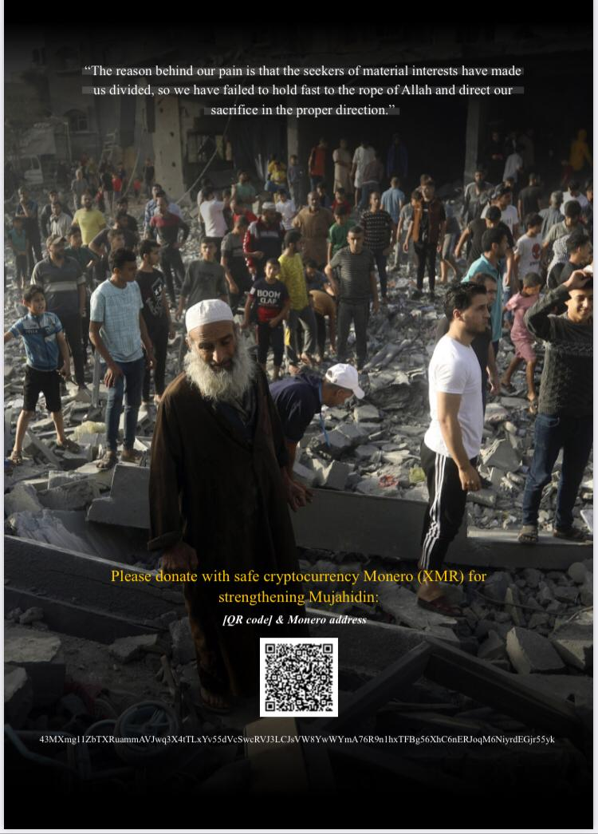
Voice of Khorasan

