Slide 1
Current Affairs
Pakistan’s External Relations
By
Assistant Professor
Dr. Zahid Mehmood Zahid (PhD – IR)
https://chat.whatsapp.com/FBRsuzoIbNoBGsHnKUmCih
https://www.facebook.com/groups/144123599347978

Slide 2
Syllabus of CA
Foreign Policy
Determinants, Decision Making and Analysis, Pakistan’s National Interests, Challenges to the sovereignty.
  Pak-Afghan Relations
  Pak-India relations,
  Pak-China Relations
  Pak-US Relations
  Pak-Russia Relations,
  Pak-Turkiye Relations

Slide 3
Foreign Policy
What do states want?
How do they make decisions to get what they want?
Why do they adopt particular diplomatic, security, or economic policies?

Slide 4
Question to Ponder!
What is the purpose of the state, and why does a state need a foreign policy?

Slide 5
FP defined by the scholars
FP is "the art of establishing priorities among objectives and finding the means to achieve them." Kissinger
“The totality of interactions by which a state pursues its objectives with actors in other states." James Rosenau
Foreign policy is the deliberate set of strategies and actions adopted by a state to pursue its national interests in the international system, influenced by both internal determinants (political, economic, ideological) and external dynamics (threats, alliances, opportunities).

Slide 6
Stages in FP DM (Initiation, Formulation, implementation)
Problem recognition and need for a FP response: the Int. & domestic political environment.
Setting priorities.
Determination of FP Options.
Decision-making process/calculation.
Implementation of a selected option – resource allocation.
Evaluation of outcomes – for possible reversal or reinforcement.

Slide 7
Permanent and Variables in Pakistan’s FP DM
Permanent Factors:
Geographical location (India, Afghanistan, China, Iran)
Relations with the Superpowers (US and China)
Relations with the Muslim world (ideology)
India & Afghan Factor (security-centric)
Variable Factors:
Domestic Factors (Economy, Technology, leadership’s cognitive biases), civil-military relations, public opinion, etc.)
International Factors (Great powers politics, Threats perception, polarity in the international system, alliances, etc.)

Slide 8
FP Decision Making structure
Prime Minister
Cabinet
National Security Committee & NSD
Parliament
Foreign Ministry
Defence & Intelligence Community
Interest Groups & Think Tanks
Public opinion

Slide 9
Foreign Policy Decision-Making Models
Rational Actor Model (RAM)
States are unitary actors to make utility-maximizing decisions.
Cost-benefit analysis with goal-oriented choices to achieve objectives.
Given the complete information, the model predicts logical responses to events.
Steps in Decision Making: Pakistan’s Joining of CPEC
Problem Identifying: energy, infrastructure, FDI, strategic ties.
Objectives: energy, infra, counter, investment, etc.
Options: ME, IMF, China, USA, etc.
Calculations: 62 US$ B, Debt burden, etc.

Slide 10
Organizational Process Model (OPM)
Govt. as a mix of powerful organizations working in concert.
SOPs – are followed.
Decentralization of responsibilities.
Decision are made step-by-step (incrementalism).
Organizational priorities, goals, and policies matter.
May 28, 1998: PM, PAEC, KRL, GHQ, PIA, PAF, NLC.
Pakistan’s Response to Pulwama:
PM Office – Expressing Resolve and Political Commitment
Military and ISPR – deterrence and signaling,
FO – China, USA, KSA, IMF talks- economic constraints,
SPD – Risk assessments to keep nuclear off the table.

Slide 11
Bureaucratic Politics Model/Govt Bargain Model
Decision-making is done by a number of competing entities (organizations).
Each brings input to the DM process, with its own view of personal, organizational, and national interests.
Collective decision is contingent upon successful negotiation, bargaining, and compromises among entities.
Players’ positions and priorities matter.
Examples: WoT: Military Interests, ISI, FO, religious and political parties – cooperation US, Taliban, managing protests by reli groups and protests by parties.

Slide 12
Three models explaining Pakistan’s joining of CPEC
RAM: Pakistan joined to boost its economy and regional connectivity through a rational cost-benefit analysis.
OPM: Decision followed SOPs of economic and planning institutions operating within their established mandates.
BPM: CPEC joining was the result of negotiations & compromises among powerful stakeholders – military, civilian leadership, and planning ministries.

Slide 13
Implementation
Instruments of Pakistan’s Foreign Policy:
Diplomacy I & II: FP is the content & diplomacy is the process through which it is carried out. (Bilateral or multilateral negotiations – OIC, UN, SAARC, SCO)
Economy (CPEC, IMF, trade agreements, etc.)
Strategic Partnerships (China, US, Turkey, etc.)
Soft power (Media, Digital Diplomacy, Religion, Sports, Education, Scholarships, culture, etc.)
Public Diplomacy (Kashmir literacy, Islamophobia, Image)
Covert activities (secret operations and intelligence cooperation)

Slide 14
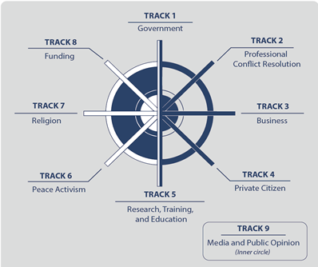
Tracks of Diplomacy: Bringing NSAs into state craft – Con Resolution and international cooperation through negotiations

Slide 15
Pakistan’s FP Objectives
Promotion of Pakistan as a dynamic, progressive, moderate, and democratic Islamic country.
Friendly relations with all/especially major powers, & immediate neighbors.
Safeguarding national security & geostrategic interests, including Kashmir. (FP starts at home)
Note: 2010s, Pak-US , geoeconomics – China, Russia, Iran, Turkey, image repair, etc.

Slide 16
4. Consolidating commercial & economic cooperation with int. community.
5. Safeguarding the interests of Pakistanis abroad.
6. Ensuring optimal utilization of national resources for regional & int. cooperation.

Slide 17
Pak’s National Interests
Territorial integrity and security (India, Afghanistan)
Counter terrorism and Internal stability
Development and Prosperity (Human, Eco, infra, energy security)
Political stability (demo and good gov)
Identity and cultural values (cultu and relig harmony)
Access to resources (water, energy, climate security)
Tech advancement (cyber and innovation)

Slide 18
Challenges to the Sovereignty
India
Cross Border terrorism (Afghan)
Terrorism and Extremism
Insurgency and Separatism
Economic Dependence
Political instability
Climate vulnerability
State (Hard)
Non-State (Soft)

Slide 19
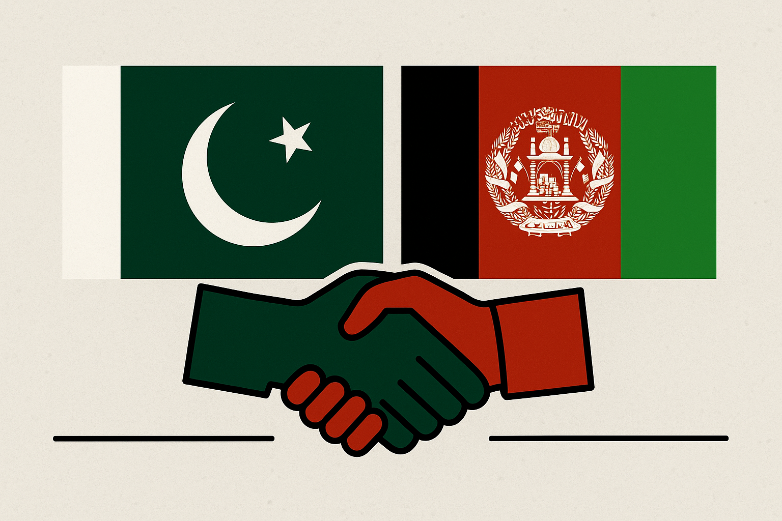
Pak-Afghan Relations

Slide 20
Afghanistan in the Cold War Theater
Cold War geopolitics, Soviets into Afghanistan1979,
‘Jihad against godless’ – fusion of religion and geopolitics.
Pakistan, US, and ME monarchies – an axis of believers.
Geneva Accord 1988,
Rise of Taliban (Appeal? .. Promise?),
Al-Qaeda Enters Afghan Theater
9/11, OEF, and toppling of Taliban govt,
Bonn Conference 2001, Karzai govt, US/NATO in Afghanistan till 2021.
Doha Process 2018 - 2021
Return of Taliban - Aug 2021.

Slide 21
Pak-Afghan Relations

Slide 22
Pak-Afghan relations
Both share more than 2600 KMs border.
Afghanistan always maintained a hostile attitude towards Pakistan.
Despite common culture, ethnicity, faith, history & geo-political dilemmas, relations have been troublesome. WHY?
Primarily because of ‘Durand Line’ issue.
Afghanistan opposed Pakistan’s entry into UNO.
July 26, 1949 – terminated all agreements with British including ‘Durand Agreement’

Slide 23
Pak-Afghan Relations:
Initial Phase: 1947 to 1979 (Afghan assertion and Pakistan’s Defensive behavior – Pakhtunistan, Durand, Pak Supported H-e-Islami)
2nd Phase: 1979 to 1989 (Soviets in Afghanistan, minimal official ties – Karmal & Najib, Pak support was seen as aggression, Pakistan diplomatic, Economic, and Security support to liberate Afghanistan)
3rd Phase: 1989 to 1994 (Cold war proxy conflict to regional competition, Peshawar Accords 1992, Islamabad Accords 1993, Pakistan’s diplomatic efforts for peace & stability in Afghanistan – under a power sharing mechanism, Civil War)

Slide 24
Pak-Afghan Relations:
4th Phase: 1996 to 2001 (strategic alignment, diplomatic recognition, economic – refugees support and informal trade, and military support – training and advisory role), Overall, religion for national security & strategic interests.
5th Phase: 2001 to 2021 (US intervention – WoT, Strategic Shift, Terrorism on both sides, Military operations – Security, 1 – 2 US$ B trade, Developmental assistance 1.5 US$ B, multilateral relations between Pak-Afghanistan)

Slide 25
Latest Phase: Afghanistan under Taliban 2.O
Optimism & Desperation, Refugee’s Expulsion, Aerial raids, border closure
Commonalities: Stability and economy ( 1 US$ Billion in the 1st half of 2025)
Differences: Terrorism (rose to 28% in 2022, 79% in 2023, & 70% in 2024), Border management, and Refugees.
Mr. Dar visits Afghanistan – April 2025
Pak-Afghan-China revived – Afghanistan joined CPEC,
Trans-Afghan railway project,
Afghan transit trade agreement will be revived in 2025,
Duty waiver to 860 items (10% duty),
Helpline for outgoing refugees’ property settlements.
Pak-Afghan Joint Coordination Committee agreed to talk about issues of security/TTP, trade, and border crossing.

Slide 26
Solution!
Forget, learn, and move into the future.
Engagement – Track I & II dialogue (economic and religious diplomacy).
Political Recognition (conditional)
Pakistan should engage Afghanistan multilaterally, based on ground realities.
Engaging friends as guarantors: China, KSA, etc.
Refugee and border management.
Intelligence sharing for counter-terrorism.
Trade and Transit

Slide 27
Questions to Attempt
Given Pakistan's growing concerns over TTP-led terrorism originating from Afghanistan, what diplomatic and strategic steps can be taken to prevent Afghanistan from serving as a sanctuary for anti-Pakistan elements?
How have shifting U.S. priorities in the region, particularly after its withdrawal from Afghanistan, influenced Pakistan’s approach towards the Afghan Taliban and regional stability?
Given Pakistan’s recent policies on Afghan refugees, including deportations, what are the humanitarian, security, and diplomatic implications for bilateral relations between the two countries?
With Pakistan increasingly concerned about cross-border militant activities, what diplomatic or strategic measures could be taken to ensure Afghanistan does not become a safe haven for anti-Pakistan elements?

