Slide 1
Pakistan: Regional & Global Organizations
SARFRAZ HUSSAIN (CSP)
          34th Common- PA&AS
          Director Finance
        MBA (Int. Fin) - UIBE Business School, Beijing
        M.Sc. Public Administration (PF) - QAU Islamabad
        Fellow Pakistan Institute of Public Finance & Accountancy
        SAP-FI Certified, Certified Performance Auditor
        Visiting Faculty:
        QAU-School of Management Sciences
        National Officers Academy
        National Institute of Management

Slide 2
Regional & global organizations
Current Affairs & Pakistan Affairs
IR, I. Law, Pol. Science

Slide 3
Multilateralism for Regional & Global Cooperation
Regionalism: Regional Organizations
Globalism---International Governmental Organizations (IGOs)
SAARC
ECO
SCO
EU
ASEAN
BRICS
Arab League
OIC
Gulf Cooperation
Council
International Political Order
LoN
UN
ICJ
International Economic Order
World Bank
IMF
WTO
Lecture-1
Lecture-4
Lecture-2
Lecture-5
Lecture-3

Slide 4
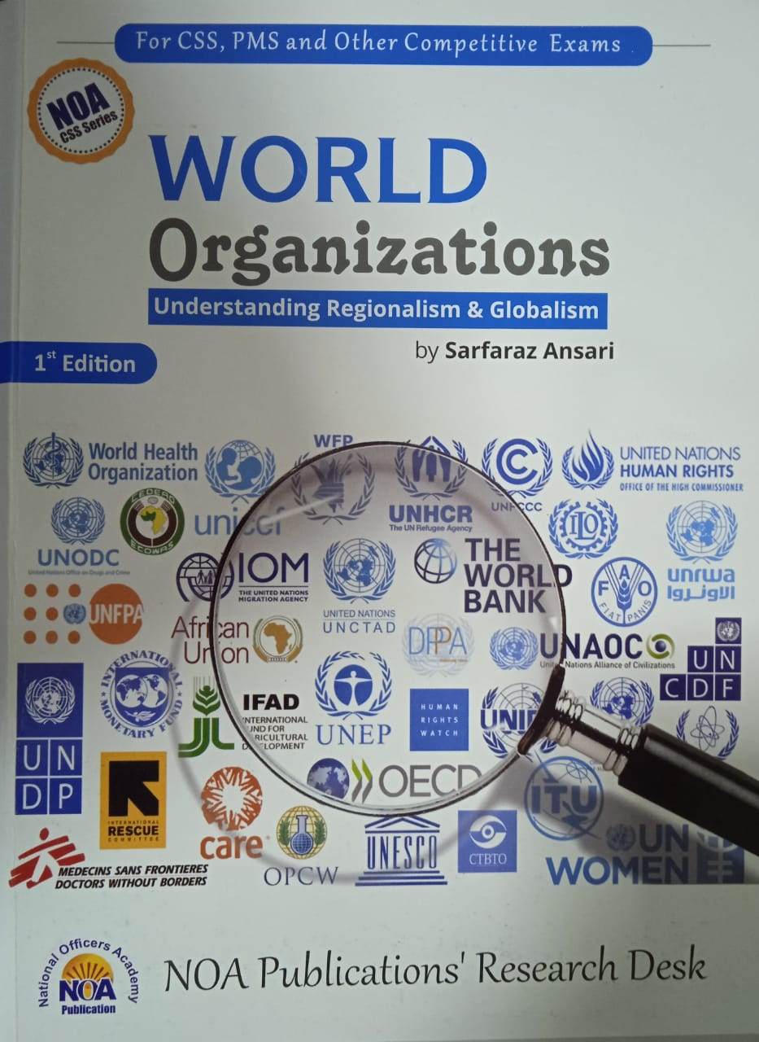
Sources of Study
World Organizations Published by NOA
Official Websites of these Organizations
CSS Five Year Papers
Watch BBC, Aljazera and DW

Slide 5
Talking Points/ Food for thought
Globalism & Regionalism
  Internationalization and the notion of ‘Collective Security’ and shared future
Nationalism Vs Super-nationalism
  Which is more important?
If both are important at the same time, whom to accord priority to?
Notes:
Slowbization…..

Slide 6
National Security Vs Collective Security
What is national security?
Who is responsible for national security?
What is ‘Self Defense’? (Article 51 of UN)
What is International Security?
Who’s responsible for Int. Security?
What is ‘Collective Security’

Slide 7
Factors that contribute in Power Politics & Competition
Tangible
Intangible
Strong Economy
Modern Technology
Political Stability
Geography
Leadership
Social Cohesion
Population Quality
Diplomacy
National Identity
On the basis of these factors certain countries start playing defining and leading role in the regional organizations they are member of.

Slide 8
Regional Integration and Regionalism
Regionalism is a political ideology that focuses on the interests of a particular region
  It invites cooperation among nations of that particular region
  The spirit being mutual integration of national systems of trade, economy, defense, and politics

Slide 9
Multilateral cooperation in order to streamline and make it uniform the national trade, economic, investment, customs, and border management laws and procedures to integrate into one entity
certain regional organizations integrate so successfully that they establish a complete sovereign system of governance and justice.
Regional Cooperation Organizations and Role of Pakistan
  SAARC
  SCO
  ECO

Slide 10
Trade Union
Economic Union
Customs Union
Monetary Union
Political Union
Trade Cooperation
Free trade of goods and commodities
Trade laws and rules uniform
Economic Cooperation
Trade of all economic goods and services
Common Market
Political Union
Single Constitution
common Election
Customs Union
Monetary Union
Single Currency
Common Customs laws
Imports export regime
TAX system
Central Bank
Credit system
Common financial system
Sovereign Parliament

Slide 11
Outline
Introduction
  Background
  Brief History (Genesis)
  Members (and membership criteria)
Charter, Objectives, Principles
Structure & Functions
Issues and Challenges
  Geo-Strategic, Geo-Economic, ideological, trade, cultural etc
  Latest/current developments
Future Prospects
Recommendations (if required)
Conclusion

Slide 12

SAARC

Slide 13
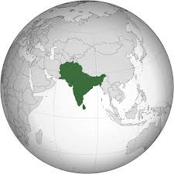
Geo-Economic and Geo-Strategic Importance of SAARC Region
SCO
South Asia is a Bridge for Asian Countries
ECO
SAARC
Indo-Pacific Region and Competition in the Indian Ocean
ASEAN
Pakistan is a Bridge for the Region

Slide 14
Historical Background (Why SAARC)
1. Role of Leadership
  President Ziaur Rahman, in December 1977, discussed regional cooperation with the Indian PM.
  in 1977, King Birendra of Nepal stressed for close regional cooperation
2. South Asian countries facing common problems demands joint action
3.A compact landmass perfect for regional Integration.
So, the officials of the seven countries met in Colombo in April 1981
4. The Colombo Plan
dictated regional cooperation for reaping max. benefits from the aid for South Asian countries.
5. Regionalism on the Rise in 1970s and 1980s

Slide 15
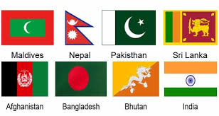
Foreign Secretaries met in 1981
In 1983, the FMs adopted the Declaration on
  South Asian Association for Regional Cooperation (SAARC)
The SAARC Charter was signed in Dhaka on 8 December 1985.
The Secretariat in Kathmandu- since 1987.
Initially seven, now eight member States
  Afghanistan joined SAARC in 2007
Notes:
Afghanistan joined SAARC in 2007

Slide 16
SAARC Permanent Members
SAARC Observers
Afghanistan
Bangladesh
Bhutan
India
Maldives
Nepal
Pakistan
Sri Lanka
Australia
China
the European Union
Iran
Japan
the Republic of Korea
Mauritius
Myanmar; and
the United States of America.
observer states—a status that entitles them to express their opinion, engage in dialogues, and give advice but denies them decision making and voting rights.
Notes:
observer states—a status that entitles them to express their opinion and give advice but denies them voting rights.

Slide 17
SAARC Charter
Total 10 Articles
  Article-I: Objectives (8 objectives)
  Article-II: Principles (3 principles)
  Article-III: Summit (heads of States/Govt)
  Article-IV: Council of FMs
  Article-VIII: Secretariat
  Article-IX: Financial Arrangements

Slide 18
Article I- SAARC OBJECTIVES
To Promote Welfare Of The Peoples of SOUTH ASIA
To Accelerate Economic Growth and Social Dev.
To Promote Collective Self-reliance
To Dev. Mutual Trust and Understanding of One Another's Problems;
To Promote Cooperation;
  Among Member States
  With Other Developing Countries;
  With International And Regional Organizations

Slide 19
Article II-PRINCIPLES (Values)
Promoting peace, stability, and progress in the region
Respect for the principles of
  Sovereign equality all member countries
  Territorial integrity
  Non-use of force
  Non-interference in the internal affairs of other states and
  Peaceful settlement of all disputes;
Fostering mutual understanding, good neighborly relations and meaningful cooperation

Slide 20
SAARC-Institutional framework
Structure

Slide 21
SAARC Structure
1. SAARC Summit
Total 18 Summits held. 19th Summit was cancelled in 2016
Once a year
4. Secretariat
5. Programming Committee
Kathmandu. Sec Gen
3-year Term of Office
6. Technical Committees
7. Committee on Economic Cooperation
For particular fields
2. Council of Foreign Ministers
3. Standing Committee
Meets twice a year
Foreign Secretaries. Meet twice a year
Commerce & Trade Secretaries: Introduced SAFTA
Notes:
Summit cancelled due to Uri attack on 18-Sep-2016

Slide 22
Article III-SAARC SUMMIT
  Meetings Of The Heads Of State Or Government
  once a year
  Unanimous decision
  All members should meet
  Take major and primary decisions
Article V- STANDING COMMITTEE
  The Standing Committee comprising of the Foreign Secretaries
  Assist and facilitate the Council of FMs
Article VI- TECHNICAL COMMITTEES
Article IV-COUNCIL OF Foreign MINISTERS
A) formulation of the policies of the ASSOCIATION;
B) review progress of cooperation
C) decision on new areas of cooperation;
D) decision on other matters of general interest to the ASSOCIATION.
The council of ministers shall meet twice a year.

Slide 23
Article-VIII SAARC SECRETARIAT
  There shall be a Secretariat of the ASSOCIATION.
  Performs day to day administrative functions
  3 year term of office
Article IX- FINANCIAL ARRANGEMENTS
The contribution of each Member State towards financing of the activities of the ASSOCIATION shall be voluntary.

Slide 24
Key issues & challenges
Successes & Failures
SAARC Future scenarios way forward
SAARC-Critical Analysis

Slide 25
Key Challenges
Regional Integration & Infrastructure Development
  Trade, Tourism, Culture and People-to-People Contact
Energy Needs are on the rise but Regional Energy Cooperation is little
  Hydel, Nuclear, and alternative energy cooperation
Climate Change, Food Security, Poverty Alleviation, and Disaster Management
Regional Security and Cooperation In Counter-terrorism.
Science & Technology and Education For Human Development

Slide 26
SAARC-geo politics:
Geo-Economic & Geo-Strategic issues

Slide 27
SAARC- Regional Power Politics
1. Two dominant players-Pakistan and India off setting each other’s influence
  the Balance of Power in South Asia
    Arms race, military competition and nuclear deterrence
  Kashmir issue as the nuclear flash point
  Playing proxies in each other’s spheres of influence

Slide 28
SAARC-Critical Analysis …conti
2. The Changing Regional Balance of Power & SAARC
  India’s increasing involvement in Indian Ocean: the Indo-Pacific Competition
  Afghanistan and Pakistan's strategic depth
  US withdrawal from Afghanistan and South Asia dynamics
3. Increasing influence of China in South Asia
  China also off sets India- it invites other global players in the region
  China and India at LAC in Galwan Valley, Laddakh
4. Presence of US in the Region and Indo-Pacific Great Game
QUAD-4
5. SAARC-ECO-SCO cooperation
  The Emerging ‘Asian Order’

Slide 29
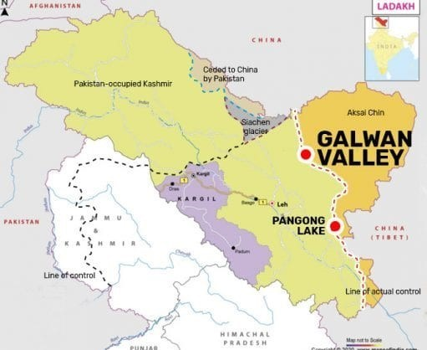
The Geo-Strategic Region Claimed by Pakistan, China and India

Slide 30
SCO
ECO
ASEAN
Indo Pacific
Geo-Strategic and Geo-Economic importance of Pakistan in SAARC Region.
Pakistan: A Regional Hub for
SAARC-ECO-SCO
The white arrow shows Pakistan’s importance in SAARC

Slide 31
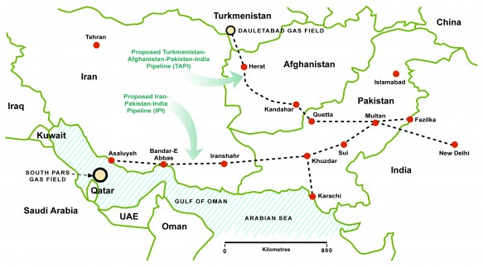
Regional Energy & Trade Routes and Importance of Pakistan

Slide 32
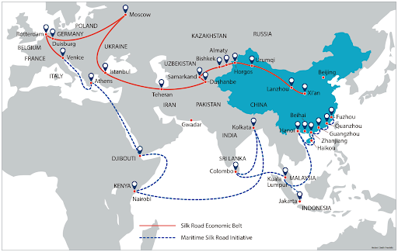

Slide 33
SARC: Successes
SAFTA was negotiated in 2005(but still a pipedream)
  To reduce customs duties- a custom union
  Trade Union- free trade
  Economic union- greater economic integration
SAARC Development Fund in 2010
    Social Window;
    Economic Window; and
    Infrastructure Window
SAARC Food Bank in 2011 in Pakistan
Agreement on Transportation & Energy in 2014
South Asian University in New Delhi
Notes:
the Kathmandu Summit 2014, there were three connectivity agreements on road, rail. Only one of these - on energy - has been signed.

Slide 34
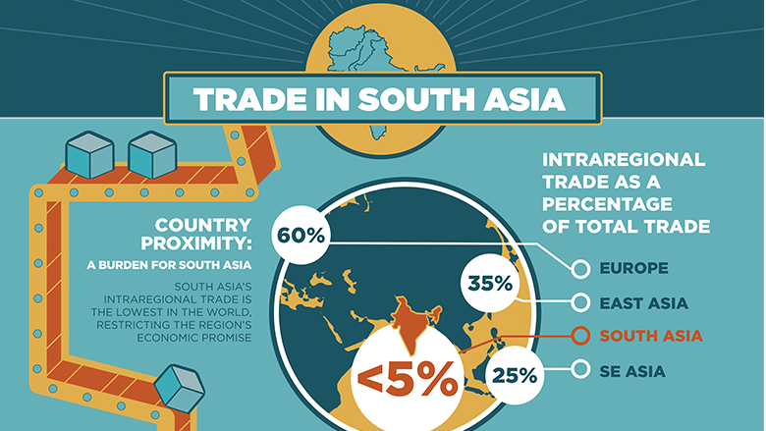
SAARC-Free Trade Area
In 1995, the first step towards a South Asian Free Trade Area (SAFTA)
The SAFTA Agreement was signed on 6 January 2004 during 12th SAARC Summit held in Islamabad, Pakistan.
Leading subsequently towards
  a Customs Union,
  Common Market and
  the Economic Union.
It is still a pipedream
The intra-regional trade of SAARC amounted to $40.5 billion in 2011, which constitutes just 5% of member countries’ trade.
Notes:
The trade between India-Pakistan, the two largest members of SAARC, is still languishing at less than 3 billion US $; studies suggest that an equal amount of trade happens through the Dubai route and illegal trade. Pakistan is yet to award India, the status of Most Favored Nation (MFN)

Slide 35
Hurdles in SAARC Integration
SAARC-A Region without Regionalism
  India’s Look East Policy: ASEAN+
  Bangladesh and Sri Lanka Looking towards ASEAN
  Pakistan’s tilt towards ECO and SCO
Indian Hegemony and Pakistan’s India-centric Policies
Use of Force as a Tool to Resolve Issues
Lack of Leadership, Trust and mutual Respect
Conflicting cultural and ideological identities
Notes:
to achieve South Asian Economic Union (SAEU) in a phased and planned manner through a Free Trade Area, a Customs Union, a Common Market, and a Common Economic and Monetary Union.

Slide 36
Future Scenarios
Three Scenarios
  SAARC would lose its importance and effectiveness and will be disintegrated- chances are remote and dim
  Status Quo- more likely
  Revival and Future Expansion- a challenge

Slide 37
SAARC: Conclusion
Areas of Cooperation
(the Pull Factors)
Areas of Conflict
(the Push Factors)
Trade and energy corridors
Food Security, Sustainability, and climate change
Poverty Alleviation, health
Biotechnology, IT & Telecom,
Human Resource Dev
Tourism
Kashmir Issue
Border Disputes
Trade Disputes
Regional Imbalance
Terrorism and interference in internal affairs
Public Opinion of mutual hatred and distrust

Slide 38
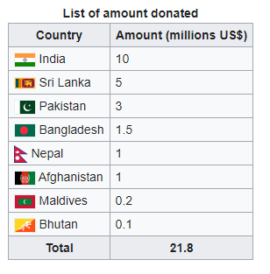
SAARC COVID Response
SAARC COVID-19 Emergency Fund-March 15, 2020
June-2020, PM of Pakistan contacted PM of Bangladesh and discussed regional issues and reviving of SAARC

Slide 39
SAARC CSS/PMS question
Why SAARC?
SAARC failures
SAARC potential
How to Revive it?

Slide 40
and the emerging ‘Asian order’
It’s an attempt to counter US influence in Asia
Indo-pacific great game
The Shanghai Cooperation Organization

Slide 41
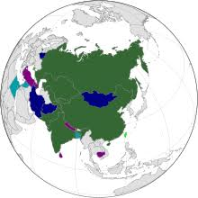
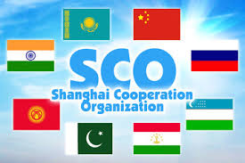
http://eng.sectsco.org/about_sco/

Slide 42
The Shanghai Cooperation Organization (SCO)
Started as Shanghai-5 Mechanism in 1996
Created on 15 June 2001 in Shanghai (China) by
  China,
  Kazakhstan,
  Kyrgyz Republic,
  Russian,
  Tajikistan, and
  Uzbekistan.
Notes:
SCO Secretary-General VLADIMIR NOROV from January, 2019, 3 year term

Slide 43
The Charter
  signed in June 2002
  put into force on 19 September 2003.
The Charter has 26 Articles which outlines ;
  Organization's Goals
  Principles
  Structure, and
  Core Activities
  Decision making process
SCO accounts for over 40% of the world’s population and over 30% of the global GDP
Trade among SCO members had risen to US$6 trillion in 2020 from US$ 0.67 trillion in 2001.
Notes:
combating terrorism, separatism, extremism, drug trafficking and transnational organized crime. These have been long-standing objectives of the SCO

Slide 44
SCO-Members, Observers, Dialogue Partners
member states
  China,
  India,
  Kazakhstan,
  Kyrgyzistan
  Pakistan,
  Russia
  Tajikistan
  Uzbekistan
  Iran
observer states
  Afghanistan,
  Belarus,
  and
  Mongolia
dialogue partners
  Azerbaijan,
  Armenia,
  Cambodia,
  Nepal,
  Turkey, and
  Sri Lanka.

Slide 45
The SCO Goals
The SCO's main goals are to;
  Strengthening Mutual Trust
  Promote Effective Cooperation In Politics, Trade, Economy, And Other Areas;
  Regional economic linkages
  Maintain Peace, Security and Stability In The Region
  Combat three evils-terrorism, separatism, and extremism
  establishment New International Political And Economic Order.

Slide 46
SCO-Structure
The Heads of States Council (HSC)
  is the supreme decision-making body
  It meets once a year
  adopts decisions on all important matters
  Issue guidelines
The Heads of Government Council (HGC)
  meets once a year
  discuss the organization's multilateral cooperation
  resolve current important economic and other issues
  approve annual budget.
3. SCO Foreign Ministers Council
4. the SCO Secretariat based in Beijing

Slide 47
5. the Executive Committee of the Regional Anti-Terrorist Structure (RATS) based in Tashkent.
  a nerve center for counter terrorism cooperation
  Information and intelligence sharing
  SCO infrastructure protection
  Border control and joint patrolling
If cooperation expands, it may become a permanent standing force for counter terrorism and other strategic cooperation
Notes:
the meeting of the SCO Council of Heads of State held via videoconference on 10 November 2020,

Slide 48
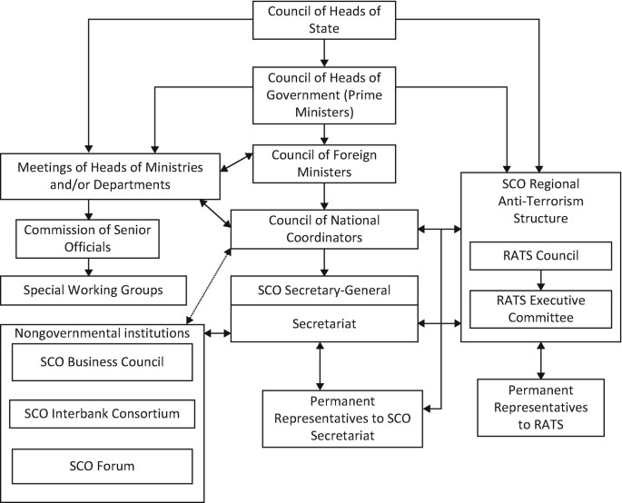
SCO Structure
Core Bodies and
Organs

Slide 49
Critical analysis
SCO

Slide 50
1. Sco and the rise of China
2. increasing partnership between China, Russia, Pakistan, India, Iran
3. Counterbalancing US Influence
4. China: Economic Infrastructure Diplomacy & Strategic Alliances in:
Central Asia
South Asia
East Asia

Slide 51
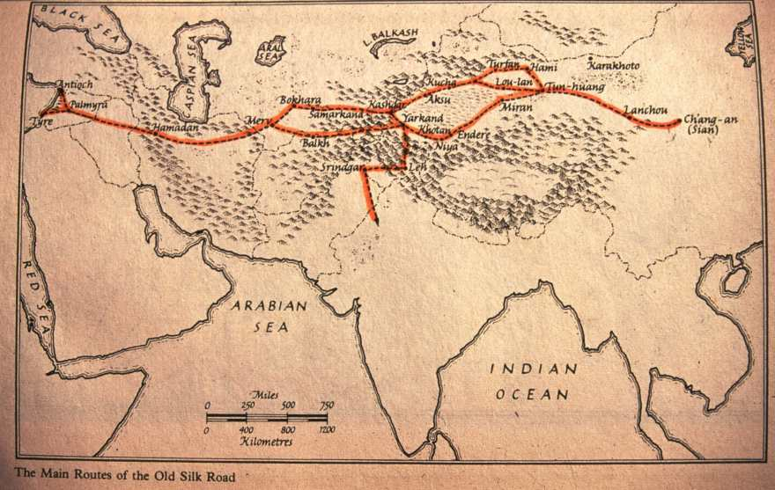
Old Silk Route Map

Slide 52
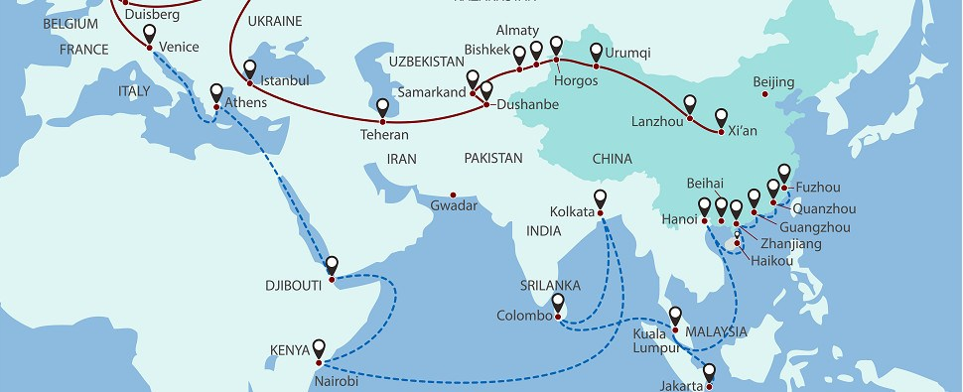
Regional Connectivity: Belt and Road Initiative Map

Slide 54
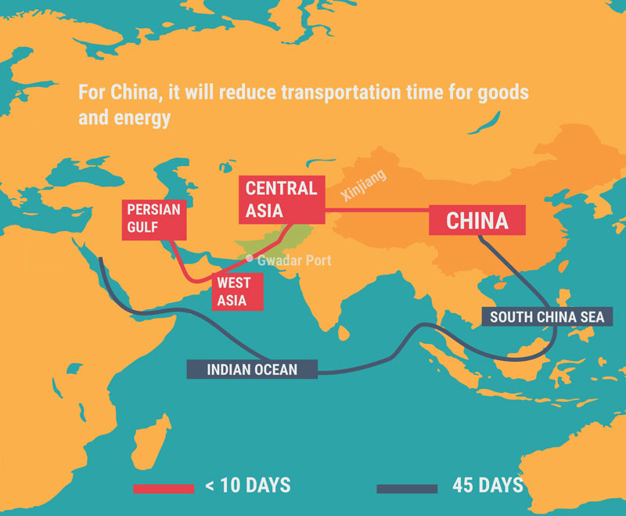

Slide 55
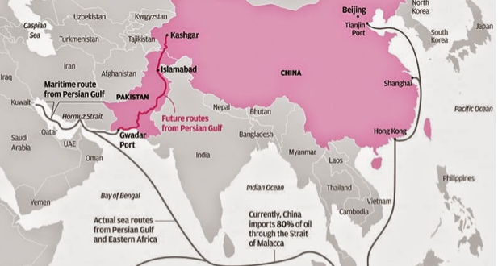
South & Central Asia

Slide 57
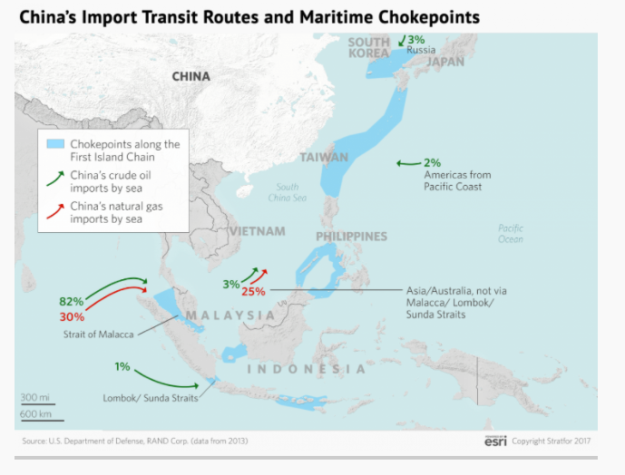
South East Asia
South China Sea

Slide 58
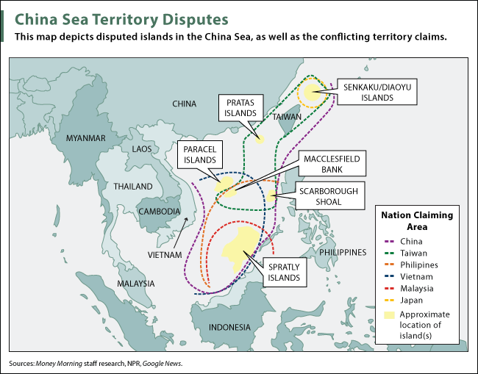
The Politics of South China Sea & Malacca Dilemma

Slide 59
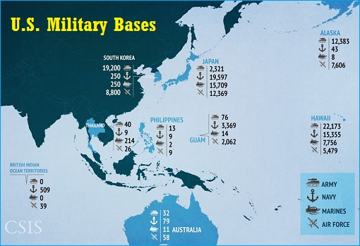
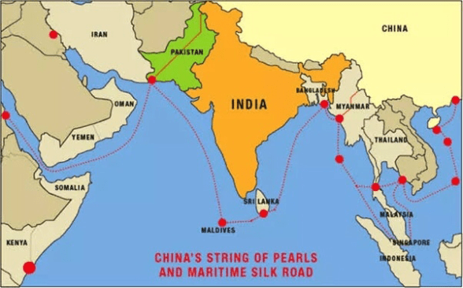

Slide 60
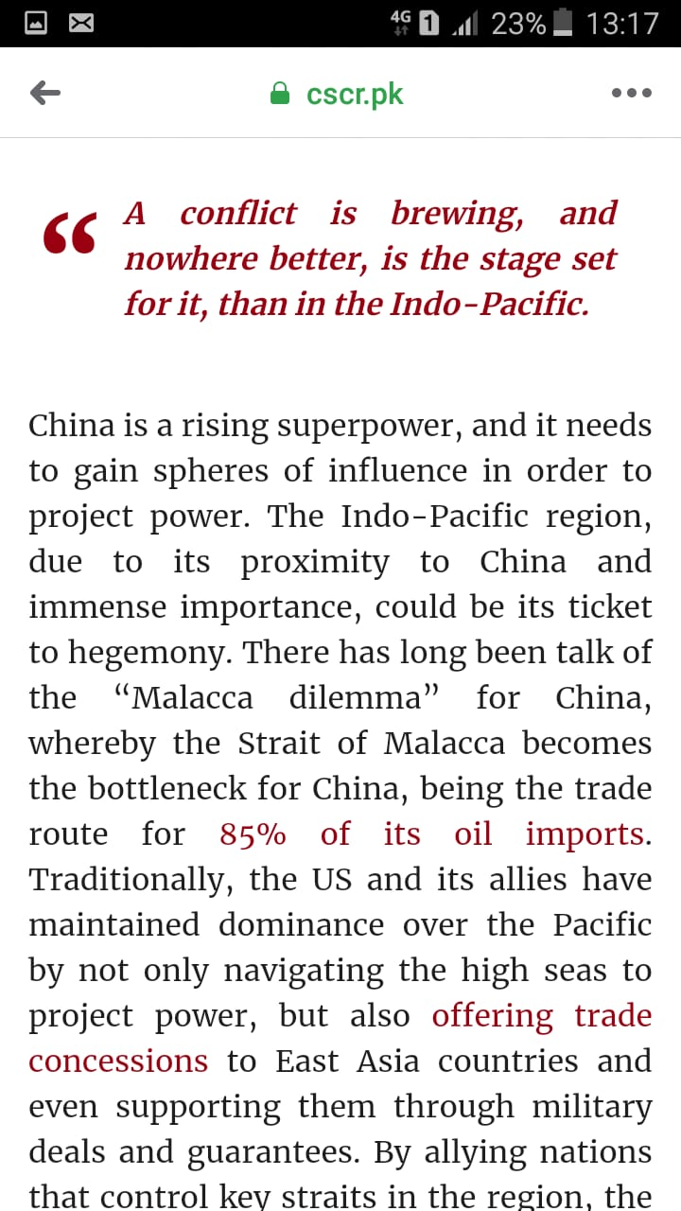
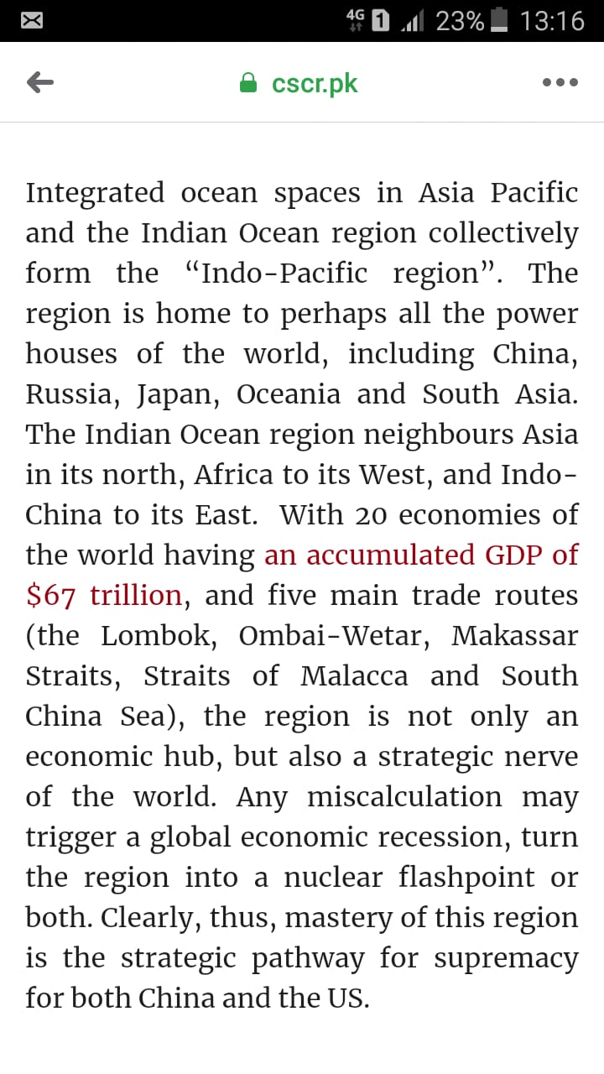

Slide 61
SCO SUMMIT 2022
SCO SUMMIT 2023
15-16 Sep. the 22nd Summit of SCO
  Samarkand, Uzbekistan
  To discuss geopolitical and economic uncertainty
  to discuss mutual security concerns, such as Afghanistan
    China commit to train 2,000 law enforcement personnel for SCO member states in the next five years
  Turkiye was out vocal to join SCO
  Establish connectivity and
4th July, 2023 New Delhi, India
virtually host the Shanghai Cooperation Organization (SCO)
Putin, Xi, and Shehbaz Sharif addressed the Summit
SCO-New Delhi Declaration
  Cooperation in countering terrorism, extremism, and separatism
  Digital transformation in SCO
Notes:
It was the 22nd Annual Summit

Slide 62
2022
The role of Iran and Turkiye at the Samarkand summit was of much greater importance
  with Iran signing a membership agreement to become a permanent SCO member and
  Turkiye announcing its bid for permanent membership.

Slide 63
SCO-CFMs Meeting 5th May 2023
Goa, India
Pakistan FM visited India after 12 years
Pakistan’s own vision in align with SCO vision of
  enhanced regional economic connectivity
  Counter terrorism and Regional stability
  Peace and shared prosperity
  overcome poverty, disease and underdevelopment,
  food and climate crisis

Slide 64
SCO Summit 2023
4th July, 2023 New Delhi, India
virtually host SCO summit
Putin, Xi, and Shehbaz Sharif addressed the Summit
SCO-New Delhi Declaration
  Cooperation in countering radicalization leading to terrorism, extremism, and separatism
  Digital transformation in SCO

Slide 65
Analysts are interested in the following themes:
  China’s expanding national security narrative and SCO
  economic opportunities and risks through infrastructure development and trade.
  significance of an Iran-Turkiye-China-Russia SCO alliance, and
  why the SCO shouldn’t simply be viewed as an anti-Western alliance?

Slide 66
SCO and Pakistan
Pakistan was an Observer from 2005 to 2017 (same was with India)
  2017- Status of a full member of the Organization was granted to India and Pakistan.

Slide 67
SCO: Advantages for Pakistan
SCO provides Geo-Strategic and Geo-Economic advantage to Pakistan
Pakistan to become a hub of regional connectivity.
  SCO can achieve its objectives of security and connectivity with the help of Pakistan.
Pakistan can offer expertise for anti-terror policies at RATS forum.
Peace in Afghanistan is key for SCO success and role of Pakistan

Slide 69
SCO: Advantages for Pakistan
Relations with China and Russia strengthened
  Establishing a balance between China and US- a real challenge
Pakistan can get security, trade and economic benefits from SCO and ECO
SCO can bring Pakistan & India closer
Notes:
US-India in August 2016 signed Logistics Exchange Memorandum of Agreement (LEMOA) that will reportedly facilitate the two allies to use each other’s military facilities to check China’s growing influence.

Slide 70
Conclusion
While reviewing the 'Modern Great Game', the SCO is emerging significantly to contain US influence in Central and South Asian regions.
China is building political and strategic capital in the region
The Cold War 2.0 with containment of China in ;
  Central Asia
  South Asia
  East Asia
Therefore, US seriously monitoring the activities of the SCO.
  As many observers label the SCO merely as an anti-NATO block
  An Iran-Turkiye-China-Russia coalition has the potential to be a powerful alliance against the Western liberal order.
SCO needs to break ‘Devil’s Triangle’ that exists among China, Pakistan-India

Slide 71
CSS Questions: SCO
China, Pakistan-Russia cooperation will find suitable support mechanism in Shanghai Cooperation Organization (SCO). Elaborate. 2020
What are the opportunities and challenges for Pakistan as one of the new members of the Shanghai Cooperation Organization (SCO)? CSS-2018
Q. No. 5. Explore the significance of Shinghai Cooperation Organization (SCO) for Pakistan. CSS-2017

Slide 72
ECO
http://eco.int/index.php
Economic Cooperation Organization

Slide 73
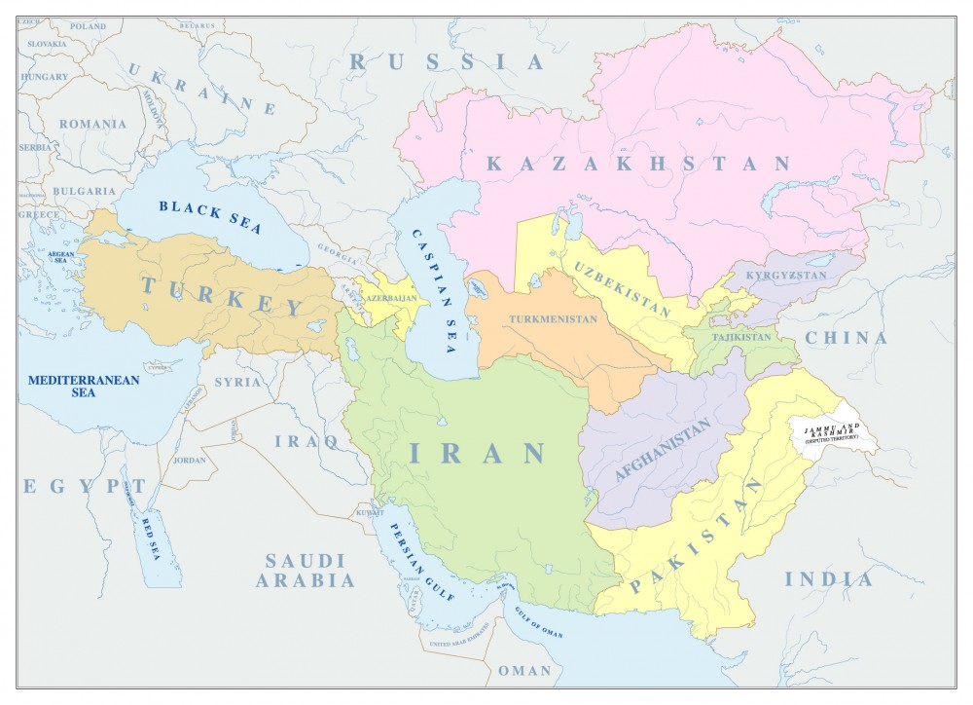

Slide 74
Economic Cooperation Organization (ECO)
An inter-governmental regional organization encompassing countries from
  Europe,
  Central Asia, and
  South Asia
The overall objective of the organization is the sustainable economic development of its member states and the region as a whole

Slide 75
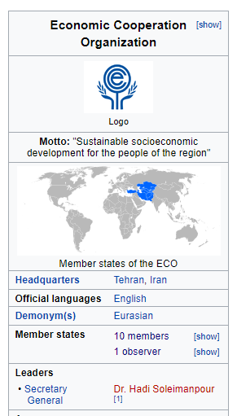
Background
Established as Regional Cooperation for Development (RCD) in 1964 by Iran, Pakistan and Turkey
Renamed as “ECO” in 1985.
The ECO's secretariat in Iran
its economic bureau is in Turkey
its scientific bureau is in Pakistan.

Slide 76
Objectives & Principles of Cooperation
To promote sustainable economic development through progressive removal of trade barriers
increased economic cooperation and Gradual integration with the economy;
Development of transport & communications infrastructure
Effective utilization of agricultural and industrial potentials with environmental protection
Effective cooperation with other regional and international organizations

Slide 77
Membership
According to the Article XIII of the Treaty Of Izmir (1977, 1990, and 1996)
  “Any State enjoying geographical contiguity with the ECO region and/or sharing the objectives and principles of ECO may apply to become a member of the Organization.”
Notes:
TREATY OF IZMIR (14 September 1996)

Slide 78
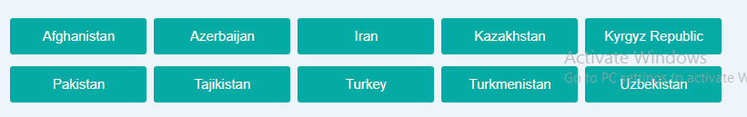
Member States
In 1992 Afghanistan and six Central Asian Republics, also joined

Slide 79
ECO Organs
The ECO functions through its intergovernmental machinery, Secretariat and specialized agencies and regional institutions.

Slide 80
ORGANIZATIONAL STRUCTURE OF ECO
There shall be,
  ECO Summit
  a Council of Foreign Ministers,
  a Council of Permanent Representatives,
  a Secretariat, and
  Specialized Agencies in specific fields of cooperation.
  a Regional Planning Council,
Notes:
he Republic of

Slide 81
1. ECO-Summit
the Article IV of the Treaty of Izmir
  the Heads of State/Government meet biennially or more often if considered necessary.
  Since ECO enlargement in 1992, 15 Summit meetings have been held.
It reviews progress in implementation of ECO programs and projects
Discuss regional and global issues of common interest to the ECO region.
The last meeting, 15th ECO Summit, was held on November 28, 2021 in Ashgabat, Turkmenistan.

Slide 82
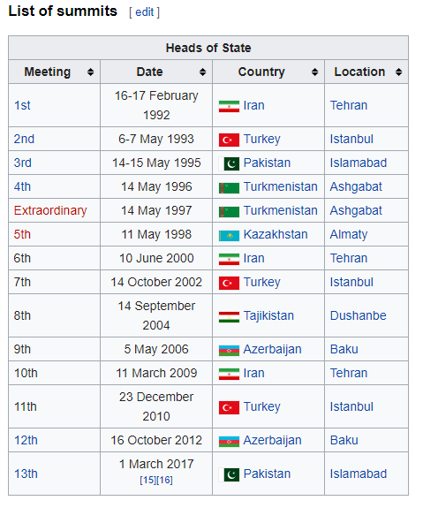
Summits Held So Far
15th : Turkmenistan organized the 15th ECO Summit virtually November, 2021
Notes:
Turkey organized the 14th ECO Summit virtually on March 4, 2021

Slide 83
2. COUNCIL OF MINISTERS
  It comprises the Ministers of Foreign Affairs
  the policy and decision-making body that approves annual workplan and programs
  responsible for approval of policies, strategies, and work programs
3. SECRETARIAT
  comprises a Secretary-General and staff
  its Headquarters in Tehran
  The Secretary-General is elected and appointed by
    the Council of Ministers
    for a non-renewable term of three years
Notes:
The incumbent H.E. Ambassador Khusrav Noziri of Tajikistan who took over his responsibilities as the 13th Secretary General of the ECO in August 2021.

Slide 84
4.The Regional Planning Council (RPC)
The Regional Planning Council (RPC) is the main technical planning body within ECO which comprises the heads of the Planning Organizations of the Member States
Formulate regional infrastructure and connectivity policies and programs
Prepare long term projects and strategic vision of ECO

Slide 85
ECO Vision 2025
A-Vision Statement
"ECO will pave the way to a territory of integrated and sustainable economies as well as free trade area achieved by highly educated societies and improved governance through enhanced cooperation“
B- Principles of Cooperation
Sustainability
Integration
Conducive Environment
C-Key Areas of Cooperation
  Trade
  Transport and Connectivity
  Energy
  Tourism
  Economic Growth and Productivity
  Social Welfare and Environment
Notes:
During the 13th Summit at Islamabad in March 2017, the ECO Heads of State/Government endorsed and adopted the ECO Vision – 2025. It is a roadmap document meant for guiding the sectoral activities of the Organization in the years to come until 2025.

Slide 86
Critical Evaluation
it is a trade block for the member states connected to
  The Mediterranean through Turkey
  The Persian Gulf via Iran, and
  The Arabian sea via Pakistan
It provides a platform to improve socio-economic development
promotes trade and investment opportunities.
The dream is to establish a single market for goods and services, much like ASEAN or the EU

Slide 87
Key Challenges
Terrorism and extremism: a common challenge for all the ECO members
Peace in Afghanistan and the Middle East: a key to ECO success
Iran and Saudi Arabia: Rivalry over Middle Eastern politics and options for Pakistan
Iran under US sanctions and options for Pakistan
  the Iran–Pakistan-India (IPI)gas pipeline, as well as a Turkmenistan–Afghanistan–Pakistan-India (TAPI) pipeline
  Indian influence in Iran and Afghanistan
CPEC as a nodal point for regional connectivity

Slide 88
23-24 Jan. 2023
26th ECO Council of Foreign Ministers Meeting
  Tashkent, Uzbekistan
  The theme is- “Year of Strengthening Connectivity”
  Focus has been on developing trade and travel infrastructure
  Connectivity of business and information communication

Slide 89
SCO-SAARC-ECO
CHANGING REGIONAL DYNAMICS & FORMATION OF NEW ALIGNMENTS

Slide 90
The Changing regional Dynamics of South Asia
Dividends of Afghan Peace Process for Pakistan and the Region
  India has been sidelined in this peace process
Iran Drops India From Chabahar Project
  Delay In Funding from India
  India gradually reduced its oil imports from Iran since 2017
China signed a ten year $400 Bil. investment deal with Iran for oil
  India is moving to US camp---India to be a pivot for the US new containment policy
Russia improving ties with Pakistan and Afghanistan
  Iran already has closed ties with Russia
  The New Great Game and emerging realignments of regional powers
Repercussions for SCO-SAARC-ECO
The questions will be???
  Should we isolate India in the region or bring her back from the US camp?
  What policy options India have in the SCO-SAARC-ECO region?
    India’s ‘Look East Policy’- ASEAN and APEC

