Slide 1
International & Regional Organizations
SARFRAZ HUSSAIN ANSARI (CSP)
34th Common- PA&AS
Deputy Secretary (F&A)
President Secretariat
MBA (IBM) - UIBE Business School, Beijing
M. Sc (Public Adm) - QAU Islamabad
Fellow Pakistan Institute of Public Finance & Accountancy
SAP-FI Certified
Certified Performance Auditor

Slide 2
Multilateralism for Regional & Global Cooperation
Globalism---IGOs
Regionalism: Regional Organizations
SAARC
ECO
SCO
EU
NAFTA
ASEAN
OIC
Gulf Cooperation
Council
Arab League
International Political Order
LoN
UN
ICJ
International Economic Order
World Bank
IMF
WTO
Lecture-1
Lecture-4
Lecture-2
Lecture-5
Lecture-3

Slide 3
International Governmental Organizations
International Political Order
International Economic Order
The League of Nations
The United Nations
International Court of Justice
4. World Trade Organization
5. WB
6. IMF

Slide 4
Talking Points/ Food for thought
Globalism & Regionalism
Internalization and the notion of ‘Collective Security’
Nationalism Vs Super-nationalism
Which is more important?
If both are important at the same time, whom to accord priority to?
Notes:
Slowbization…..

Slide 5
National Security Vs Collective Security
What is national security?
Who is responsible for national security?
What is ‘Self Defense’? (Article 51 of UN)
What is International Security?
Who’s responsible for Int. Security?
What is ‘Collective Security’

Slide 6
Factors that contribute in Power Politics & Competition
Tangible
Intangible
Strong Economy
Modern Technology
Standing Military Might
Political Stability
Geography
Leadership
Social Cohesion
Population Size & Quality
Diplomacy, Lobbying, Alliances
National Identity
On the basis of these factors certain countries start playing defining and leading role in the regional or global organizations they are member of.

Slide 7
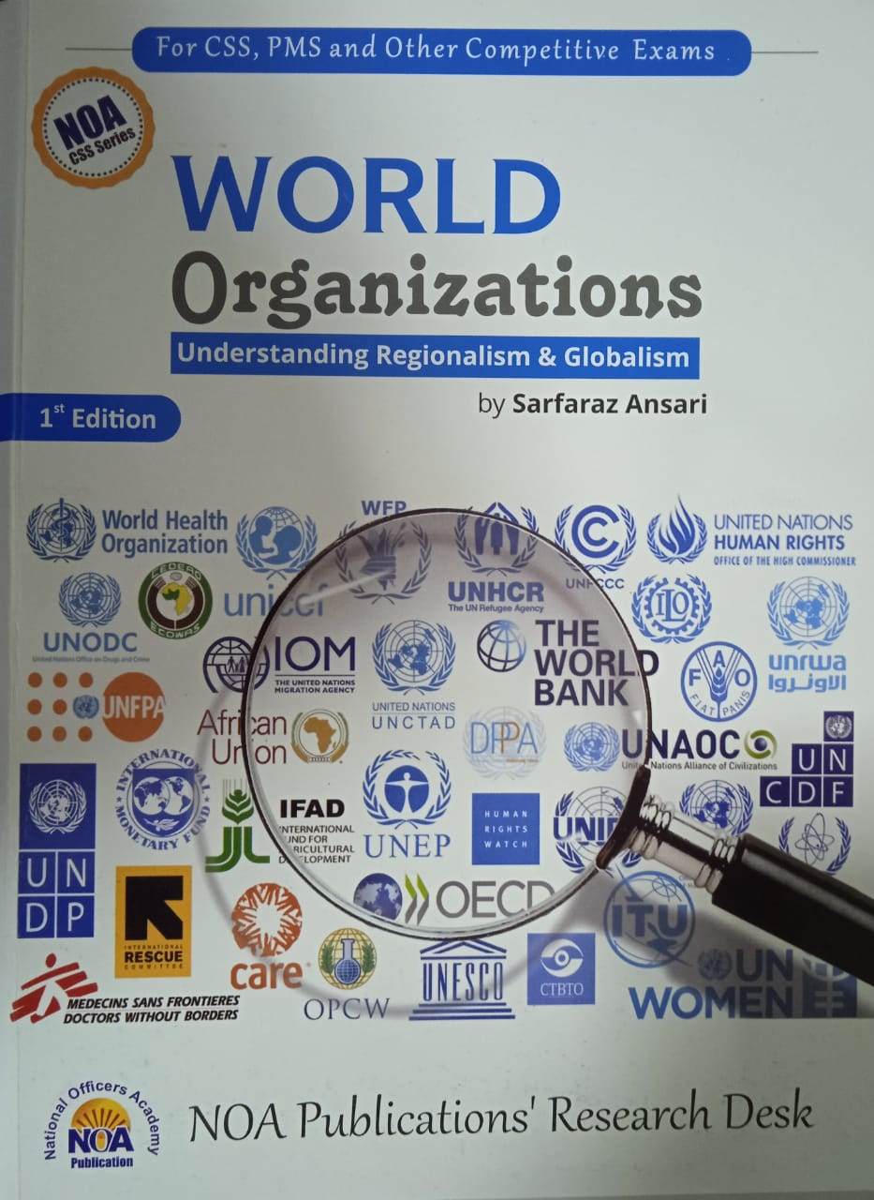
global organizations
Current Affairs & Pakistan Affairs

Slide 8
The Idea of Collective Security
Background
1.The concept of a peaceful community of nations proposed by Immanuel Kant-1795
He proposed a league of nations to control conflict and promote peace.
But not in a sense of a global government
2. The Concert of Europe (1814-15)
3.The Geneva Convention- 1864

Slide 9
The Origin of LoN
G.L. Dickinson, a British political scientist, coined the term "League of Nations" in 1914.
Woodrow Wilson’s campaign;
US joined WW-I with a motto ‘a war to end all wars’
Fourteen Points and the LoN
Speaking before the U.S. Congress on January 8, 1918, President Woodrow Wilson enumerated the last of his Fourteen Points, which called for a….
“general association of nations…formed under specific covenants for the purpose of affording mutual guarantees of political independence and territorial integrity to great and small states alike (equality).”

Slide 10
League of Nations-Genesis
The League of Nations was an international organization
Established by Part I of the Treaty of Versailles On 28 June 1919
It came into force on 10 January 1920, after WW-I
headquartered in Geneva, Switzerland,
Raison d’etre:
Provided a forum for resolving international disputes.
44 states signed the Covenant
At its greatest extent from 1934 to 1935, it had 58 members.

Slide 11

The League held its first Council meeting in Paris on 16 January 1920
the first General Assembly was held on 15 November 1920

Slide 12
LoN-Aims (Primary)
Principal mission was to maintain world peace.
Its primary goals, as stated in its Covenant were,
Preventing wars
Collective security
Disarmament
Settling international disputes through negotiation and arbitration
To encourage international cooperation for socio-economic development

Slide 13
LoN- Secondary Aims
Other issues in the treaties included
Improve labor conditions
Control human and drug trafficking and arms trade
Global health
Exchange of Prisoners of war, and
Protection of refugees and minorities.

Slide 14
LoN: Structure & Functions
The League’s Structure
General Assembly of all members,
Executive Council
Five permanent members
Four rotating members for 3-year term,
Permanent Court of International Justice.
The Secretariat
the League would guarantee
the territorial integrity
political independence of member states
Equality of all
through collective security
The Covenant authorized to
take “any action…to safeguard the world peace,”
establish procedures for arbitration, and
create the mechanisms for economic and military sanctions on aggressor(s).

Slide 15
Critical Analysis
LoN

Slide 16
1. The Idea of Collective Security
Article 16 of the Covenant of the LoN
In a dispute, the two sides were to refrain from war for at least three months while the League looked for a solution
If one party turned out to be the aggressor, all League members were required to break all ties
If that could not work, the Council could recommend military actions
The notion of collective security failed due to;
Failure to define what the ‘Aggression’ is
Forcing members to be with the Council for applying sanctions
Contribution for finances and military

Slide 17
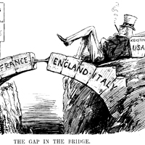
2. USA did not join League
Wilson’s insistence that the Covenant be linked to the Treaty was a blunder;
over time, the Treaty was discredited as
unenforceable,
short-sighted, or
too extreme in its provisions,
the League failed either to enforce or revise it
The Treaty of Versailles contained the seeds of WW-II in it
An active America willing to contribute military force for ‘collective security’ might have made a huge difference

Slide 18
3. No Standing Army of LoN
The League lacked its own armed force
depended on the victorious Great Powers of World War I
To enforce its resolutions,
To enforce its economic sanctions, or
Provide an army when needed.
The Great Powers were often reluctant to do so.
Sanctions could hurt League members, so they were reluctant to comply with them.
The Allied Powers
(Victorious Powers of WW-I)
UK, France, Italy, Japan, USA, Russia
The Central Powers
( Defeated Powers of WW-I)
Germany, Ottoman Empire, Austria-Hungary, Bulgaria

Slide 19
4. The Beginning of the End
Japanese conquest of Manchuria in 1931
(Britain and French colonial interests in the Far East)
They did not even try to stop Japan from aggression
Italy under Mussolini conquered Ethiopia in 1935
(Britain allowed Italy the use of Suez Canal)
Hitler noted League’s weak response and
Hitler’s consolidation of German people
until 1939, he invaded Poland and the outbreak of WW-II
World War II began on September 1, 1939, with the German invasion of Poland. Ended on 2nd Sep 1945

Slide 20
Failure of LoN (1920-45)
Isolationism of US
Britain’s policy of appeasement towards Hitler, and Timidity of France
Indifference of Russia and Japan from the European affairs
Harsh punishments on Germany gave rise to German Nazism and Hitler
Socialism and Fascism transformed human political development by introducing totalitarianism.
Great Depression of 1929
These led to 2nd World War

Slide 21
International Political Order
The UN and its Role in World Affairs
Security: Israel-Palestine, Kashmir, North Korea, Iran
Peacekeeping & Peace Making
Terrorism
Socio-economic development: Global Economic Cooperation
Poverty, Hunger, human dignity and protection of women and children
Humanitarian Crisis
Climate Crisis, Pandemics, Food Insecurity
Modern War Technology and Space
Veto Power Politics on these issues
Misuse of Veto Power
Irresponsible behavior of world powers
Reforming the UN System
Way Forward

Slide 22
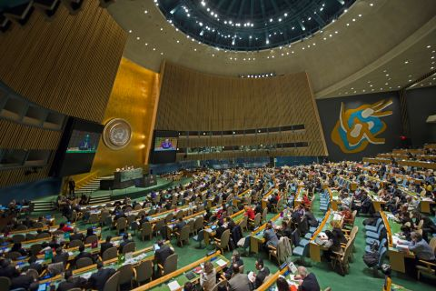
The rise of international governmental organizations
The United Nations
On January 1, 1942, 26 nations at war with the Axis powers met in Washington to sign the Declaration of the United Nations
Yalta Conference 1944-45
San Francisco Conferences in 1945

Slide 23
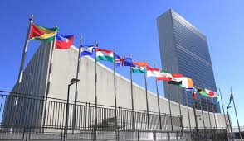
The United Nations can take action on the issues confronting humanity in the 21st century, including:
Maintain international peace and security
Protect human rights
Deliver humanitarian aid
Promote sustainable development
Uphold international law

Slide 24

The United Nations
The Rise of the UN
Franklin D Roosevelt influenced by Wilson’s idealism wanted to rectify the failures of the LoN
He got Churchill and Stalin on his side
Truman continues his campaign for the UN during WW-II
This time America was the most enthusiastic supporter
In 24 October 1945, the UN was established with the aim of preventing future wars with its Charter.
At its founding, the UN had 51 member states; there are now 193.
Notes:
The Charter of the United Nations is the founding document of the United Nations. It was signed on 26 June 1945, in San Francisco, at the conclusion of the United Nations Conference on International Organization, and came into force on 24 October 1945.

Slide 25
The Charter consists of
a preamble and
111 articles grouped into 19 chapters.

Slide 26
The Structure
General Assembly that meets every fall and all nations have one vote
All 193 Member States discuss international issues
Plays a significant role in the codification of international law.
Make recommendations to States on international issues within its competence
78th sessions held till Sep. 2023 THEME
“Rebuilding trust and reigniting global solidarity: Accelerating action on the 2030 Agenda and its Sustainable Development Goals towards peace, prosperity, progress and sustainability for all.”
It has power to recommend only and is done with the process of voting and adopting resolutions
Notes:
The term was first officially used on January 1, 1942, when representatives of 26 Allied nations met in Washington, D.C., and signed the Declaration by the United Nations, which endorsed the Atlantic Charter and presented the united war aims of the Allies.

Slide 27
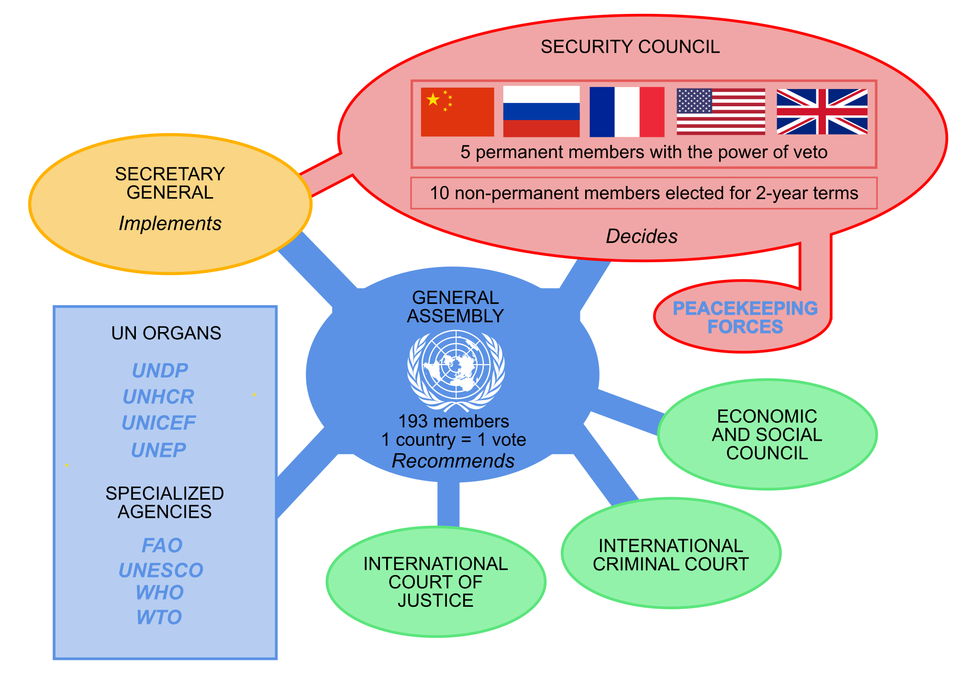
Global Bureaucracy
the Military Staff Committee
SDGs
Investigate & Prosecutes Crimes against humanity
Adjudicates Legal Disputes
UN+organogram&source=lnms&tbm=isch&sa=X&ved=0ahUKEwjR8_-49avg
Notes:
UNEP-UN Env Prog, UNICEF- United Nations International Children's Emergency Fund, the Military Staff Committee

Slide 28
The top 10 providers of assessed contributions to United Nations Peacekeeping operations for 2020-2021
United States (27.89%)
China (15.21%)
Japan (8.56%)
Germany (6.09%)
United Kingdom (5.79%)
France (5.61%)
Italy (3.30%)
Russian Federation (3.04%)
Canada (2.73%)
Republic of Korea (2.26%)
The UN General Assembly adopted budget of $3,500,830,500 for the United Nations to cover the year 2024
with the US financing about one fifth, of that.
the US to pay 22% of the UN’s general budget and 28% of the peacekeeping budget.
Notes:
In 2016, the organization’s total expenditures were nearly $50 billion, with the US financing about $10 billion, or one fifth, of that. A complex formula requires the US to pay 22% of the UN’s general budget and 28% of the peacekeeping budget.

Slide 29
UN: Successes & Failures
Critical Analysis

Slide 30
UN: Successes
1.Peace Making and Peace Keeping Efforts
A cease-fire in the Iran-Iraq War 1988
The independence of Namibia-1990
The end of the civil wars in Angola (sequels from 1975 to 2002), Cambodia (1967-75) and El Salvador (1979-92)
2. Global Socio-Economic Development Agenda
MDGs and SDGs
Poverty alleviation, child protection, and women empowerment
3.Climate Change and Global Environment
4.Human Rights Protection & Humanitarian Efforts
Refugees management
5.Scientific, cultural and human development
Notes:
Saddam started war in 1980. South Africa gave independence to Namibia in 21/03/1990. Angola got independence from Purtugal in 1975, civil war till 2002.

Slide 31

SDGs-2015-30

Slide 32
Disillusion with the UN (Failures)
The Kashmir Issue- 1947 to date
The Palestine Issue-1947 to date
Israel-Hammas War 2023
The Korean War- 1950-54 and Korean Peninsula today
No solution of US-Iran tensions since 1979 by UN
New World Order and the First Iraq War
Notes:
The United Nations Security Council Resolution 47, adopted on 21 April 1948, concerns the resolution of the Kashmir conflict.

Slide 33
Disillusion with the UN (Failures)
Post 9/11 and Doctrine of ‘Pre-emption’ as against the idea of collective security.
The Middle East on fire-Syria, Yemen, Iraq, Libya
Russia-Ukraine war
Israel-Gaza War 2023
Somalia Famine and civil war

Slide 34
Reforming the UN
https://reform.un.org/
GA
UNSC
UN Secretariat
the UN General Assembly President has said that
the UN Security Council (UNSC) has become “paralyzed” and “dysfunctional” in its “present form”
it has not been able to take any decision since the Russia-Ukraine war started.
Israel’s war crimes in Gaza and SC’s inaction

Slide 35
The Reform Agenda!!!
Making the UN System more
Democratic
Representative
Effective, Efficient, and Accountable
Meaningful

Slide 36
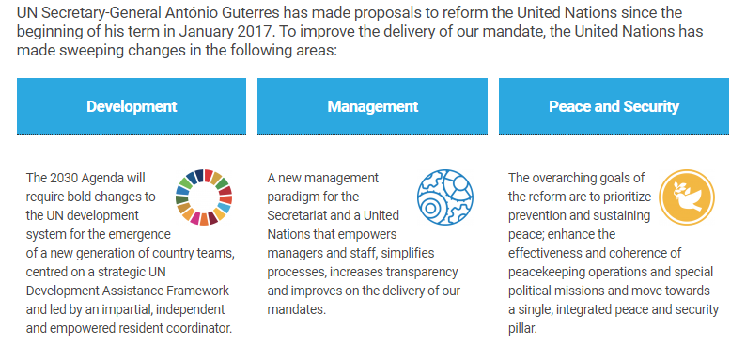

Slide 37
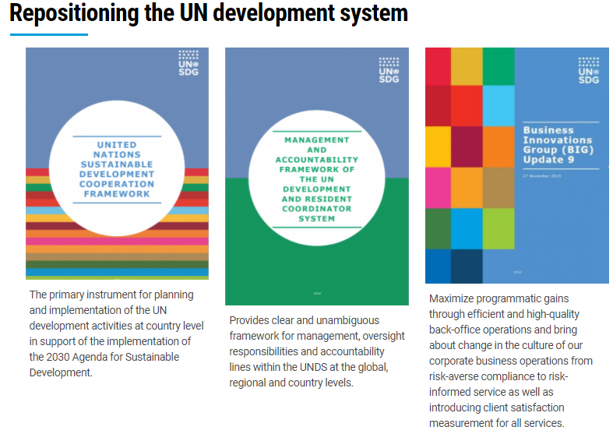

Slide 38
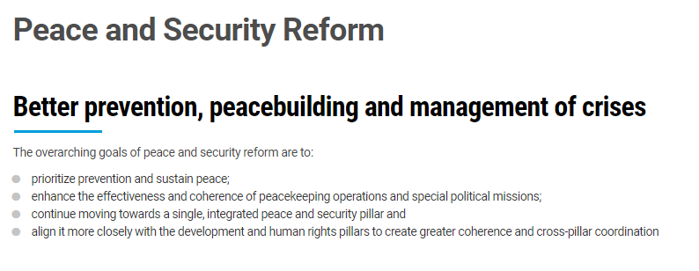

Slide 39
A Security Council which can meet any time to preserve peace
has primary responsibility for the maintenance of international peace and security.
It has 15 Members (5 permanent and 10 non-permanent members).
Each Member has one vote.
all UN Member States to comply with Council decisions

Slide 40
A Secretariat to run the organization
A SG is elected by the GA for renewable 5-year term
The bureaucratic administration of the day to day affairs of the UN
The global bureaucracy

Slide 41
Pakistan for UNSC Reforms
Uniting for Consensus (UfC), nicknamed the Coffee Club
Under the leadership of Italy, it aims to counter the bids for permanent seats proposed by G4 nations
Ask for a consensus before any decision
Italy, Spain, Australia, Canada, South Korea, Argentina, and Pakistan.
India for UNSC Reforms
two separate groupings
G-4 (Brazil, Germany, India, and Japan) and L-69
On the sidelines of the UN General Assembly.
The G-4 agree to forego their right to the veto for at least 15 years.

Slide 42
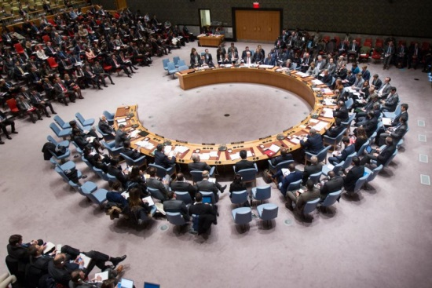
The Security Council
The peace keeping and peace making body
determines the existence of a threat or act of aggression.
The power of Veto vested with 5 permanent members (US, Russia, China, UK, France)
Each of the five can veto any of the resolution
The ten non-permanent members are elected by the GA for two-year term
Have an ordinary vote without veto
Nothing can go against the wishes of any one of the ‘Big Five’

Slide 43
Problems/Issues with UNSC
1.Lack of Adequate Representation
the membership of the Security Council has changed very little
the relative power of UN member states has changed
Latin America, Africa, and Oceania have no permanent membership
2.Misuse of Veto Power & Geopolitical Rivalry within P5
the system is highly unequal, rigid and inefficient
total 263 time Veto used
the P5 have on many occasions abused their veto powers.

Slide 44
Critical Analysis of UNSC
3.Global Geo-Political Landscape is Changing: other POWERS have emerged
Germany and Japan have overtaken UK and France in terms of economy
India as a rising power has demanded permanent seat
Russia and China are struggling to stand firmly
4.Threat to State’s Sovereignty and Unilateral Actions
5.No mechanism for adding new permanent SC members.
UN Charter needs revision.

Slide 45
A more basic problem is:
Why any major country should have a veto power over the will of the majority?
The veto power politics has rendered the SC toothless but has kept the big powers talking instead of leaving the system
The veto system has kept the UN alive but the price for holding the system together is its powerlessness or inaction to resolve many disputes
It is a necessary evil…..

Slide 46
Jacques Fomerand states the "the North–South Split"
Southern nations tend to favor a more empowered UN with a stronger General Assembly, allowing them a greater voice in world affairs,
while Northern nations prefer an economically laissez-faire UN that focuses on transnational threats such as terrorism
France wants the UN to be the center of global governance
Critics have also accused the UN of bureaucratic inefficiency, waste, and corruption.

Slide 47
Reforming the UN!!
The General Assembly Task Force on Security Council Reform

Slide 48
2005 Kofi Annan plan
On 21 March 2005, the then UN Secretary General Kofi Annan called on the UN to reach a consensus on expanding the council to 24 members
The two options mentioned by Annan are referred to as Plan A and Plan B:
Plan A calls for creating six new permanent members, plus three new nonpermanent members for a total of 24 seats in the council.
Plan B calls for creating eight new seats in a new class of members, who would serve for four years, subject to renewal, plus one nonpermanent seat, also for a total of 24.

Slide 49
Future Reforms: 3 Scenarios
A-Security Council
1. Abolish Veto System and Increase the members of the Security Council’s Non-Permanent Members
Decision by simple majority on ordinary and procedural issues
Decisions by two-third majority on substantial issues
2. Increase the No. of Permanent as well as Non-Permanent Members
Admit new countries with full veto powers
Admit new countries and modify the veto system for all
B-. Empower the UN General Assembly to run the show
C- Reforms are also needed to make UN Bureaucracy more
Efficient
Accountable (Transparent)
Effective (Responsive)

Slide 50
Conclusion
In evaluating the UN as a whole, Jacques Fomerand writes that the "accomplishments of the United Nations in the last 70 years are impressive”.
in human development during the 20th century
Evaluating the first 50 years of the UN's history, the author Stanley Meisler writes that
"the United Nations never fulfilled the hopes of its founders, but it accomplished a great deal nevertheless“
citing its role in decolonization and its many successful peacekeeping efforts.
The British historian Paul Kennedy states that
while the organization has suffered some major setbacks,
"when all its aspects are considered, the UN has brought great benefits to our generation….”

Slide 51

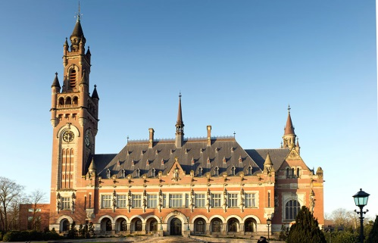
The international court of justice
International Organizations

Slide 52
The International Court of Justice
The principal judicial organ of the UN
It settles legal disputes between member states
Gives advisory opinions to UN organs and agencies.
It comprises a panel of 15 judges elected by the General Assembly and approved by Security Council for nine-year terms.
It is seated in the peace palace in the Hague, Netherlands

Slide 53
History
Established in 1945 by the UN Charter
the court began work in 1946 as the successor to the Permanent Court of International Justice.
The Statute of the International Court of Justice is ,
the main constitutional document regulating the court
It is part of the UN Charter

Slide 54
ICJ-Role
The Court, which is composed of 15 judges, has a twofold role:
first, to settle legal disputes between States submitted to it by them
second, to give advisory opinions on legal matters referred to it by United Nations organs and specialized agencies.

Slide 55
Jurisdiction
Only States are eligible to appear before the Court in contentious cases.
The Court has no jurisdiction to deal with applications from individuals, non-governmental organizations, corporations or any other private entity.
However, a State may take up the case of one of its nationals and invoke against another State the wrongs which its national claims to have suffered at the hands of the latter (Kalbhoshan)

Slide 56
ICJ Vs ICC
What differentiates the International Court of Justice from the International Criminal Court
The International Court of Justice has no jurisdiction to try individuals accused of war crimes or crimes against humanity.
As it is not a criminal court, it does not have a prosecutor able to initiate proceedings.
The jurisdiction of the International Court of Justice is general and thereby differs from that of specialist international tribunals
The main difference is that ICJ settles arguments between countries, but the ICC punishes people of war crimes, acts of terrorism, and genocide.

Slide 57
Why are some disputes between States not considered by the Court?
The Court can only hear a dispute when requested to do so by one or more States.
The States involved in the dispute must have accepted its jurisdiction
It cannot deal with a dispute on its own.
Neither is it permitted to investigate and rule on acts of sovereign states.

Slide 58
Are decisions of the Court binding?
Judgments delivered by the Court in disputes between States are binding upon the parties concerned.
Article 94 of the United Nations Charter provides that
“each Member of the United Nations undertakes to comply with the decision of [the Court] in any case to which it is a party”.
Judgments are final and without appeal.
If there is a dispute about the meaning or scope of a judgment, the only possibility is for one of the parties to make a request to the Court for an interpretation.
In the event of the discovery of a fact hitherto unknown to the Court which might be a decisive factor, either party may apply for revision of the judgment.

Slide 59
ICJ and Security Council
The relationship between the ICJ and the Security Council, and the separation of their powers
If the judgment is against one of the permanent five members of the Security Council or its allies, any resolution on enforcement would then be vetoed
if the Security Council refuses to enforce a judgment against any other state, there is no method of forcing the state to comply
ICJ is toothless for implementing its decisions

Slide 60
In theory, "so far as the parties to the case are concerned, a judgment of the Court is binding, final and without appeal,"
and "by signing the Charter, a member of the UN undertakes to comply with any decision of the International Court of Justice in a case to which it is a party".
as the Court has no means to enforce its rulings, its survival is dependent on its political legitimacy & moral obligations.

Slide 61
Kalbhushan Yaduv Case

Slide 62
Kulbhushan Jadhav’s Case
Jadhav was arrested from Balochistan in March 2016
found involved in anti state and terrorists activities in violation of Sate Laws of Pak.
He was sentenced to death in 2017 by a Pakistani military court on charges of terrorism and spying
10th April, 2017, he was sentenced to death by a Field General Court Martial of Pakistan.
India approached ICJ and accused Pakistan of;
Arresting her ‘innocent’ citizen
violating international law by not granting consular access to Kulbhushan
self defense
The issue of jurisdiction of Pakistan’s Military Courts and due process
Demanded his acquittal and setting aside the death penalty

Slide 63
The Vienna Convention on Consular Relations of 1963
Article 36 ;
The Convention provides that "consular officers shall be free to communicate with nationals of the sending State and to have access to them.“
The treaty provides for consular immunity
The Convention (Article 43) provides for consular immunity
Consular officers and consular employees have "functional immunity" (i.e., immunity from the jurisdiction of the receiving state “ in exercise of consular function")
but do not enjoy the broader "personal immunity" accorded to diplomats

Slide 64
ICJ on 18 May, 2017 had restrained Pakistan from executing Jadhav till the adjudication of the case
On 17 July, 2019, The ICJ has ordered that
Pakistan should review the conviction and the death sentence
Provide Consular access (which have been provided many times)
Case proceedings under the laws of Pakistan with due regard to self defense and due process
But ICJ rejects India’s plea for Kulbhushan Jadhav’s acquittal
Notes:
Bolivia Vs Chile over access to the Pacific, Nicaragua Vs Costa Rica over Caribbean Ocean maritime delimitation. Maritime dispute between Peru and Chile

Slide 65
Latest Developments
Consular access provided thrice
21-May-2020, an Ordinance was passed to empower IHC to hear the plea of Kalbhushan
the International Court of Justice (Review and Re-consideration) Ordinance, 2020
The GoP filed a petition before IHC on 22/07/2020 seeking appointment of a legal representative for Kalbhushan
A 2-member IHC Bench has been constituted on 30/07/2020
The Bench take up the Government plea on 03-08-2020

Slide 66
The IHC Jurisdiction
the high court shall examine whether any prejudice has been caused to the foreign national in respect of his;
Right of defense,
Right to evidence, and
Principles of fair trial
Due process
due to denial of consular access according to Vienna Convention on Consular Relations of 24 April 1963.
Notes:
In a nutshell, unanimity is when everyone agrees and consensus is when no one disagrees. ... Unanimity is reached if everyone votes for the same option. Consensus, in contrast, allows some (or even a majority) to not make up their mind and to simply remain silent.

Slide 67
Likely Questions
UN System has turned outdated, inefficient, ineffective and is criticized being under the influence of ‘Big Powers’, particularly US since the end of Cold War. Critically discuss the UN system and propose particular reforms.
The system, structure and working of UNSC has been criticized for its inaction and control of P5 in maintaining world peace and order. Under changing global dynamics the UNSC has become irrelevant. Pl Discuss.
ICJ and Pakistan-A Short Note (may be but not likely)

Slide 68
Out line
UN-Background
Yalta Conference
San Francisco Conference
The UN
Charter
Structure
Functions
Role of UN in World Affairs
Peace Making and Peace Keeping
Dispute resolutions
Disarmament
Counter-terrorism
Economic and Human Development
Climate Change and Fighting Pandemics
SDGs
Refugees
Critical Analysis; Failures and Successes
Conclusion

Slide 69
Reforming the UN
UN SC Reforms
UN GA Reforms
HR Reforms

Slide 70
