Slide 1
Arab league
GCC
OIC
The Middle East and North Africa

Slide 2
The Middle east conundrum
The Centuries Old Religious Wars in ME
  Islam Vs Other Religions
  Islam vs Judaism
  The Crusades and the Ottoman Empire
WW-I and disintegration of Ottoman Empire
Creation of Israel & Rise of Arab Nationalism
The Cold War in the Islamic World Since 1979: Sectarian Divide
9/11-War on Terror
  Islamophobia in the West
  Radical Islam, Terrorism, & Extremism
Civil Wars in the ME
Islam under siege: radical Islam and reaction of the Modern World

Slide 3
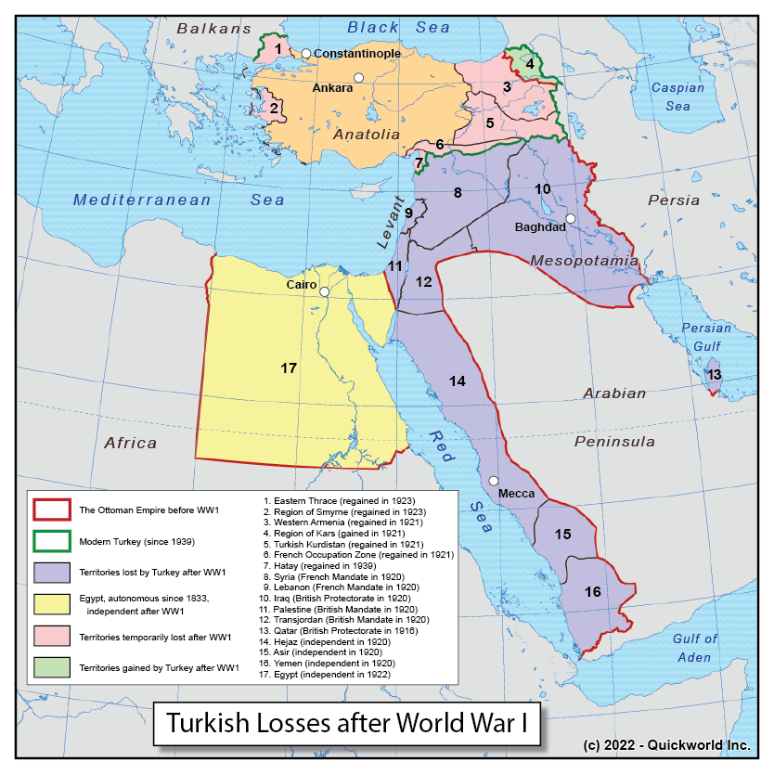

Slide 4
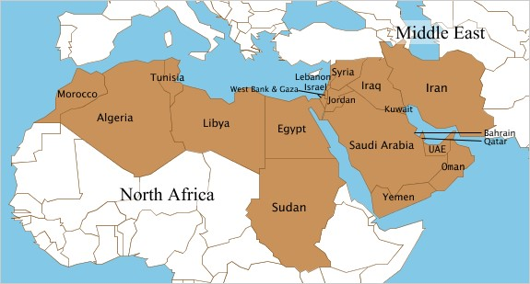

Slide 5
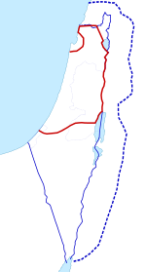
Israel-Palestine:1919-48
Three proposals for Palestine Territory.
The red line proposed in the 1916 Sykes–Picot Agreement between UK & France for Israel
the thin blue line refers to the 1923–48 Mandatory Palestine Territory under UK.
the dashed blue line is the 1919 Zionist demand
1
3
2
UK’s Balfour Declaration-1917

Slide 6
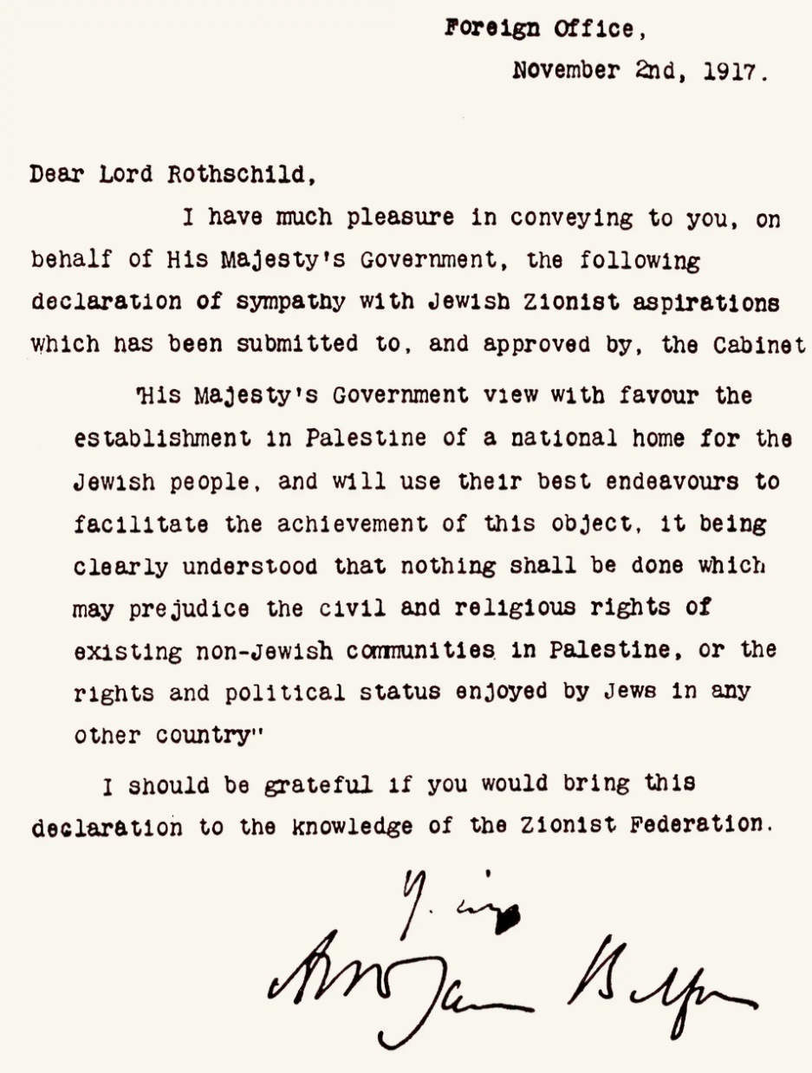
the UK's Foreign Secretary Arthur Balfour’s letter to Lord Rothschild, a leader of the British Jewish community .

Slide 7
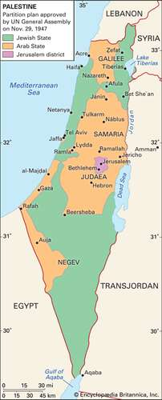
UN partition plan for Palestine adopted in 1947.
Encyclopedia Britannica, Inc.

Slide 8
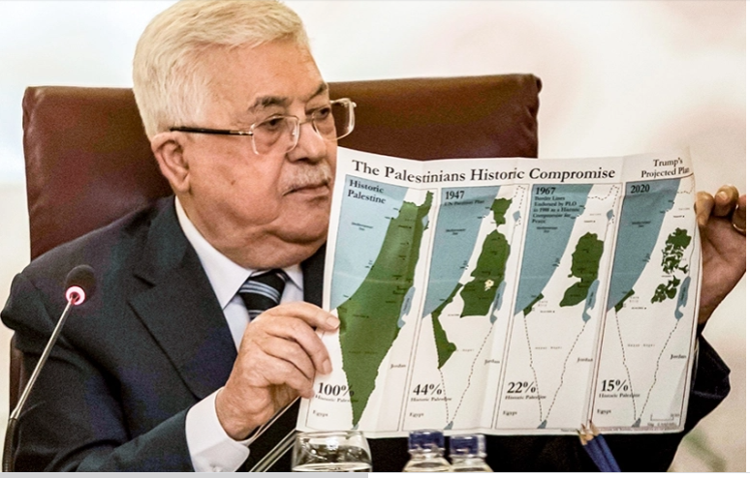

Slide 9
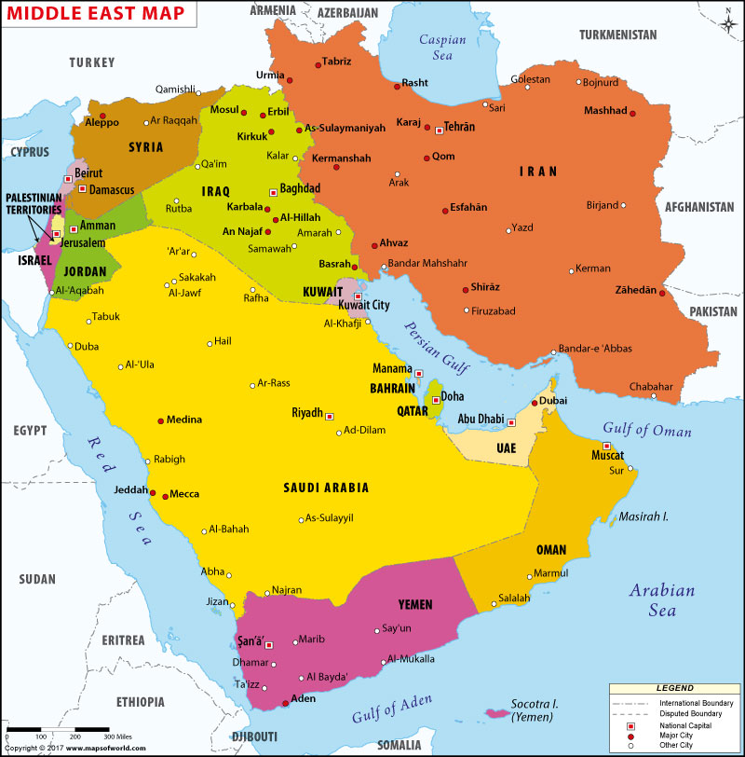
The Middle East: 1979 ‘Afghan Jihad’ & Iranian Revolution
Suez
Canal
Cold War
Proxies
Strait of Hormuz
Bab ul Mandab

Slide 10
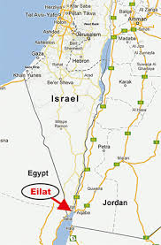

Slide 11
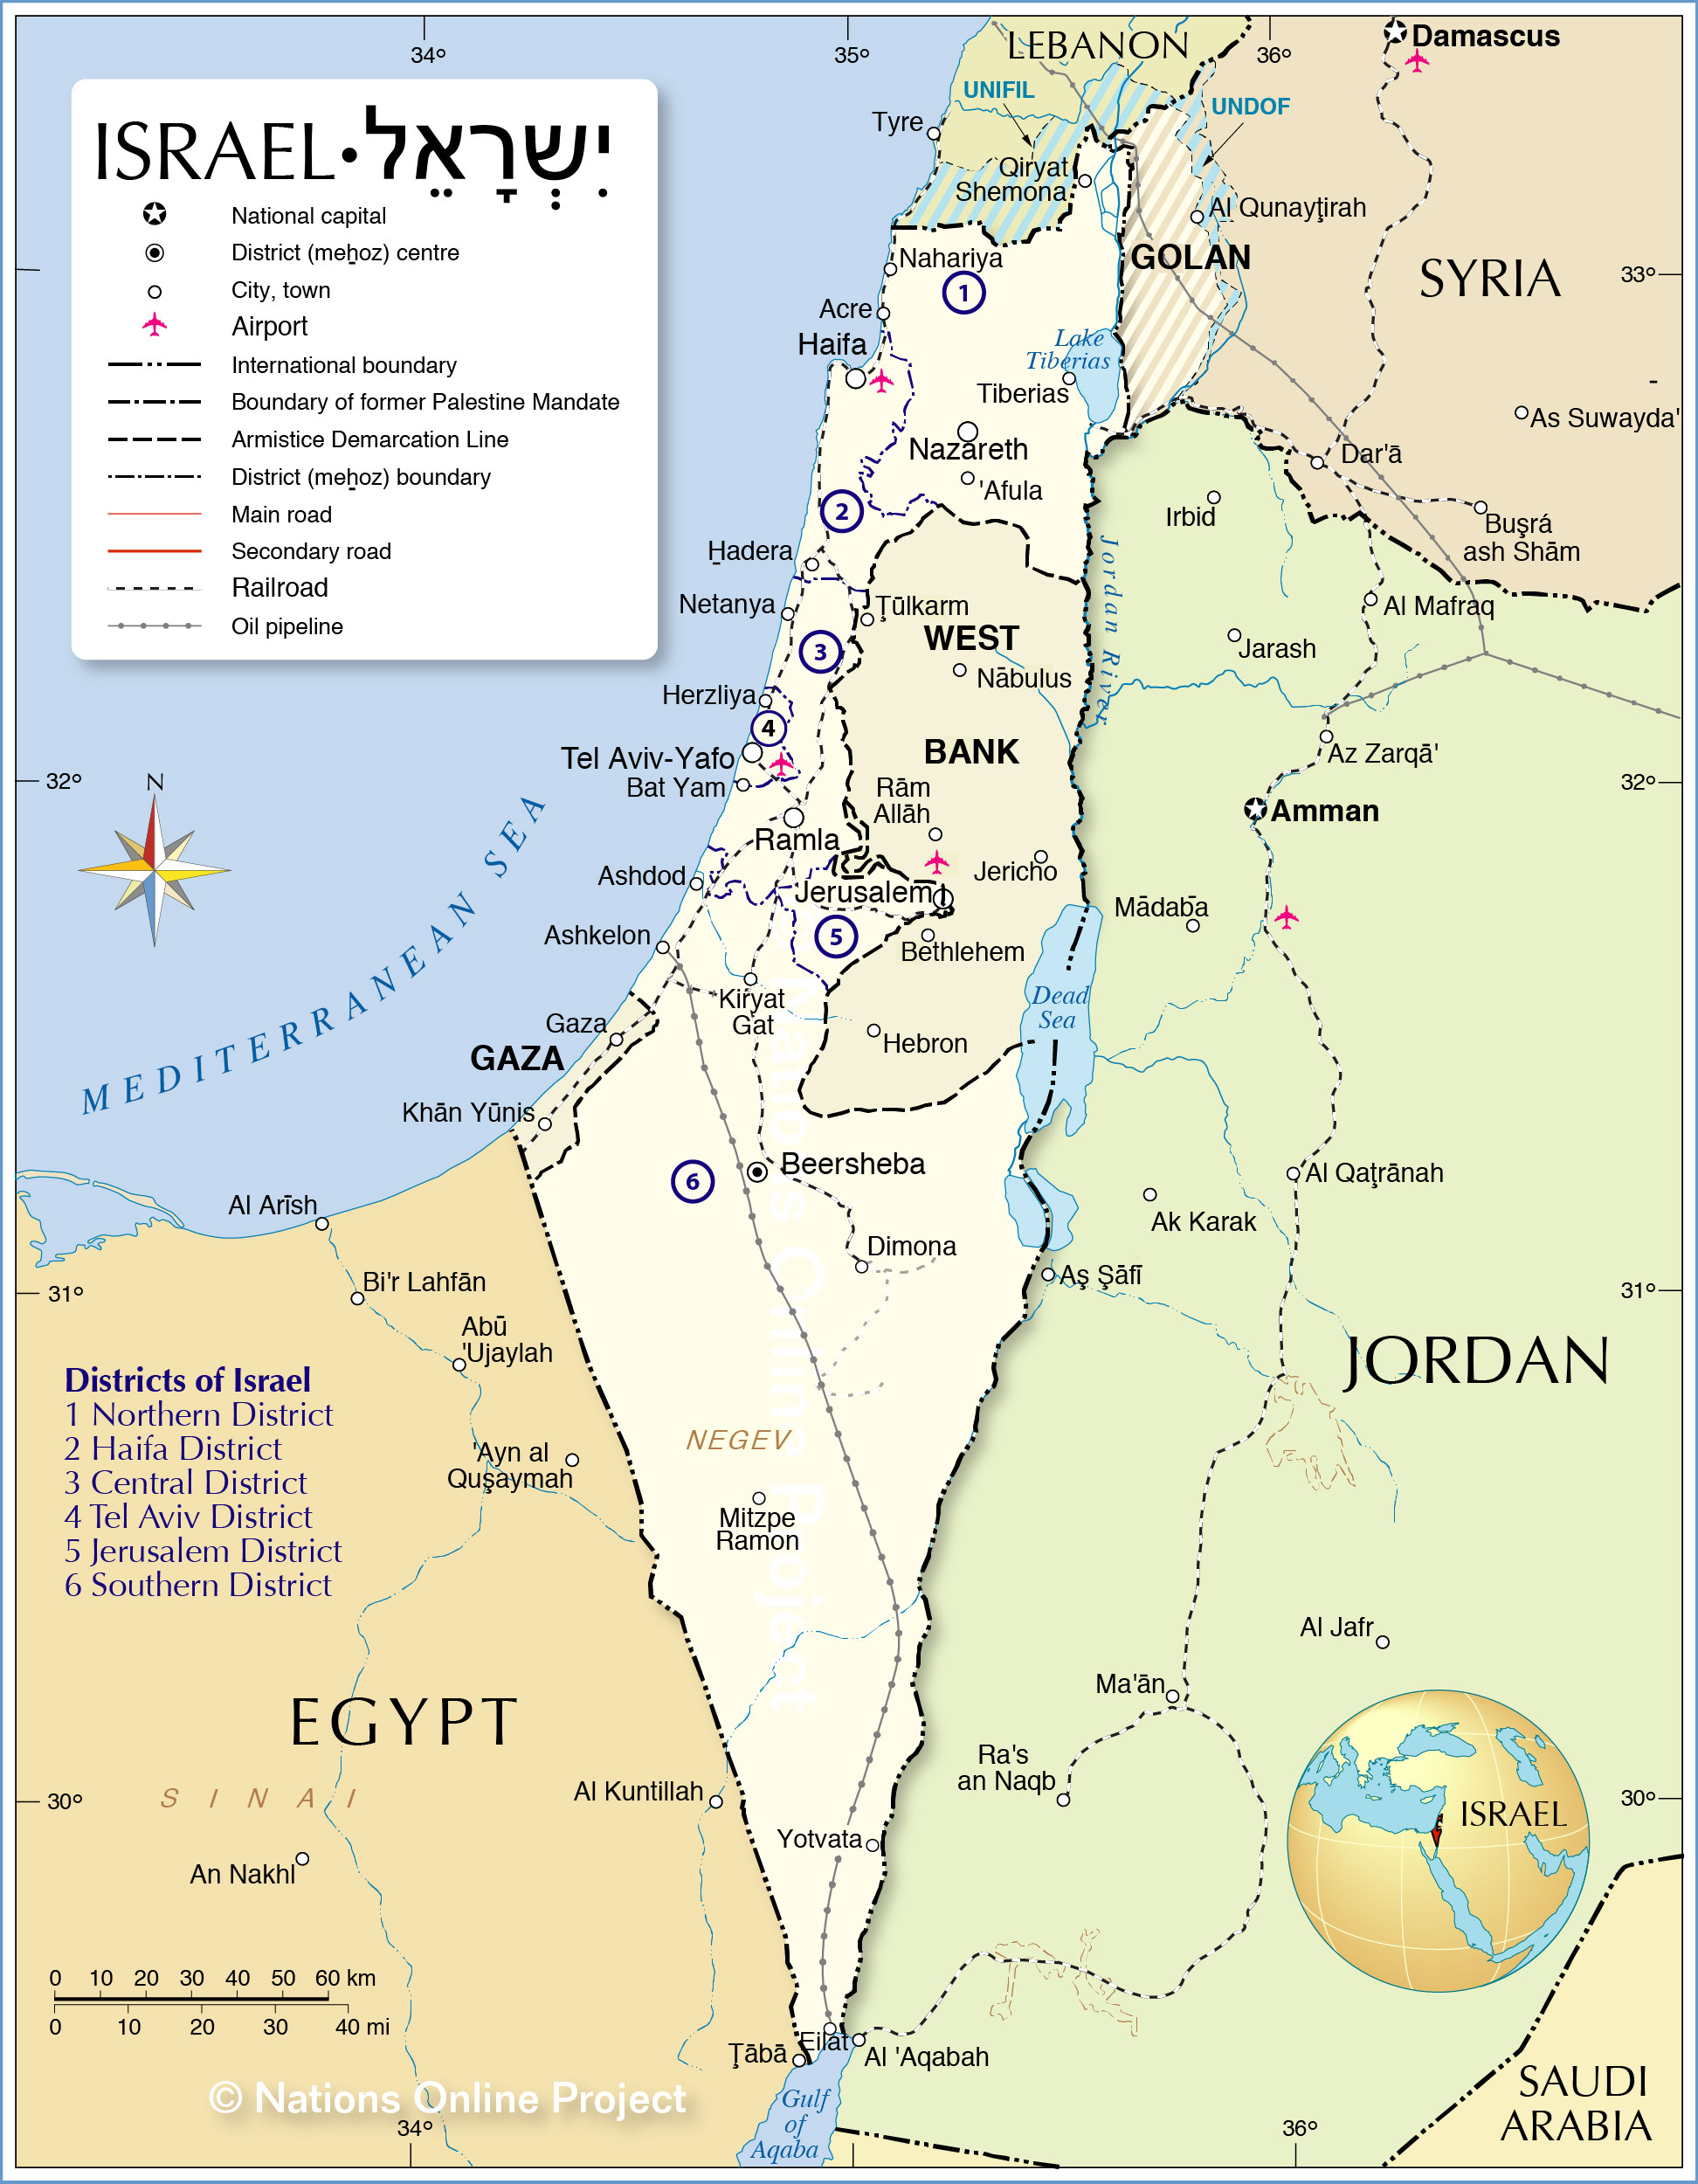
Suez Canal

Slide 12
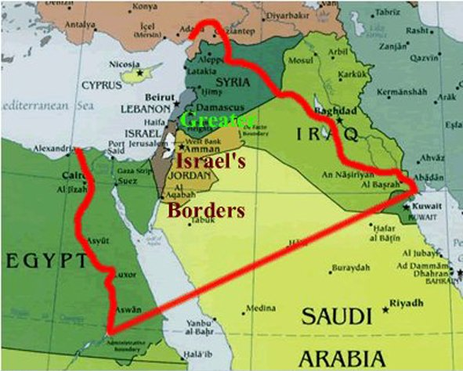

Slide 13
Arab-Israeli wars
series of military conflicts between Israeli and various Arab forces;
  1948–49: Israel’s War Of Independence And The Palestinian Nakbah
  1956: Suez Crisis
  1967: Six-Day War
  1973: Yom Kippur War
  1982: Lebanon War
  2006: Second Lebanon War
  Israel-Hamas War-2023
The Two-States Solution Vs Greater Israel

Slide 14
The arab league

Slide 15
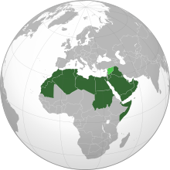
The Arab League-Map
The Member States stretch geographically from the far west of northern Africa to the Middle East and the Gulf region.
in 1945: six founding members.
Today: 22 members
Middle East and N. Africa

Slide 16
  Arab League: Raison d’eter
The Arab League was created to;
  Raise joint concerns over postwar colonial divisions of Arab territories
  2. Oppose the creation of a Jewish state on Palestinian territory
  3. integrate the member countries in political, economic, military, and cultural fields.

Slide 17
Background
The Ottoman Empire called ‘the Sick Man of Europe’ -after WW-I
  The fall of Ottoman Empire and end to ‘Khilafat’
  The rise of Arab nationalism to unify the Arab world
During World War-I, the Sharif of Mecca, backed by the British forces, led an Arab revolt.
  The British government assured Arabs the establishment of an independent state.
    However, the Sykes-Picot Agreement signed in 1916 between UK & France, and
    The Balfour Declaration-1917 betrayed this plan
    They carved up Arab lands into their respective spheres of influence
    the Creation of Jewish State
The devastation of the WW-II and decolonization
  The USA and Russian involvement since the end of WW-II
  Creation of Israel and Arab-Israel Wars

Slide 18
Genesis
March 1945 at Cairo under the Alexandria Protocol.
The 6 founder States are
  Egypt, Lebanon, Iraq, Jordan, Syria, Saudi Arabia
  and Yemen joined subsequently in May, 1945
Currently, the League has 22 members
Six countries are observer states—
  Eritrea, Brazil, Venezuela, India, Armenia, Chad
Notes:
a status that entitles them to express their opinion and give advice but denies them voting and decision making rights.

Slide 19
The Charter of Arab League
the Charter;
  Consists of 20 articles that defines the aims of the League
  The charter is amendable by a 2/3rd majority
The Arab League is a regional political organization that aims to secure the interest of Arab countries.
But, most importantly, we have to see;
  “What are the interests of Arabs?”

Slide 20
Article 1. Members
Independent Arab States that have signed this Pact.
  Founding members
  Subsequent members

Slide 21
Article 2. The purpose of the League
To draw close relations between member States
to safeguard their independence and sovereignty
To Protect and promote interests of the Arab countries.
close co-operation in the following areas:
  Economic and financial, trade, customs, and industry;
  Development of Communications infrastructure
  Social and cultural welfare and health.
  Matters connected with nationality, passports, visas etc.

Slide 22
Structure
The Council (Article-3)
  Composed of the representatives of the member States.
  Each State shall have one vote
  Enforce the Charter
  The function is to realize the purpose of the League
  Supervise the execution of the agreements concluded between the member States
  Collaborate with the international organizations
  The Council of the League shall meet twice a year.
Permanent Secretariat and Secretary General at Cairo
Special Committees (Article-4)
  In certain specialized areas of mutual interest for technical cooperation

Slide 23
Non Use of Force among Members
Article 5. Use of force for the settlement of disputes between member States not allowed.
Article 6. In case of aggression or threat of aggression
  The Council shall determine the necessary measures to repel this aggression.
  Its decision shall be taken unanimously.

Slide 24
The Decisions of the League
Article 7. The decisions of the Council taken by a unanimous vote are binding

Slide 25
Critical analysis

Slide 26
Arab League: disunity, mutual distrusts, and non-cooperation
Involvement of the Western Powers in the ME
Regional power politics resulting from conflicts between its members: Proxy wars
Not able to play a role in;
    fighting terrorism and radicalism
    Provision of basic human rights in the Arab world
    Managing refugees
    to stop wars taking place in the Middle East

Slide 27
The Arab League and Arab Peace Initiative
The Arab League in The Beirut Summit of 2002 offered: “the Land for Peace” initiative
  Israel to withdraw from Palestinian lands and recede to pre-1967 borders
  Return of Palestinian Refugees back to their homeland
  Peaceful co-existence
  Recognition of Israel by Arab States
Israel called it a non-starter

Slide 28
Failures
Some of the failures are related to the decision-making process
  The charter states that decisions reached by a majority “shall bind only those states that accept them,”
  It limits the league’s ability to take collective action.
others are due to power politics resulting from conflicts between its members.
Despotic regimes working for their vested interests
Puppets installed by the world powers
Territorial anomalies and the Proxy wars

Slide 29
The Arab Spring-2011
The Arab League and the “Arab Spring”
  Arab League showed an indifference towards the popular rising taking place since 2011
  Led to the outbreak of internal wars and conflicts in Syria, Yemen, and Libya
  Unrest in Egypt
  Destruction of Iraq
  Rise and fall of ISIL, ISIS, AL Qaida, Ikhwanul Muslemoon and other ‘Islamist’ organizations

Slide 30
the Middle East Today
Civil wars in Libya, Syrian and Yemen
UAE and Bahrain have accepted Israel-the Abraham Accords
US involvement in Middle East for Israel’s recognition by Arab countries
  MBS and Netanyaho reportedly met
Pakistan issued statement demanding just and peaceful solution of Palestine issue according to the wishes of the Palestinians
Notes:
Egypt26 March 1979, 26 October 1994, UAE and Bahrain 15 September 2020. Turkey has diplomatic relations since 1949.
As of 11 September 2020, 163 of the 193 UN member states recognize Israel.

Slide 31
The Rise of 'New Ottomans‘
The 'New Ottomans‘-Turkey getting more assertive in Eastern Mediterranean
  Oil exploration in The Mediterranean
  The Black Sea
  Recent row between Turkey and UAE
Turkey has intervened heavily on the side of the UN-backed Libyan government while the UAE and Egypt back the eastern militias of Gen Khalifa Haftar.
The Arab countries are facing both internal and external crises….
The Arab League is accused of its inaction, disunity, and divided over the very aims it was founded for.

Slide 32
The May 16, 2024, Bahrain Arab League Summit
All 22 Arab leaders attended
UN Secretary-General Antonio Guterres also addressed
the summit was dominated by the Israel-Hamas war.
leaders condemned Israeli forces' "barbaric" actions in Gaza
On May 16, 2024, The Arab League issued a "Manama Declaration"
  end to forced displacement in the Palestinian territory & immediate cease-fire
  peacekeeping forces of the UN until a two-state solution
  Consideration of the Palestine Liberation Organization (PLO) as the sole legitimate representative of the Palestinian people.
  Urging all Palestinian factions to join under the umbrella of the PLO.
  civil wars and unrest in Sudan and Yemen, Syria, Iraq, Lebanon, and Libya

Slide 33
Middle East Redefined
China Trying to bring Muslim countries closer, particularly KSA, Iran, and Syria
  Iran-Saudi Relations improving
  Syria participated in Arab League Council meetings this year
Hope for a Two-Nation solution of Israel-Palestine conflict
Recent ‘Intifada’ ---attack by Hamas and declaration of war by Israel
  07.10.23
Invading Gaza Is the Least Bad Option for Israel
All the Other Options Have Already Failed
Notes:
to destroy Hamas as a military force: to remove the group from power in Gaza: how deep Israeli forces will go into the enclave and how long

Slide 34
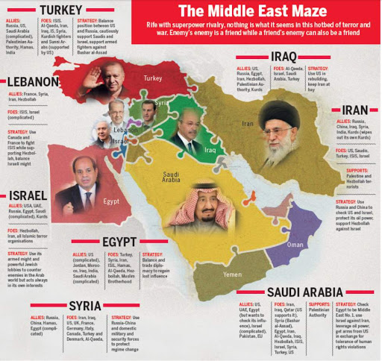

Slide 35

Organization of Islamic Cooperation
OIC
"the collective voice of the Muslim world"
But it seldom speaks.
None pays heed of if hardly ever do so.

Slide 36
History
The arson of Al-Aqsa Mosque in occupied Jerusalem on 21 August 1969
  Amin al-Husseini, the former Mufti of Jerusalem called for all Muslim heads of states to convene a summit.
  The Islamic Conference-was established in Rabat, Morocco on 25 September 1969
A resolution was passed stating that;
  Muslim governments to promote close cooperation and mutual assistance in the
    economic
    Political
    cultural and spiritual fields
  inspired by the teachings of Islam.

Slide 37
1970 the first meeting of Islamic Conference of Foreign Ministers (ICFM) held in Jeddah
  to establish a permanent secretariat in Jeddah
In Feb.1972, the Organization of the Islamic Conference (now the Organization of Islamic Cooperation) was founded during the 3rd ICFM Session
  The first OIC Charter was adopted
  It laid down the objectives, principles and structure, functions of the organization

Slide 38
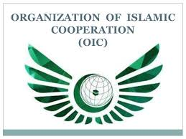
the second largest inter-governmental political organization
57 member states, across four continents, with 1.9 billion people (2019).
To Promote international peace and harmony
  The OIC has permanent delegations to the UN and the EU.
The official languages are- Arabic, English, and French.

Slide 39
The OIC Charter
The present revised Charter of the OIC was adopted in March 2008
It has 18 Chapters and 39 Articles
The revised charter promotes
  Democracy & Human rights
  Good governance in all member states.
  Peace and Prosperity
  Inter-faith harmony and inter religious dialogue
Notes:
Dakar-Capital of Senegal

Slide 40
OIC: Objectives
Promotion of Islamic Solidarity
Enhance cooperation among Muslim countries in economic, social, cultural and scientific fields
To coordinate among members for protection of Holy places
To promote unity and the image of Ummah through strengthening ties with other regional and international organizations

Slide 41
Articles-I & II: Objectives & Principles
According to its Charter (Article –I), the OIC aims to;
  Promote Islamic social and economic values;
    increase cooperation in social, economic and political areas;
    To strengthen intra-Islamic economic and trade cooperation
  uphold international peace and security; and
  Respect independence, territorial integrity, equality and sovereignty of member states

Slide 42
Objectives & Principles
  To protect and defend
    the true image of Islam,
    combat defamation of Islam and
    encourage dialogue among civilizations and religions
  To protect human rights and the rights of women and minorities.
  combating terrorism in all its forms and manifestations
  To support and empower the Palestinian people
  settle disputes through peaceful means and refrain from use of force

Slide 43
Article-III: Membership
Any State, member of the United Nations, having Muslim majority and abiding by the Charter, may join the Organization if approved by consensus by the Council of Foreign Ministers

Slide 44
Organization Structure
Islamic Summit
Islamic Conference of Foreign Ministers
Permanent Secretariat & the Secretary General
The Apex body
the heads of states and governments of the member states
convenes every two years
Meets once a year
Monitor and review progress of Summit’s decisions and programs
Elected by the Council of Foreign Ministers for five years, renewable once.
Administrative functions
the administrative organ of the Organization
entrusted with the implementation of the decisions of the two preceding bodies

Slide 45
Organization Structure
Other Organizations
Specialized Institutions
IIUs, IU of Technology
The Islamic Centre for the Development of Trade
Islamic Development Bank
the Al-Quds Committee
World Islamic Economic Forum

Slide 46
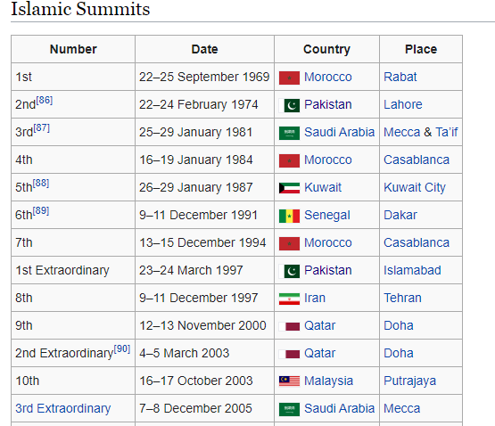
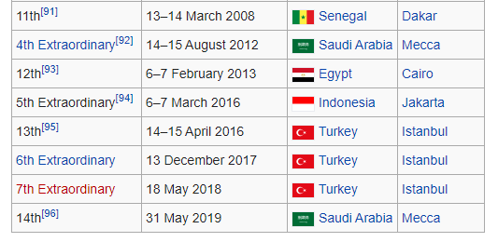
THE 15TH SESSION OF THE ISLAMIC SUMMIT
BANJUL, REPUBLIC OF THE GAMBIA (May 04-05, 2024 )

Slide 47
OIC- Issues and Challenges
The Member States of the OIC face many challenges in the 21st century
the noble Islamic values of unity and fraternity, peace, solidarity, tolerance, equality, justice, moderation, balance and human dignity

Slide 48
the OIC has taken steps to remove misperceptions and has strongly advocated elimination of discrimination against Muslims in all forms and manifestations.

Slide 49
OIC- Issues and Challenges
OIC Leadership Crisis over The Middle-East Issues;
  Israel-Palestine
  The Yemen Crisis
  The Syrian Civil War
Shia-Sunni Divide in the Muslim world
Democracy & Human Rights, Economic Dev
Islamophobia and the Role of OIC
Combating three menaces-Terrorism, extremism and Radicalism
Notes:
The Dialogue and Outreach Department at the OIC

Slide 50
OIC- Issues and Challenges
OIC and Muslim Renaissance- a remote possibility or a reality in near future?
Pan-Islamism and the Unity of ‘Ummah’- a gigantic challenge
Establishing a single economic and political entity as of EU???----seems impossible

Slide 51
Islamic Military Counter Terrorism Coalition
For military intervention against ISIL, Yemen and fro other counter-terrorist activities
  Original 34 members.
  countries joined and the number reached to 41
Most of its participants are members of the OIC
Coalition having majority Sunni Muslim populations
  it has been called "a sectarian coalition" by Hakeem Azameli, a member of the Security and Defense Commission in the Iraqi parliament
  Iran has expressed strong reservations
  Turkey is apprehensive

Slide 52
Pakistan and the OIC
Pakistan continues to enjoy a prominent status in the OIC
Pakistan is one of the most powerful members of OIC.
  population.
  nuclear weapons
  seventh-largest standing military force
  research, education and economy
  large labor force working in various Muslim countries
  Counter-terrorism achievements
the 2nd summit of OIC held in Lahore between 22–24 February 1974

Slide 53
Pakistan and OIC
Support for Palestine and Middle East issues
Islamic Military Counter Terrorism Coalition
Pakistan’s Relations with Iran and Saudi Arabia- how to strike a balance???
Saudi Arab and Gulf States’ tilt towards India and the India’s increasing role in the Middle East
OIC Contact Group on Kashmir
China's representation in OIC through Pakistan

Slide 54
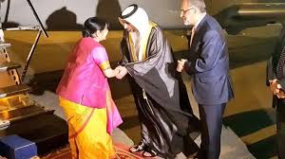
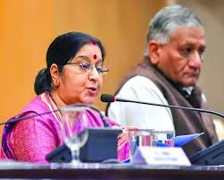
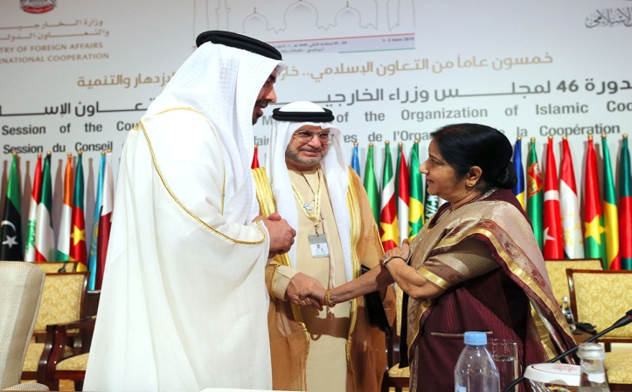
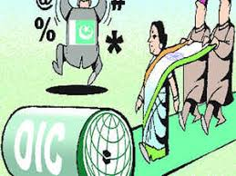
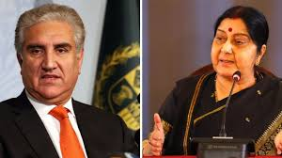
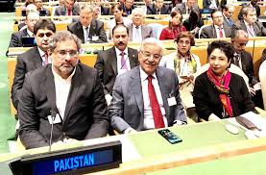
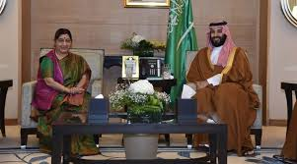
OIC invite India in Muslim world
It is the first time by OIC to invite India in five decades.
Sushma as the “Guest of Honour”
at the 46th meeting of OIC Foreign Ministers (1-2 Mar 2019.
Pakistan did not attend the OIC’s FMs meeting

Slide 55
The OIC FMs Council Meetings in Islamabad-2021 & 2022
Council meeting held on 18-19 Dec. 2021 & March 2022
  to devise a mechanism for the international community to deliver aid to Afghanistan, despite sanctions.
Post-Taliban Afghanistan and OIC efforts
India held conference on Afghanistan
  The Delhi Regional Security Dialogue on Afghanistan
  representatives from India, Iran, Russia, Kazakhstan, Kyrgyzstan, Tajikistan, Turkmenistan and Uzbekistan.
Pakistan accusing India of being a 'spoiler' in the region.

Slide 56
Making oic effective
Peace and Security: OIC Need to work for both internal as well as world peace and security.
Cultural Revolution: Political and Social Reforms
Economic Reforms in the Muslim World

Slide 57
The Future: OIC- Vision 2025
focuses on following priority areas
  Peace and Security, Dialogue
  Palestine and Al-Quds
  Counter-terrorism
  Joint Islamic Humanitarian Action
  Investment and Finance,
  Poverty Alleviation,
  Food Security
  Climate Change and Sustainability
  Science & Technology
  Moderation
  Culture and Interfaith Harmony
  Empowerment of Women
  Human Rights and Good Governance

Slide 58

Gulf Cooperation Council
GCC

Slide 59
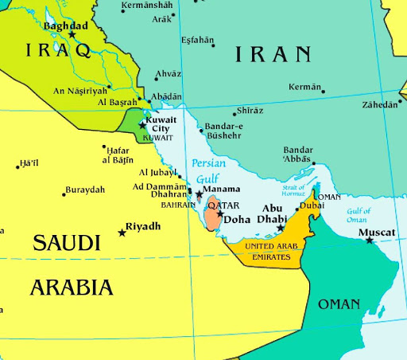
Persian Gulf

Slide 60
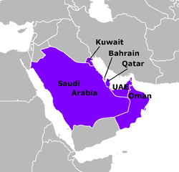

Slide 61
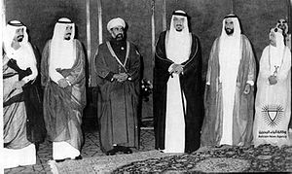
Historical Background
Agreement of the Gulf Cooperation Council was signed on 11 November 1981 in Abu Dhabi.
Heads of States of the Gulf region met in Abu Dhabi on 25 May 1981

Slide 62
The Cooperation Council for the Arab States of the Gulf
Known as the Gulf Cooperation Council (GCC)
  A regional intergovernmental political and economic union
  consisting of all Arab states of the Persian Gulf except Iraq
The Charter of the Gulf Cooperation Council was signed on 25 May 1981
Its headquarters in Riyadh, Saudi Arabia

Slide 63
Introduction
All current member states are monarchies
This area has some of the fastest-growing economies in the world
There have been discussions regarding the future membership of Jordan, Morocco, and Yemen

Slide 64
The objectives of the GCC (Article-IV )
Regional integration between Member States
To strengthen cooperation among them in various fields, including the following:
  Economic and financial affairs
  Commerce, customs and communications , and
  Education and culture
To stimulate scientific and technological progress
To establish joint ventures and encourage cooperation by the private sector
Ensure peace, stability and security of the region

Slide 65
Structure
1. Supreme Council(SC)
The heads of states
Highest decision making body
2. Ministerial Council(MC)
Composed of the Foreign Ministers
Meets every three months
3. The Secretariat and secretary General
The administrative arm of the GCC
Implements decisions approved by the Supreme or Ministerial Council
Sets objectives and programs
Each member state has one vote
Decisions on substantial issues unanimously
Procedural matters require a majority
Formulates policies and promote cooperation
Implement projects
It’s decisions are subject to approval by the SC
Compiles studies
Prepares reports
Notes:
GCC 44th Summit 5th Dec. 2023

Slide 66
5. Monetary Council(MC)
To introduce a single currency
7. Peninsula Shield Force
Military arm of the GCC
Joint Response against military aggression
Establishing a central bank
Choosing a currency regime
Any intervention by the force must include all member states

Slide 67
Geo-economics & Geo-politics
GCC-CRITICAL ANALYSIS

Slide 68
Steps towards a Monetary Union
In 2001, the GCC Supreme Council set the following goals:
  A common Customs Union until January 2003
  Common market be established by 2007
  Common currency be introduced by 2010
The name ’Khaleeji’ has been proposed for this currency.
If realized, the GCC monetary union would be the second-largest monetary union in the world.

Slide 69
Monetary Council: Bottlenecks
On 15 December 2009, GCC created a Monetary Council
  To introduce a single currency for the union.
  Establishing a central bank, and
  Choosing a currency regime
The Council met for the first time on 30 March 2010.
Kuwait said that a single currency may take up to ten years to establish.

Slide 70
GCC’s Internal Dynamics
Oman announced that it would not be able to meet the target date for a common currency.
the UAE announced withdrawal from the monetary union scheme
  It wanted GCC Central Bank in UAE not KSA
Saudi Arabia and Kuwait: disputes over shared oilfields

Slide 71
The Row with Qatar
Saudi Arabia, Bahrain and UAE pressuring Qatar-serious row among the three
  Qatar’s support to the Muslim Brotherhood, Hamas, and Islamists in Libya
  They have reservations on Al Jazeera’s coverage of Middle Eastern issues- demanded its closure
  Qatar’s exit from OPEC after 57 years to focus on natural gas market.
In June 2017, Saudi Arabia, the United Arab Emirates, and Bahrain put a ban on Qataris and their businesses.

Slide 72
GCC Summit 2021
Since 2017, blockade of Qatar ended in 2021
GCC countries agreed to end it on 05/01/2021
  Signed a “Solidarity and Stability” deal
  Called the Al Ula Agreement
Trump Administration brokered the deal
Kuwaiti Emir also played his role
It is to further isolate and pressurize Iran

Slide 73
GCC and Regional Dynamics
The GCC — set up in 1980 as a fortification against Iran and Iraq
Iraq is the only Arab country bordering the Persian Gulf that is not a member of the GCC.
In 2012, Iraq stated that it wanted to join the GCC
The lack of membership of Iraq is widely believed to be due to
  Low-income economy
  Its substantial Shia population
  Its political system, and
  Its invasion of member state Kuwait during the gulf war
  Iraq under turmoil since the fall of Saddam Hussain
Yemen was also negotiating for membership
  Yemen War and Humanitarian Crisis

Slide 74
The Oil Politics is on the Decline
Oil politics in the region on the decline
the GCC states are pursuing wider economic structural reforms
In 2011, Saudi Arabia proposed to transform the GCC into a "Gulf Union“
  With greater economic, political and military coordination
  To counterbalance the Iranian influence in the region

Slide 75
Pakistan and GCC
Pakistan-GCC Free Trade Agreement negotiations since March 2017
  Joint ventures and business opportunities- a source of FDI for Pakistan
  Pakistan’s manpower in Gulf countries
  It is on the decline
Rising Indian influence in Gulf region and Middle East-a challenge for Pakistan
Pakistan trying to strike a balance for its relations with
  Saudi Arabia and Qatar
  Saudi Arabia & Iran
Islamic Force and Pakistan's role
  Pros and Cons for Pakistan

Slide 76
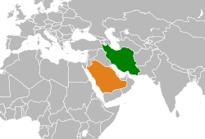
Iran-Saudi Normalization and GCC

Slide 77
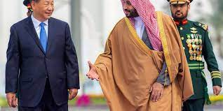
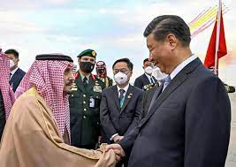
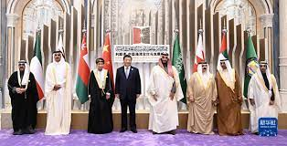
China’s Increasing Interest in ME
Counterbalancing US influence in ME
  Trade & Economic Cooperation
  Infrastructure Dev
Strategic Cooperation
  Nuclear & Missile Cooperation
In distant future, bringing SA & Iran closer
  Dual advantage for Pakistan
  US & India apprehensive

Slide 78
Conclusion
GCC Economic union and monetary union seem remote possibilities
Peninsula Shield Force has been eclipsed by the Islamic Military Counter Terrorism Coalition Force
US involvement in the region and rising pressure on Saudi Arabia
  Saudi Arabia has always looked to the United States for protection against Iran
  US-Iran rivalry
Iran’s involvement in the ME and Gulf would remain a serious concern for the GCC
Future expansion or disintegration of GCC??

Slide 79
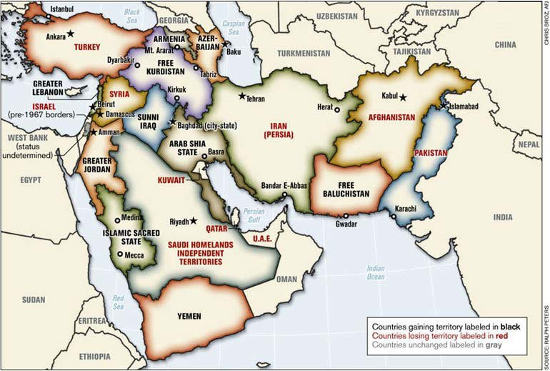

Slide 80
CSS-2020
Q. No. 7. Discuss in detail the role of OIC, Arab league and GCC in the Middle East crises and conflicts.

