Slide 1
International & Regional Organizations
SARFRAZ HUSSAIN ANSARI (CSP)
            34th Common- PA&AS
      Director Finance
      MBA (Int. Fin) - UIBE Business School, Beijing
      M.Sc Pub. Adm. (Pub. Fin) - QAU Islamabad
      Fellow Pakistan Institute of Public Finance & Accountancy
      SAP-FI Certified, Certified Performance Auditor

Slide 2
Regional & global organizations
Current Affairs & Pakistan Affairs

Slide 3
Multilateralism for Regional & Global Cooperation
Globalism---IGOs
Regionalism: Regional Organizations
SAARC
ECO
SCO
EU
NAFTA
ASEAN
OIC
Gulf Cooperation
Council
Arab League
International Political Order
LoN
UN
ICJ
International Economic Order
World Bank
IMF
WTO
Lecture-1
Lecture-4
Lecture-2
Lecture-5
Lecture-3

Slide 4
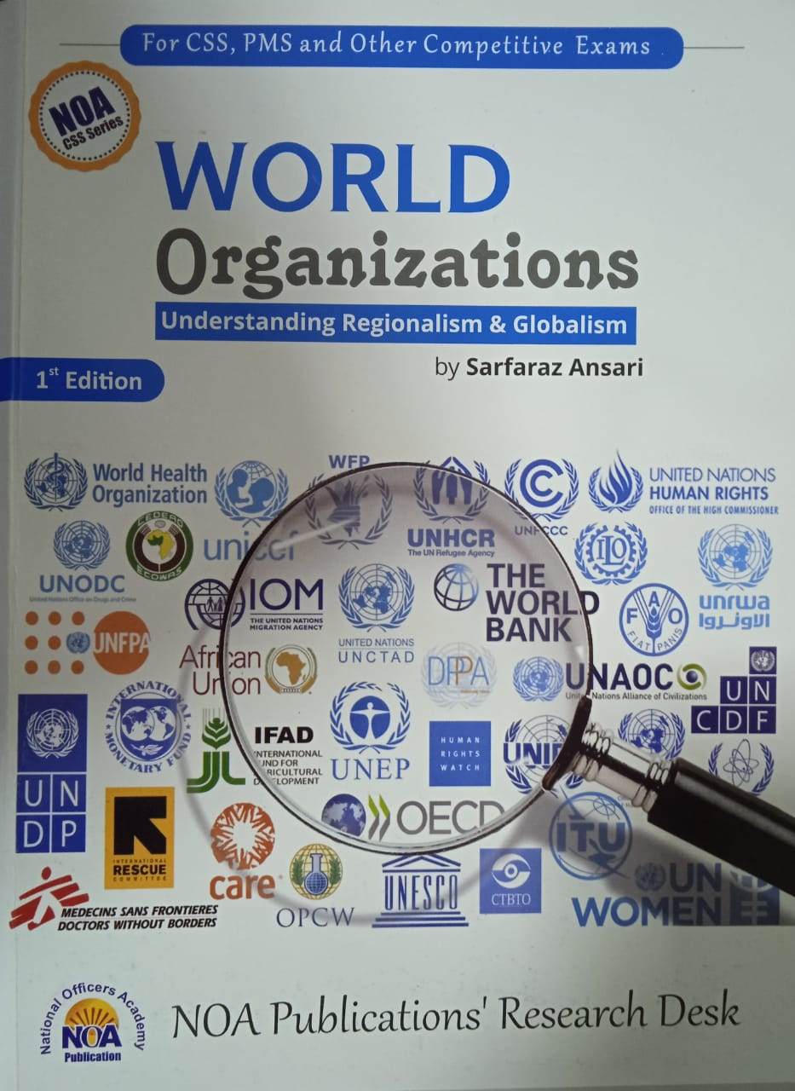
Sources of Study
My Lectures
Official Websites of these Organizations
CSS Five Year Papers
Watch BBC ‘Outside Source’ Aljazera and DW

Slide 5
Regional Integration and Regionalism
Regionalism
  the theory and practice of regional rather than national systems of administration or economic, or socio-cultural, or political affiliation.
Regional Cooperation Organizations
  EU
  ASEAN
  NAFTA

Slide 6
Outline
Introduction
  Background
  Brief History (Genesis)
  Members (and membership criteria)
Charter, Objectives, Principles
Structure
Functions
Issues and Challenges
  Geo-Strategic, Geo-Economic, ideological, trade, cultural etc
  Latest/current developments
Future Prospects
Recommendations
Conclusion

Slide 7
The European union
1.the rise of EU and its impact on the region, the world, and Pakistan
2.Why Brexit? ItS causes & Consequences
3.EU: the Future…….the road of European integration will not be smooth
https://www.europarl.europa.eu/news/en
BBC.COM/NEWS/Brexit
Regional Organizations

Slide 8
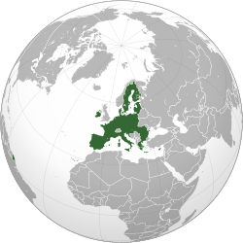

Slide 9
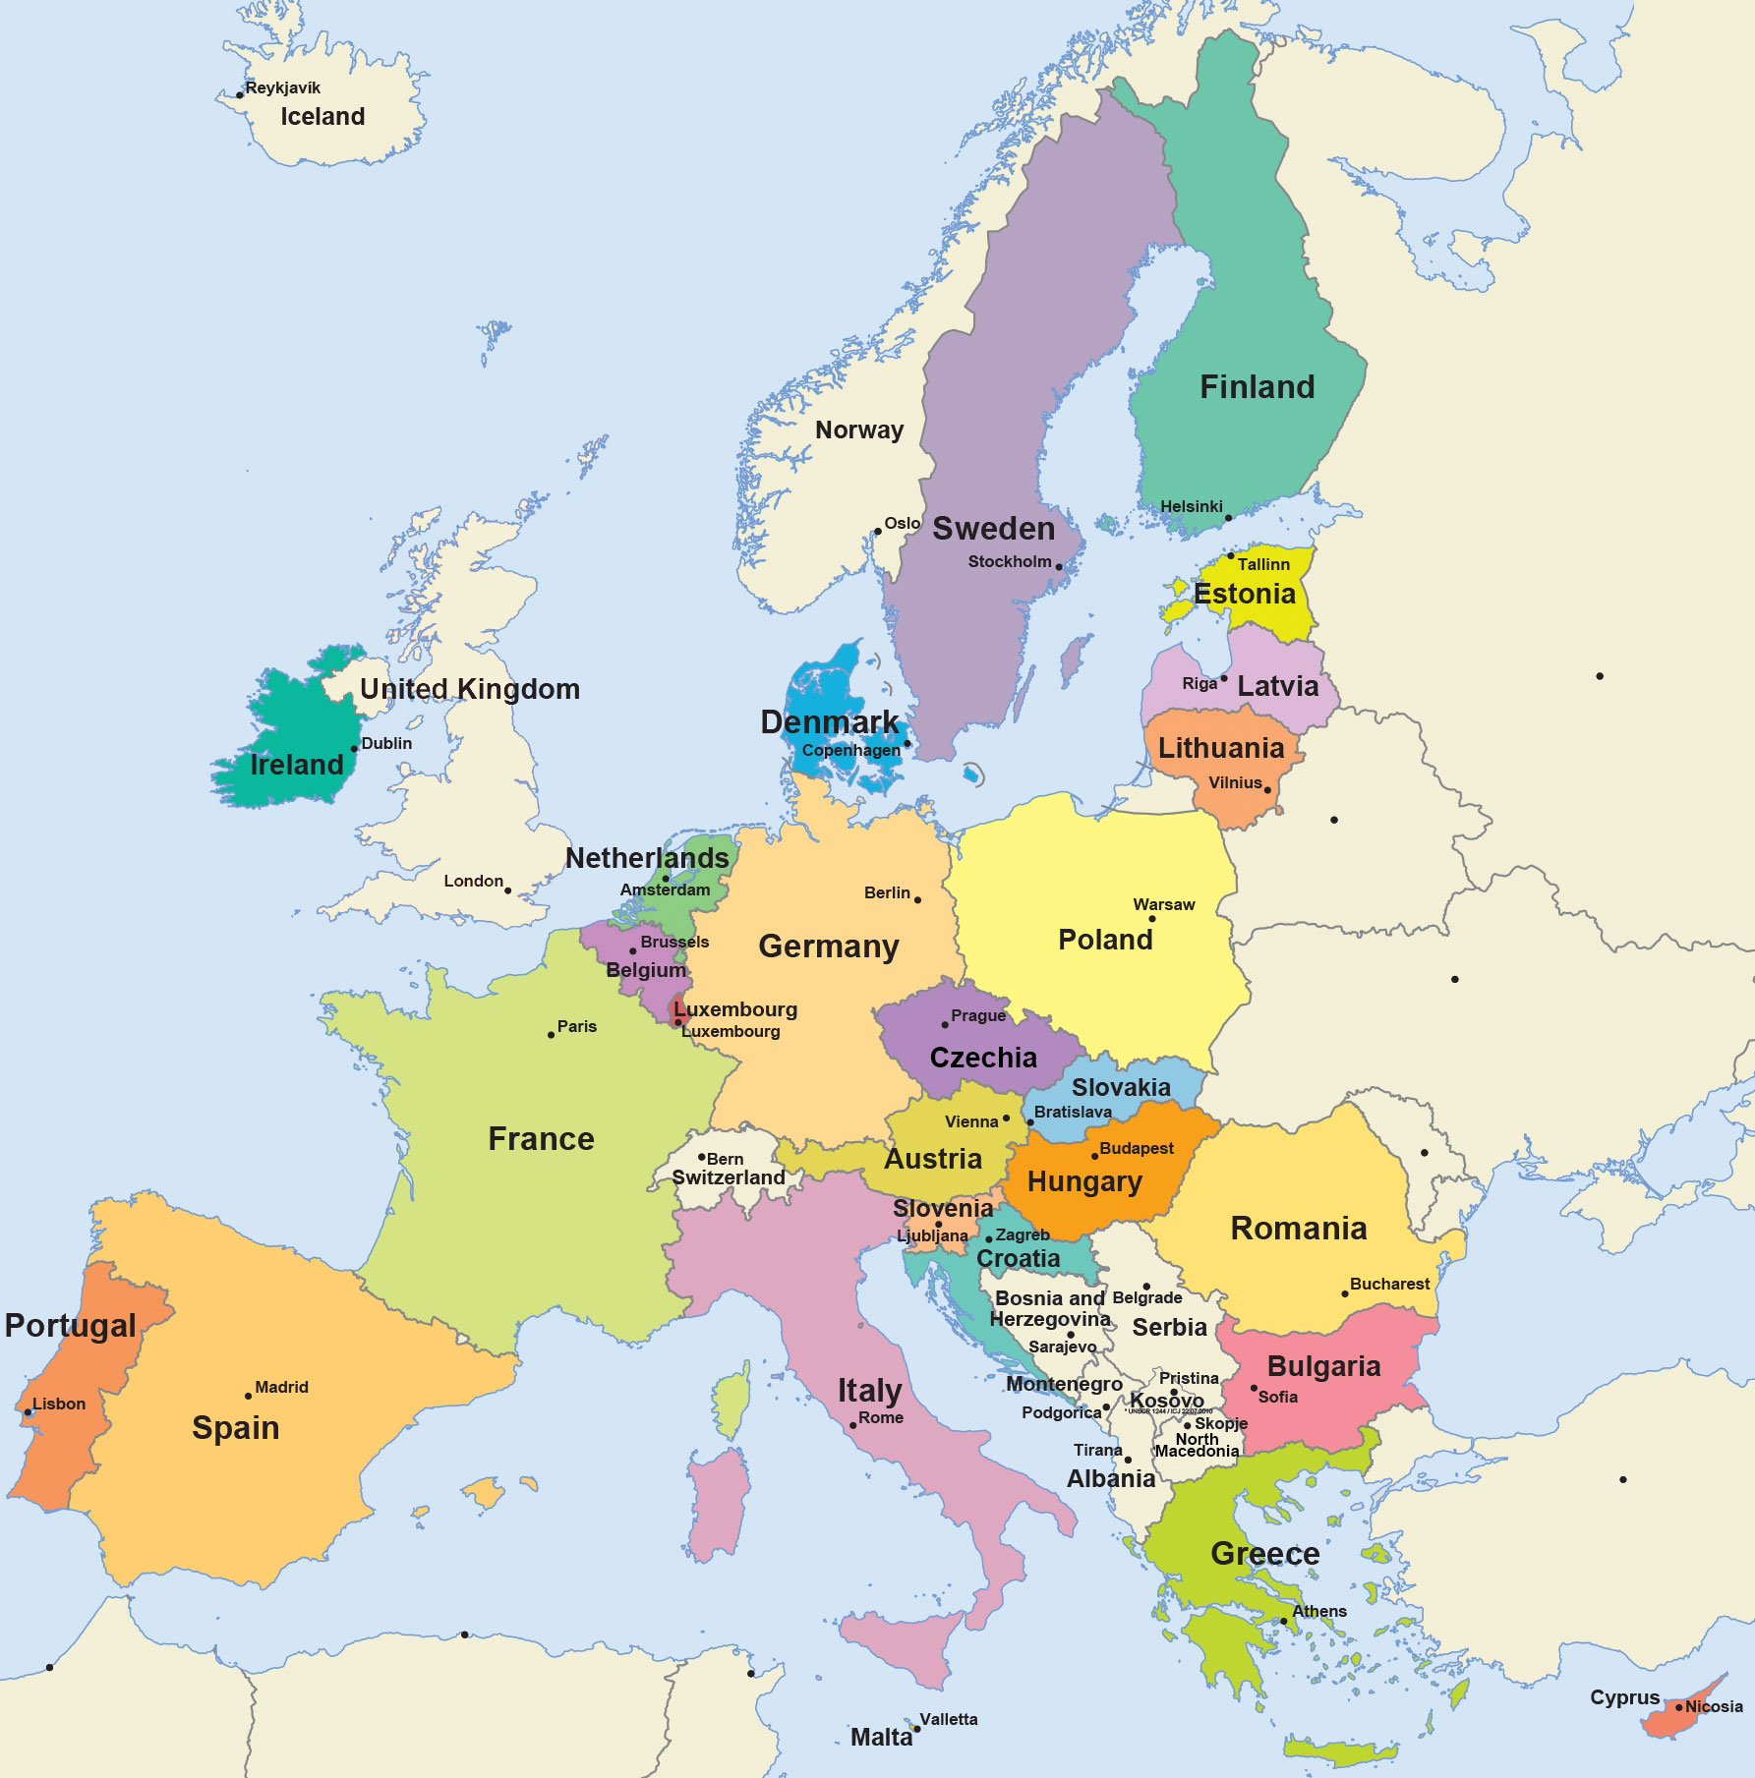
Russia
Ukraine
Black Sea
Turkiye

Slide 10
EU:Facts
Headquarters:
  Brussels, Belgium
Founded:
  November 1, 1993, Maastricht, Netherlands
  Lisbon Treaty governs the EU
Government:
  Intergovernmental and supranational
Members: 27
Founders:
  Germany, Italy, France, Netherlands, Belgium, Luxembourg
5.8% of the world population (2020)
the EU (excluding the United Kingdom) has a nominal GDP of US$15.5 trillion in 2019
US emerged as the superpower and leader of the liberal capitalist West
USSR became a 2nd super power leading the Socialist Eastern Europe

Slide 11
History (Factors which led to the creation of EU)
Post War Europe need for Reconstruction and Development demanded cooperation
US Aid for Europe’s Recovery-the US$ 17 Bil. Marshal Plan
Leadership and European Idealism
  Churchill while addressing in Zurich University in 1945 called for a ‘United States of Europe’
  The Schuman Declaration of 9 May, 1950
      French Foreign Minister Robert Schuman proposed the creation of a European Coal and Steel Community
The USSR at the gates of Western Europe
  NATO
Cold War divided the world into two blocks

Slide 12
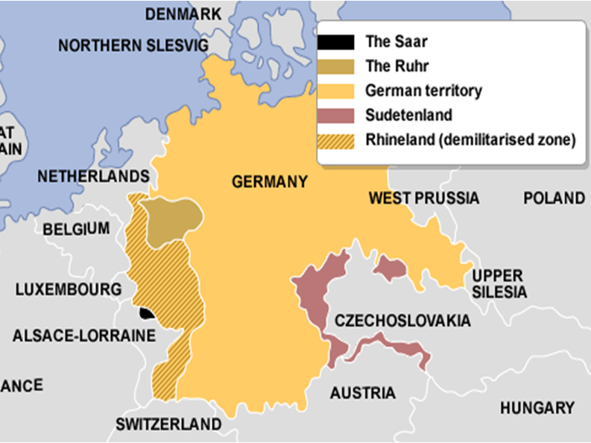
The Rhine Land

Slide 13
Genesis
The EU traces its origins to
1. the European Coal and Steel Community (ECSC)- by the 1951 Treaty of Paris, which converted to,
2. the European Economic Community (EEC)-1957 Treaty of Rome.
  the Inner Six signed a customs union (EEC).
  The original members of the European Community were;
  the Inner Six:
    Belgium, France, Italy, Luxembourg, the Netherlands, and West Germany.

Slide 14
Treaty of Rome (1957–92)
  The Treaty came into force in 1958
  In 1979, the first direct elections to the European Parliament held
  In 1986, the Single European Act was signed for;
    Elimination of customs
    A single banking market
    A uniform VAT
    A Common Agri. Policy
    A common environment policy
It created
  A Council of Ministers
  A Commission
  A Parliament
  A Court
  "a first step in the federation of Europe“
Britain’s skepticism about EEC led her to form EFTA in 1959.
-a parallel Block but ended with UK and other EFTA countries joined EEC in 1973
Notes:
The main issue was and is UK’s size of contribution to the EU along with other differences.
the "outer seven": Austria, Denmark, Norway, Portugal, Sweden, Switzerland and the United Kingdom

Slide 15
Inner Six: EEC
the “Outer Seven": EFTA
    Belgium,
    France,
    Italy,
    Luxembourg,
    the Netherlands, and
    West Germany.
  Austria,
  Denmark,
  Norway,
  Portugal,
  Sweden
  Switzerland and
  the United Kingdom

Slide 16
3. Maastricht Treaty (1992–2007)- the EU
the Maastricht Treaty came into force on 1 November 1993
  The European Union was formally established as a single market
  In 2002- EU Monetary Union and Central Bank
    euro banknotes and coins replaced national currencies in 12 of the member states.
    Since then, the euro-zone has increased to 19 countries.
4. Lisbon Treaty (2007–present)-it established
  a Constitution of Europe and EU System
  ratified all previous Treaties
  Introduced more centralized EU system and EU Foreign Policy
  EU Defense and Security

Slide 17
In 1986, the Single European Act
Lisbon Treaty (2007)
1951 Treaty of Paris
Trade Cooperation
Free trade of goods and commodities
Trade laws and rules uniform
Economic Cooperation
Trade of all economic goods and services
Common Market
Political Union
Single Constitution
common Election
Customs Union
Monetary Union
Single Currency
Common Customs laws
Imports export regime
TAX system
Central Bank
Credit system
Common financial system
Sovereign Parliament
Trade Union
Economic Union
Customs Union
Monetary Union
Political Union
In 2002- EU Monetary Union
1957 Treaty of Rome

Slide 18
EU: Membership Criteria
The Union shall be open to all European States which respect its values .
Becoming a member of the EU is a complex procedure.
Copenhagen Criteria
  a free-market economy
  a stable democracy
  the rule of law
  the acceptance of all EU legislation
Geographic Factors
Political Factors
  Democracy
  Rule of law
  Human rights
  Protection of minorities
Economic Factors
  capitalism

Slide 19
Candidate countries
  These countries are in the process of integrating EU legislation into national laws:
  Albania
  Montenegro
  North Macedonia
  Serbia
  Turkey
Potential candidates
  Potential candidate countries do not yet fulfill the requirements for EU membership:
  Bosnia and Herzegovina
  Kosovo
Notes:
There are 44 countries in Europe

Slide 20
The European Union (EU) System
Political and economic union of 27 member states of Europe
The EU has developed an internal single market
EU policies aim to ensure
  Free movement of people, goods, services and capital
  Enact legislation in justice and home affairs; and
  Maintain common policies

Slide 21
Structure
EU
Political & Economic Union
European Parliament
Scrutinize and Amend Legislation
Council Of The European Union
Scrutinize Legislation
European Council
Limited Executive Authority
European Commission
Full Executive Authority
Court Of Justice Of The European Union
The Interpretation And The Application Of EU Law And The Treaties
European Central Bank
Controls monetary policy of the Eurozone
European Court Of Auditors
The EU Budget Is Scrutinized
Legislative
Executive
Judicial
Legislate in matters of exclusive and shared sovereignty
Make EU policies, programs and projects. Propose bills and amendments. Prepare budgets

Slide 22
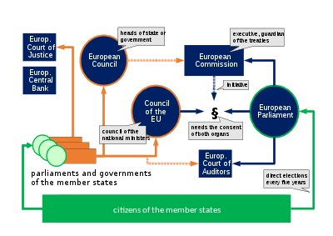
Elected Heads of States/Govt. set overall direction and Policies of EU
Executives.-Guardian of the Treaties
National Ministers of each country
Direct Elections every 5 years
Organogram of the political system with the seven institutions of the Union in blue, national / intergovernmental elements in orange
Notes:
Strasbourg is the seat of the European Parliament, the Council of Europe, and the European Court of Human Rights.

Slide 23
The European Parliament- Scrutinize and Amend Legislation
consists of 751 directly elected representatives
The Council Of The European Union- Scrutinize and Amend Legislation
Comprising of the Ministers from the member countries
The European Council- Limited Executive Authority
sets the general political directions and priorities of the Union
It shares with the Council of the EU equal legislative powers
It elects the Commission's President, approves the College of Commissioners, and may vote to remove them collectively from office
Its approval is required for any proposal to enter into law.
It adopts laws and coordinates policies through ‘Codecision’ process
The conclusions of its summits (held at least quarterly) are adopted by consensus.

Slide 24
the European Commission- the "Guardian of the Treaties"
An executive cabinet of public officials.
One commissioner from each member . It is led by an indirectly elected President.
this College of Commissioners manages and directs the Commission's permanent civil service.
the EU Court of Justice : Two Courts------the Court of Justice and the General Court
ensures the uniform application of EU law
resolves disputes between EU institutions and member states, and against EU institutions on behalf of individuals.
the European Court of Auditors
investigates the proper management of finances within both the EU entities and EU funding provided to its member states.
provide oversight and advice
refer unresolved issues to the European Court of Justice
the European Central Bank is responsible for monetary stability within member states.
Frankfurt.

Slide 25
Critical analysis

Slide 26

Fault Lines Of EU Integration:
Political
Economic
Monetary
Cultural
Demographic
Regional and Global Dynamics
The Europe’s East-West Divide
  is more political and cultural
The Europe’s North-South Divide
  Is more economic than political and cultural

Slide 27
The Politics of Control
The British were skeptical of a fully integrated economic and monetary union from the start
  Britain questioned the control of her currency by Euro. Bank and retained the option to ‘opt out’ of EU
The Maastricht Criteria is difficult to meet for the member countries for controlling/reducing their;
  Inflation
  budget deficits
  public debt, and
  Subsidies
Germany asserts EU to follow low inflation policies

Slide 28
Economic Fault Lines: Euro Bank
The autonomy of European Central Bank
Maintaining a stable Euro was another challenge
Britain fears loosing sovereignty to a continental institution
The admission of new members from Eastern Europe raises additional concerns both economic and political

Slide 29
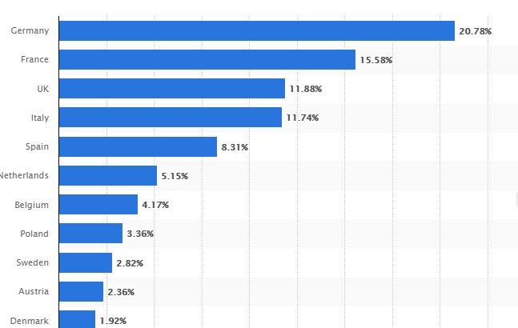
Share of Total Contribution to the EU Budget

Slide 30
Demographic and Cultural
Major EU countries have witnessed changes in their population mix
  Elderly population on the rise
  Immigrants from former colonies
  Former Socialist outlook of eastern Europe
  Refugees from troubled regions
  The rise of ultra Rightists in Europe

Slide 31
Regional & Global Factors
NATO’s expansion
Russia-Ukraine War
EU energy supplies
EU Food Security
Climate Crisis
Terrorism and Extremism is rising in EU
Terrorism & Islamophobia
Rise of other Regional Organizations as a challenge to the domination of the West in world politics
China’s BRI and Involvement in the Middle East and Eastern Europe
Climate Crisis

Slide 32


Slide 33
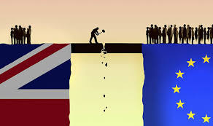
BREXIT

Slide 34
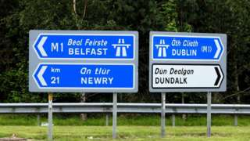
The Irish Question: The Backstop

Slide 35
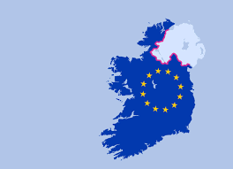
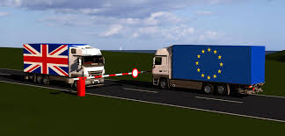
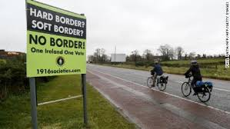
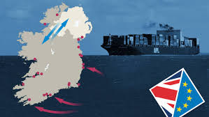

Slide 36
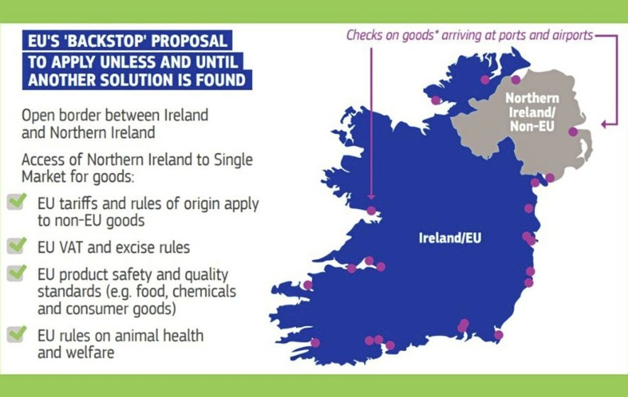

Slide 37
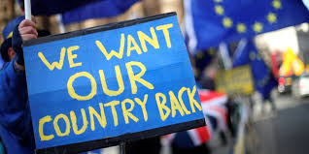
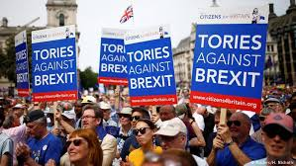
Brexit-Background Reflections
the Labour Party's 1983 election
manifesto advocating full withdrawal
The Conservative Party led to rebellion over the Maastricht Treaty in 1992.

Slide 38
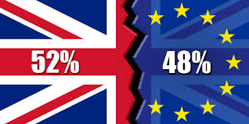
Referendum: What was the breakdown across the UK?
JUNE 23, 2016:Overall Result
To Leave
England voted for Brexit, by 53.4% to 46.6%.
Wales also voted for Brexit, by 52.5% to 47.5%.
To Remain
Scotland and Northern Ireland.
  Scotland backed Remain by 62% to 38%,
  Northern Ireland by 55.8% to 44.2%

Slide 39
Why BREXIT?
Social and demographic changes in UK.
Political traditions and UK’s historical role as dominant player in the European affairs.
Englishmen are proud of their traditions, sovereignty and political independence.
Changes in voting patterns in UK
  Rise of the educated middle class
Increasing control of EU Parliament, EU Court of Justice, EU Central Bank
Rising financial obligations

Slide 40
For the UK to leave the EU it invoked Article 50 of the Lisbon Treaty
Theresa May triggered this process on 29 March, 2017
the UK has left the EU on 31/01/2020
  Transitional period till 31/12/2020 for a deal
  The Deal has bee done on Christmas
A SOFT BREXIT will be HARD enough to implement:
Determines UK’s future relations with EU under certain terms and agreements

Slide 41
Why do both sides want a deal?
The main points of having a deal between the UK and the EU are to;
  ensure smooth exit for businesses and individuals
  allow a permanent trading relationship.
  The question of Irelands
  The control of the seas and fishing rights
  Environment & Security
  Fair play and equal treatment for businesses

Slide 42
What is the deal with the EU?
the UK and EU signed a Brexit deal. It comes in two parts.
The Withdrawal Agreement
The Statement on Future Relations
This is a legally-binding text
sets the terms of the UK's divorce from the EU.
It covers how much money the UK owes the EU - an estimated £39bn – and
what happens to UK citizens living elsewhere in the EU and EU citizens living in the UK.
It also proposes a method of avoiding the return of a physical Northern Ireland border (the Backstop).
This is not legally-binding
It sketches out the kind of long-term relationship the UK and EU want to have in a range of areas, including
  trade,
  environment,
  defense and
  security

Slide 43
From 1 January, 2021, the free movement of people and goods and services between the UK and the EU have ended.
This means significant differences to how people live, work and travel.

Slide 44
The Brexit trade and security Deal
Trade & Tariffs
  Tariff-free and quota-free access of UK’s goods to EU. There will be mutual recognition of laws. This means UK producers will have to comply with both UK and EU standards.
2.Professional qualifications
  There will be no more automatic recognition for doctors, nurses, architects, dentists, pharmacists, vets, engineers. They will now have to seek recognition in the member state they wish to practice in.
3. Travel– freedom of movement
  UK nationals no longer have the freedom to work, study, start a business or live in the EU and vice versa.

Slide 45
4. Fisheries
The UK will leave the common fisheries policy.
New quotas reducing the EU’s fishing share by 25% in next five and a half years.
A quarter of the EU’s catch will be “repatriated” to.
After that, the two sides will hold annual negotiations.
The EU vessels that fish 6 to 12 nautical miles from the British coastline will be able to continue during the transition, but access will be negotiated on an annual basis after that.
5. Subsidies-State aid
The EU had insisted the UK align with its state aid rules.
But the UK will set up its own subsidy regime.

Slide 46
6. Standards or level playing field
  A set of rules to ensure that one country, or group of countries, doesn't have an unfair advantage over another.
7. Dispute resolution
  If either party feels trade is being distorted, it can take measures after consultation. An arbitration panel would meet within 30 days and adjudicate.
8. Security and law enforcement
  Cross-border police investigations and law enforcement can continue, with agreements that the UK can remain in key exchange programs but not all.
  Nor will the UK be a full member of Europol or Eurojust.
9. No Hard Border between the Irelands
  some new checks will be needed on certain goods arriving into Northern Ireland from the rest of the UK (England, Scotland and Wales)
  Some new paperwork will nevertheless be required
  it allows Northern Ireland to adopt EU customs rules in keeping with the Republic of Ireland

Slide 47
Brexit Deal: Negotiations at Brussels
EU Stance
UK Stance
The EU wants one comprehensive deal.
the EU wants the UK to provide level playing field to all businesses under EU rules on;
  workers' rights,
  environmental regulations and
  subsidies for business.
EU wants full fishing rights in UK waters.
For police, coastguard and security co-operation. The UK wants to maintain the same access to shared databases that it has now, but the EU says that isn't for non-members.
The UK - a Free Trade deal first
Fishing: the UK want full access to the EU market to sell its fish.
future role of the EU Court of Justice for dispute resolution not acceptable to UK
keeping the land border in Ireland as open as it is now.
EU students will be charged more from 2021

Slide 48
Brexit Impact
Food and Drinks- 16% of UK’s total manufacturing
Farming-60% is consumed in UK and EU is the biggest market. Also farm subsidies provides support to UK farmers
UK’s financial and business services will be threatened
Since the Brexit vote, the pound has gone down against the euro.
Impact on UK universities would be negative
Challenge of retaining highly skilled workforce
Brexit will likely reduce the UK's real per capita income in the medium term and long term
the Brexit referendum itself had damaged the economy a 1% decline in her GDP before COVID-19

Slide 49
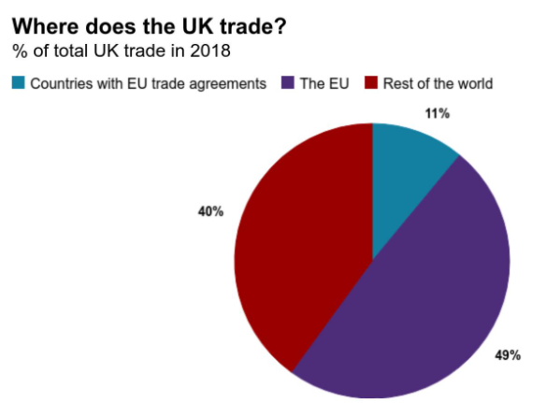
Brexit Impact
£550bn of trade between the UK and its nearest trading partner.
The UK exported £291bn of goods and services to other EU countries in 2018, which was 45% of all UK exports.
It imported £357bn of goods and services from the EU, which was 53% of all UK imports.
Notes:
The EU's agreement with Canada is called the Comprehensive Economic and Trade Agreement

Slide 50
UK’s Options outside EU
Looking Beyond Europe
  Trade and strategic ties with USA and Japan
  New emerging markets and trade blocks
  Commonwealth counties
  WTO Trade
  AUKUS Deal
Notes:
membership in agreements in the European Economic Area (EEA) established in 1994, and by virtue of being a founding member of the European Free Trade Association (EFTA) which was founded in 1960, one of the two historically dominant western European trade blocs.

Slide 51
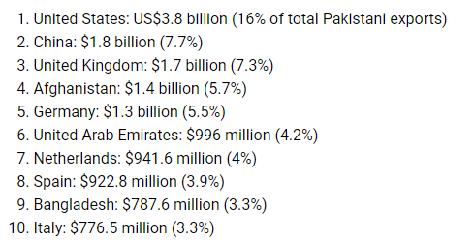
Pakistan and EU
The EU-Pakistan: 21.2 percent of Pakistan’s total exports.
Pakistan was awarded the Generalized System of Preferences Plus (GSP) in 2013.
  EU is Pakistan’s 2nd Largest trade partner
  Pakistan trade with EU is at $5.5 Billion in 2020
EU Parliament has passed a bill to end GSP-Plus status of Pakistan on 30.04.21
Pakistan’s Exports
94% of Pakistan’s exports concentrate only 7 sectors of products.

Slide 52
Challenges for Pakistan:
  Less diversified economy
  High cost of production.
  Less competitiveness in international markets.
  Volatile prices of raw materials.
  Difficulty in achieving the required market standards
  To implement and maintain the 27 conventions set by EU.

Slide 53
Responding to COVID-19 and Post Covid EU Alignments
“It’s a big challenge to the existence of Europe,” Italy’s Prime Minister Giuseppe Conte told the BBC.
“If Europe fails to come up with a monetary and financial policy adequate for the biggest challenge since the World War II, not only Italians but European citizens will be deeply disappointed,” he said.

Slide 54
The EU response to COVID-19
the Next Generation EU (€750 billion) recovery plan
  the package will help the EU to rebuild after the COVID-19
  €390 billion are grants
  €360 billion in loans.
Row over the use of recovery package between the more fiscally conservative north and the indebted south
divisions among countries on sharing the financial burden of crises (the Frugal Four demanding strict conditions with aid)
Notes:
SAND: Sweden, Austria, Netehrlands, Denmark

Slide 55
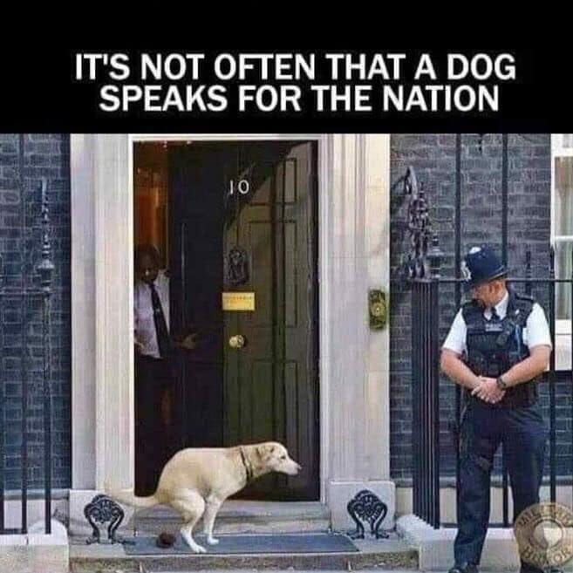

Slide 56
The Future…….
The raising of EU Defense Force
  The EU has no standing army, so relies on ad hoc forces contributed by EU countries.
  USA may withdraw from Europe’s collective defense
  NATO may disintegrate
Rise of Russia and Trans-European Gas Pipeline
  USA has shown reservations and may apply sanctions on Russia
    EU opposes US move
  Can Russia join EU? Or Sino-Russian ties will put EU on toes against Russia
EU eastward expansion…….
Turkey: will it subdue to EU demands for membership or adopt a divergent path?
Keeping the EU members intact---a big challenge
EU foreign policy and world affairs
  Israel-Palestine
  Refugees influx in EU
  Counter Terrorism
  EU & OIC

Slide 57
Likely Questions
1. Why Brexit? It’s causes & Consequences
2.EU: the Future…….the road of European future integration will not be smooth
3. the rise of EU and its impact on the region, the world, and Pakistan

Slide 58
Association of Southeast Asian Nations

Slide 59
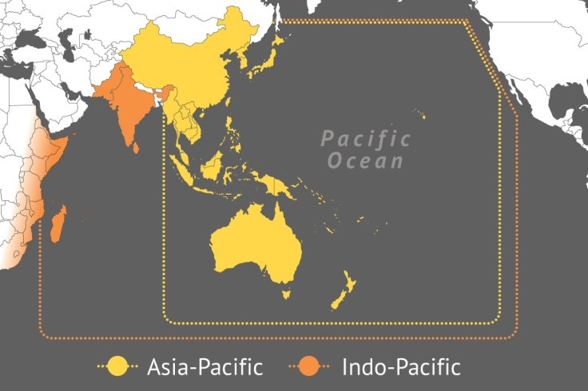

Slide 60
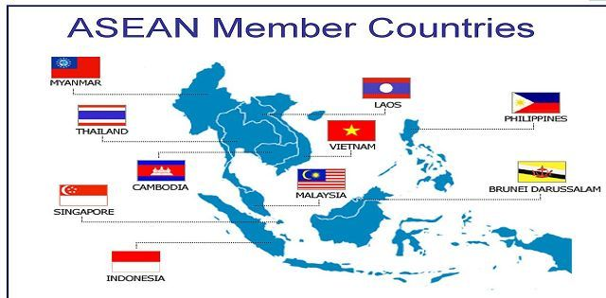
v
Malacca Strait

Slide 61

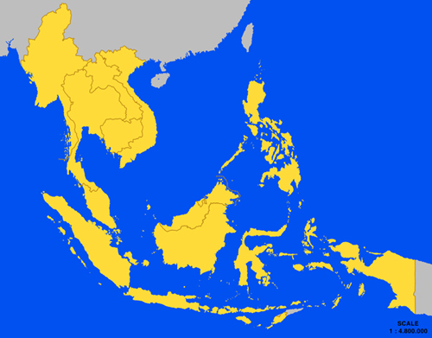

Slide 62
History: The Founding of ASEAN
31 July 1961-the Association of Southeast Asia (ASA)
  a group consisting of
    the Philippines
    the Federation of Malaya, and
    Thailand.
8 August 1967– the Foreign Ministers of Indonesia, Malaysia, the Philippines, Singapore and Thailand –signed the ASEAN Declaration.
ASEAN has evolved as the most successful inter-governmental organization in the developing world today.

Slide 63
ASEAN
Ten countries in Southeast Asia (Asia Pacific)
promotes intergovernmental cooperation
Headquarters: Jakarta, Indonesia
Founded: August 8, 1967
the ASEAN Plus Three, consisting of ASEAN, China, Japan and South Korea, was created in 1997.
The group became ASEAN Plus Six with Australia, New Zealand and India in 2013

Slide 64
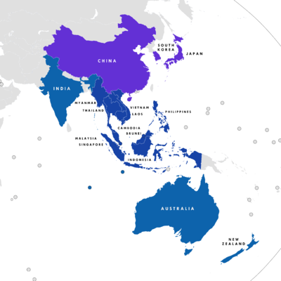
Indo-Pacific
Asia-Pacific

Slide 65
ASEAN-Aims
The aims and purposes;
  Cooperation in the economic, social, cultural, technical, educational and other fields
  Promotion of regional peace and stability
  Respect for justice and the rule of law
  Adherence to the principles of the UN Charter.
It stipulated that the Association would be open for participation by all States in the Southeast Asian region subscribing to its aims, principles and purposes

Slide 66
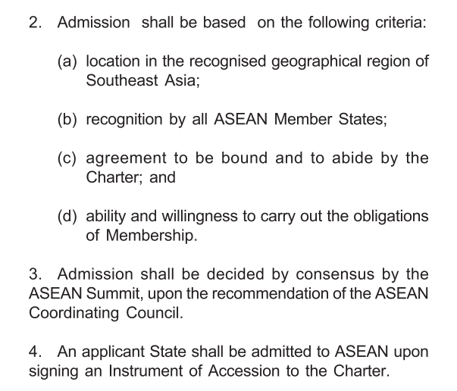
Membership Criteria

Slide 67
Structure
The ASEAN SUMMIT-heads of States or Govt
  supreme policy making body
  Meetings held twice annually
ASEAN Coordinating Council of Foreign Ministers- implements decisions and agreements of the Summit
ASEAN Committee of Permanent Representatives
ASEAN Secretariat
ASEAN Sectoral Ministerial Bodies
ASEAN Community Councils
  ASEAN Political-Security Community Council
  ASEAN Economic Community Council
  ASEAN Socio-Cultural Community Council
(The Secretary-General: H.E. Dato Lim Jock Hoi from Brunei Darussalam.)

Slide 68
WEF
630 million people and economic growth averaging 5% per annum

Slide 69
The Future

Slide 70
The ASEAN New Charter
15 December 2008-member states met in Jakarta
  launch a charter (signed in November 2007)
with the aim of moving closer to
  "an EU-style community".
Create a single free-trade area for the region of 630 million people.

Slide 71
ASEAN Economic Community
On 20 November 2007, during the 13th ASEAN Summit in Singapore, its blueprint was adopted
aims to "implement economic integration initiatives"
  the declaration of the ASEAN Economic Community during the 27th ASEAN Summit in Kuala Lumpur, 2015
  to create a single market across ASEAN member states.
  An EU-style system is emerging in ASEAN region
ASEAN Community Councils
  ASEAN Political-Security Community Council
  ASEAN Economic Community Council
  ASEAN Socio-Cultural Community Council
ASEAN will rise globally as one market

Slide 72
Geo-Strategic Dynamics of ASEAN Region
The influence and presence of the US in the ASEAN region and the rise of China
  Sino-Russia ties
  Sino-US rivalry
BRI and the US investments in ASEAN countries
SCO and ASEAN may collaborate for regional security
Rising influence of India both in ASEAN and SCO-options for Pakistan
  The emerging ‘Asian Order’
Can Pakistan become a member?

Slide 73
Options for ASEAN and New Regional Alignments
Alignment Under China
  Russia, North Korea, Pakistan, Iran
Alignment Under USA
  Japan, South Korea, Taiwan, Australia, India
QUAD-4 & AUKUS alliances in the Indian Ocean
These alignments and factor have their impact on ASEAN

Slide 74
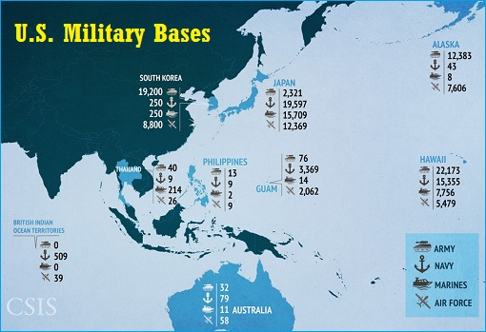
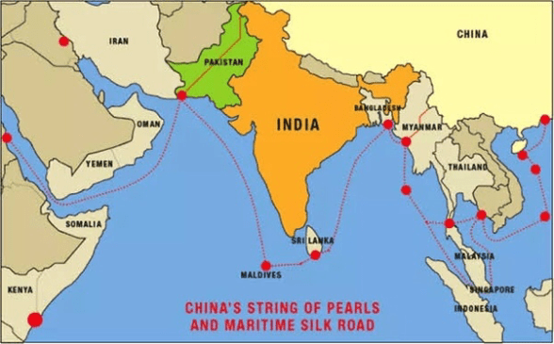

Slide 75
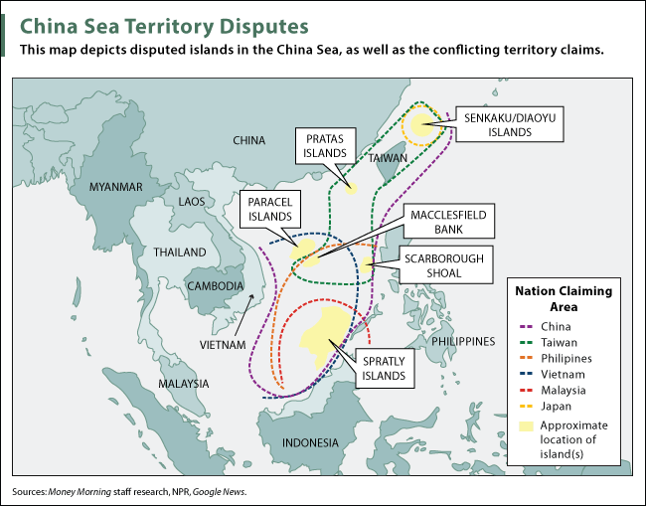

Slide 76
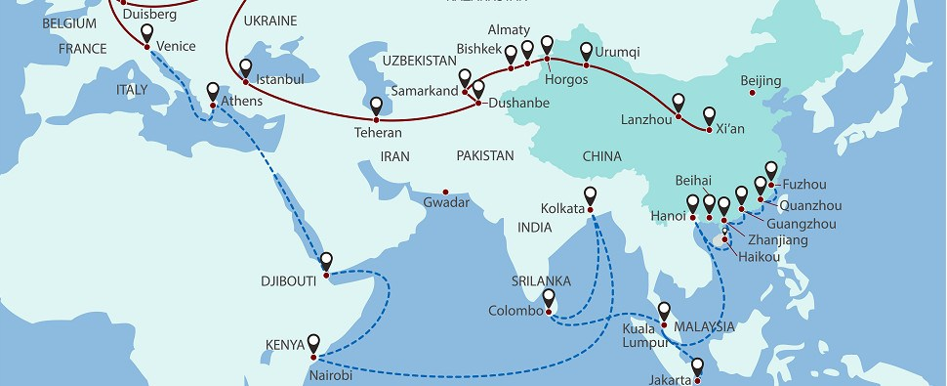
Regional Connectivity: Belt and Road Initiative Map

Slide 77
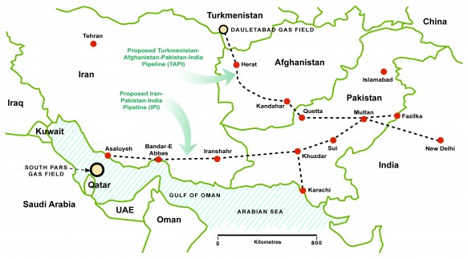

Slide 78
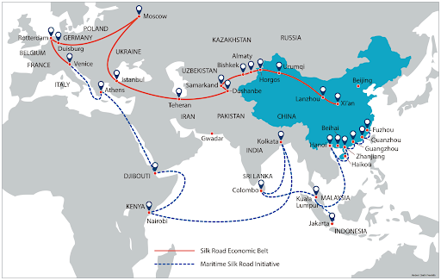

Slide 79
Looking Beyond ASEAN
It also engages other countries in the Asia-Pacific region and beyond.
  As a major partner of Shanghai Cooperation Organization,
  ASEAN maintains a global network of alliances and dialogue partners
  APEC-Asia Pacific Economic Cooperation: converted into CEPA
  QUAD-4-----Quadrilateral Strategic Cooperation in the Indo-Pacific among USA-India-Japan-Australia
  AUKUS

Slide 80
Conclusion
The complete political, cultural and economic integration is a long road to traverse for the ASEAN members due to;
  Diverse political systems
  Types of governments
  Various religions
  Borders and islands’ control issues
  Poverty, crime and weak rule of law
  Evolving regional institutions of ASEAN
  Economic Restructuring & Capacity issues
  Changing regional dynamics

Slide 81
ASEAN Future Challenges
Geo-political and Strategic
    The Taiwan Question and ‘One China’ Policy
    The Korean Question and Nuclear Flash Point in the Asia-Pacific
    The South China Sea Islands’ Sovereignty Question
    Presence of US as protectorate of Japan, South Korea, Philippines……
Economic
    Needs capital and modern technology
    Needs to improve quality of their population
    Population control
    Converting manufacturing economy to services and high-tech economy
Monetary and Banking System- A Remote Possibility
Regional Organizations-To Cooperate or Not To Cooperate
    SCO
    CEPA
    SAARC

Slide 82
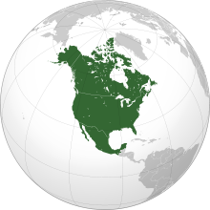

North America free trade agreement
NAFTA

Slide 83
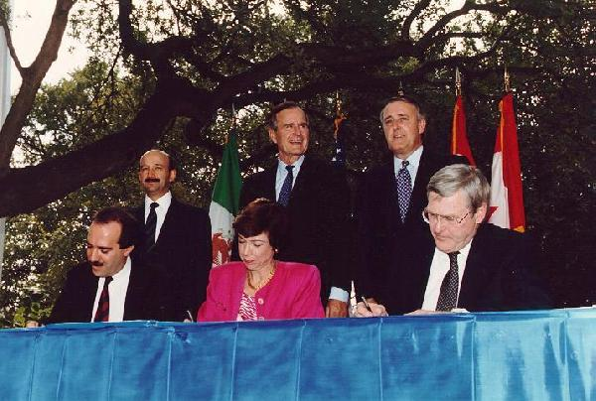
“It was on Oct. 7, 1992, under an old oak tree in downtown San Antonio that Mexican President Carlos Salinas, U.S. President George Herbert Walker Bush and Canadian Prime Minister Brian Mulroney signed the historic treaty that dropped trade barriers on the continent.”

Slide 84
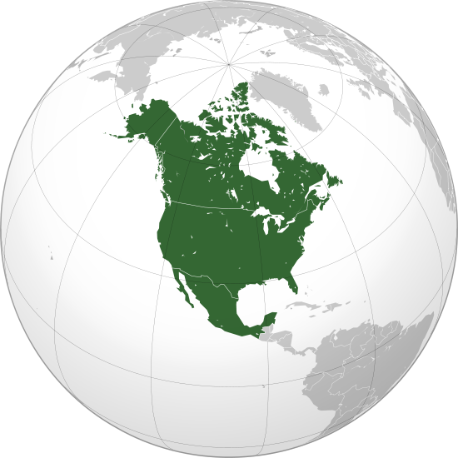
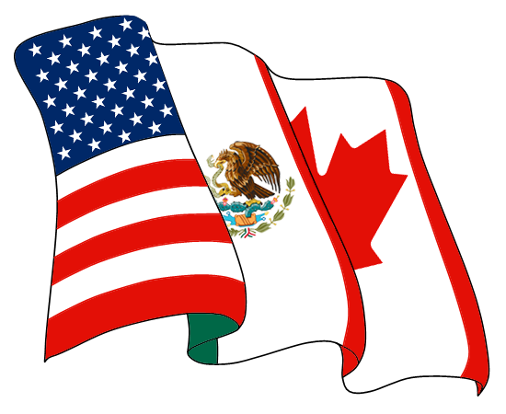

Slide 85

What is NAFTA?
NAFTA-“North American Free Trade Agreement”.
an agreement between the countries of North America: Canada, United States, & Mexico.
NAFTA was signed in 1993 and went into effect on January 1st, 1994.
NAFTA to create a Free Trade Area in North America

Slide 86
It eliminates only internal trade barriers between the three member countries
It does not set barriers with other states, nor does it create supranational economic or political institutions

Slide 87
NAFTA: Raison d’etre
The purpose of the agreement is to:
  Allow free movement of goods and services
  Promote competition in the free trade areas.
  Protect the IPRs
  Dispute Resolution that arise among the member countries.
  Encourage cooperation among member countries.
The agreement opened the door for
  free trade,
  ending tariffs on various goods and services, and
  equality between Canada, USA, and Mexico.

Slide 88

NAFTA’s
ISSUES & CHALLENGES

Slide 89
Supporters of NAFTA
free trade would create jobs and lower consumer prices
Also tax, environment and labor protection laws would benefit Mexico more in the longer run
makes Mexican products more competitive in NAFTA region
Opportunity to explore future trade potential
Looking beyond NAFTA

Slide 90
Issues
Free trade has caused more U.S. job losses especially for higher-wage jobs.
  American factories shifted to Mexico due to;
    Fewer labor regulations in Mexico,
    Mexico weak environmental regulations
  Some argue that borders should be open like the EU.
  others feel the borders should be closed.

Slide 91
NAFTA Today
NAFTA now links over 450 million people producing $17 trillion worth of goods and services.
It has met many of its goals:
  It created jobs in Mexico and helped build up Mexico's middle class.
  Trade between US, Mexico, & Canada has more than tripled since 1994.
NAFTA still has its problems.
Small farmers in Mexico were put out of business by cheap U.S. agricultural exports.
  They were forced to move to bigger cities, adding to poverty, pollution, overcrowding, and illegal immigration to the U.S.
  The population of illegal immigrants in the U.S. in 1990 was 2 million, now it's around 11 million.
There is major pollution in the emerging cities in Mexico
The Mexican Wall

Slide 92
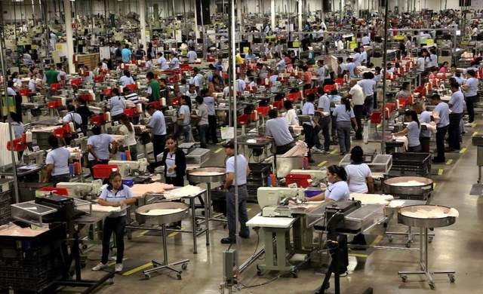
Employees work at an American-owned factory located in Mexico.

Slide 93
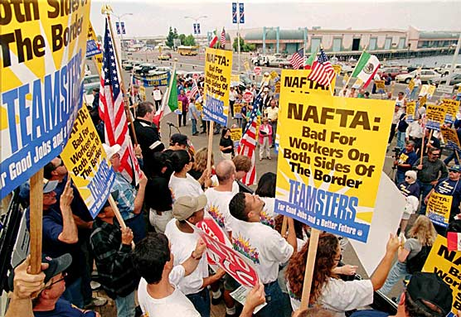
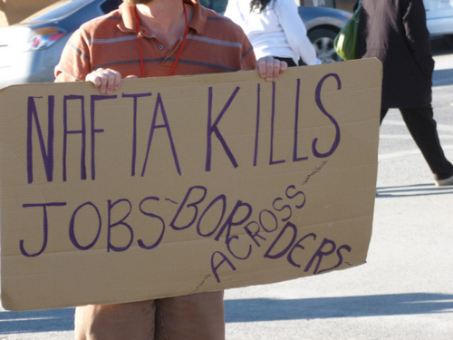

Slide 94
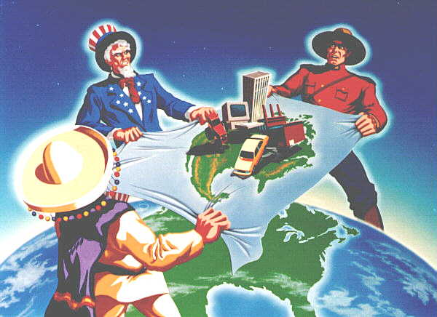

Slide 95
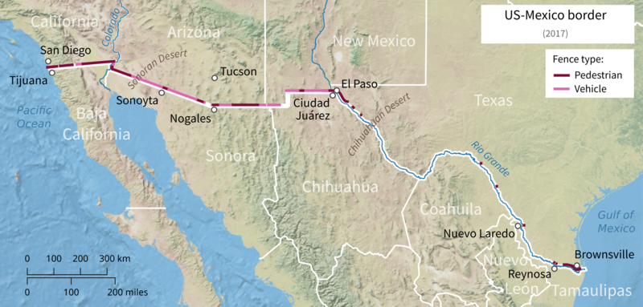
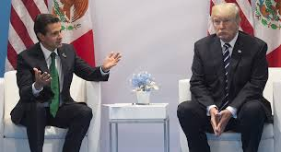
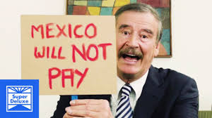
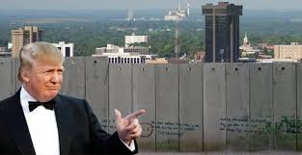
Notes:
3145 Km border between US and Mexico

Slide 96
Controversy over NAFTA
NAFTA is an agreement integrating First and Third World economies.
The debate against NAFTA and Mexico is still going on
US objects antidemocratic practices of Mexico
The overall impact of NAFTA has been modest

Slide 97
Trump’s campaign
Trump calls NAFTA "the worst trade deal" ever signed by the US.
  wiping out US manufacturing jobs
  Unemployment in bordering US states particularly
    Blue-collar workers and college dropouts are the most affected
  Human and drug trafficking-so the Mexican Wall
NAFTA –renegotiating terms and conditions

Slide 98
Renegotiations-6 Points
Auto companies should manufacture 75 % parts in US, Canada or Maxico (it’s 62.5%)
Canada should open up dairy market
More strict IPRs
U.S. drug companies can sell products in Canada for 10 years before facing generic competition. It was eight years under NAFTA
Mexican trucks must meet U.S. road safety standards before crossing the border
US demands guarantee for her oil companies regarding dispute resolution

Slide 99
The Future of NAFTA
Making NAFTA a Free Trade Area of the Americas (FTAA)
  US opposed Chile's membership
  However, the trade volume between members has continued to grow (Aprox. US $ 1.02 Tril)
It has also promoted work specialization and trade in components/parts manufacturing
The Mexican Wall- exchange of hot words between leaders
Crisis in Venezuela
Drug and human trafficking

Slide 100
THANKS

