Slide 1
Current Affairs
Pakistan’s External Relations
By
Assistant Professor
Dr. Zahid Mehmood Zahid (PhD – IR)
https://chat.whatsapp.com/FBRsuzoIbNoBGsHnKUmCih
https://www.facebook.com/groups/144123599347978

Slide 2
Syllabus of CA
Foreign Policy
  Determinants, Decision Making and Analysis, Pakistan’s National Interests, Challenges to the sovereignty.
Pak-Afghan Relations
Pak-India relations,
Pak-China Relations
Pak-US Relations
Pak-Russia Relations,
Pak-Turkiye Relations

Slide 3
Sovereignty
Right & power of a state to govern itself without any internal or external interference.
Supreme authority over its territory, people, law making, politico-social affairs.
Independent foreign policy – relations and agreements.
State is recognized and acting as independent under I. Law.
Historical roots: Westphalia 1648, ended ‘thirty years war’, and established principles of sovereignty:
  Territorial Integrity, Political Independence, & Non-interference.

Slide 4
National Interest
Totality of a state's goals and objectives in the international arena, driven by its need to survive, grow, and influence.
What a state wishes to achieve in domestic and foreign affairs.
  Sovereignty, security, and economic well-being
It represents the priorities of a state, & can be defined in multiple ways:
  USA, China, Russia, Ukraine, India, Pakistan, Afghanistan, etc.

Slide 5
Balance of Power
BOP (a system/strategy in International Relations) refers to the distribution of power among states to prevent any single nation from dominating the system.

Slide 6
Foreign Policy
Determinants, Decision Making, and Analysis

Slide 7
Question to Ponder!
What is the purpose of the state?
Why do states need foreign policy state?

Slide 8
FP defined by the scholars
FP is "the art of establishing priorities among objectives and finding the means to achieve them." Kissinger
“The totality of interactions by which a state pursues its objectives with actors in other states." James Rosenau
“An element of the process by which a state translates its broadly conceived goals and interests into concrete courses of action.” Padelford & Lincoln

Slide 9
Stages in FP DM (Initiation, Formulation, implementation)
Problem/Need for a decision/Assessment of the Int. & domestic political environment.
Setting priorities.
Determination of FP Options.
Decision-making process/calculation.
Implementation of a selected option – resource allocation.
NOTE: Evaluation and Effectiveness are measured afterwards.

Slide 10
Permanent and Variables in Pakistan’s FP DM
Permanent Factors:
Geographical location
Relations with the US and China
Relations with the Muslim world (ideology)
India & Afghan Factor (security-centric)
Variable Factors:
Domestic Factors (civil-military relations, public opinion, leadership, economy, bureaucratic institutions).
International Factors (Great powers politics, WoT & Afghanistan, Int. Institutions, Iran & Middle Eastern politics).

Slide 11
FP Decision Making structure
Prime Minister
Cabinet
National Security Committee
Parliament
Foreign Ministry
Defence & Intelligence Community
Interest Groups
Public opinion

Slide 12
Foreign Policy Decision-Making Models
Rational Actor Model (RAM)
Assumes the decision-making actor is rational and can be relied on to make informed and calculated decisions.
Assumes – he has complete information for optimized decision-making.
Steps in Decision Making:
Goals: Preventing Iran from becoming nuclear-capable
Options: Sanctions, Negotiations, Military attack
Rational Decision: diplomacy and negotiations
Examples: WoT and Pakistan’s cooperation with US

Slide 13
Organizational Process Model (OPM)
Govt. as a mix of powerful organizations working in concert.
SOPs – are followed.
Decentralization of responsibilities.
Decision are made step-by-step (incrementalism).
Organizational priorities, goals, and policies matter.
May 28, 1998:
PM, PAEC, KRL, GHQ, PIA, PAF, NLC.
Response to Pulwama:
Military and ISPR – deterrence and signaling,
FO – China, USA, KSA, IMF talks- economic constraints,
SPD – Risk assessments to keep nuclear off the table.

Slide 14
Bureaucratic Politics Model/Govt Bargain Model
Decision-making is done by a number of competing entities (organizations).
Each brings input to the DM process, with its own view of personal, organizational, and national interests.
Collective decision is contingent upon successful negotiation, bargaining, and compromises among entities.
Players’ positions and priorities matter.
Examples: WoT: Military Interests, ISI, FO, religious and political parties – cooperation US, Taliban, managing protests by reli groups and protests by parties.

Slide 15
Implementation
Instruments of Pakistan’s Foreign Policy:
Diplomacy (Bilateral or multilateral negotiations – OIC, UN, SAARC, SCO)
Economy (CPEC, IMF, trade agreements etc.)
Strategic Partnerships (China, US, Turkey, etc.)
Media and Culture/ideology (media, education, sports, religion, diaspora)
Covert activities (secret operations, and intelligence cooperation)

Slide 16
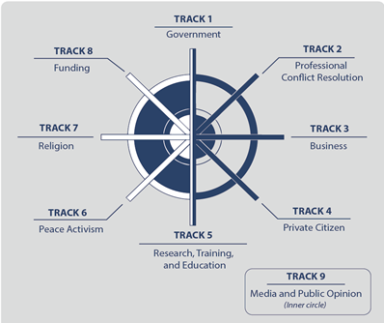
Tracks of Diplomacy: Bringing NSAs into state craft – Con Resolution and international cooperation through negotiations

Slide 17
Pakistan’s FP Objectives
Promotion of Pakistan as a dynamic, progressive, moderate, and democratic Islamic country.
Friendly relations with all/especially major powers, & immediate neighbors.
Safeguarding national security & geostrategic interests, including Kashmir. (FP starts at home)

Slide 18
4. Consolidating commercial & economic cooperation with int. community.
5. Safeguarding the interests of Pakistanis abroad.
6. Ensuring optimal utilization of national resources for regional & int. cooperation.

Slide 19
Pak’s National Interests
Territorial integrity and security (India, Afghanistan)
Counter terrorism and Internal stability
Development and Prosperity (Human, Eco, infra, energy security)
Political stability (demo and good gov)
Identity and cultural values (cultu and relig harmony)
Access to resources (water, energy, climate security)
Tech advancement (cyber and innovation)

Slide 20
Challenges to the Sovereignty
India
Cross Border terrorism (Afghan)
Terrorism and Extremism
Insurgency and Separatism
Economic Dependence
Political instability
Climate vulnerability
State (Hard)
Non-State (Soft)

Slide 21
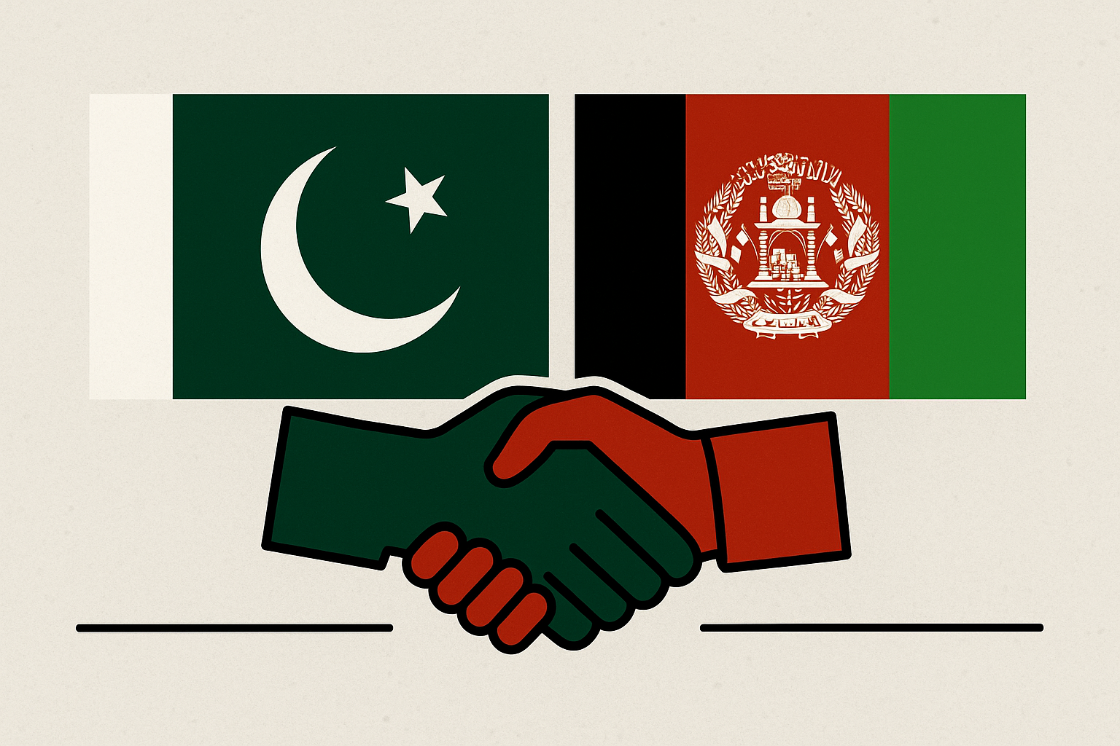
Pak-Afghan Relations

Slide 22
Afghanistan in the Cold War Theater
Cold War geopolitics, Soviets into Afghanistan1979,
‘Jihad against godless’ – fusion of religion and geopolitics.
Pakistan, US, and ME monarchies – an axis of believers.
Geneva Accord 1988,
Rise of Taliban (Appeal? .. Promise?),
Al-Qaeda Enters Afghan Theater
9/11, Operation Enduring Freedom, and toppling of Taliban govt,
Bonn Conference 2001, Karzai govt, US/NATO in Afghanistan till 2021.
Doha Process 2018 - 2021
Return of Taliban in Aug 2021.

Slide 23
Pak-Afghan Relations

Slide 24
Pak-Afghan relations
Both share more than 2600 KMs border - Durand Line.
Afghanistan - always maintained a hostile posture/attitude towards Pakistan.
Despite common culture, ethnicity, faith, history & geo-political dilemmas, relations have been troublesome. WHY?
Primarily because of ‘Durand Line’ issue.
Afghanistan opposed Pakistan’s entry into UNO.
July 26, 1949 – terminated all agreements with British including ‘Durand Agreement’

Slide 25
Pak-Afghan Relations:
Initial Phase: 1947 to 1979 (Afghan assertion and Pakistan’s Defensive behavior)
2nd Phase: 1979 to 1989 (Soviets in Afghanistan, Pakistan diplomatic, Economic, and Security support to liberate Afghanistan)
3rd Phase: 1989 to 1994 (Civil War, Pakistan’s diplomatic efforts for the peace & stability in Afghanistan)
4th Phase: 1996 to 2001 (Pak accords diplomatic recognition, economic and military support – religion for national security & strategic interests)
5th Phase: 2001 to 2021 (WoT, Strategic Shift, multilateral relations between Pak-Afghanistan)
Latest Phase 2021 till date (Afghanistan under Taliban 2.O, From optimism to gloom)

Slide 26
Latest Phase: Afghanistan under Taliban 2.O
Optimism – India factor
Desperation – betrayal and broken promises.
Commonalities:
  Stability and economy
Differences:
  Terrorism (TTP and BLA attacks rose to 28% in 2022, 79% in 2023, and 70% in 2024 – PIPS report).
  Border management
  Refugees.

Slide 27
Pak-Afghan: complicating factors
Turbulent/subjective history (ontologically historical)
Cross-border Terrorism and sovereignty.
Border closures/Diplomatic strains.
Regional competition (Indian question).
Recognition.
Refugees (Pak should not spoil its goodwill)
Lack of Shared economic vision.

Slide 28
Solution!
Forget, learn, and move into the future.
Track I & II dialogue – religious diplomacy.
Political Recognition (conditional)
Pakistan should engage Afghanistan multilaterally – based on ground realities.
Engaging friends (guarantors) – China, KSA, Turkey, etc.
Refugee and border management.
Intelligence sharing for counter-terrorism.
Connectivity and shared economic vision.

Slide 29
Questions to Attempt
Given Pakistan's growing concerns over TTP-led terrorism originating from Afghanistan, what diplomatic and strategic steps can be taken to prevent Afghanistan from serving as a sanctuary for anti-Pakistan elements?
How have shifting U.S. priorities in the region, particularly after its withdrawal from Afghanistan, influenced Pakistan’s approach towards the Afghan Taliban and regional stability?
Given Pakistan’s recent policies on Afghan refugees, including deportations, what are the humanitarian, security, and diplomatic implications for bilateral relations between the two countries?
With Pakistan increasingly concerned about cross-border militant activities, what diplomatic or strategic measures could be taken to ensure Afghanistan does not become a safe haven for anti-Pakistan elements?

