Slide 1
pesticide

Slide 2
What is a pesticide?
Any toxic substance that is used to kill animals, insects, plants or weeds that cause economic damage to crops, ornamental plants or are hazardous to the health of domestic animals and humans

Slide 3
How does a pesticide work ?
Pesticides enter the living cells and interfere with normal metabolism thereby killing the living thing

Slide 4
Classification type 1
Classification is on the basis of target pest:
Herbicides
Insecticides
Insect Growth Regulator
Nematicides
Rodenticides
Arachinides
Fungicides
Disinfectants

Slide 5
Pesticide classification type 11
ORGANIC PESTICIDES
INORGANIC PESTICIDES
The contain carbon in their molecular structure
They do not readily dissolve in water
Organic pesticides which occur natural include Pyrethrum & Rotenone
Inorganic pesticides do not contain carbon and are usually derived from mineral ores extracted from the earth
They readily dissolve in water
Used since ancient times, exempli gratia, Lime & Sulpher

Slide 6
uses
For crops
For Livestock
For Humans (control of diseases like malaria, dengue, yellow fever etc.)
Other usage ( Tree protection, Furniture protection and wooden structure preservation etc.)

Slide 7
Impacts of pesticides
IMPACTS ON HEALTH
Accidental poisoning
Suicidal poisoning ( gandam ki golyaan also known as organo-phosphorous tablets)
Skin irritation, eye irritation, promotes abortion and cancers
Chlorinated hydrocarbons get accumulated in fats and are not excreted
Impacts on water bodies
Pesticides reach water bodies in four ways
A) Percolates B) Leaches C) Field run off D) Deliberate dumping and polluting of water bodies

Slide 8
CONTINUED…
IMPACTS ON WATER BODIES
Pesticides reach water bodies in four ways:
A) They percolate
B) They leache
C) Through field run off
D) Deliberate dumping and polluting of water bodies
Chlorinated Hydrocarbon get accumulated in the aquatic marine bodies

Slide 9
CONTINUED…
AIR POLLUTION :
The industries producing Pesticides produce/emit greenhouse gases adding to pollution and global warming
Over 95-98% of the sprayed pesticides reach a destination other than target species when suspended particles are taken away by the wind. This has led to a sharp decline in the global insect population

Slide 10
CONTINUED…
SOIL POLLUTION:
The waste from pesticide producing industries is dumped in convenient landfills
The dumped by products contain pollutants resistant to degradation by chemical, biological and photolytic processes
Persistent use of pesticides reduce the biodiversity in field soil

Slide 11
Continued…
IMPACTS ON ECOLOGICAL SYSTEM
Pesticides also kill useful insects e.g Bees
Reduces pollination
Destroys habitats
May kill non target birds
May kill already endangered species
Reduces biodiversity

Slide 12
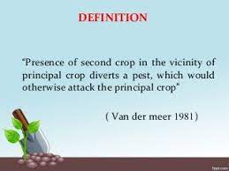
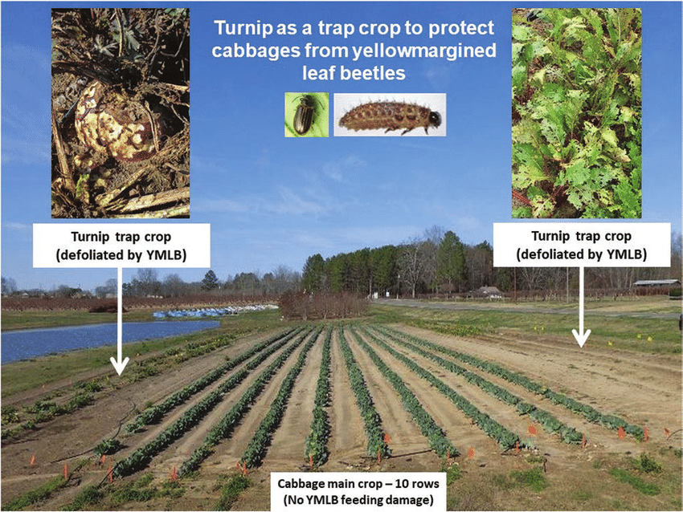
How to prevent pesticide pollution?
TRAP CROP CULTIVATION

Slide 13
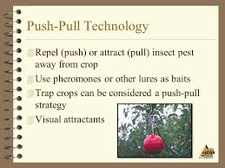
Continued…
Trap crops are also considered a “Push & pull” strategy

Slide 14
Continued…
Use of biodegradable pesticides
Use of selective pesticides
Preventing the erosion from field and water run off from fields treated with pesticides
Pesticide manufacturing and selling Businesses/ factories can reduce pesticide pollution by managing and reducing their emissions into air and water.

Slide 15
THANK YOU!

