Slide 1
CYCLONES

Slide 2
cyclone & anticyclones
CYCLONES
ANTI CYCLONES
A cyclone is a weather system with a low atmospheric pressure at its center, around which air circulates in a counterclockwise (Northern Hemisphere) and clockwise (Southern Hemisphere) as viewed from above
Cyclones are usually accompanied by violent storms and bad weather
An anti-cyclone is a weather system with a high barometric pressure at its center, around which air slowly circulates in a clockwise (northern hemisphere) or anticlockwise (southern hemisphere) direction
Anticyclones are associated with calm, fine weather

Slide 3
Random fact check!
Cyclones rotate counterclockwise in the Northern Hemisphere and clockwise in the Southern Hemisphere due to coriolis effect
The center of a cyclone is called an eye
Cyclones can be of two types: Tropical and Extra tropical cyclones
Extra tropical cyclone are also known as mid latitude cyclones , hurricanes, typhoon and baroclinic storm etc.

Slide 4
Types of cyclones
TROPICAL CYCLONES
EXTRA TROPICAL CYCLONES
Doesn’t have a clear frontal system
Originate over the seas and dissipate upon reaching the land
Much more destructive
Moves from east to west
Has a clear frontal system
Covers a very large area and can happen over both, the land and sea
It is also destructive, but still less than tropical cyclones
Moves from west to east
Extra tropical cyclone are also known as mid latitude cyclones , hurricanes, typhoon and baroclinic storm etc.

Slide 5
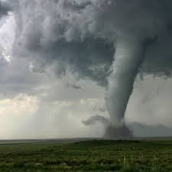
Tornado
A tornado is a violently rotating column of air that is in contact with both the surface of the Earth and a cloud containing rotating debris and dust beneath it
It is often referred to as a twister, whirlwind
The most extreme tornadoes can attain wind speeds of more than 480 kilometers per hour and can span more than 3 kilometers in diameter
Various types of tornadoes include the multiple-vortex tornado, landspout, and waterspout

Slide 6
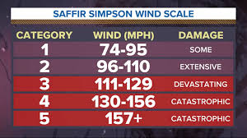
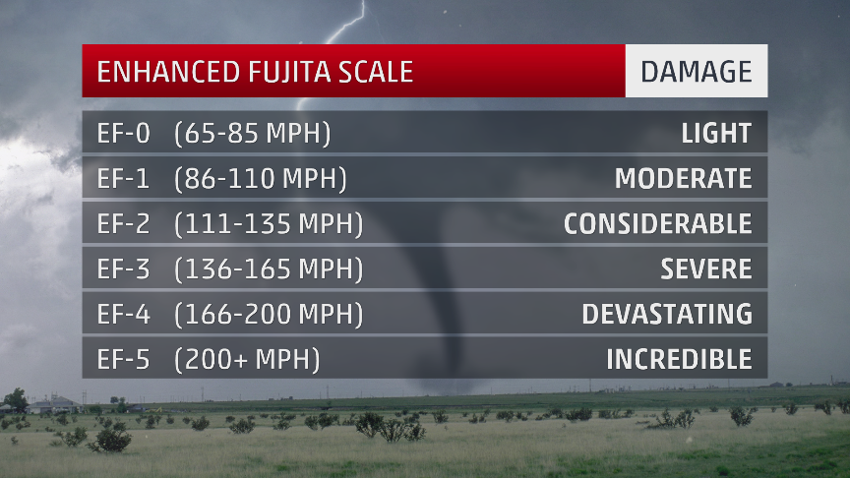
classification
SAFFIR SIMPSON FOR CYCLONES
FUJITA SCALE FOR TORNADO

Slide 7
prediction & warning systems
Prediction
Warning System
Yes
Tropical cyclones can follow erratic paths and predicting their movement is complicated however still possible
Yes
Once forecasters have determined that a tropical cyclone is likely to make landfall, warnings are issued for the areas that may be affected

Slide 8
Well, thankyou!

