Slide 1
Section 6
Public Administration & Governance in Islam
Concept of Public Administration
Concept of Islamic Public Administration
The System of Islamic Public Administration
Governance Under Pious Caliphate
Responsibilities of Civil Servants
Sources of Islamic Law
System of Accountability in Islam
Letter of Ali R.A. to Malik Al-Ashtar, Governor of Egypt

Slide 2
Past Paper Questions
Highlight the concept of Public Administration in Islam. Explain the responsibilities of Civil Servants. (2016)
Highlight the responsibilities of civil servants in the light of Islamic teachings. (2018)
Express the principles of accountability of rulers according to the Holy Quran and Sunnah (2021)
How can the system of accountability in Pakistan be idealized in the teachings of the Holy Prophet? Explain. (2024)

Slide 3
Concept of Public Administration
Implementation of government policies
An academic discipline that prepares public servants for public offices
Woodrow Wilson, the father of public administration defined it as; “a detailed and systematic execution of public law.”
He divided government institutions into two separate sectors; administration and politics.
Motive is to manage government policies so that the government can function efficiently

Slide 4
The Concept of Islamic Public Administration
The Arabic word used for administration is تدبير
“He manages all affairs.” يدبر الامر (Ar-Ra’d – 2)
“He regulates all affairs from the heavens, to the earth” يدبر الامر من السماء الي الارض (As-Sajdah – 5)
Dr. Muhammad Abdullah Al‐Buraey defines Islamic administration in his book; “Administrative Development: An Islamic Perspective”, as:
“Islamic public administration is a system that is universal, holistic, and it is based on Tauheed.”
He also adds that it is a mission given to mankind, and is not a choice.
And that it fulfills the demands of two sectors
The demands of human beings
The demands of Allah SWT

Slide 5
A well-cooperated and well integrated system
And does not neglect the aspects of spirituality, i.e. (reliance on the Almighty Allah SWT (tawakkul)
Crux of the matter – administering the public affairs along with relying on Allah SWT.
7 Elements of Public Administration as mentioned by Dr. Abdullah
Intention
Planning
Organizing
Implementing
Monitoring
Controlling
Evaluating

Slide 6
Governance
The act of governing
Formulating policies
Legislating
According to United Nations, Good Governance has 8 characteristics;
Participatory
Consensus Oriented
Accountable
Transparent
Responsive
Effective & Efficient
Equitable
Inclusive

Slide 7
Islamic Public Administration
Fundamentals
The Concept of ‘Amaanah’
“We offered the Trust to the heavens, and the earth, and the mountains; but they refused to bear it, and were apprehensive of it; but the human being accepted it. He was unfair and ignorant.” (Al-Ahzab - 72)
Amaanah in the above verse refers to ‘free will’.
It is actually a trust of Allah SWT on us. It makes our lives meaningful that we are serving our Creator and doing what He commands us to.
The magnitude of Amaanah differs with difference in the social status of people.
Allah SWT tests everyone according to their magnitude of Amaanah
The public administrators and civil servants must realize that after assuming office, their magnitude of Amaanah is not the same as of an ordinary citizen.
They must understand that now, they will not just be accountable and answerable for their own selves but they will also be answerable for the jurisdictions they serve.

Slide 8
2. Khilaafat
Effective and Efficient Public administration or good governance depends upon good leadership
When Allah SWT said that He is placing a successor (khalifah) on earth, (Al-Baqarah - 30), He sent Adam A.S. who is a Prophet
Whenever Allah SWT directly sent His vicegerent, he only sent Prophets who are best of the best
This shows that only good leadership can result in good governance

Slide 9
Features of Islamic Public Administration
Administration by Consultation
“and consult them in the conduct of affairs.” (Aal e Imran - 159)
“And those who respond to their Lord, and pray regularly, and conduct their affairs by mutual consultation, and give of what We have provided them.” (Ash-Shura - 38)
Ensuring Justice
“O you who believe! Be upright to God, witnessing with justice; and let not the hatred of a certain people prevent you from acting justly. Adhere to justice, for that is nearer to piety; and fear God. God is informed of what you do.” (Al-Maidah - 8)
“O you who believe! Stand firmly for justice, as witnesses to God, even if against yourselves, or your parents, or your relatives. Whether one is rich or poor, God takes care of both.” (An-Nisa - 135)
“But if you judge, judge between them equitably. God loves the equitable.” (An-Nisa - 42)

Slide 10
Establishing Rule of Law
“O people, those who have gone before you were destroyed, because if any one of high rank committed theft amongst them, they spared him; and it anyone of low rank committed theft, they inflicted the prescribed punishment upon him. By Allah, if Fatima, daughter of Muhammad, were to steal, I would have her hand cut off.” (Muslim - 1688)
Ensuring Accountability
Each of you is a shepherd and each of you is responsible for his flock. The ruler who is over the people is a shepherd and is responsible for his flock; a man is a shepherd in charge of the inhabitants of his household and he is responsible for his flock; a woman is a shepherdess in charge of her husband's house and children, and she is responsible for them; and a man's slave is a shepherd in charge of his master's property, and he is responsible for it. So, each of you is a shepherd and each of you is responsible for his flock. (Abu Dawood - 2928)
Maintaining Transparency
A man came to the Prophet SAW, and said, “O Messenger of Allah, instruct me.” The Prophet said, “Worship Allah and associate none with Him, perform the prayer, give charity, fast the month of Ramadan, and perform the two pilgrimages. Listen to and obey your leaders. You must be transparent and beware of secrecy.” (As-Sunnah - 1070)

Slide 11
Promotion of Welfare
“You are the best community that ever emerged for humanity: you advocate what is moral, and forbid what is immoral, and believe in God.” (Aal e Imran - 110)
“Whoever amongst you sees an evil, he must change it with his hand; if he is unable to do so, then with his tongue; and if he is unable to do so, then with his heart; and that is the weakest form of Faith.” (Nasaai - 5008)
Meritocracy/Right People for the Job
Compilation of Quran headed by Zaid bin Thabit R.A
The commanders appointed were always those who had expertise in military expeditions, even if they accepted Islam late, such as Khalid bin Waleed and Amar bin Aas R.A
Usama bin Zaid R.A was appointed a commander of an extremely important battle even though he was just 18 years old, and the army consisted of many senior companions such as Abubakar & Umar R.A.
Equality of All Citizens
Ensuring that there is no discrimination on any basis whatsoever
All are equal in the sight of Allah SWT and there is no justification of favoring one over the other
Even a Muslim will not be favored over a non-Muslim

Slide 12
The Pious Caliphate
Caliph | Name | Duration
1st | Abubakar R.A. | 632 - 634 (2.5 years)
2nd | Umar R.A. | 634 - 644 (10 years)
3rd | Usman R.A. | 644 - 656 (12 years)
4th | Ali R.A. | 656 - 662 (5.5 years)
Total Duration of the Pious Caliphate - 30 years
Why is it known as the Rightly-Guided or Pious Caliphate?
Because it was a form of government that was closest to the system brought by the Prophet SAW. It was purely based on the principles set by the Prophet SAW and the principles laid down by Allah SWT in the Quran

Slide 13
Governance Under Pious Caliphate
The Concept of Caliph
Head of the state & Central Authority (responsible for everything)
Process of Selection (discussed in Section 7 - Political System of Islam)
The Institution of Council
Masjid; a gathering place
On need basis; when to gather, whom to gather
Process of decision making - People had full right to give their suggestions, but the caliph had discretionary powers to issue orders. But the Caliph is instructed to always consult before making any decision

Slide 14
A Strong Centralized System With Multiple Departments
The caliph had all the powers, but there were multiple departments for smooth administration
  Diwaan ul Kharaaj - treasury
  Diwaan ul Jund – military
  Diwaan ul Khatm – letters, correspondence
  Diwaan ul Bareed – post office, also served intelligence services
  Diwaan ur Rasaail – Writing letters
  Diwaan ul Mazaalim – Ombudsman
Establishment of Provinces & Districts
During the time of Umar R.A.
Arabian peninsula divided into Makkah & Madinah (administratively)
Iraq divided into Basra & Kufa

Slide 15
Persia divided into Khurasaan, Azerbaijan & Faris
Then Usman R.A. divided the Islamic state into 12 provinces; Makkah, Madinah, Yemen, Kufa, Basra, Syria, Egypt, North Africa, Jazeera, Faris, Azerbaijan & Khurasaan.
These provinces stayed during the time of Ali R.A. as well
Officials of Provinces
Waali - Governor/Head - Qazi - Judge
Katib - Chief Secretary
Katib ud Dewaan - Military Secretary
Sahib ul Kharaaj - Revenue/Zakat Collector
Sahib ul Ahdaath - Police Chief
Sahib Bait ul Maal - Income & Expenditure/Treasury
‘Amil - District Officer/Administrator

Slide 16
Judicial Administration
Completely independent from the Executive branch
Men of status or wealthy men were prioritized to become Qazis so that they do not come under any pressure
Police Administration (Ash-Shurta)
Concept given by the Prophet SAW (Muhammad bin Maslamah R.A. – the first official police officer of Madinah
Established by Umar R.A. after the expansion of the Islamic state
System of Jails/Prisons in every province or district
Set up one himself in Madinah, Ali R.A. set up in Kufa, Mu’awiyah R.A. set up in Damascus (Syria)

Slide 17
Bait ul Maal
All the sources of government revenue were collected in Bait ul Maal
Were spent accordingly
Sources of Revenue;
Zakat
Sadaqaat (Voluntary donations)
Ghanimah (Spoils of war)
Jizya (Tax on every adult male non-Muslim living under Islamic rule)
Ushr (Zakat on land’s produce)
Kharaaj – tax on lands to be given by non-Muslims
Postal Offices
Concept given and established by Umar R.A
Highly efficient for communication & coordination between state officials
Ensured speedy communication

Slide 18
Town Planning
The need for this arose when the Prophet SAW migrated to Madinah and its population started to increase at a gradual and steady pace.
Houses were made in a certain manner and discipline
Instructions on the width of streets (should accommodate two-way traffic)
Instructions on the distance between houses
The Prophet SAW discouraged the construction of big buildings in order to accommodate everyone and to maintain a certain level of equality
The Importance of Census
The Prophet SAW conducted a census of Madinah’s Muslim population as soon as he migrated to it
The first ever census was the census of the adult Muslim male population
This was carried out to find out the number of soldiers as Jihaad was to be obligated soon

Slide 19
Responsibilities of Civil Servants
Joining the Service with a Clean Intention
“The reward of deeds depends upon the intentions and every person will get the reward according to what he has intended.” (Bukhari - 1)
Ensure Justice
Ensure Rule of Law
Ensure Transparency
Abstaining from Nepotism, Favoritism etc.
Engage in Promoting Welfare
Being Easily Accessible
Ensure Accountability of Themselves & Others
Abstaining from Discrimination
Upholding Islamic Values as much as Possible

Slide 20
System of Accountability in Islam
The Importance of Accountability in Islam
Belief in the Life Hereafter and the Belief in the Day of Judgment are two of the core beliefs of the Muslim faith
Muslims firmly believe that Allah SWT will gather them on the Day of Judgment, and everyone will be held accountable for their deeds
And after the judgment has been done, they will be either rewarded or punished in the Life Hereafter
What can be Derived from the Above?
The fact that there is a life after this one and everyone will be held accountable for what they did in this life is sufficient evidence on the importance of accountability in Islam.
Even if accountability is not ensured in this life, Allah SWT will ensure it on the Day of Judgment and in the Life Hereafter
Therefore, it is only sensible for those entrusted with the responsibility of maintaining accountability, to ensure it to the best of their abilities to avoid embarrassment in th enext life

Slide 21
System of Accountability in Islam
Accountability in the Next Life
Only 1 Judge; Allah SWT
No one will be dealt unfairly.
Everyone will be held accountable, and justice will prevail
We set up the scales of justice for the Day of Judgment, so no soul will be wronged in the least. And (even) if a deed is the weight of a mustard seed, We will bring it forth. And sufficient are We as a (vigilant) Reckoner. (Al-Anbiyaa - 47)
“Then for the one who had rebelled and preferred the worldly life (to the Hereafter), Hell will be the abode. Whereas for the one who feared to stand before his Lord, and restrained his self from the evil, Paradise will be the abode.” (An-Nazi’at: 37 - 41)
“The as for him whose scales (of good deeds) are heavy, he will be in a happy life. But he whose scales are light, his abode will be Abyss. And what may you know what Abyss is. A blazing Fire!” (Al-Qari’ah: 6 - 11)
So whoever does an atom’s weight of good will see it. So whoever does an atom’s weight of good will see it. (Az-ZilZaal: 7 - 8)

Slide 22
System of Accountability in Islam
Accountability in this World
Allah has delegated this task to humans as they are His vicegerents.
“(Remember) when your Lord said to the angels, “I am going to place a successive (human) authority on earth.” (Al-Baqarah - 30)
The following hadith provides a basis for ensuring accountability
“Every one of you is a shepherd and is responsible for his flock. The leader of people is a guardian and is responsible for his subjects. A man is the guardian of his family, and he is responsible for them. A woman is the guardian of her husband’s home and his children, and she is responsible for them. The servant of a man is a guardian of the property of his master, and he is responsible for it. No doubt, every one of you is a shepherd and is responsible for his flock.” (Abu Dawood - 2928)
The concept of ensuring accountability in this world is sufficiently explained in the hadith above
If a simple man (with no position) is guardian of his family and will be held responsible, in the same manner, officials who hold such positions are most definitely responsible for their jurisdictions.
According to Islam, no one will be spared from this.

Slide 23
System of Accountability in Islam
Accountability During the Time of the Prophet SAW & His Caliphs
Proper System of Judiciary & Accountability
The Prophet SAW appointed judges in different areas
Umar R.A. was the appointed judge at Madinah
Ali & Ma’az R.A. were sent to different areas of Yemen
The Department of Accountability (Hisbah)
Established during the time of the Caliphs for the accountability of the public
The motive was naturally to ensure that people are held accountable for their responsibilities

Slide 24
System of Accountability in Islam
Accountability During the Time of the Prophet SAW & His Caliphs
The Department of Ombudsman
Established for the accountability of public office bearers
Known as ‘Deewan e Mazalim’
Even the Caliphs allowed the people to hold them accountable when required
Abubakar’s R.A. first address after assuming Caliphate
“O people, I have been appointed over you, though I am not the best among you. If I do well, then help me; and if I act wrongly, then correct me. Truthfulness is synonymous with fulfilling the trust, and lying is equivalent to treachery. The weak among you is deemed strong by me, until I return to them that which is rightfully theirs, in sha Allah. And the strong among you is deemed weak by me, until I take from them what is rightfully (someone else’s), in sha Allah.”
How Umar R.A. held Saeed bin Amir (Governor of Hims) Accountable

Slide 25
System of Accountability in Islam
When the meeting was convened, Umar asked what complaints they had against him.
"He only comes out to us when the sun is already high," they said.
"What do you have to say to that, Said?" asked Umar.
Said was silent for a moment, then said, "By God, I really didn't want to say this but there seems to be no way out. My family does not have a house help, so I get up every morning and prepare dough for bread. I wait a little until it rises and then bake for them. I then make wudu and go out to the people."
"What's your other complaint?" asked Umar.
"He does not answer anyone at night," they said.
To this Said reluctantly said, "By God, I really wouldn't have liked to disclose this also. but I have left the day for them and the night for God, Great and Sublime is He."
"And what's your other complaint about him?" asked Umar.
"He does not come out to us from one day in every month," they said.
To this Said replied, "I do not have a home help, O Amir al-Mumineen and I do not have any clothes except what's on me. This, I wash once a month, and I wait for it to dry. Then I go out in the later part of the day."
"Any other complaint about him?" asked Umar.
"From time to time, he blacks out in meetings," they said.
To this Said replied, "I witnessed the killing of Khubayb ibn Adiy when I was a mushrik. I saw the Quraysh cutting him and saying, "Would you like Muhammad to be in your place?" to which Khubayb replied, "I would not wish to be safe and secure among my family while a thorn hurts Muhammad." By God, whenever I remember that day and how I failed to come to his aid, I only think that God would not forgive me, and I black out."

Slide 26
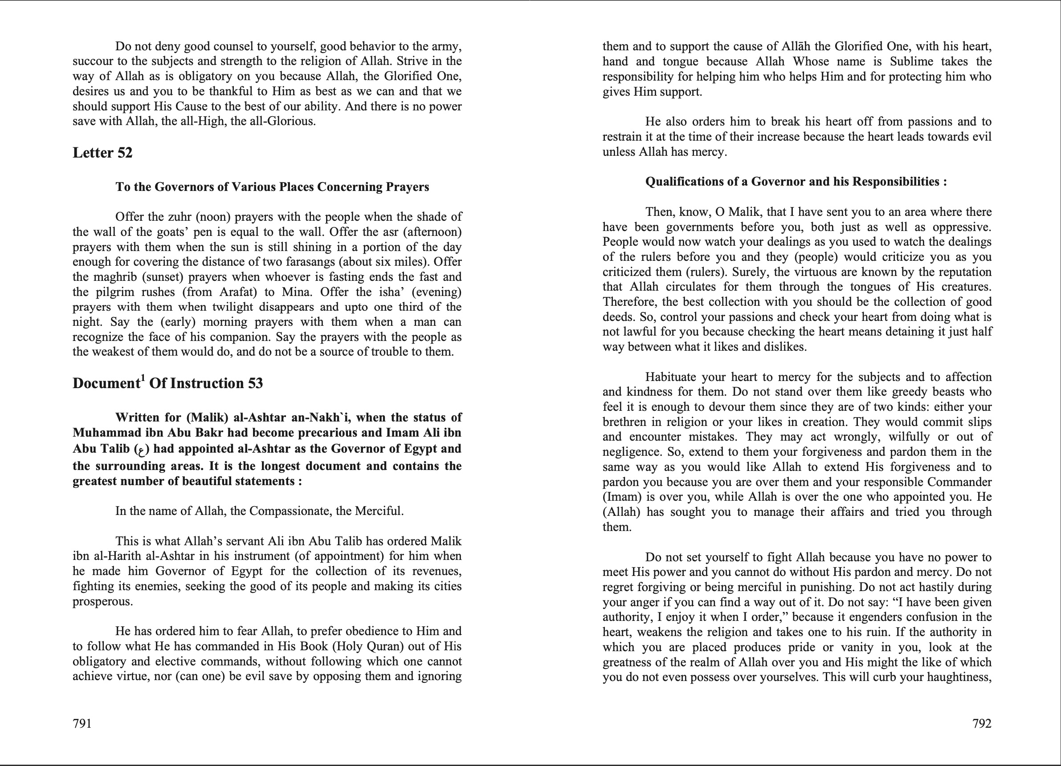
Letters of Ali R.A. to Malik Al-Ashtar

Slide 27
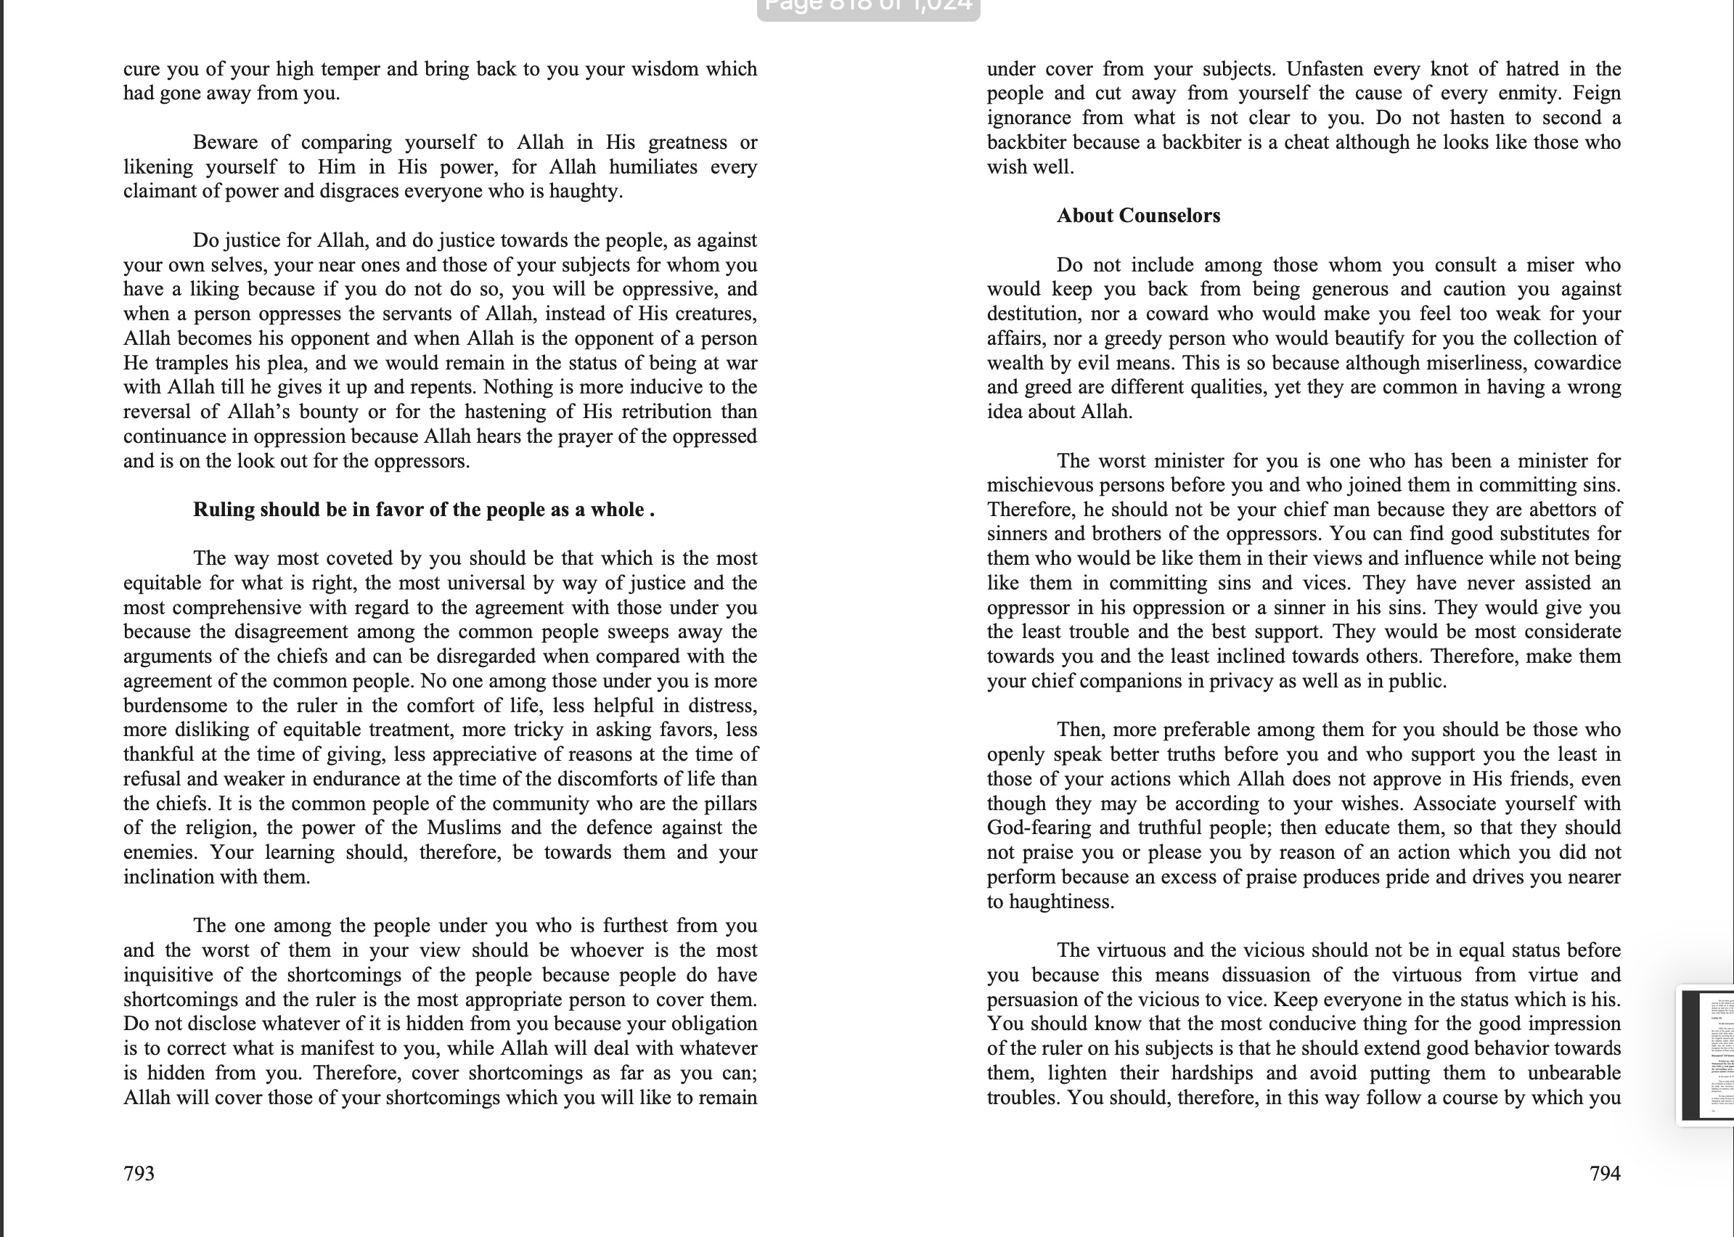
Letters of Ali R.A. to Malik Al-Ashtar

Slide 28
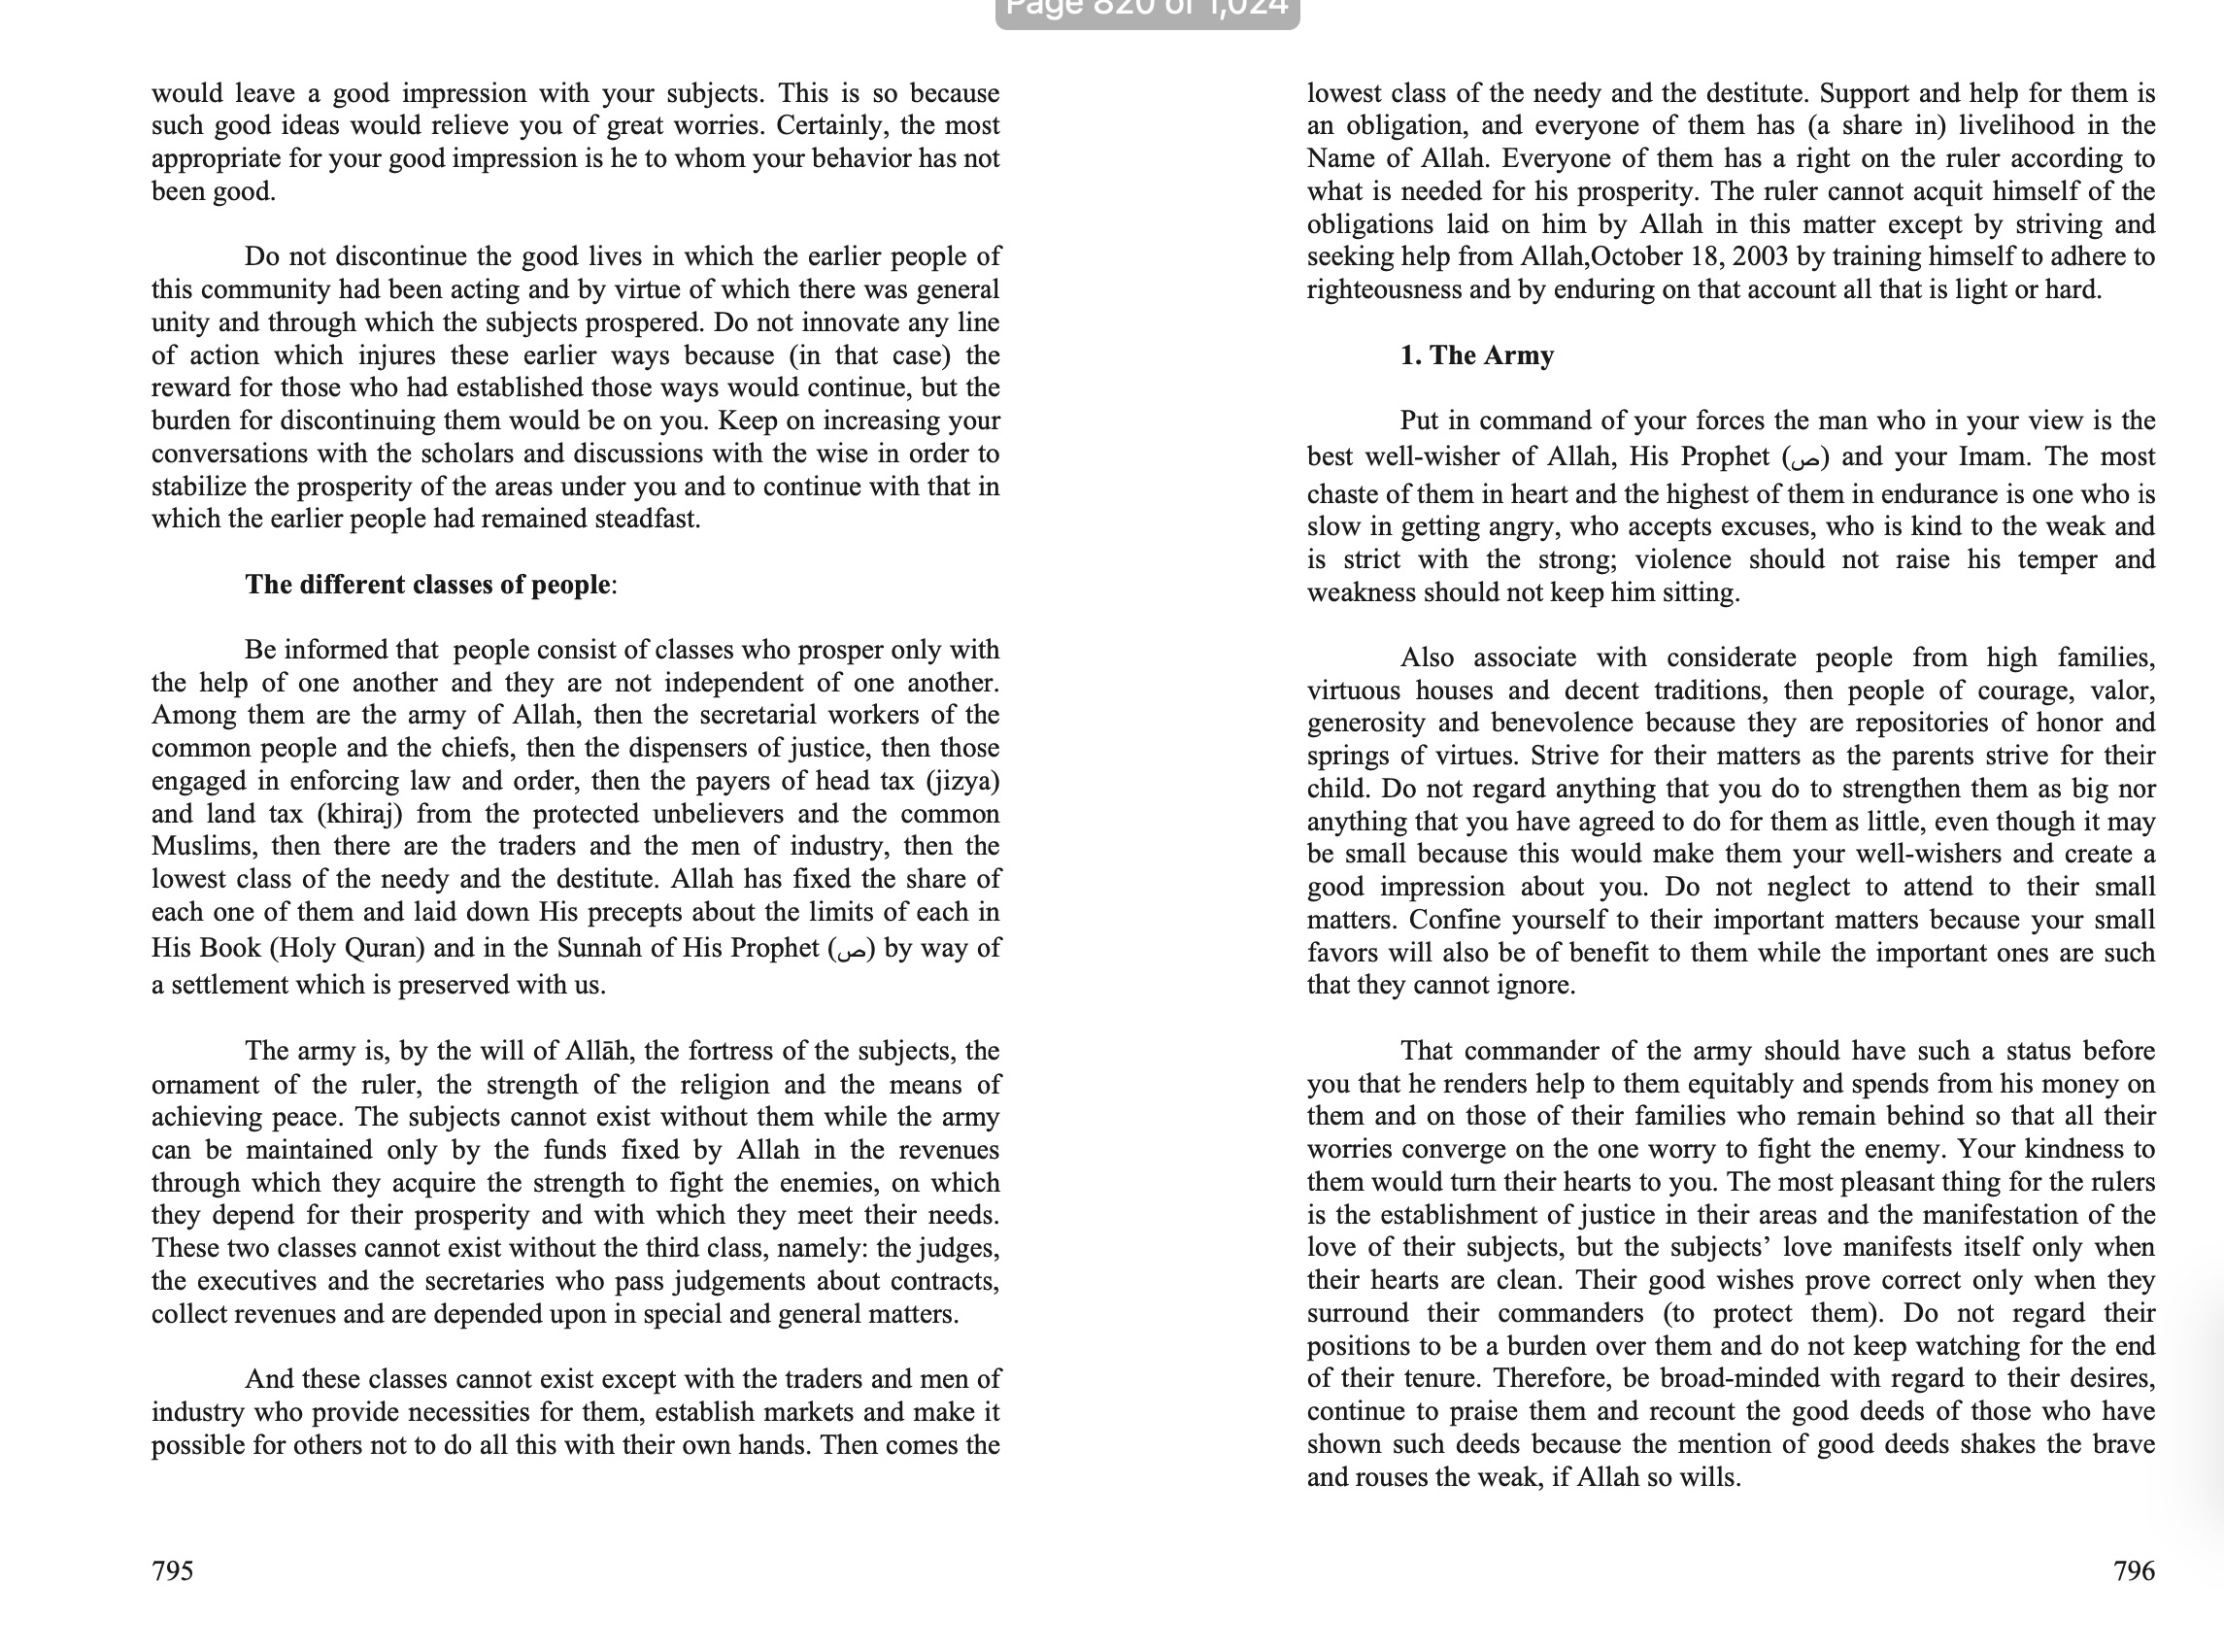
Letters of Ali R.A. to Malik Al-Ashtar

Slide 29
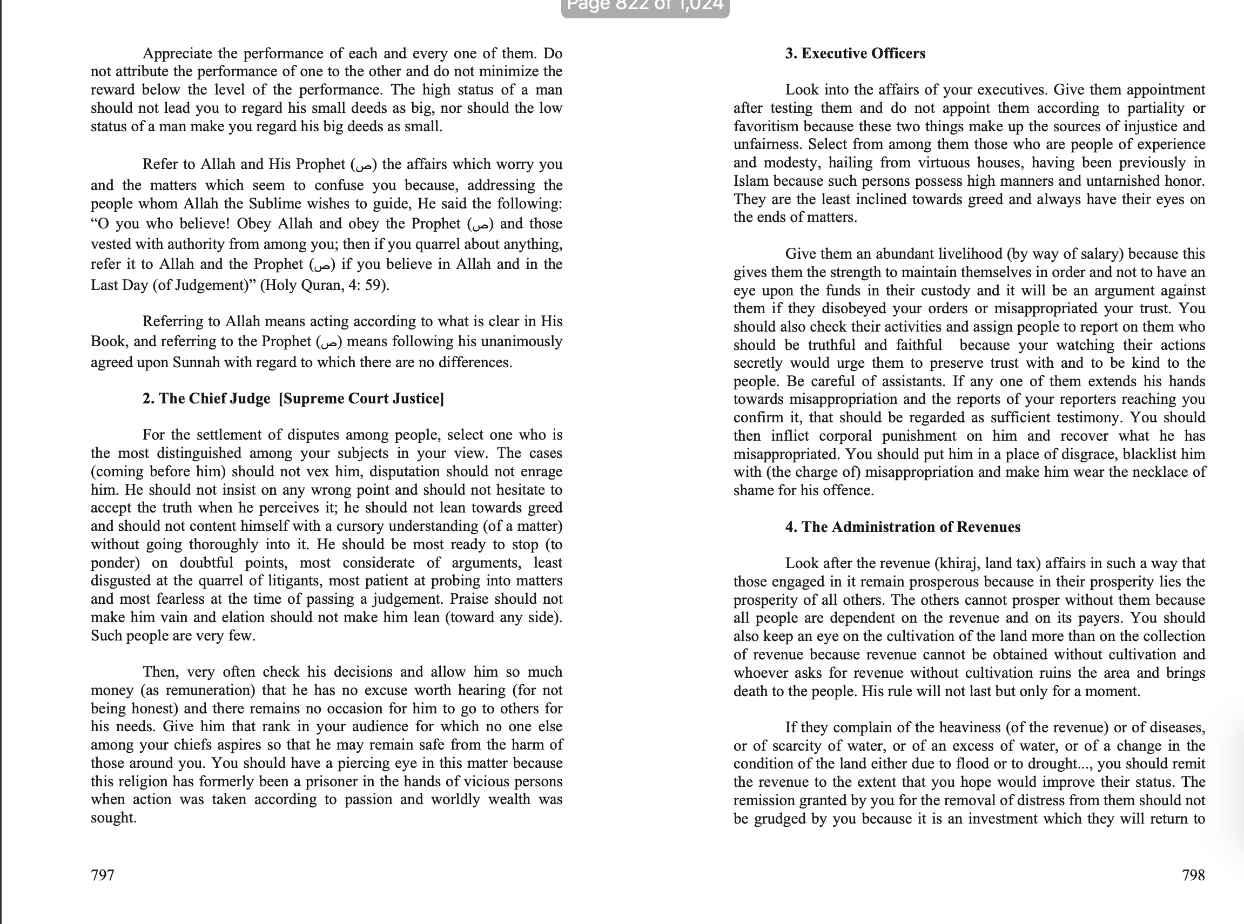
Letters of Ali R.A. to Malik Al-Ashtar

Slide 30
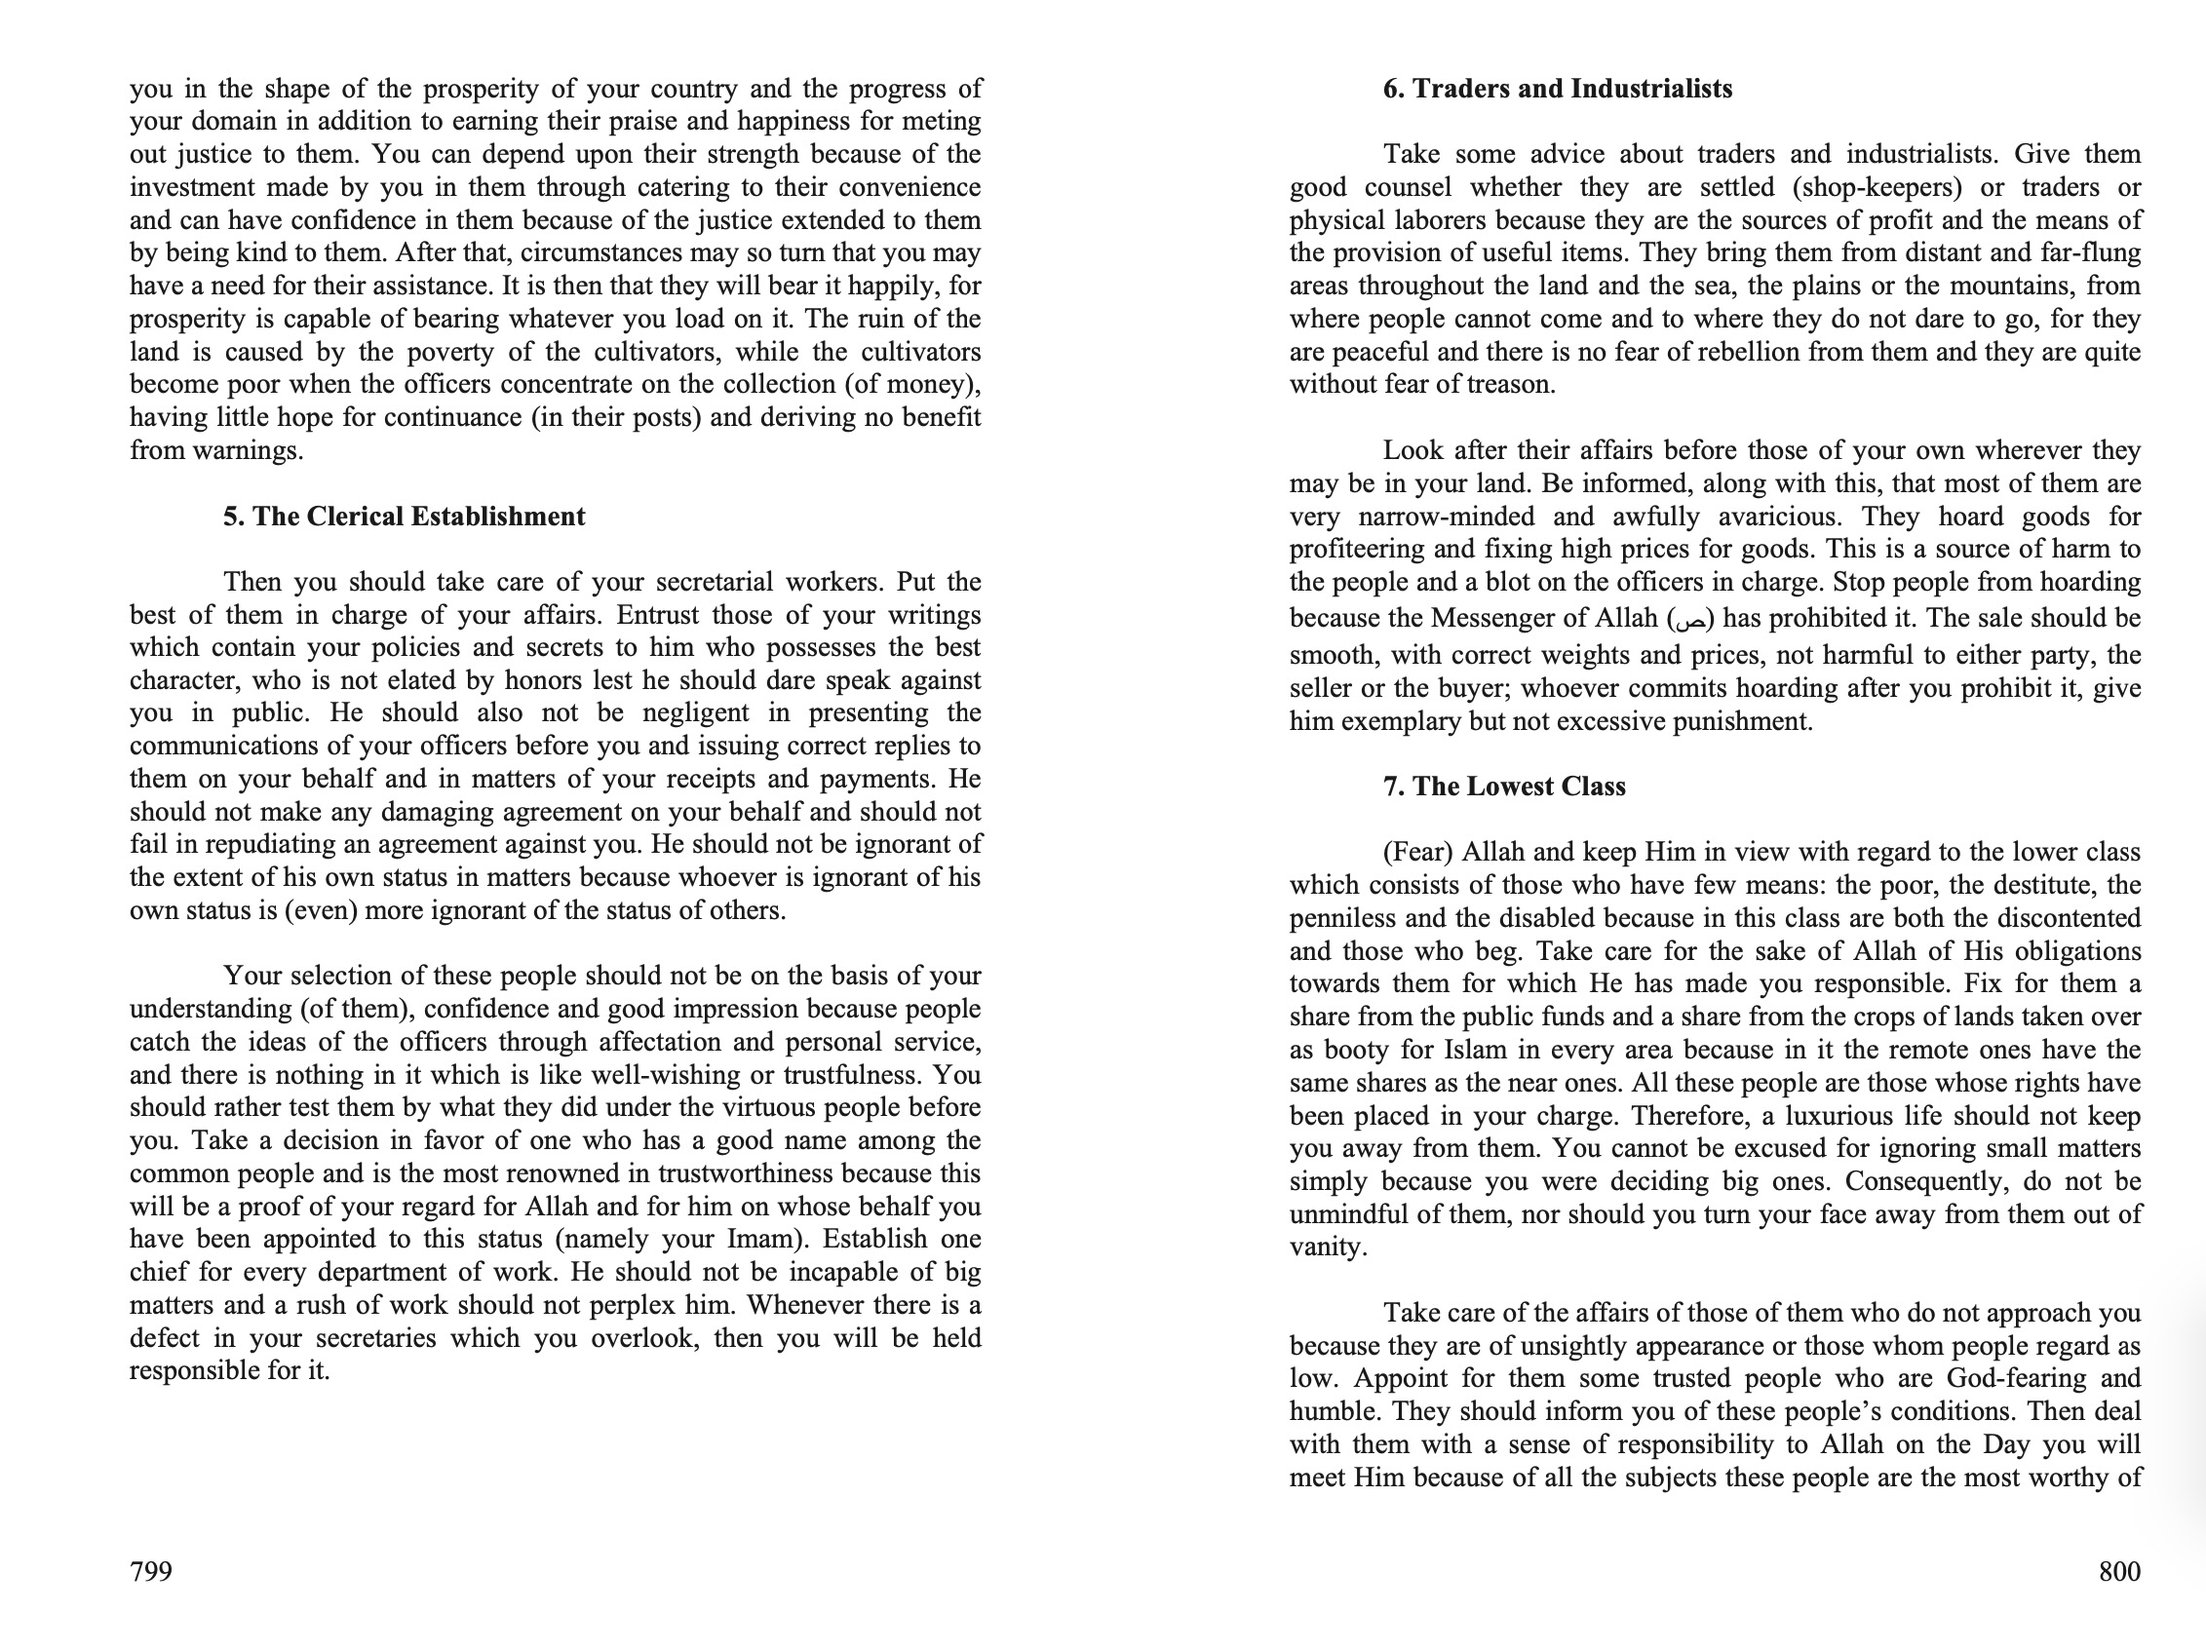
Letters of Ali R.A. to Malik Al-Ashtar

Slide 31
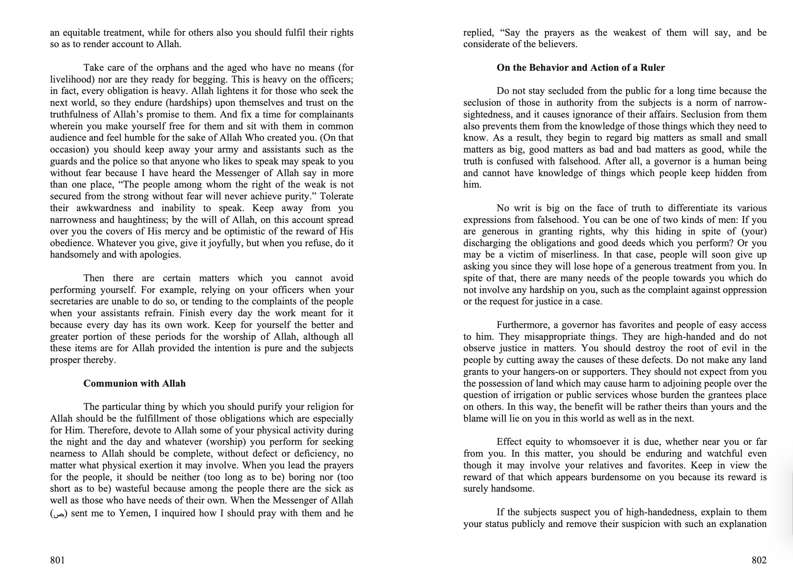
Letters of Ali R.A. to Malik Al-Ashtar

Slide 32
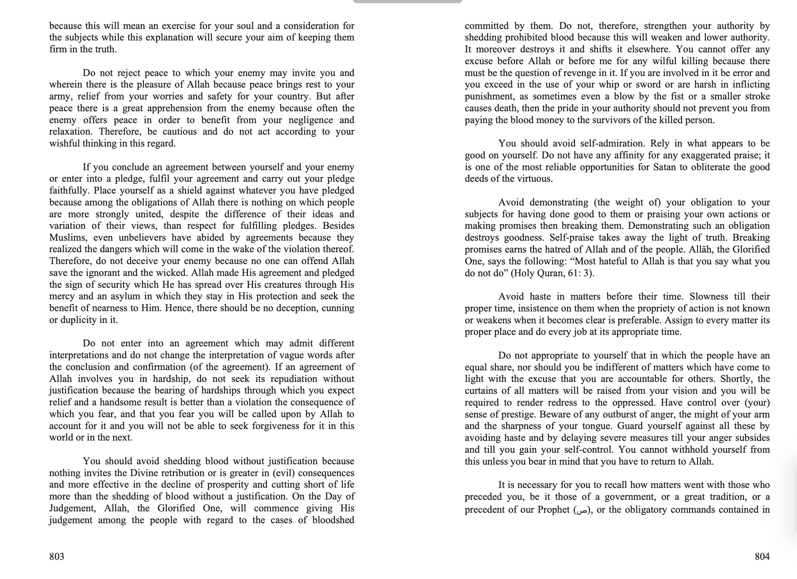
Letters of Ali R.A. to Malik Al-Ashtar

Slide 33
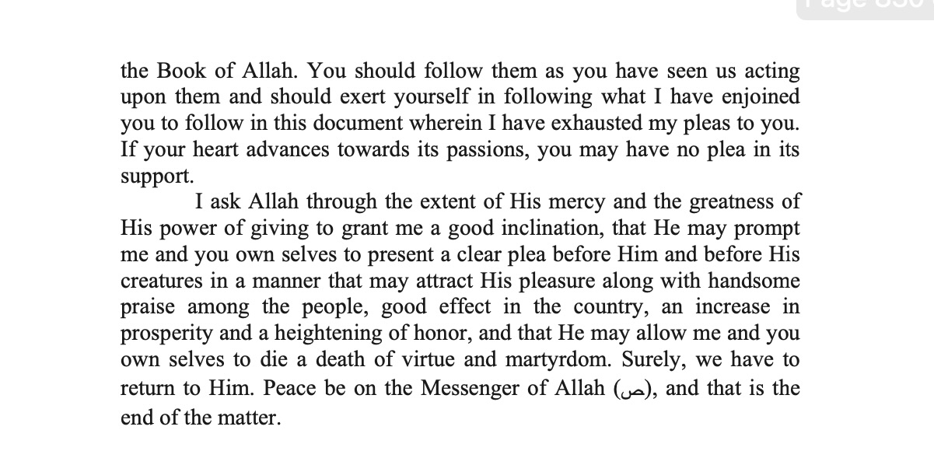
Letters of Ali R.A. to Malik Al-Ashtar

Slide 34
Lessons from Letter
Even though you are a leader, you are just a servant of Allah SWT
“He has ordered him to fear Allah, to prefer obedience to Him and to follow what He has commanded in His Book (Holy Quran) out of His obligatory and elective commands.”
Be Cautious
“Then, know, O Malik, that I have sent you to an area where there have been governments before you, both just as well as oppressive. People would now watch your dealings as you used to watch the dealings of the rulers before you and they (people) would criticize you as you criticized them (rulers).”
Be Forgiving & Tolerant
“Habituate your heart to mercy for the subjects and to affection and kindness for them. Do not stand over them like greedy beasts who feel it is enough to devour them since they are of two kinds: either your brethren in religion or your likes in creation. They would commit slips and encounter mistakes. They may act wrongly, wilfully or out of negligence. So, extend to them your forgiveness and pardon them in the same way as you would like Allah to extend His forgiveness and to pardon you.”

Slide 35
Lessons from the Letter
Remove the Negativity from Around You
“The one among the people under you who is furthest from you and the worst of them in your view should be whoever is the most inquisitive of the shortcomings of the people because people do have shortcomings, and the ruler is the most appropriate person to cover them.”
Remove the Hatred
“Unfasten every knot of hatred in the people and cut away from yourself the cause of every enmity. Feign ignorance from what is not clear to you. Do not hasten to second a backbiter because a backbiter is a cheat although he looks like those who wish well.”
Distinguish Between Justice & Equality
“The virtuous and the vicious should not be in equal status before you because this means dissuasion of the virtuous from virtue and persuasion of the vicious to vice. Keep everyone in the status which is his.”

Slide 36
Lessons from the Letter
Do Not Mend the Unbroken
“Do not discontinue the good lives in which the earlier people of this community had been acting and by virtue of which there was general unity and through which the subjects prospered. Do not innovate any line of action which injures these earlier ways because (in that case) the reward for those who had established those ways would continue, but the burden for discontinuing them would be on you.”
Give Credit Where It’s Due
“Appreciate the performance of each and every one of them. Do not attribute the performance of one to the other and do not minimize the reward below the level of the performance. The high status of a man should not lead you to regard his small deeds as big, nor should the low status of a man make you regard his big deeds as small.”
Appoint Those Who Fulfil the Merit
“Give them appointment after testing them and do not appoint them according to partiality or favoritism because these two things make up the sources of injustice and unfairness.”

Slide 37
Lessons from the Letter
Listen to Your People
“And fix a time for complainants wherein you make yourself free for them and sit with them in common audience and feel humble for the sake of Allah Who created you.”
Let Them See You
“Do not stay secluded from the public for a long time because the seclusion of those in authority from the subjects is a norm of narrow- sightedness, and it causes ignorance of their affairs.”
Be Organised
“Assign to every matter its proper place and do every job at its appropriate time.”

