Slide 1
Arab league GCC OIC
The Middle East and North Africa

Slide 2
The Middle east conundrum
The Centuries Old Religious Wars in ME
Islam Vs Other Religions
Islam vs Judaism
The Crusades and the Ottoman Empire
WW-I and disintegration of Ottoman Empire
Creation of Israel & Rise of Arab Nationalism
The Cold War in the Islamic World Since 1979: Sectarian Divide
9/11-War on Terror
Islamophobia in the West
Radical Islam, Terrorism, & Extremism
Civil Wars in the ME
Islam under siege: radical Islam and reaction of the Modern World

Slide 5
Israel-Palestine:1919-48
Three proposals for Palestine Territory.
The red line proposed in the 1916 Sykes–Picot Agreement between UK & France for Israel
the thin blue line refers to the 1923–48 Mandatory Palestine Territory under UK.
the dashed blue line is the 1919 Zionist demand
1
3
2
UK’s Balfour Declaration-1917

Slide 6
the UK's Foreign Secretary Arthur Balfour’s letter to Lord Rothschild, a leader of the British Jewish community .

Slide 7
UN partition plan for Palestine adopted in 1947. Encyclopedia Britannica, Inc.

Slide 9
The Middle East: 1979 ‘Afghan Jihad’ & Iranian Revolution
Suez
Canal
Cold War
Proxies
Strait of Hormuz
Bab ul Mandab

Slide 11
Suez Canal

Slide 13
Arab-Israeli wars
series of military conflicts between Israeli and various Arab forces;
1948–49: Israel’s War Of Independence And The Palestinian Nakbah
1956: Suez Crisis
1967: Six-Day War
1973: Yom Kippur War
1982: Lebanon War
2006: Second Lebanon War
Israel-Hamas War-2023
The Two-States Solution Vs Greater Israel

Slide 14
The arab league

Slide 15
The Arab League-Map
The Member States stretch geographically from the far west of northern Africa to the Middle East and the Gulf region.
in 1945: six founding members.
Today: 22 members
Middle East and N. Africa

Slide 16
Arab League: Raison d’eter
The Arab League was created to;
Raise joint concerns over postwar colonial divisions of Arab territories
2. Oppose the creation of a Jewish state on Palestinian territory
3. integrate the member countries in political, economic, military, and cultural fields.

Slide 17
Background
The Ottoman Empire called ‘the Sick Man of Europe’ -after WW-I
The fall of Ottoman Empire and end to ‘Khilafat’
The rise of Arab nationalism to unify the Arab world
During World War-I, the Sharif of Mecca, backed by the British forces, led an Arab revolt.
The British government assured Arabs the establishment of an independent state.
However, the Sykes-Picot Agreement signed in 1916 between UK & France, and
The Balfour Declaration-1917 betrayed this plan
They carved up Arab lands into their respective spheres of influence
the Creation of Jewish State
The devastation of the WW-II and decolonization
The USA and Russian involvement since the end of WW-II
Creation of Israel and Arab-Israel Wars

Slide 18
Genesis
March 1945 at Cairo under the Alexandria Protocol.
The 6 founder States are
Egypt, Lebanon, Iraq, Jordan, Syria, Saudi Arabia
and Yemen joined subsequently in May, 1945
Currently, the League has 22 members
Six countries are observer states—
Eritrea, Brazil, Venezuela, India, Armenia, Chad
Notes:
a status that entitles them to express their opinion and give advice but denies them voting and decision making rights.

Slide 19
The Charter of Arab League
the Charter;
Consists of 20 articles that defines the aims of the League
The charter is amendable by a 2/3rd majority
The Arab League is a regional political organization that aims to secure the interest of Arab countries.
But, most importantly, we have to see;
“What are the interests of Arabs?”

Slide 20
Article 1. Members
Independent Arab States that have signed this Pact.
Founding members
Subsequent members

Slide 21
Article 2. The purpose of the League
To draw close relations between member States
to safeguard their independence and sovereignty
To Protect and promote interests of the Arab countries.
close co-operation in the following areas:
Economic and financial, trade, customs, and industry;
Development of Communications infrastructure
Social and cultural welfare and health.
Matters connected with nationality, passports, visas etc.

Slide 22
Structure
The Council (Article-3)
Composed of the representatives of the member States.
Each State shall have one vote
Enforce the Charter
The function is to realize the purpose of the League
Supervise the execution of the agreements concluded between the member States
Collaborate with the international organizations
The Council of the League shall meet twice a year.
Permanent Secretariat and Secretary General at Cairo
Special Committees (Article-4)
In certain specialized areas of mutual interest for technical cooperation

Slide 23
Non Use of Force among Members
Article 5. Use of force for the settlement of disputes between member States not allowed.
Article 6. In case of aggression or threat of aggression
The Council shall determine the necessary measures to repel this aggression.
Its decision shall be taken unanimously.

Slide 24
The Decisions of the League
Article 7. The decisions of the Council taken by a unanimous vote are binding

Slide 25
Critical analysis

Slide 26
Arab League: disunity, mutual distrusts, and non-cooperation
Involvement of the Western Powers in the ME
Regional power politics resulting from conflicts between its members: Proxy wars
Not able to play a role in;
fighting terrorism and radicalism
Provision of basic human rights in the Arab world
Managing refugees
to stop wars taking place in the Middle East

Slide 27
The Arab League and Arab Peace Initiative
The Arab League in The Beirut Summit of 2002 offered: “the Land for Peace” initiative
Israel to withdraw from Palestinian lands and recede to pre-1967 borders
Return of Palestinian Refugees back to their homeland
Peaceful co-existence
Recognition of Israel by Arab States
Israel called it a non-starter

Slide 28
Failures
Some of the failures are related to the decision-making process
The charter states that decisions reached by a majority “shall bind only those states that accept them,”
It limits the league’s ability to take collective action.
others are due to power politics resulting from conflicts between its members.
Despotic regimes working for their vested interests
Puppets installed by the world powers
Territorial anomalies and the Proxy wars

Slide 29
The Arab Spring-2011
The Arab League and the “Arab Spring”
Arab League showed an indifference towards the popular rising taking place since 2011
Led to the outbreak of internal wars and conflicts in Syria, Yemen, and Libya
Unrest in Egypt
Destruction of Iraq
Rise and fall of ISIL, ISIS, AL Qaida, Ikhwanul Muslemoon and other ‘Islamist’ organizations

Slide 30
the Middle East Today
Civil wars in Libya, Syrian and Yemen
UAE and Bahrain have accepted Israel-the Abraham Accords
US involvement in Middle East for Israel’s recognition by Arab countries
MBS and Netanyaho reportedly met
Pakistan issued statement demanding just and peaceful solution of Palestine issue according to the wishes of the Palestinians
Notes:
Egypt26 March 1979, 26 October 1994, UAE and Bahrain 15 September 2020. Turkey has diplomatic relations since 1949.
As of 11 September 2020, 163 of the 193 UN member states recognize Israel.

Slide 31
The Rise of 'New Ottomans‘
The 'New Ottomans‘-Turkey getting more assertive in Eastern Mediterranean
Oil exploration in The Mediterranean
The Black Sea
Recent row between Turkey and UAE
Turkey has intervened heavily on the side of the UN-backed Libyan government while the UAE and Egypt back the eastern militias of Gen Khalifa Haftar.
The Arab countries are facing both internal and external crises….
The Arab League is accused of its inaction, disunity, and divided over the very aims it was founded for.

Slide 32
The May 16, 2024, Bahrain Arab League Summit
All 22 Arab leaders attended
UN Secretary-General Antonio Guterres also addressed
the summit was dominated by the Israel-Hamas war.
leaders condemned Israeli forces' "barbaric" actions in Gaza
On May 16, 2024, The Arab League issued a "Manama Declaration"
end to forced displacement in the Palestinian territory & immediate cease-fire
peacekeeping forces of the UN until a two-state solution
Consideration of the Palestine Liberation Organization (PLO) as the sole legitimate representative of the Palestinian people.
Urging all Palestinian factions to join under the umbrella of the PLO.
civil wars and unrest in Sudan and Yemen, Syria, Iraq, Lebanon, and Libya

Slide 33
Middle East Redefined
China Trying to bring Muslim countries closer, particularly KSA, Iran, and Syria
Iran-Saudi Relations improving
Syria participated in Arab League Council meetings this year
Hope for a Two-Nation solution of Israel-Palestine conflict
Recent ‘Intifada’ ---attack by Hamas and declaration of war by Israel
07.10.23
Invading Gaza Is the Least Bad Option for Israel
All the Other Options Have Already Failed
Notes:
to destroy Hamas as a military force: to remove the group from power in Gaza: how deep Israeli forces will go into the enclave and how long

Slide 34
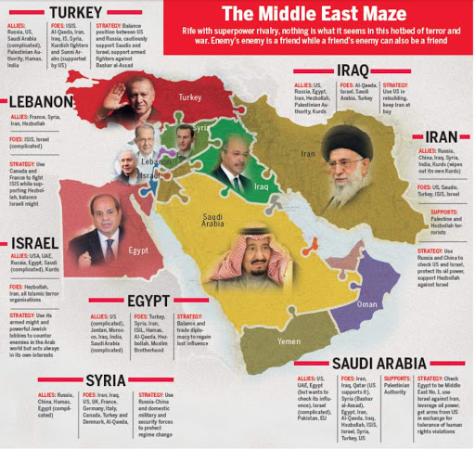

Slide 35
Organization of Islamic Cooperation
OIC
"the collective voice of the Muslim world"
But it seldom speaks.
None pays heed of if hardly ever do so.

Slide 36
History
The arson of Al-Aqsa Mosque in occupied Jerusalem on 21 August 1969
Amin al-Husseini, the former Mufti of Jerusalem called for all Muslim heads of states to convene a summit.
The Islamic Conference-was established in Rabat, Morocco on 25 September 1969
A resolution was passed stating that;
Muslim governments to promote close cooperation and mutual assistance in the
economic
Political
cultural and spiritual fields
inspired by the teachings of Islam.

Slide 37
1970 the first meeting of Islamic Conference of Foreign Ministers (ICFM) held in Jeddah
to establish a permanent secretariat in Jeddah
In Feb.1972, the Organization of the Islamic Conference (now the Organization of Islamic Cooperation) was founded during the 3rd ICFM Session
The first OIC Charter was adopted
It laid down the objectives, principles and structure, functions of the organization

Slide 38
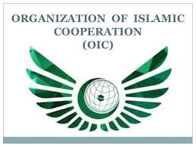
the second largest inter-governmental political organization
57 member states, across four continents, with 1.9 billion people (2019).
To Promote international peace and harmony
The OIC has permanent delegations to the UN and the EU.
The official languages are- Arabic, English, and French.

Slide 39
The OIC Charter
The present revised Charter of the OIC was adopted in March 2008
It has 18 Chapters and 39 Articles
The revised charter promotes
Democracy & Human rights
Good governance in all member states.
Peace and Prosperity
Inter-faith harmony and inter religious dialogue
Notes:
Dakar-Capital of Senegal

Slide 40
OIC: Objectives
Promotion of Islamic Solidarity
Enhance cooperation among Muslim countries in economic, social, cultural and scientific fields
To coordinate among members for protection of Holy places
To promote unity and the image of Ummah through strengthening ties with other regional and international organizations

Slide 41
Articles-I & II: Objectives & Principles
According to its Charter (Article –I), the OIC aims to;
Promote Islamic social and economic values;
increase cooperation in social, economic and political areas;
To strengthen intra-Islamic economic and trade cooperation
uphold international peace and security; and
Respect independence, territorial integrity, equality and sovereignty of member states

Slide 42
Objectives & Principles
To protect and defend
the true image of Islam,
combat defamation of Islam and
encourage dialogue among civilizations and religions
To protect human rights and the rights of women and minorities.
combating terrorism in all its forms and manifestations
To support and empower the Palestinian people
settle disputes through peaceful means and refrain from use of force

Slide 43
Article-III: Membership
Any State, member of the United Nations, having Muslim majority and abiding by the Charter, may join the Organization if approved by consensus by the Council of Foreign Ministers

Slide 44
Organization Structure
Islamic Summit
Islamic Conference of Foreign Ministers
Permanent Secretariat & the Secretary General
The Apex body
the heads of states and governments of the member states
convenes every two years
Meets once a year
Monitor and review progress of Summit’s decisions and programs
Elected by the Council of Foreign Ministers for five years, renewable once.
Administrative functions
the administrative organ of the Organization
entrusted with the implementation of the decisions of the two preceding bodies

Slide 45
Organization Structure
Other Organizations
Specialized Institutions
IIUs, IU of Technology
The Islamic Centre for the Development of Trade
Islamic Development Bank
the Al-Quds Committee
World Islamic Economic Forum

Slide 46
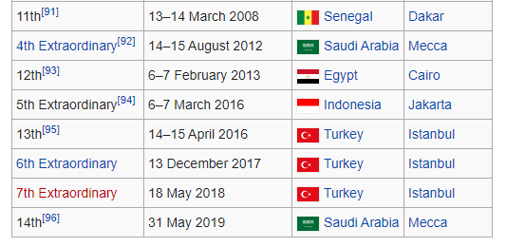
THE 15TH SESSION OF THE ISLAMIC SUMMIT
BANJUL, REPUBLIC OF THE GAMBIA (May 04-05, 2024 )

Slide 47
OIC- Issues and Challenges
The Member States of the OIC face many challenges in the 21st century
the noble Islamic values of unity and fraternity, peace, solidarity, tolerance, equality, justice, moderation, balance and human dignity

Slide 48
the OIC has taken steps to remove misperceptions and has strongly advocated elimination of discrimination against Muslims in all forms and manifestations.

Slide 49
OIC- Issues and Challenges
OIC Leadership Crisis over The Middle-East Issues;
Israel-Palestine
The Yemen Crisis
The Syrian Civil War
Shia-Sunni Divide in the Muslim world
Democracy & Human Rights, Economic Dev
Islamophobia and the Role of OIC
Combating three menaces-Terrorism, extremism and Radicalism
Notes:
The Dialogue and Outreach Department at the OIC

Slide 50
OIC- Issues and Challenges
OIC and Muslim Renaissance- a remote possibility or a reality in near future?
Pan-Islamism and the Unity of ‘Ummah’- a gigantic challenge
Establishing a single economic and political entity as of EU???----seems impossible

Slide 51
Islamic Military Counter Terrorism Coalition
For military intervention against ISIL, Yemen and fro other counter-terrorist activities
Original 34 members.
countries joined and the number reached to 41
Most of its participants are members of the OIC
Coalition having majority Sunni Muslim populations
it has been called "a sectarian coalition" by Hakeem Azameli, a member of the Security and Defense Commission in the Iraqi parliament
Iran has expressed strong reservations
Turkey is apprehensive

Slide 52
Pakistan and the OIC
Pakistan continues to enjoy a prominent status in the OIC
Pakistan is one of the most powerful members of OIC.
population.
nuclear weapons
seventh-largest standing military force
research, education and economy
large labor force working in various Muslim countries
Counter-terrorism achievements
the 2nd summit of OIC held in Lahore between 22–24 February 1974

Slide 53
Pakistan and OIC
Support for Palestine and Middle East issues
Islamic Military Counter Terrorism Coalition
Pakistan’s Relations with Iran and Saudi Arabia- how to strike a balance???
Saudi Arab and Gulf States’ tilt towards India and the India’s increasing role in the Middle East
OIC Contact Group on Kashmir
China's representation in OIC through Pakistan

Slide 54
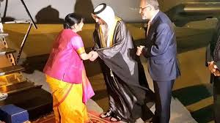
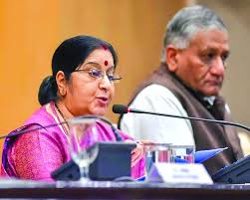
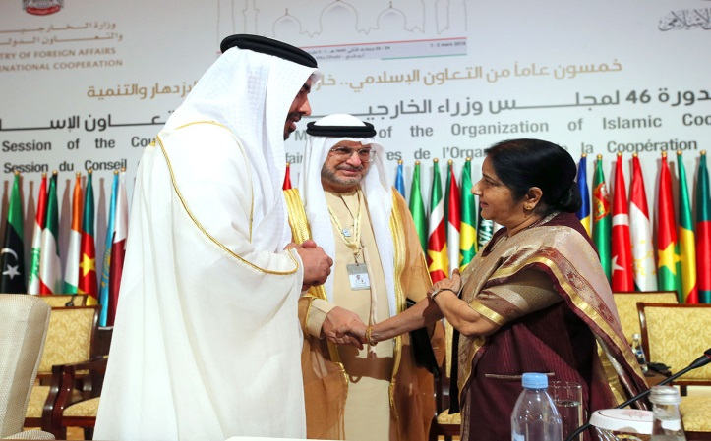
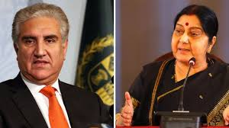
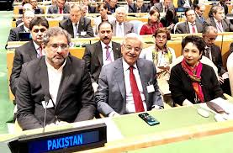
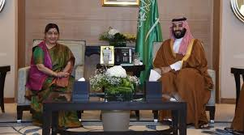
OIC invite India in Muslim world
It is the first time by OIC to invite India in five decades.
Sushma as the “Guest of Honour”
at the 46th meeting of OIC Foreign Ministers (1-2 Mar 2019.
Pakistan did not attend the OIC’s FMs meeting

Slide 55
The OIC FMs Council Meetings in Islamabad-2021 & 2022
Council meeting held on 18-19 Dec. 2021 & March 2022
to devise a mechanism for the international community to deliver aid to Afghanistan, despite sanctions.
Post-Taliban Afghanistan and OIC efforts
India held conference on Afghanistan
The Delhi Regional Security Dialogue on Afghanistan
representatives from India, Iran, Russia, Kazakhstan, Kyrgyzstan, Tajikistan, Turkmenistan and Uzbekistan.
Pakistan accusing India of being a 'spoiler' in the region.

Slide 56
Making oic effective
Peace and Security: OIC Need to work for both internal as well as world peace and security.
Cultural Revolution: Political and Social Reforms
Economic Reforms in the Muslim World

Slide 57
The Future: OIC- Vision 2025
focuses on following priority areas
Peace and Security, Dialogue
Palestine and Al-Quds
Counter-terrorism
Joint Islamic Humanitarian Action
Investment and Finance,
Poverty Alleviation,
Food Security
Climate Change and Sustainability
Science & Technology
Moderation
Culture and Interfaith Harmony
Empowerment of Women
Human Rights and Good Governance

Slide 58
Gulf Cooperation Council
GCC

Slide 59
Persian Gulf

Slide 61
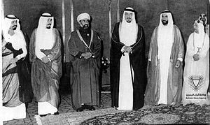
Historical Background
Agreement of the Gulf Cooperation Council was signed on 11 November 1981 in Abu Dhabi.
Heads of States of the Gulf region met in Abu Dhabi on 25 May 1981

Slide 62
The Cooperation Council for the Arab States of the Gulf
Known as the Gulf Cooperation Council (GCC)
A regional intergovernmental political and economic union
consisting of all Arab states of the Persian Gulf except Iraq
The Charter of the Gulf Cooperation Council was signed on 25 May 1981
Its headquarters in Riyadh, Saudi Arabia

Slide 63
Introduction
All current member states are monarchies
This area has some of the fastest-growing economies in the world
There have been discussions regarding the future membership of Jordan, Morocco, and Yemen

Slide 64
The objectives of the GCC (Article-IV )
Regional integration between Member States
To strengthen cooperation among them in various fields, including the following:
Economic and financial affairs
Commerce, customs and communications , and
Education and culture
To stimulate scientific and technological progress
To establish joint ventures and encourage cooperation by the private sector
Ensure peace, stability and security of the region

Slide 65
Structure
1. Supreme Council(SC)
The heads of states
Highest decision making body
2. Ministerial Council(MC)
Composed of the Foreign Ministers
Meets every three months
3. The Secretariat and secretary General
The administrative arm of the GCC
Implements decisions approved by the Supreme or Ministerial Council
Sets objectives and programs
Each member state has one vote
Decisions on substantial issues unanimously
Procedural matters require a majority
Formulates policies and promote cooperation
Implement projects
It’s decisions are subject to approval by the SC
Compiles studies
Prepares reports
Notes:
GCC 44th Summit 5th Dec. 2023

Slide 66
5. Monetary Council(MC)
To introduce a single currency
7. Peninsula Shield Force
Military arm of the GCC
Joint Response against military aggression
Establishing a central bank
Choosing a currency regime
Any intervention by the force must include all member states

Slide 67
Geo-economics & Geo-politics
GCC-CRITICAL ANALYSIS

Slide 68
Steps towards a Monetary Union
In 2001, the GCC Supreme Council set the following goals:
A common Customs Union until January 2003
Common market be established by 2007
Common currency be introduced by 2010
The name ’Khaleeji’ has been proposed for this currency.
If realized, the GCC monetary union would be the second-largest monetary union in the world.

Slide 69
Monetary Council: Bottlenecks
On 15 December 2009, GCC created a Monetary Council
To introduce a single currency for the union.
Establishing a central bank, and
Choosing a currency regime
The Council met for the first time on 30 March 2010.
Kuwait said that a single currency may take up to ten years to establish.

Slide 70
GCC’s Internal Dynamics
Oman announced that it would not be able to meet the target date for a common currency.
the UAE announced withdrawal from the monetary union scheme
It wanted GCC Central Bank in UAE not KSA
Saudi Arabia and Kuwait: disputes over shared oilfields

Slide 71
The Row with Qatar
Saudi Arabia, Bahrain and UAE pressuring Qatar-serious row among the three
Qatar’s support to the Muslim Brotherhood, Hamas, and Islamists in Libya
They have reservations on Al Jazeera’s coverage of Middle Eastern issues- demanded its closure
Qatar’s exit from OPEC after 57 years to focus on natural gas market.
In June 2017, Saudi Arabia, the United Arab Emirates, and Bahrain put a ban on Qataris and their businesses.

Slide 72
GCC Summit 2021
Since 2017, blockade of Qatar ended in 2021
GCC countries agreed to end it on 05/01/2021
Signed a “Solidarity and Stability” deal
Called the Al Ula Agreement
Trump Administration brokered the deal
Kuwaiti Emir also played his role
It is to further isolate and pressurize Iran

Slide 73
GCC and Regional Dynamics
The GCC — set up in 1980 as a fortification against Iran and Iraq
Iraq is the only Arab country bordering the Persian Gulf that is not a member of the GCC.
In 2012, Iraq stated that it wanted to join the GCC
The lack of membership of Iraq is widely believed to be due to
Low-income economy
Its substantial Shia population
Its political system, and
Its invasion of member state Kuwait during the gulf war
Iraq under turmoil since the fall of Saddam Hussain
Yemen was also negotiating for membership
Yemen War and Humanitarian Crisis

Slide 74
The Oil Politics is on the Decline
Oil politics in the region on the decline
the GCC states are pursuing wider economic structural reforms
In 2011, Saudi Arabia proposed to transform the GCC into a "Gulf Union“
With greater economic, political and military coordination
To counterbalance the Iranian influence in the region

Slide 75
Pakistan and GCC
Pakistan-GCC Free Trade Agreement negotiations since March 2017
Joint ventures and business opportunities- a source of FDI for Pakistan
Pakistan’s manpower in Gulf countries
It is on the decline
Rising Indian influence in Gulf region and Middle East-a challenge for Pakistan
Pakistan trying to strike a balance for its relations with
Saudi Arabia and Qatar
Saudi Arabia & Iran
Islamic Force and Pakistan's role
Pros and Cons for Pakistan

Slide 76
Iran-Saudi Normalization and GCC

Slide 77
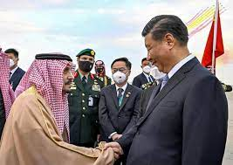
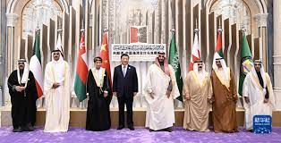
China’s Increasing Interest in ME
Counterbalancing US influence in ME
Trade & Economic Cooperation
Infrastructure Dev
Strategic Cooperation
Nuclear & Missile Cooperation
In distant future, bringing SA & Iran closer
Dual advantage for Pakistan
US & India apprehensive

Slide 78
Conclusion
GCC Economic union and monetary union seem remote possibilities
Peninsula Shield Force has been eclipsed by the Islamic Military Counter Terrorism Coalition Force
US involvement in the region and rising pressure on Saudi Arabia
Saudi Arabia has always looked to the United States for protection against Iran
US-Iran rivalry
Iran’s involvement in the ME and Gulf would remain a serious concern for the GCC
Future expansion or disintegration of GCC??

Slide 80
CSS-2020
Q. No. 7. Discuss in detail the role of OIC, Arab league and GCC in the Middle East crises and conflicts.

