Slide 1
Pakistan Affairs (Constitution)

Slide 2
LECTURE # 3
Comparison of the constitutions of Pakistan
Islamic provisions: part IX of the constitution
Constitutional Amendments
18TH AMENDMENT
Constitutional amendment bill (process)
Background
Key reasons for 18th amendment
Features of 18th amendment
Analysis on 18th amendment

Slide 3
Comparison of the constitutions of Pakistan

Slide 4
 | 1956 | 1962 | 1973
Date | 23rd March 1956 | 08th June 1962 | 14 August 1973
Written/unwritten | Written Constitution | Written Constitution | Written Constitution
Articles, Parts and Schedule | 234 Article, 13 Parts and 6 Schedule | 250 Article, 12 Parts and 5 Schedule | 280 Article, 12 Parts and 7 Schedule
Drafted By | Constituent Assembly | President/ Constitutional reforms committee | Parliament of Pakistan
Form of Government | Parliamentary | Presidential | Parliamentary
Name of the Country | Islamic Republic of Pakistan | Islamic Republic of Pakistan | Islamic Republic of Pakistan
Base of Preamble | Objectives Resolution 1949 | Objectives Resolution 1949 | Objectives Resolution 1949
Amendment | 2/3rd Majority is required | 2/3rd Majority is required | 2/3rd Majority is required

Slide 5
Houses | Unicameral /National Assembly | Unicameral /National Assembly | Bicameral Legislature Upper house/Senate =104 Lower house /NA =342
Distribution powers / Legislative Lists | Three list Federal Provincial Concurrent list | Two list Central and Provincial | One list Federal
Judiciary | Independent | Independent | Independent
Judicial Review (for protection of law) | Yes | Yes | Yes

Slide 6
Judicial Review | Yes | Yes | Yes
Local Govt System | No | In 1962 (80000) LG/BD system | Yes
State Religion | No official religion | No official religion | Declared Islam as the state Religion
Definition of Muslim | No | No | Defines Muslims and declared Ahmadi/Qadiyani as non-muslim
Constitution making body | Constituent Assembly | President/ Constitutional reforms committee | National Assembly
National Language | Urdu and Bengali | Urdu and Bengali | Urdu

Slide 7
Islamic Institution | No Institution | Introduce Advisory council of Islamic Ideology and Islamic Research Institution | Council of Islamic Ideology and Federal Shariat Court
Election of the head of Government | National Assembly had the right to elect | BD Members (Local Govt) | National Assembly
Mode of Elections | Direct | Indirect | Direct
Judicial Accountability | Supreme Court of Pakistan | Supreme Judicial Council | Supreme Judicial Council
Distribution of seats of federal legislature among federating units | 300 seats equally divided 5 seats reserved for women from each province | National Assembly was 156 and three seats were reserved for women from each province. | NA basis of population & Senate equal 23 each
President Age | 40 | 35 | 45
Concept of Referendum | No | Concept was introduced | President can hold referendum on national issue

Slide 8
Islamic provisions: part IX of the constitution
Provisions relating to the Holy Qur’an and Sunnah
Composition, etc. of Islamic Council
Reference by Majlis-e-Shoora (Parliament), etc. to Islamic Council
Functions of the Islamic Council

Slide 9
Provisions | Constitution of 1956 | Constitution of 1962 | Constitution of 1973 and Relevant Article
Objective Resolution in the Preamble of the Constitution | Yes | Yes | Yes
Name of the state being “Islamic Republic of Pakistan” | Yes | Yes | Yes
Islam as a State Religion | No | No | Yes
Objective Resolution made substantive part of the Constitution | No | No | Yes
Islamic Way of Life | Yes | Yes | Yes
Elimination of Riba as early as possible | Yes | Yes | Yes

Slide 10
Strengthening bond with Muslim World | Yes | Yes | Yes
President to be Muslim | Yes | Yes | Yes
Federal Shariat Court | No | NO | Yes
No Law to be made in violation of Islamic Injunctions and existing Laws to be brought in conformity with the Sharia | Yes | Yes | Yes
Council of Islamic Ideology | No | Yes | Yes

Slide 11
Constitutional Amendments

Slide 12
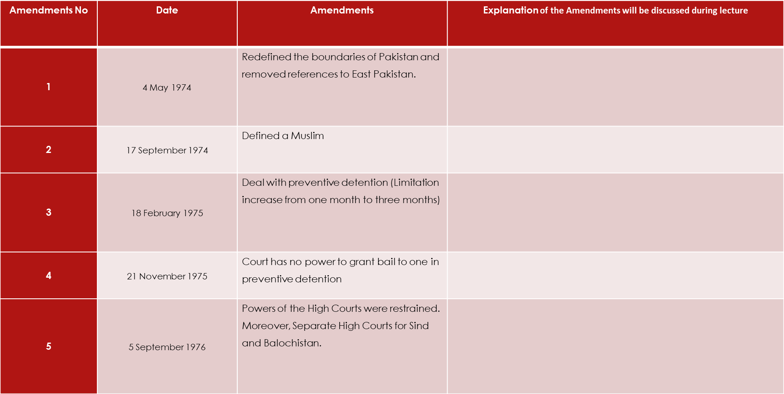

Slide 13
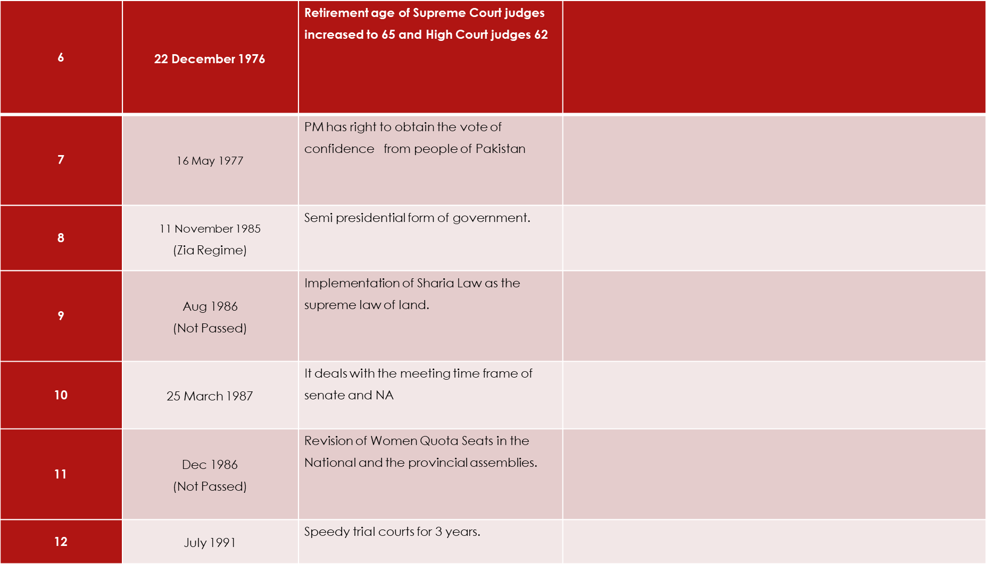

Slide 14
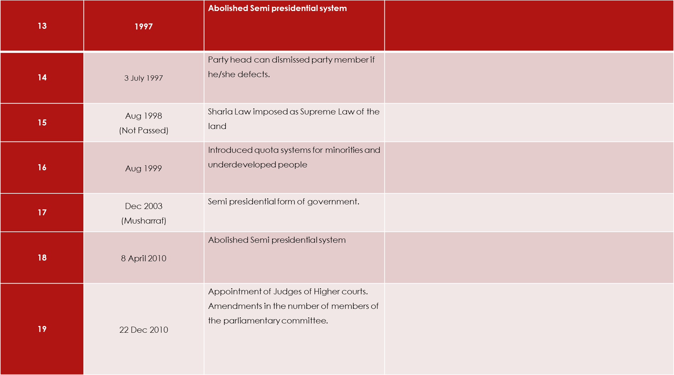

Slide 15
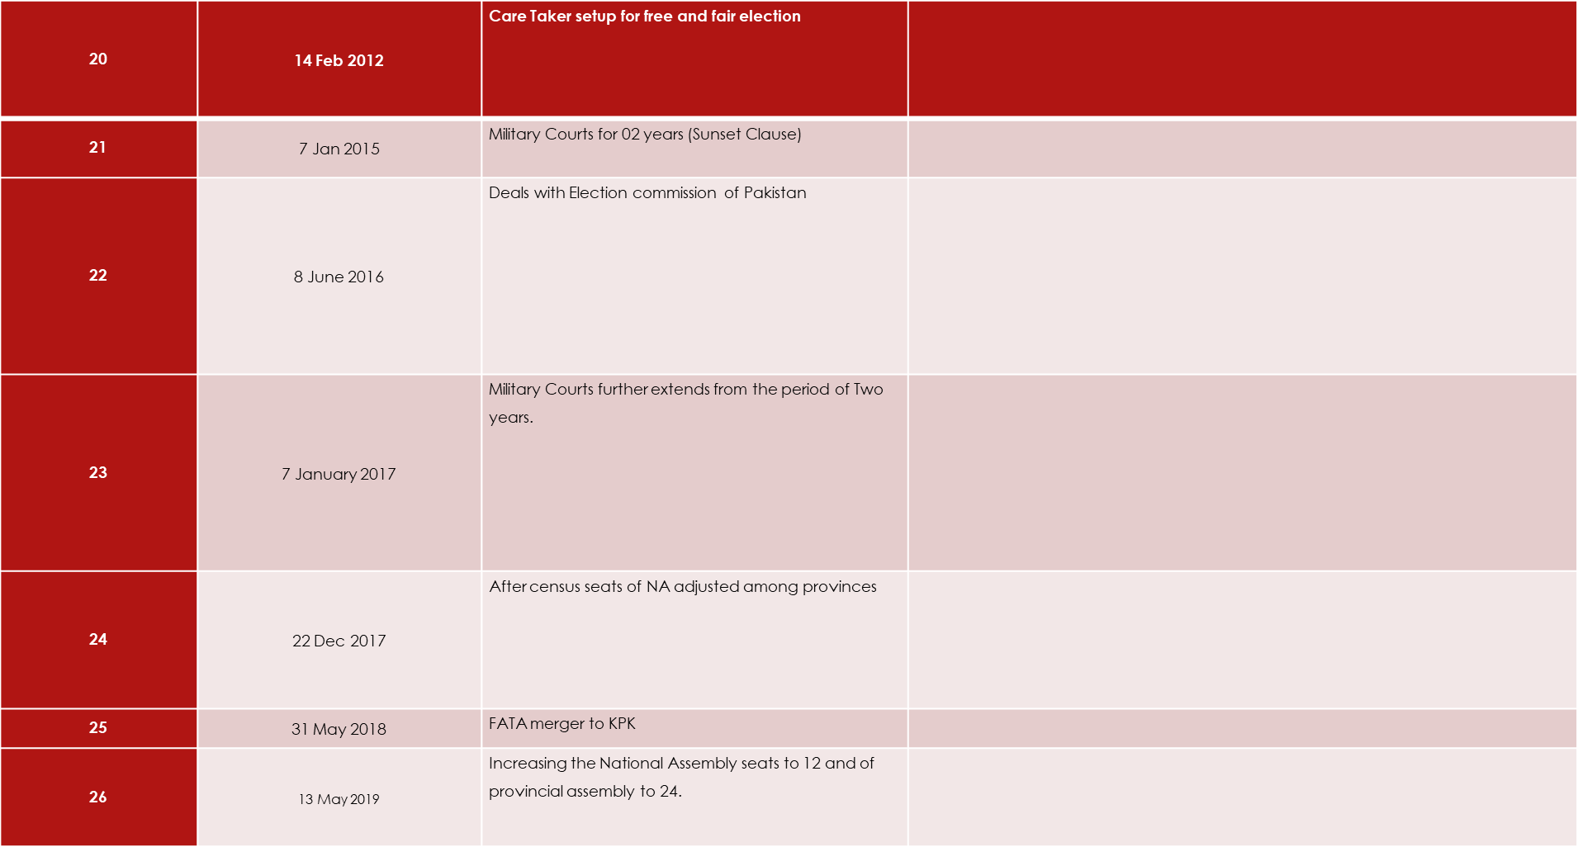

Slide 16
18TH AMENDMENT
(10th April 2009 from NA)
(29th April 2009 from Senate)

Slide 17
DEFINATION OF AMENDMENT
Black’s law Dictionary
CONSTITUTIONAL AMENDMENT BILL (PROCESS)

Slide 18
BACKGROUND
Heterogeneous society
Federation
Presidential system
Military interventions
Original form of constitution is parliamentary
Strong center and marginalized provinces
8th amendment by Zia and 17th amendment by Musharf

Slide 19
KEY REASONS FOR 18TH AMENDMENT
-17th Amendment by Musharaf
-Abolish Article 58 (2)(b)
-Provincial Autonomy
-Restoration of Parliamentary System
-Increase of provincial shares in NFC Award

Slide 20
FEATURES OF 18TH AMENDMENT
Removal of General Zia ul Haq name from constitution
Curtail the power of president
Political parties are allowed in FATA
Presidential powers restricted
High treason Art 06 amended
Omitted Article 112
CCI

Slide 21
Parliamentary supremacy
Federal and provincial balance of power
Provincial autonomy
Appointment of chief election commissioner by gov’t and opposition
Ban lifted on 3rd time PM
Article 157
National finance commission (NFC)
Provincial legislature shall have exclusive domain over laws governing marriage, labor, educational curriculum and environmental pollution.
Article 92

Slide 22
KPK name changed from NWFP
Baluchistan (Balochistan)
Sind (Sindh)
Article 175-A higher judiciary appointment
Establishment of Islamabad high court.

Slide 23
Addition of following Articles
Article 10-A
Article 19A
Article 25A
Expansion the membership of the two special bodies i.e. NEC and CCI

Slide 24
ANALYSIS ON 18th AMENDMENT

