Slide 1
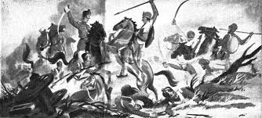

Slide 2
War of Independence-1857
NOA, Islamabad

Slide 3
War of Independence
War or Mutiny?
  Soldiers alone were not involved
  Entire population of India
  General political unrest
  To paraphrase Sir Syed Ahmad Khan a single event can never become cause of a general uprising
  Previous mutinies – Madras, 1806, Bengal 1842, Rawalpindi 1849 & 1852, Punjab – Response of the British
  The what if argument………….

Slide 4
War of Independence
Causes'
Political Causes
  Loss of power & Territory – Battle of Plassy & Buxar 1757 & 1764 respectively
  Neutralizing main threats like Tipy Sultan, Marathas, Sikhs
  Loss of estates
  Bitterness among the Political Nobility (Ashrafiya)
  Polices like “doctrine of lapse” 1850s
    https://www.britannica.com/topic/doctrine-of-lapse

Slide 5
War of Independence
Economic Causes
  Loss of trade – Economic exploitation
  De-industrialization - loss of local industry- maiming of Indian craftsmen – Silk-cotton-carpet- gem & jewelry
  New agrarian arrangements like proof of land- increased taxation etc.
  Loss of economic status – jobs
  Loss of jobs of people working at the courts of hundreds of states

Slide 6
War of Independence
Religious Causes
  Propagation of Christianity
  Patronage of Christian missionaries
  Unity under the Cross
  India -The “bulwark of Christianity in the East”
  Condemnation of native religions
  According to Sir Syed Ahmad Khan “intervention in religious affairs” fueled the uprising

Slide 7
War of Independence
Military Causes
  “inhuman and unjust” treatment of Indian soldiers
  No regard for soldiers’ religions – discontinued use of tilak and safa
  Discrimination in salaries and other benefits like promotions
  Military barracks as preaching grounds for conversion
  To save the souls of non-Christians
  Overseas wars – Brahman Philosophy of overseas voyage

Slide 8
War of Independence
Immediate Cause
  Greased cartridges – soaked in cow and pork fat
  Sir Syed Ahmad Khan – English Officers – proximate cause of war
  The outbreak of war – Meerut May 1857, Lucknow & Kanpur
  Marched to Dehli and declared support for the Mughal King
  General Bakht Khan , Rani of Jhansi , Tantia Topi, Nana Sahib

Slide 9
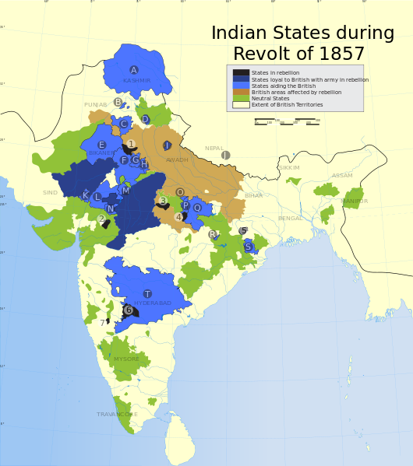

Slide 10
The War of Independence
Causes of Failure
  Change of plan- premature beginning of an end- 31st May, 1857
  The treachery of Sikhs – No participation – provided assistance to the English Army – Financial & military support to the Company
  Support form Gorkhas
  “Courageous natives” ?

Slide 11
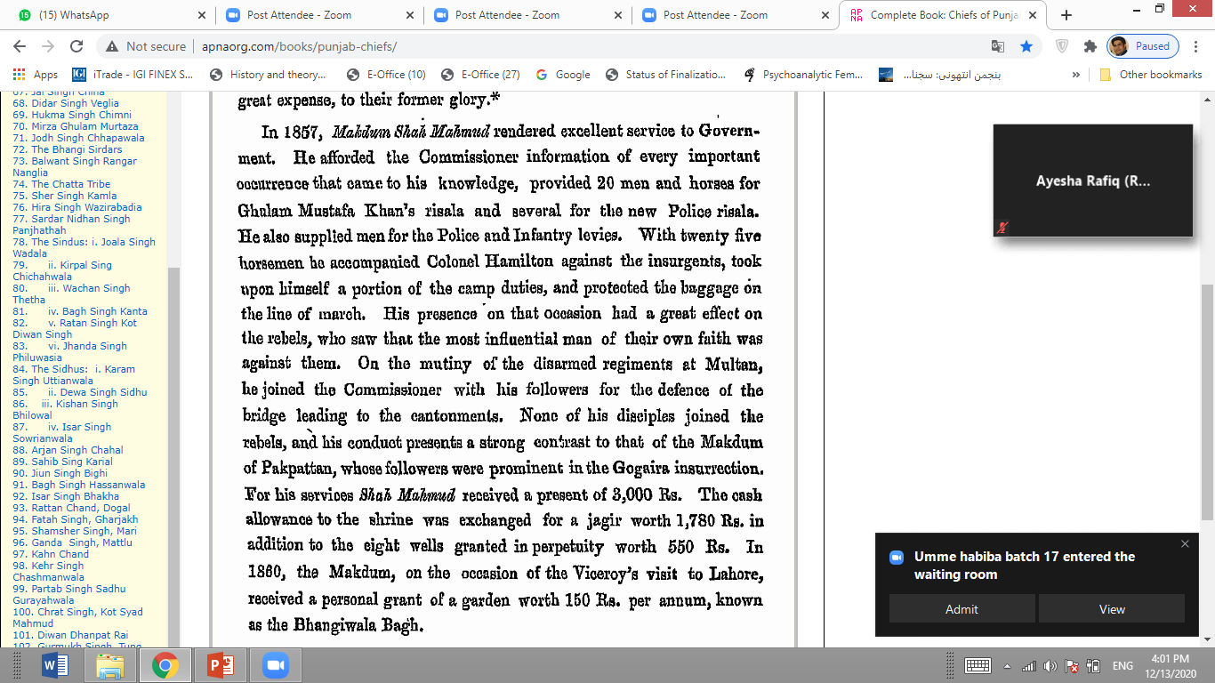

Slide 12
The War of Independence
Causes of Failure
  Absence of leadership – no single commander
  Communication & Transport - “India was saved by the electronic wire” Robert Montgomery
  Economic vulnerabilities – empty coffins

Slide 13
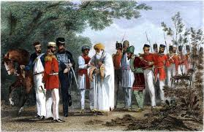

Slide 14
The War of Independence
Results
  First & direct popular challenge
  Spirit of freedom – national movement
  End of the Mughal Rule
  New Era – India came under the British Crown
  End of the EIC – Secretary of State for India
  The War and Muslims – Impact –wiping out of the Muslims – extermination
  Memory of the war , not the war did more damage to the British rule - R.C Mujamdar

Slide 15


