Slide 1
PAKISTAN AFFAIRS
PRE-PARTITION
LEC:01
(MUHAMMAD AFTAB MUNIR)
PAS

Slide 2
Today’s Agenda:
Brief self introduction
Introduction about the subject
Analysis of the pre-partition syllabus and past papers
Brief overview of history of the subcontinent
Muslim rule in the subcontinent
Downfall of Muslim rule
Questions from past papers
Pro-tip

Slide 4
Overview of the subject

Slide 5
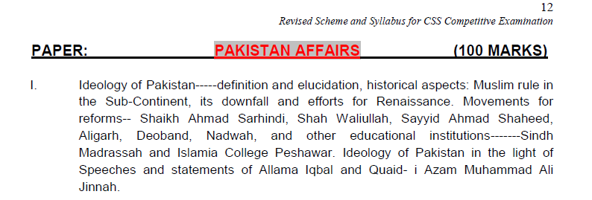
Syllabus of Pre- Partition

Slide 6
Overview of the history of subcontinent
aryans
Maurian empire
Hun dynasty

Slide 7
Muslim Rule in the subcontinent
Attack by Muhammad Bin Qasim
Ghaznavid dynasty
Ghauri dynasty
Started as an ideology

Slide 8
Contd.
Establishment of Muslim rule by Ghauri
Attacking any foreign territory
Annexing of that area
Consolidation of power over that territory
Administration of the said area

Slide 9
The Delhi Sultanate (1206 – 1526)
Slave Dynasty (1206-1290)
Khilji Dynasty (1290-1320)
Tughlaq Dynasty (1320-1414)
Sayyed Dynasty (1414-1451)
Lodhi Dynasty (1451-1526)

Slide 10
The Mughal Empire
Babur beating Lodhi in the 1st battle of Panipat
2 phases of Mughal era
1526–1707
Golden era
1707–1857
Era of downfall

Slide 11
Golden era of Mughal Empire
Babur
Humayun
Akbar
Jahangir
Shahjahan
Aurangzaib Alamgir

Slide 12
Important MCQS ( MONUMENTS)
Taj Mahal, Lal Qila, Shalimar Bagh, masjid Wazir Khan = Shahjahan
Lahore fort = Akbar
Badshahi mosque = Aurangzeb
Haran minar = Jahangir

Slide 13
Causes of Downfall of Muslim Rule
1. INTERNAL FACTORS
2. EXTERNAL FACTORS

Slide 14
1. Internal Factors
Wars of succession
Internal conspiracies
Lagging in education
Moral decadence
Demoralized and undisciplined Army
Immensity of the empire
Nothing for public welfare
Sway from religion
Faltered economy

Slide 15
Contd.
Rise of independent dynasties
Threat of marhattas and sikhs
Absence of naval power

Slide 16
2. External Factors
Rise of British
Colonization by Dutch, Portuguese, British etc
Attacks by Nadir Shah and Ahmad Shah Abdali

Slide 17
CURRENT SCENARIO OF MUSLIMS AROUND THE GLOBE
Most of the Islamic world in turmoil
Causes of this situation, more or less similar
Problem= no lesson learnt

Slide 18
Need of the hour???

Slide 19
SUMMARY OF THE LECTURE
Overview of the syllabus and important topics
1
Brief historical synopsis of rule in subcontinent , specifically Muslim rule.
2
Up and down of the Muslim rule
3

Slide 20
Today’s Pro-Tip

Slide 21
Any questions??

