Slide 1
comets

Slide 2
introduction
A comet is an icy, small solar system body which when passing close to the sun, warms and begins to release gases, a process called out-gassing
A comet may range in size from several 100 meters to tens of kilometers
While its tail may stretch up to one astronomical unit
Its astronomical symbol is☄

Slide 3
Structure
Nucleus: It is the central core of a comet made up of rock, dust, water ice and frozen gases such as carbon dioxide, carbon monoxide, methane and ammonia
Surface: The surface of a comet is dry, dusty or rocky wrapped around the central core
Coma: The atmosphere around the comet is called a “coma”
Tail: Solar radiations cause the volatile gases in the nucleus to heat up , vapourises and stream out, forming a tail. As the comet moves the tail is formed in the sky

Slide 4
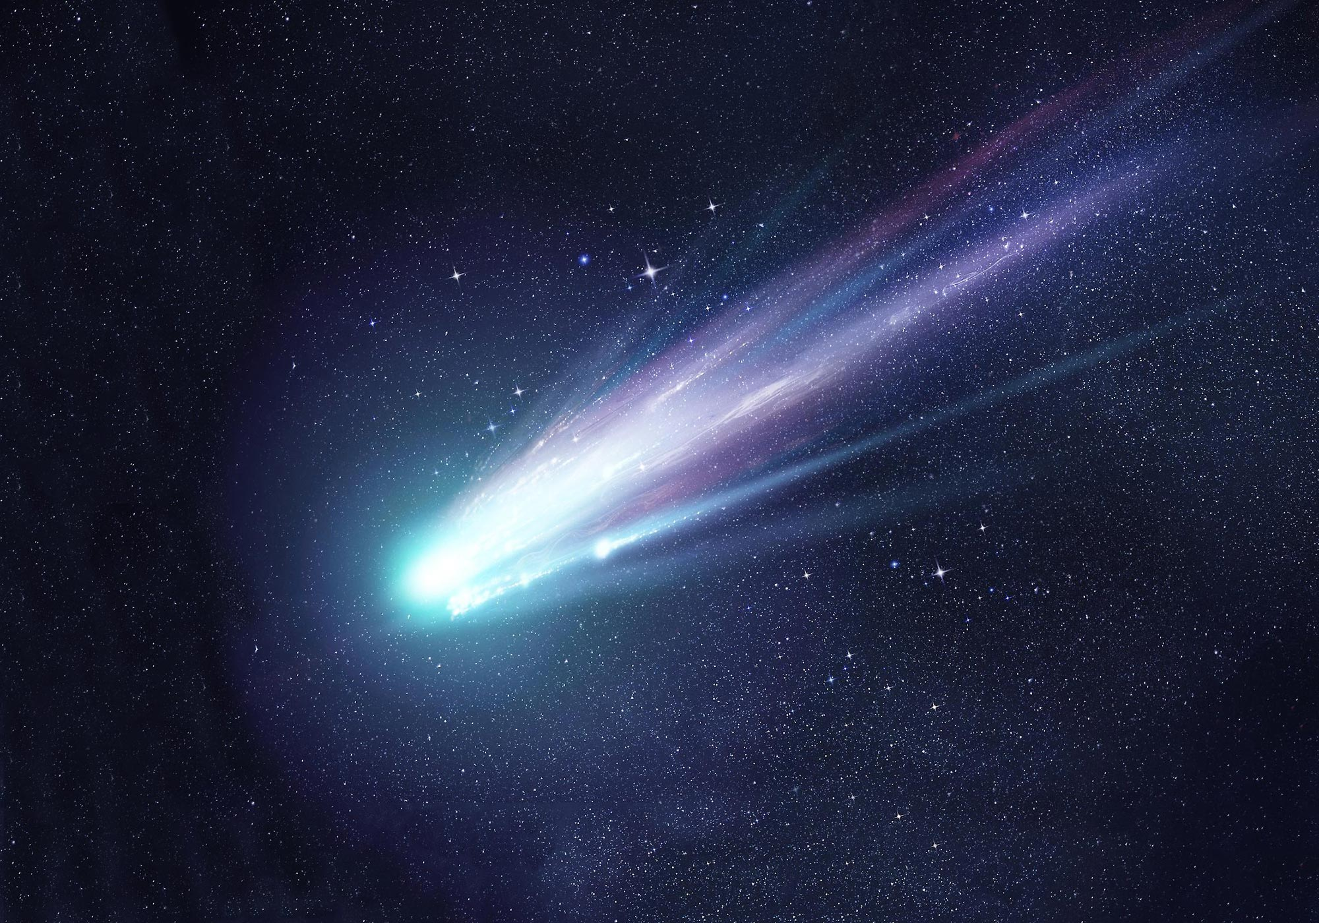

Slide 5
Meteor showers
In particular months, specific comets cross the Earth’s path during the course of their revolution around the sun
As they pass by, pieces of their surface breakdown and they can be seen as bright meteors in the sky
Examples include
Orionid Shower (from Comet Halley)
Taurid Shower (from Encke’s Comet seen usually between Sep – Nov)
Andromedid Shower (from Biela’s Comet)
Perseid Shower (from Swift-Tuttle Comet)
P-O-A-T (use this Nemonics to memorize the different types of showers)

Slide 6


Slide 7
Classification of comets
SHORT PERIOD COMETS
They have an orbital period of less than 200 years
Exempli Gratia:
Halley’s Comet,
Encke’s Comet
Biela’s Comet
Swift Tuttle Comet
LONG PERIOD COMETS
They have an orbital period ranging from 200 years to thousands of years
Exempli Gratia:
Comet McNaught,
Comet Lovejoy
Comet love joy has an orbital period of 698 years. It was last seen in 2011, it will next be seen in 2550

Slide 8
THANK YOU!

