Slide 1
Theories and Approaches
The Classical Approaches-Realism and Liberalism, Post-modernism, Constructivism, International society, Feminism.

Slide 2
Think ..!
Is it the state or individual that makes the decisions?
Have you ever thought in any morning, I will be dead by the evening? No/Yes, …Why?
If you see a man with gun charging against you, your possible reaction?
Your enemy at your doorstep, won’t you protect your house, your loved ones, and household?

Slide 3
Think and relate …
How does USA deal with Ukraine?
How does USA deal with Russia?
How does a student of IR analyze the FP behavior of a state?

Slide 4
Generally, there are two types of relationships among states in International Arena.
Cooperative
Interest convergence
Mutual benefits
Win-Sum (win win)
Examples: Pak China, European Nations, US-EU relations, ASEAN countries relationship.
Liberalism
Competitive
Interest divergence
confrontation over interests
Zero-Sum (win-loss)
Examples: Indo-Pak relations, Iran-KSA, US-China, Indo-China, SCS countries relations.
Realism

Slide 5
What is Theory?
Theory is speculation about - how to explain what happens.
Theories are general statements that describe and explain causes or effects of classes of phenomena. (Van Evera 1997)
Rather than being mere collections of laws, theories are statements that explain them. (Waltz 1979)
Observe - Who are involved
Explain - The type of relationship they have
Predict - How will they behave in the future

Slide 6
Key Concepts
International System
The totality of ‘rules & regulations’ that govern the behaviour of states.
Anarchy
‘absence of International government’.
Hegemony
Ability of a state with overwhelming capabilities to shape events coercively and non-coercively.

Slide 7
Security Dilemma
When a state increases its military power, it actually decreases the power of the other. (Iran Nuclear) John Herz, 1950
States cannot be certain about the intentions of other states, and a lack of effective communication in int. system.
Power and elements
Military, Economy, Population, geography, human and material resources, technological advancement, etc.

Slide 8
Balance of Power
“An even distribution of power among states [in a region mostly] where no single powerful state can dictate other states”
Interdependence
Mutual trade among countries.
Zero Sum
A gain of one side is the loss of the other.

Slide 9
Significance of Realism
Man’s aspiration for power is not an accident of history; it is not a temporary deviation from a natural state of freedom; it is an all-permeating fact which is of the very essence of human existence.
Hans J. Morgenthau 1948: 312
Structures never tell us all that we want to know. Instead they tell us a small number of big and important things.
Kenneth Waltz 1979: 72

Slide 10
Realism Defined:
Realism is a theoretical framework that seeks to explain the dynamics of international politics.
Realists argue that the central driving force in international relations is the pursuit of power. Why?
“International politics is a struggle among self-interested states for power and position under anarchy, with each competing state pursuing its own national interests.”
Realism is the oldest & most dominant theory of IR.

Slide 11
What is Realism all about!
It claims a monopoly on really understanding the realities of the int politics.
  others are ‘idealism’, ‘utopianism’, ‘illusions’
It is characterized by sense of pessimism about int politics.
It deals with ‘int politics’, not economics, culture, or religion.
It is the theory of conflict, even if cooperation is required it is military alliance.
For it, pursuit of power by states is endless.
Believes the Int System is Anarchic.
It is state-centric, State, Survival, and Self help (3Ss).

Slide 12
Key Ideas in Realist Tradition
Power is the only currency states should acquire arms and “prepare for war to keep peace,” and not be hesitant to use arms, since “might makes right.”
No place for morality: there is no justice.
Economic is to acquire and expand state power and prestige.
No one is above state
Maximization of power is the only way forward

Slide 13
Ancestors of Realism
Thucydides (395-460 BC)
“the strong do what they have the power to do and weak accept what they have to accept”
Strong always wins over the weak.
Tragedy befall on those who rely on hope, justice, and supposed friends.
Notes:
Aristotle said, man is political animal.

Slide 14
Sun Tzu (Around 512 BC)
Rulers always face armed & dangerous neighbors,
No moral principle, but power can protect a state’s interests & survival.
“Appear weak when you are strong, and strong when you are weak.”
All war is based on deception – so your enemy cannot plan against you.

Slide 15
Niccolo Machiavelli (1469-1527)
Power and deception are the two essential means for FP.
Ruler must not act according to Christian ethics; “Love your neighbour”, be peaceful, be charitable.
Concentration of power through alliances.
“People in general are ungrateful, fickle, and deceitful, eager to avoid dangers, and avid for gain, and while you are useful to them they are all with you, offering you their blood, their property, and their sons so long as danger is remote, but when it approaches they turn on you.”

Slide 16
Thomas Hobbes (1588-1679)
In the absence of govt (anarchy), world is like jungle, solution of which is ‘powerful’ govt.
People find themselves in permanent ‘state of war’.
War of all against all is inevitable.
Eradicating the instinct for power is a utopian aspiration.

Slide 17
E. H Carr (1892-1982)
One must look world as it is, not as it ought to be.
Creators of League, you need to analyze politics objectively as it is, not as it should be.
In reality, nations’ selfish concerns dominate.
Clash among national interests is inevitable.
Only way to minimize war is balance of power among states.

Slide 18
Hans J. Morgenthau (1904-1980)
Human nature shapes politics.
Interests (conver/diver) determine political conduct of states.
Interests are always defined in terms of power.
Realism rejects the legalistic-moralist approach to Int. Politics.

Slide 19
Variants of Realist
Classical Realism: Assumptions
Primacy of Human Nature
State as the Principal Actor
Anarchy and Power Politics
Importance of National Interest
Role of Morality and Ethics

Slide 20
Classical Realism: Basic Principles
Classical realism was born as a strong critique on liberal after the outbreak of Second World War.
Causes of war rooted in selfish and egoist human nature hence, unending phenomenon.
IR has not changed, pattern of conflict & war can be traced to the history.
War is a permanent phenomenon – writings of sun Tzu, Kuttalia, Thucydides and Hobbes.
States as unitary actors in IR – try to maximize national interest.

Slide 21
No other organization is equal to state.
Anarchy – no one can check the struggle for ulterior motives of states.
States’ behavior should be assessed on rational level.
In a nutshell, human nature shapes the nature of international system
Maximization of military power is the only way out.

Slide 22
Neorealism: Assumptions
Int. System shapes states’ behavior in IR.
Anarchy and Systemic Structure (anarchic structure leads to competition, uncertainty, and the prioritization of survival and security).
State as the principal actor.
Distribution of Power amongst states shape the structure and FP (uni, bi, multi polarity).
Balance of Power (alliances)

Slide 23
Definition of Neorealism
“The structure of the international System influences the behaviour (FP) of the states based on global hierarchy defined by distribution of power”
Advanced by Kenneth Waltz, in his book “Theory of International Politics”,1979.
Structure compels states to act in a particular direction (Structure determines state actions).
It explains the foreign policies of great powers.

Slide 24
Vicious BOP cycle
System is Anarchic
State increases Power
It causes Security Dilemma of the other
To overcome SD, State Maximize Power
B.O.P

Slide 25
How much power is sufficient to ensure a state’s security & survival?

Slide 26
Offensive Realism answers the question:
“to ensure survival, it is best to become the most powerful state of the region/globe” John Mearsheimer
States are hegemony seekers and power maximizers.
Hegemon doesn’t allow the rise of a competitor.
Example: US rise as global power.
  US against Germany in WWI
  US against Germany and Japan in WWII
  US against USSR during Cold-War.
If any of these countries had attained hegemony in Europe – it would have marched to the US.
Prediction: US containment of China
Notes:
Hegemony means dominance or leadership

Slide 27
Defensive Realism answers the question:
‘state must seek power enough for its security’ K. Waltz
Excessive power accumulation provokes hostile alliances as balancing coalition.
It is, therefore, foolhardy to opt for unlimited power pursuit.

Slide 28
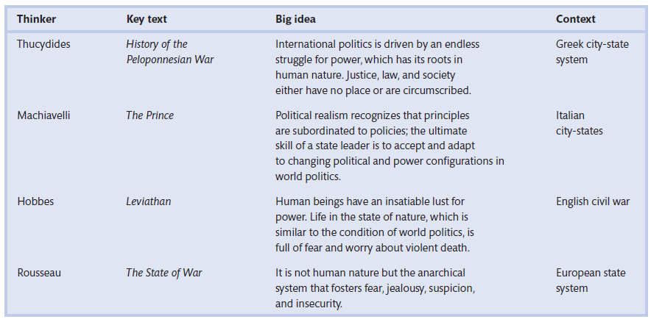
Realist Thinkers and their core ideas

Slide 29
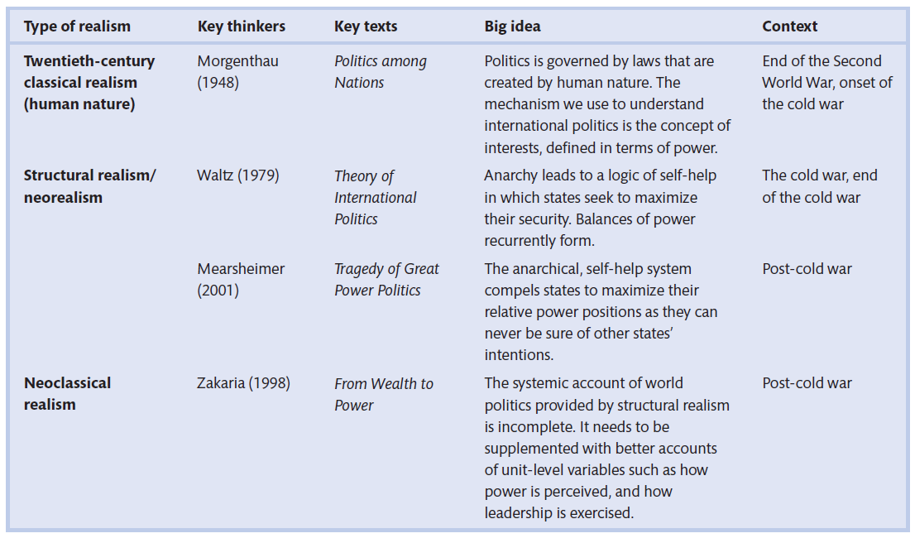
Realism, Thinkers, Big idea, and Context

Slide 30
Liberalism
The use of human reason and ethics in IR can lead to more orderly, just, prosperous, and cooperative world; and anarchy and war can be managed by int. institutions and law.
Liberalism focuses that govt. must ensure protection of life, liberty, and property of the individual.
It speaks the issues what Realism disregards (impact of domestic politics on state behavior, implication of economic interdependence, role of global institutions, etc.)
States, business groups, individual want more peace & prosperity

Slide 31
Liberalism Assumptions
An optimistic approach to global politics based on characteristics;
Faith in Human reason. (John Lock: 1632-1704)
Belief in progress & Growth. (Human are rational)
Democracies don’t go for war (E. Kant, T. Paine)
Economic interdependence among states (D. Ricardo, R. Cobden)
International Institutions – LoN & UNO, ensure peace.

Slide 32
Explanation!
It rejects power politics.
Advocates about mutual benefits & cooperation.
Emphasizes on economic interdependence.
Focuses on the necessity of Int. Institutions –UNO, EU, IMF, WB, ASEAN, G7, G20, etc.
Supports free trade & democracy.
Its unit of analysis (Point of focus) is individual.
Notes:
Idealism a term coined by realists to ridicule liberals who believed in international law, morality, and international institutions like LoN.

Slide 33
Liberal Ideas
An emphasis on the unity of humankind rather than narrow national interests.
The importance of individuals (freedom, human rights, equality above state sovereignty and interest).
Using the power of ideas to educate people against the warfare.
Not the lust for power, but the conditions under which people live, are the sources of conflict - reforming those conditions will enhance the prospects for peace.

Slide 34
Other Arguments
Establishment of consolidated democracies – compromise, tolerance, civil liberties to have a political culture that shun lethal force as means of settling disagreements.
“Democratic government will make wars less likely” W . Wilson
“the continued maintenance and improvement of democracy constitute the most important guarantee of international peace.” FDR
“Liberal democracy is the best form of government ever practiced.” F. Fukuyama
Diplomacy instead of use of force.
Politics is not zero-sum, persuasion rather than coercion.

Slide 35
Economic interdependence mitigates conflicts (Kant, Lock, Smith, Rousseau).
Econ Inter is even more important than democracy (Mousseau 2013)
“People who raise each others’ living standards through commerce are less likely to become combatants.” Bill Clinton, 1993
International Institutions promote peace and constrain the wars.
Perpetual peace by E. Kant.
Notes:
Transnational means going beyond the borders.

Slide 36
Neoliberalism
“Theory of political & economic practices, proposing that human well-being can best be advanced by the maximization of economic freedoms within the institutional framework characterized by private property rights, individual liberty, unencumbered markets , and free trade” (Harvey, 2007)
The “new” liberal theoretical perspective that accounts for the way international institutions promote global change, cooperation, peace, and prosperity through collective programs for reforms.

Slide 37
Constructivism (A. Wendt, M. Onuf, F. Kratochwil)
“Int. politics is a function of the ways/norms that states construct and respond to the meanings (identity) given to conflictual or cooperative politics.”
Our understanding of the world define the reality.
Ideas define identities, which gives meanings to material capabilities and behavior.
India (Hindu), Pakistan (Muslim), USA (Christian).
Pakistan (Taliban supporter - part of problem, USA part of solution).

Slide 38
Constructivism
It believes that neither objects nor concepts have any objective identity; rather, it is constructed through social interaction.
Example: Mosque & Money
It discusses how states construct their interest through their interaction with one another. (USA in the past and China today)
Constructivists focus on social aspects of IR than material – “military & economy” power.

Slide 39
Social Constructivism
The way we give meanings to others.
Meanings (Identity) makes us act accordingly.
Enmity and Amity – states act differently, they ally with friends and go against enemies.
“people act towards objects/humans on the basis of the meanings that they have for them”. A. Wendt
  Indian battle tank on Pak-India border? N. Korean bomb disturbs US, but UK’s not? WWI,II & today’s EU war is unthinkable? Where is power politics, anarchy, and militaries?
Anarchy, sovereignty, and power, are what we make of it.” Wendt, 2013.
Notes:
Titanic ‘s boats example …

Slide 40
Let’s take the case of 9/11
9/11 incident as:
Act of terrorism,
a criminal act,
revenge,
replica of pearl harbor,
attack on freedom,
Islamo-fascism,
clash of civilization,
a reaction of US Foreign Policy.

Slide 41
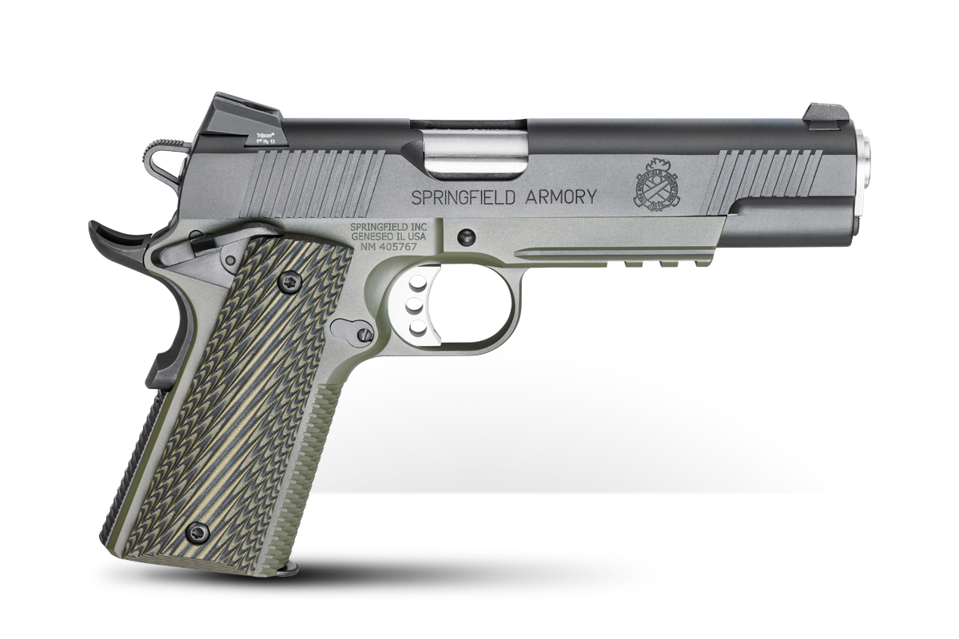
What does this physical entity represent?
Danger or safety?
Repression or freedom?
Fun or destruction?
Power or impotence?
Order or chaos?
Police gun or terrorist’s gun?

Slide 42
Assumptions
Reality does not exist.
All social realities are constructed.
Identities (friends & foe, terrorist & Mujahid, good & bad, Ally & competitor) are constructed.

Slide 43
Class Activity
Why has Indo-Pak rivalry endured?
Realism: Both prioritize power, security, security dilemma.
Liberalism: Weak insti. Democratic deficit, No interdep.
Constructivism: Identity, historical narratives, and socially constructed norms – socialization by the elite.
Conflict in Syria?
Realism: Struggle for power among states
Liberalism: Strong Int. Inst are needed to enforce peace agreements, Humanitarian inter, Human rights, etc.
Constructivism: identity based conflict – Sectarian, religious, ethnic, and ideological differences.

Slide 44
Post-modernism (J. Derrida, M. Foucault, Deleuze, Lyotard)
Approach to knowing – “what is truth & what not”
It questions previous approaches to knowing (pre-modern and modern).
Advocates Scepticism towards all established truths (narratives).
Postmodernism focuses on the question of representation - how a certain forms of action is legitimized while marginalizing others.

Slide 45
Key characteristics of Postmodernism
Skepticism of objective truth
Representation through language
Power
Deconstruction
Pluralism (rejects the idea of single fixed truth)
Stresses on Socio-cultural context.

Slide 46
Post-modernism
Post-modernism is essentially concerned with deconstructing the narratives’ truths.
“Palestinians are terrorists”
“Afghans are brave & love fighting”
“China, an East India Company”.
“Democracy, the only legitimate form of govt”.
“Vote ko Izzat do”
“Women are homemakers”
“Prosperity leads to modernity”
Teaches how things are created and got accepted through representation.

Slide 47
Significance in to IR
Politicians, leaders, authors, religious figures, and writers have their own biases & interests.
They represent their interests as universal truth.
Counter narrative can be introduced.
How legitimization and criminalization are normalized.
How highlighting one and silencing other is done.
How narratives, through language, construct social realities.

Slide 48
International Society Defined:
“International Society exists when a group of states, conscious of certain common interests and common values, form a society in the sense that they conceive themselves to be bound by a common set of rules in their relationship with one another, and share in the working of common institutions.” (H. Bull,1977)

Slide 49
Core claims:
Int. System (world) is a society.
States are members of this society.
This society is made of common rules & institutions (independence, security, justice, order, I. Law, Diplomacy, UNO, etc.)

Slide 50
International Society: 1950s onwards
It is based on the writings of H. Grotius, H. Bull, M. White, B. Buzan.
It believes “IR is a branch of human relations”.
It is a middle way between realism & liberalism.

Slide 51
Int. Society B/W Realism and Liberalism
Realism: world is like jungle where life is brutish and nasty under anarchy.
Liberalism: Let’s repeat what we do domestically.
Int. Society: International life is not that bad, let’s work together.

Slide 52
Assumptions
World politics is an “Anarchical Society”.
International Order can be non hierarchical.
Focuses on institutional approach (int. level) to the study of int. Politics, e.g. diplomacy, Int. Law etc.

Slide 53
Contemporary International Society
Globalization
Multilateralism and int. Institutions (UN, WTO, etc.)
MNCs
Humanitarian concerns (armed conflicts, HR violations, pandemic, climate crises)
Digital age (Internet, Social Media for connectivity and mobilization)
Climate change and sustainable development

Slide 54
Feminism
Belief in social, economic, and political equality of the sexes.
Feminism is an interdisciplinary approach to issues of equality and equity based on gender, its expression, identity, sex, and sexuality as understood through social theories and political activism.
“While women represent half the global population, one-third of the paid labor force, responsible for two-thirds of all working hours, yet they receive only a tenth of world income and own less than one percent of world property.” A. Tickner

Slide 55
Gender in International Relations
Gender in IR is about power relations, where feminists & masculinists are relative to each other.
What ‘men do’, or what ‘women do’, can’t be separated from power.
Feminism identifies & addresses gender subordination in global politics.

Slide 56
Gender is socially ‘constructed expectation’ that a particular sex have particular characteristics.
It is all about masculinization and feminization by constructing artificial boundaries.

Slide 57
How feminization is done in Politics?
Gender subordination – in military training under performing men regarded as ‘girl’.
When a state challenges other state’s masculinity with military manoeuvres.
Use of rape & forced impregnation as weapon of war.

Slide 58
Intentional victimization of women.
Women said to be crisis of national security, and men have to defend them.
Disarmament is casted as a-masculinity.

Slide 59
Foreign irrational & unpredictable govts are feminized.
Women should be kept out of security issues and be confined to economic issues.
SONS are ‘citizen warriors’ & DAUGHTERS are ‘home makers’

Slide 60
IR Concepts with gender bias.
Power: emanates from the barrel of the gun, and man behind the gun.
War: men wage war to protect the vulnerable segments of the society.
State: like men, is egoist & does not surrender,
Governance/Leadership: men are bringers of order, good at governance.

Slide 61
Woman as Industry ..
Women in IR, is defined by the need of the state to reproduce itself as means of security objectives.
States use women to increase Birth rate – to meet economic & military interests.
In USSR, female were coerced to bear more child in reaction to high death rates in WWII.

Slide 62
Recently, French, Polish, Italian govts offered financial incentives to have more kids.
In 3rd world, women are denied access to birth control, and abortion to increase in production rates.
Women are treated as ‘national wombs’ – a space out side politics (and least discussed).

Slide 63
Conclusion
Central claim - gender is a socially constructed issue not a biological one .
Feminism rejects male dominance in IR.
It has passionate interest in the possibilities for the change in world politics.

