Slide 1
Lecture 5
Pak-Iran & Pak-Saudia Relations
Pak-UK and Pak-EU relations

Slide 2
Pak-Iran Relations
Pak-Iran shares a 900 KM long border.
Relations have a mixed history of cooperation (during CW) and skepticism (after the 1979 revolution).
Enjoyed cordial relations during the Cold War.
Diplomatic Engagements:
The first country to recognize Pakistan in 1947.
PM Liaquat Ali Khan visited Iran in 1949, and diplomatic relations were established, Shah of Iran also reciprocated this in return.
Since then, Pakistan and Iran have maintained regular high-level diplomatic communications to address mutual concerns and enhance cooperation.

Slide 3
Pakistan saw Iran as the preferred country (sect, geography, US umbrella, etc.) when the Arabs were in the pre-oil era.
ECO (RCD), and OIC plate forms of cooperation.
Iran supported Pakistan, diplomatically, financially, and militarily in the Pak-India wars of 1965 and 1971.
Geopolitics (Shia-Sunni) of Religion
After revolution, the rise of Shia identity in the region and containment-counter-containment efforts by Iran and Saudi Arabia have influenced the relationship.

Slide 4
Pak-US strategic Partnership: After 1979, Iran moved away from the US, and Pakistan became the most allied ally – Afghan Jihad.
  Afghanistan: point of divergence, Deobandi Taliban and Shia Hazaras, and sphere of influence politics.
Indo-Iran Strategic Partnership. Pakistan’s tilt towards Arabs, and Iran’s love affair with New Delhi (Baloch separatists, oil diplomacy, Kulbhushan Jadhav 2016).

Slide 5
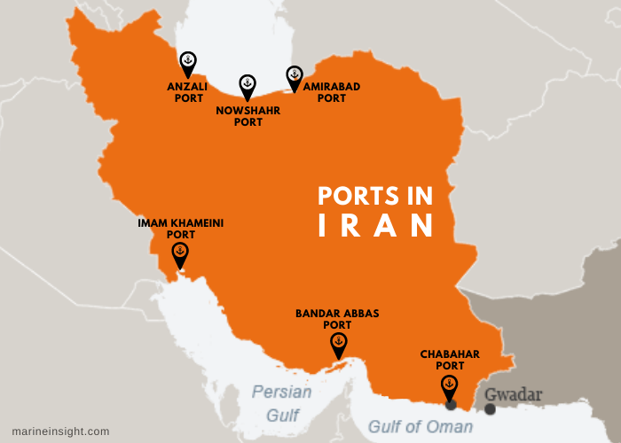
Pak-Iran competition over access to CARs
Strategic Rivalry
Port Qasim & Gwadar
Versus
Bandar Abbas & Chabahar.

Slide 6
Economic Relations
Bilateral trade volume 2.3 billion US$ in 2023.
Pak-Iran signed a trade agreement in 2023 (to rise to 5 Billion)
April 2024, agreed to raise to 10 Billion (Raisi Visited Pakistan)
8 MOUs signed – easefire in Gaza, Ban terror outfits, and work against drug trafficking, smuggling, and terrorist’ movement.
Pak-Iran gas pipeline… ??
Pakistan Imports: Dry fruits, Nuts, Petrol, Dairy products, honey, Lubricants, tea, spices, Soap and Shampoos.

Slide 7
Contemporary Issues and Way Forward:
Security is a major issue: Cross-border terrorism, Smuggling, and Human trafficking.
Balochistan insurgency, and terrorism (Jundullah, Jaish Ul Adl)
Convergence: Afghanistan, Sectarianism, Terrorism, China factor.
US withdrawal is a positive development (India & IS).
Energy-starved Pakistan and energy-rich Iran have great economic potential in the energy sector.
Religious tourism – Zaireen visit Iran
People to people between Balochistan and Sistan Balochistan of Iran.

Slide 8
Conclusion
Pak-Iran relations are complex with bilateral, regional, and global dimensions.
Continuous engagement is the only way forward for both nations' regional stability and prosperity.
Tangible bilateral cooperation is far below potential.
FATF black-listing of Iran and sanctions are challenges.

Slide 9
Pak-Saudia Relations
Pak-Saudi relations revolve around the religious, economic, and strategic commonalities since 1947.
Early years: diplomatic relations were established soon after Pakistan’s independence.
Islamic solidarity – mutual support in Int forums like OIC.
Saudia supported during Indo-Pak wars (in 1971- financial and diplomatic support)
Economic Cooperation: The oil boom kicked the economic cooperation in 1970s – Saudia supported with oil subsidies, and financial assistance, Pakistan exported work force and remittances. (2.64 Billion).

Slide 10
The last phase of the Cold War: Geopolitics of Religion
The Soviet invasion of Afghanistan: KSA and Pakistan supported Mujahedeen: Saudia with finances and Pakistan with manpower, logistics, and weapons.
Religious influence: Wahabism (domestic ideology of KSA) to counter the Iranian revolution (Shia-Sunni sectarianism).
Economic support: during the days of political instability of the 1990s and post-nuclearization of South Asia.

Slide 11
9/11, WoT, and Counterterrorism Cooperation.
Counter-extremist ideologies and dismantling terrorist networks (intelligence sharing).
Pak-KSA-USA cooperation posed a challenge for Pakistan in balancing its relationship with Iran and KSA.
The Arab Spring, Yemen Conflict, and Pakistan’s limited FP choices pushed Saudia to India.

Slide 12
Contemporary Relations and Future Prospects
Economic ties: MBS’s 2030 vision (Modernization Project) presents economic opportunities in various sectors – human resources and material.
Military ties: exercises, and training.
Diplomatic ties: engagement on critical issues like Palestine, Kashmir, terrorism, etc.

Slide 13
Conclusion
Relations between Saudia and Pakistan have evolved from mere diplomatic cooperation to strategic, economic, and cultural dimensions.
It has more potential than what it is right now.
However, with the changing geopolitical landscape both countries may face some challenges that may change the trajectory of the relationship.

Slide 14
Pak-UK Relations
History of Colonialism
The history of relations can be traced back to the colonial period.
Independence of Pakistan led to bilateral relations.
Pakistan is a member of commonwealth countries – that fosters cooperation in politics (mediation), economics (trade), education, capacity building (governance and sustainable development), and culture.

Slide 15
Diplomatic Relations
Regular exchange of high-level visits and meetings from both sides.
UK supports Pakistan’s democratic institutions and governance reforms.
Strategic cooperation
On Security, Counterterrorism, capacity building, and regional stability (Afghanistan).
Economic Relations
4.1 Billion US$ bilateral trade volume 2023
1.6 Million Pakistanis send almost 3 billion US$ annually (third highest after KSA, and UAE).
One of the largest export destinations for Pakistan.
DFID assists Pakistan in education, health, and poverty eradication programs.

Slide 16
Future Prospects:
Educational exchange (visa regime be softened – potential for cooperation).
Export of quality human resources (remittances and soft power)
Human Rights and Governance (concerns of the UK)
Trade can be enhanced to harness the optimum potential.

Slide 17
PaK-EU Relations
Economy, Values, and Security are the interacting points.
Economic Relations
EU granted GSP + status (generalized scheme of Preferences Plus) in 2014 (boosting Pakistan’s exports’ entry into EU market).
Trade volume 39.810 billion US$ in 2022-23.
Pakistan exports textile and agri products, and imports machinery and chemicals.
Development and assistance: for rural development, education, and sustainable development.

Slide 18
Strategic Engagement Plan 2019
  Both agreed to cooperate on:
  Peace and Security
  Democracy, Law, Governance, and Human rights
  Migration and mobility
  Trade and Investment
  Sustainable development (eco, soci, envi sustainbility)
  Education and Culture
  Science and Technology

Slide 19
Human rights, Security, and Counter-Terrorism
EU has communicated concerns over Freedom of expression, women’s rights, treatment of minorities.
Both engage in dialogue to address these issues.
Information sharing (EU disinfo lab is an example)
Work together on terrorism, extremism, counter-terrorism, capacity building, and regional security.

Slide 20
Conclusion
Economy, governance, liberal values, and security will continue to be the points of interaction.
Strategic Engagement Plan 2019 should be worked on for economic cooperation, development, education, and science.

