Slide 1


Slide 2
Part-II (General Ability) 40 Marks
VI. Quantitative Ability/Reasoning
· Basic Mathematical Skills.
· Concepts and ability to reasons quantitatively and solve problems in a quantitative setting.
· Basic Arithmetic, Algebra and Geometry (Average, Ratios, Rates, Percentage, Angles, Triangles, Sets, Remainders, Equations, Symbols, Rounding of Numbers
· Random Sampling

Slide 3
VII. Logical Reasoning and Analytical Reasoning/Ability
· Logical Reasoning includes the process of using a rational, systematic series of steps based on sound mathematical procedures and given statements to arrive at a conclusion
· Analytical Reasoning/Ability includes visualizing, articulating and solving both complex and uncomplicated problems and concepts and making decisions that are sensible based on available information, including demonstration of the ability to apply logical thinking to gathering and analyzing information.
VIII. Mental Abilities
· Mental Abilities Scales that measures specific constructs such as verbal, mechanical, numerical and social ability.

Slide 4
Missing Terms/Number Series

Slide 5
Find the missing number to complete each sum a. 9+8-5=2x(__) b. 3x9-14=24-(__) c. 15÷3x12=41+(__) d. 24÷4+5=66÷(__) e. 8x6-13+3=7x6-(__)

Slide 6
Find the missing terms in given series
4, 12, 20, ____
4, 9, 16, 25, 36, ____
4, 8, 16, 32, ____
2, 5, 11, 23, 44, _____

Slide 7
1, 8, 4, 27, 9, ___, ___
3, 6, 8, 16, 18, ____
2, 8, 512___
4, 16, 36, 64, ____

Slide 8
3,5,10,20,37_____
1, 1/4, 1/13, 1/40, _____
8,5,13,11,18,17,23,23,28____
14, 27, 52, 101, 198, _____

Slide 9
CSS-2024
Find the missing terms a. 121, 11, 81, 9, ___, 7 b. 100, 50, 25, ___, 6.25 c. 4, 9, 64, 125, 1296, ___ d. 2, 5, 12, 24, 48, ___ e. 44, 22, 66, 33, 132, ___

Slide 10
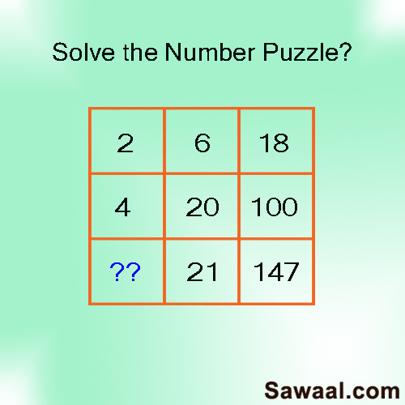

Slide 11
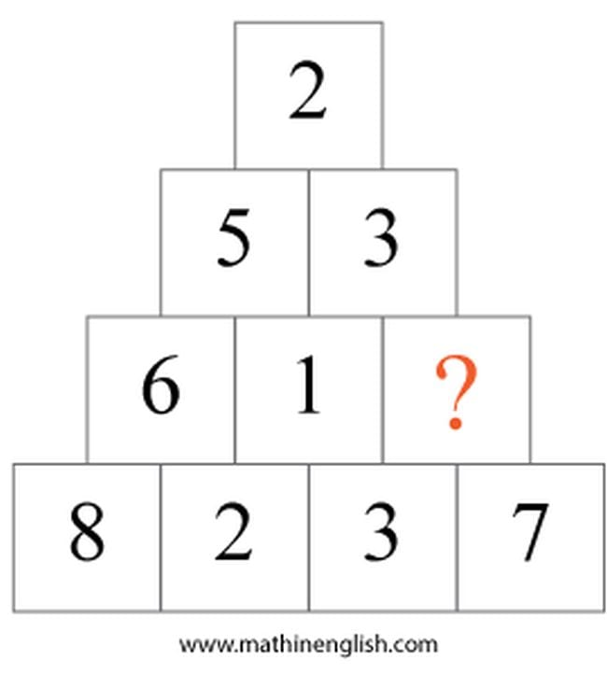

Slide 12
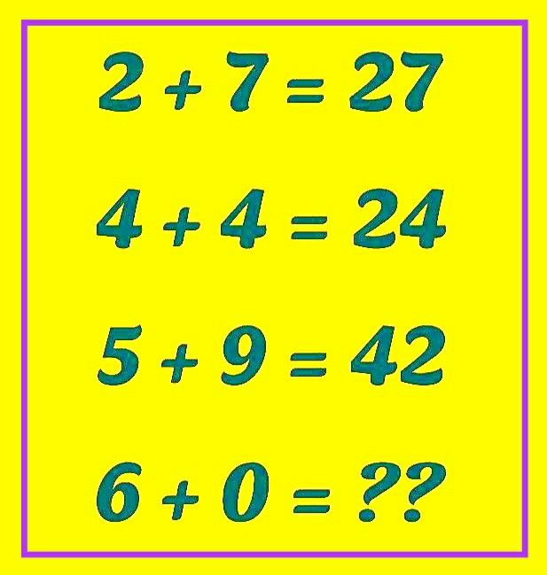

Slide 13
Alphabetical Series
&
Coding/Decoding

Slide 14
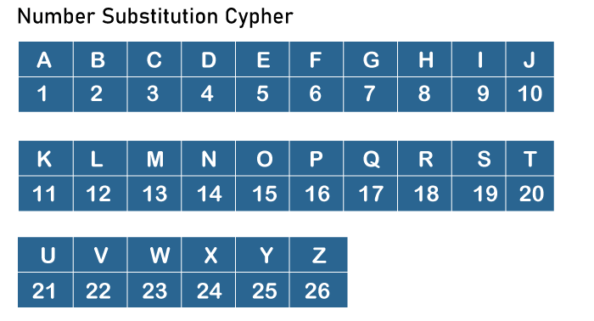

Slide 15
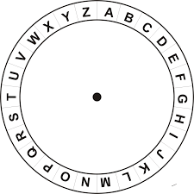

Slide 16
Questions:
Find the missing term in given
1. E, H, L, O, S, ____
2. A, A, B, F, ____
3. AB,DE,GH,JK, ____
4. PDZ, ____, RBX, SAW

Slide 17
3. A,D,I,P,Y,J___
4. AZ, GT, MN, ___, YB
5. PMT, OOS, NQR, MSQ, ___
6. O,T,T,F,F,S,S,E,N____

Slide 18
The word SUPERMAN is written as a code “TTQDSLBM” then the code of SPIDERMAN is?

Slide 19
PAKISTAN: SCLIRRXJ
PESHAWAR: ??
CERTAIN: BFQUZJM
MUNDANE: ??

Slide 20
If in a certain language, BROTHER is written as QDGSNQA, then in the same language SISTER would be written as…? (CSS-2022)
COMPUTER: RFUVQNPC
MEDICINE: ???
(CSS-2017/19)

Slide 21
Look at this series: F2,___, D8, C16, B32. What number should fill the blank? (CSS-2018)
In a certain language LANDMINE is written as PYRBQGRC. How will HOMEMADE be written in that code language? (CSS-2018)

Slide 22
Algebraic Expression

Slide 23
The sum of three consecutive odd number is 273. What are the three odd numbers?

Slide 24
1. The sum of four consecutive integers is 210. Which one of these four integers is prime?
2. Find three consecutive even numbers with a sum of 72.

Slide 25
3. Sum of three consecutive prime number is 97. Find the numbers.
4. The sum of three consecutive prime number is 287. Find the numbers.

Slide 26
Q1.
If a number and its fourth part added together becomes 27. What is the number?
Q2.
Sum of two numbers is 45. One of the numbers exceeds the other by 13. Find the numbers.
Q3.
A telephone company charges initially Rs. 0.50 and then Rs. 011, for every minute. Write and expression that gives the cost of a call that lasts ‘N’ minutes. (CSS)

Slide 27
Q4. Tayyaba visited a book store; she purchased three books and 8 pens for 4350, while the cost of two books and five pens is Rs. 2800. Find the cost of one book and one pen.
Q5. If the sum of two numbers is 30 and their difference is 8. What is their product?
Q6. Two bus tickets from RWP to ISB and three tickets from RWP to Murree cost Rs. 770 but three tickets from RWP to ISB and two tickets from RWP to Murree cost Rs. 730. What are the fares for cities ISB and Murree from RWP? (CSS)

Slide 28
Q7. Zahid left a property worth Rs. 1,750,000. His family had to pay off a debt of Rs. 150,000. The rest of the money was distributed between a son and a daughter. How much did each child receive if the share of a son was double that of a daughter? (CSS)
8. The sum of two numbers is 18 and the product of these two numbers is 56. What are the numbers?

Slide 29
In a farm, a farmer counted 78legs and 35heads consisting of cows and hens. How many hens does the farmer have?
A farmer keeps hens and rabbits on his farm. One day he counted the total of 70heads and 196legs. How many more hens than rabbits does he have? (CSS)

Slide 30
If the sum of three-digit number is 15 and sum of 10th and unit digit is 12. The difference of unit digit from 10th digit is equal to 02. What is the three-digit number?
CSS-24

Slide 31
If the sum of four numbers is 105. When 03 is added to a number, twice of another number, five times of third number and fourth number becomes equal to each other. What are these numbers in ascending order
CSS-2024

