Slide 1
NPT, MTCR ,
WEAPONIZATION OF SPACE
By
Abdul Qadeer pas

Slide 2
Non-Proliferation treaty NPT
Main purpose of the treaty
1- Preventing the spread of Nuclear weapons
2- Promoting cooperation in the peaceful use of Nuclear Energy
3- Disarmament of Nuclear weapons
Ever since it came into effect since 1970 after it was opened for signing in 1968, the Non-Proliferation Treaty has 187 nations who are a party to it – more than any other arms limitation treaty.The treaty established a safeguard system under the responsibility of IAEA , which also plays a key role in the peaceful transfer of Nuclear energy.

Slide 3
Three pillars of NPT
1- Non-Proliferation
2-Disarmament
3- Peaceful Uses of Nuclear Technology
It was a bargain between NWS and NNWS. NNWS pledged not to acquire nuclear weapons in exchange of getting benefits of peaceful use of Nuclear energy.

Slide 4
Article I-III (Focus on Non-Proliferation)
NWS undertakes not to transfer “nuclear weapons or other nuclear devices” to NNWS (Article I)
NNWS agreed not to receive manufacture or acquire nuclear weapons (Article II)
NNWS agreed to accept safeguards by the IAEA to verify that they are not diverting nuclear energy from peaceful uses to nuclear weapons. ( Article III)

Slide 5
Article IV-V( Peaceful use of Nuclear Energy)
Recognized the inalienable right of sovereign states to use nuclear energy for peaceful purposes but in conformity with Article I and II.
All the parties to the treaty undertake to facilitate and have the right to participate in the fullest possible exchange of equipment, material , scientific and technological information for the peaceful uses of nuclear energy. ( Article IV)
Measures to ensure the potential benefits of peaceful use of Nuclear technology to NNWS without any discrimination. ( Article V)

Slide 6
Article VI ( Disarmament )
Each of the parties to the treaty undertakes to pursue negotiations in good faith on effective measures relation to cessation of nuclear arms race at an early date and take effective steps to nuclear disarmament.

Slide 7
Failure on the part of NPT
Nuclear disarmament : still a far cry
Failure to include Pak , India Israel and NK in the realm of NWS
Undue restrictions even for seeking peaceful use of Nuclear technology
Monopoly of NWS is still in place
No reference to testing ban or freezing of production of fissile material
NWWS also feels that the restrictions on Peaceful Nuclear Explosion (PNE) technology are one-sided. ‘atomic apartheid’ and ‘commercial super-monopoly,’ and insisted that PNE rights need to be integral to all peaceful uses of nuclear energy.

Slide 8
Purpose of Nuclear weapons was to avert war
“Thus far the chief purpose of our military establishment has been to win wars. From now on its chief purpose must be to avert them.” Bernard Brodie (American Nuclear Strategist)
“It did not take atomic weapons to make man want peace. But the atomic bomb was the turn of the screw. It has made the prospect of war unendurable.” Robert Oppenheimer

Slide 9
World without Nuclear Weapons
In a major speech in Prague on April 5, 2009, President Obama expressed “America’s commitment to seek the peace and security of a world without nuclear weapons.”
The reasons advanced in favor of elimination are many.
First, the world has been lucky for some decades, but despite the best efforts of leaders, nuclear war (due to accident, technical malfunction, etc.) cannot be avoided for perpetuity;
second, maintaining nuclear arsenals encourages proliferation;
third, deterrence rests on the threat to kill innocent civilians;
and, last but not least, nuclear weapons contribute more to insecurity than to security.

Slide 10
Missile Technology Control Regime

Slide 11
MTCR
CONTROL REGIME of nonproliferation of systems capable of delivering weapons of mass destruction (other than manned aircraft.)
The MTCR was originally established in 1987 by Canada, France, Germany, Italy, Japan, the United Kingdom and the United States. Since that time, the number of MTCR partners has increased to a total of 35 countries, all of which have equal standing within the regime.

Slide 12
Revisiting MTCR in 1992
The regime encourages the member states to restrict the export of missiles and the related technologies. Initially, the regime was limited to curbing the proliferation of nuclear capable missiles, which were defined as a missiles able to travel at least 300 km with a 500 kg payload. Later in 1992, the member states agreed to expand the regime’s mandate to include missiles and related technologies designed for chemical and biological weapons.
Notes:
The MTCR has a list of restricted items specified in the “Equipment, Software and Technology Annex,” which includes a broad range of military and the dual-use equipments and technology related to missile development. The Annex is further divided into Category-I and Category-II items. Category-I includes a complete list of ballistic missiles, space launch vehicles, rockets and sub-systems and UAV systems including cruise missiles systems and drones. Category-II includes specialised materials, technologies, propellants and sub-components for missiles and rockets.
Category-I items are relatively restricted since they may include ballistic missiles or entire systems. Category-II items are less restricted since they include items that have civilian uses. However, the members are required to exercise caution in the transfer of Category-II items as well.

Slide 13
MTCR A Voluntary Regime
MTCR is a voluntary regime, it is the responsibility of the members to assess whether it wants to export certain items or not.
No member can object to or veto other member’s exports.
There is no penalty for the violators either.
Notes:
However, the US has laws in place that sanction entities, individuals, and governments, irrespective of whether they are the MTCR members or not, if they export the MTCR-restricted products to countries that pose a proliferation threat or potential danger to the US security. The US can also impose sanctions if it considers a transfer contrary to the MTCR

Slide 14
India’s Membership of MTCR: Implications for South Asia

Slide 15
INDIA & MTCR
India applied for the membership of the MTCR and obtained it in June 2016.

Slide 16
US support to INDIA
The Indian Ministry of External Affairs announced that India became a member of the MTCR on June 27, 2016. In 2016, India’s membership of the MTCR was ensured when a US-India joint statement released on June 7, during the Indian President’s visit to Washington, stated that the Indian and the US Presidents looked forward to India’s “imminent entry” into the group. The US has been vigorously campaigning to get India into elite export control groups like the NSG and MTCR.
Notes:
It had initially applied for the membership in June 2015, and the matter was discussed in the October 2015, plenary session of the MTCR but could not be approved because Italy objected to the membership. Since membership decisions are taken through consensus, India could not get the membership in 2015.

Slide 17
India’s Motive of Joining Regime
India’s primary motivation of joining the regime is to strengthen its efforts to join the NSG.
India, backed by the US and Western supporters, is trying to represent itself as a responsible member of the international community, which is committed to countering the proliferation of WMDs.
Far from promoting non-proliferation goals, the MTCR membership would help India to advance its missile programme, as it is expecting to get easier access to some advanced missile technology.
Notes:
The Ministry of External Affairs in its statement also stated that India’s membership of the MTCR would help strengthen the global non-proliferation objectives. However, India’s application to join the NSG was not yet approved.

Slide 18
India’s Motive of Joining Regime
India’s membership would mean that supplier countries can be less fearful of the US sanctions if they wish to sell to India.
It would also help India acquire military hardware from the US. It might have a positive effect on India’s effort to acquire armed Predator drones from the US.
Notes:
India can also now have access to systems like the Israeli Arrow-II missiles. India had attempted to procure the missile interceptor systems in the past as part of its missile defence systems. However, the transfer of the missiles and related technology required the US approval since it had helped Israel develop the interceptor technology of the Arrow-II system. The US administration at that time was committed to applying the MTCR guidelines in any re–transfer of the system. As a result, the sale of Arrow II did not materialise even though Israel was willing to sell it. India can now hope to purchase these systems as a member of the MTCR.

Slide 19
MTCR BOOST INDIA’S MISSILE PROGRAMMES
India’s space programme also stands to gain from the membership of the MTCR. The Indian Space Research Organization (ISRO) has been working on an expansive space launch technology since the 1990s. The Geosynchronous Satellite Launch Vehicle (GSLV) was initiated in 1990, with the objective of developing indigenous satellite launch capability since India was mostly dependent on the US or Europe for launching its satellites.
Notes:
India is also expected to get access to subsystem technology and expertise that can feed into India’s indigenous weapons development that may cross the MTCR boundaries. Theoretically, the Indian defence industry could access German or British propulsion and aero structure expertise like airframe design and random materials to advance the development of long range cruise missile or to improve existing cruise missile designs. While India has been working hard to develop indigenous systems and technologies, being able to tap into foreign technology and expertise would help accelerate indigenous systems.

Slide 20
MTCR Membership Boost India’s Arms Exports
Another advantage of joining the MTCR is that it broadens the scope of possible offset investment and collaboration for foreign vendors.
The MTCR membership would also boost India’s arms exports. India has accelerated its efforts for the sale of jointly developed Indo-Russian supersonic cruise missile BrahMos. BrahMos has a range of 290 km and can be fired from land, sea and submarine.
,
Notes:
An air-launched version is under testing. According to the reports, India has stepped up its efforts to sell BrahMos to Vietnam and has at least 15 more markets in its sights. India has ordered BrahMos Aerospace, which produces the missiles, to accelerate sales to a list of five countries topped by Vietnam, Indonesia, South Africa, Chile and Brazil. Other countries have also expressed interest in acquiring BrahMos, which includes Philippines, Malaysia.
India’s MTCR membership will give it access to high-end sensitive missile technology and hardware. It is also likely that the member states can transfer sensitive technologies to India without the fear of facing US sanctions.
India is hoping to procure drones from the US that were hitherto not available to. India is already developing the long endurance drones like Medium Altitude Long Endurance (MALE) and High Altitude Long Endurance Drones (HALE) with endurance capabilities at station ranging from a few weeks to a month.
India faces critical technological issues in the development of the drones. However, after becoming a member of the MTCR, India would be able to seek and develop these technologies in collaboration with other member states.

Slide 21
MTCR Membership Boost India’s Arms Exports
Overall, the MTCR membership would help India a great deal in entering the global missile market. It can become a significant importer of missiles and technology and an exporter as well.
The membership of the MTCR has brought India a step closer to its goal of joining the NSG. As an MTCR member, India’s credentials to join other export control regimes have improved.
Notes:
India has already made tremendous progress in designing, developing and producing a wide variety of missiles. Cutting edge technologies that it can access as a member of the MTCR would further enhance its expertise in missile development.

Slide 22
Implications for South Asia
India would also be able to get technology for its space programme. This means that India’s space programme would be accelerated. It also means that India’s ICBM development would benefit as well since the space launch technology is the same as the ICBM technology. India is currently working on Agni-V and Agni-VI ICBMs. Once these missiles are developed India can target China and Europe and beyond.
Being able to procure high-end missile technology means an accelerated missile programme, which would result in a further missile and nuclear asymmetry between India and Pakistan. This and acquisition of drones would further heighten Pakistan’s threat perceptions.
Balance more tilted towards India
Notes:
Besides the most obvious, the real advantage of India’s MTCR membership is increase of its prestige and status. India is central to the US policy of pivot to Asia whereby the latter hopes to build India up as a strategic balancer against China. The fear is that with the US pushing for India’s membership to the NSG, India’s entry into the group on exceptional basis would further tilt the South Asian balance in India’s favour.

Slide 23
Pakistan and MTCR
SHOULD PAK JOIN MTCR?
Joining the MTCR does not add any value and that it has adequate capacity to ensure its own security and deterrence
Joining the MTCR could put Islamabad under international pressure
“we do not feel that it is a propitious time for applying. "At the same time, Pakistan has emphasized that it is already voluntarily following the MTCR guidelines and it meets the entire MTCR criteria. Nafees Zakaria Spokesman FO
Executive Director of the Centre for International Strategic Studies (CISS), Ambassador Sarwar Naqvi, said that Pakistan did not feel the need for entering the MTCR because it had indigenous missile capability that was adequate for its own security and deterrence
Notes:
The debate within Pakistan on the merits and demerits of joining the MTCR is reflective of uncertainty surrounding the issue. Pakistan seems to understand that joining the MTCR is prone to risk since the US could use the MTCR to control and shape Pakistan’s missile programme. India’s special status and subsequent advantages from the MTCR membership stem from the convergence of its interests with the US. It is in the US interest to have a powerful India as a balancer against China. However, the US has no such convergence of strategic interests with Pakistan. Pakistan is no more important for strategic reasons nor is it a big economic market. Consequently, once Pakistan joins the MTCR, the US could very well demand that Pakistan dismantle all missiles over the range of 300 km or may insist on putting limitations on the development of missiles.
Besides the debate over the utility of formally joining the MTCR, there is also the issue of whether Pakistan would be able to win the consensus of all the member states to enter the regime. It is likely that Pakistan would be faced with some tough campaign of consensus building, even if it chose to apply for the MTCR membership. No membership is granted without the consensus of all member states.

Slide 24
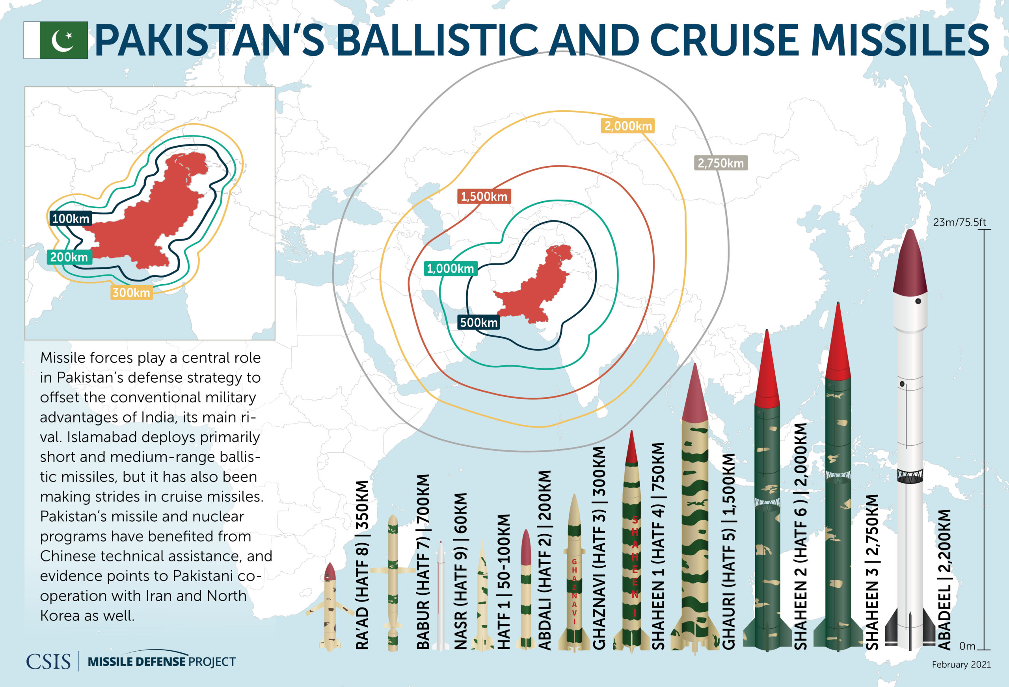

Slide 25
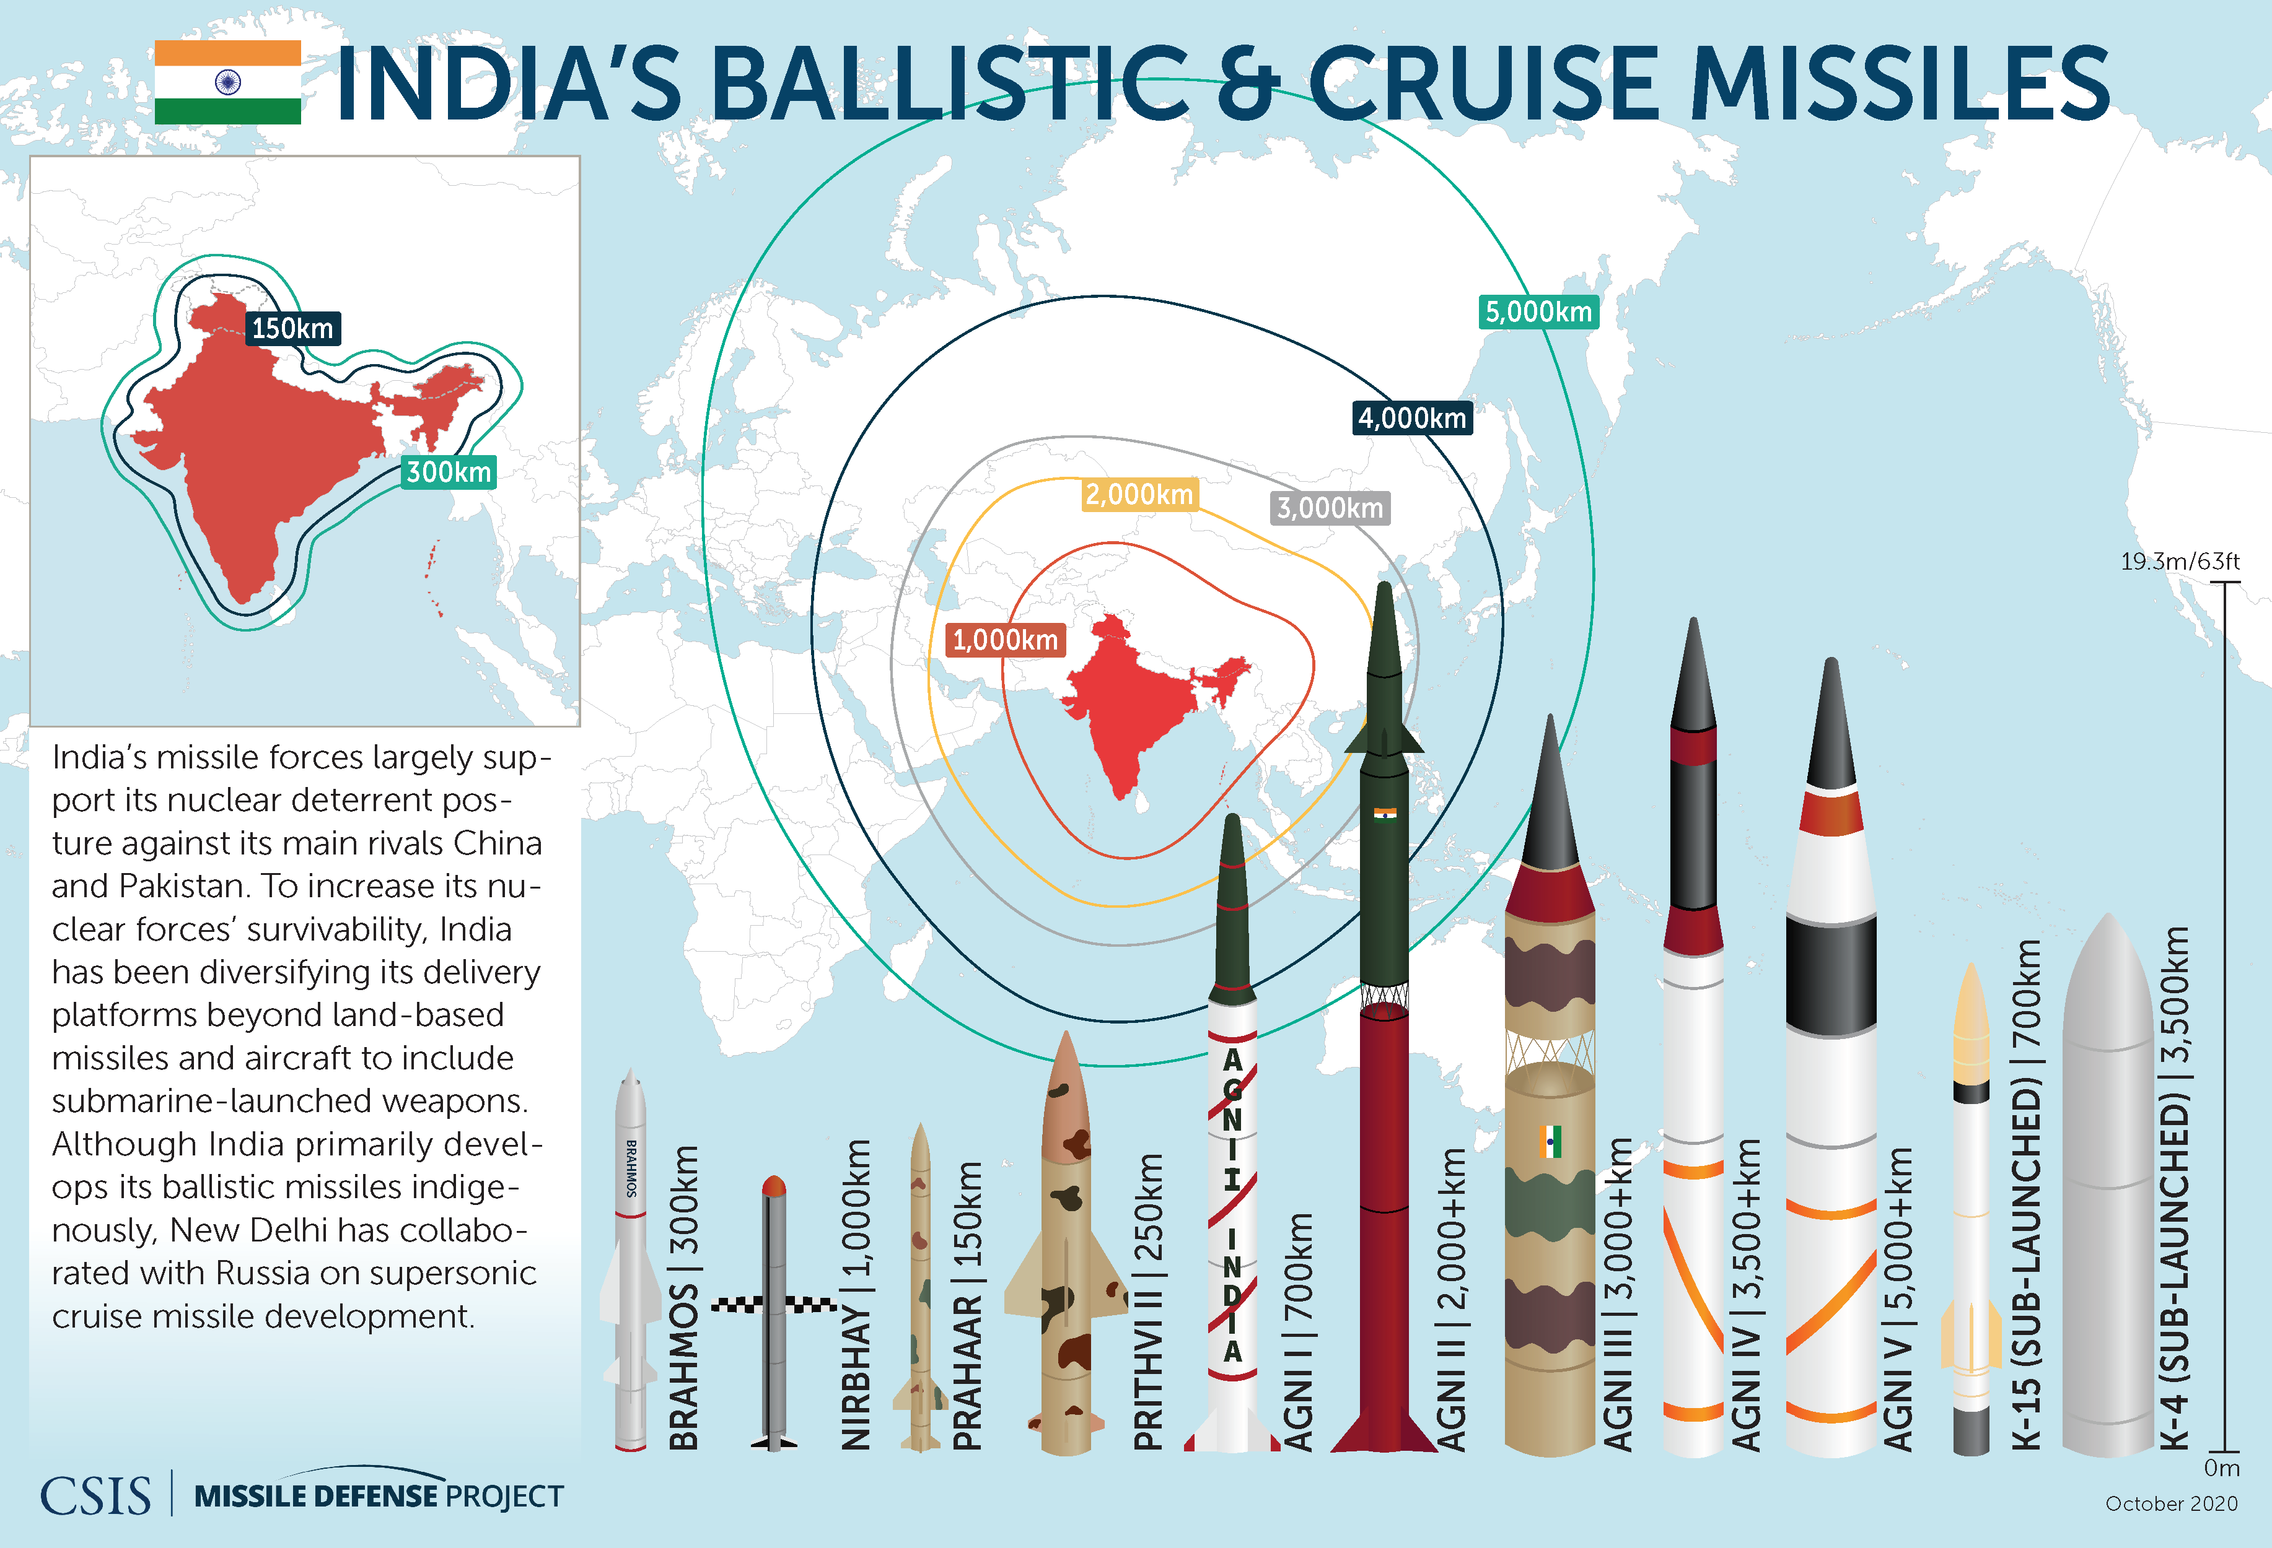

Slide 26
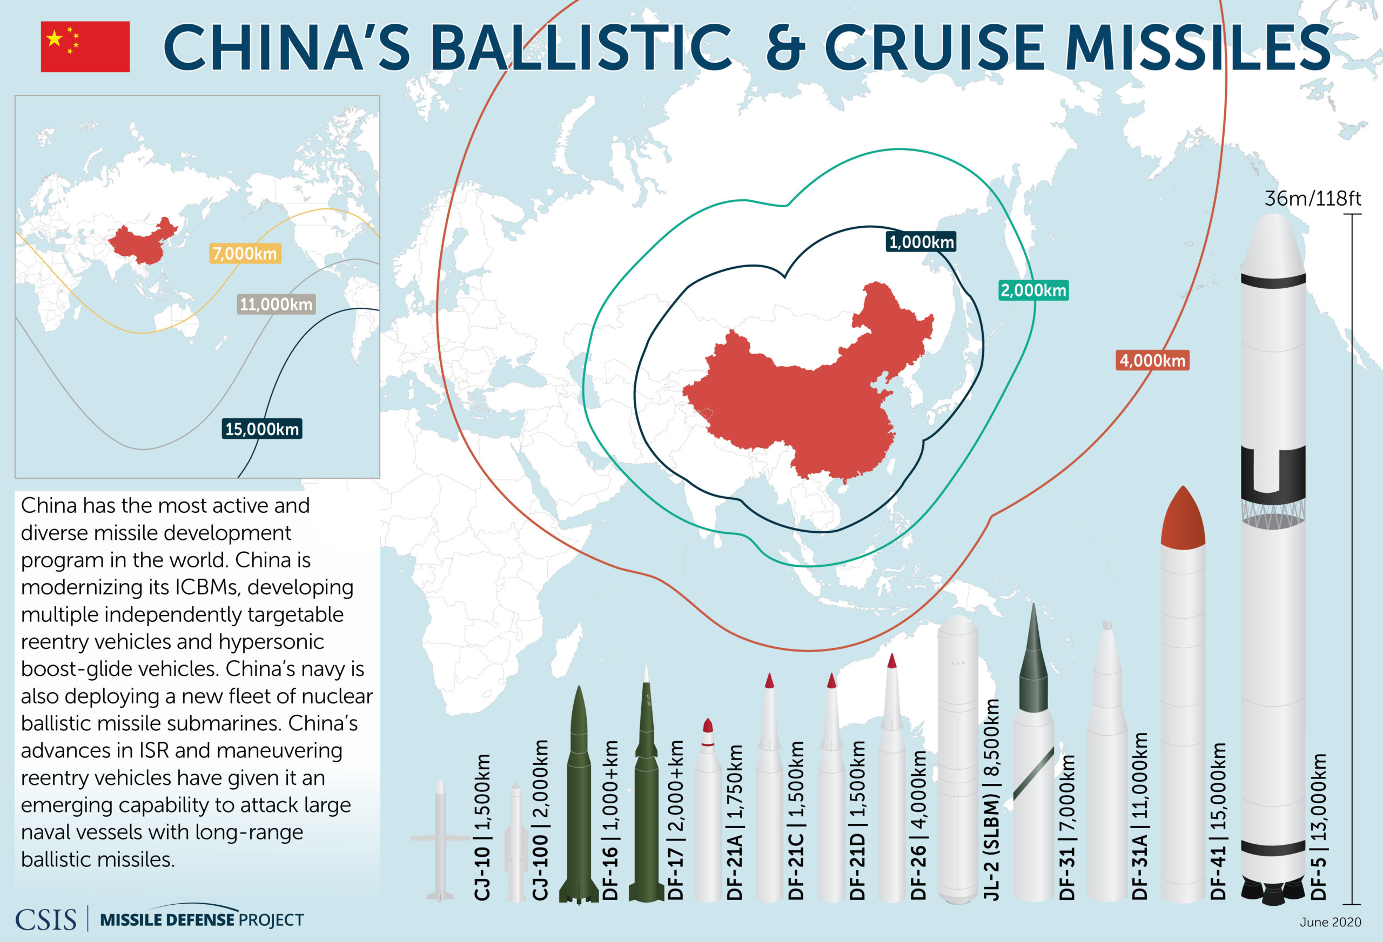

Slide 29
Questions need to be explored
Nuclear threat in South China Sea and in Indo Pacific Ocean
Role of AUKUS AND QUAD in deterring any Nuclear threat
Options for CHINA
Impact of Russia Ukraine war on Europe

Slide 30
WEAPONIZATION OF SPACE

Slide 31
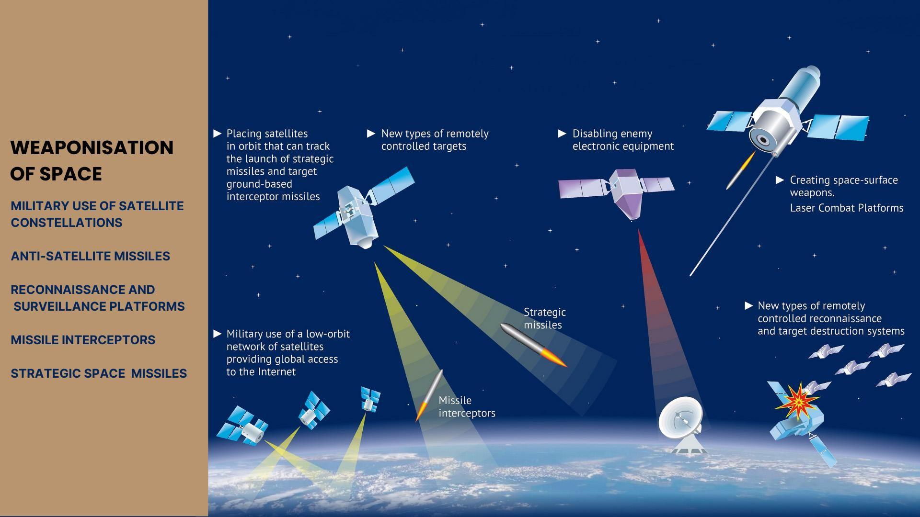

Slide 32
Weaponization of Space
Space weaponization is the process of placement of weapons in outer space or on heavenly bodies. It also involves the creation of weapons that will transit outer space or simply travel from earth to attack or destroy targets in space.
Weaponization of space v/s militarization of space
The weaponization of space is different from the militarization of space. Militarization of space includes the usage of space-based assets for command, control, communication, surveillance, and reconnaissance activities.
Militarization of space assists armies on the conventional battlefield whereas via weaponization of space, outer space itself becomes the battlefield. Space emerges as the ‘fourth frontier of war’

Slide 33
HISTORICAL ACCOUNT OF SPACE
The USSR became the first power on planet to launch first artificial satellite SPUTNIK in 1957.
we choose to go to the moon and do other things, not because they are easy but because they are hard. Because that goal will serve to organize and measure the best of our energies and skills. Because that challenge is the one we are willing to accept, one we are unwilling to postpone and one we intend to win. President John F Kennedy

Slide 34
On April 12, 1961, Russian Lt. Yuri Gagarin became the first human to orbit Earth in Vostok 1. His flight lasted 108 minutes, and Gagarin reached an altitude of 327 kilometers (about 202 miles).
The first U.S. satellite, Explorer 1, went into orbit on Jan. 31, 1958
On July 20, 1969, astronaut Neil Armstrong took “one giant leap for mankind” as he stepped onto the Moon. Six Apollo missions were made to explore the Moon between 1969 and 1972.

Slide 35
HISTORICAL ACCOUNT OF SPACE
Skylab, America’s first space station, was a human-spaceflight highlight of the 1970s, as was the Apollo Soyuz Test Project, the world’s first internationally crewed (American and Russian) space mission. The International Space Station is a research laboratory in low Earth orbit.
Satellites discovered an ozone hole over Antarctica, pinpointed forest fires, and gave us photographs of the nuclear power plant disaster at Chernobyl in 1986
Astronomical satellites found new stars and gave us a new view of the center of our galaxy.

Slide 36
Weaponization of outer space
Space weaponization is generally understood to refer to the placement in orbit of space-based devices that have a destructive capacity. Some also argue that weapons that travel through space in order to reach their targets, such as hypersonic technology vehicles, also contribute to the weaponization of space.
Notes:
Many experts argue that ground-based systems designed or used to attack space-based assets also constitute space weapons, though are not technically part of the “weaponization of outer space” since they are not placed in orbit. Many elements of the US ballistic “missile defense” system currently being developed or planned could constitute space weapons as well, as many possess “dual-use” characteristics, allowing them to destroy space assets as well as ballistic missiles.

Slide 37
How much the US is investing in Space missions and why?
The US military space budget is estimated at 25 billion dollars and possibly even at more than $40billion .
“I’m convinced that in this century the nations that lead in the world are going to be those that create new knowledge. And one of the places where you have a huge opportunity to create new knowledge will be exploration of the universe, exploration of the solar system, and the building of technology that allows you to do that,” said former congressman and aerospace expert Robert Walker at a meeting on space policy in 2013.
Notes:
Hypersonic missiles rely on satellites to function properly and for this reason both Russia and China are increasingly developing the capacity to destroy US satellites. Destroying a satellite could render the US military both blind and deaf, subsequently obscuring the precise targeting capabilities of hypersonic missiles for moving targets, which require a steady stream of data.

Slide 38
ANTI- SATELLITE EFFORTS (ASAT)
China was involved in the most high-profile incident of ASAT testing in 2007, when it used a missile to blow up one of its own defunct weather satellites in LEO.
Both the US and Russia have also successfully tested anti-satellite weaponry – the US taking down a low-orbit defunct satellite in 2008 and the Russians completing a flight test of the A-235 Nudol direct ascent anti-satellite missile.

Slide 39
ASAT ( Kinetic and Non-kinetic methods)
Kinetic methods
ASAT missiles
Ballistic Missiles
Non-kinetic methods
Laser directed methods
Frequency Jammers
Cyber attacks

Slide 40
Why Space is Important?
Mankind is highly dependent on space:-
Civil space activities ( Space exploration, Space Communication Satellites, Navigation system, weather reporting, Early warnings )
Commercial space activities ( Space Communication Satellites, Space Internet facilities, Space Tourism and many other )
The global economy is now intimately tied to assets in space. Space provides economic and commercial opportunities.
Security space activities ( Military’s heavy reliance on GPS, Warning system of missiles, Nuclear alerts, Navigation, intelligence, surveillance )

Slide 41
How Many Satellites are in Space?
According to the numbers provided by “Orbiting Now”, there are total 7930 satellites in the Low earth orbit.
A low Earth orbit (LEO) is, as the name suggests, an orbit that is relatively close to Earth's surface. It is normally at an altitude of less than 2000 km but could be as low as 160 km above Earth – which is low compared to other orbits, but still very far above Earth's surface.
Medium Earth orbit (MEO), sometimes called intermediate circular orbit (ICO), is the region of space around Earth above low Earth orbit (altitude of 2,000 km (1,243 mi) above sea level) and below geosynchronous orbit (altitude of 35,786 km (22,236 mi) above sea level).
Total objects in MEO till this day are around 206 .
A geosynchronous orbit (sometimes abbreviated GSO) is an Earth-centered orbit with an orbital period that matches Earth's rotation on its axis, 23 hours, 56 minutes, and 4 seconds (one sidereal day).
Total objects in GEO till this day are around 561 objects.

Slide 42
Countries with domination in space
US covering almost 50 percent of Space assets
Civilian : 24.4 %
Military Satellites: 24.6%
China : 5.2%
Russia : 2.3 %
India : 2.1%
France: 2%

Slide 43
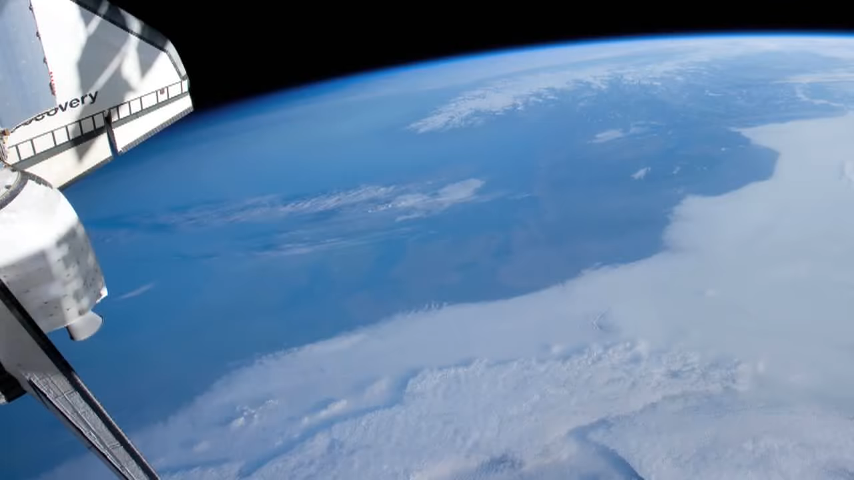

Slide 44
Description
The animation begins with a view of snow-covered Norway and the Jutland Peninsula. Low clouds cover Central Europe .The animation continues as the Station flies by Ukraine, eastern Russia, the Volga River, and then the Russian Steppes. South and east of the steppes, a dust storm comes into view over the Taklimakan Desert, followed shortly by the lake-studded Tibetan Plateau and the glaciers of the Himalayan Mountains. Smoke-shrouded lowlands hug the southern margin of the Himalaya. Smoke also covers much of South-east Asia, including the Irrawaddy Delta.
After the Space Station passes over the sapphire-blue South China Sea, the island of Borneo appears, followed by the open expanse of the Indian Ocean. A trio of coral reefs lies off the coast of Western Australia, which is studded with clouds. Australia’s arid interior is coloured myriad shades of red. As sunset nears, cloud shadows lengthen, highlighting their structure. Night falls as the Space Station crosses the terminator above the South Pacific.

Slide 45
Military dependence on Space
Space has been used to support military planning and operations on Earth since the beginning of the space age, even before human spaceflight.
Early military space missions used space systems for intelligence, surveillance, and reconnaissance (ISR);
communications; position, navigation, and timing (PNT);
and other functions to allow terrestrial forces to operate more effectively.
Satellites provided early warning of missile launches and detection of nuclear detonations.
Orderly regulation of space weaponization can help avoid a costly and potentially devastating arms race. Space, after all, is a congested and contested domain. If we do not establish order there, the struggle for availability of limited assets may render it a cause for Earth-bound conflicts
Notes:
The peaceful side of military power is also reliant on space. Self-defense against military buildup, invasion, or missile attack is enhanced by surveillance from space. Such visibility of aggressive military actions can serve as a deterrent against aggression by providing targeted nations time to react and verify their concerns in international discussions.

Slide 46
Why US maintain its hegemony in Space?
Acc to US strategists the lessons of history demonstrated that “every medium—air, land, and sea—has seen conflict. Reality indicates that space will be no different.” In order to avoid a “Space Pearl Harbor,” this report called for the United States to develop “superior” capabilities for “power projection in, from, and through space” in order to “negate the hostile use of space against U.S. interests ( Report of the Commission to Assess US National Security Space Management by Secretary of Defense Donald H. Rumsfled- 2007)
Notes:
If war-fighting in or from space is inevitable, it then follows that the United States should have the panoply of military capabilities not just to deter warfare in the heavens, but also to actively defend satellites in orbit that are essential for the conduct of U.S. military operations on the ground. “Space control,” however, is a far more demanding pursuit. It requires the protection of satellites against attacks in space, as well as the ability to carry out offensive strikes, whether from platforms orbiting the earth or from those on the ground, sea, and air. Moreover, if the weaponization of space is a virtual certainty, it also follows that arms control efforts, whether broadly or narrowly defined, to foreclose this competition are without merit. If such a competition is foreordained, America should compete to win.

Slide 47
Warfare follows commercial interests
They say that the militarization of space is very much like the development of navies. The British navy ruled the seas in order to protect British investments and commercial interests. And then, of course, other navies responded, like the German navy. You go on and get into the First World War.
They also compare the militarization of space to the U.S. army in the nineteenth century. As they put it, the U.S. army in the nineteenth century had the responsibility for protecting the U.S. wagon trains and settlements. That’s a way of looking at it. To translate that into reality, they had the responsibility for massive ethnic cleansing and conquering half of Mexico and going on to the Caribbean and the Philippines, and then defending what was there, “defending” what they had established.
Once you carry out the ethnic cleansing and wipe out the population, you still need to protect it from others who might still resist. So you needed the army. And it was indeed in that sense that they were protecting investments and commercial interests. They point out that space is just the next frontier.

Slide 48
Importance of Space for the US
Any attack on the US commercial satellites could bring US business and industry to a halt.
Space is the backbone of our national security, there is no substitute and there is no alternative to military dominance in space.
If you object when the US Navy deployed hundreds of heavily armed warships in every one of the world’s oceans no one accuses us of contributing weaponization of the sea because they knew the presence of our weapons ensures free transit for all who pursue their peaceful interests. US system in space could similarly patrol the commons for the good of all. Senator Jon Kyl

Slide 49
Space war?
“It’s politically sensitive, but it’s going to happen. . . . We’re going to fight in space. We’re going to fight from space and we’re going to fight into space.”
—General Joseph Ashy, former commander in chief, U.S. Space Command
“the stage could be set for a Cold War–style space race that overwhelms any multilateral cooperation.” Council of Foreign Relations' Stewart M. Patrick

Slide 50
Commercial Space activity
Commercial space activity is at the center of the “modern space race,” having tripled from $110 billion to almost $357 billion from 2005 to 2020.
Major players including SpaceX, Blue Origin, and Virgin have been competing to become leaders in space tourism and communications.
Even though more traditional players such as the U.S., China, and Russia have experienced the most growth in the commercial satellite industry, now an Argentine company, Satellogic, and a Finnish company, ICEYE, are among the top five leading commercial space satellite companies.
Notes:
These satellite constellations produce an enormous amount of data, which is leading to the huge growth in the demand for data storage and analysis, with companies using AI, especially machine learning and deep learning, to turn data into intelligence that powers a range of commercial uses including monitoring food supply, tracking greenhouse gas emissions, and monitoring energy supply chains.

Slide 51
Space Tourism
In 2020 SpaceX, owned by Elon Musk, became the first private company to send people into orbit. Space is now more accessible than ever.
Notes:
Richard Branson’s Virgin Galactic and Jeff Bezos’ Blue Origin made suborbital flights. Their efforts made it possible to reduce costs and open a new era of space activity

Slide 52
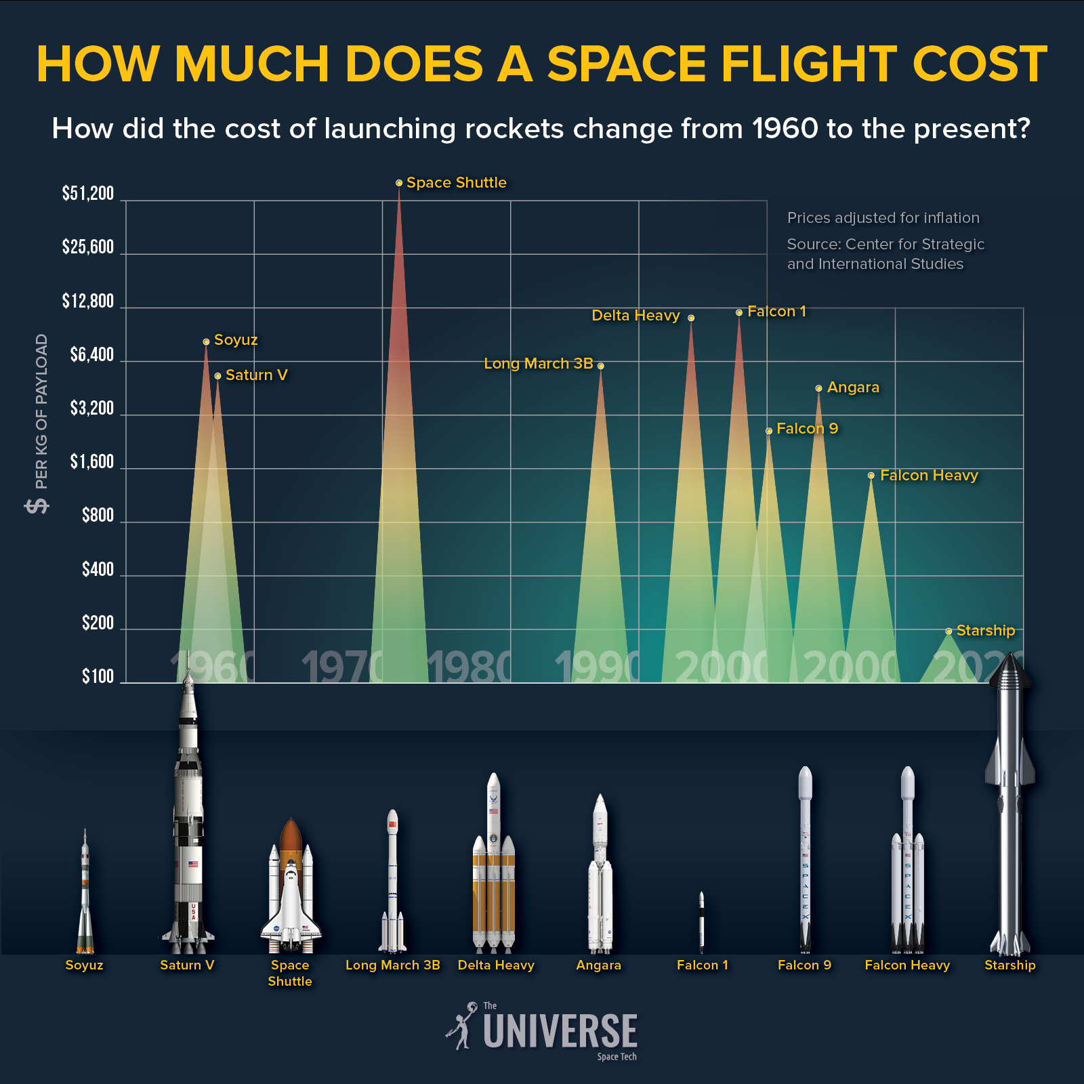

Slide 53
Space tourism: A new opportunity
Currently, the cheapest delivery of a kilogram of cargo to low Earth orbit is provided by the SpaceX company: $2,100 for the Falcon 9 rocket and $1,400 for the Falcon Heavy.
In February 2022, Elon Musk announced that his company’s Starship craft and Super Heavy rocket (together called Starship) would revolutionize space exploration. According to the idea of ​​the creators, Starship will be able to rise to Earth orbit every 6-8 hours and bring more than 100 tons there in one flight. The Super Heavy rocket can be reused almost hourly. All this will make it possible to significantly reduce the cost of every launch. Elon Musk said: “In two or three years, I think it is very likely that the entire flight will cost less than 10 million dollars, and this is for 100 tons of cargo.” That is, the cost of lifting 1 kg into orbit will decrease to 100 dollars.
Notes:
They are a fully reusable transport system designed to deliver crews and cargo to Earth orbit, the Moon, Mars and beyond.

Slide 54
Total Investment in Space by the US and China
US invested $54.6 billion in public space investment in 2021 – almost 60 % of global investment in space.
China’s commitment to space investment as a driver for economic competitiveness has quickly catapulted the country to global leadership in space. Second to the U.S. in space investment and innovation, China spent $10.3 billion on space programs in 2021, increasing satellite launches, applications, and imagery while investing in an even more advanced telescope than the Hubble that will photograph 40% of the Earth’s sky.

Slide 55
Global Satellite Communication
September 24, 2022, only SpaceX launched 3,397 Starlink satellites into orbit having performed 64 launches of the Falcon 9 launch vehicle.
According to a SkyQuest Technology Group report published in 2022, the global satellite communications (SATCOM) market last year was valued at $38.98 billion. According to the forecasts of this company, by 2028, at an average annual growth rate of 11.45%, it will reach 83.25 billion dollars. ​​
This will be due to the growing demand for mobile broadband access, due to the growing sales of mobile devices and the popularity of Internet applications. Currently, the market is dominated by several private companies, mainly Starlink, Oneweb, SES, Intelsat, Telesat and Viasat.

Slide 56
Why space weaponization?
The desire to establish military supremacy on all fronts of warfare. lack of faith in the present missile defense system to stall an Intercontinental Ballistic Missile.
To preserve space assets from incoming anti-satellite weapons (ASAT).
Space supremacy complements other areas of warfare like sea, air, and land
Notes:
Mutual suspicion-Fear of war generates competition and aggressive deployment between nations
Threat to other commercial and scientific missions-A country that deploys a military satellite would be reluctant to disclose sensitive information like orbital and radio frequency. This affects the entire coordination system
Space Debris– Space weaponization and may further aggravate the concern of an increase in space debris. It further paves way for Kessler’s syndrome. Want to know more about space debris and the threat that it creates? click here to know more.
The monopoly of orbits-The limited number of orbital slots gets monopolized by developed countries limiting the scope for scientific and commercial explorations.

Slide 57
Treaty to secure Outer Space
Global Frameworks to Prevent Space Weaponization
Outer Space Treaty -It was conceptualized by the United Nations in 1967. It emphasizes that the use of outer space should be peaceful and beneficial to all mankind. It claims that one nation cannot claim national sovereignty in outer space.
Prevention of an outer space arms race-It stresses the use of space for peaceful purposes. Further, it calls for the importance of avoiding an arms race.
Notes:
Space
For 50 years we have succeeded in not shooting at each other in space, which is quite
an accomplishment. As space gets much more crowded and space assets become more
critical to national economies and militaries, will this peace last, or will space war
become increasingly difficult to prevent? In 30–40 years, the space landscape will have
been deeply transformed by new orbital management techniques, more diverse players,
and space applications increasingly devoted to societal security issues. This transformation
should be anticipated.
access to space is no longer limited to a select club of major powers, as
was the case during the 20th century: There are more than 50 countries that own and
operate satellites, in addition to various private operators.16 To sum up, attacks on space
assets today can cripple vital military capabilities, degrade crucial civilian infrastructures,
create massive debris fields, and prevent effective use of the space environment.
In addition, as already mentioned, space capabilities are proliferating

Slide 58
Outer space treaty 1967
Principles Governing the Activities of States in the Exploration and Use of Outer Space, including the Moon and Other Celestial Bodies (the Outer Space Treaty).
“The exploration and use of outer space, including the Moon and other celestial bodies, shall be carried out for the benefit and in the interests of all countries, irrespective of their degree of economic or scientific development, and shall be the province of all mankind.”

Slide 59
Outer space treaty 1967
outer space shall be free for exploration and use by all States;
outer space is not subject to national appropriation by claim of sovereignty, by means of use or occupation, or by any other means;
States shall not place nuclear weapons or other weapons of mass destruction in orbit or on celestial bodies or station them in outer space in any other manner;
the Moon and other celestial bodies shall be used exclusively for peaceful purposes;
astronauts shall be regarded as the envoys of mankind;
States shall be responsible for national space activities whether carried out by governmental or non-governmental entities;
States shall be liable for damage caused by their space objects; and
States shall avoid harmful contamination of space and celestial bodies.

Slide 60
Outer space treaty 1967
Article I that the use of outer space shall be for the benefit and use of all countries;
Article III that activities shall be carried out in accordance with international law;
Article IV that no nuclear weapons or weapons of mass destruction shall be placed in orbit around the Earth or placed on any celestial body;
and Articles VI and VII that responsibility and liability shall be placed for damage caused by an object launched or by its components on Earth.

Slide 61
Step towards Disarmament in Space
In February 2008, China and Russia jointly submitted to the UN Conference on Disarmament a draft Treaty on Prevention of the Placement of Weapons in Outer Space and of the Threat or Use of Force against Outer Space Objects (PPWT)
.The Prevention of an Arms Race in Outer Space (PAROS) is a UN resolution seeking a ban on the weaponization of space. It was originally proposed in the 1980s from an ad hoc committee of the Conference on Disarmament. The proposal was reintroduced in recent years and is voted on annually, with the United States being the only country to oppose it.

Slide 62
Time to renew
The ban on weapons in space was limited to nuclear and other weapons of mass destruction as these types of weapons were of most concern during the Cold War era when the treaty was created.
This treaty only addressed weapons that were “placed in orbit” or on a celestial body, and liability was not clearly spelled out. A relevant treaty addressing liabilities for damages caused in space is the Convention on International Liability for Damage Caused by Space Objects.

Slide 63
Q&A

