Slide 1
ALL INDIA
MUSLIM LEAGUE (AIML) & Pakistan Movement

Slide 2
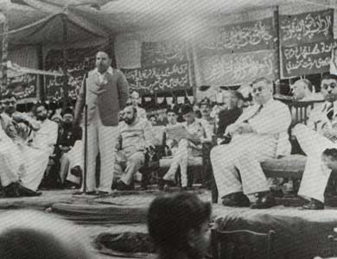
Why AIML? Need for separate Muslim Political Party
Conflicting interests B/W Hindus and Muslims – Congress couldn’t safeguard Muslim interests
Sir Syed’s apprehensions / contentions proved by the events and circumstances
Sir Syed’s opposition to joint electorates (demand for separate electorates) was the first seed to culminate in the formation of AIML
Indian Councils Act, 1892, system of electorate proved futile for Muslims – no Muslim candidate could obtain any seat up to 1906

Slide 3
AIML- Simla Deputation & Lord Minto
Simla Deputation (1905) – Muslim leaders
Lord Minto was positive – encouraged Muslims to concentrate their energies on separate electorates
Hindu historians argue that ML was created on official instigation to break Congress dominance & weaken Indian freedom movement. However, no evidence provided to substantiate the claim.

Slide 4
AIML--- Aims & Objectives – 1906-1913
Protect political rights of Muslims in India
Foster loyalty to the British and to remove misunderstandings with the government
Cooperation with other communities without prejudice to above goals
Secure supremacy of Urdu language
Change of Creed of AIML 1913

Slide 5
Lucknow Pact 1916
Hindu-Muslim Unity
Tireless efforts of the Quaid-e-Azam to bridge the gaps b/w two communities
Major Success for Indian Nationalists
Congress recognized the Muslim League as the political party representing the Muslims of India
Quaid-e-Azam emerged as “Ambassador of Hindu-Muslim Unity” Sarojini Naido

Slide 6
Lucknow Pact 1916 – Salient Features
There shall be self-government in India.
Muslims should be given one-third representation in the central government.
There should be separate electorates for all the communities until a community demanded for joint electorates.
System of weightage should be adopted.
All members of the Legislative Councils to be elected directly on the basis of adult franchise.
No bill concerning a community should be passed if the bill is opposed by three-fourth of the members of that community in the Legislative Council –Communal Veto
The Executive should be separated from the Judiciary.

Slide 7
Khilafat Movement 1919-1924
Pan-Islamic movement
An effort to protect the Ottoman caliphate as a symbol of unity among the Muslim community in India during the British raj
The empire’s defeat in World War I (1914–18)
Disintegration of the empire – Treaty of Lausanne- 1923
Detachment of all non-Turkish regions from the empire

Slide 8
Khilafat Movement 1919-1924 – Formation & Demands
The movement was launched by Moulana Shoukat Ali Johar, Moulana Muhammad Ali Johar & Moulana Abul kalam Azad Dr. Mukhtar Ahmed Ansari Raees-ul-Muhajireen Barrister Jan Muhammad Junejo, Hasrat Mohani, and Hakim Ajmal Khan
Gandhi also joined the Movement --- Non-cooperation & non-violence
Caliph Sultan must retain sufficient territories so that he is able to defend the Islamic Faith.
The places which are called Jazirat-ul-arab, including the Arabia, Syria, Iraq and Palestine must remain under Muslim suzerainty.
On November 23 1919, the All India Khilafat Conference was organized at Delhi and later a Khilafat Manifesto was published which called upon the British to protect the Caliphate

Slide 9
Khilafat Movement 1919-1924 ---- Impacts
The Movement was an attempt towards religious consciousness –
The only movement during British India which had no direct concern with the affairs of Muslims of India – Pan Islamism
It greatly influenced subsequent political strategy of Indian Muslims – in fact spearheaded Pakistan movement
Popular politics - Involvement of masses in politics
Hijrat – Migration from India – A poor political move
  Muslim misery – Afghanistan denied the Indian Muslims to enter
Quaid & Iqbal distanced themselves
  AIML to stay way from the affairs of foreign countries & focus on Indian affairs
  Iqbal didn’t believe in a Khilafat achieved through demands

Slide 10
Nehru Report - Demands
Dominion Status for India – Parliamentary form of government
Rejected Federation on communal basis – in fact suggested ‘unitary state’
Provincial autonomy but residuary powers at centre
NWFP be given provincial status
Sindh separated from Bombay subject to financial viability

Slide 11
Nehru Report - Demands
“Separate electorates” abandoned – in favour of joint electorate
Communal veto scrapped
Universal adult suffrage proposed
Only 1/4th seats for Muslims in Central Legislature
Hindi to be official language of India

Slide 12
Nehru Report – Critique
The report regarded Muslim problem as purely religious and cultural (communal) matter – to be cured by full religious liberty and cultural autonomy –
Muslims knew where they stood in Congress scheme – In 1916 when they needed AIML support they accepted ‘Separate Electorate’ - here they scrapped it!
AIML didn’t accept the Report
  On 12-03-1929 when the Report was debated in the Indian Legislative Assembly all Muslim members including Jinnah rejected it

Slide 13
Fourteen Points of Jinnah
Separate electorates – with possibility of joint electorates at a later stage
1/3rd Muslim representation at Centre
Communal veto demanded
Weightage – without changing majority into minority, especially in Bengal & Punjab

Slide 14
Fourteen Points of Jinnah
Bi-national state with loose Federation of 5 Muslim and 6 Hindu majority provinces
Complete provincial autonomy - Residuary powers to provinces
Change in the Constitution – only with the consent of the constituent states
Adult franchise

Slide 15
Fourteen Points of Jinnah
Separation of Sindh from Bombay
Reforms in NWFP and Balochistan on the same footing as in other provinces
Necessary territorial adjustments should not convert Muslim majorities into minorities in Punjab, Bengal and NWFP
Full religious liberty i.e. liberty of belief, worship, and observance, propaganda, association, and education, shall be guaranteed to all communities
Adequate share for Muslims in all the services of the State and in local self-governing bodies
Adequate safeguards for the protection of Muslim culture and for the protection and promotion of Muslim education, language, religion and personal laws and Muslim charitable institutions

Slide 16
Parting of Ways
This was turning point in the history of India – the two communities never united afterwards
Conclusion
This political development convinced the Muslims that they could not trust Congress / Hindus
Henceforth, co-existentialism replaced with separatism – struggle for freedom
AIML
INC

Slide 17
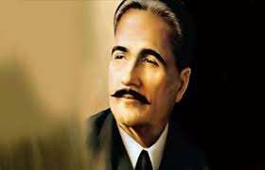
Allama Iqbal’s Allahabad Address - 1930
A landmark in the history of Muslim India
He was dubbed as visionary and an idealist but time proved that his solution was genuine, possible and practical – to the complex social, political and religious problems of India
A road map for the future of Muslims in India

Slide 18
Allahabad Address – 1930 – The Address
Recognition of Muslim majority in a federal system with the same privileges as given to Hindus
India was not a county but a continent where many nations live - each with separate identity, religion, culture, etc.
Federalism can’t succeed without recognizing the national identity of Muslims
Modern nationalism / unitary form of government simply unthinkable for Muslims
Redistribution of India – Muslim India within India
Propounded two nation theory logically

Slide 19
Allahabad Address – 1930 – The Address
1930, Iqbal chaired a meeting of AIML in Allahabad
Independent homeland for Muslims
Islam has given a creed which had forged Indian Muslims into one nation
Iqbal said that he would like ot see Punjab, NWFP, Sindh and Balochistan amalgamated into a single state, either within the British Empire or outside it.
“The formation of a consolidated North-West Indian Muslim state appears to me to be the final destiny of the Muslims”
Bengal and Assam did not appear into his calculations – later on brought into the scheme by Muslims

Slide 20
Allahabad Address – 1930 – CRITICAL ANALYSIS
Some critics claim that Iqbal never argued for an independent state (Making of Pakistan by K. K. Aziz)
The criticism can be repudiated by Iqbal’s letters to Jinnah (from May 1936 to Nov. 1937)
On 28-03-1937, he wrote “it is necessary to redistribute the country and provide one or more Muslim states with absolute majorities. Don’t you think the time for such a demand has already arrived?”

Slide 21
Allahabad Address – 1930 – Significance
Provided new opportunities to think in terms of a separate homeland for Muslims
Jinnah gave most serious consideration to Iqbal’s scheme of partition
Iqbal was the one who gave possible solution to the troubles of India - Jinnah gave reality to his dream
Lahore Resolution finally demanded a separate homeland which was initially thought by Iqbal

Slide 22
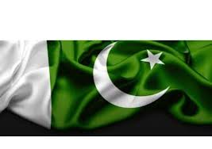
Towards Pakistan

Slide 23
The Rule of Congress 1937-1939 – The Congress Tyranny
The Congress aimed to erase Muslim culture
Hindu extremist behaved in appalling ways
Bande Matram – nationalist Hindu song – Muslims to be expelled from Hindustan – Singing of song was made compulsory in provincial Assemblies
The Wardha Scheme – teaching to be in Hindi – spinning cotton & no religious education – bowing down before picture of Gandhi –conversion to Hinduism
Muslims were forbidden to eat beef and punished severely if they slaughtered cows
Azaan was forbidden and attacks on mosques were carried
Noisy processions at the time of prayers in front of mosques
Even pushing pigs into mosques
Anti-Muslim riots – houses & properties set on fire
End of Congress Rule - The Day of Deliverance 22 Dec. 1939

Slide 24
The Pakistan Resolution – 23rd March, 1940
Sir Syed Ahmad Khan
Allama Muhammad Iqbal
Choudhry Rehmat Ali
Muslim League’s reluctance to accept the Idea of a separate homeland
Congress Rule and the realization that the British would leave soon convinced ML & Quaid-i- Azam to consider establishing a Muslim state
Annual session of ML in Lahore 22-23 March, 1940, Maulvi Fazal-ul-haq
‘Regions in which Muslims are numerically a majority , as in the north-western and eastern zones of India, should be grouped to constitute independent states in which the constituent units shall be autonomous and sovereign’

Slide 25
The Pakistan Resolution – 23rd March, 1940
The Resolution was passed unanimously & became known as ‘Lahore Resolution’
The Hindu press started calling it the ‘Pakistan Resolution’ & soon it was adopted by the Muslims
Pakistan, the final destination for Muslims in India
Struggle for the new homeland
Muslim League became the political party for Muslims
Quaid-i- Azam as leader of the Pakistan Movement

Slide 26
The Cabinet Mission Plan 1946
In march, 1946, final effort to diffuse differences between two communities i.e. Muslims & Hindus
A three men delegation was sent to India to find a settlement acceptable to all parties – Pethick-lawrence, Stafford Crips & A.V. Alexander
The Cabinet Mission met representatives of Muslim League, Congress, Hindu Mahasaba, & Sikhs
The Mission found that there was little common grounds b/w the Muslims League & Congress
Quaid-i- Azam demanded Pakistan comprising of six provinces
The Congress was opposed to any partition of India & rejected Quaid-i- Azam’s demand

Slide 27
The Cabinet Mission Plan 1946
The Mission adopted a different approach
Interim govt. to rule India whilst the British withdrawal was to be organized
The interim govt. to form an all-India Commission to decide whether there should be one or two states after the British had left
Plan was rejected by both ML & Congress
In may, 1947, the Cabinet Mission announced its final plan
  It rejected the idea of Pakistan
  There would be three different parts to a post-British India
    The Hindu majority territories
    The western Muslim provinces
    Bengal and Assam
  Each part to have local autonomy and being able to draw up its own constitution
  Foreign affairs, defence and communication to be managed by a central Indian Union

Slide 28
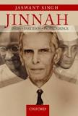
The Cabinet Mission Plan 1946
Muslim League was prepared to nominate members to an interim cabinet to oversee the process of independence as per Cabinet Mission Plan
However, Nehru, observed that Congress would not feel bound by the plan once the British had left
Therefore, the Cabinet Mission Plan was dropped by AIML
Jinnah: India, Partition, Independence by Jaswant Singh 2009
Jaswant Singh has observed that it was the arrogance of Nehru
that led to partition of India and to hold Muslim League and
Jinnah responsible for the partition of India is wrong
Did Quaid-i- Azam really quit the idea of Pakistan by accepting the Cabinet Mission Plan?

Slide 29
The Radcliff Award
Cyril Radcliff headed the commission to establish new borders in Bengal and Punjab
He was assisted by four assistants : 2 nominated by Muslim League & 2 by Congress
One important matter which couldn’t be resolved by 15 August 1947 was the boundary between Muslim and non-Muslim areas
The decision of the Boundary Commission aka Radcliff Award was announced on 16th August, 1947
Calcutta in Bengal, was given to India even though it was surrounded by Muslim areas
In Punjab, Ferozpur and Gurdaspur, Muslim majority areas were given to India
By awarding Gudaspur to India , the new Indian state now had border with Kashmir and future disputes between two countries were inevitable
Quaid-i- Azam remarked that the award were ‘wrong, unjust and perverse’

Slide 30
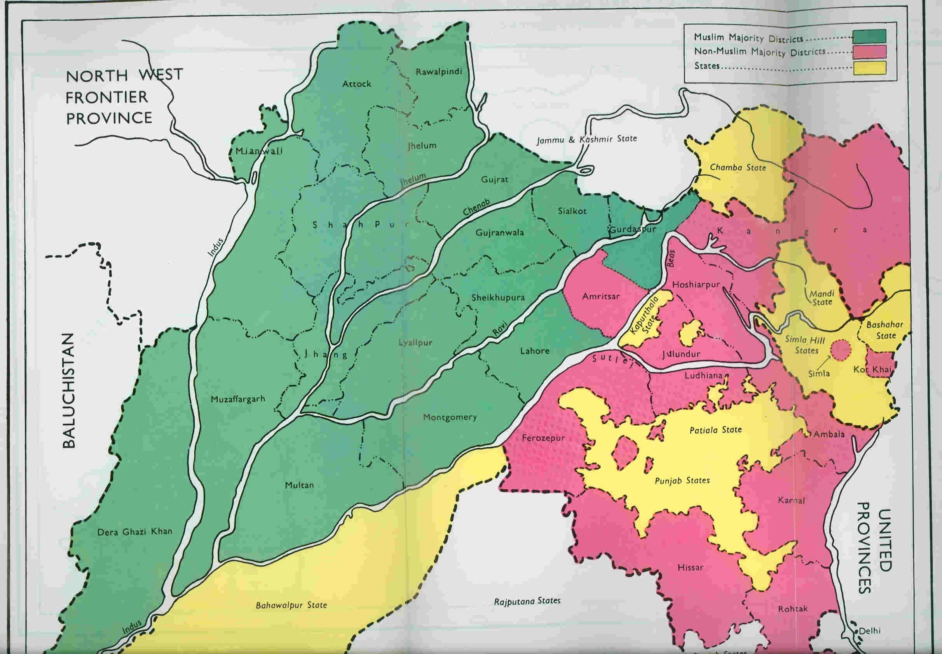

Slide 31
Ideology of Pakistan- Definition & Elucidation
Ideology grows out of dissatisfaction of majority of people in a given geography
Ideology of Pakistan – in the context of Subcontinent – to maintain Muslim identify – threatened by the Hindu majority
Islam & Hinduism not only two different religions but have also given birth to separate cultures – cuisine, apparel, languages, rituals, literature, art, music, architecture
Different political orders & different social orders – different world views

Slide 32
Ideology of Pakistan- Evolution & elucidation
“Pakistan was created that day first Indian national entered the field of Islam” Quaid e Azam
Arab Traders – Introduction of Islam in India
Mass conversion to Islam in Malabar – I.H. Qureshi
Muslim Rule in Sindh 712 – Delhi Sultanate 1206-1526- Mughal Period 1526 -1857
Mujaddad Alf Sani (Sheik Ahmad Sirhindi) 1564-1624 - Revival of Islam – Muslim Identity – Hindu political power – Protection of Islam- Wahdat ul Shahood - Hindu Muslim two separate people
Hazrat Shah Waliullah – 1703-1761- Period of Decline – explanation of Muslim decline - Unity among Muslim – Redefining Islamic principles to answer new challenges – Muslim Identity & its protection
Sir Syed Ahmed Khan 1817-1898 – Ideologue of Two Nation Theory – Political Leadership in the time of chaos & disorder – Rapprochement – diagnosis of Muslim decline, Redefining Muslim ethos – Education, language – literature - politics, economy, society, religion – provided firm foundations on which Pakistan was built
Allama Iqbal – 1877- 1938- Redefined & rekindled Islamic spirit in Muslims in India – Ideologue of the Modern India – conceived the idea of separate Muslim homeland – Political leadership- close coordination with Quaid e Azam
Quaid Azam 1876-1948 - Political leadership – Protection of Muslim political, economic, social and religious interests- Spearheaded the constitutional struggle for a Muslim country – demand for Pakistan – Creation of Pakistan 1947

Slide 33
Allama Iqbal & Ideology of Pakistan
Conceived the idea of separate Muslim homeland
Separate political identity of Muslim in India
Redefining concept of Muslim Umma – Reconstruction of Religious Thought in Islam – - need for Ijtahad – new thinking in Islam
ایک ہوں مسلم حرم کی پاسبانی کے لیئے- نیل کے ساحل سے لے کر تا بخاکِ کاشغر
Political , historical and religious grounds for a modern Muslim State – the very first of its kind – “I would like to see the Punjab, North-West Frontier Province, Sind and Baluchistan amalgamated into a single State. -------North-West Indian Muslim State appears to me to be the final destiny of the Muslims” Allabad Address 1930
Two Nation Theory – Islam as complete code of life
Opposition to the concept of Modern Nation state based on language or culture
Islam the raison d'etre for a Muslim State - Pakistan

Slide 34
Quaid e Azam & ideology of Pakistan
India---------- is subcontinent of nationalities
Nehru Report vs. 14 points
Refusal of Nehru’s belief “ two parties in India INC and the British- there is a third Party – Muslim League
End of Congress Rule – 1939- The majority community has shown that Hindustan is for Hindus
1939- Quaid said, “Muslims and Hindus are two nations. We are going to live as a nation and play a role as a nation”.
1940- “Muslim are not a minority, Muslim are a nation by every definition
1944- the only “politically realistic” way is to divide Hindustan in two sovereign states
Pakistan as a modern democratic state – Muslim as distinctive nation- Islam as the binding force
“Few individuals significantly alter the course of History. Fewer still modify the map of the world. Hardly any one can be credited with creating a nation state. Muhammad Ali Jinnah did all three”. Jinnah of Pakistan by Stanley Wolpert

Slide 35
Pakistan – A Country, A Civilization
The Indus Valley civilization, one of the oldest in the world and dating back at least to 5,000 years, spread over much of what is presently Pakistan
During the second millennium B.C., remnants of this culture fused with the migrating Indo-Aryan peoples
The area underwent successive invasions in subsequent centuries from the Persians, Greeks, Arabs (who brought Islam - 712), Afghans, and Turks
Remained under Delhi Sultanate 1206-1526
The Mughal Empire flourished in the 16th and 17th centuries
The British came to dominate the region in the 18th century
The separation in 1947 of British India into the Muslim state of Pakistan (with West and East Wings)
However, Hindus never accepted the partition- India and Pakistan fought two wars and a limited conflict - in 1947-48, 1965, and 1999 respectively - over the disputed Kashmir territory
A third war between these countries in 1971 - in which India assisted an indigenous movement reacting to the marginalization of Bengalis in Pakistani politics - resulted in East Pakistan becoming the separate nation of Bangladesh

Slide 36
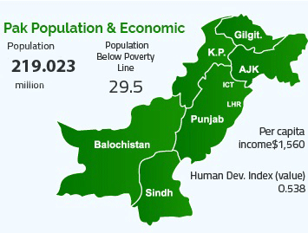
Pakistan
Ethnic groups
Punjabi 44.7%, Pashtun (Pathan) 15.4%, Sindhi 14.1%, Saraiki 8.4%, Muhajirs 7.6%, Baloch 3.6%, other 6.3%
Languages
Punjabi 48%, Sindhi 12%, Saraiki (a Punjabi variant) 10%, Pashto (alternate name, Pashtu) 8%, Urdu (official) 8%, Balochi 3%, Hindko 2%, Brahui 1%, English (official; lingua franca of Pakistani elite and most government ministries), and other 8%
Age structure
0-14 years: 36.01% (male 42,923,925/female 41,149,694)
15-24 years: 19.3% (male 23,119,205/female 21,952,976)
25-54 years: 34.7% (male 41,589,381/female 39,442,046)
55-64 years: 5.55% (male 6,526,656/female 6,423,993)
65 years and over: 4.44% (male 4,802,165/female 5,570,595)
Population Growth Rate 2.07
Urbanization 37.2% of total population
Literacy: definition: age 15 and over can read and write
Total population: 59.1%
Male: 71.1%
Female: 46.5% (2015)

