Slide 1
DEVELOPMENT AND HISTORICAL CONTEXT OF NUCLEAR WEAPONS
By
ABDUL QADEER PAS

Slide 2
SYLLABUS
CURRENT AFFAIRS
Nuclear Proliferation and Nuclear Security
Nuclear Politics in South Asia
PAKISTAN AFFAIRS
Nuclear Program of Pakistan, its Safety and Security; International Concerns
INTERNATIONAL RELATIONS
Arms Control /Disarmament and Nuclear Non proliferation Regime
Proliferation of Nuclear Weapons
Nuclear Weapon States- Programs and Postures: Indian-Pakistan Nuclear Doctrines
Nuclear Non –Proliferation Regime: International Atomic Energy Agency, Nuclear Non- Proliferation Treaty; Nuclear Supplier Group; Partial Test Ban Treaty; Comprehensive Test Ban Treaty; Fissile Material Cut-off Treaty
Challenges of Non-Proliferation, Cooperation for Nuclear Energy

Slide 3
THE ATOMIC AGE: HOW DID THE WORLD BECOME NUCLEAR?
THE MANHATTAN PROJECT
SCIENCE OF NUCLEAR WEAPONS
HIROSHIMA AND NAGASAKI
THE ERA OF COLD WAR
NUCLEAR ARMS RACE
HOW CLOSE THE WORLD CAME TO NUCLEAR WARS
ARMS CONTROL AND DISARMAMENT

Slide 4
THE DISCOVERY OF AN ATOM: AN ERA OF SCIENTIFIC DEVELOPMENT
Rutherford discovery of atom and its properties
Sir Ernest Rutherford in 1911 established that the mass of the atom is concentrated in its nucleus; he also proposed that the nucleus has a positive charge and is surrounded by negatively charged electrons.
A major characteristic of an atom is its atomic number, which is defined as the number of protons. The chemical properties of an atom are determined by its atomic number.
The total number of what is called nucleons (protons and neutrons) in an atom is the atomic mass number. Atoms with the same atomic number but with different numbers of neutrons and, therefore, different atomic masses are called isotopes. Isotopes have identical chemical properties, yet have different physical properties. There are stable isotopes, which do not emit radiation, and there are unstable isotopes, which do emit radiation. The latter are called radioisotopes.

Slide 5
EINSTEIN THEORY OF RELATIVITY
In 1905, Einstein developed the special theory of relativity, one of the implications of which was that matter and energy are interchangeable with one another.
E = mc2
This equation states that a mass (m) can be converted into a tremendous amount of energy (E), where c is the speed of light. a small amount of matter can be converted into a tremendous amount of energy. Einstein’s equation is the key to the power of nuclear weapons and nuclear reactors.

Slide 6
HOW DID IT START: THE MAKING OF NUCLEAR BOMB
In 1939 , Albert Einstein had written a letter to inform Roosevelt that recent research had made it ‘probable … that it may become possible to set up a nuclear chain reaction in a large mass of uranium, by which vast amounts of power and large quantities of new radium-like elements could be generated’, leading ‘to the construction of bombs, and it is conceivable that extremely powerful bombs of a new type may thus be constructed'. This was all likely to happen ‘in the immediate future’.
Einstein believed, rightly, that the Nazi government was actively supporting research in the area and urged the US government to do the same.

Slide 7
FEAR OF NAZI GERMANY
Roosevelt’s approval of uranium research in October 1939, based on his belief that the United States could not take the risk of allowing Hitler to achieve unilateral possession of ‘extremely powerful Bombs’, was the first of many decisions that ultimately led to the establishment of the only atomic bomb effort that succeeded in World War II.

Slide 8
The Manhattan Project?
The project was a top secret research and development program to build first nuclear bomb. It was initiated in response to fears that Nazi Germany was developing its nuclear bomb.
The project was led by physicist J. Robert Openhemier and the team was able to develop the bomb successfully in 1945 just before the conclusion of WWII.
Almost 60,000 people worked over the life of the project but not everyone was aware the nature of the project.

Slide 9
SCIENCE OF NUCLEAR WEAPON
Nuclear Reactor vs Nuclear Weapon
Management of Nuclear Chain reaction and energy produced is different in both scenarios
In Nuclear weapon, chain reaction is uncontrolled and lead to massive release of uncontrolled energy
In the Nuclear reactor, the chain reaction is controlled and energy released in the result of reaction is controlled.

Slide 10
Where does nuclear material come from?
Uranium is found all over the world, though mostly in trace quantities. Five countries—Australia, Canada, Kazakhstan, Namibia, and Russia—possess two-thirds of the world’s known supply.
Uranium is mined from the earth and then converted to gas so it can be enriched for nuclear purposes—either peaceful or destructive.
Uranium is a slightly radioactive metal that is found in the earth’s crust and is composed of three isotopes—uranium-238, uranium-235, and uranium-234—with proportions of 99.284%, 0.711 %, 0.0055 % respectively.
The main ingredient for producing both nuclear energy and a nuclear explosion is fissile material—that is, elements with nuclei that can break apart in a chain reaction called fission. Some of the more common fissile materials are uranium- 235(U-235), uranium-233(U-233), and plutonium-239 (Pu-239).

Slide 11
Contd..
Only U-235 is naturally occurring and is fed into the nuclear fuel cycle; the other two are by-products of the nuclear fuel cycle in a nuclear reactor.
When the U-235 nucleus absorbs a neutron, it readily splits apart releasing energy and one or more neutrons. The presence of U-235 in natural uranium is rare, however, so to achieve a critical mass of this material to power a nuclear reactor, the uranium feed needs to undergo enrichment.
Once the percentage of U-235 reaches a critical mass through enrichment, enough atoms can split to release energy as well other neutrons, continuing the cycle and creating a “chain reaction” inside the nuclear reactor—or a nuclear bomb.

Slide 12
HOW IS NUCLEAR ENERGY MADE?
In nature, uranium is a mix of mostly two isotopes: uranium-235 (U-235) and uranium-238 (U-238). U-235 is especially important because it easily undergoes fission (unlike U-238) and is extremely rare, accounting for less than 1 percent of the world’s natural uranium.
So countries with nuclear ambitions—peaceful or not—need to first increase the proportion of U-235 in their uranium samples through a process called enrichment.
Nuclear energy production begins with URANIUM ENRICHMENT.
Uranium enrichment most commonly occurs in gas centrifuges. After uranium is converted into gas, it is fed into centrifuges, which rotate at high speeds, to separate the slightly heavier U-238 from U-235. Each round of rotation in a centrifuge lowers the proportion of U-238 and increases that of U-235 in the sample.
Notes:
a mechanical device used for nuclear enrichment. Nuclear centrifuges contain rotors that spin quickly to separate different forms of the radioactive element uranium

Slide 13
ENRICHMENT OF URANIUM
Uranium can be enriched to various levels, which fall into two categories:
Low-enriched uranium (LEU), which has less than 20 percent U-235 and is often used for nuclear power or in non-power reactors, which produce materials for medical use, scientific research, and other purposes; and
highly enriched uranium (HEU), which has 20 percent or more U-235 and is mainly used for military purposes: to develop nuclear weapons and in a few other specialized applications such as the reactors on nuclear-powered submarines.
Any level of HEU can be used for a weapon, but HEU enriched to at least 90 percent, sometimes called weapons-grade uranium, is the most common. Higher levels of enrichment mean that less uranium is required to produce a weapon. That means warheads can be smaller and lighter, enabling missiles to cover greater distances and aircraft to deliver more weapons.

Slide 15
Contd…
Once a country can enrich uranium, it can produce enough HEU for a nuclear weapon within months.
The materials, technology, and expertise needed for enrichment can be used to both generate nuclear power and develop nuclear weapons. Once a country is capable of enriching uranium for nuclear purposes, even peaceful ones, it usually can produce enough material for a nuclear weapon. For that reason, monitoring proliferation is exceptionally difficult.

Slide 16
Enriching uranium in its natural state to between 3 and 5 percent U-235, the LEU enrichment level used in most nuclear power plants, takes a lot of time and resources. It's relatively easier and quicker to then enrich LEU to 90 percent needed for weapons-grade uranium.

Slide 18
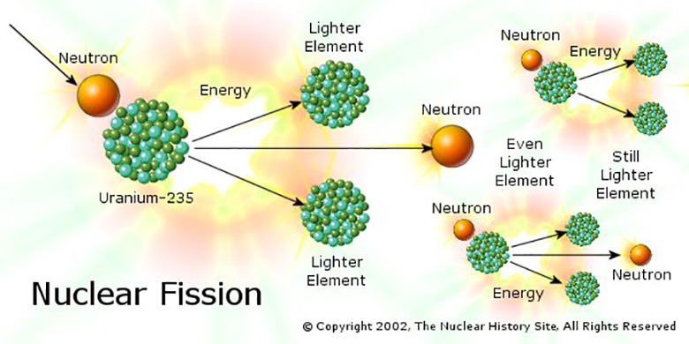
Chain reaction of Nuclear weapon
The isotopes Uranium-235 and Plutonium-239 were selected by the atomic scientists because they readily undergo fission . Fission occurs when a neutron strikes the nucleus of either isotope, splitting the nucleus into fragments and releasing a tremendous amount of energy. The fission process becomes self-sustaining as neutrons produced by the splitting of atom strike nearby nuclei and produce more fission. This is known as a chain reaction and is what causes an atomic explosion

Slide 19
NUCLEAR FISSION REACTION
U₉₂²³⁵+ 1 neutron → ⁹²₃₆Kr + ¹⁴¹₅₆Ba + 3 neutrons + energy

Slide 20
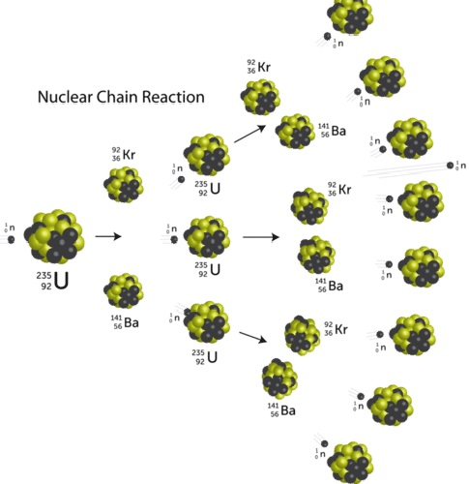

Slide 21
HIROSHIMA AND NAGASAKI
The US conducted first successful nuclear test on 16th July, 1945
On 6th August , 1945 a B-29 “super bomber” dropped a uranium bomb over Hiroshima in an attempt to force Japan’s unconditional surrender. Three days later, the U.S. dropped a plutonium bomb, identical to the Trinity test bomb, over Nagasaki.
With the end of WWII, the world had engulfed in the era of cold war and the nuclear arms race.

Slide 22
TRUMAN WHILE MAKING THE DECISION
‘I am going to make a decision which no man in history has ever had to make’, ‘I will make the decision, but it is terrifying to think about what I will have to decide.’

Slide 24
“A weapon of an unparalleled power is being created which will completely change all future conditions of warfare... Humanity will, therefore, be confronted with dangers of unprecedented character unless, in due time, measures can be taken to forestall a disastrous competition in such formidable armaments and to establish an international control of the manufacture and use of the powerful materials.” —Neils Bohr, writing in November 1944 and March 1945. Bohr won the Nobel Price for Physics in 1922 and worked on the Manhatten Project that developed the bomb.

Slide 25
EVENTS HAPPENING AROUND THE WORLD
Confrontation of two ideologies
First proxy war in Greek (civil war) 1946-1949
USSR became Nuclear
USA tested hydrogen bomb
Era of Proxy Wars
Korean War- Communism vs Capitalism
Berlin Crisis
Expansion of the two ideologies
Fiedal Castro rise in Cuba
Vietnam war
The prague spring

Slide 26
POST WWII ERA- IRON CURTAIN
Eastern Europe becoming communist
The Soviet Union had begun shaping Eastern Europe in their image, bringing the governments of many nations into line with Moscow.
An iron curtain has been drawn
On March 5, 1946, at Westminster College in Fulton, Churchill’s famous words “From Stettin in the Baltic, to Trieste in the Adriatic, an iron curtain has descended across the continent,” ushered in the cold war and framed the geo-political landscape for the next 50 years.

Slide 27
EVENTS HAPPENING AROUND THE WORLD
Greece Civil War 1946-1949
USSR supporting the communist opposition group while the US poured money, provided weapons and other military support to the Greece government. With the support of the UK and US, the Greek government forces ultimately prevailed.
War in Korean Peninsula
The Korean War was fought between North Korea and South Korea from 1950 to 1953. South Korea is supported by the US through the UN .
Berlin Crisis
The crisis started on June 24, 1948, when Soviet forces blockaded rail, road, and water access to Allied-controlled areas of Berlin. The United States and United Kingdom responded by airlifting food and fuel to Berlin from Allied airbases in western Germany. The crisis ended on May 12, 1949, when Soviet forces lifted the blockade on land access to western Berlin.

Slide 28
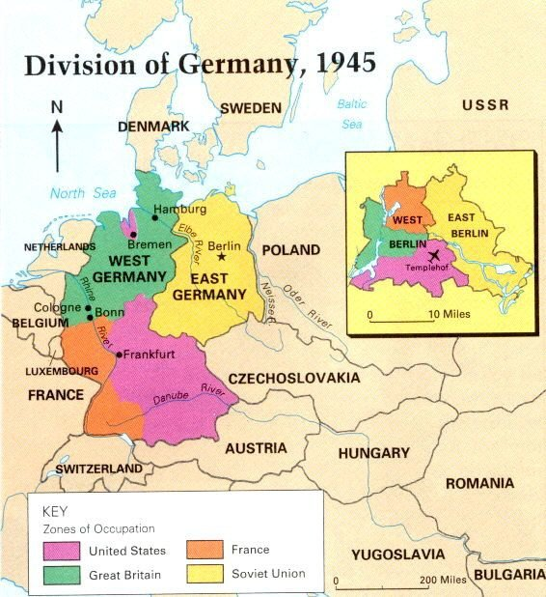

Slide 29
Nuclear Arms Race kicked off
From Aug 1945, it was soviet policy to destroy the American atomic monopoly in the shortest possible time. On 29 August 1949, the Soviet Union secretly conducted its first successful weapon test.it was alarming for U.S. strategists by the fact that it occurred one-to-four years sooner than analysts had expected.
The discovery that the United States had lost its nuclear monopoly created alarm about falling behind Moscow and a resolve to stay ahead.
On 31st 1950 January, the US decided to authorize a thermonuclear weapons program.
On November 1, 1952. the US tested first thermonuclear device. It was followed by the USSR hydrogen explosion on Aug 12, 1953.

Slide 30
Nuclear Arms Race
In the year 1945, there was only six nuclear weapons in the possession of the US.
By 1990, this figure has surged to 59000 nuclear arsenals and spread to more than 5 countries.
NUCLEAR ARSENALS SINCE 1945
 | 1945 | 1950 | 1955 | 1960 | 1970 | 1985 | 1990
USA | 6 | 369 | 3057 | 20,434 | 26,662 | 24,327 | 21,004
USSR | - | 5 | 200 | 1605 | 11,643 | 39,197 | 37,000
UK | - |  | 10 | 30 | 280 | 300 | 300
FRANC | - |  |  |  | 36 | 360 | 505
CHINA | - |  |  |  | 75 | 425 | 430
TOTAL | 6 | 374 | 3267 | 22,069 | 38,696 | 64,609 | 59,239

Slide 31
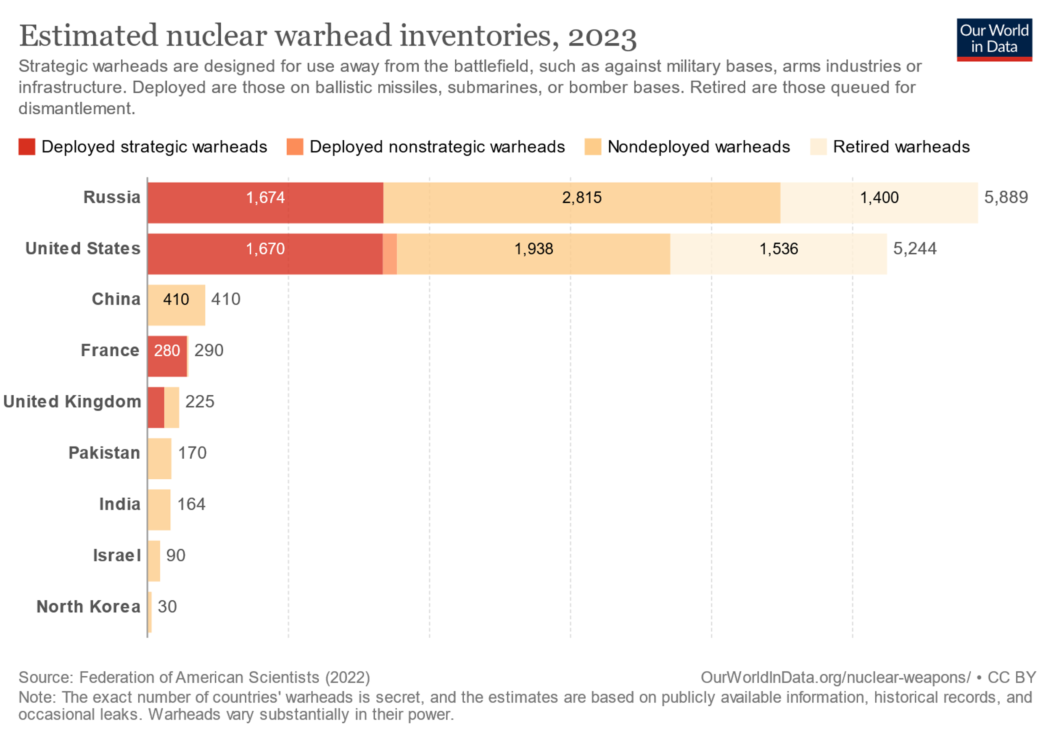

Slide 32
Nuclear Arms Race
“No matter how many bombs they had or how big their explosions grew, they needed more and bigger,” writes historian Craig Nelson. ”Enough was never enough.”
in early 2020 there were an estimated 13,410 nuclear weapons in the world—down from a peak of around 70,300 in 1986—according to the Federation of American Scientists. The decline happened mainly because of the US and Russia dismantling retired warheads.
As per SIPRI report 2023, 91 percent of all nuclear warheads are owned by Russia and the U.S.
Estimated number of nuclear weapons currently deployed with operational forces were 3820 in 2021. out of which 2000 belonged to Russia or USA- were kept in a state of high alert.
how much is enough? British Laborite Denis Healey, Foreign Secretary in the early 1980s, declared that only 5% of the warheads in hand were actually necessary to deter Moscow, the remaining 95% were merely to assure the general public

Slide 33
CUBAN MISSILE CRISIS
US failed attempt to overthrow the Castro regime in Cuba in 1962
Deployment of Nuclear weapons in Cuba by Soviet Union heightened the tensions between the two super powers.
President Kennedy announced Naval Blockade of the Island
Superpowers stood eyeball to eyeball
Notes:
After the failed U.S. attempt to overthrow the Castro regime in Cuba with the Bay of Pigs invasion, and while the Kennedy administration planned Operation Mongoose, in July 1962 Soviet premier Nikita Khrushchev reached a secret agreement with Cuban premier Fidel Castro to place Soviet nuclear missiles in Cuba to deter any future invasion attempt.
In October 1962, the United States discovered that, contrary to private and public assurances, the Soviet leadership was secretly deploying nuclear missiles in Cuba. President Kennedy responded with a naval blockade of the island, and American nuclear forces moved to unprecedented states of alert. The superpowers stood ‘eyeball to eyeball’, and most historians believe this was the moment in the cold war when the risk of nuclear war was greatest.

Slide 34
CUBAN MISSILE CRISIS
“It shall be the policy of this nation to regard any nuclear missile launched from Cuba against any nation in the Western Hemisphere as an attack by the Soviet Union on the United States, requiring a full retaliatory response upon the Soviet Union.” ~President Kennedy
Khrushchev responded to Kennedy’s message with a statement that the U.S. “blockade” was an “act of aggression” and that Soviet ships bound for Cuba would be ordered to proceed.

Slide 35
KENEDY AND KRUSHCHEV both recognized the risk of escalation of nuclear war
“If there is no intention to doom the world to the catastrophe of thermonuclear war, then let us not only relax the forces pulling on the ends of the rope, let us take measures to untie that knot. We are ready for this.” KRUSHCHEV
The diplomatic impasse was resolved six days after Kennedy announced the blockade, when Nikita Khrushchev undertook to withdraw the missiles in return for assurances that America would not invade Cuba.
Notes:
That afternoon, however, the crisis took a dramatic turn. ABC News correspondent John Scali reported to the White House that he had been approached by a Soviet agent suggesting that an agreement could be reached in which the Soviets would remove their missiles from Cuba if the United States promised not to invade the island.
recent evidence suggests that the risk of inadvertent nuclear war—arising from a concatenation of misperception, the actions of subordinates, and organizational failure—was much greater than was realized by political leaders then or by historians later.

Slide 36
Did nuclear weapons avert third world war?
Nuclear weapons did act as a deterrent between Soviet-American Conflict
It has averted third world war
Scott Sagan remarks,
    “Relying on nuclear deterrence to maintain peace is like skating on thin ice. The fact that you have done it before does not mean you should expect to be able to do it safely forever.”
Notes:
without nuclear weapons direct Soviet-American conflict would have been much more likely, and that had nuclear weapons not acted as a deterrent, then war in Europe would have been much more likely. On the other hand, there are those who contend that nuclear weapons played a limited role in East-West relations, and that their importance is exaggerated.

Slide 37
At the end of the 1970s, Queen Elizabeth declared that nuclear weaponry’s ‘awesome destructive power has preserved the world from a major war for the past thirty-five years’,
John Lewis Gaddis viewed the 45-year Cold War as ‘the long peace’ since there were no direct major hostilities between the United States and the Soviet Union.

Slide 38
Kenneth Waltz maintains, for example, that nuclear weapons preserve an ‘imperfect peace’ on the subcontinent between India and Pakistan. Responding to reports that all Pentagon war games involving India and Pakistan always end in a nuclear exchange, Waltz argues that ‘Has everyone in that building forgotten that deterrence works precisely because nuclear states fear that conventional military engagements may escalate to the nuclear level, and therefore they draw back from the brink?’

Slide 39
Arms Control and disarmament
The Baruch Plans, 1946
Atoms for Peace 1953
IAEA-1957
1959 Antarctic treaty
Hot line agreement 1963
Partial test ban treaty- 1963
Outer space treaty 1967
Non Proliferation treaty- 1968
Strategic arms reduction treaty
Comprehensive test ban treaty 1996
Treaty on Prohibition of Nuclear weapons

Slide 40
The Baruch Plans, 1946
The United Nations takes the first steps to control nuclear energy, as States create the UN Atomic Energy Commission (UNAEC).
On June 14, 1946, before a session of the United Nations Atomic Energy Commission (UNAEC), U.S. representative Bernard Baruch, presented a proposal for the creation of an international Atomic Development Authority
to establish international oversight of the use of atomic energy in the hopes of avoiding unchecked proliferation of nuclear power in the post World War II period.

Slide 41
THE BARUCH PLAN
We are here to make a choice between the quick and the Dead. … If we fail, then we have damned every man to be a slave of Fear. Let us not deceive ourselves: We must elect World Peace or World Destruction

Slide 42
THE BARUCH PLANS, 1946
President Truman did not want to accept any international agreement that might force the United States to abolish its nuclear weapons program without assurances that the Soviet Union would be unable to produce its own atomic bomb.
Notes:
to oversee the mining and use of fissile materials, the operation of all nuclear facilities that could produce weaponry, and the right to dispense licenses to those countries wishing to pursue peaceful nuclear research.

Slide 43
THE BARUCH PLAN 1946
Under the Baruch Plan the Atomic Development Authority would
oversee the development and use of atomic energy,
manage any nuclear installation with the ability to produce nuclear weapons,
and inspect any nuclear facility conducting research for peaceful purposes.
The plan also prohibited the illegal possession of an atomic bomb, the seizure of facilities administered by the Atomic Development Authority, and punished violators who interfered with inspections
Notes:
. The Atomic Development Authority would answer only to the Security Council, which was charged with punishing those nations that violated the terms of the plan by imposing sanctions. Most importantly, the Baruch Plan would have stripped all members of the United Nations Security Council of their veto power concerning the issue of United Nations sanctions against nations that engaged in prohibited activities. Once the plan was fully implemented, the United States was to begin the process of destroying its nuclear arsenal

Slide 44
BARUCH PLAN COULDN’T TAKE OFF
The Soviets strongly opposed any plan that allowed the United States to retain its nuclear monopoly.
The vote was held on December 30, with 10 of the UNAEC’s 12 members in favor, while the other two members (the Soviet Union and Poland) abstained. The vote required unanimity to pass. As such, the Polish and Soviet abstentions thwarted the adoption of the Baruch Plan.
Notes:
, not to mention international inspections of Soviet domestic nuclear facilities. The Soviets also rejected the idea of surrendering their Security Council veto over any issue as they argued that the council was already stacked in favor the United States.

Slide 45
A major defect of the Baruch Plan was America’s insistence that other countries give up their right to explore military uses of nuclear energy and turn over raw materials to an international authority, whereas the United States would not give up its weapons until it deemed such a system was in place. It would believed the US would not be amenable to such a deal if the tables were turned.

Slide 46
ATOMS FOR PEACE
1953 US President Dwight Eisenhower proposes harnessing “atoms for peace”. He calls for an “international atomic energy agency” to safeguard nuclear material and to “devise methods” whereby it would be allocated to serve the “peaceful pursuits of mankind”.
The more important responsibility of this atomic energy agency would be to devise methods whereby this fissionable material would be allocated to serve the peaceful pursuits of mankind. Experts would be mobilized to apply atomic energy to the needs of agriculture, medicine and other peaceful activities. A special purpose would be to provide abundant electrical energy in the power-starved areas of the world.
Thus the contributing Powers would be dedicating some of their strength to serve the needs rather than the fears of mankind.
Notes:
He calls for an “international atomic energy agency” to safeguard nuclear material and to “devise methods” whereby it would be allocated to serve the “peaceful pursuits of mankind”.

Slide 47
IAEA-1957
In 1955 Work begins on drafting the Statute of the International Atomic Energy Agency (IAEA) with representatives from Australia, Belgium, Canada, France, Portugal, South Africa, United Kingdom, and the US.
The drafting group later expands to twelve with representatives from the USSR, Czechoslovakia, India, and Brazil.
In 1956 In New York, States approve the IAEA Statute at a conference in October of 82 States at the UN. It incorporates responsibilities for both the control and development of nuclear energy for exclusively peaceful purposes.
The IAEA officially comes into existence 29 July 1957, the day when the required number of Member States ratify the Statute.

Slide 48
OBJECTIVE OF IAEA – ARTICLE II OF THE STATUTE
The Agency shall seek to accelerate and enlarge the contribution of atomic energy to peace, health and prosperity throughout the world. It shall ensure, so far as it is able, that assistance provided by it or at its request or under its supervision or control is not used in such a way as to further any military purpose.

Slide 49
Functions defined in Article III
To encourage and assist research on, and development and practical application of, atomic energy for peaceful uses throughout the world
To foster the exchange of scientific and technical information on peaceful uses of atomic energy
Establish control over the use of special fissionable materials received by the Agency, in order to ensure that these materials are used only for peaceful purposes

Slide 50
The Antarctic Treaty-1963
At a time when atmospheric testing of nuclear bombs averages more than one explosion per week, States adopt the Antarctic Treaty, the first nuclear-weapon-free-zone, albeit in an area uninhabited by people.

Slide 51
PARTIAL/LIMITED TEST BAN TREATY 1963
Treaty Banning Nuclear Tests in the Atmosphere, in Outer Space and Under Water
The Treaty requires Parties to prohibit, prevent, and abstain from carrying out nuclear weapons tests or any other nuclear explosions in the atmosphere, in outer space, under water, or in any other environment.

Slide 52
ADDRESSING NUCLEAR PROLIFERATION
“Personally, I am haunted by the feeling that by 1970, unless we are successful, there may be ten nuclear powers instead of four, and by 1975, fifteen or twenty.... I see the possibility in the 1970s of the President of the United States having to face a world in which fifteen or twenty or twenty-five nations may have these weapons. I regard this as the greatest possible danger and hazard.” “US President Kennedy”
Notes:
The Non-Proliferation Treaty (NPT) was signed in 1968 after the Americans and the Soviets reluctantly agreed ‘to pursue obligations in good faith’ to halt the arms race ‘at the earliest possible date’) and to seek ‘a treaty on general and complete disarmament under strict effective international control’. Questionable adherence to this pledge annoyed non-nuclear nations at subsequent NPT review conferences only to draw renewed, feeble pledges from the superpowers. Nevertheless, the Non-Proliferation Treaty became the cornerstone of a loosely structured non-proliferation regime. The
IAEA established international inspections and safeguards aimed at preventing nuclear materials being diverted to military uses.

Slide 53
NON PROLIFERATION TREATY- 1968
NPT is a multilateral treaty aimed at limiting the spread of nuclear weapons.
It was opened for signatures in 1968 and entered into force in 1970.
NPT is a binding commitment.
Notes:
Nuclear Non-Proliferation Treaty (NPT): The global NPT is finalized and opens for signature. It essentially freezes the number of declared nuclear-weapon States at five (US, Soviet Union (now Russia), UK, France, China), who are obligated to make “good faith” efforts toward disarmament. Other States grouped as nonnuclear weapon States, who are required to forego the nuclear weapons option and to conclude comprehensive safeguards agreements with the IAEA on their nuclear materials. The Treaty provides for these States to receive assistance for the transfer of technology for peaceful applications of nuclear energy

Slide 54
OBJECTIVES OF NPT
Three main objectives of the treaty are:-
1- Nuclear non-proliferation
2-Nuclear Disarmament
3-Peaceful use of Nuclear Energy
NPT establishes a safeguard system under the responsibility of IAEA. It is used for compliance of treaty through inspection conducted by IAEA.
Notes:
The Non-Proliferation Treaty (NPT) was signed in 1968 after the Americans and the Soviets reluctantly agreed ‘to pursue obligations in good faith’ to halt the arms race ‘at the earliest possible date’) and to seek ‘a treaty on general and complete disarmament under strict effective international control’. Questionable adherence to this pledge annoyed non-nuclear nations at subsequent NPT review conferences only to draw renewed, feeble pledges from the superpowers. Nevertheless, the Non-Proliferation Treaty became the cornerstone of a loosely structured non-proliferation regime. The
IAEA established international inspections and safeguards aimed at preventing nuclear materials being diverted to military uses.

Slide 55
NPT declares NWS as those that had manufactured and detonated nuclear explosive device prior to 1st Jan , 1967.
All other states are considered as NNWS.
Both NWS and NNWS who have ratified NPT can access nuclear technology for peaceful purpose.

Slide 56
What has NPT achieved?
NPT remained a kind of discriminatory treaty as there was no specific bar on NWS.
It has divided the world into haves and have nots.
Legitimized the monopoly of NWS.
As per SIPRI report 2023, nuclear war heads do reduced in comparison to late 1980s but it was due to the dismantling of obsolete weapons by the US and Russia.
Modernization of war heads suggest that the capacity of modern nuclear weapons have increased massively.
At the time of US bombing on Japan, the weight of the bombs were 15kt to 22kt. Today the US has a SLBM weapon with the capacity of 455 kt weight while the Russia has ICBM carrying 800kt weight of nuclear weapon. ( source the economist)

Slide 57
SUCCESS OF NPT
Development of nuclear free zones through different treaties
Latin America and the Caribbean
Africa
Central Asia
Southeast Asia
South pacific
For all its faults, the NPT stands out as the high-water mark of multilateral global efforts to establish an enforceable regime to curb the further spread of nuclear weapons.

Slide 58
WHAT IS DESIRED?
Complete elimination of nuclear weapons is required
Binding commitment from all states
Production of nuclear weapons must cease immediately.

Slide 59
Strategic Arms Reduction Treaty (START I )
The Strategic Arms Reduction Treaty (START I), signed in 1991, was a bilateral arms control treaty between the United States and the Soviet Union.
The result of the agreement was the first significant reduction in the number of strategic nuclear weapons in both the U.S. and the Soviet stockpiles. It entered into force in 1994, after the Soviet Union’s dissolution, and eventually expired in 2009.
The treaty is considered one of the most successful arms control agreements because by the time of its full implementation in 2001, 80 % of all the world’s strategic nuclear weapons were dismantled.
Notes:
START I produced terms mandating that each party have no more than:
1,600 deployed ICBMs, SLBMs and heavy bombers
154 deployed heavy ICBMSs
6,000 nuclear warheads on ICBMs, SLBMs and heavy bombers, with maximums per missile type:
4,900 on ICBMs or SLBMs
1,540 on heavy ICBMs
1,100 on mobile ICBMs
3,600 metric tons of throw-weights, or 3,600 metric tons of lifting power of ballistic missiles

Slide 60
New START Treaty
The Treaty between the United States of America and the Russian Federation on Measures for the Further Reduction and Limitation of Strategic Offensive Arms, also known as the New START Treaty
The New START Treaty entered into force on February 5, 2011. Under the treaty, the United States and the Russian Federation had seven years to meet the treaty’s central limits on strategic offensive arms (by February 5, 2018) and are then obligated to maintain those limits for as long as the treaty remains in force.
The United States and the Russian Federation have agreed to extend the treaty through February 4, 2026.
The treaty provides for 18 on-site inspections per year for U.S. and Russian inspection teams

Slide 61
AGGREGATE LIMIT AS PER THE TREATY
Both the United States and the Russian Federation met the central limits of the New START Treaty by February 5, 2018, and have stayed at or below them ever since. Those limits are:
700 deployed intercontinental ballistic missiles (ICBMs), deployed submarine-launched ballistic missiles (SLBMs), and deployed heavy bombers equipped for nuclear armaments;
1,550 nuclear warheads on deployed ICBMs, deployed SLBMs, and deployed heavy bombers equipped for nuclear armaments (each such heavy bomber is counted as one warhead toward this limit);
800 deployed and non-deployed ICBM launchers, SLBM launchers, and heavy bombers equipped for nuclear armaments.

Slide 62
COMPREHENSIVE TEST BAN TREATY 1996
The Comprehensive Test Ban Treaty (CTBT) prohibits “any nuclear weapon test explosion or any other nuclear explosion” anywhere in the world. The treaty was opened for signature in September 1996, and has been signed by 186 nations and ratified by 176. The treaty cannot formally enter into force until it is ratified by 44 specific nations, eight of which have yet to do so: China, India, Pakistan, North Korea, Israel, Iran, Egypt, and the United State
Although the CTBT has not formally entered into force, the treaty has, for now, achieved its primary goal: ending nuclear weapon test explosions

Slide 63
FISSILE MATERIAL CUT OFF TREATY
A fissile material cutoff treaty would ban the production of fissile material for nuclear weapons purposes. Fissile materials, principally highly enriched uranium (HEU) and plutonium, are the essential ingredients for building nuclear weapons. The effective control and elimination of fissile materials is an essential step toward effective non-proliferation and a precondition for nuclear disarmament.
The Fissile Material Cut Off Treaty (FMCT) is a proposed international treaty that would prohibit the production of fissile material for use in nuclear weapons or other explosive devices. The idea for the treaty was first proposed in the 1950s, but negotiations did not begin in earnest until the 1990s. As of 2021, negotiations are ongoing.

Slide 64
CHALLENGE FOR THE TREATY
One of the main challenges in negotiating and implementing the FMCT is related to verification and compliance. It is difficult to determine whether a state is complying with the treaty, as fissile material can be produced using a variety of methods and can be difficult to detect. Additionally, there is a lack of trust between states, particularly those with nuclear capabilities, which can hinder negotiations and implementation.

Slide 65
Contd…
Non-Nuclear Weapon States generally view FMCT as a step toward the elimination of nuclear weapons. They therefore desire a treaty that would prevent civilian stocks and stocks declared in excess for military use from being diverted for use in weapons.

Slide 66
US NUCLEAR DOCTRINE
The US Nuclear doctrine affirmed three roles for US nuclear weapons: ‘Deter strategic attacks; Assure Allies and partners; and Achieve US objectives if deterrence fails.’ The review states that ‘The United States would only consider the use of nuclear weapons in extreme circumstances to defend the vital interests of the United States or its Allies and partners’; however, it does not elaborate on what specifically constitutes ‘vital interests’, nor does it define the phrase ‘Allies and partners’.
Source : 2022 SIPRI report

Slide 67
RUSSIA NUCLEAR DOCTRINE
Russia’s official deterrence policy (last updated in 2020) lays out explicit conditions under which it could launch nuclear weapons: to retaliate against an ongoing attack ‘against critical governmental or military sites’ by ballistic missiles, nuclear weapons or other weapons of mass destruction (WMD), and to retaliate against ‘the use of conventional weapons when the very existence of the state is in jeopardy’.
SOURCE: SIPRI REPORT

Slide 68
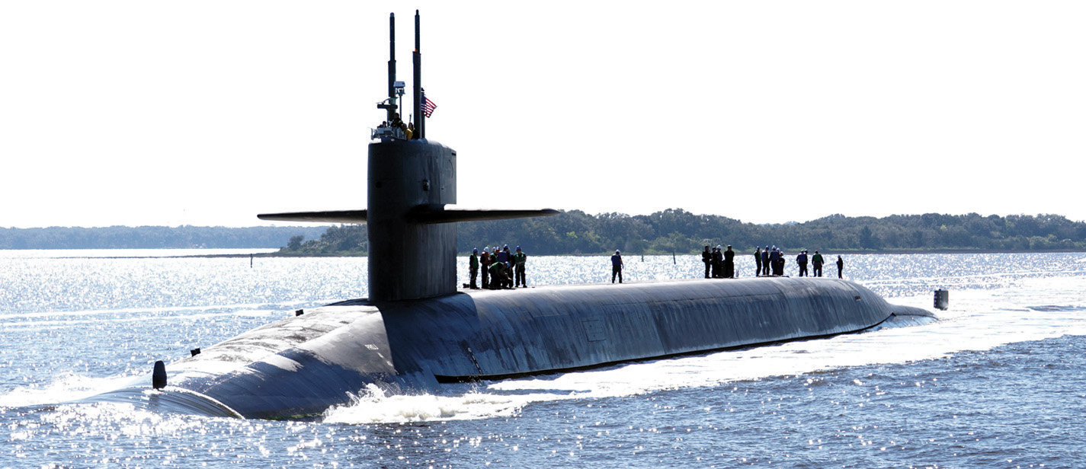
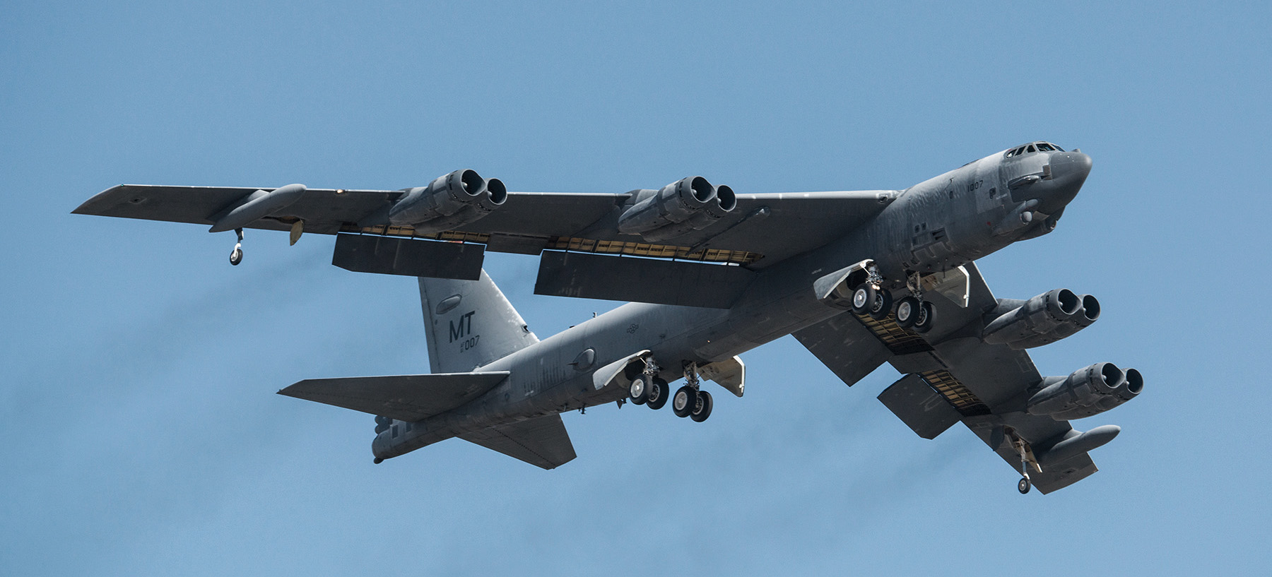
NUCLEAR TRIAD

Slide 69
