Slide 1
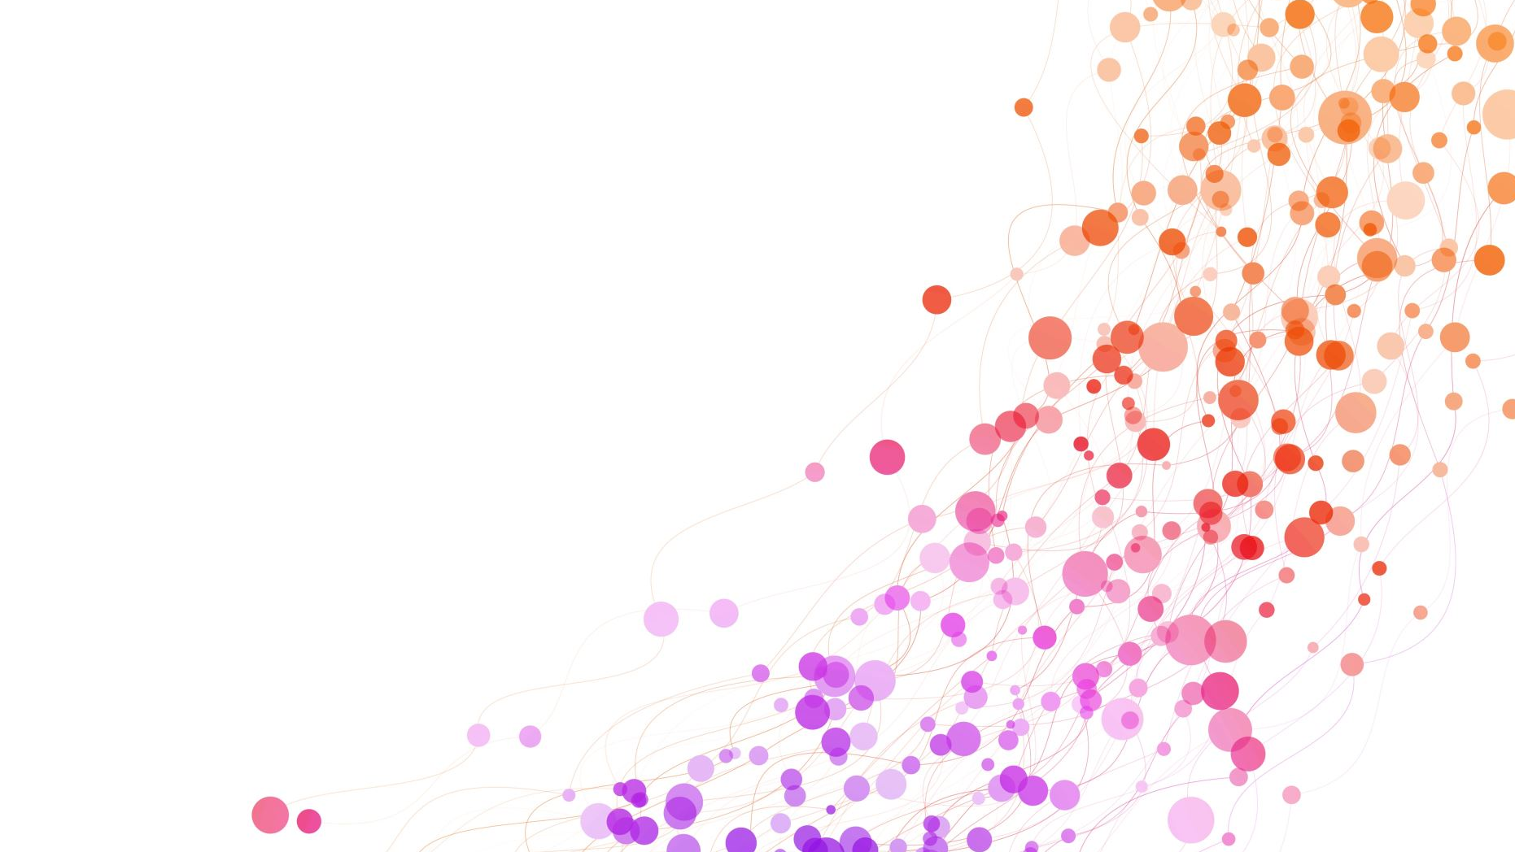
POLITICAL SCIENCE
LEC:03
MUHAMMAD AFTAB MUNIR (PAS)

Slide 2
TODAY’S AGENDA:

Slide 3
THOMAS HOBBES
BACKGROUND
BOOKS
NATURE OF MEN
CONCEPT OF SOVEREIGN & COMMONWEALTH
DISEASES OF COMMONWEALTH
CRITICAL ANALYSIS

Slide 4
JOHN LOCKE
BACKGROUND
BOOKS
THE FIRST TREATISE
THE SECOND TREATISE
ESTABLISHMENT OF SOCIETY & GOVT
RIGHT OF REVOLUTION
RIGHT OF PROPERTY
THE LETTER ON TOLERATION
CRITICAL ANALYSIS

Slide 5
JEAN JACQUES ROUSSEAU
BACKGROUND
BOOKS
STATE OF NATURE
DOCTRINE OF GENERAL WILL
INFLUENCE OF ROUSSEAU’S THEORY
CRITICAL ANALYSIS

