Slide 1
Types of Feminism
NOA, Islamabad

Slide 2
Previous Questions
Marxist feminism is a philosophical variant of feminism that incorporates and extends Marxist theory and analyzes the ways in which women are exploited through capitalism and the individual ownership of private property. Discuss the development of Marxist/Socialist feminism and the philosophical stance they hold to discuss gender issues and exploitation. 2021
Psychoanalytic feminism is a theory of oppression, which asserts that men have an inherent psychological need to subjugate women. As elaborated, give a detailed analysis of the gender oppression and women’s subordination promulgated by Psychoanalytic Feminism. 2021
What type(s) of feminism can elevate the social-cultural, economic and political status of women in Pakistan? 2018

Slide 3
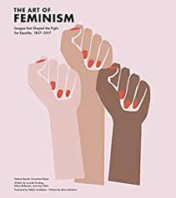
What is Feminism
The theory of the political, economic, and social equality of the sexes
Organized activity on behalf of women's rights and interests

Slide 4
Types of Feminism
Liberal Feminism
Radical Feminism
Marxist/Socialist Feminism
Psychoanalytic Feminism
Men’s Feminism
Post-Structural Feminism
Each perspective has made important contributions to improving women's status, but each also has limitations
The feminist perspectives have insight into the problems of gender inequality, and all have come up with good strategies for remedying these problems
All the feminisms are still very much relevant
There are continuities and convergences, as well as sharp debates, among the different feminisms

Slide 5
1. Liberal Feminism
Liberal feminism claims that gender differences are not based in biology
If women and men are not different, then they should not be treated differently under the law
But liberal feminism could not overcome the prevailing belief that women and men are intrinsically different
It was somewhat more successful in proving that even if women are different from men, they are not inferior

Slide 6
Liberal Feminism
Liberal feminism asserts the equality of men and women through political and legal reforms
It is also an individualistic form of feminism, which focuses on women’s ability to show and maintain their equality through their own actions and choices
According to liberal feminists, all women are capable of asserting their ability to achieve equality, therefore it is possible for change to happen without altering the structure of society
The main contribution of liberal feminism is showing how much modern society discriminates against women
Equality of Opportunity vs. Equality of Outcome
Classical liberals believe we achieve the ideal of equality through equality of opportunity.
In contrast, egalitarian liberals believe the state should focus on minimizing economic disparities as well as protecting civil liberties.

Slide 7
Liberal Feminism
Issues important to liberal feminists include
Reproductive and abortion rights
Sexual harassment
Voting
Education
Equal pay for equal work
Recognition of work
Affordable childcare & affordable health care
And bringing to light the frequency of sexual and domestic violence against women.

Slide 8
Liberal Feminism
Liberal feminism conceives of freedom as personal autonomy—living a life of one's own choosing—and political autonomy—being co author of the conditions under which one lives
Women should live lives of their own choosing
Enabling Conditions for Personal Autonomy
Being free of violence and the threat of violence
Being free of the limits set by patriarchal paternalistic and moralistic laws
Having access to options

Slide 9
Liberal Feminism – Some Other Features
Fairness in Personal Relationships - Justice
Intimate relationships
Access to information
Personal Autonomy and the State
Liberal feminists hold that the state must effectively protect women from violence, regardless of where that violence takes place – private and public
Political Autonomy
being co-author of the conditions under which one lives
Public Deliberation & Electoral Politics
Participation in the processes of democratic self-determination

Slide 10
Liberal Feminism – Criticism 1/2
Some Feminists argue that liberal feminism runs the risk of being insufficiently liberal e.g. quotas on party seats or in elected bodies & ban on pornography
Other set of feminists believe that L.F neglects power relations
L.F ignores the gendered nature of states
Patriarchal norms and values are not properly accounted for when analyzing status of women
However, by emphasizing the role of the state, L.F helps women to hold state accountable

Slide 11
Criticism 2/2
Martha Nussbaum, an egalitarian feminist, insists that to be equal men and women must have the same resources and opportunities in life.
In her view all people need ten “central human functional capabilities” to live a flourishing life:
the ability to live to the end of a human life,
to have good health,
to move freely,
to use their senses,
to have emotional attachments to others,
to plan their own lives,
to have a social basis for self-respect,
to laugh and enjoy life,
to live in harmony with nature,
to exhibit political autonomy.
The central idea of Nussbaum’s “capabilities approach” to human flourishing is that morality and equality demand that the state provide everyone with access to these capabilities.

Slide 12
2. Radical Feminism (R.F)
R.F , the theory of gender inequality that goes beyond discrimination to oppression
Discussions on women's daily lives –family, housework, serving men's emotional and sexual needs, menstruation, pregnancy, childbirth, menopause
Characteristics that are valued in male-dominated societies like objectivity, distance, control, coolness, aggressiveness, and competitiveness -- and blames them for wars, poverty, rape, battering, child abuse, pornography, and incest

Slide 13
Radical Feminism- Claims
Radical feminism claims that most men have the potential to use physical violence against women, including rape and murder
They point to the commonness of date rape, marital rape and wife beating, murders of ex-wives and former girl friends
The commercial side of this systemic misogyny, or women-hating, is the way women are depicted as sex objects in the mass media and as pieces of meat in pornography
The global exploitation of girls and young women in human trafficking and prostitution
By using the threat of violence and rape, the patriarchy controls all women

Slide 14
Radical Feminism
Radical feminists believe that women can free themselves only when they have done away with an inherently oppressive and dominating patriarchal system
Radical feminists feel that there is a male-based authority and power structure and that it is responsible for oppression and inequality, and that as long as the system and its values are in place, society will not be able to be reformed in any significant way

Slide 15
Radical Feminism
Main focus is on Patriarchy
Patriarchy is a ‘system of social structures and practices in which men dominate, oppress, and exploit women’ Sylvia Walby – Theorizing Patriarchy
Private and public patriarchies There are two distinctive forms of patriarchy that exist in the social world: private patriarchy and public patriarch - Walby

Slide 16
Private Patriarchy
This form of patriarchy can be found in the household
One individual patriarch (the dominant male) dominates and oppresses the subjugated females
Walby believes this acts as an exclusionary tactic as women are prevented from taking part in public discourse
Have you experienced or observed this type of patriarchy in your home or life around you?
Are you allowed to participate in public discourse like politics, economics, society, culture, religion, status of women, protests etc.? And if allowed, do your family members listen to you intently? Give weightage to your opinion?

Slide 17
Public Patriarchy
This patriarchy operates in the public world
Most often associated with the working world, public patriarchy is manifested in market place, workplace, etc.
Women are more collectively separated from power, wealth, and influence than men are -Walby
Have you ever experienced or observed Public Patriarchy at your job place, in market or anywhere outside home?
Have you ever experienced being separated from power, wealth and influence?

Slide 18
Patriarchy & Control Making Patriarchy Visible
Control over women’s Productive Power – job-income
Control over women’s Reproductive Power- childbirth
Control over women’s Mobility – job- residence, car- motorbike
Control over women’s Sexuality – love, marriage , desires
Control over women’s Economic Resources – Inheritance

Slide 19
Critique
Abolishing patriarchy is a noble ideal but how to achieve it? RF does not provide the answer
If the state, the family, media, education, religion all are patriarchal construct, why will they allow abolition of patriarchy?
Besides, Radical Feminism has not sufficiently paid attention to the broader structures of society that underpin patriarchy and benefit from it like economic system
If the economic system remains the same, that is, capitalism, there will still be forms of exploitation of women
However, R.F has helped problematized patriarchy leading to deeper and broader understanding of the phenomenon

Slide 20
3. Marxist/Socialist Feminism
Marxist/Socialist Feminism-
The Origin of the Family, Private Property and the State – 1902 by Friedrich Engels
Focuses on the two main activities that order human relations, namely production and reproduction.
Production refers to the organization of the economy (tribal, feudal, capitalist, socialist or other)
Reproduction refers to the manner in which human societies ensure the survival of the species through procreation, as well as the social organization and division of labor for the care and upbringing of the young.

Slide 21
Marxist/Socialist Feminism
Marxist feminists call for a change in the system of production to eliminate social classes which are based on the exploitation of one class by another
The Socialist Feminism combines the insights of the Marxist and Radical feminists and addresses both the private and public spheres, i.e. reproduction as well as production.
Marxist/Socialist Feminists demand a fundamental change in socio-economic structures – Economy & Patriarchy

Slide 22
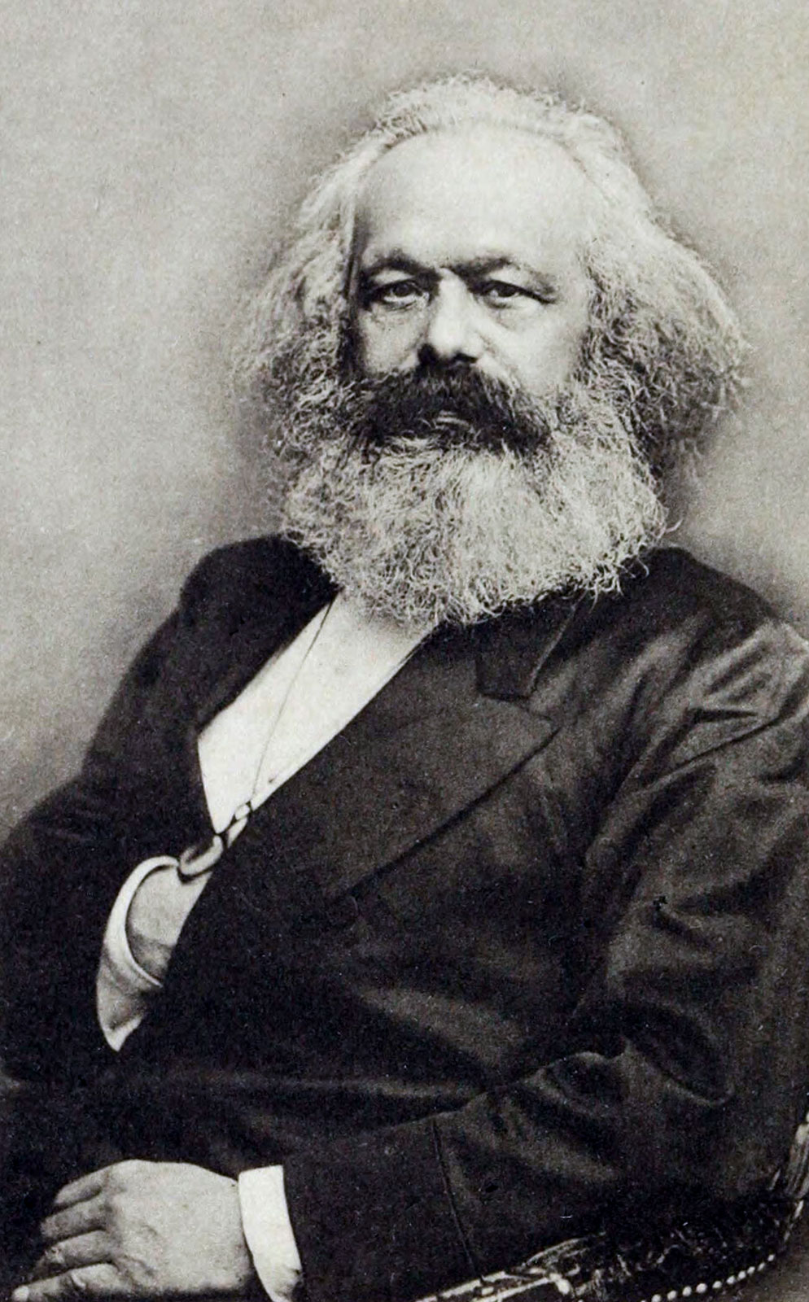
Maxist/Socialist Feminism
Religious System
Political System
Economy (capitalist vs. socialist)
Proletariat & Bourgeoisie
Social System
Legal System

Slide 23
Critique
Marxist/Socialist Feminism provides a relatively balanced approach to bring equality between the sexes by focusing on both patriarchy as well as capitalism
Patriarchy and capitalism reinforce each other to exploit women… examples
Patriarchy and capitalism go against each other on certain matters concerning women examples….
Changing the structure of patriarchy and capitalism can only lead to emancipation of women

Slide 24
Another important type of feminism came out of feminist re-readings of Freud and the French feminist engagement with Lacan, Derrida, and Foucault

Slide 25
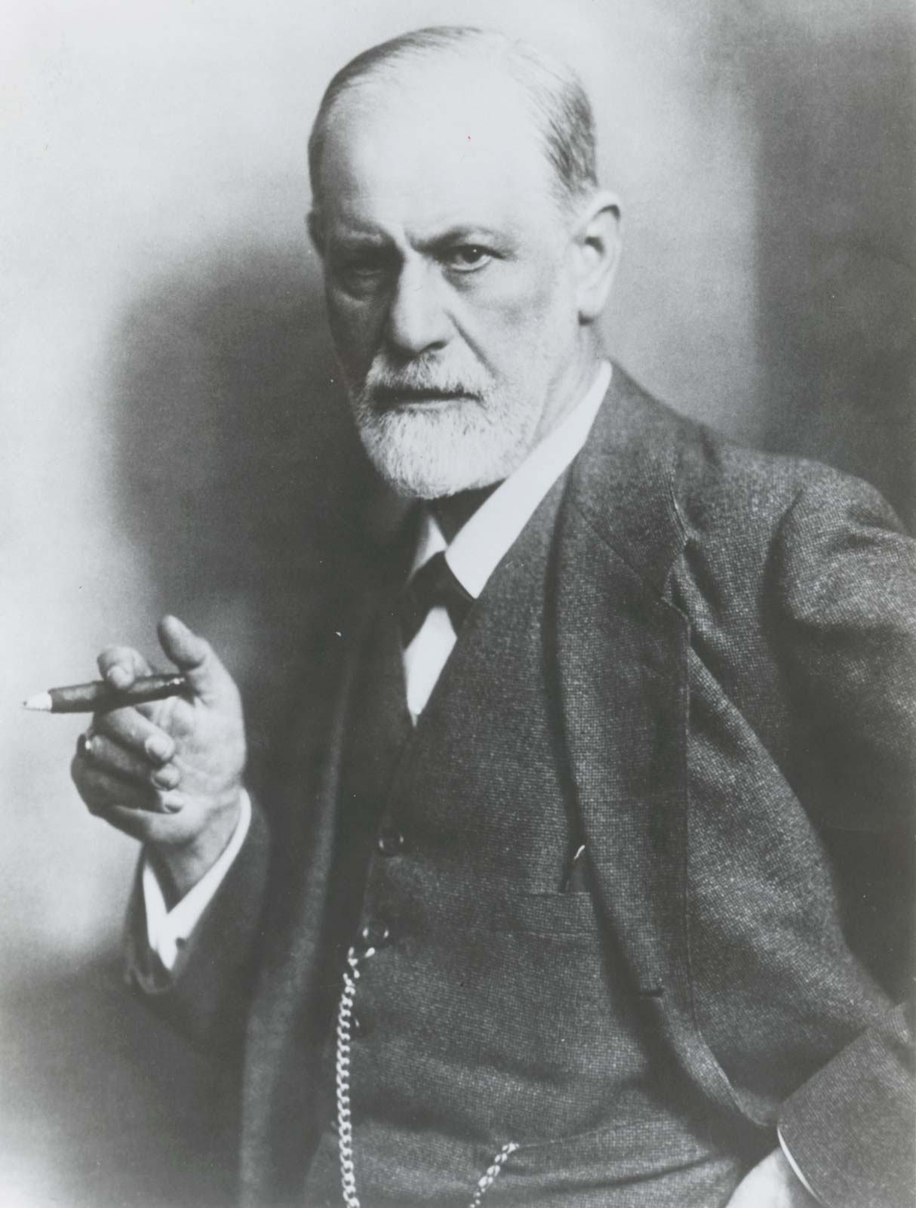
4. Psychoanalytical Feminism
What is psychoanalysis? Talking cure
The theory of the ‘unconscious’ was structured on the idea that there were parts of the mind’s that were inaccessible to the individual themselves
But are manifested by other means – dreams, slips of the tongue and physical ailments

Slide 26
Freud and Women
Freudian notion of women as biologically, psychically, and morally inferior to men- “the other”
Women’s inferiority complex is a result of ‘lack of penis’ OR ‘penis envy’
Freud’s theory about the development of women (Oedipus Complex)is a central problem for feminists, where the female is supposedly perceived by the male (and perceives herself) as castrated when she sees the male genitals and discovers her own lack of a penis

Slide 27
Psychoanalytical Feminism
The healthy resolution of this complex, according to Freud, is the acceptance of her castration and the wish to take her mother’s place in her father’s affections and thus acquire a ‘feminine attitude’ towards men in general
Her lack of a penis makes a woman long for a baby and the two wishes – to possess a penis and a child – remain strongly embedded in the unconscious and help to prepare the female creature for her later sexual role

Slide 28
Psychoanalytical Feminism – Critique
Freud’s theories were largely seen as the perfect embodiment of using the male principle to explain normal ‘humanity’ and then tacking women on to the end of it
Freud’s perspectives on the development of female sexuality are patriarchal
The image of women as ‘castrated’ men who must prepare themselves for a passive sexual role conveys the idea of their secondary status to men – that their lack of the penis is translated in social terms as lack of power, status and authority
Kate Millett in her book Sexual Politics contends that his understanding of the female is based upon his idea of penis envy, which results in the inevitable conceptualization of woman as lack
For Millett this means that Freud’s theories are essentially conservative, working in the interests of patriarchy
how social beings emerge from merely biological ones
Justification of male dominance rather explanation
Freud’s influence led to further exacerbate the position of women

Slide 29
5. Men’s Feminism
Men's feminism is a burgeoning field of study that applies feminist theories to the study of men and masculinity
Men's feminism takes on the task to treat men as well as women as a gender and to scrutinize masculinity carefully
A prime goal has been to develop a theory, not of masculinity, but of masculinities, because of the diversity among men
There are no universal masculine characteristics that are the same in every society
The main theory developed in men's feminism is the concept of hegemonic masculinity
Hegemonic or dominant men are those who are economically successful, ethnically superior, and visibly heterosexual
Yet the characteristics of masculinity, hegemonic or otherwise, are not the source of men's gender status
Genders -- men's and women's -- are relational and embedded in the structure of the social order

Slide 30
Men’s Feminism
Low-level men workers around the world are oppressed by the inequalities of the global economy,& young working class urban men's impoverished environment & "taste for risk“ has made them an endangered species
Men's feminism blames sports, the military, fraternities, & other arenas of male bonding for encouraging physical and sexual violence & misogyny
It deplores the pressure on men to identify with but not be emotionally close to their fathers & to be "cool" and unfeeling towards the women in their lives and distant from their own children
The sources of gender inequality that men's feminism concentrates on are embedded in the stratification systems of Western (modern) societies as well as in the homophobia of heterosexual men, who construct their masculinity as clearly opposite to that of homosexual men
It is necessary for prominent men of all ethnic groups in politics, sports, & the mass media to appear heterosexual

Slide 31
Men’s Feminism
Examining homosexuality from a gender perspective shows that homosexual men are men, not a third gender, and share the privileges and disadvantages and life style of men of the same ethnic group and social class
Nonetheless, because homosexual men do not have sexual relationships with women -- an important marker of manhood in the Western society -- they are considered not-quite men
Homosexual men also benefit from retaining some of the "patriarchal dividend” of male advantage
Critique
Men's feminism provides a needed corrective in bringing men into gender research as a specific subject of study
It does not offer new theoretical perspectives
Rather, men's feminism is an amalgam of social construction, multi-ethnic, psychoanalytic, and development feminism and gay studies

